Slide 1
App Inventor- Artemis 2012
By: Jiajia Liang, Alissah Sillah, and Samantha Rivera
Notes:
All

Slide 2
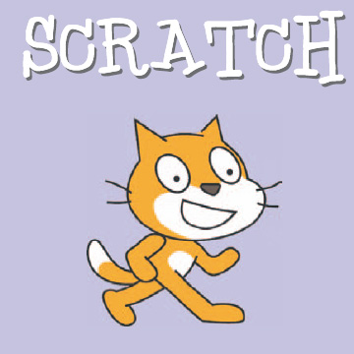
About App Inventor
App inventor was originally owned and was started by Google in 2010, but was shut down the same year. Luckily MIT restarted it in early may of this year and even though it is called MIT app inventor it still very much involves Google.
MIT’s App Inventor is more of a “grown-up version” of MIT’s first programming tool Scratch.
Notes:
Sam

Slide 3
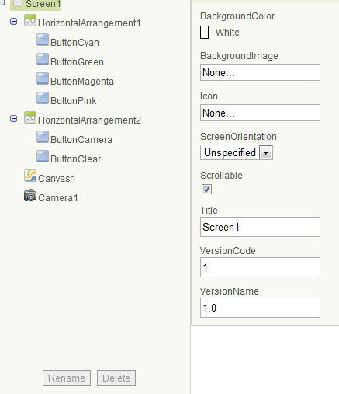
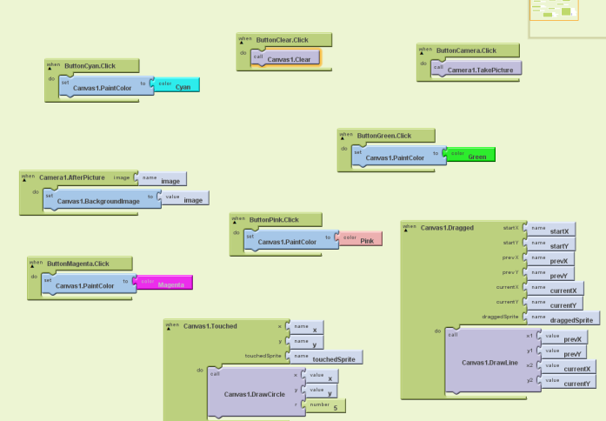
Class Project- Paint Me
You could also take a picture and draw on that!
Notes:
Alissah

Slide 4
Our Project- Ladybug Chase
We worked on Ladybug Chase, which is a game designed to have the ladybug eat aphids while avoiding being eaten by a frog
Objective: The controller will tilt the phone to control the ladybug. There will be an energy bar indicating when the ladybug will be starved. The lady bug will chase & eat the aphids while avoiding the frog.
Notes:
Jiajia

Slide 5
How We Made Ladybug Chase
On the app inventor website we started a new project named LadybugChase and added Ladybug, Clock and OrientationSensor from downloads to the components. We then modified the properties of the components from the default to what we wanted and started working in the blocks editor.
Notes:
Sam

Slide 6
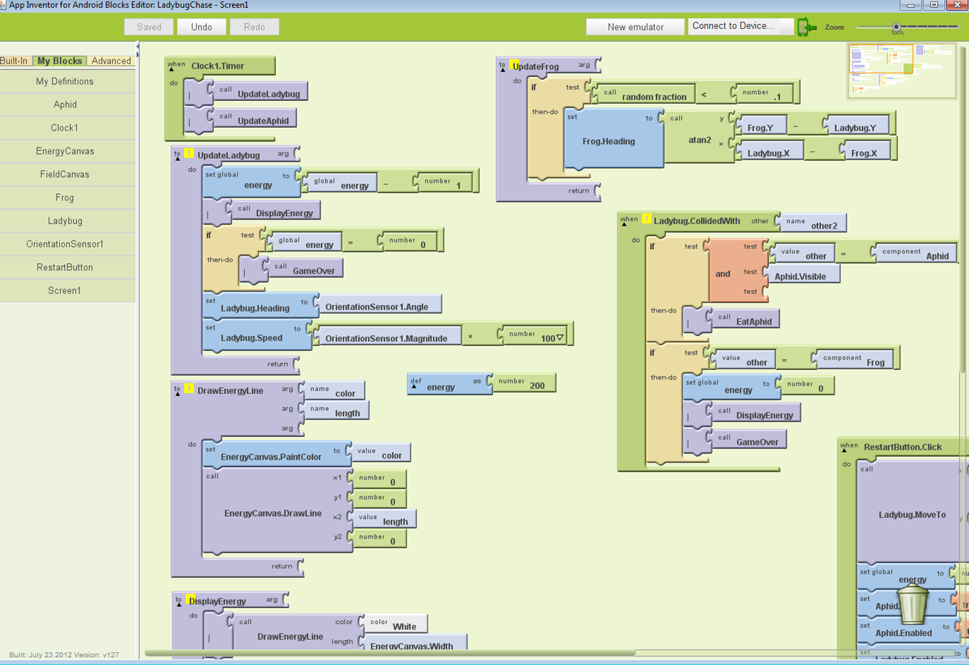
How We Made Ladybug Chase(2)
After opening the blocks editor we started adding blocks that were going to be controlling what happens during the game including how the frog, ladybug and aphid were going to move and what would happen when they died.
Notes:
Jiajia

Slide 7
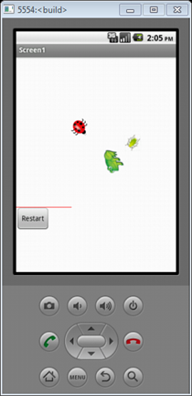
How We Made Ladybug Chase(3)
Finally we opened an emulator which is like an android phone but on the computer, and we connected the blocks editor to it. This made the game show up on the “phone” and we got to play it. This process took us approximately 5 hours.
Notes:
Alissah

Slide 8
More About App Inventor
App Inventor is a program that people can use to make their own apps for android. The program was designed to let people with little to no programming experience be able to make their own apps.
App Inventor also provides free tutorials for getting started and if you’re needing help.
Notes:
Sam

Slide 9
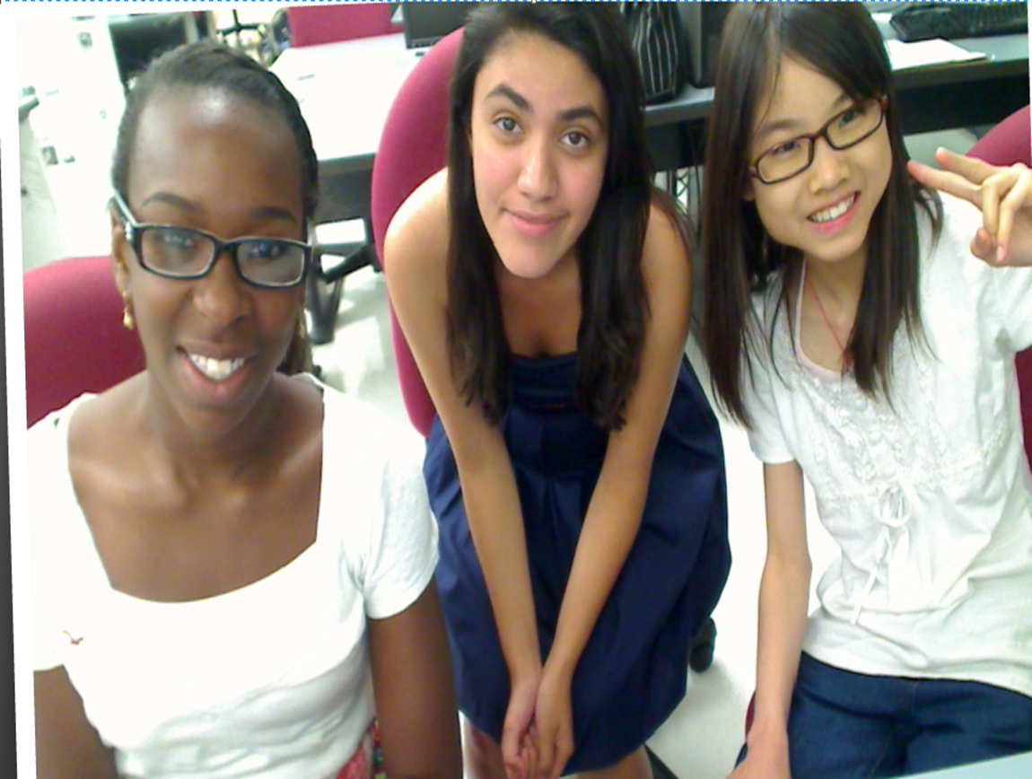
Thank You for Listening!
From: Samantha, Alissah, and Jiajia
Notes:
All

