Slide 1
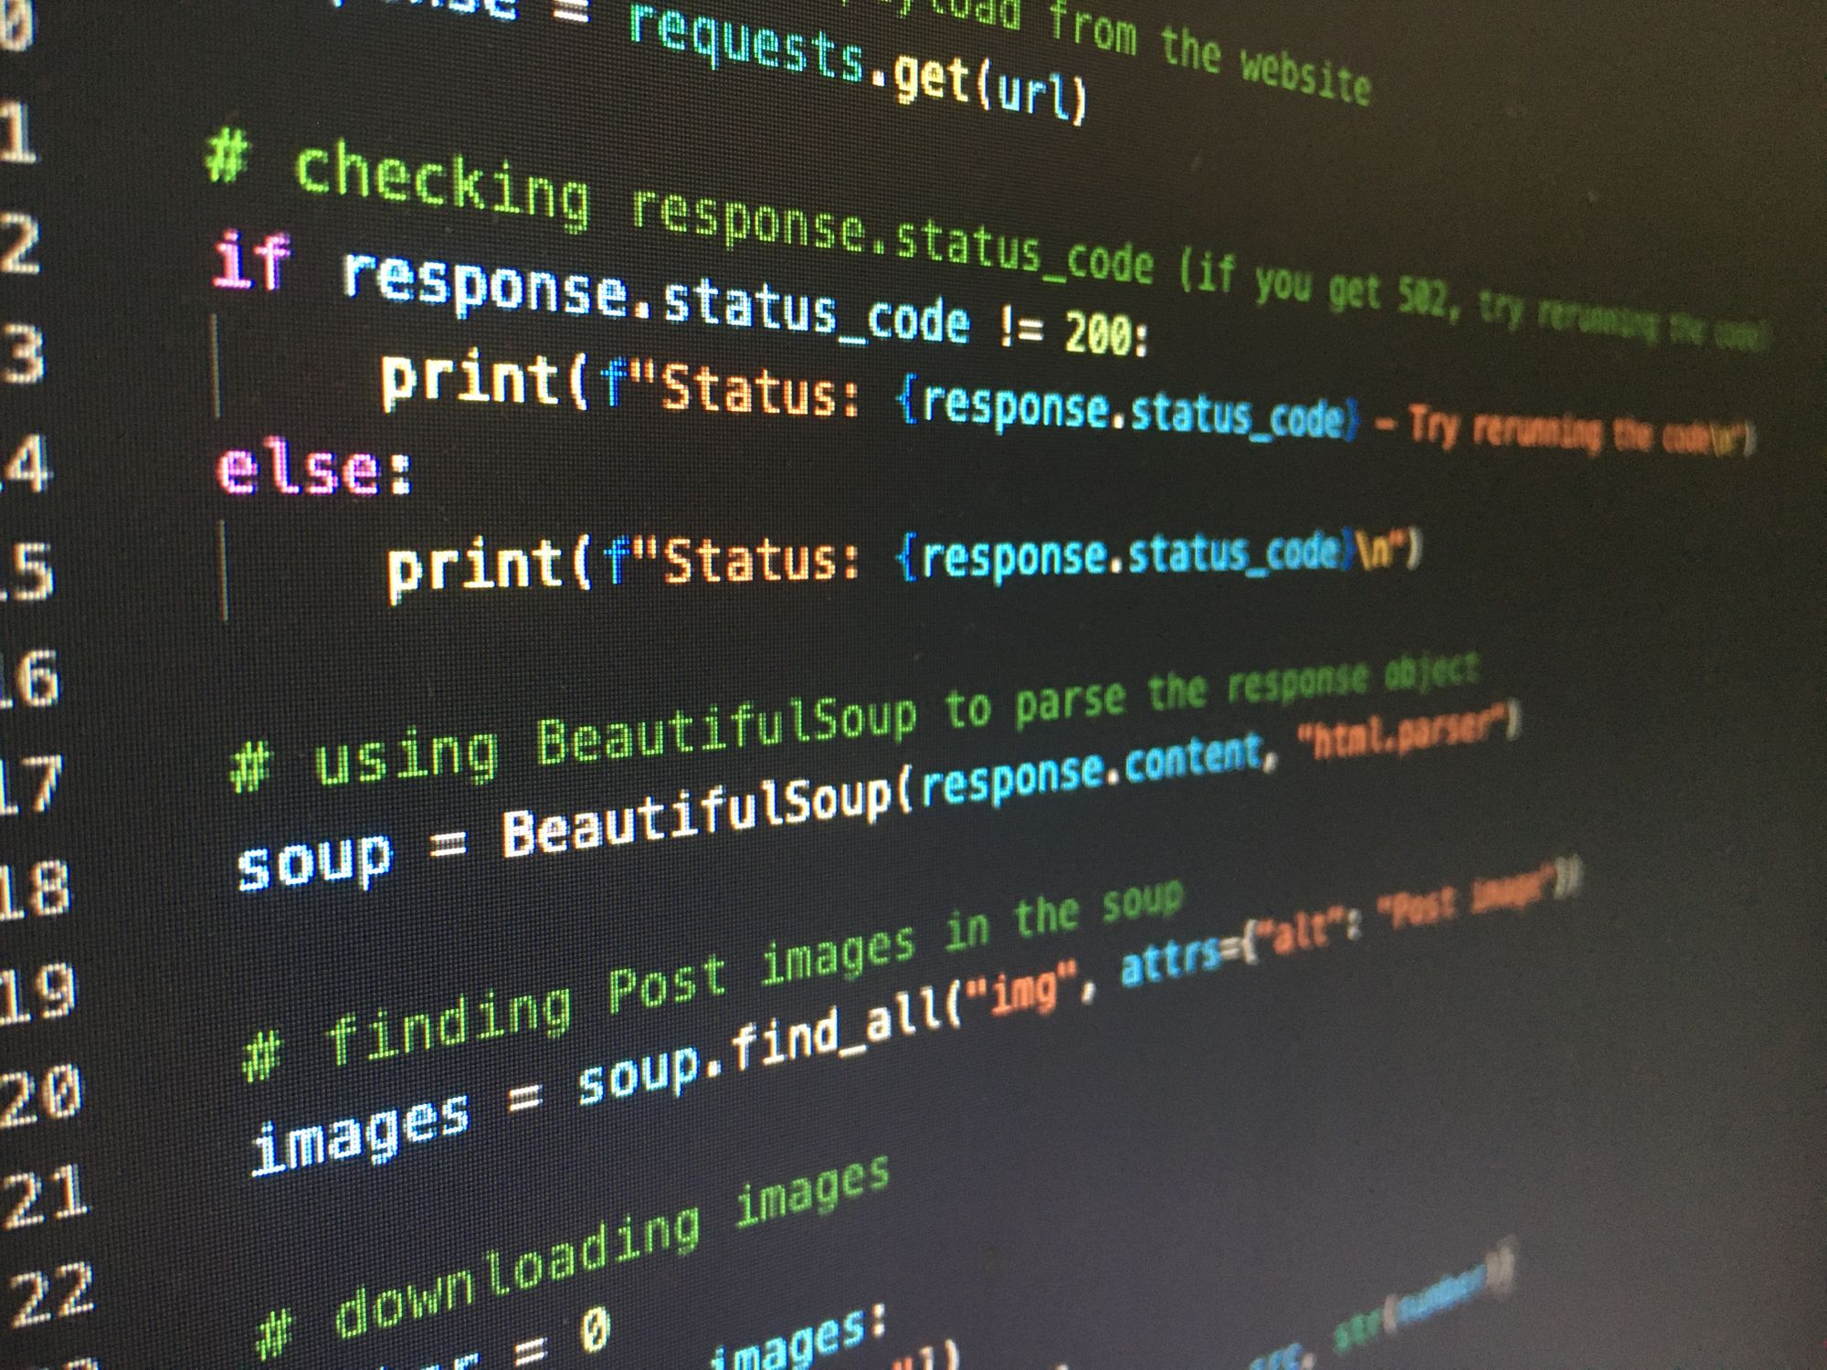
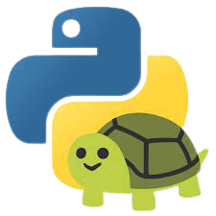
Python
Karen, Anvi, and Olivia

Slide 2
What is Python?
Python is a computer programming language that is used to code both hardware and software. It was first launched in 1991 by Guido van Rossum, and is still in use today. It is easy to learn and popular for beginners.
A snake walks into a bar. The bartender says, “How did you do that?”
Notes:
Anvi

Slide 3
Some Basics of Python
Case sensitive: capitals and lowercase letters are different
print function: prints out the enclosed text
  ex:
    input: print(“welcome to artemis”)
    Output: welcome to artemis
Loops:
  for x in range (_)
  times = input()
  while
if, while, then, elif, else statements
Why is Voldemort so good with computers?
He’s fluent in Python.
Notes:
karen

Slide 4
Strings, Integers and Floats
“Strings”:
collection of characters
Python notation: str
Surrounded by quotes
Integers:
Whole numbers
Python notation: int(_)
Floats:
Fractions, decimals, whole numbers
Floats put into integers will round down to become integers
str → int
input: num = “10”
output: int(num) → 10
int → str
input: x = 10
output: str (x) → ?
Concatenating Strings:
Combine strings using +
print(“Hello ” + “world”)
Prints Hello world
Notes:
ANVI

Slide 5
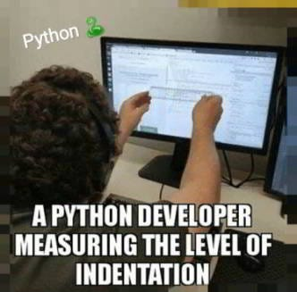
Labelling Strings
s | t | r | i | n | g
0 | 1 | 2 | 3 | 4 | 5
input: x = ‘string’
y = x[0] +x[3] + x[4] + x[5]
print (x) → string
print (y) → sing
print(“string”(2)) → r
input: x = string
print (x[4]) → n
Notes:
olivia

Slide 6
More Efficient Ways of Labelling Strings
s | t | r | i | n | g
0 | 1 | 2 | 3 | 4 | 5
If the colon is on the right side of the number, the string runs until the end.
If the colon is on the left side of the number, the string starts at the beginning and runs until the number before the given number.
If the colon in between 2 numbers, the code runs from the first number up to but not including the last bracketed number.
input: x = ‘string’
x[0] +x[3:] → sing
x [0:3] → str
x [:4] → stri
x [2:] → ring
Notes:
olivia

Slide 7
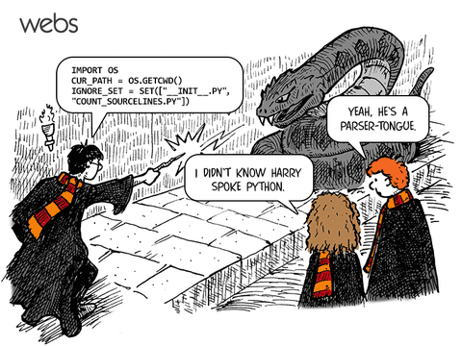
More Efficient Ways of Labelling Strings: Negative Indices
s | t | r | i | n | g
-6 | -5 | -4 | -3 | -2 | -1
Negative indices can be used to find the last letter in a very long string without counting all the components.
Notes:
Anvi

Slide 8
Function: a procedure or routine
Built - in
Premade
Give commands
Use strings
Ex: print function
General syntax: function_name (value that the function operates on)
User-defined
Made and defined by user
Contains built-in functions
User gives the computer the commands
Defining a function:
def function():
print(“This is how to define a function”)
Notes:
Karen

Slide 9
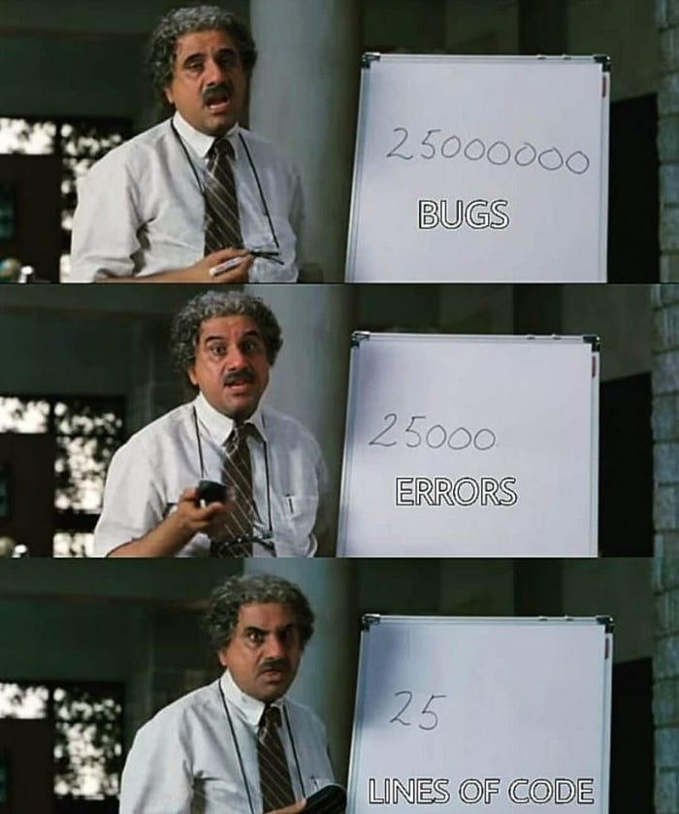
Math Operations
Addition: to add 2 numbers, use a plus(+)
Subtraction: to subtract 2 numbers, use a minus (-)
Multiplication: to multiply 2 numbers, use a star (*)
Division: for an integer result, use a double slash to
truncate the number (//).
For a float result, use a single slash (/)
Exponents: to apply exponents, use a double star (**)
Remainder: to see a remainder, use the percent symbol (%)
Notes:
olivia

Slide 10
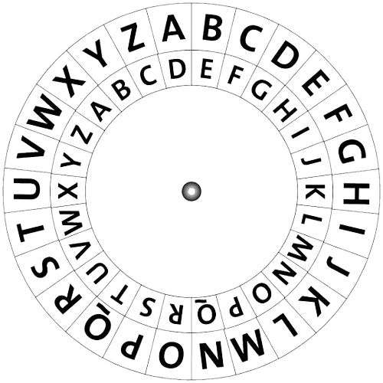
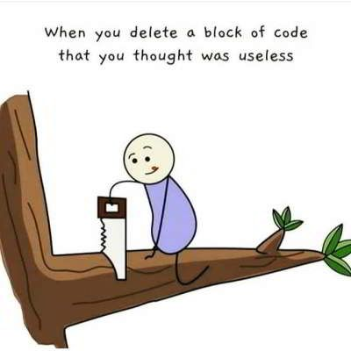
Caesar Cipher
To encode: inside → out
To decode: outside → in
Was used for secret military communications
Has 25 encryptions - AA is neutral
Caesar’s cipher is a spinning wheel with an inner and outer circle that each contain the 26 letters of the alphabet. To encode or decode, the wheel is rotated clockwise a certain amount based on the given shift, changing the letters.
Notes:
Karen

Slide 11
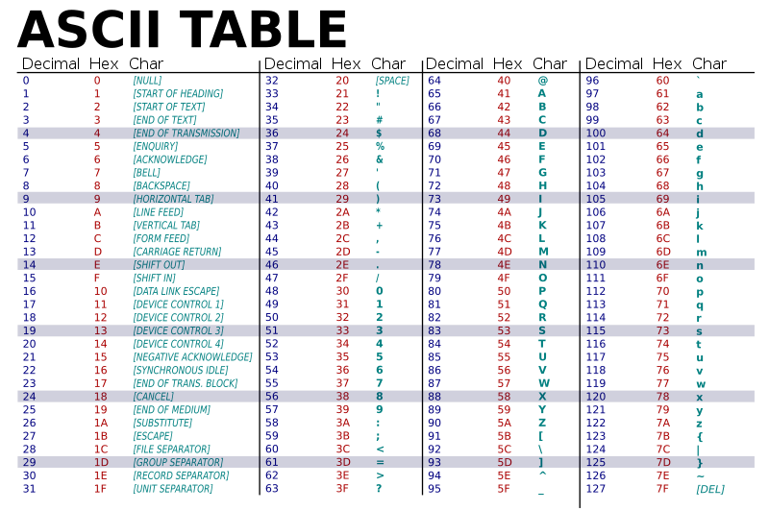
Ord and Chr Functions
Ord: ASCII → decimal number
Chr: decimal number → ASCII
Ex: ord(‘a’) = 97
chr(97) = ‘a’
These functions are very useful for cyphers in code.
Notes:
olivia

Slide 12
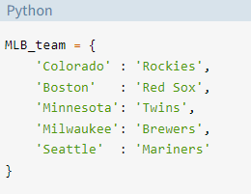
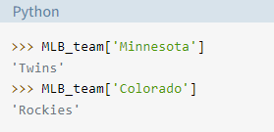
Dictionaries
Dictionaries in python contain many key value pairs, which are functions that link two elements together. Dictionary elements are not accessed using numbers, but a value can be found in a dictionary by typing in the key value with square brackets.
Input:
Output:
Notes:
anvi

Slide 13
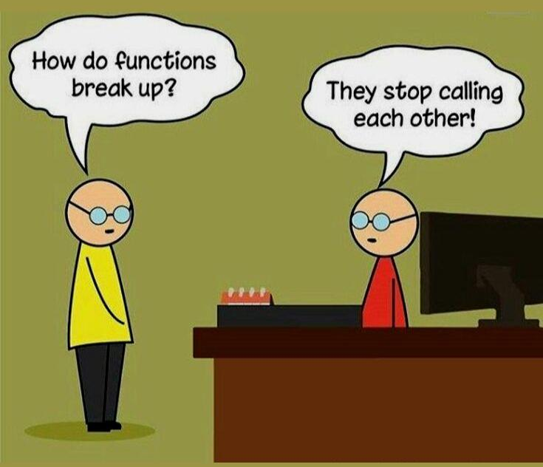
Variables
A changeable data item stored under a name
Example:
greeting="Hello"
“greeting” is the name of the variable with the string value “Hello”
greeting="Hi"
The value of “greeting” changes to “Hi”
Notes:
Karen

Slide 14

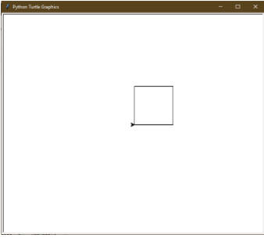
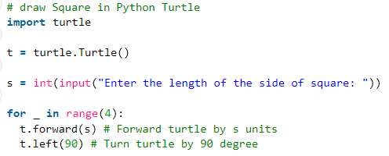
Python with Turtle
Turtle is a pre-installed python library that enables users to create graphics by providing them with a canvas.
Input:
Output:
Notes:
Anvi

Slide 15
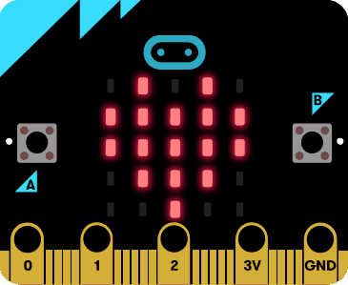
Microbits with Python
Python can also run programs on hardware like microbits. Using a small board with lights, python can be coded to play rock paper scissors, flip a coin, or act as a magic 8 ball.
from microbit import *
import random
while True:
if button_a.was_pressed():
rand = random.randint(0, 1)
if rand == 1:
display.show(Image.SAD)
sleep(500)
display.clear()
else:
display.show(Image.HAPPY)
sleep(500)
display.clear()
Notes:
olivia

Slide 16
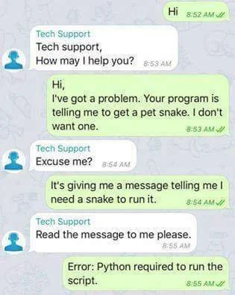
Thanks for listening!

