Slide 1
HTML/CSS
By Arielle Howard, Emily Liu, Suri Yang
...
Notes:
Arielle

Slide 2
Table of contents
01
02
03
What is HTML & CSS
Basic definitions and origins
HTML & CSS Basics
How they work & what they’re used for
Examples of HTML & CSS
Broken-down coding & structure examples
Notes:
Emily
We’ll be learning about what is HTML and CSS and their basics and then go through some example code to get a better understanding of their features

Slide 3
01
What is HTML & CSS?

Slide 4
What is HTML and CSS?
HTML, or “HyperText Markup Language” is a programming language used for WEBSITE DEVELOPMENT. CSS (“Cascading Style Sheets”), on the other hand, is a stylesheet language used for formatting the content of HTML and other types of documents used for web development.
HTML makes up the functional portion of a website
CSS creates visuals
Together, they make websites!
In the next few slides, we’ll further explain in-depth HTML/CSS, their uses, and showing some EXAMPLE CODE.
*
Notes:
Suri
HTML is a programming language used for web development whilst CSS is a stylesheet language used for formatting the content ofHTML and other types of documents in a standardized way. HTML makes the functional portion. CSS makes it visually appealing and together they create great websites
You can imagine it as a house where HTML is the frame whilst CSS is the paint
We’ll explain in further detail in later slides

Slide 5

The Origins of HTML
HTML was originally designed around 1993 by Tim Berners-Lee (same guy who made the World Wide Web) for document distribution between academics and researchers!
Since then, many versions of HTML have been released, edited, and used by programmers and ordinary people around the world! One example of this is XHTML - a rewritten HTML in another language (XML)!
Sources: University of Washington, Library of Congress, & Wikipedia
}
..
Notes:
Arielle:
HTML was originally designed around 1993 by Tim Berners Lee for document distribution between academics and researchers. Since then, HTML has taken off and been edited, released, and used by programmers around the globe.

Slide 6
02
Basics of HTML+CSS
Notes:
Emily

Slide 7
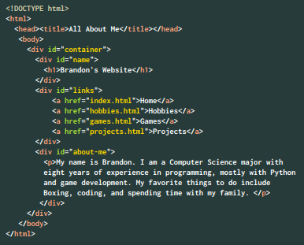
HTML Basics
*
The structure of HTML is fairly simple:
You must start with <!DOCTYPE HTML> & <html></html>
Goes in a descending order (top → bottom)
Less organized than CSS
Because HTML makes up more of the ‘building blocks’ of a website, the actual program can be a bit more chaotic in organization!
Notes:
Emily
The basics of HTML and CSS. So the structure of HTML is fairly simple. There are certain tags to use and they operate in descending order. The overall look of HTML seems less organized than CSS but tags like div can be used to make them more organized.

Slide 8
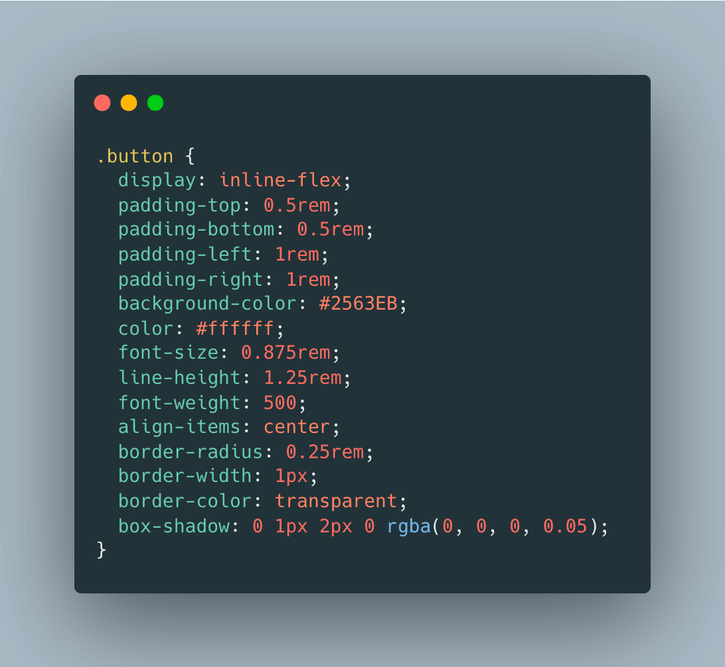
CSS Basics
*
The structure of CSS is slightly different than its HTML counterpart:
You need to connect each stylesheet to the HTML pages
More concise
Focuses groups of code on individual parts of the website
CSS doesn’t make any slightly complex parts (somewhat).
Notes:
Suri
For CSS the structure is slightly different. You’ll need to connect each stylesheet to the HTML pagse for it to be applied
It’s way more concise
And it focuses different groups of code on individual parts of the website

Slide 9
03
Example Code
< We’ll walk you through some example HTML/CSS code!>

Slide 10
HTML Structure
<!DOCTYPE HTML> | <!-- Tells the browser that this is a HTML document -->
<html> | <!-- Contains the contents of the HTML document -->
<head> | <!-- Contains the metadata or background information of the site -->
<title> | <!-- Declares name of website on the browser tab -->
</title>
</head>
<body> | <!-- Contains the content that appears on the webpage -->
</body>
</html>
Notes:
Mention how each have an opening tag and closing tag Arielle:
Doctype tells the browser that you will be using HTML in the document. Anything within the HTML tags will be applied to your website - for example, the head tag contains non-visual aspects whereas the body contains all elements you wish to show

Slide 11
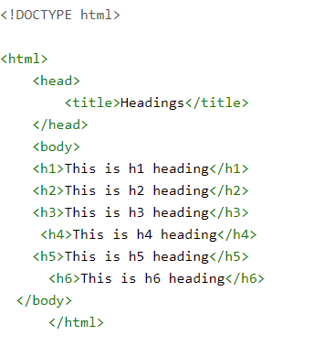
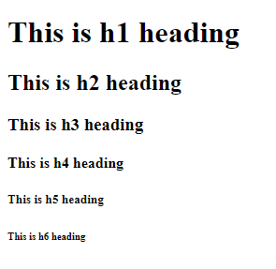
Headings
Heading tags are helpful to create...headings!
They range from h1 to h6; h1 being the largest
Can be modified in CSS to have different fonts, colors, ect.
Allows website to look organized
Notes:
Emily
An important tag of HTML are headings. They range from h1 to h6 for h1 being the largest. They can be modified in CSS to make them different fonts or colors. Using headings can allow the website to look more structured

Slide 12
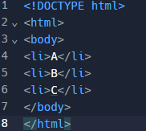

Lists
Lists are always useful!
Creates a list of items
Can be bulleted or numbered
Helps with organization and user experience
Notes:
Suri
In HTML you can create lists like on the code shown here on the left
They can be both bulleted and numbered and is great for organizing the website to make it easier for users

Slide 13
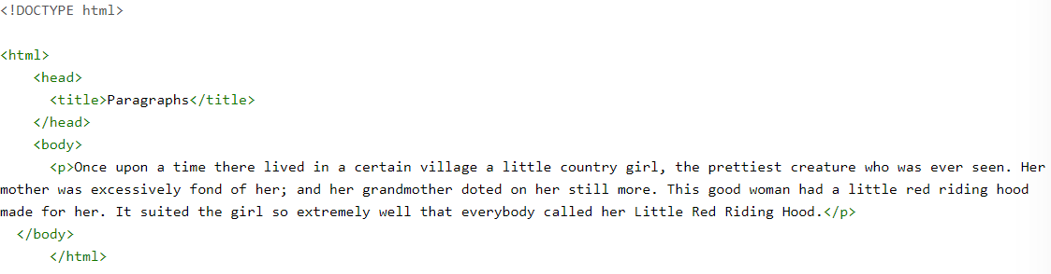
Use a paragraph tag!
<p></p>
↪
Notes:
Explain that they look like this Arielle:
Paragraphs are usually located within the body tag, and are labeled with the p tag. However, I must mention that your paragraphs WILL NOT be indented by default, and will instead appear as a block of text without the help of CSS.

Slide 14
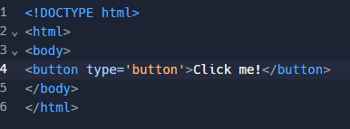

Buttons
How would a website function without BUTTONS??
You can create as many buttons as you want
They can be completely modified by CSS
Makes your website more fun and interactive!
Notes:
Emily
A fun addition to add to websites are buttons. Buttons are created using the two button tags. In between the two button tags is the place to put a label for the button. In this case, it says Click me!. Buttons can also be modified in CSS

Slide 15
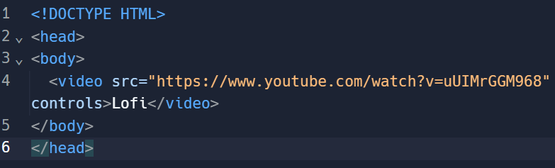
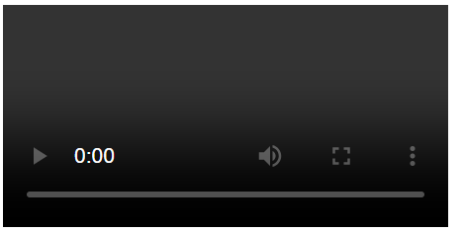
Videos
You can add an informative video to your website!
Explain your website’s contents in a concise, interesting way
Notes:
Suri
You can also add videos with HTML to help improve your site and explain it in a succinct way
You just have to follow the code shown on the left and provide a video source and you’ll have a video

Slide 16
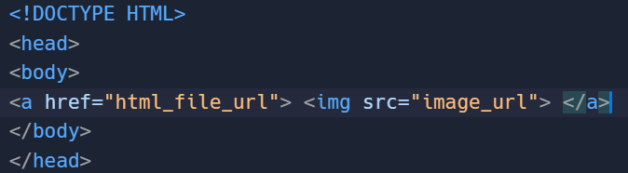
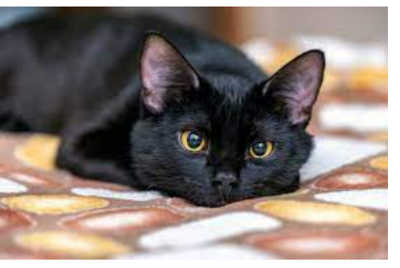
Images
What is a good website without cat pictures - nothing.
You can insert as many pictures as you want
Simply paste the URL in place of the orange lettering (with quotes)
The image should show up on your website, and can be centered with CSS
I had to delete the URL because of how long it was!
Notes:
Arielle: In order to insert an image, you need to copy the image URL and paste it into the given spaces displayed in orange on the left. You can insert as many images as you want, however they won’t be spaced or aligned without the help of CSS.

Slide 17
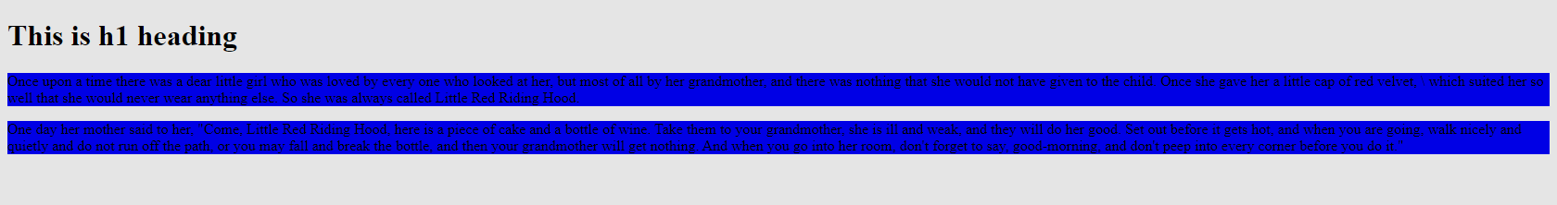
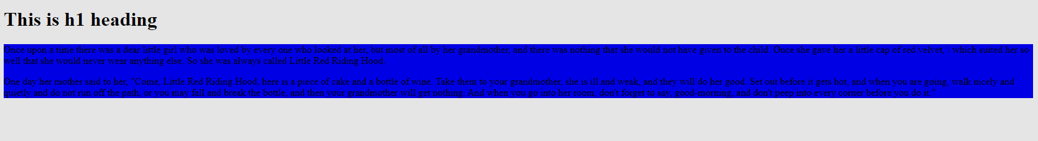
Dividers
Without <div>
Helps with styling
Makes Website look neater
Also helps with positioning
With <div>
*
Notes:
Emily
As mentioned before, div tags can make websites more organized. Using divs, as seen in the second example, can group elements together. Think of them as containers: whatever is in the container has the same properties applied to them. Using divs can also help with positioning.

Slide 18
CSS Structure
styles.css | <!-- Tells the browser that this is a CSS document -->
.button{ | <!-- Tells the program what is being edited-->
font-size: | <!-- Changes the font size-->
background-color: | <!-- Changes the color of the object -->
color: | <!-- Changes the font color-->
padding-left: | <!-- Chooses the amount of padding on the specified side-->
font-weight: | <!-- Chooses the boldness of the font-->
border: | <!-- Chooses the border thickness OR no border at all-->
margin-left:} | <!-- Chooses the size of the spacing is between an object on the specified side-->
Notes:
Suri
Now to move onto CSS is structured like this
Styles.css tells the browser that the document is a CSS document
.button{} tells the program whats being edited
Font-size declares teh font size
Background color changes the background color of the thing that holsd that object
Color changes the font color
Padding-left/right chooses the amount of padding on the side thats chosen so you can just replace hte left with right
Font weight chooses the boldness of the font
Border chooses the border thickness of the element or the lack thereof
Margin-left can chooses the size of sp[acing between the object and everything else on teh specified side

Slide 19
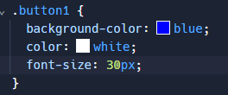

Colors
With every website comes a good color scheme!
You can design or edit as many aspects as you want/are in your website
You MUST LINK YOUR CSS TO YOUR HTML
Helps brighten up your website for viewers
You can choose any aspect - I just chose a button!
Notes:
Arielle: Colors can be applied to nearly any component in your website, and can make it more visually appealing to your users. In this case, I used a button to demonstrate - but I cannot stress enough how important it is to link your css to your html! Without doing so, none of your css will be applied to the website.

Slide 20
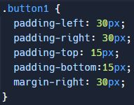

Padding & Margins
Properly spacing elements is essential in website development.
Padding helps make objects larger/edit shapes
Margin helps space objects in relation to one another
Makes more aesthetically pleasing & easy-to-use websites
Notes:
Emily
Paddings and margins are spacing elements. In CSS, everything has a box around it. Padding is the spacing inside the box and around the content; like the first example. Margins are the spacing around the box, like the second example. Margins are also helpful for creating space between two elements.

Slide 21
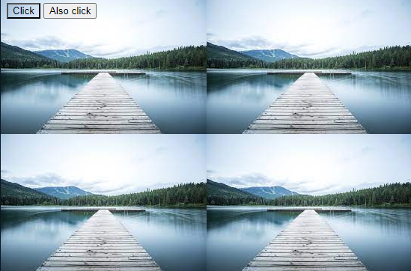
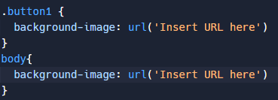
Background
Pictures help make websites interesting
Capture a viewer’s interest
Can be applied to nearly any element in your website
Make sure to resize your image to make it fit (and not repeat or get cut off)
Notes:
Suri
You can add pictures as backgrounds to make the website more interesting
You can add it to most elements on the website
Just make suer to resize teh image so that it wont repeat because its too small or get cut off because its too big

Slide 22
Fonts are a bit tricky…
The issue with fonts is that your computer has to already have them DOWNLOADED or IMPORTED prior to using them in your website - as without downloading, the program will completely ignore the command.
P.S: You can use google fonts to IMPORT easily!
Notes:
Arielle

Slide 23
Summary
HTML
CSS
Used to create the structure of websites.
Used to style the contents of a website
*
Notes:
Emily
That’s the end for our presentation; and now for a little summary: HTML is used for creating the structure of the website; CSS is for styling the website

Slide 24
Thanks!
<p> Do you have any questions? </p>
Notes:
If you have any questions feel free to ask us now and we Thank you for your time

Slide 25
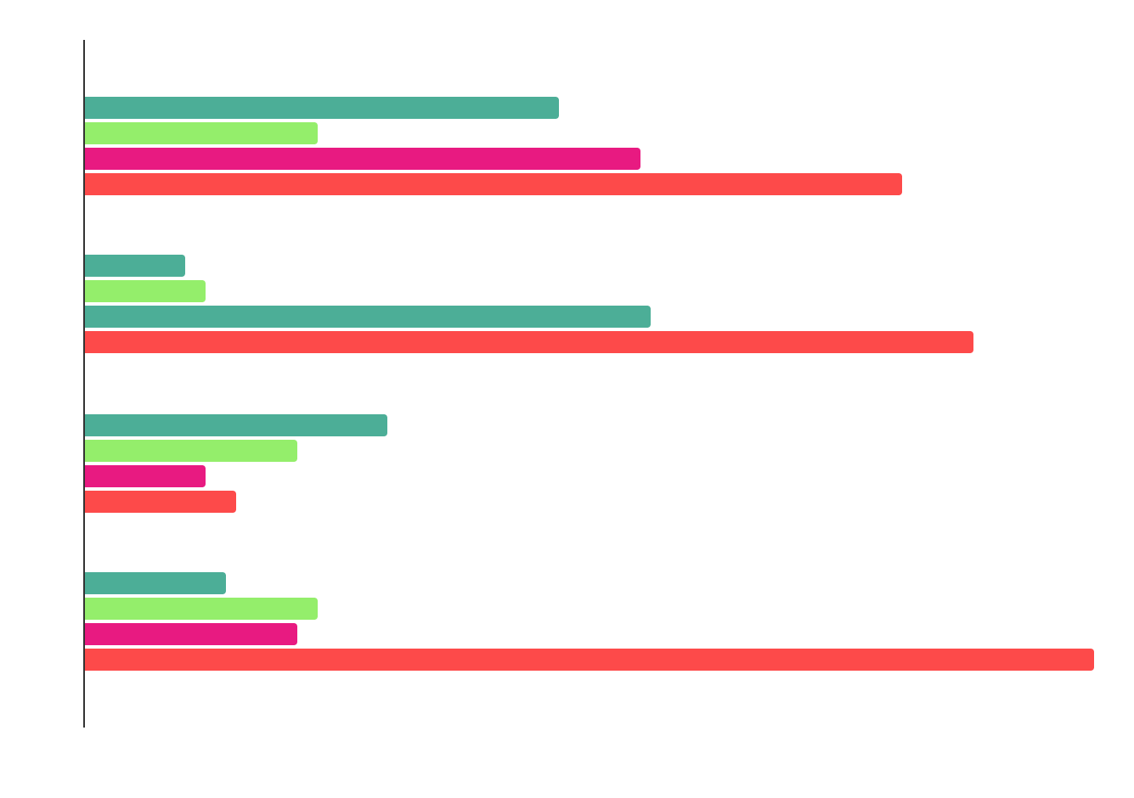
You can use this graph
Mercury
Venus
Jupiter
Saturn
*
Mercury is the smallest planet
Venus has very high temperatures
Jupiter is the biggest planet
Saturn is a gas giant with rings
Follow the link in the graph to modify its data and then paste the new one here. For more info, click here

Slide 26
Practical exercise 07
Write a Java program to reverse a string.
Input data:
Input a string: My dog’s name is Ralph
Expected output:
Reverse string: hplaR si eman s‘god yM

Slide 27
Alternative resources
Here’s an assortment of alternative resources whose style fits the one of this template:
Programmers concept with flat design

Slide 28
Resources
Did you like the resources on this template? Get them for free at our other websites:
Photos
Html and css collage concept with person I
Html and css collage concept with person II
Html and css collage concept with person III
Html and css collage concept with person IV
Medium shot smiley woman at library
Medium shot man holding notebook

Slide 29
Instructions for use
If you have a free account, in order to use this template, you must credit Slidesgo by keeping the Thanks slide. Please refer to the next slide to read the instructions for premium users.
As a Free user, you are allowed to:
Modify this template.
Use it for both personal and commercial projects.
You are not allowed to:
Sublicense, sell or rent any of Slidesgo Content (or a modified version of Slidesgo Content).
Distribute Slidesgo Content unless it has been expressly authorized by Slidesgo.
Include Slidesgo Content in an online or offline database or file.
Offer Slidesgo templates (or modified versions of Slidesgo templates) for download.
Acquire the copyright of Slidesgo Content.
For more information about editing slides, please read our FAQs or visit our blog:
https://slidesgo.com/faqs and https://slidesgo.com/slidesgo-school

Slide 30
Instructions for use (premium users)
As a Premium user, you can use this template without attributing Slidesgo or keeping the Thanks slide.
You are allowed to:
Modify this template.
Use it for both personal and commercial purposes.
Hide or delete the “Thanks” slide and the mention to Slidesgo in the credits.
Share this template in an editable format with people who are not part of your team.
You are not allowed to:
Sublicense, sell or rent this Slidesgo Template (or a modified version of this Slidesgo Template).
Distribute this Slidesgo Template (or a modified version of this Slidesgo Template) or include it in a database or in any other product or service that offers downloadable images, icons or presentations that may be subject to distribution or resale.
Use any of the elements that are part of this Slidesgo Template in an isolated and separated way from this Template.
Register any of the elements that are part of this template as a trademark or logo, or register it as a work in an intellectual property registry or similar.
For more information about editing slides, please read our FAQs or visit our blog:
https://slidesgo.com/faqs and https://slidesgo.com/slidesgo-school

Slide 31
Fonts & colors used
This presentation has been made using the following fonts:
Source Code Pro
(https://fonts.google.com/specimen/Source+Code+Pro)
#e7e7e7
#10111a
#fd4a4a
#ec7955
#e81a81
#94ee6b
#4cae97
#bd64b5
#ffff99
#2c293a

Slide 32

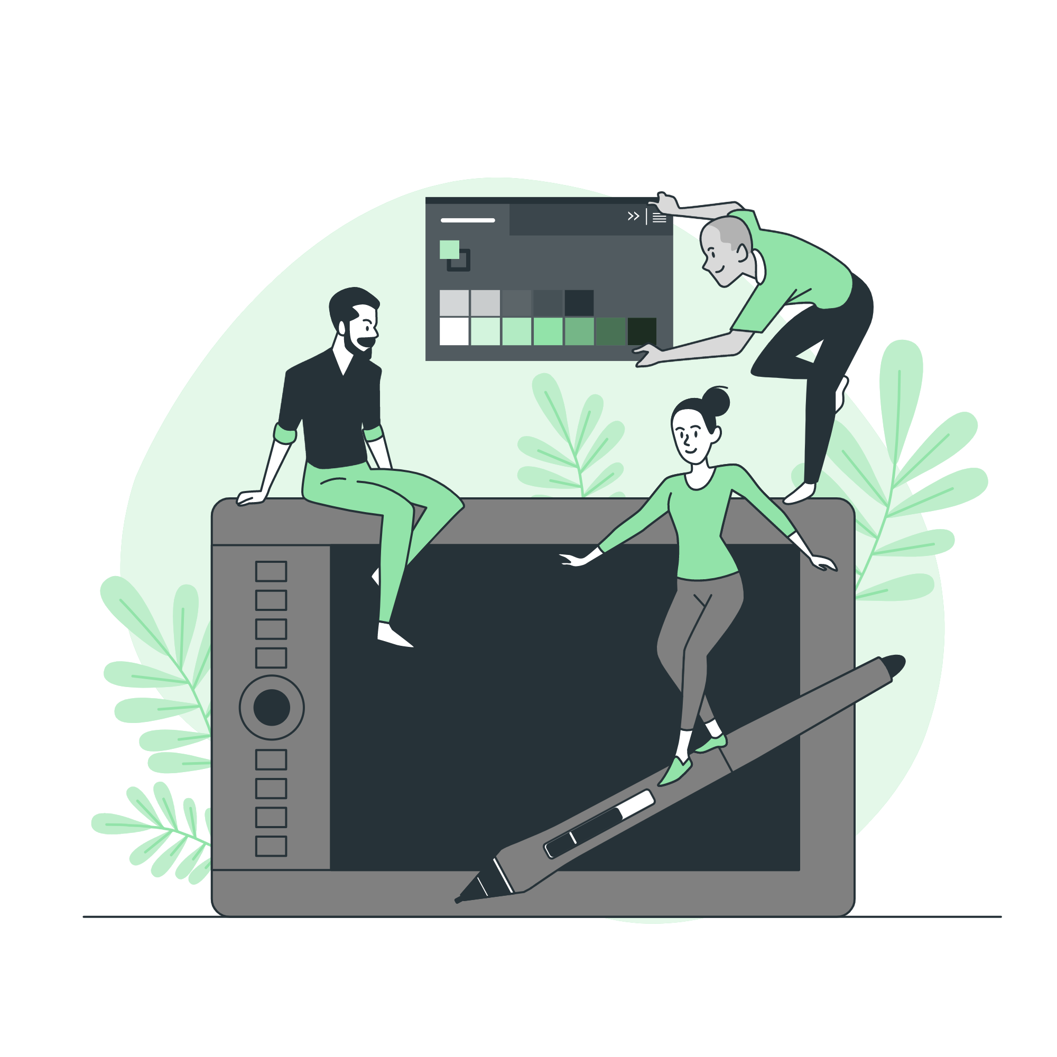



Storyset
Create your Story with our illustrated concepts. Choose the style you like the most, edit its colors, pick the background and layers you want to show and bring them to life with the animator panel! It will boost your presentation. Check out how it works.
Pana
Amico
Bro
Rafiki
Cuate

Slide 33
Use our editable graphic resources...
You can easily resize these resources without losing quality. To change the color, just ungroup the resource and click on the object you want to change. Then, click on the paint bucket and select the color you want. Group the resource again when you’re done. You can also look for more infographics on Slidesgo.

Slide 36
JANUARY
FEBRUARY
MARCH
APRIL
MAY
JUNE
PHASE 1
Task 1
Task 2
PHASE 2
Task 1
Task 2
JANUARY
FEBRUARY
MARCH
APRIL
PHASE 1
Task 1
Task 2

Slide 39
...and our sets of editable icons
You can resize these icons without losing quality.
You can change the stroke and fill color; just select the icon and click on the paint bucket/pen.
In Google Slides, you can also use Flaticon’s extension, allowing you to customize and add even more icons.

Slide 40
Educational Icons
Medical Icons

Slide 41
Business Icons
Teamwork Icons

Slide 42
Help & Support Icons
Avatar Icons

Slide 43
Creative Process Icons
Performing Arts Icons

Slide 44
Nature Icons

Slide 45
SEO & Marketing Icons

