Slide 1
Cryptography
ﾟ･｡+☆+｡･ﾟ･｡+☆+｡･ﾟ･｡+☆+｡･ﾟ･｡+☆+｡･ﾟ･｡+☆+｡･ﾟ･｡+☆+｡･ﾟ･｡+☆
By: Isabel, Abby, and Sampreetha

Slide 2
Table of contents
01
02
03
04
☆;+;｡･ﾟ･｡;+;☆;+;｡･ﾟ･｡;+;☆;+;｡･ﾟ･｡;+;☆;+;｡･ﾟ･｡;+;☆;+;｡･ﾟ･｡;+;☆;+;｡･ﾟ･｡;+;☆;
Basics
Cyphers
Significance
Protection

Slide 3
01
The Basics of Cryptography
*☆*――*☆*――*☆*――*☆*――*☆*―
In the next few slides we will cover the history of cryptography, along with some basic terminology and background information.

Slide 4
Termanology
*:._.:*~*:._.:*~*:._.:*~*:._.:*~*:._.:*~*:._.:*~*:._.:*~*:._
Cipher
Plaintext
A secret or disguised way of writing; a code.
Readable data — including binary files — in a form that can be utilized without the need for decryption.
Encipher
Decipher
Convert (a message or piece of text) into a coded form; encrypt.
Convert (a text written in code, or a coded signal) into normal language.

Slide 5
What is Cryptography:
Cryptography- is the study of techniques for secure communication.
  More generally, cryptography is about creating and analyzing programs to prevent third parties or the public from retrieving private messages.
Vocabulary:
  Crypto (prefix)- secure communication
  Bit and Byte- The bit is the most basic unit of information in computing and digital communications. A byte is 8 of these bits making it a larger unit of information

Slide 6
Timeline:
Note: There are traces of cryptography existing since the egyptians hieroglyphics
Herban rotating machines
Advanced encryption standard
This machine was created by edward Herban as the first ever electric cipher device
AES replaced DES since it had crashed in 1997. AES used a symmetric-key algorithm with large bit key lengths. It became the national standard that year
1917
1977
2001
2023
Data Encryption Standard
TLS
It was created to protect sensitive electronic government information using a symmetric-key algorithm and has a key-length of 56 bits. It became the federal information processing standard in the US.
Today we are protected while on the internet because of TLS. TLS uses asymmetric and symmetric encryption to ensure our information safety when on websites

Slide 7
Why was it invented?
World War II
Private Data
Cryptography was intended for military purposes, and to hide secret military information
Ensures the confidential transfer of private data
Private key Encryption
Confidentiality
Insures that unauthorized users can not gain access to sensitive information
When logging into websites your username and password is often encrypted before transmitted into web server

Slide 8
02
Cyphers
*・゜・*:.。.*.。.:*・☆・゜・*:.。.*.。.
In the next few slides we will cover some popular cyphers, along with the Caesar cipher.

Slide 9
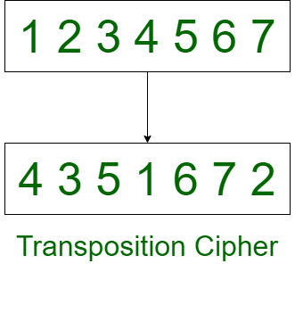
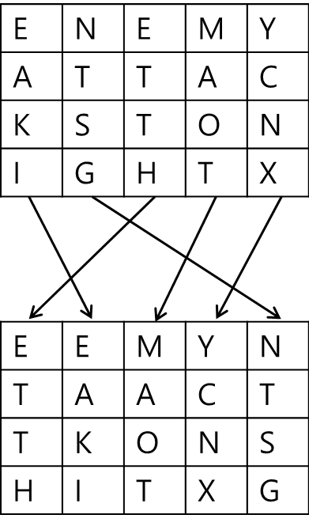
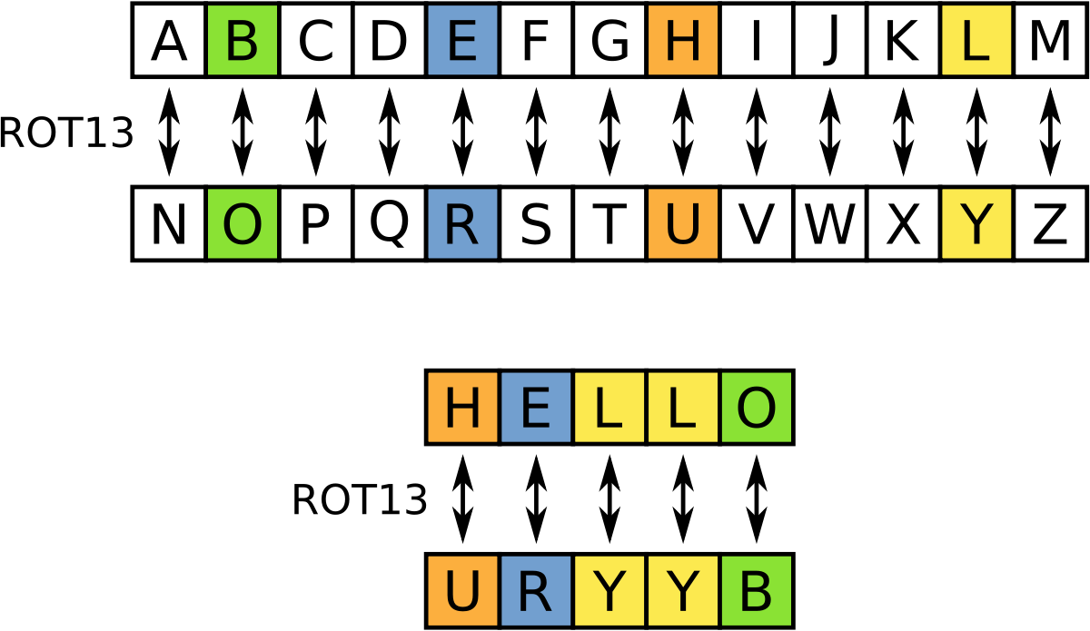
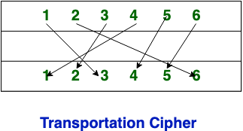
Types of Ciphers
Substitution Cipher
Transposition Cipher
◇◆◇◆◇◆◇◆◇◆◇◆◇◆◇◆◇◆◇◆◇◆◇◆◇◆◇◆
Plaintext
Ciphertext
Plaintext
Ciphertext
HOW?
HOW?
The encryption is done by changing the positions of the letters
The encryption is completed by changing the letters
Substitution cipher
monoalphabetic cipher
polyalphabetic cipher
Notes:
There are two main types of Ciphers, Substitution CIphers and Transposition Ciphers. In a substitution cipher the plaintext is encoded into ciphertext, and it is done in a manner that has previously been established. This means that it can be decoded by the reader using a key (or similar).
Even within Substitution ciphers there are subtypes, such as monoalphabetic ciphers or polyalphabetic ciphers. A monoalphabetic cipher utilizes the same format and uses fixed substitution over the entire message, whereas a polyalphabetic cipher uses a number of substitutions at different positions in the message, where a unit from the plaintext is mapped to one of several possibilities in the ciphertext.
On the other hand a Transposition Cipher changes the order of the letters, instead of substituting them as a substitution cipher does. Despite the Ciphers operating in different manners, Transposition Ciphers possess some similarities to Substitution Ciphers, as they ultimately provide the same function, even if the idea or plan to reach the end goal of encryption is different.

Slide 10
Caesar Cypher
. ⋅ ˚̣- : ✧ : – ⭒ ⊹ ⭒ – : ✧ : -˚̣⋅ . ⋅ ˚̣- : ✧ : – ⭒ ⊹ ⭒ – : ✧ :
Shift Cipher
Caesars Shift
Caesars Code
x | y | z
a | b | c | d | e | f | g | h | i | j | k | l | m
a | b | c | d | e | f | g | h | i | j | k | l | m
a | b | c | d | e | f | g | h | i | j | k | l | m
n | o | p
Notes:
In the days of the Roman Empire, encryption was used by Julius Caesar and the Roman Army, this is the origin of the widely popular Caesar Cypher. The Caesar Cypher is also known as the Shift Cipher, Caesars Shift, and Caesar's Code.
Caesar is believed to have used the cypher at a left shift of three. This means that each letter in the alphabet was shifted three letters to the left. It would have looked similar to this. An A would have become a D, and in turn each letter would be replaced by the letter three to the left of it.
For the letters at the end of the alphabet, such as x, y, and z, they would become a, b, and c, as the alphabet wraps around.
Generally Caesar Cypher isn't difficult to decode, as there is only 25 possible variations of the alphabet using this cipher, but more difficult to decode ciphers have been created that used Caesar Cypher as the base.

Slide 11


Significance:
It protects our privacy and keeps our conversation and data confidential
  This can all be programmed through algorithms that use symmetric key and asymmetric key algorithms.
Core principles of cryptography:
  Data Confidentiality
  Data Integrity
  Authentication
Cryptographer’s can also play specialized roles that provide technical support to the government, and business to secure their data and prevent a data breach .

Slide 12
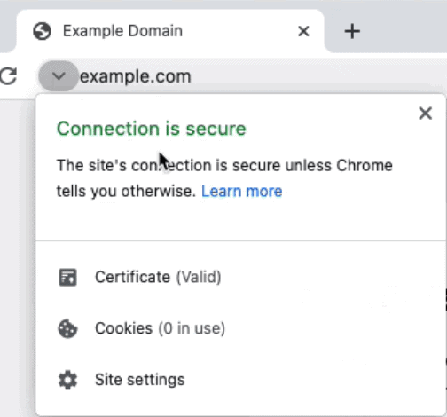
Protection
Here we will look at how crypto is used in real life!
The Google lock:
Located on the upper left hand of the google browser we have the lock icon
  Even through this lock is small the security and algorithm to ensure our security are very complex
Lets us know that this website it safe to use
Small pieces of text sent to your browser by a website you visit. They help that website remember information about your visit.
SSL/TLS (Secure Sockets Layer) certificates are what enable websites to use HTTPS.
An SSL certificate has the website's public key, as well as information specific to the site's identity.
What is a public key?
In crypto there are 2 keys used when programing algorithms for security. Public and private keys. A public key can encrypt and only a private key can decode it

Slide 13
Sources
The History of Cryptography | DigiCert
Bits and Bytes
Cryptography | Computer science
Substitution cipher - Wikipedia
Transposition cipher - Wikipedia
What is an SSL certificate? | Cloudflare
Public and private keys

Slide 14
Questions?
♡♥♡♥♡♥♡♥♡♥♡♥♡♥♡♥♡♥♡♥♡♥♡♥♡♥♡♥♡♥♡♥♡♥♡♥♡♥♡♥♡♥♡♥
artemis@bu.edu
(617) 237-6189
https://www.bu.edu/lernet/artemis/index.html
Please keep this slide for attribution

Slide 15
Thank you for listening!
≿━━━━༺❀༻━━━━≾

