Slide 1
Binary
By Abirami, Fatima, and Lily

Slide 2
Intro to
Binary
01

Slide 3

What is Binary and why is it used?
A language spoken by computers entirely composed of 0s and 1s.
It’s used because the way a computer works resembles rows and rows of switches- “on” being 1, and “off” being 0.
Each binary number has a combination of four 0 or 1 digits, and each combination varies between what letter or number it represents.

Slide 4
Binary
To Decimal
02
Abirami Tilak

Slide 5
Binary to Decimal
Heavily relies on powers of two
0’s on the left of the number don’t count to the number
0 | 0 | 0 | 0 | 1 | 1 | 1 | 1
2⁷ | 2⁶ | 2⁵ | 2⁴ | 2³ | 2² | 2¹ | 2⁰
X | X | X | X | 8 + | 4 + | 2 + | 1 = | 15

Slide 6
Decimal to Binary
Like binary to decimal, heavily relies on powers of two
16 is the biggest power of 2 in 19
19-16=3
2⁷ | 2⁶ | 2⁵ | 2⁴ | 2³ | 2² | 2¹ | 2⁰
X | X | X | 16 + | X | X | 2 + | 1 = | 19
0 | 0 | 0 | 1 | 0 | 0 | 1 | 1

Slide 7
Hexadecimal
03
Abirami Tilak

Slide 8
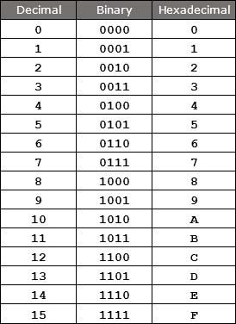
What is Hexadecimal?
Hexadecimal is another type of number system
Base 16
Can contain 0-9 and A-F
Each letter is equivalent to half a byte

Slide 9
Hexadecimal to Decimal
Heavily relies on powers of 16 instead of 2
3 | 2 | A
3*16² | 2*16¹ | 10*16⁰
768 + | 32 + | 10 = | 810

Slide 10
Binary to Hexadecimal
Ex. 100100101100
1001 | 0010 | 1100
9 | 2 | C

Slide 11
Hexadecimal to Binary
Similar to Binary to Hexadecimal
7 | 5 | D
0111 | 0101 | 1101

Slide 12

Addition and Subtraction in Binary
04
Liliana Ng

Slide 13

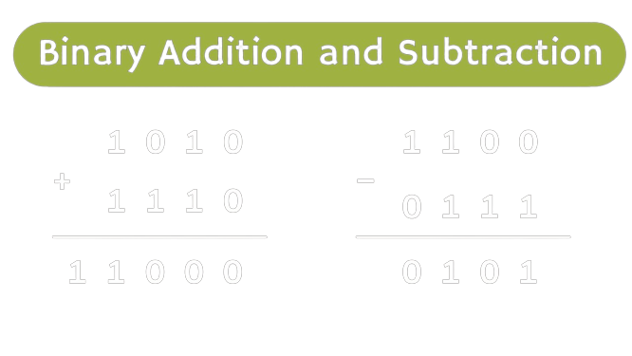
Intro to Binary Math:
Just like normal decimal math
+ - ÷ ×
Only 0’s and 1’s!
Notes:
Doing math in binary is just like doing normal math. Only with different ways of writing out numbers
I’m going to go deeper into math functions, addition, subtraction, multiplication, and division
Remember to keep in mind, in binary, there are only 0s and 1s, digits are shown like base ten, but in powers of two. Don’t worry, i’ll go deeper into this.

Slide 14
Addition: (+)
0+0=
0
+1
28
13
__________________________________
0+1=
1
Start with single digits
1+1=
10
1+1+1=
11
4
1
In decimal math, when the sum of two #’s>9, the 10s digit carries over
+1
+1
+1
0110
1110
_______________________
Carrying causes the first digit to be a 0, and the next adds 1
1
0
1
0
0
Notes:
To start out easy, each digit is quite simple. 0+0=0 pretty simple, then 0+1=1. However, 1+1=10. As you learned earlier, this is actually a one zero, not a ten. If you converted this to decimal, this would equal two.
Ok, now we are going to get a little bit more complicated. In decimal adding, when two numbers in the same digit are added and the sum is greater than 9, you just add a 1 to the next digit to the left.
(Explain the binary addition)

Slide 15
Subtraction: (-)
0-0=
0
+1
3
42
17
__________________________________
1-0=
1
Start with single digits (again)
1-1=
0
0-1=
01
2
5
When the difference of two numbers in the same digit <0, you have to take from the digit on the left
+1
0
11011
0110
___________________________
Like addition, subtraction in binary works the same way as decimal
1
0
1
0
1

Slide 16
Multiplication and Division in Binary
05
Fatima Mulyono

Slide 17
Multiplication: (×)
101
×100
_______________________
Just normal multiplication, the product should also be written in binary
1
0
0
10000
_________________________________
10100

Slide 18
Division: (÷)
0÷0=
Not defined
Start with single digits
Division with big numbers is harder
1÷0=
Not defined
0÷1=
0
1÷1=
1

Slide 19

Negatives
05
Liliana Ng

Slide 20



Negatives
What defines a negative number?
  A number and it’s opposite have to add up to 0
  Ex. 3+(-3)=0
  Ex. 6+(-6)=0
1001
+0110
__________________________
1111
1001
0110
Thinking backwards
The process:
0110 +1
= 0111
Flip the 1’s & 0’s
2. Check: If those two numbers are added, you should get all 1’s
3. Add a 1 to the rightmost digit
4. Check: If the original number and the new number are added, it should have a one on the left side, and the rest should be zeros
1001
+0111
__________________________
10000
5. In the sum you just added, the
left 1 doesn’t actually matter,
you’re done!
Notes:
To start out easy, each digit is quite simple. 0+0=0 pretty simple, then 0+1=1. However, 1+1=10. As you learned earlier, this is actually a one zero, not a ten. If you converted this to decimal, this would equal two.
Ok, now we are going to get a little bit more complicated. In decimal adding, when two numbers in the same digit are added and the sum is greater than 9, you just add a 1 to the next digit to the left.
(Use 28+13 as example)
(Explain the binary addition)

Slide 21
ASCII
06
Fatima Mulyono

Slide 22
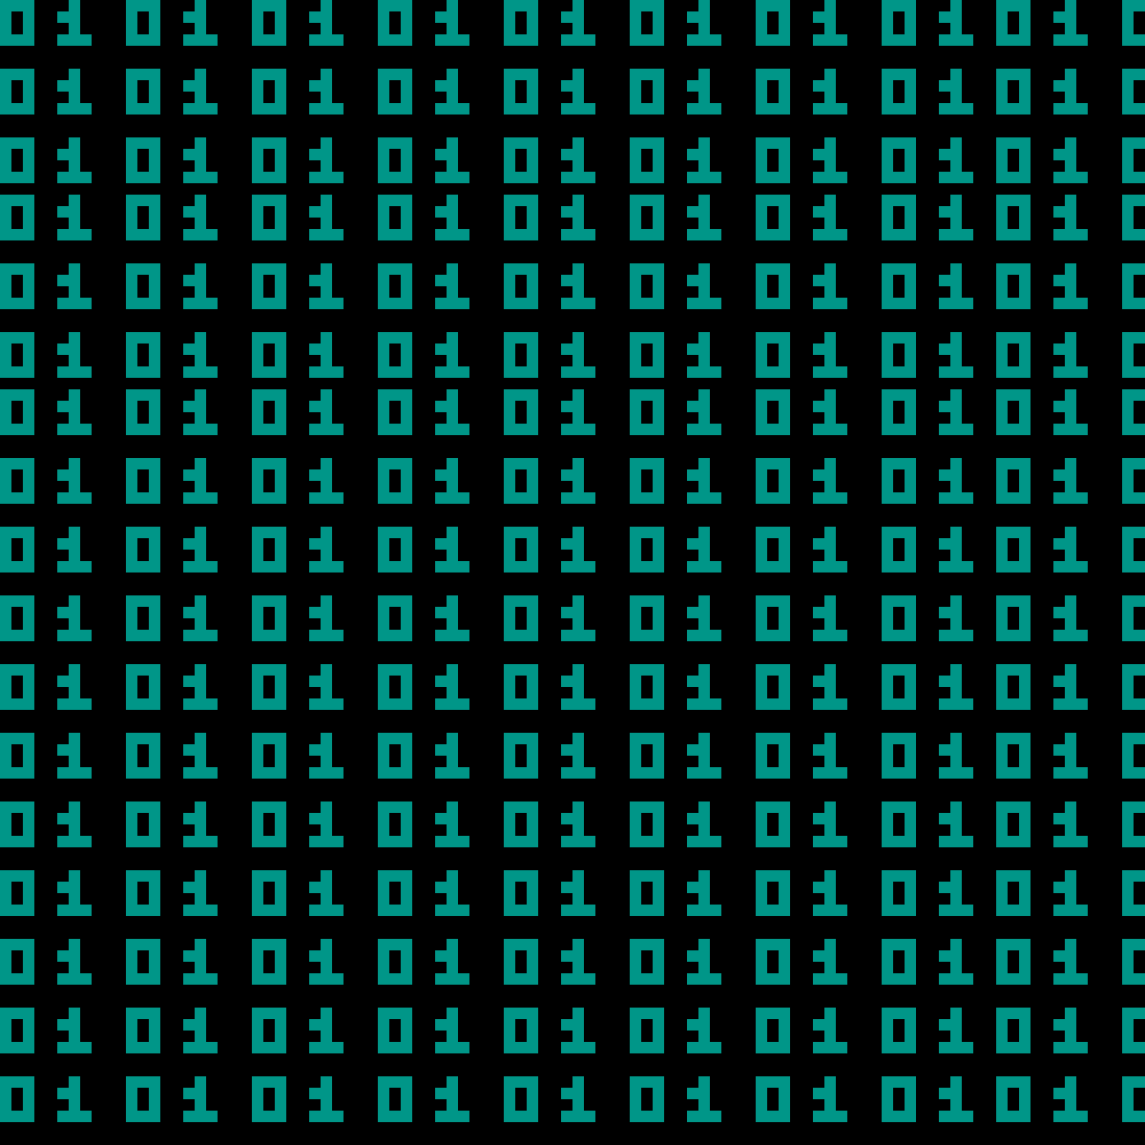
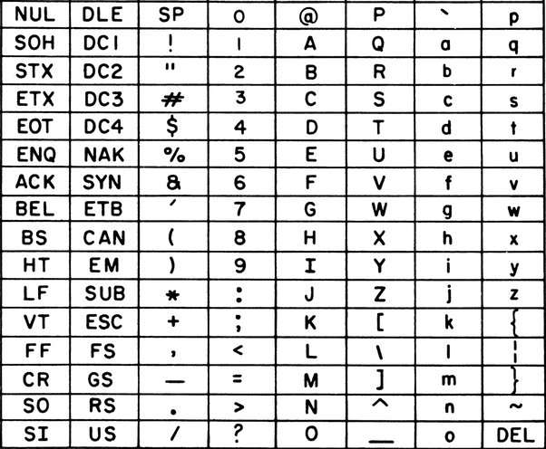
What is ASCII?
The first major character encoding standard for data processing
An acronym that stands for “American Standard Code for Information Interchange
Used to represent text in computers
ASCII-encoded data can be translated into 128 various alphabetic, numeric or special additional characters and control codes
You can convert ASCII code into binary!

Slide 23
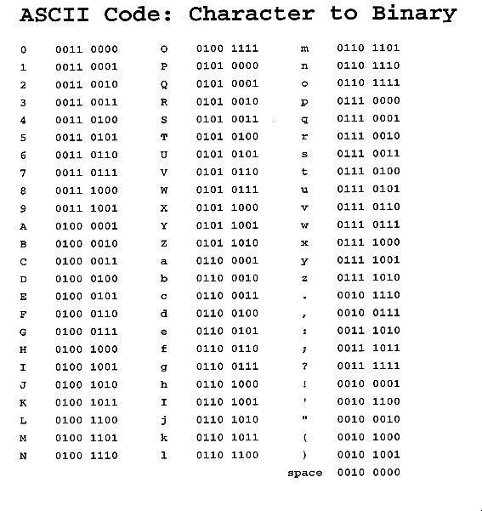
Converting ASCII to Binary
Get your character (number, letter, or additional character)
Use an ASCII table to find the binary conversion of your character
or
Get your character (number, letter, or additional character)
Find the decimal code of your character from an ASCII table
Convert that decimal code to its binary code
Note: in order to convert binary to ASCII, just reverse the system!
Notes:
Be sure to include doing the scavenger hunt in

Slide 24

Thanks!
Any questions?
Feel free to ask afterwards!

