Slide 1
By: Aahuti, Jacey, Mirela!
3D

Slide 2
CONTENTS
Introduction
Materials/Types of 3D printing
Advantages and Disadvantages
Why?
Examples
Pictures

Slide 3
WHAT IS 3D PRINTING?
“the action or process of making a physical object from a three-dimensional digital model, typically by laying down many thin layers of a material in succession.” (Oxford Languages)
Inventor : Charles Hull
WHAT IS 3D?
3D, or three dimensional, refers to the three spatial dimensions of width, height and depth ( Having or appearing to have length, breadth, and depth)

Slide 4
MATERIALS/TYPES
MATERIALS
Paper
Plastics(ABS, Nylon, etc.)
Metals(steel, aluminum, etc.)
Resins(different properties depending on what you are making)
TYPES OF 3D PRINTING
Selective laser melting:printing uses a high power laser beam to fuse the metallic powders together
Fused deposition modeling: prints object layers and uses thermoplastic material
Digital light processing: uses digital micro mirrors to reflect the lasers to melt the liquid plastic resin
list of filaments

Slide 5
ADVANTAGES
Flexible design-3D printing allows for the design and print of more complex designs than traditional manufacturing processes. More traditional processes have design restrictions which no longer apply with the use of 3D printing.
Print on demand- Print on demand is another advantage as it doesn’t need a lot of space to stock inventory, unlike traditional manufacturing processes. This saves space and costs as there is no need to print in bulk unless required.
Rapid Prototyping- 3D printing can manufacture parts within hours, which speeds up the prototyping process. This allows for each stage to complete faster to create parts as the part can be finished in hours, allowing each design modification to be completed at a much more efficient rate.

Slide 6
DISADVANTAGES
Limited materials: While 3D Printing can create items in a selection of plastics and metals the available selection of raw materials is not exhaustive. This is due to the fact that not all metals or plastics can be temperature controlled enough to allow 3D printing. In addition, many of these printable materials cannot be recycled and very few are food safe.
Reduction in manufacturing jobs: Another of the disadvantages of 3D technology is the potential reduction in human labour, since most of the production is automated and done by printers. However, many third world countries rely on low skill jobs to keep their economies running, and this technology could put these manufacturing jobs at risk by cutting out the need for production abroad.

Slide 7
WHY 3D?
We use 3D printing to make quick and easy prototypes and product models for designers and companies. It is also used to test out different materials for products. It can help you save time and money because you don’t have to physically build new products with every change in designs. However, 3D printing has often been used to make final products as well. 3D printing can also be used to make mini models of buildings and cars to help visualize the product and test physics. It ultimately is a crucial strategy for improving the building and its structure.

Slide 8
Uses for 3d Printing
Fashion
3D digital design helps brands design and sample clothing more quickly and with less waste. Designers can now build a 3D garment directly on a digital avatar (model) of their size.
Architecture
Construction industry can use 3D modelling to demonstrate proposed buildings instead of using more traditional physical architectural models. This can help with extensive structures such as arches or unique extensions.
Food
3D food printers make use of precisely controlled stepper motors to dispense ingredients. The machine can be left to build the food while other portions of the meal are prepared.
Medical
helpful for patient education and pre-operative planning for surgeons
3d printed organs/prosthetics

Slide 9
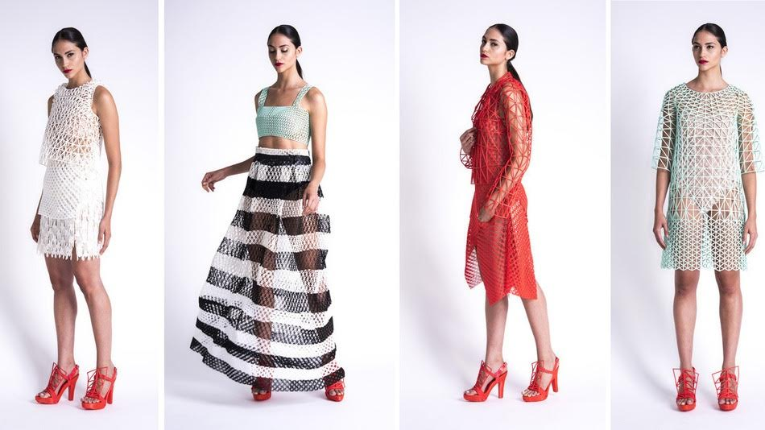
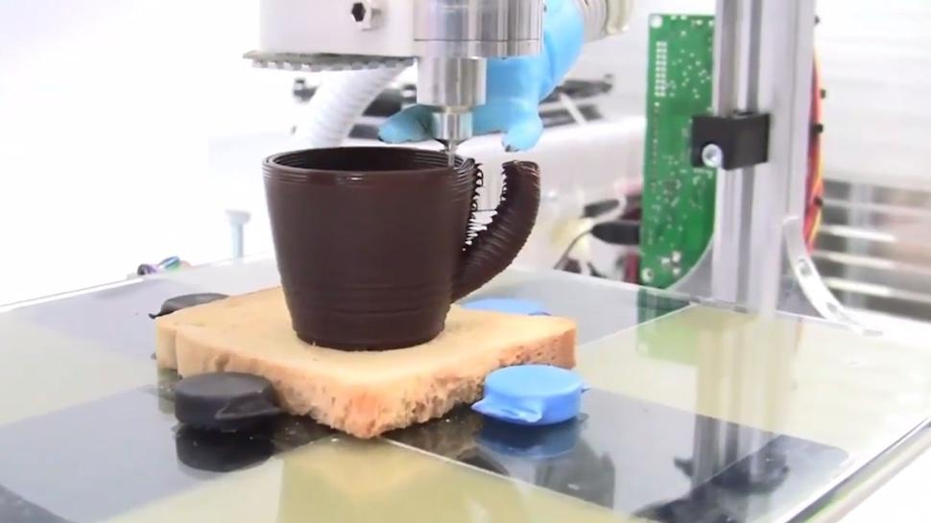
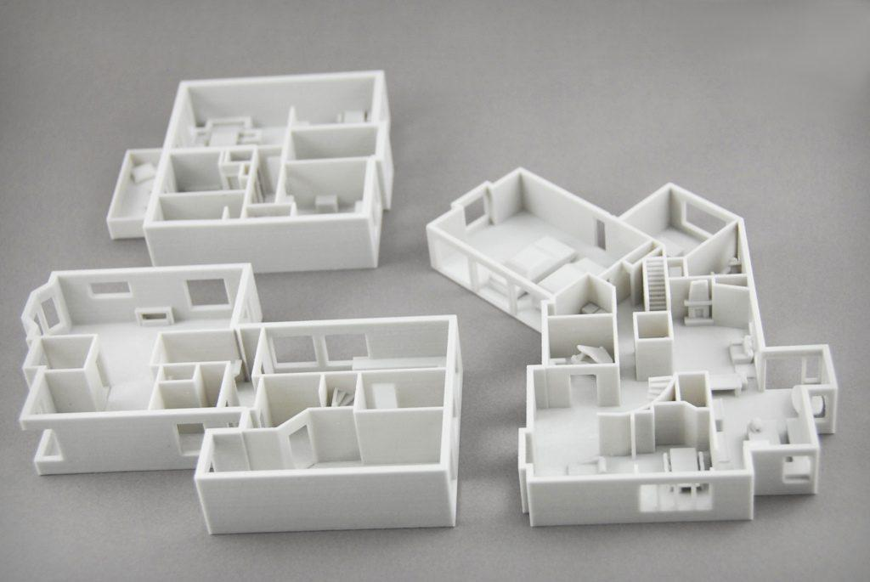
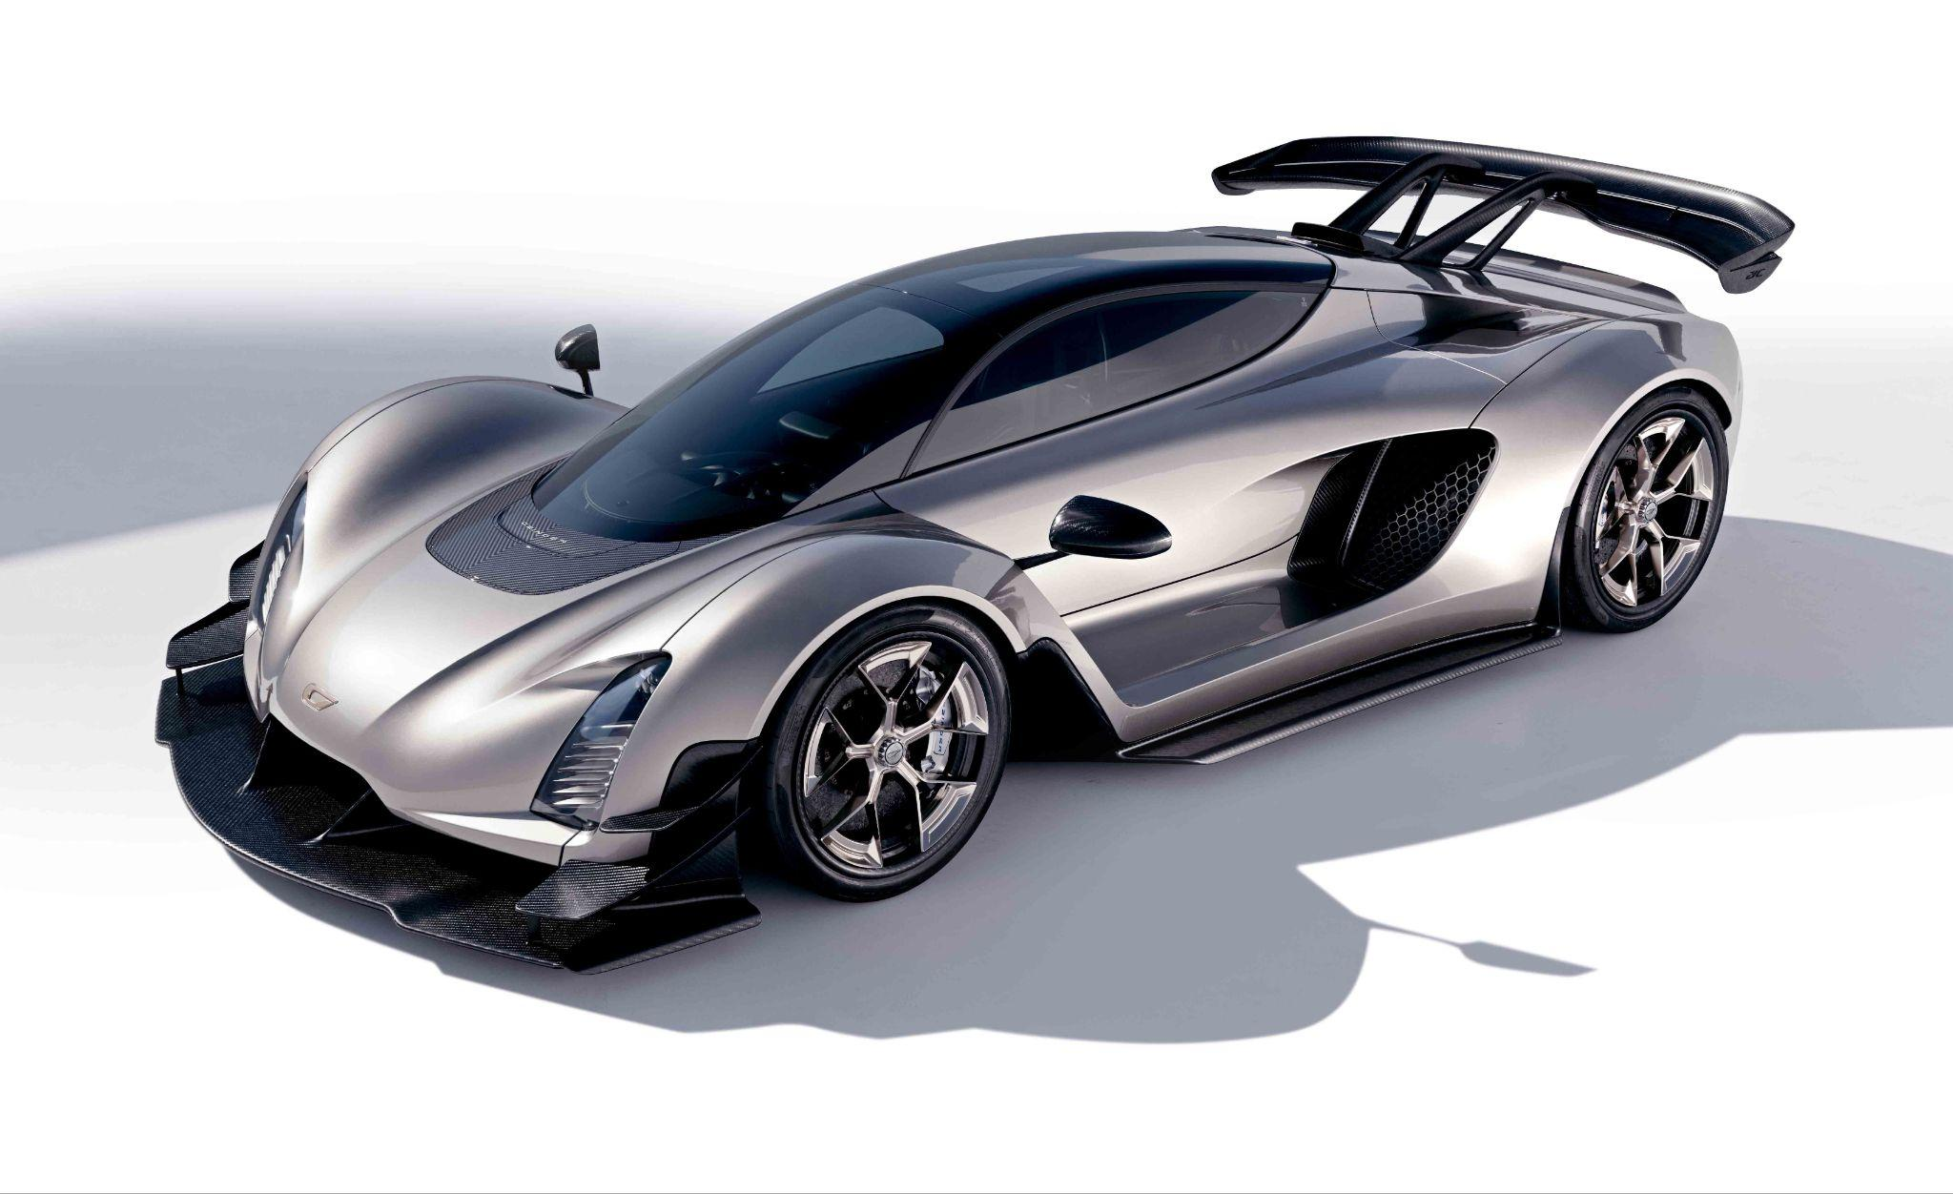
PICTURES

Slide 10
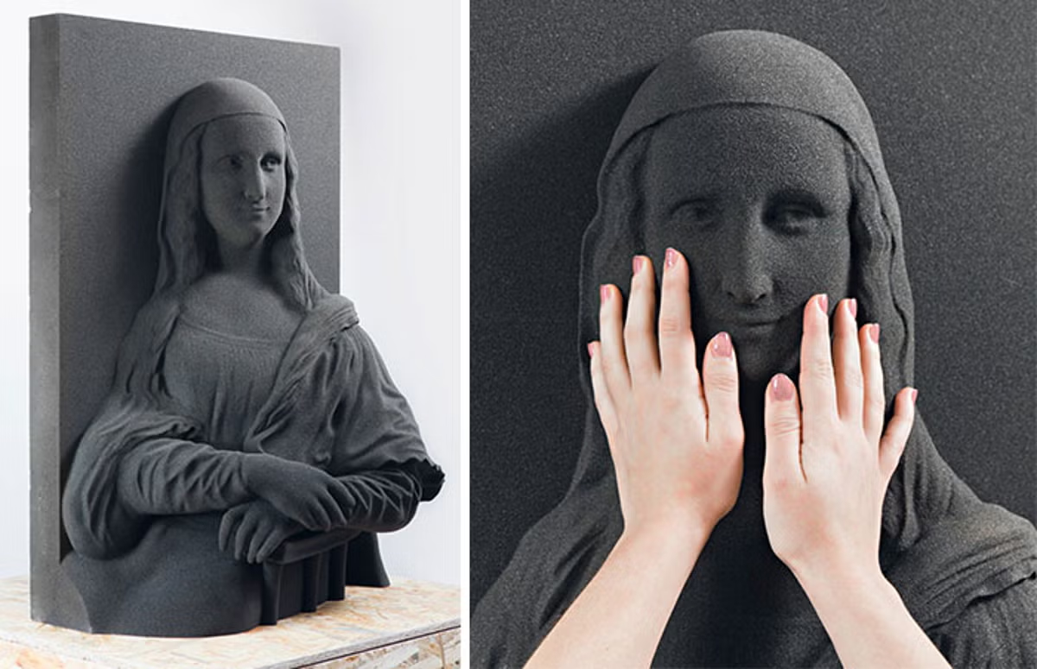
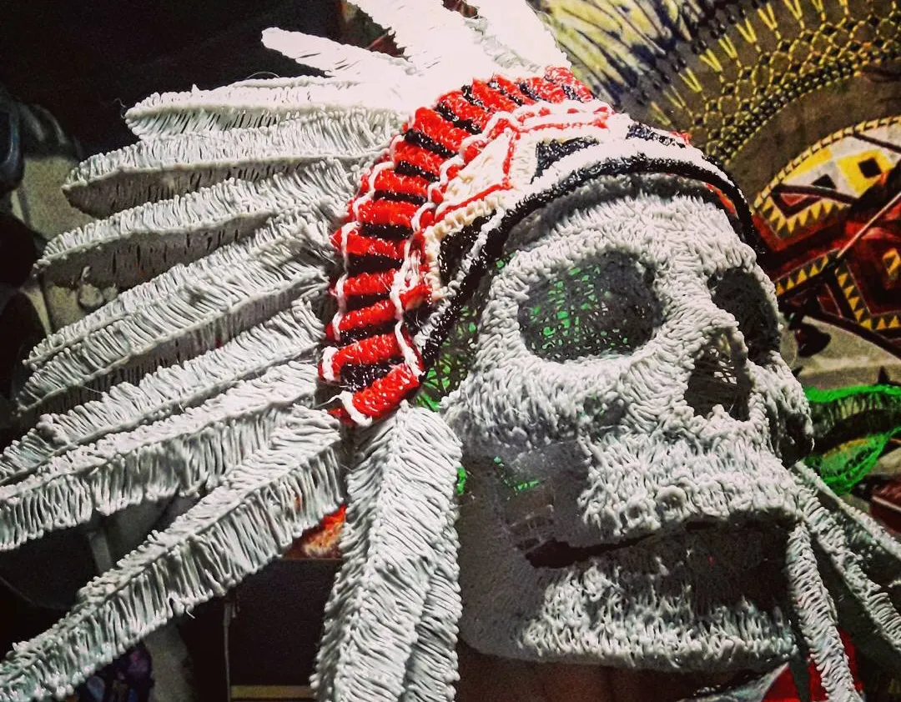
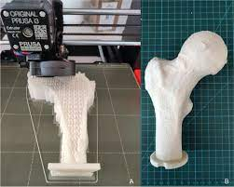
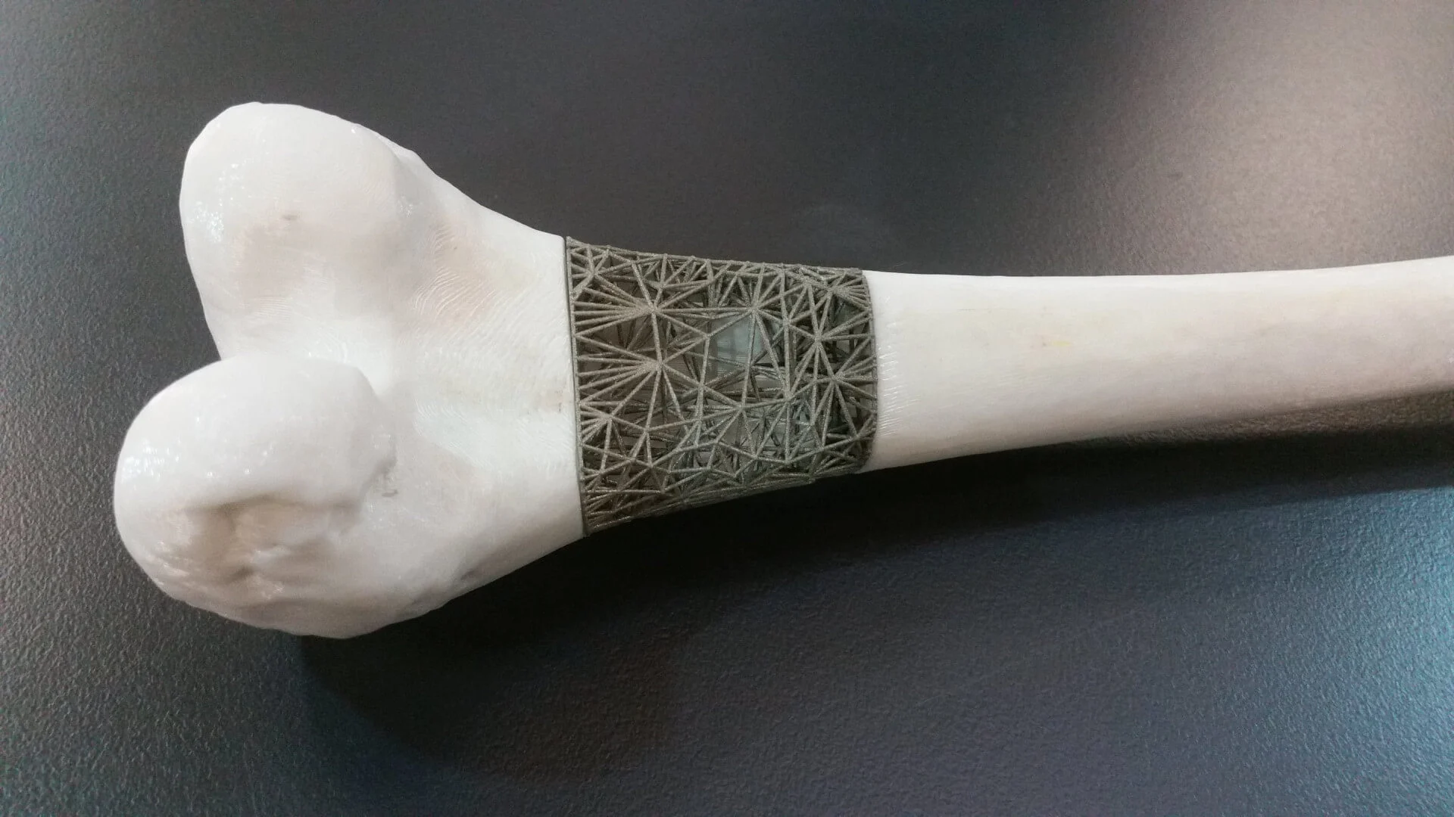

Slide 11
THE END!

