Slide 1
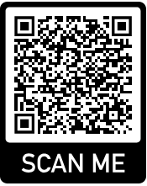
Stone Moot Court
If you will need to leave early, please fill this out now for attendance purposes!
Info Session 2025

Slide 2
Meet the Team!
Advocacy and Legal Skills Program
Jen McCloskey, Executive Director
jataylor@bu.edu
617-353-3199
Room 510D
Noah Chasen, Assistant Director
Stone Directors (stonemc@bu.edu)
Catherine Bartzen
Seth Kahler
Steven Mitchell

Slide 3
Overview: Where to Find Info
Stone website: www.bu.edu/law/stone
Dates and deadlines
Application
Workshop recordings
Competition materials
Competition schedules
Echo360: Oral argument recordings (after competition)
Questions? Email stonemc@bu.edu

Slide 4
Overview: Dates & Deadlines
Tuesday, September 23 Registration forms due by 2:00 p.m.
Tuesday, September 23 List of unpaired registrants emailed ASAP
Wednesday, September 24 Deadline to inform Directors of pairings (time till be in the pairing email); team pairings and assignments will be emailed as soon as possible after this deadline.
Thursday, September 25 Problems posted on Stone Moot Court website.
Monday, September 29 Brief Writing Workshop: 1:00 – 2:00 p.m.
Friday, October 10 Deadline to submit questions and oral argument conflicts
Friday, October 17 Briefs due via email by 3:00 p.m.
Monday, October 20 Oral Advocacy Workshop: 1:00 - 2:00 p.m.
October 27 – 31 Oral Arguments Mon.-Thurs. 6:30 p.m.; Fri. 3:00 p.m. November 3 – 7 November 10 – 14
Thursday, November 20 Stone Awards Announcement and Reception

Slide 5
Overview: Cases and Teams
Team Assignments
Problem Distribution
Clarifications
Resources and Assistance
For briefs
For oral arguments
A note about plagiarism

Slide 6
Briefs
Format
Review rules carefully
3000 words per argument is a max, not a min
A note about sample briefs
Submission
Due Friday, October 17 by 3:00 p.m.
Signature
Late briefs
Partner concerns
Scoring
Scored by 3Ls
Deductions
Disqualification

Slide 7
Oral Arguments
All arguments are recorded!
Dates and Conflicts
Send conflicts to stonemc@bu.edu
We do not know your class schedule!
Argument
30 minutes/team; divide evenly; ok to not use all time
Up to 2 minutes rebuttal for P-side teams
Weekly schedule posted one week in advance
Check in on 6th floor
No scouting/spectating
Bench and Scoring
1-2 attorneys + 1-2 3Ls (3 people total)
Feedback from bench; scored by 3Ls
Disqualification

Slide 8
Albers + Prizes
Homer Albers Prize:
16 to 32 students advance
Invites are distributed proportionally among the three Stone problems
50% brief + 50% oral argument score
Do not have to accept if invited
Stone Awards:
Best Brief (team award)
Best Oralist (individual award)
One of each per problem
Cash prize!
Stone Awards Reception:
Thursday, November 20 at 1pm
Mandatory unless unavailable
Good food!

Slide 9
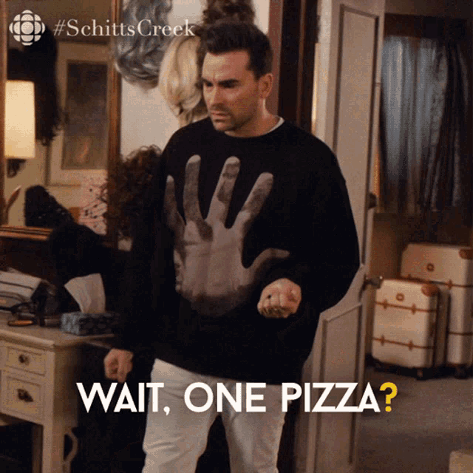
Before you go!
Exit Survey/Attendance

