Slide 1
Stress
Managing stress to optimize exam performance

Slide 2
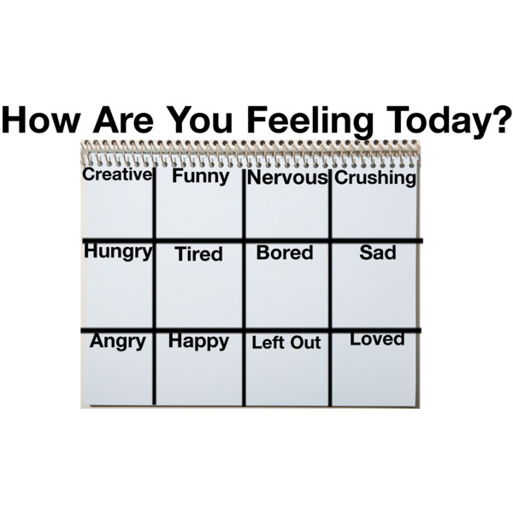

Slide 3
How about that stress?

Slide 4

Evolutionary Basis

Slide 5
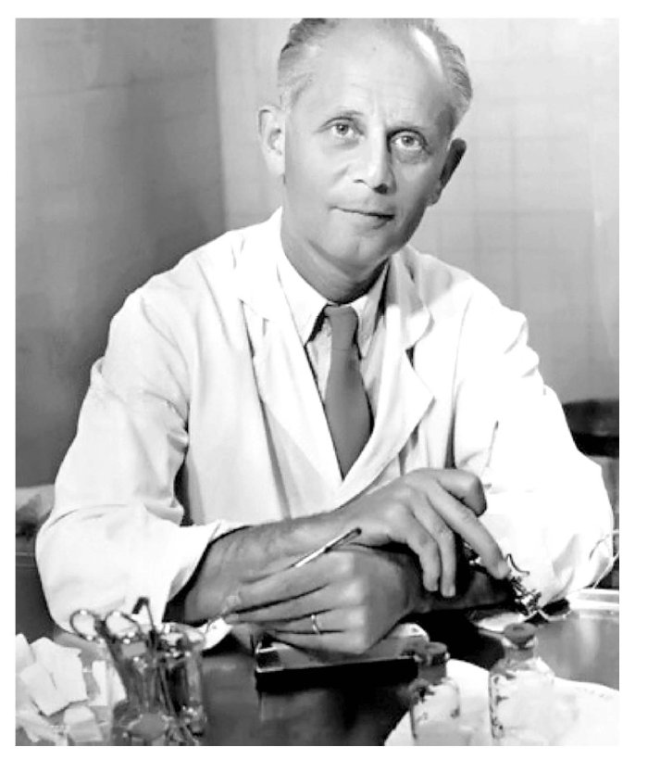
Meet Hans Selye,
Father of Stress Research…
Medical researcher in Montreal
Studied hormonal changes in rats
Late 1930s, he realized that the rats he was studying were responding not merely to his injections, but also to the stress caused by the experiments.
Concluded that it was stress that caused the rats to become ill and die.

Slide 6
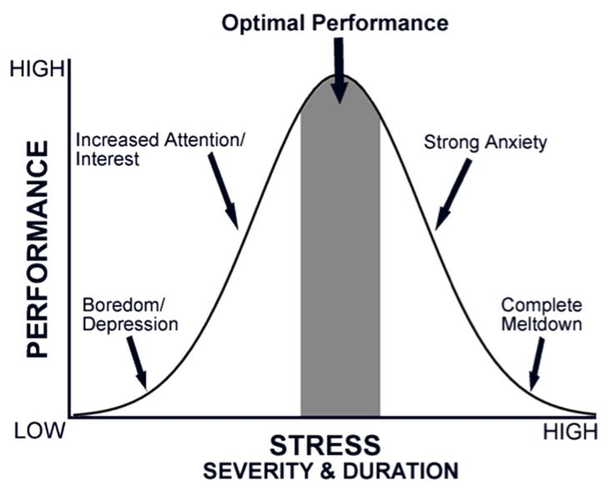

Slide 7
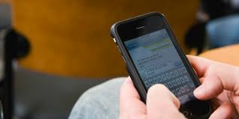

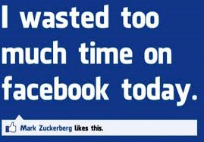
No stress…

Slide 8
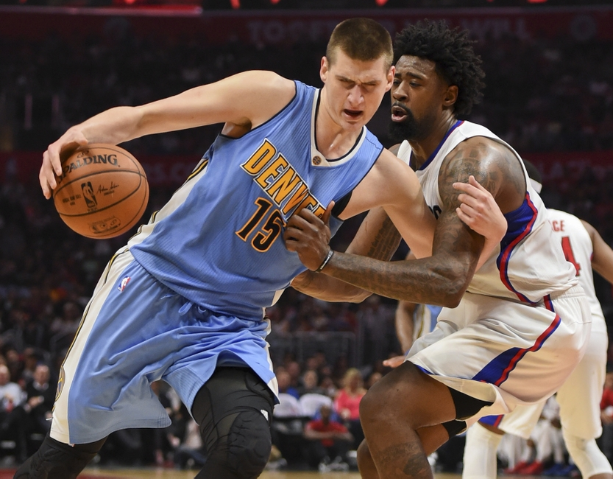
The Benefits of “Good Stress”
As level of stress increases, the performance level also increases, to the point of eustress, or healthy tension.

Slide 9


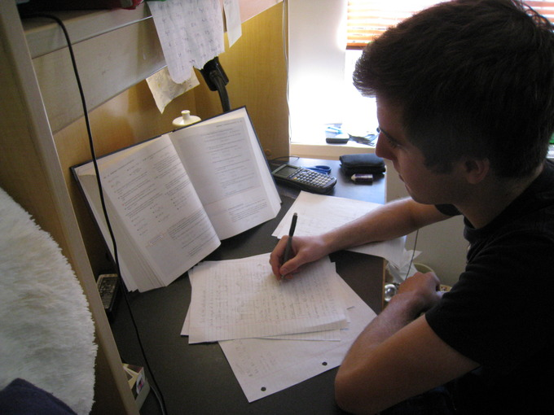
Good Stress

Slide 10
Three stages of how stress affects the body

Slide 11
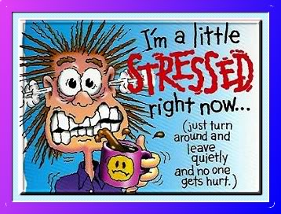
Stage 1--
Alarm

Slide 12
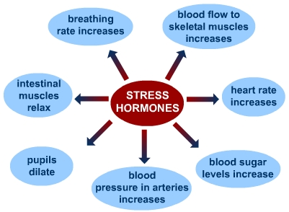
Stage 1: Alarm
Flight or flight response. Body is ready to take action.
  Release of adrenaline and cortisol into bloodstream
  Breathing rate, heartbeat, sweat production increased
  Digestive system slows down, decrease in production of urine.

Slide 13
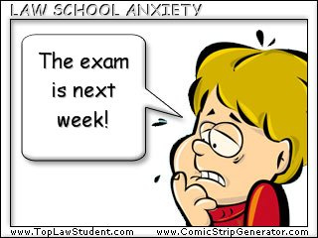
Stage 2
Resistance

Slide 14
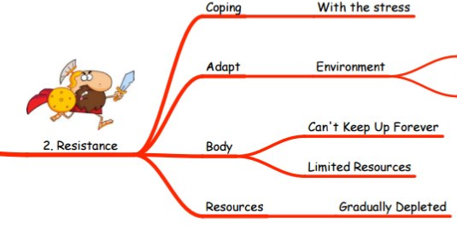
STAGE 2: Resistance
  Body tries to recover from alarm in first stage.
  Stressor remains in the body so the body can’t return to homeostasis.
  Body becomes tired, more irritable, less able to handle additional stress

Slide 15
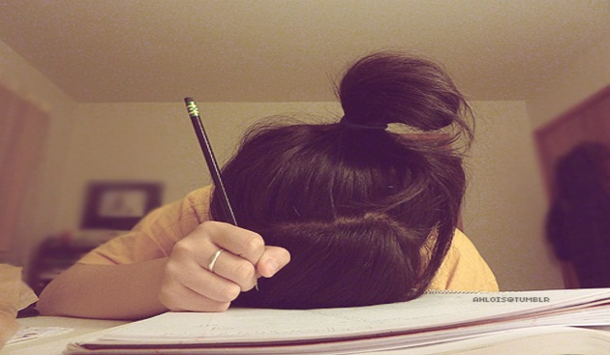
Stage Three: Exhaustion

Slide 16
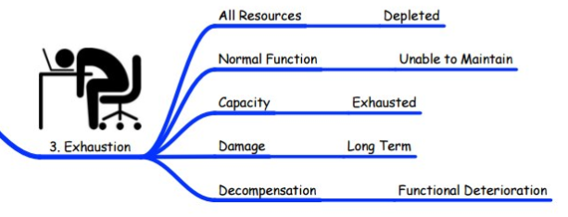
STAGE 3: Exhaustion
  Exhaustion occurs if stressor remains in the body.
  Body is worn down and no longer has energy to fight off the stressor.

Slide 17
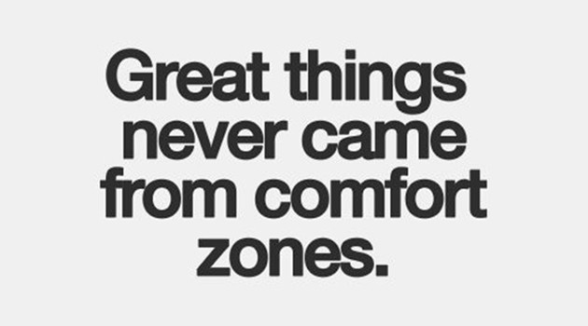
Stress is a reality– optimize it.

Slide 18
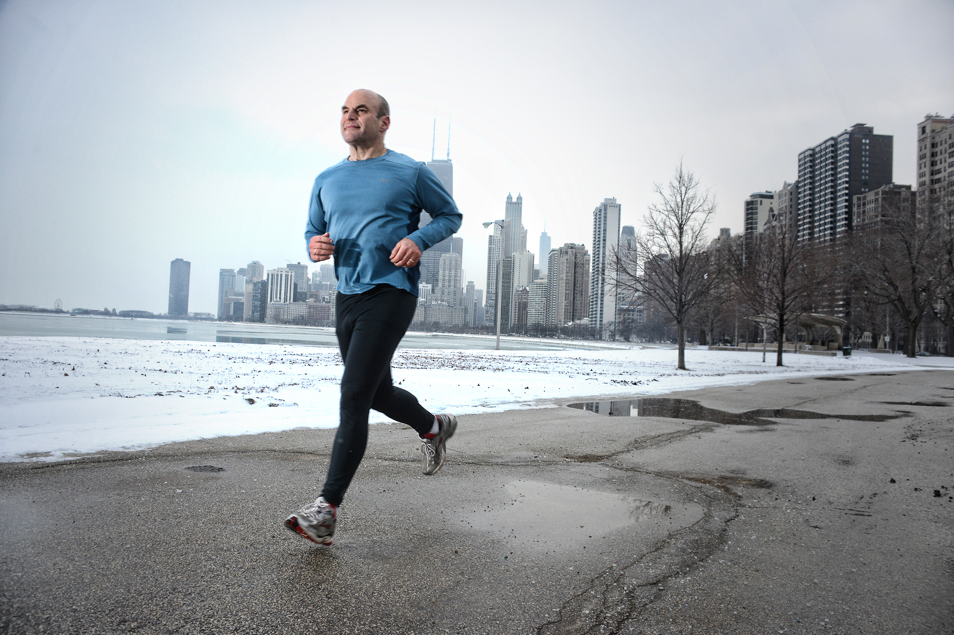
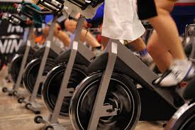

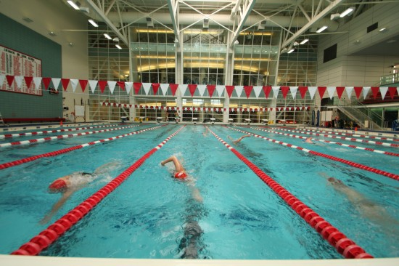
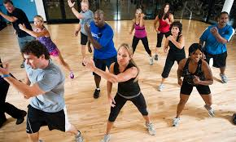
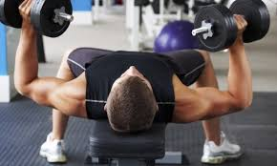
Minimize maladaptive stress response

Slide 19
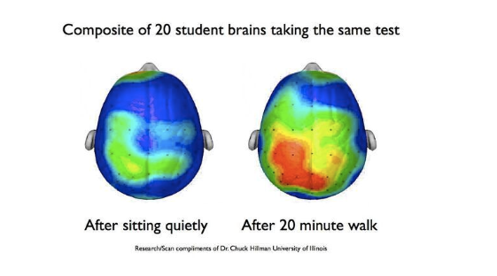
Even a short walk will do it…
Studies show that exercise is very effective at reducing fatigue, improving alertness and concentration, and at enhancing overall cognitive function.

Slide 20
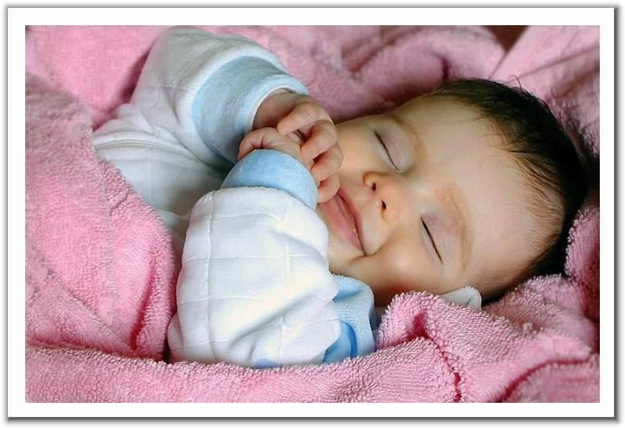
Sleep– powerful weapon against stress
-Necessary human function
-Allows our brains to recharge and our bodies to rest.
-Without proper sleep, our bodies do not get the full benefits of sleep, such as muscle repair and memory consolidation.
-Sleep is so crucial that even slight sleep deprivation or poor sleep can affect memory, judgment and mood.

Slide 21
Stress and eating…
EAT
-Recent study found that in the past month, 30 percent of adults report skipping a meal due to stress.
-After skipping meals due to stress, 24% say they feel sluggish or lazy and 22% report being irritable.

Slide 22

Stress & Poor Eating
Physical or emotional distress
can increase urge for intake
of food high in fat, sugar, or
both.
Unhealthy eating behaviors often lead to one feeling sluggish, lazy and/or with an unproductive bodily preoccupation.

Slide 23
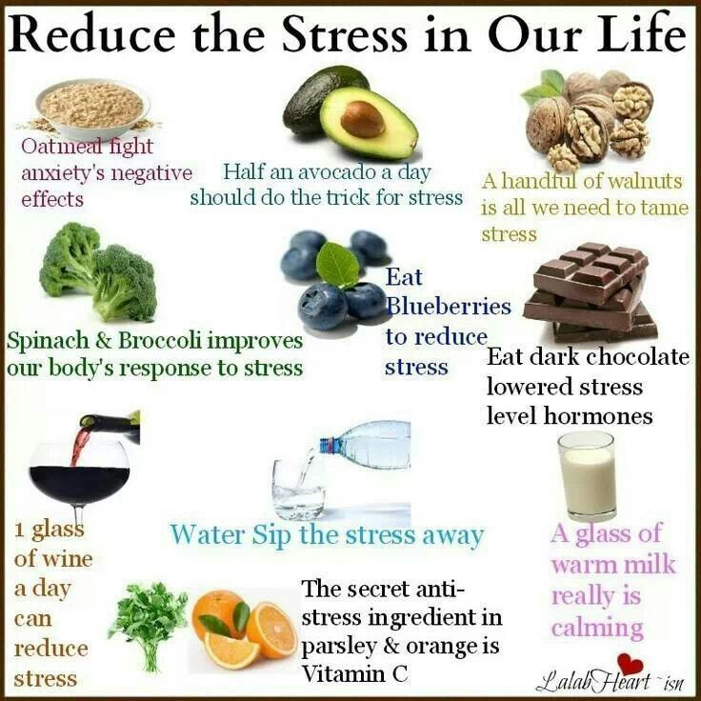

Eat well…

Slide 24
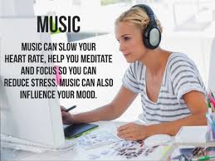
Music affects mood & helps stress…
-Soothing power of music is well-established.
–Has a unique link to our emotions
-- Can have beneficial effects on our physiological functions, slowing the pulse and heart rate, lowering blood pressure, and decreasing the levels of stress hormones.

Slide 25
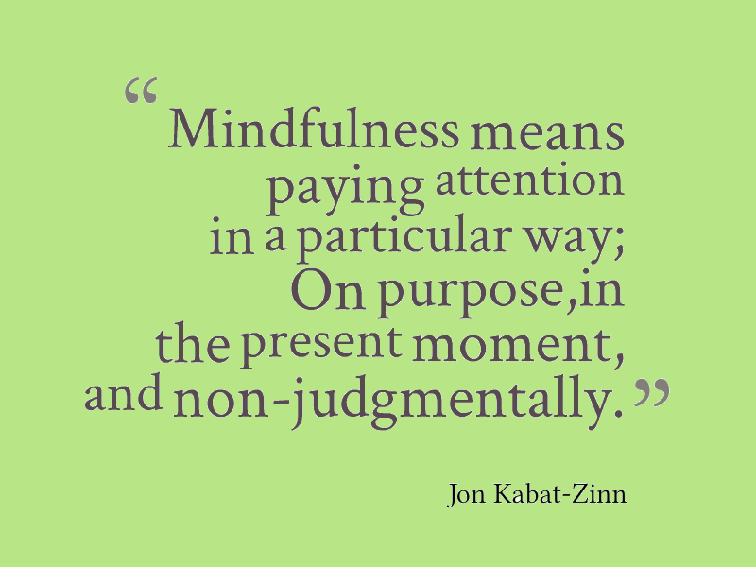
Cultivate Mindfulness
Mindfulness involves focusing one’s attention and awareness on the here-and-now
Results in reduction of stress and anxiety and boosts levels of attention and concentration.
Mindfulness reduces worry and self-defeating negative thinking.

Slide 26
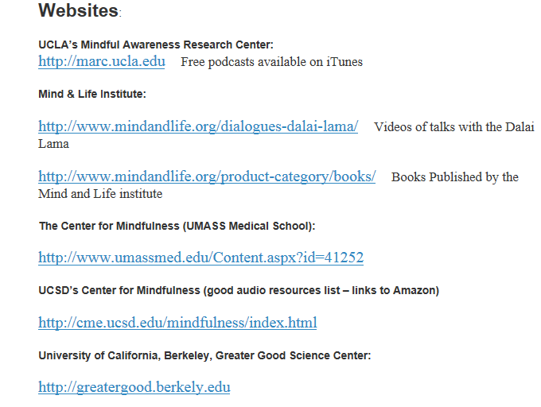
Mindfulness Resources

Slide 27
Meditation
-The word meditation is derived from two Latin words: “meditari” (to think, to dwell upon) and “mederi” (to heal).
-Meditation means a cessation of the thought process.
-Describes a state of consciousness, when the mind is free of scattered thoughts and various patterns.
-The observer (one who is doing meditation) realizes that all the activity of the mind is reduced to one.

Slide 28
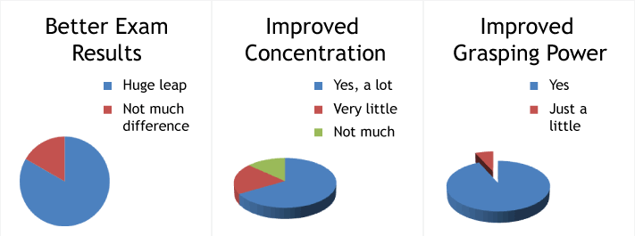
Effects of mediation on exam performance
Based on sample of 30 students who had practiced mediation and reported results of practice relative to exam performance.

Slide 29
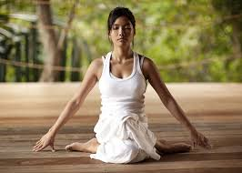
Doesn’t have to be….

Slide 30


Slide 31
Types of Meditation
  Mindfulness
  Concentration
  Reflective
  Mindful eating
  Mindful walking
  Visualization
  Body Scan
  Deep breathing
  Sitting meditation
  Visualization
  Creative

Slide 32
Your turn to practice…. 2 minutes
Meditation

Slide 33

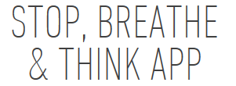
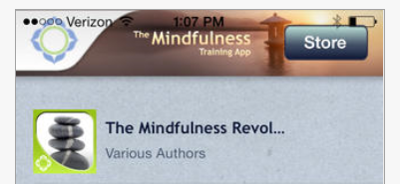
Meditation Resources

Slide 34

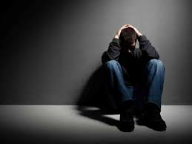

Slide 35
There may be a time when you need additional support. Get it.

Slide 36
Help is available…
-Student Health Services, including the Behavioral Medicine Clinic: includes a walk-in medical clinic, in-house laboratory, infirmary, confidential mental health and counseling services, and a crisis intervention counselor.
-Danielsen Institute: Boston University’s confidential mental health care clinic licensed by the Massachusetts Department of Public Health.
-Center for Anxiety and Related Disorders: provides comprehensive cognitive-behavioral treatments in individual and group formats and assessments of psychological functioning.
-Boston University Sexual Assault Response & Prevention Center: provides rapid, confidential, compassionate, supportive, and free-of-charge advocacy and assistance to BU students who have experienced a traumatic incident
-Lawyers Concerned For Lawyers, Inc.: LCL provides confidential counseling services for a wide variety of issues, including depression, anxiety, stress, work/family balance issues, questions related to information that must be reported to the bar authorities, and substance abuse.
Take the LCL self-tests for alcohol/drug; depression; bipolar disorder; problem gambling; ADHD

Slide 37
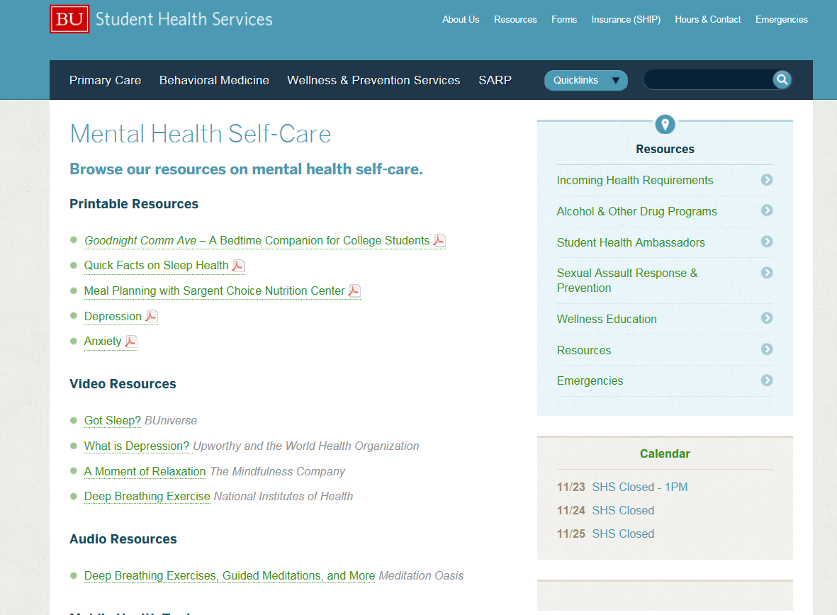

Slide 38
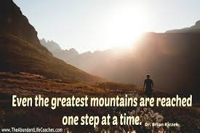
Reality Check …

Slide 39
Finally…

Slide 40
Take a moment to be with something/someone that matters to you….

