Slide 1
THE RISE OF EXTRACTIVE LOGICS
Data presented come from:
1)Expulsions (Harvard Univ Press).Traduccion Castellano Ed Katz
2)Predatory Formations Dressed in Wall Street Suits and Algorithmic Math . Science, Technology & Society 22:1 (2017)
3)--A MASSIVE LOSS OF HABITAT
http://socdev.ucpress.edu/content/2/2/204
4) --WHO OWNS THE CITY?
http://www.theguardian.com/cities/2015/nov/24/who-owns-our-cities-and-why-this-urban-takeover-should-concern-us-all
5) AND IF U LIKE FAIRY TALES—here is that version..A MONSTER ENTERS THE CITY
http://www.theguardian.com/cities/2015/dec/23/monster-city-urban-fairytale-saskia-sassen?CMP=twt_gu
ALL IN MI WWW.SASKIASASSEN.COM

Slide 2
we make...

Slide 3
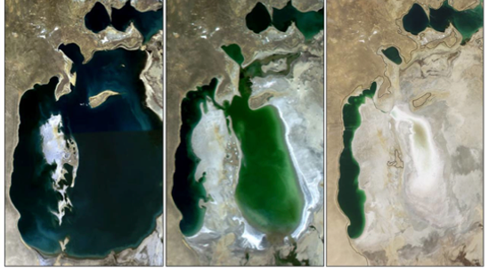
Exhibit 5.9. Aral Sea, 1989-2009

Slide 4
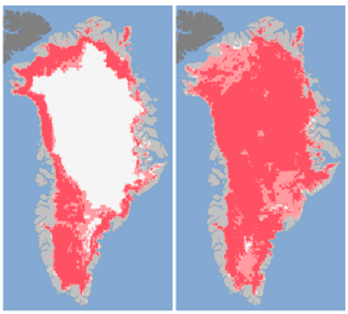
Exhibit 5.11. Extent of Surface Melt over Greenland’s Ice Sheet, 2012
Source: Viñas, Maria-José. "Satellites See Unprecedented Greenland Ice Sheet Surface Melt." NASA. Accessed July 30, 2012. http://www.nasa.gov/topics/earth/features/greenland-melt.html.

Slide 5
THE POWER OF KEYCODES
AND AGGREGATIONS
Keycode: a sort of DNA that is written/made ( finance’s “risk”-models; VW cheat software)
Just a bit of code can achieve enormous effects: scale-ups and massive aggregations –the crappy keycode time 12 million cars,14 million mortgages
We need to develop a craft of writing keycodes for new scale-ups and modes of aggregating and deploying the power of aggregation.
SOURCE: Sassen and Koob-Sassen “COLONIZING THE SCALAR NICHE”

Slide 7
  WHAT IS THE STEAM ENGINE
  OF OUR EPOCH?
  THAT WHICH CAN MAKE A NEW ORDERING…(.NOT CHANGE EVERYTHING)
  THAT WHICH SHAPES WHAT IS IN AND WHAT IS OUT?

Slide 8
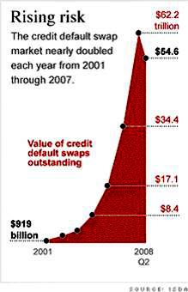

Slide 9
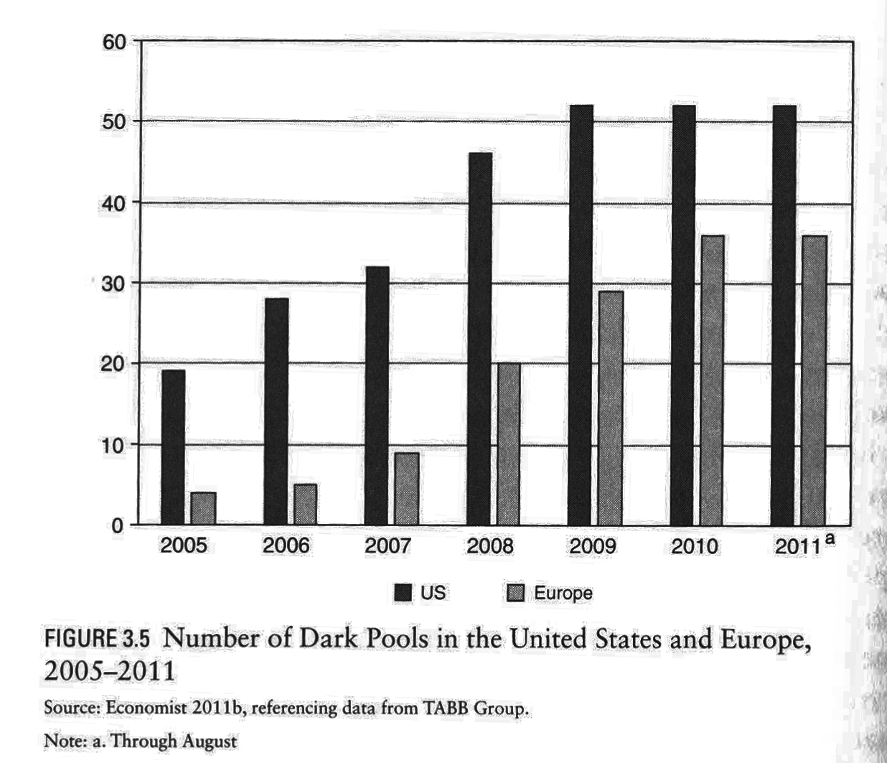

Slide 10
FINANCE AS CAPABILITY--
DIRECT AND INDIRECT PATHWAYS
.

Slide 11
When modest neighborhoods become part of global finance
The making of instruments that enable the use of modest elements/assets to build a powerful financial instrument useful to top level investors: sub-prime mortgage for low- and modest-income households.
The key is that the source of profits for investors is NOT payment on the mortgage. All that is needed is a signed contract.
The source of profits is the bundling of a large number of these mortgages with high-value debt to sell them on to investors, including banks and foreign investors. It worked because they were mixed up with high quality debts of all sorts.

Slide 12
New foreclosures per year(2006-14)
2006 : 1.2 million foreclosures.
(One for every 92 households)
2007: 2.2 million foreclosures.
2008: 3.1 million
2009: 3.9 million
(1 in 45 US households)
2010: 2.9 mill forecolsures
2011: 2,698,967
2012: 2,304,941
2013: foreclosures filed on 1,361,795 properties
2014: foreclosure filed on 1,117,426 properties
Source: RealtyTrac based on Federal Reserve Bank data
Source: Data from the Fed Reserve, organized by RealtyTrac

Slide 13
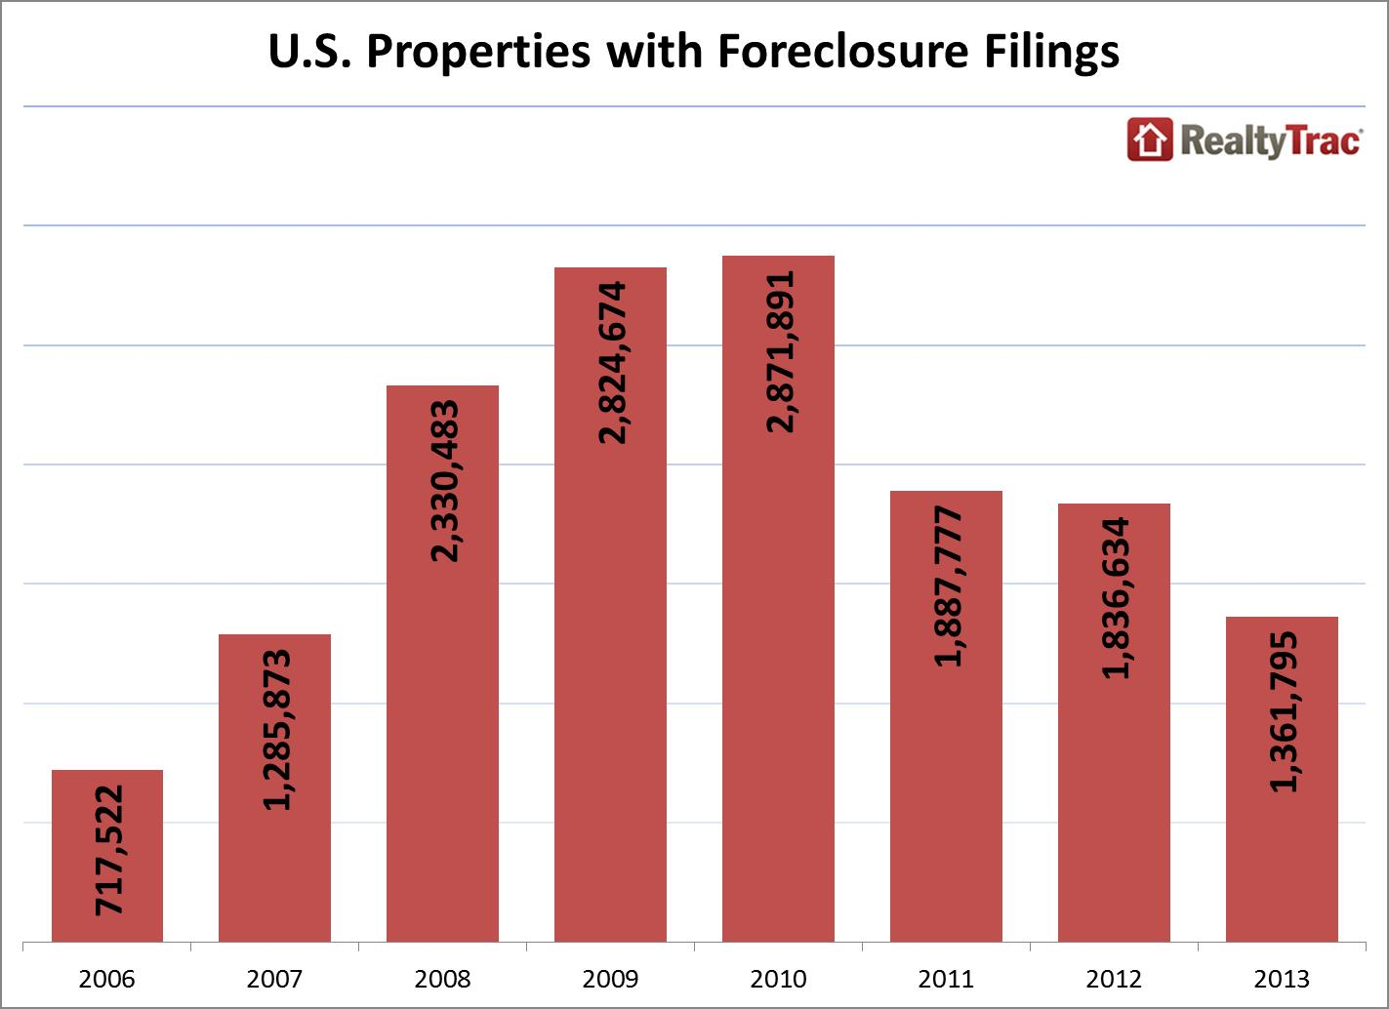
Notes:
Slide 3 update

Slide 14
European Countries with Either Highest or Lowest Number of Foreclosures, 2007-2009
 | Annual Number of Foreclosures (2007-9)
 |  | 2007 | 2008 | 2009
Highest Foreclosures | Hungary | 225,663 | 245,597 | 71,683
 | Germany | 91,788 | 88,379 | 86,617
 | Spain | 25,943 | 58,686 | 93,319
 | United Kingdom | 27,869 | 46,984 | 54,014
Lowest Foreclosures | Bulgaria | 499 | 866 | 1,570
 | Finland | 506 | 82 5 | 1,036
 | Denmark | 1,015 | 1,942 | 2,860
 | Netherlands | 1,811 | 1,961 | 2,256
Notes:
Source: White, A. 2013. “Foreclosure Crisis in Europe vs US.” Credit Slips: A Discussion on Credit, Finance, and Bankruptcy. www.creditslips.org/creditslips/2011/08/foreclosure -crisis-in-europe-vs-us.html. Accessed February 8, 2013.

Slide 15
Table 8: Ratio of Household Credit to Personal Disposable Income (2000-05)
 | 2000 | 2001 | 2002 | 2003 | 2004 | 2005
Emerging Markets
Czech Republic | 8.5 | 10.1 | 12.9 | 16.4 | 21.3 | 27.1
Hungary | 11.2 | 14.4 | 20.9 | 29.5 | 33.9 | 39.3
Poland | 10.1 | 10.3 | 10.9 | 12.6 | 14.5 | 18.2
India | 4.7 | 5.4 | 6.4 | 7.4 | 9.7 | …
Korea | 33.0 | 43.9 | 57.3 | 62.6 | 64.5 | 68.9
Philippines | 1.7 | 4.6 | 5.5 | 5.5 | 5.6 | …
Taiwan | 75.1 | 72.7 | 76.0 | 83.0 | 95.5 | …
Thailand | 26.0 | 25.6 | 28.6 | 34.3 | 36.4 | …
Mature Markets
Australia | 83.3 | 86.7 | 95.6 | 109.0 | 119.0 | 124.5
France | 57.8 | 57.5 | 58.2 | 59.8 | 64.2 | 69.2
Germany | 70.4 | 70.1 | 69.1 | 70.3 | 70.5 | 70.0
Italy | 25.0 | 25.8 | 27.0 | 28.7 | 31.8 | 34.8
Japan | 73.6 | 75.7 | 77.6 | 77.3 | 77.9 | 77.8
Spain | 65.2 | 70.4 | 76.9 | 86.4 | 98.8 | 112.7
United States | 104.0 | 105.1 | 110.8 | 118.2 | 126.0 | 132.7
Source: IMF Staff estimates based on data from country authoriies, CEIC, OECD, and Bloomberg

Slide 16
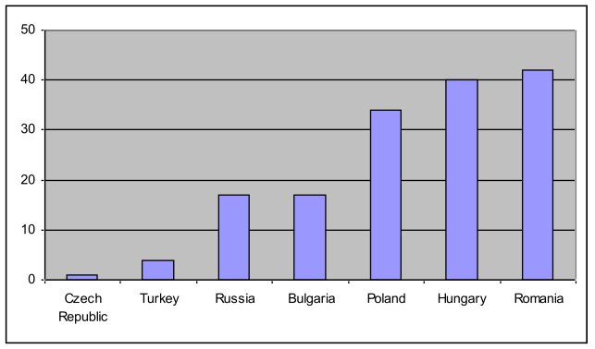
Table 11: Share of Foreign-Currency-Denominated Household Credit, End-2005 (In percent of total household credit)
Source: IMF 2006. “Global Financial Stability Report: Market Developments and Issues.” IMF: World Economic and Financial Surveys. September, 2006. Retrieved August 26, 2008. [http://www.imf.org/external/pubs/ft/GFSR/2006/02/pdf/chap2.pdf] p. 54

Slide 17
IN SHORT:
Extractive sectors can extract even from modest households

Slide 18
YET ANOTHER EXTRATIVE MODE

Slide 19
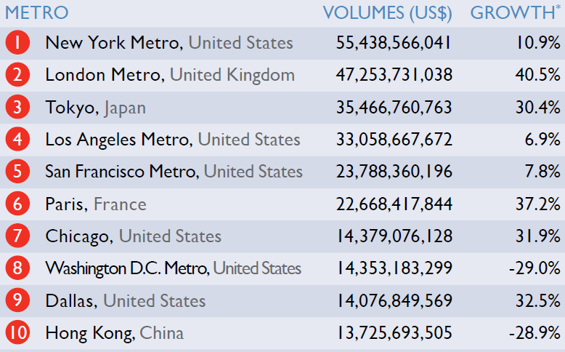
TOTAL(national and foreign) INVESTMENT VOLUMES
(EXcept DEV. SITES, Q3 2013 – Q2 2014)

Slide 20

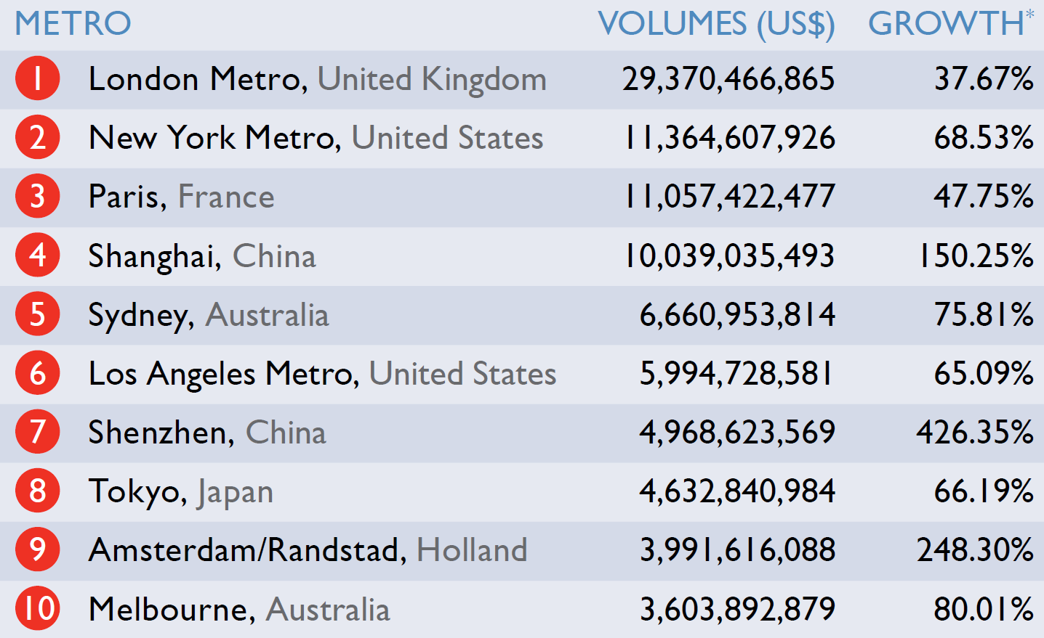
Total FOREIGN investment in property
(Q3 2013 – Q2 2014)

Slide 21
Total value of these types of acquisitions in the 100 top cities by acquisition. THIS IS JUST acquisitions of existing buildings, NOT new construction.
Mid-2014 to mid-2015: 600 billions US$
Mid 2015 to mid-2016: Over 1 trillion US$

Slide 22
THE TOP 100 CITIES (by PROPERTY INVESTMENT 2016) ACCOUNT FOR:
10% of the world’s population
30% of the world’s GDP
76% of property investment

Slide 23
Worldwide real estate assets comprise nearly 60% of the value of all global assets, including equities, bonds and gold
US$217,000,000,000,000
SOURCE: SAVILLS WORLD RESEARCH, 2016

Slide 24
What does this all look like?

Slide 25
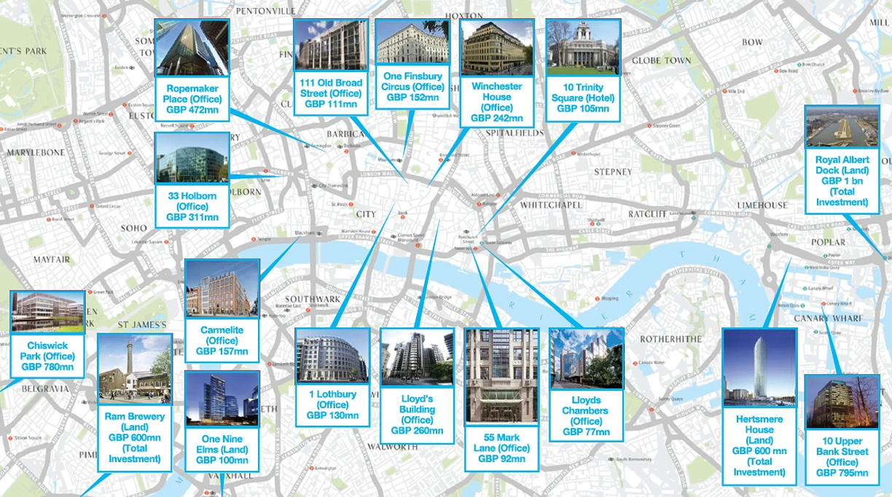
Chinese property investments in London
IMAGE: Knight Frank

Slide 26
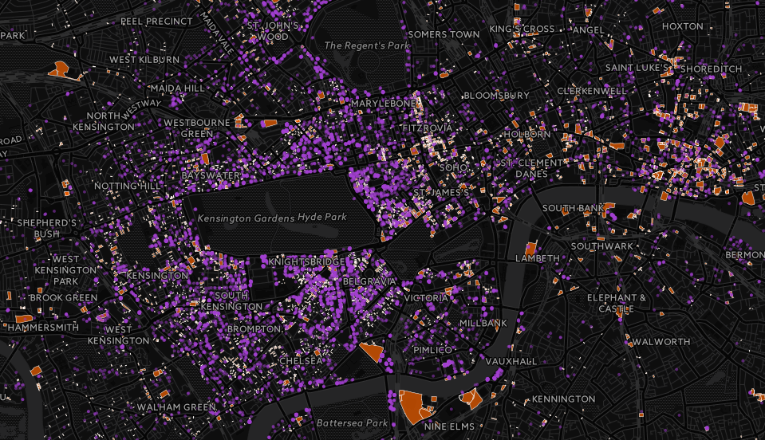

LONDON PROPERTY PURCHASED BY OVERSEAS COMPANIES: 2005-2014
IMAGE: PRIVATE EYE
Notes:
Among the properties were 20,590 acquired by companies registered in Jersey, 12,061 in the Isle of Man, 11,536 in Guernsey, 2,782 in Mauritius, 2,657 in Gibraltar, 1,963 in Panama and 1,245 in the Cayman Islands. But the most popular location for registering a property company offshore, with 22,155 in the period, was that convenient financial centre of… the British Virgin Islands.

Slide 27
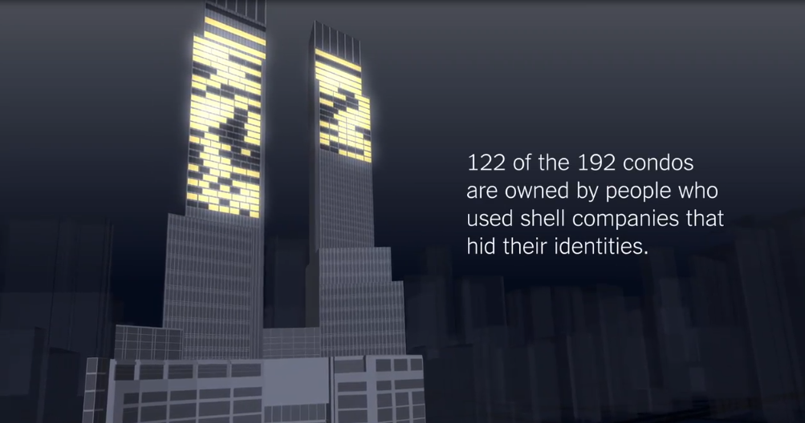
Time warner center, NEW YORK CITY
Notes:
Source: New York Times

Slide 28
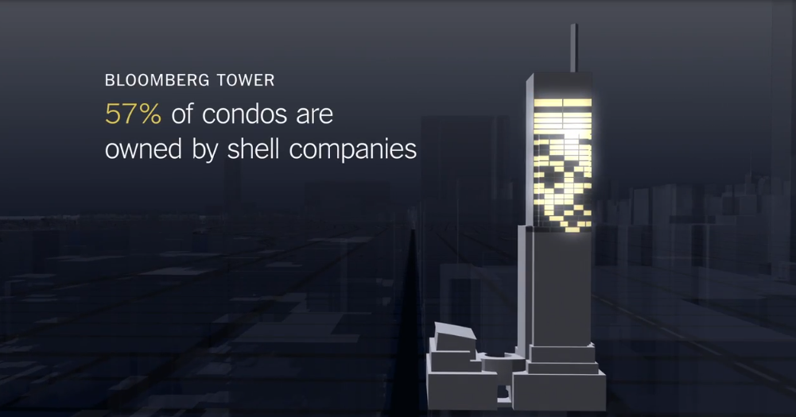

Slide 29
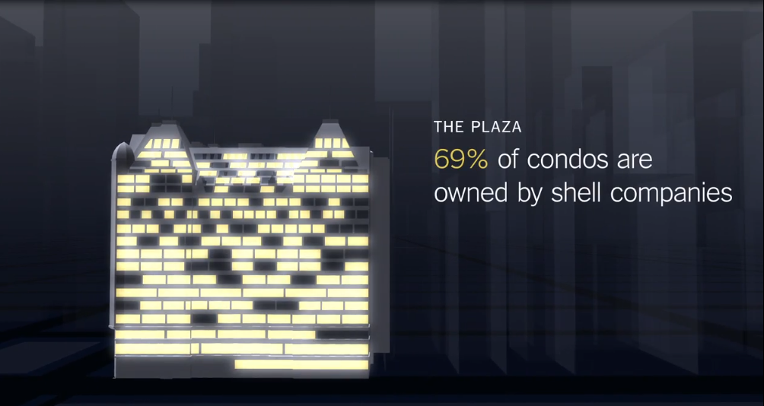

Slide 30
FORMATS OF THE FUTURE?
THINKING OF OUR LARGER WORLD WHERE MOST PEOPLE ARE POOR AND ARE GETTING EXPELLED FROM THEIR LAND

Slide 31
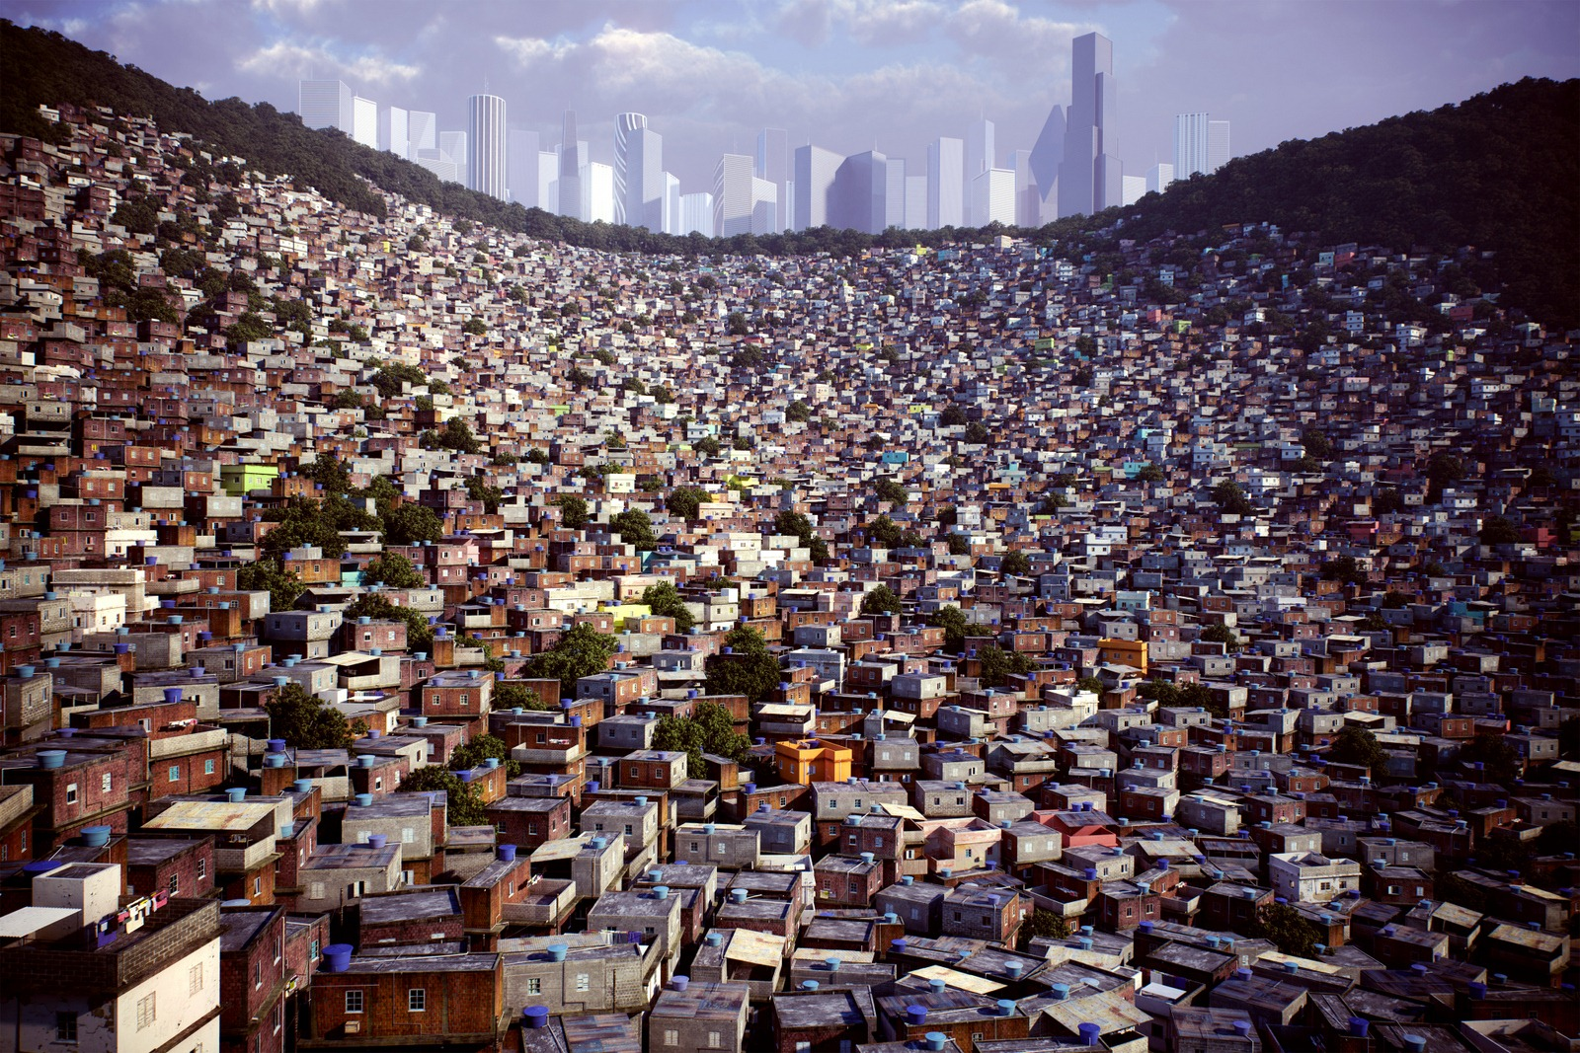

Slide 32
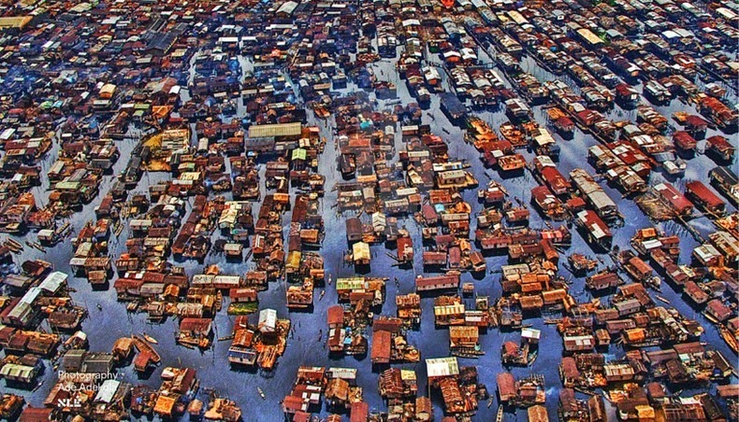
.

Slide 34
WHY DOES ALL OF THIS MATTER?
The city as a space Where those without power get to make a history

Slide 35
The CAPACITY OF THE CITY TO MAKE US ALL, WHETHER RICH OR POOR, INTO URBAN SUBJECTS….
EVEN IF ONLY FOR A MOMENT
THIS MATTERS –ONE INSTRUMENT IN SUPPORTING THE NOTION OF A CIVIC SUBJECT –BEYOND WEALTH VERSUS POVERTY

Slide 36
THERE ARE MOMENTS IN THE DAILY ROUTINES OF A CITY WHEN
THE CITY CAN HACK ALL THE OTHER, MORE SPECIFIC SUBJECTS WE ALSO ARE.

Slide 37
THIS IS UNLIKE THE TYPICAL TRENDS FOR THE POST WW2 PATTERNS
NEW SYSTEMICS?
THE RISE OF LOGICS OF EXTRACTION

Slide 38
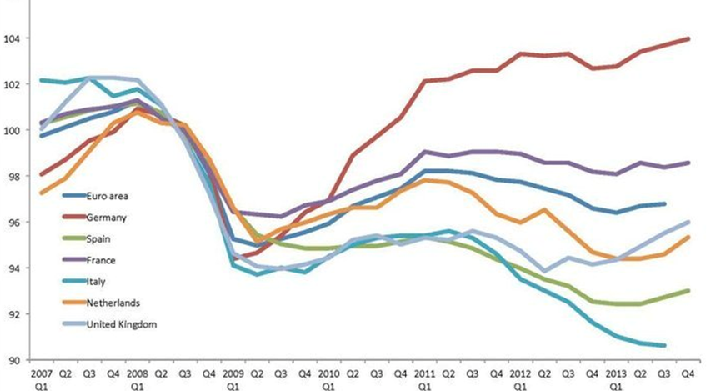
GDP per capita 2007-2013, select European countries (2008=100)
Source: Office of National Statistics of the United Kingdom 2014.

Slide 39
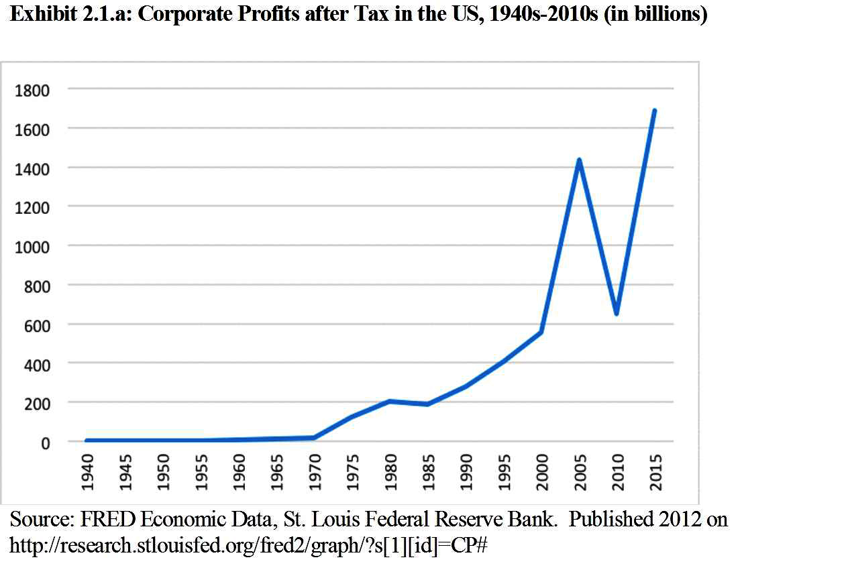

Slide 40
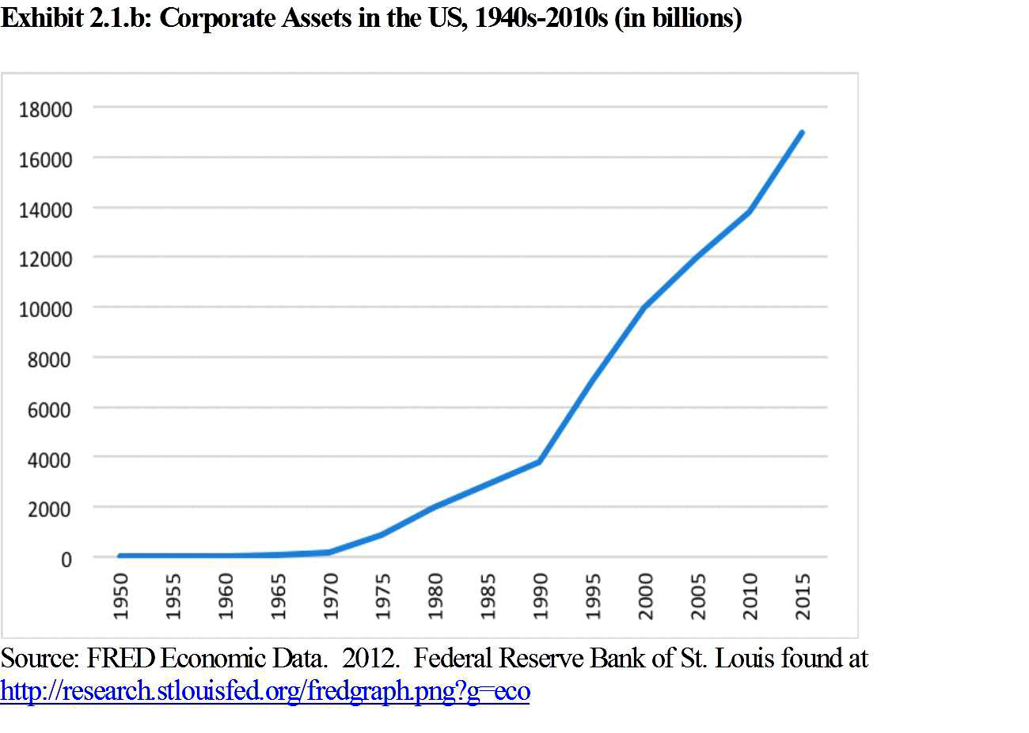

Slide 41
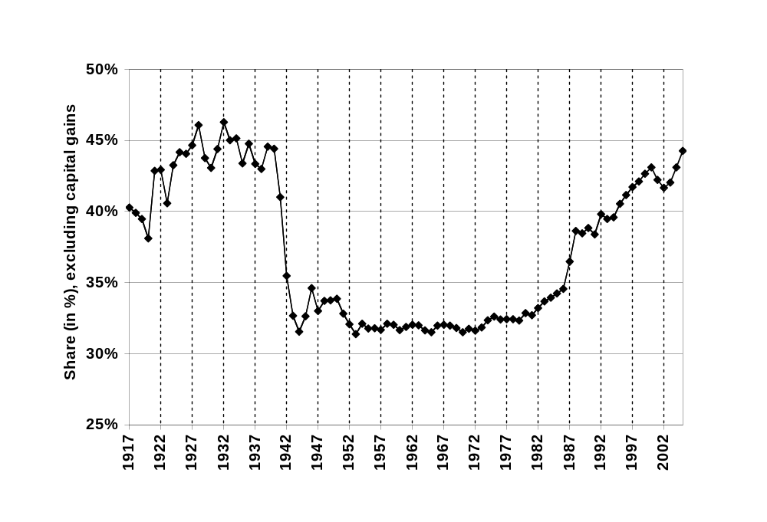
Income Share of top 10% earners,
USA 1917-2005
*Income is defined as market income but excludes capital gains
Source: Mishel, L. 2004. “Unfettered Markets, Income Inequality, and Religious Values.” Viewpoints. May 19, 2004. Economic Policy Institute. Retrieved July 26, 2008 [ www.epi.org/content.cfm/webfeatures_viewpoints_moral_markets_presentation.]

Slide 42
UNSTABLE MEANINGS
Given all these negatives.....
more and more expulsions from increasingly scarce livable space?
GROWING inequality
Rapidly growing population of refugees and internally displaced –about 60 million +
ALL OUR LIBERAL DEMOCRACIES HAVE INSTITUTED PARTIAL SECURITY EMERGENCIES WHICH ALLOW THEM TO VIOLATE THEIR OWN LAWS REGARDING CITIZENS
............WHO ARE WE THE CITIZENS?

Slide 43
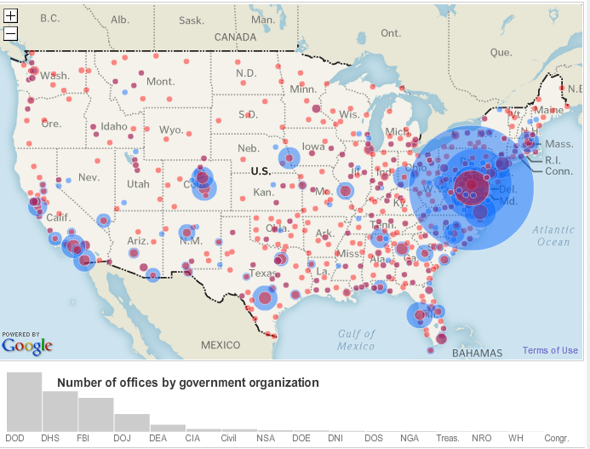
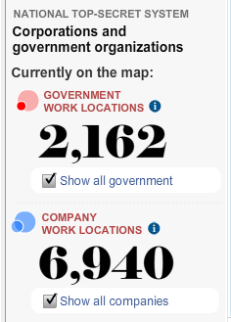
Map of government and private surveillance agencies in the US
Source: Washington Post. 2010. “Top Secret America,” Interactive Maps. Washington Post, July 2010. http://projects.washingtonpost.com/top-secret-america/map/

Slide 45
What We Know the NSA Can Do
....So Far thank you: Jody Avirgan; E.Snowden's Docs

Slide 46
.
It can track the numbers of both parties on a phone call, + location, time and duration. (More)
It can hack Chinese phones and text messages. (More)
It can set up fake internet cafes. (More)
It can spy on foreign leaders' cell phones. (More)
It can tap underwater fiber-optic cables. (Clarification: Shane Harris explains that there were reports the NSA was trying to tap directly into cables using submarines, but is now more likely trying to intercept information once it has reached land.) (More)
It can track communication within media organizations like Al Jazeera. (More)
It can hack into the UN video conferencing system. (More)
It can track bank transactions. (More)
It can monitor text messages. (More)
It can access your email, chat, and web browsing history. (More)
It can map your social networks. (More)
It can access your smart-phone app data. (More)

Slide 47
.
It is trying to get into secret networks like Tor, diverting users to less secure channels. (More)
It can go undercover within embassies to have closer access to foreign networks. (More)
It can set up listening posts on the roofs of buildings to monitor communications in a city. (More)
It can set up a fake LinkedIn. (More)
It can track the reservations at upscale hotels. (More)
It can intercept the talking points for Ban Ki-moon’s meeting with Obama. (More)
It can crack cellphone encryption codes. (More)
It can hack computers that aren’t connected to the internet using radio waves. (Update: Clarification -- the NSA can access offline computers through radio waves on which it has already installed hidden devices.) (More)
It can intercept phone calls by setting up fake base stations. (More)
It can remotely access a computer by setting up a fake wireless connection. (More)

Slide 48
.
It can fake a USB thumb drive that's actually a monitoring device. (More)
It can crack all types of sophisticated computer encryption. (Update: It is trying to build this capability.) (More)
It can go into online games and monitor communication. (More)
It can intercept communications between aircraft and airports. (More)
It can physically intercept deliveries, open packages, and make changes to devices. (More) (h/t)
It can tap into the links between Google and Yahoo data centers to collect email and other data. (More) (h/t)
It can monitor, in real-time, Youtube views and Facebook "Likes." (More)
It can monitor online behavior through free Wi-Fi at Canadian airports. (More)

Slide 49
.
It can shut down chat rooms used by Anonymous and identify Anonymous members. (More)
It can use real-time data to help identify and locate targets for US drone strikes. (More)
It can collect the IP addresses of visitors to the Wikileaks website. (More)
It can spy on US law firms representing foreign countries in trade negotiations. (More)
It can post false information on the Internet in order to hurt the reputation of targets. (More)
It can intercept and store webcam images. (More)
It can record phone calls and replay them up to a month later. (More)
It can harvest images from emails, texts, videoconferencing and more and feed it into facial recognition software. (More)

Slide 50
Set up in 2015
A new European commission counter-terror plan will require the blanket collection and storage for up to five years of personal data records of all passengers flying in and out of Europe
breaches a recent European court of justice ruling that blanket collection of personal data without detailed safeguards is a severe incursion on personal privacy.

