Slide 1


Intimate Partner Violence, Child Health and Family Resilience
MEGAN Bair-merritt, MD, MSCE
Boston Medical Center
Cities & Kids: enabling optimal development for Urban youth
Notes:
Thanks; add Hannah’s letter and will see formal CME objectives but really hope that people walk away from this talk committed to making some change that helps families who have experienced violence to heal, whether that be through writing a letter or through small changes in daily practice with patients

Slide 2
Key Questions
How common is intimate partner violence (IPV), and why is it a children’s issue?
How does IPV potentially affect children’s health?
How can we support families’ resilience in the face of IPV, including the role of health care?

Slide 3

Childhood IPV Exposure Prevalence
In the US, prevalence of childhood IPV exposure is about twice that of prevalence of childhood asthma
Prevalence of childhood IPV exposure: 15 million
  Exposure to severe IPV: 7 million
Higher prevalence in families with kids <5 years

Slide 4
But, how does IPV relate to children?
26 year old mother of an infant describing an abusive event:
“K. was like only a couple months, so– and I was going through postpartum very bad. It was like midnight [and my boyfriend came home drunk]. I’m just ‘We have newborn. Why are you coming home drunk, and the next thing I know, he’s choking me, and I got the baby in my arms, and he spit in my face. He’s calling me all kind of names…. And then he took the baby out of my arms, put him in the bedroom, laid him on the bed, and then came back after me again and started choking me….”

Slide 5
Toxic Stress & Physiology
What is happening, from a physiologic perspective, to even this infant as this event occurs?
  Activation of stress response
    Autonomic nervous system leads to heart rate and BP increases, HPA axis kicks out cortisol
THIS IS TOXIC STRESS &
TOXIC STRESS IS BAD FOR CHILDREN’S HEALTH

Slide 6
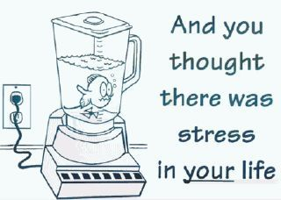

Slide 7
Toxic Stress & Physiology
“Toxic stress refers to strong, frequent
or prolonged activation of the body’s
stress management system.
Stressful events that are chronic,
uncontrollable, and/or experienced
without the child having access to
support from a caring adult
provoke…toxic stress responses.”
Shonkoff JP, et al. (2005) National Scientific Council on the Developing Child. Excessive Stress Disrupts the Architecture of the Developing Brain: Working Paper #3

Slide 8
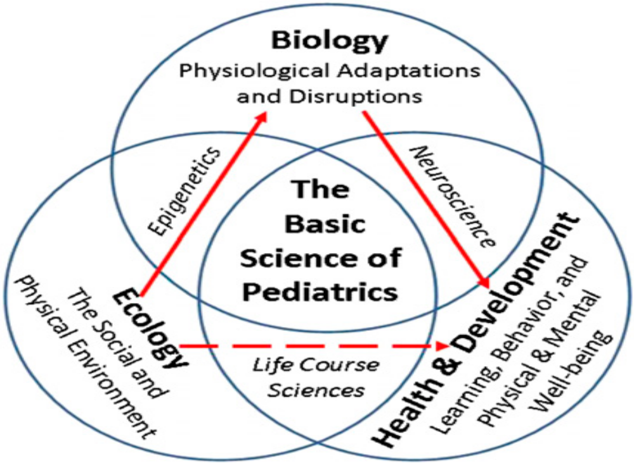
Ecobiodevelopmental Framework

Slide 9
IPV & Child Health
0-<5 years
Dysregulated eating, sleeping patterns
Developmental delay
Irritability, sadness, anger
Increased separation anxiety; clinginess
Less well child care
Lack of appropriate immunizations
5-12 years
Increased aggression
Increased distractibility/high activity level
Somatic symptoms
Sleep difficulties/nightmares
Increased withdrawal/apathy
Higher rates of asthma & obesity

Slide 10

IPV & Child Health
Adolescence
  Exposure at home predictive of entering into violent dating relationship
  Substance use and abuse
  Risky sexual behaviors
  School failure

Slide 11

Resilience
The human capacity to face, overcome, and be strengthened by adversity.
The brain is not “fixed” but can change based on inputs throughout life (neuroplasticity)

Slide 12

Resilience
Adults help children build healthy brain “pathways” through encouragement, support and nurturing
  Protects against the negative impact of toxic stress
  Discuss with families what they are already doing to support their children
  Parents and supportive adults as children’s most important teacher
  Routines, time together

Slide 13
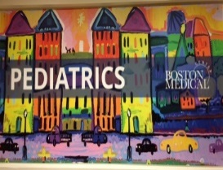
The Opportunity in Health Care
We see families frequently– 6 times in the first year alone
We develop longitudinal relationships
Caring for children means caring for parents (bi-generational wellness)
Health in infancy and childhood predicts health in adulthood

Slide 14

Thinking about Prevention and Treatment
Purposeful Parenting (MCHB-funded)
  Universal program of enhanced anticipatory guidance to support responsive parenting
  Delivered at each well child visit in the first year of life by member of the medical team
  Dimock Health Center and BMC
  ~250 families enrolled in RCT; will look at parent-child interaction, parenting stress, knowledge of development

Slide 15
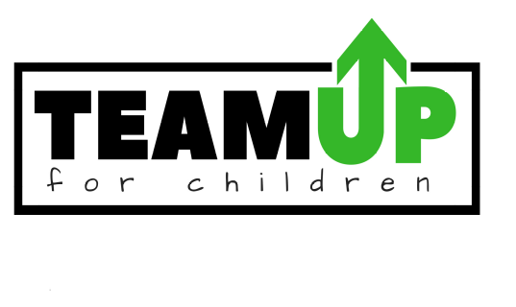
Thinking about Prevention and Treatment
  TEAM UP: Transforming and Expanding Access to Mental Health in Urban Pediatrics (funded by the Richard and Susan Smith Family Foundation)
  Complete behavioral health integration at three CHCs (Codman, Dimock and Lowell) primary care pediatrics
  Components include universal screening; adding on-site therapists to manage mild/moderate symptoms; training all pediatric staff; adding CHWs; psychiatry support as needed

Slide 16

Thinking about Prevention and Treatment
Center for the Urban Child & Healthy Family
Mission: To improve the health and wellbeing of children and families living in Boston’s most impoverished neighborhoods.
Vision: Develop and validate novel, community-oriented approaches to pediatric care; implement these innovative approaches into our daily care of families; and disseminating them locally and nationally.
Areas of focus: BHI/TIC, child-family-community continuum, care of the child with chronic conditions

Slide 17
The Opportunity: Next Steps
Remove siloes and better connect health, education/early education, community organizations
Research-practice partnerships with research questions and interventions deeply guided by community
Need more research focus that takes a strengths-based approach and includes diverse voices

Slide 18

"There is no trust more sacred than the one the world holds with children. There is no duty more important than ensuring that their rights are respected, that their welfare is protected, that their lives are free from fear and want and that they grow up in peace.“
--Kofi A. Annan

