Slide 1
Meredith Wilson
Clemson University/College of Charleston
Master of Science in Historic Preservation
April 2, 2016
Dynamic Cities Conference
Boston University

Slide 2
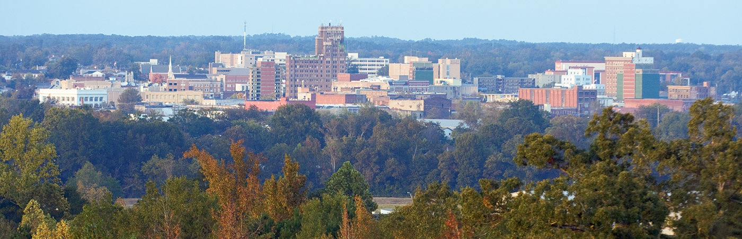
Can the Center Hold?
Image courtesy of veryshareimg.com
Grappling with the decline of a small-city downtown in Meridian, Mississippi

Slide 3
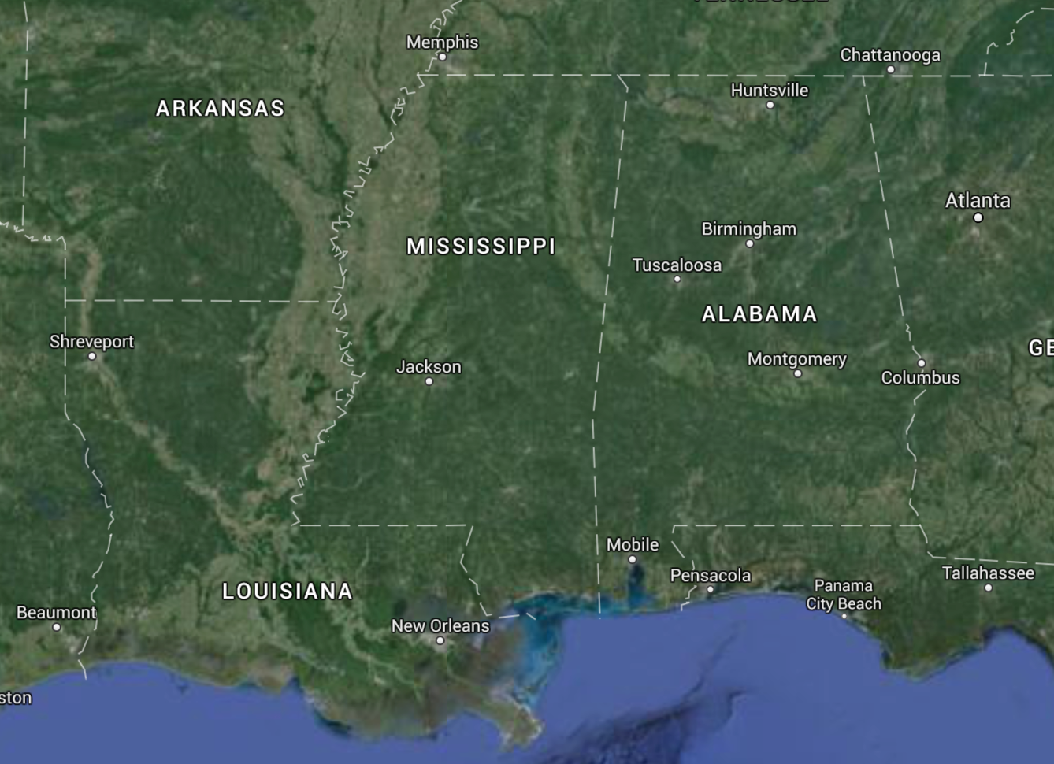

Meridian
Image courtesy of Google Maps

Slide 4
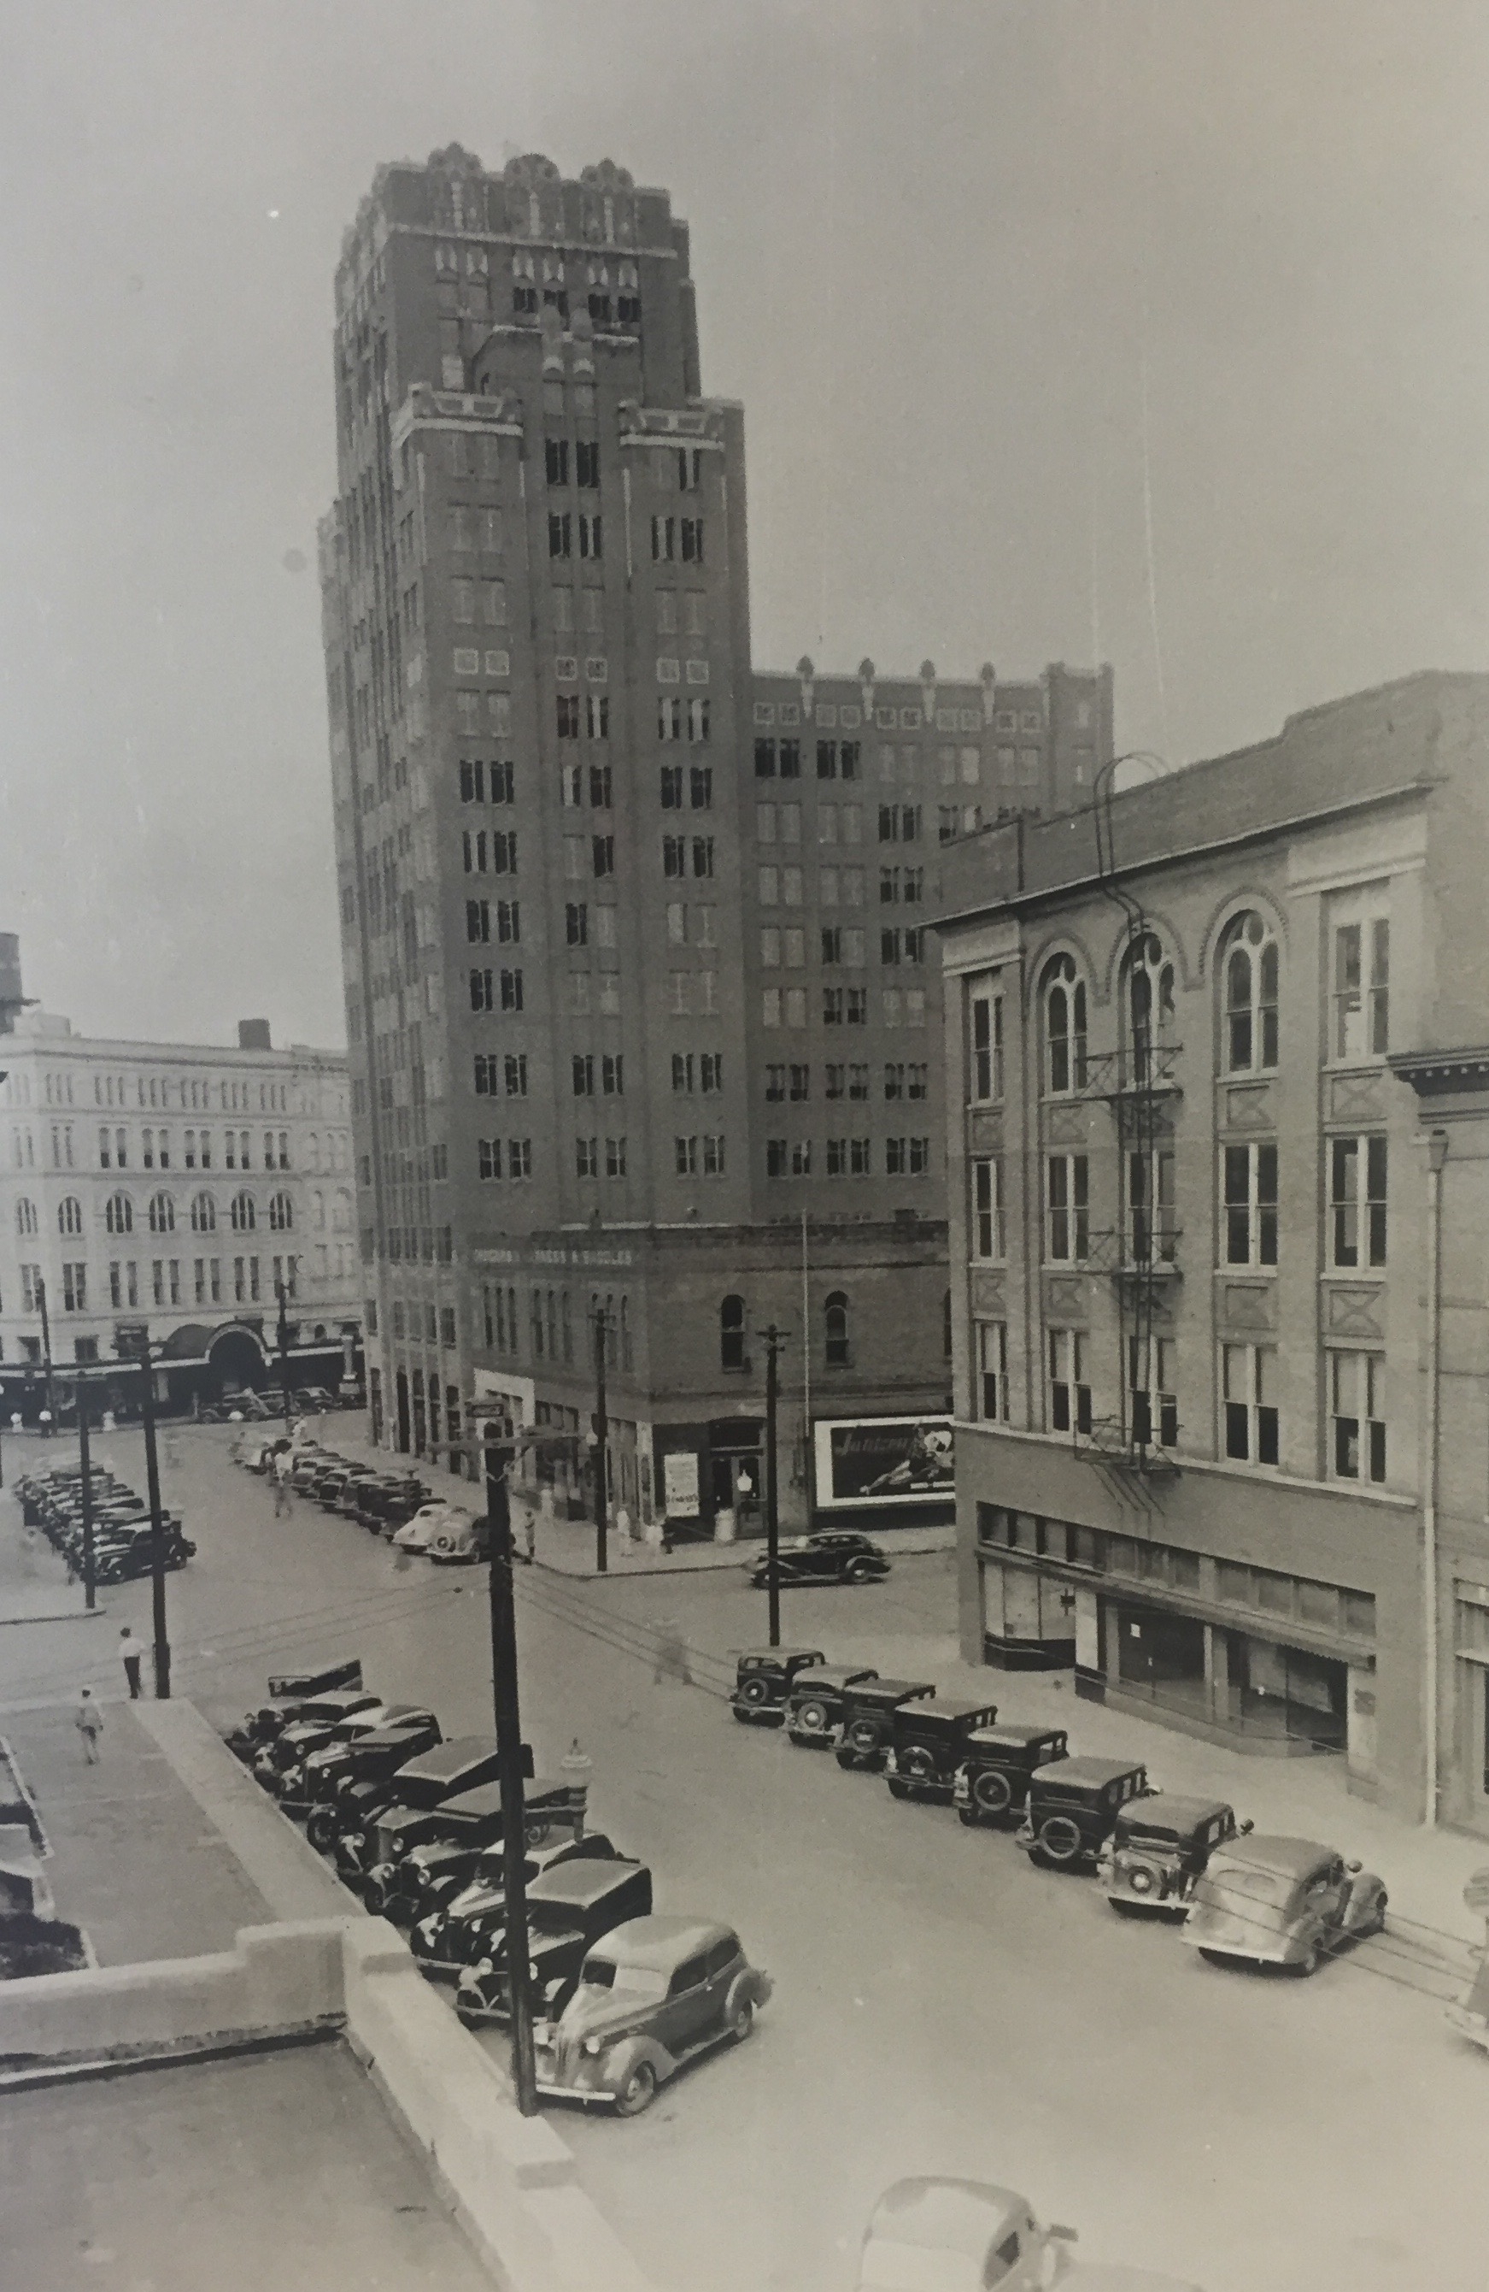
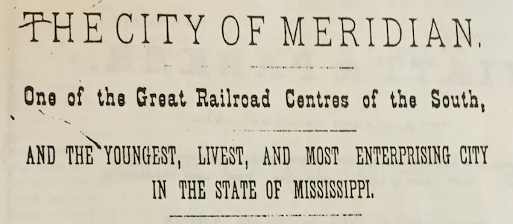
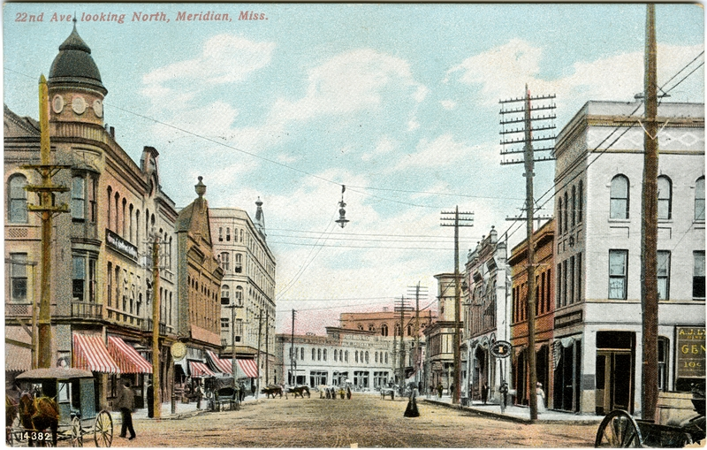
Image courtesy of Lauderdale County Department of Archives and History
Image courtesy of Mississippi Department of Archives and History
Image courtesy of criticalflame.org

Slide 5
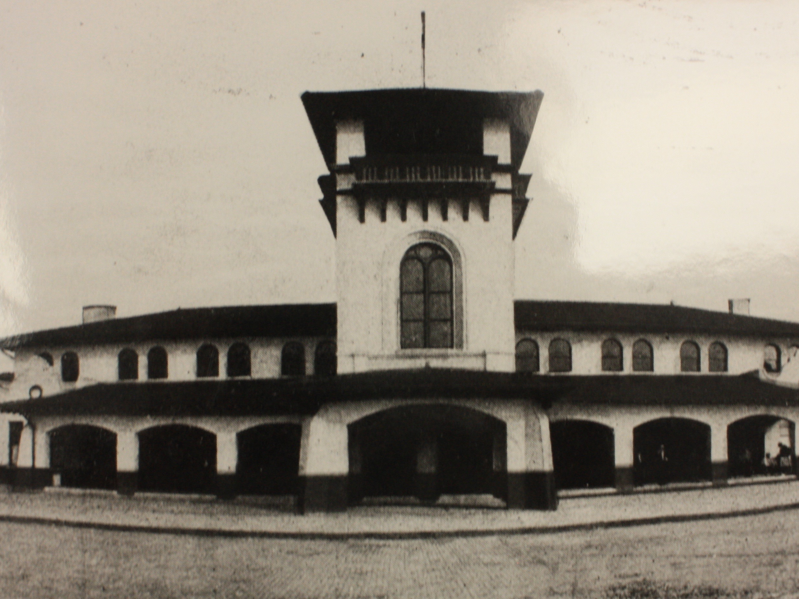
Union Station, c. 1906
Image courtesy of Mississippi Department of Archives and History

Slide 6
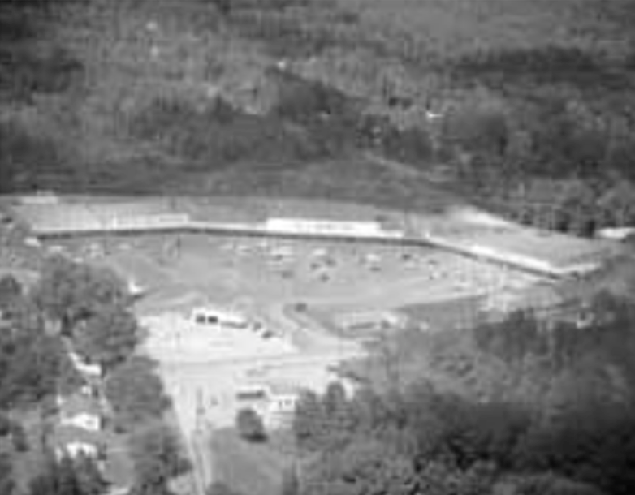
Construction of Broadmoor Shopping Center, c. 1960
Image courtesy of Meridian Historic Preservation Commission

Slide 7
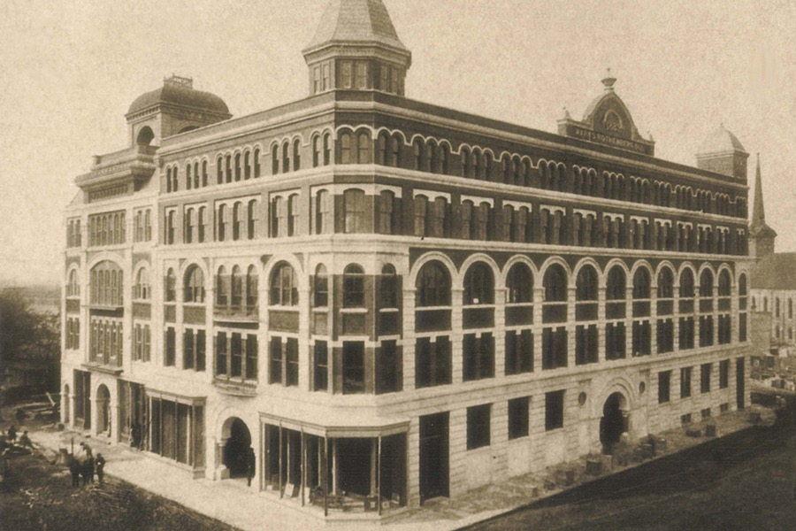
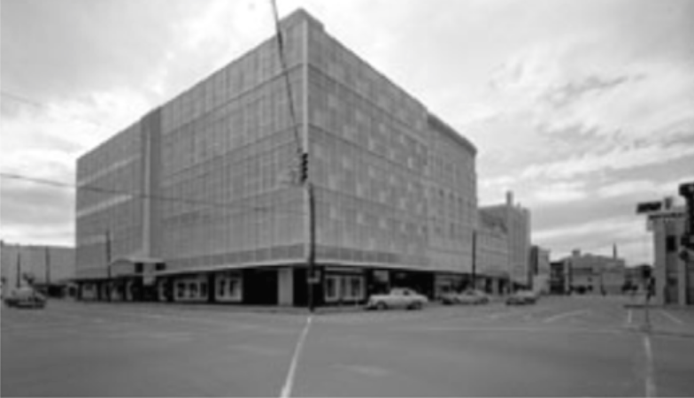
Marks Rothenberg Department Store
c. 1889
Image courtesy of MSU-Riley Center
Marks Rothenberg Department Store
c. 1960
Image courtesy of Meridian Historic Preservation Commission

Slide 8
Preservation in Meridian

Slide 9

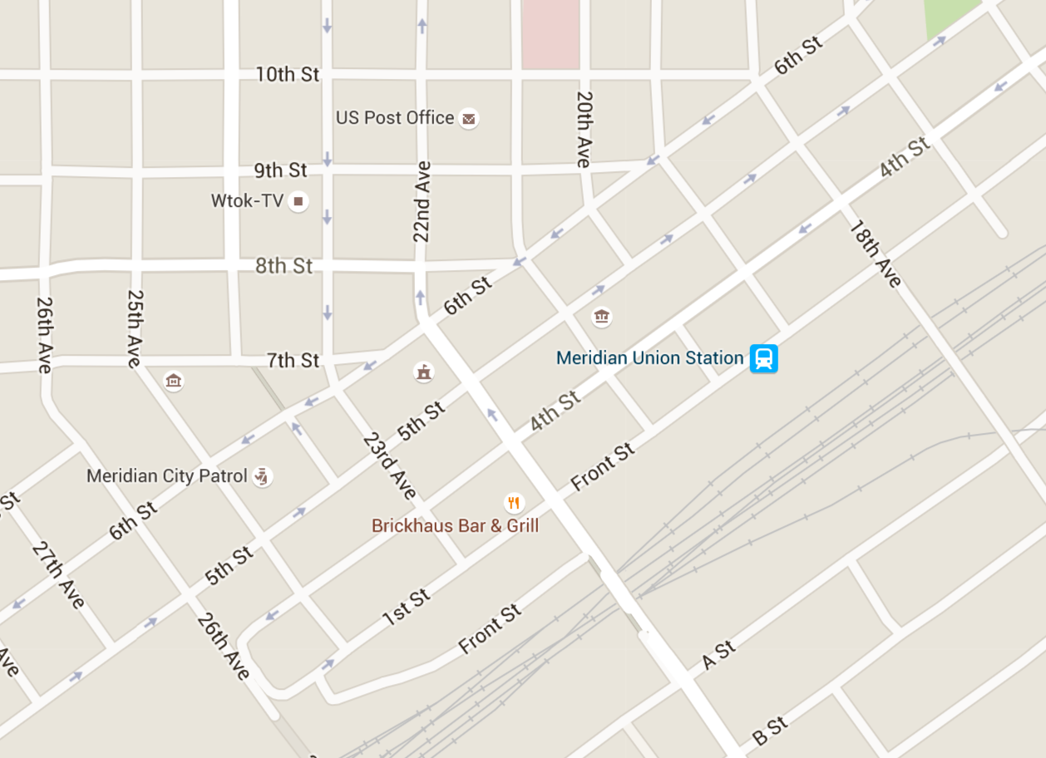
Union
Station
Urban Center
Downtown Historic Districts
1979-2006

Slide 10
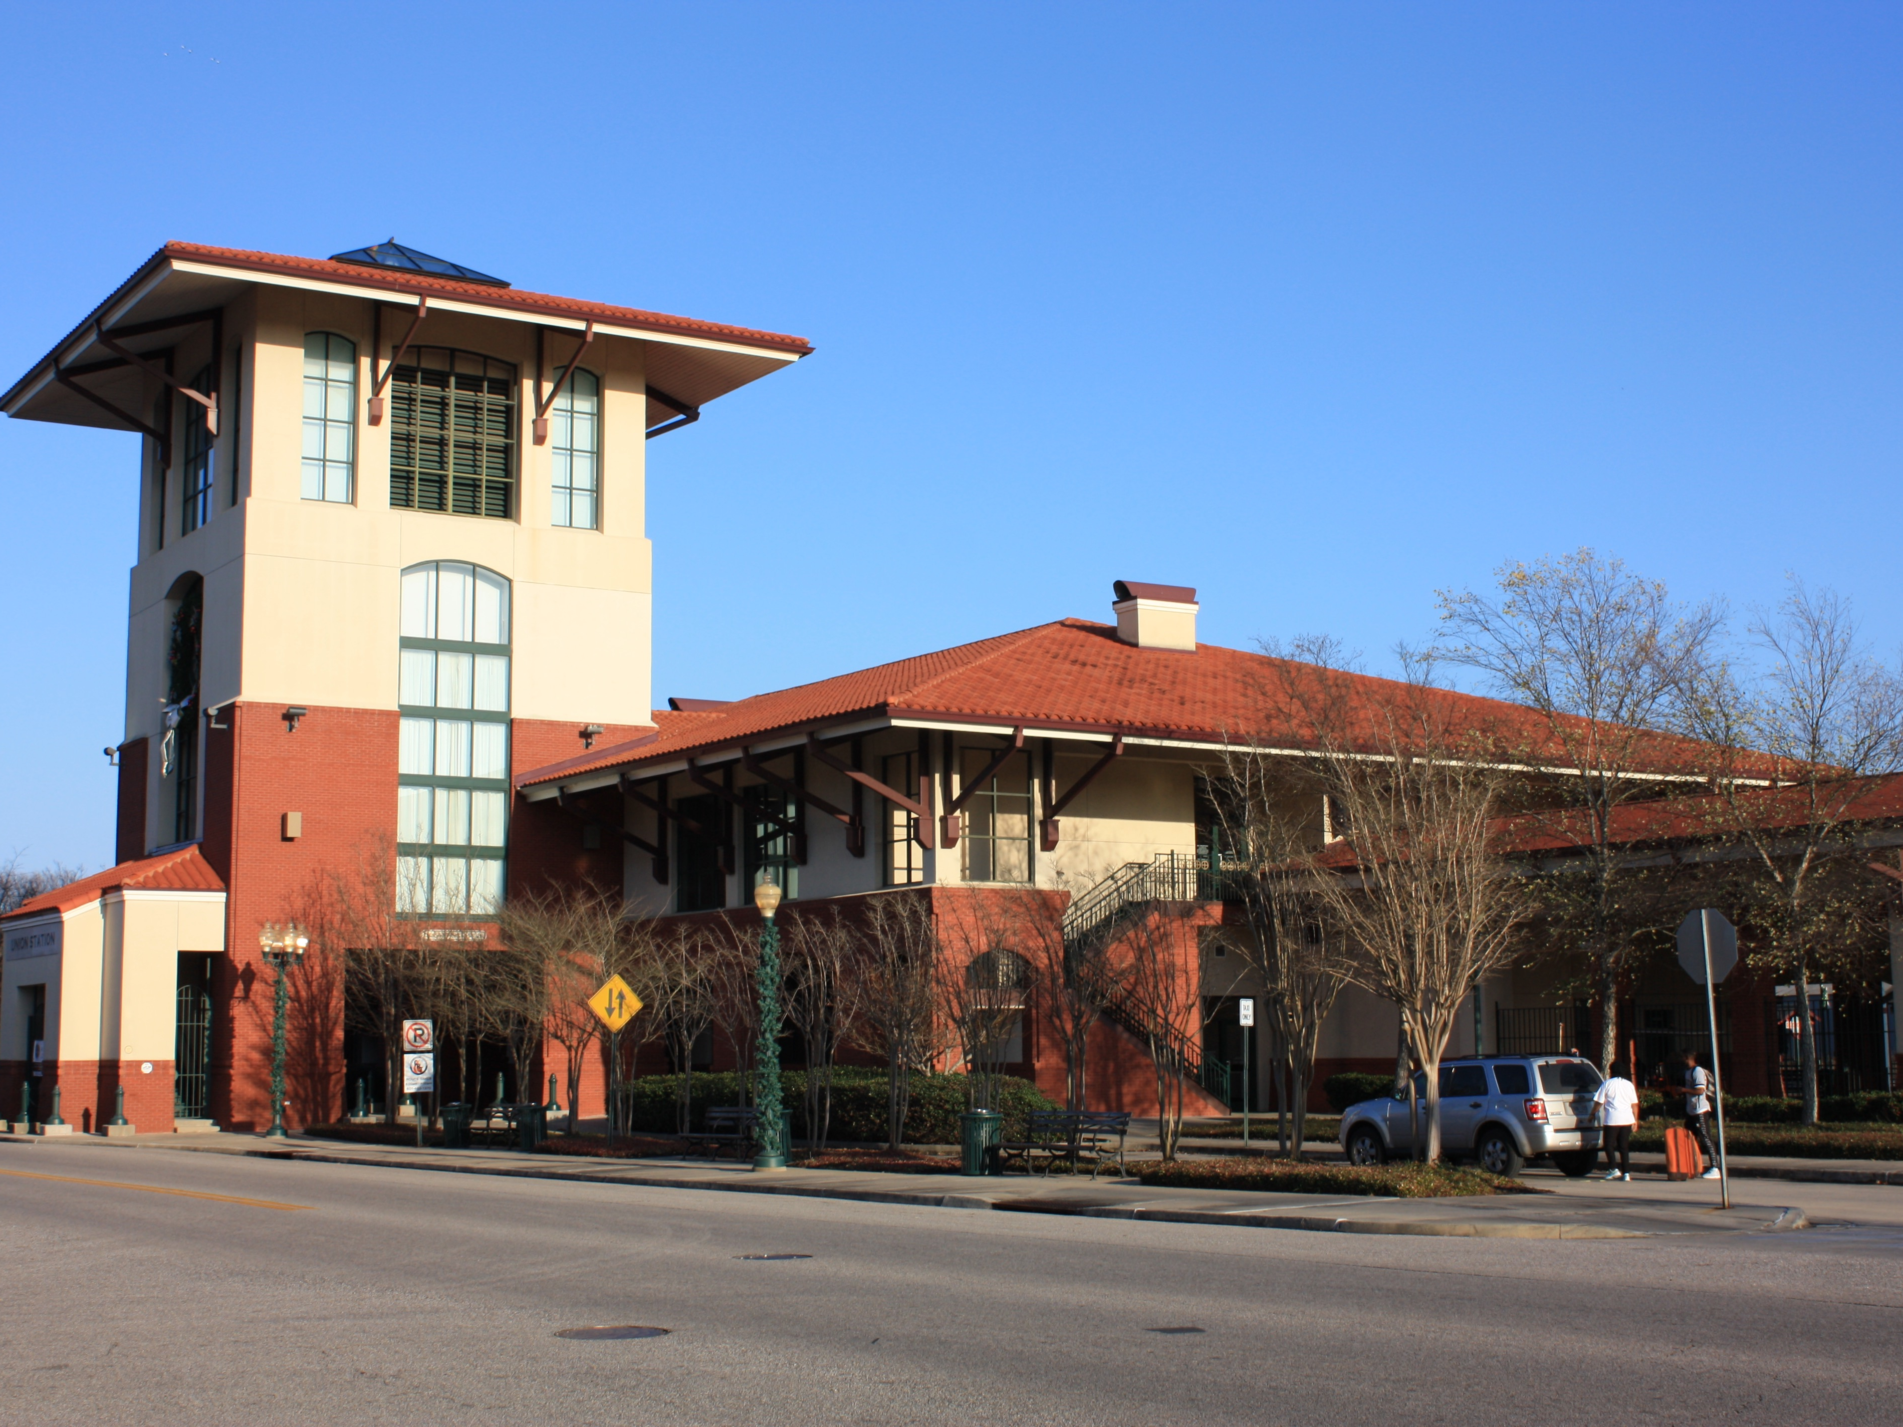
Union Station Multi-Modal Transportation Center

Slide 11
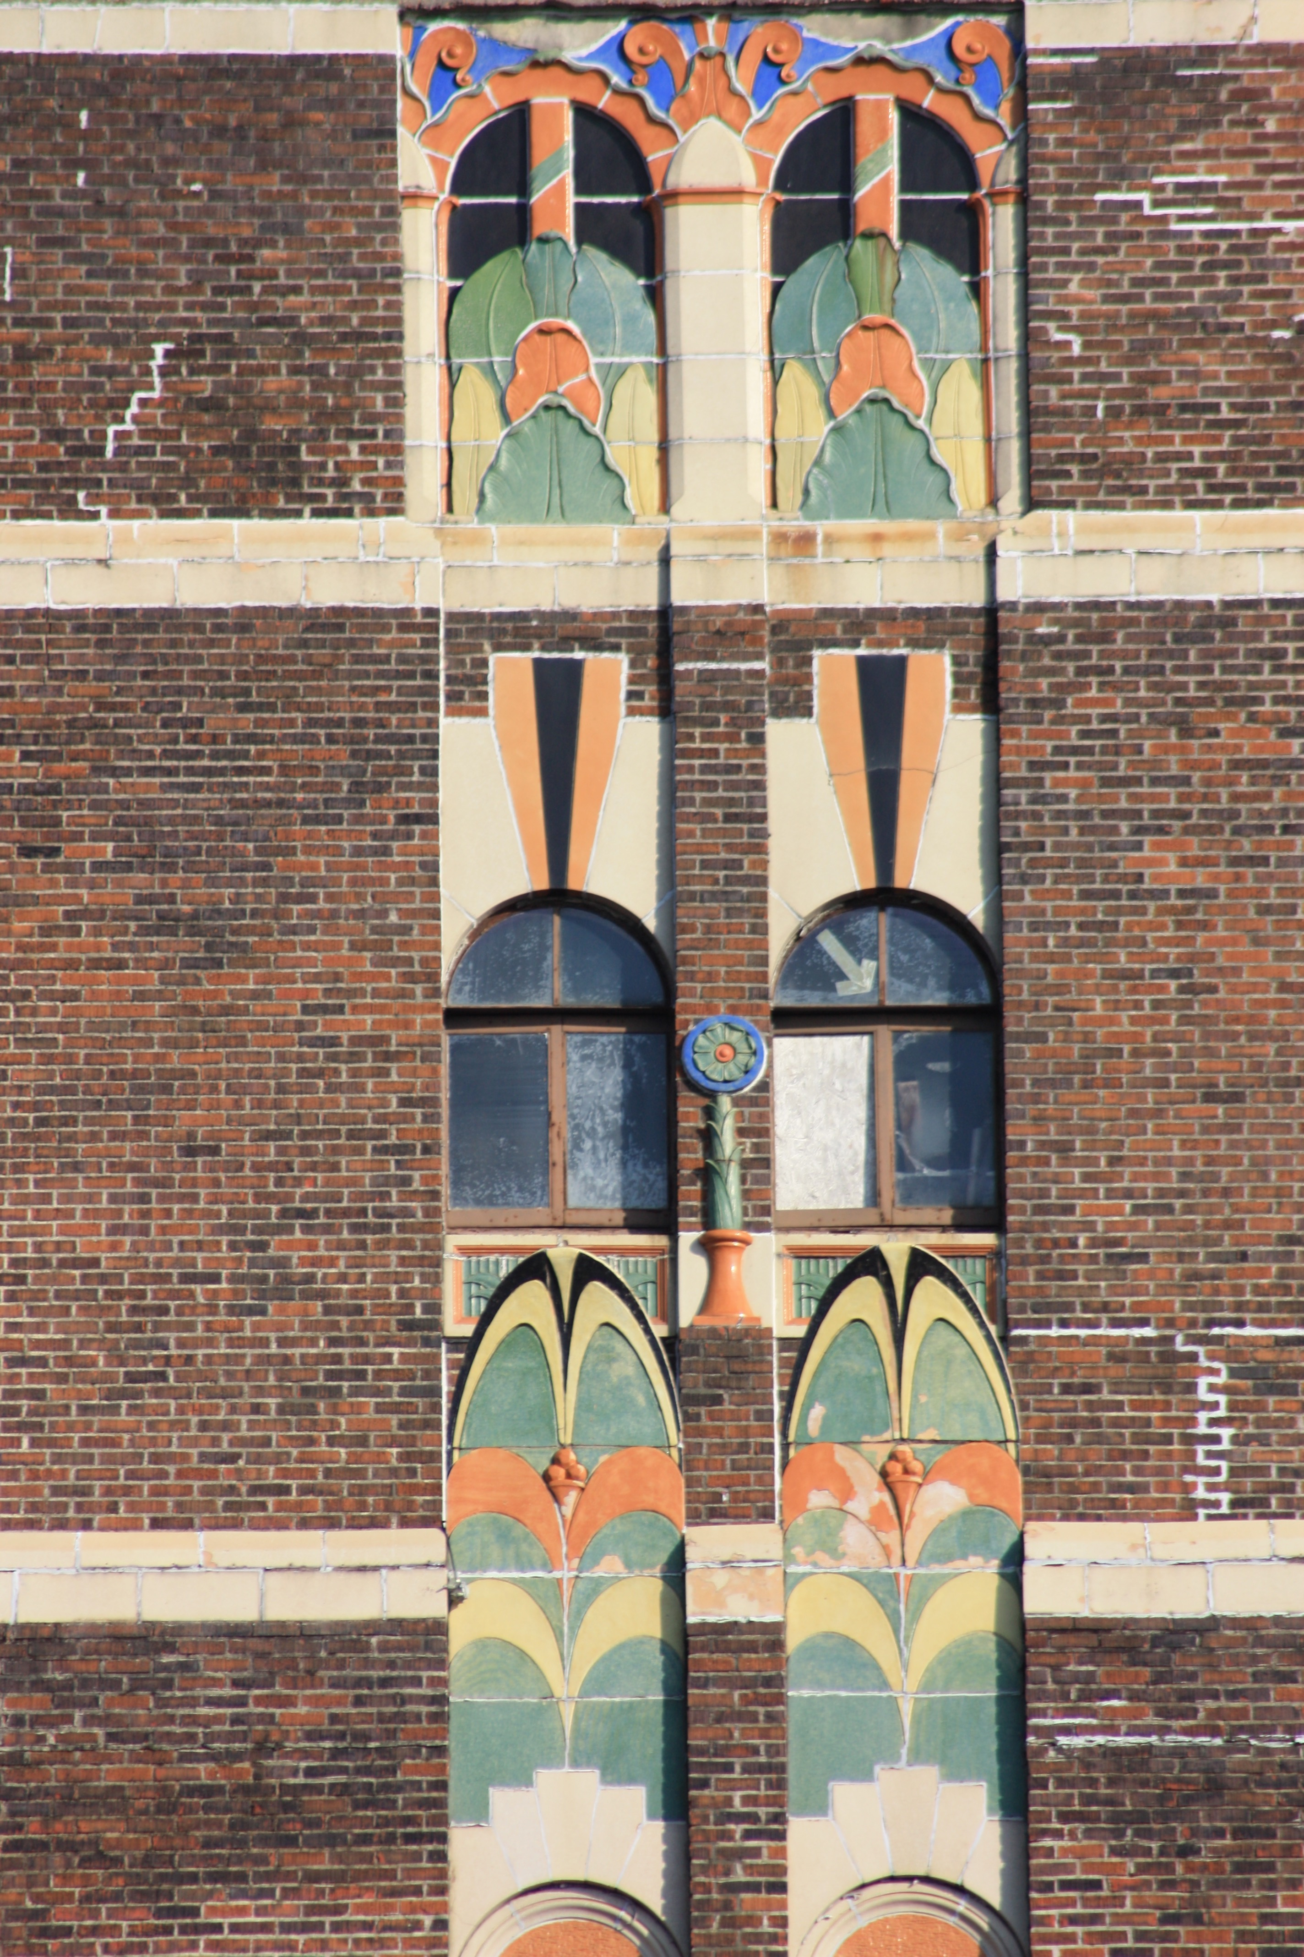
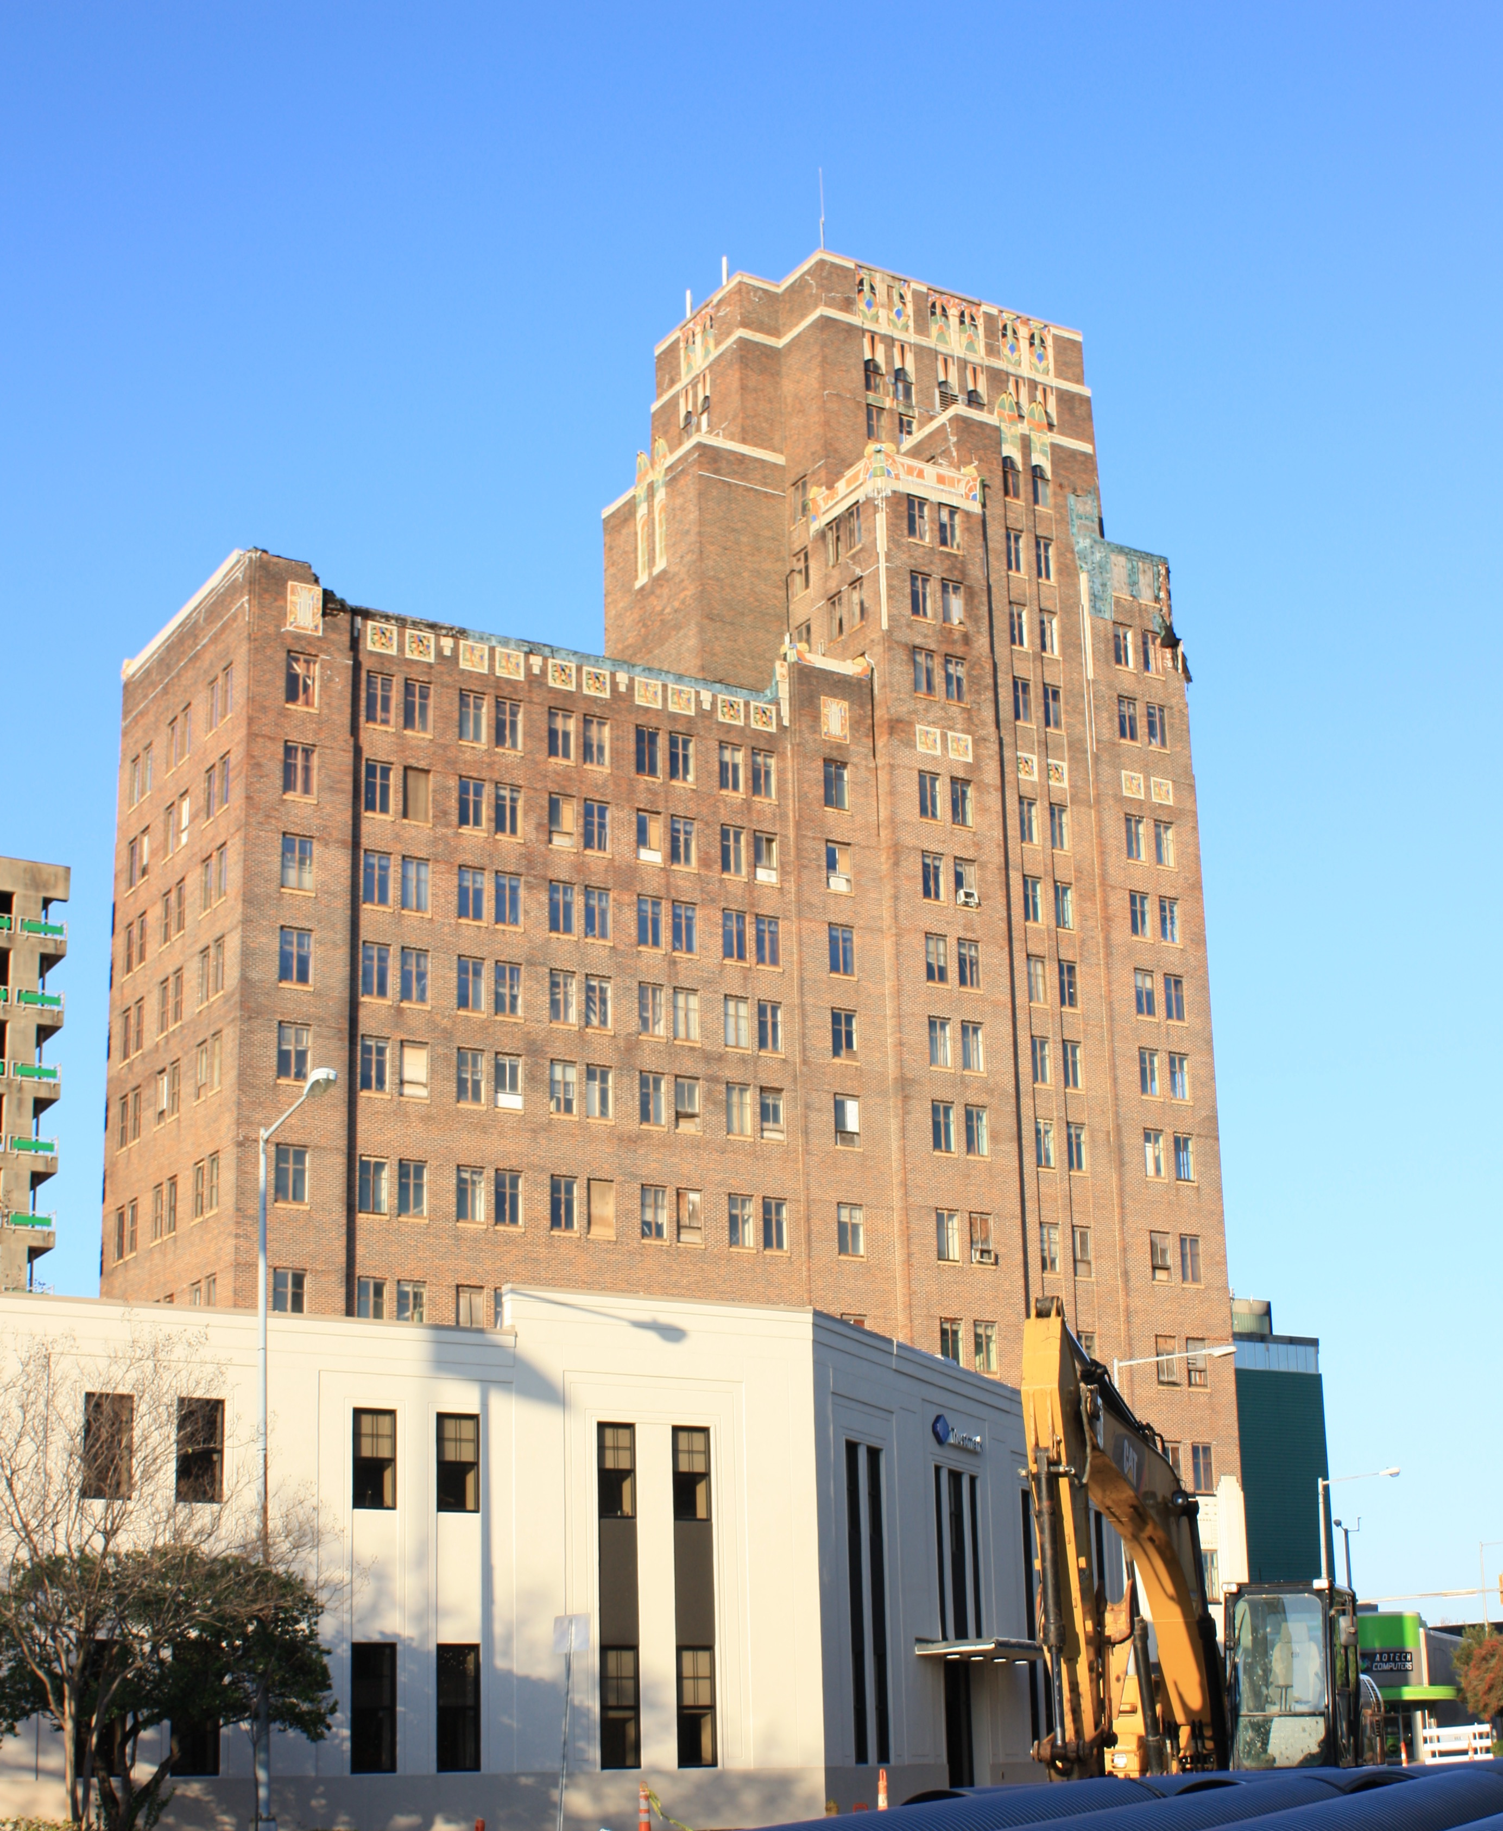
The Threefoot Building
1929

Slide 12
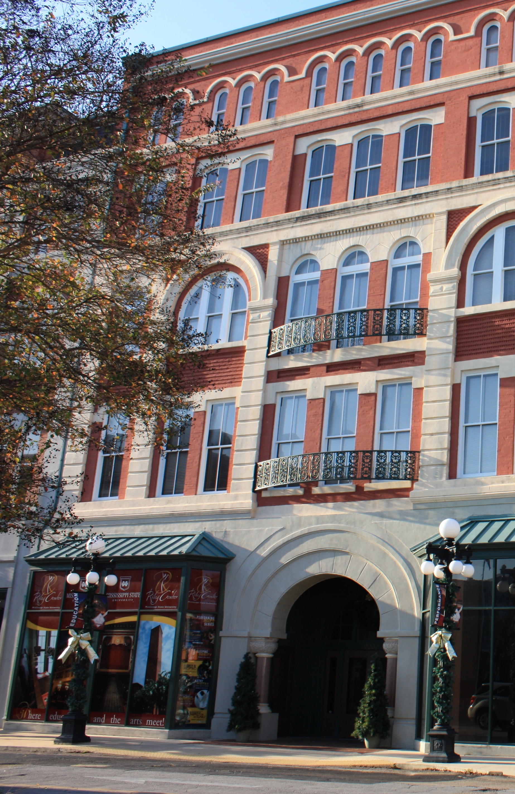
MSU-Riley Center for the Performing Arts
Image courtesy of MSU-Riley Center
Image courtesy of Meridian Historic Preservation Commission

Slide 13
Meridian Downtown Historic District
Present Day

Slide 14
An Arts and Entertainment Center

Slide 15
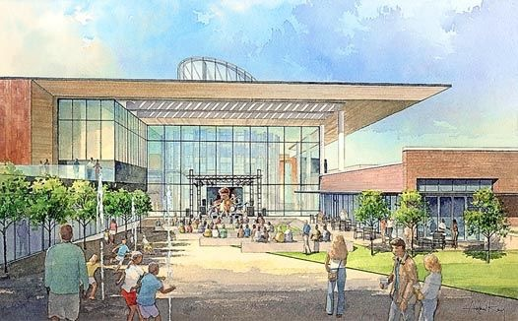
Mississippi Arts and Entertainment Experience
Image courtesy of Mississippi Arts and Entertainment Center

Slide 16
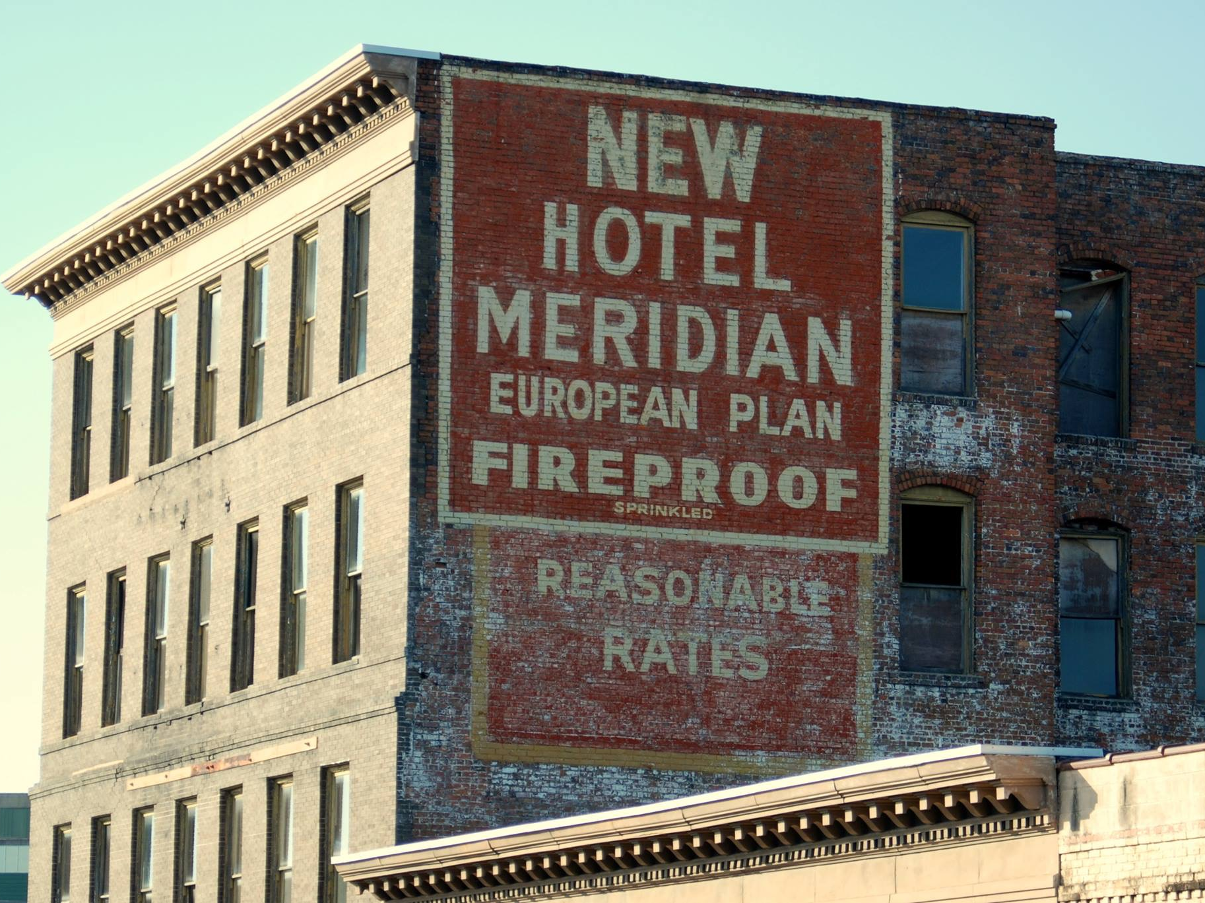
Hotel Meridian, c. 1907
Image courtesy of Shauna Rynn Waters

Slide 17
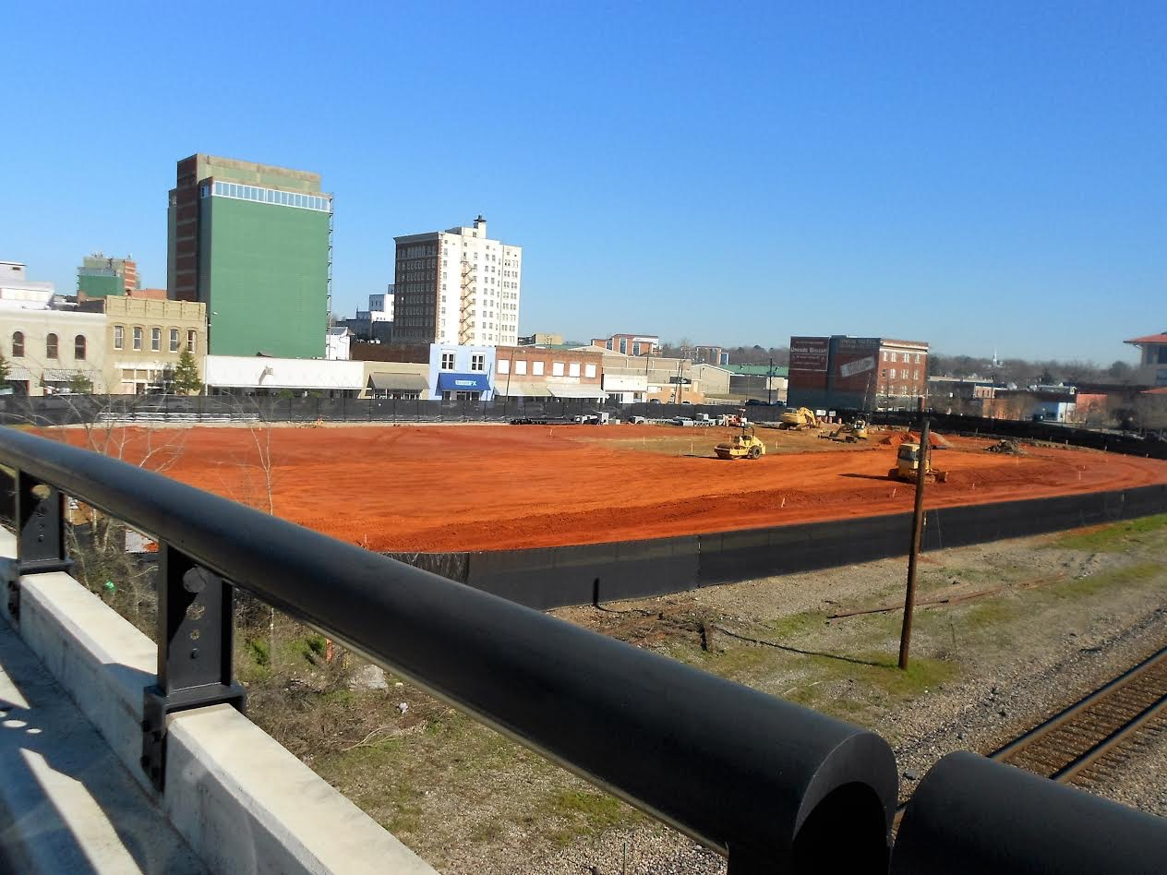
Image courtesy of Claire Lee

Slide 18
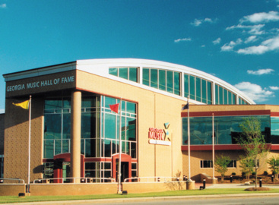
Georgia Music Hall of Fame - Macon, Georgia
Image courtesy of clatl.com

Slide 19
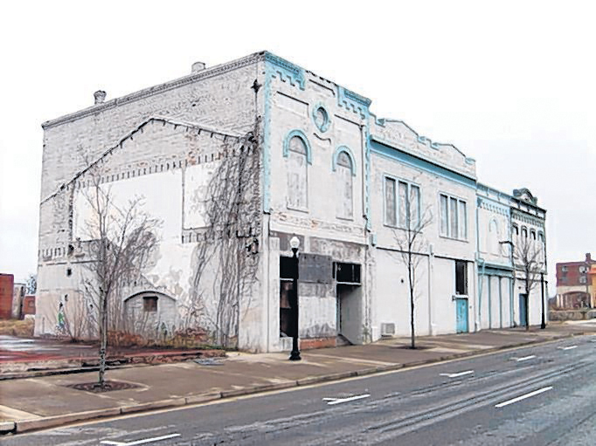
Capricorn Recording Studios - Macon, Georgia
Image courtesy of Atlanta Journal Constitution

Slide 20
The African American Business District

Slide 21
African American Business District

Slide 22
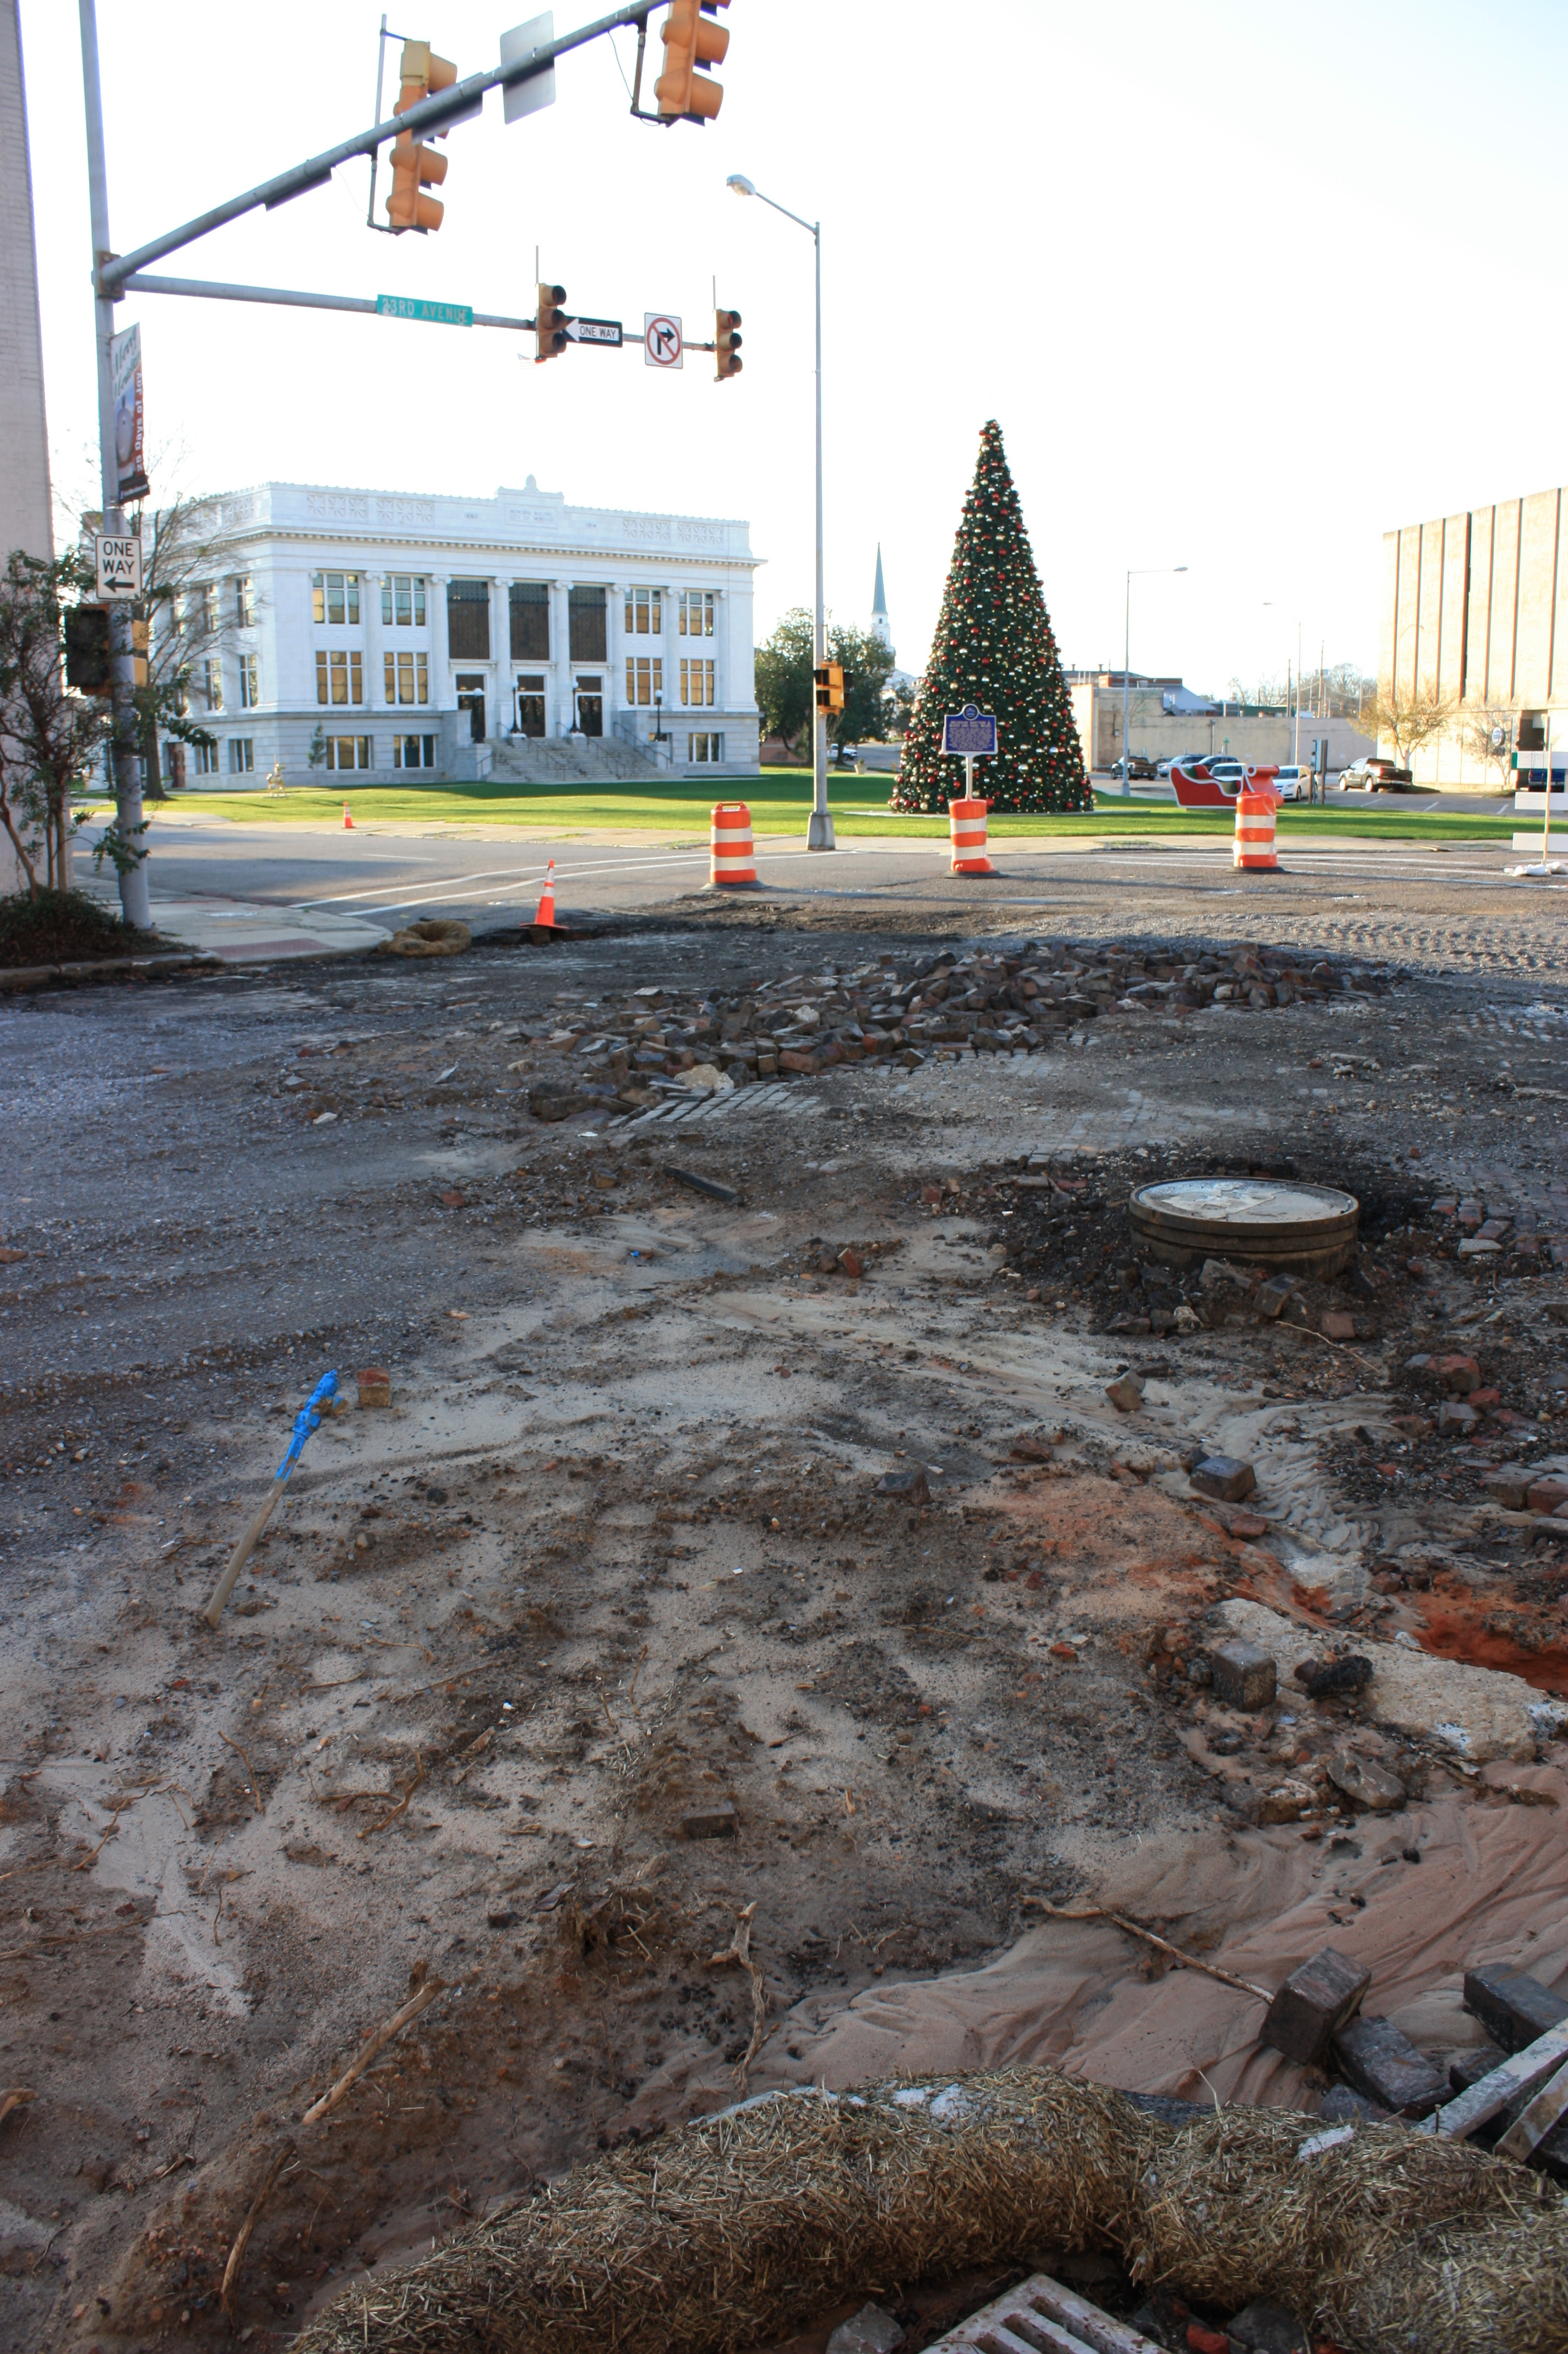
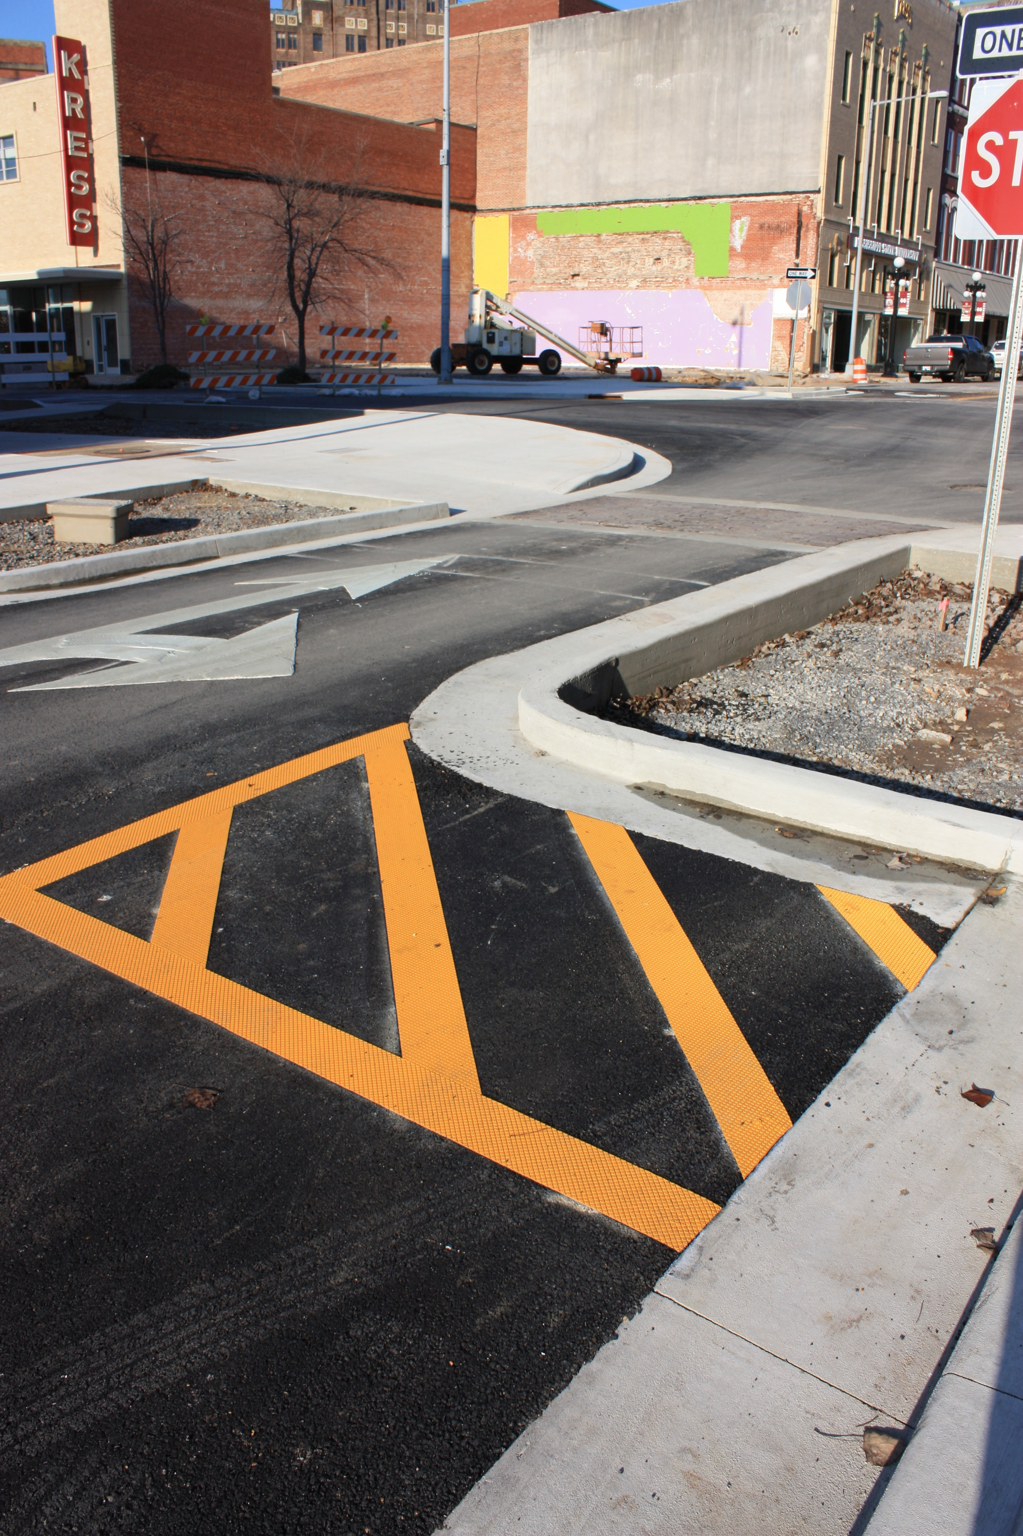

Slide 23
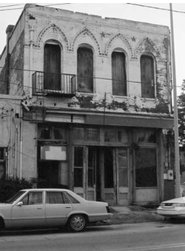
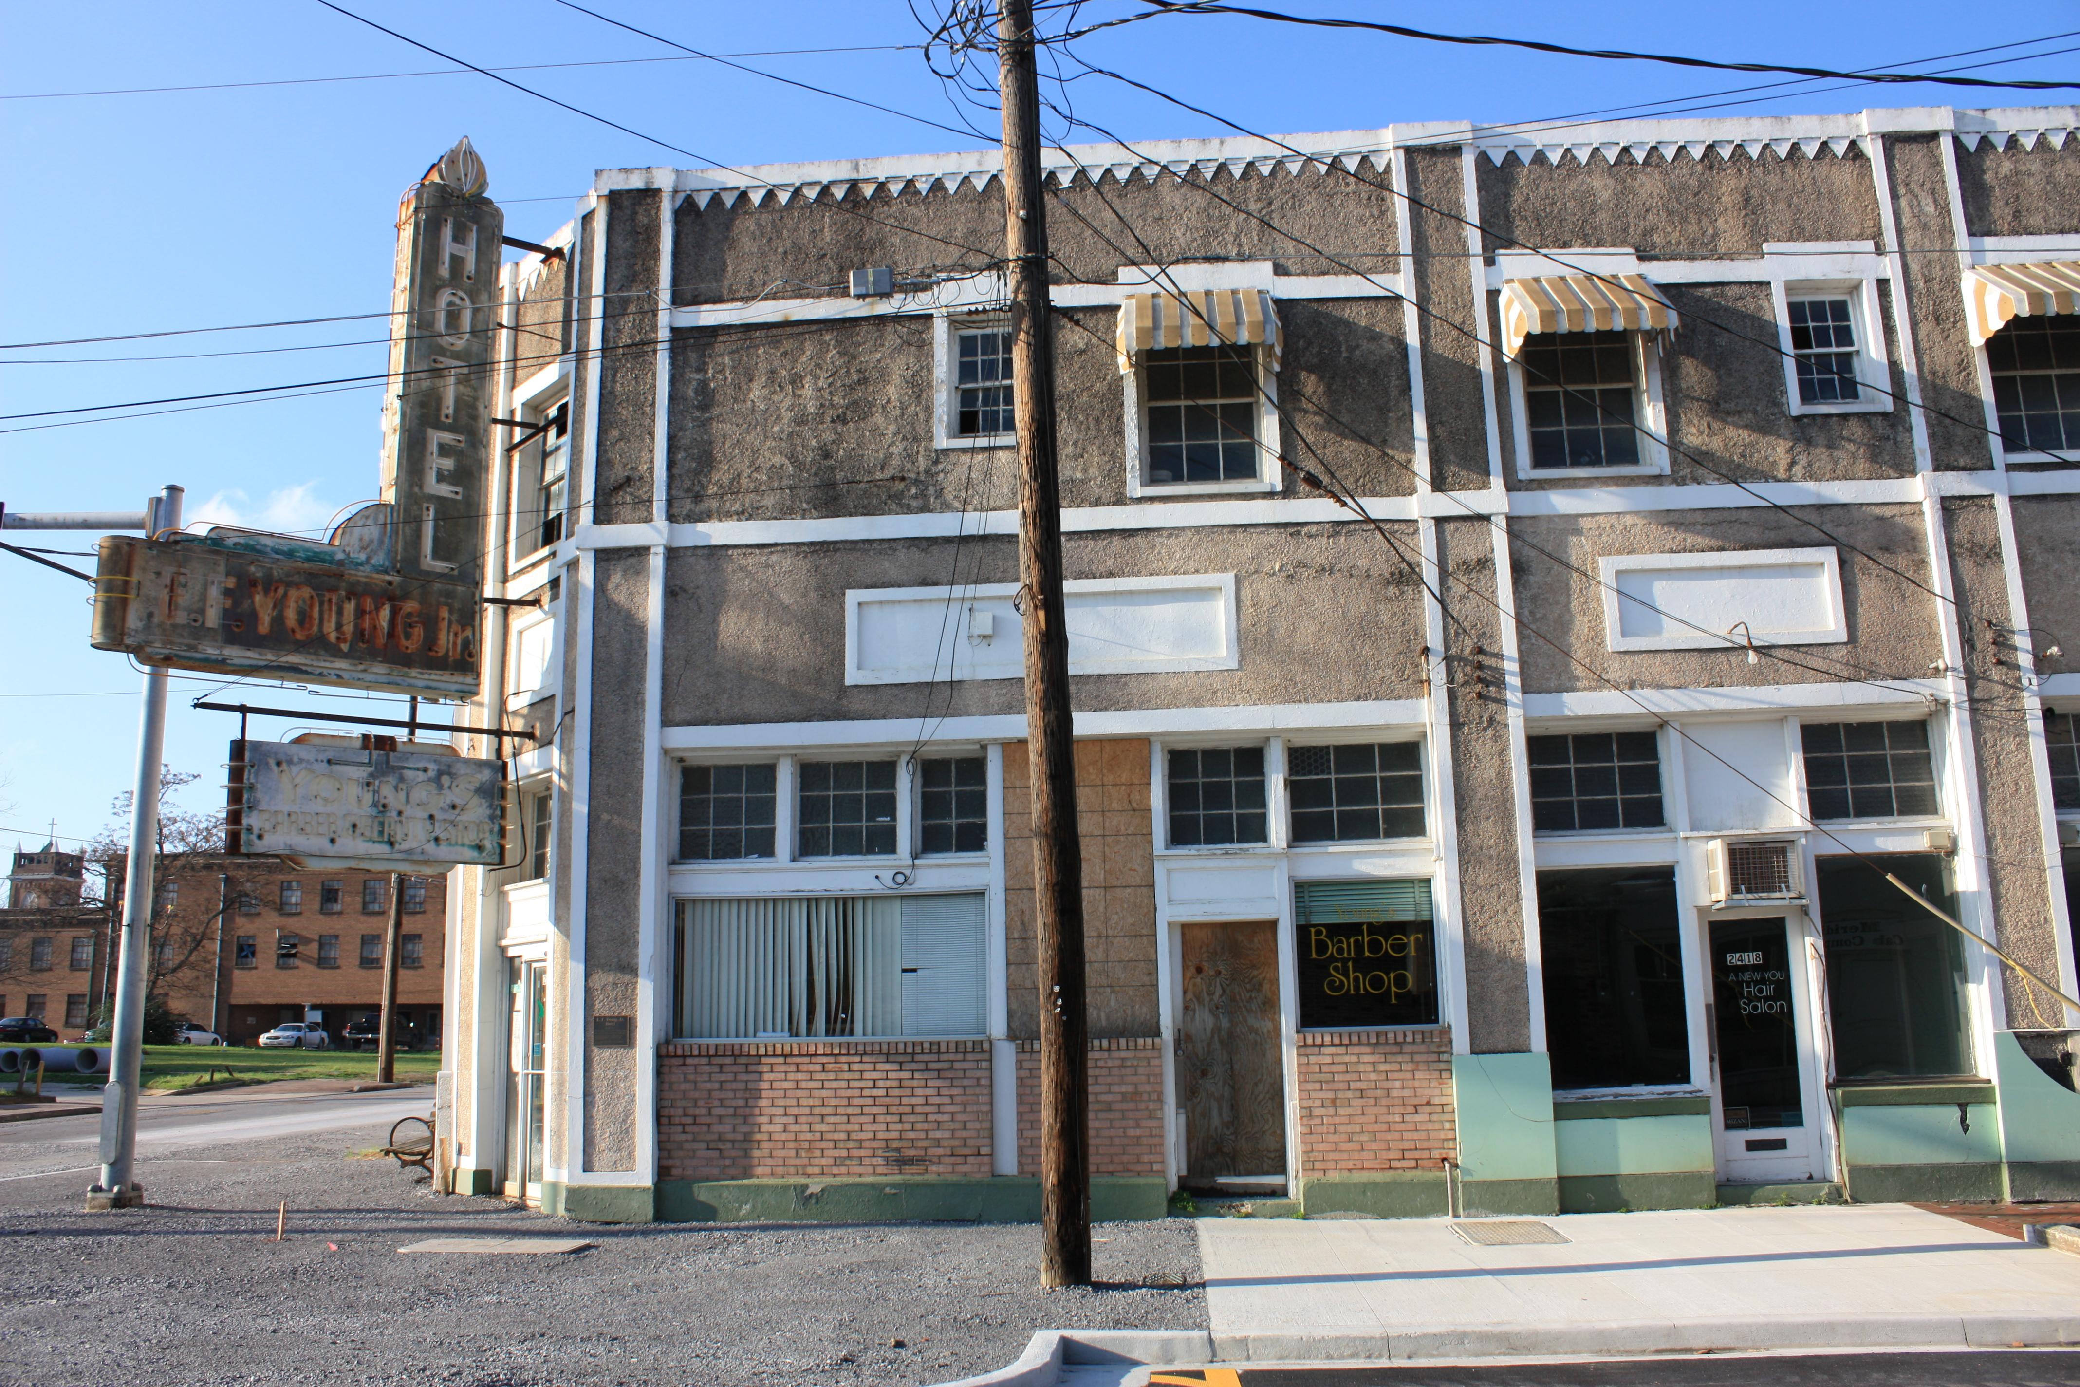
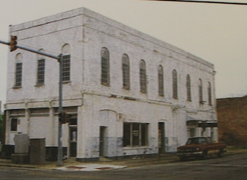
Cohn Sheehan Building
E.F. Young Hotel
COFO Building
Image courtesy of Mississippi Department of Archives and History
Image courtesy of Mississippi Department of Archives and History

Slide 24
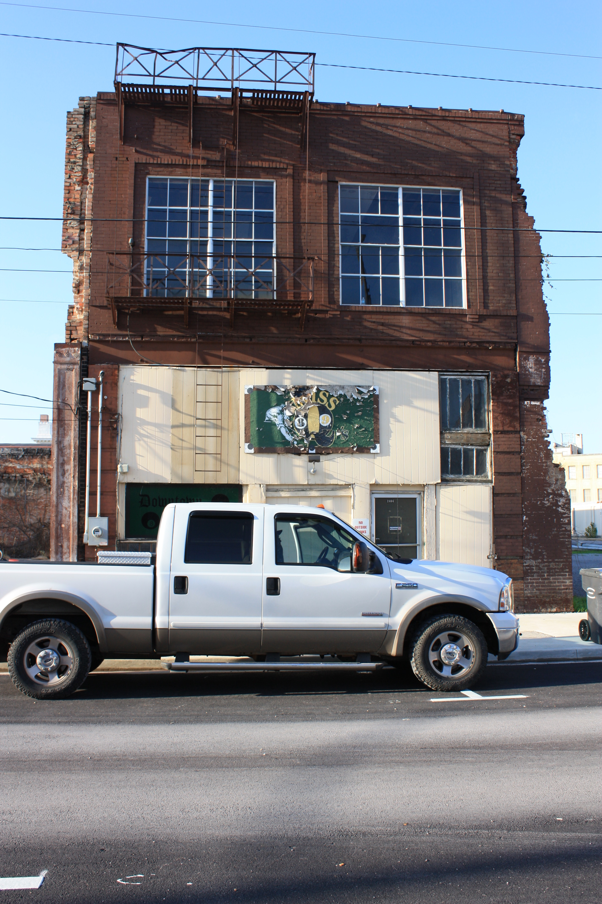
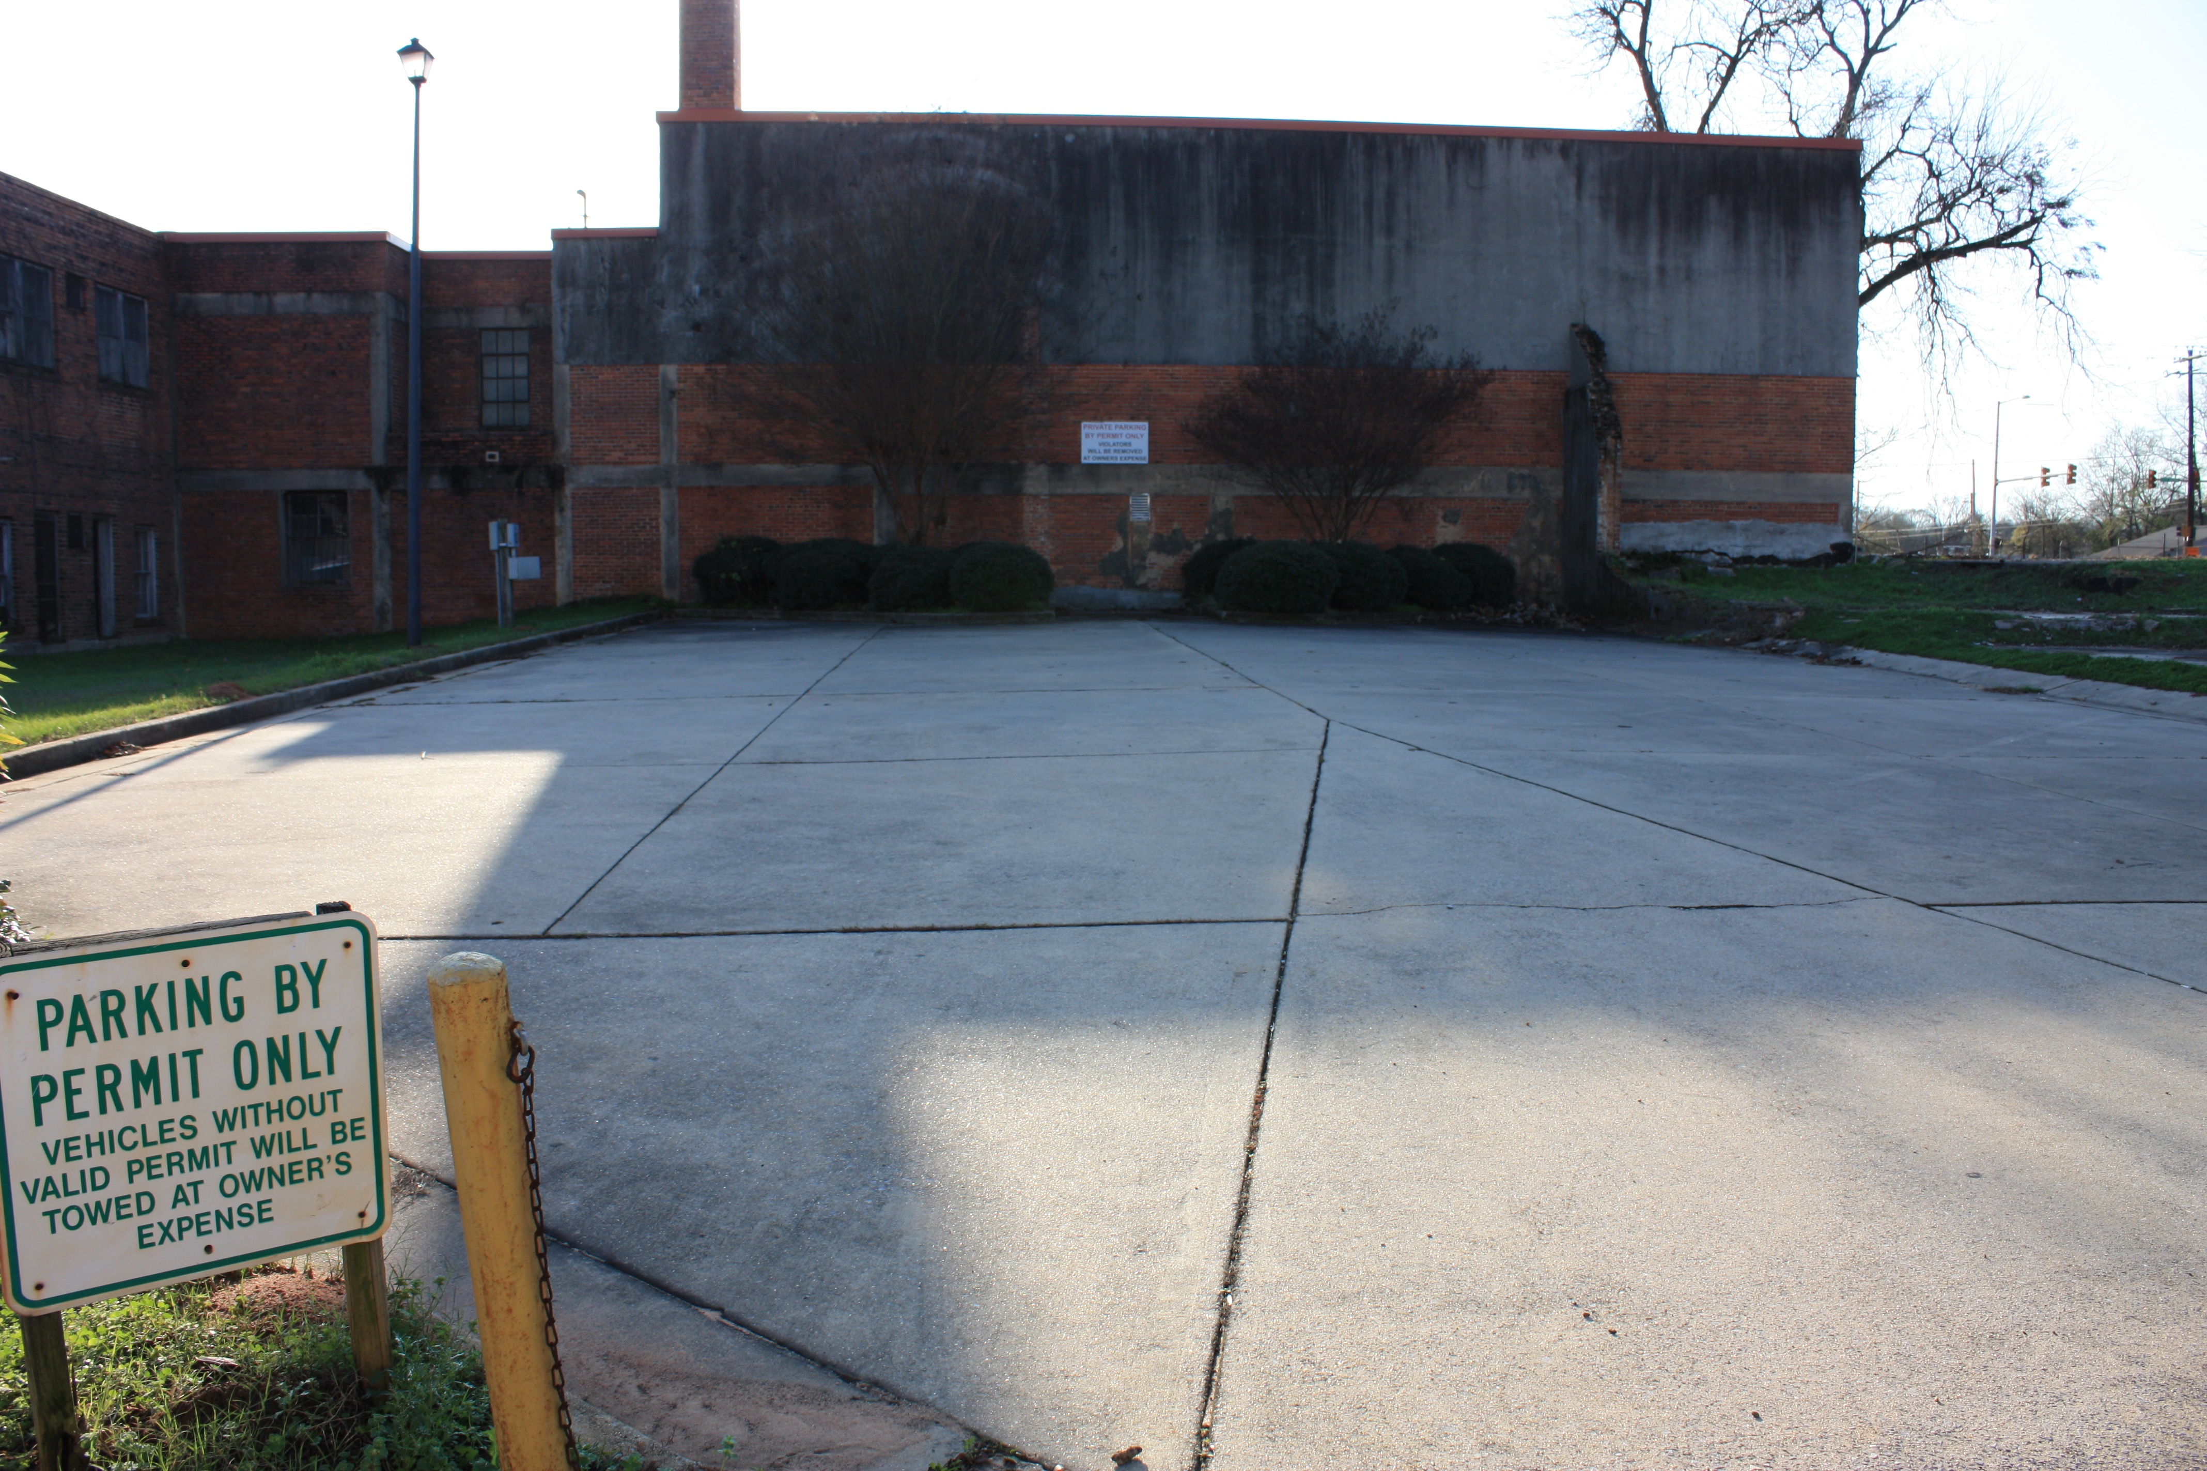
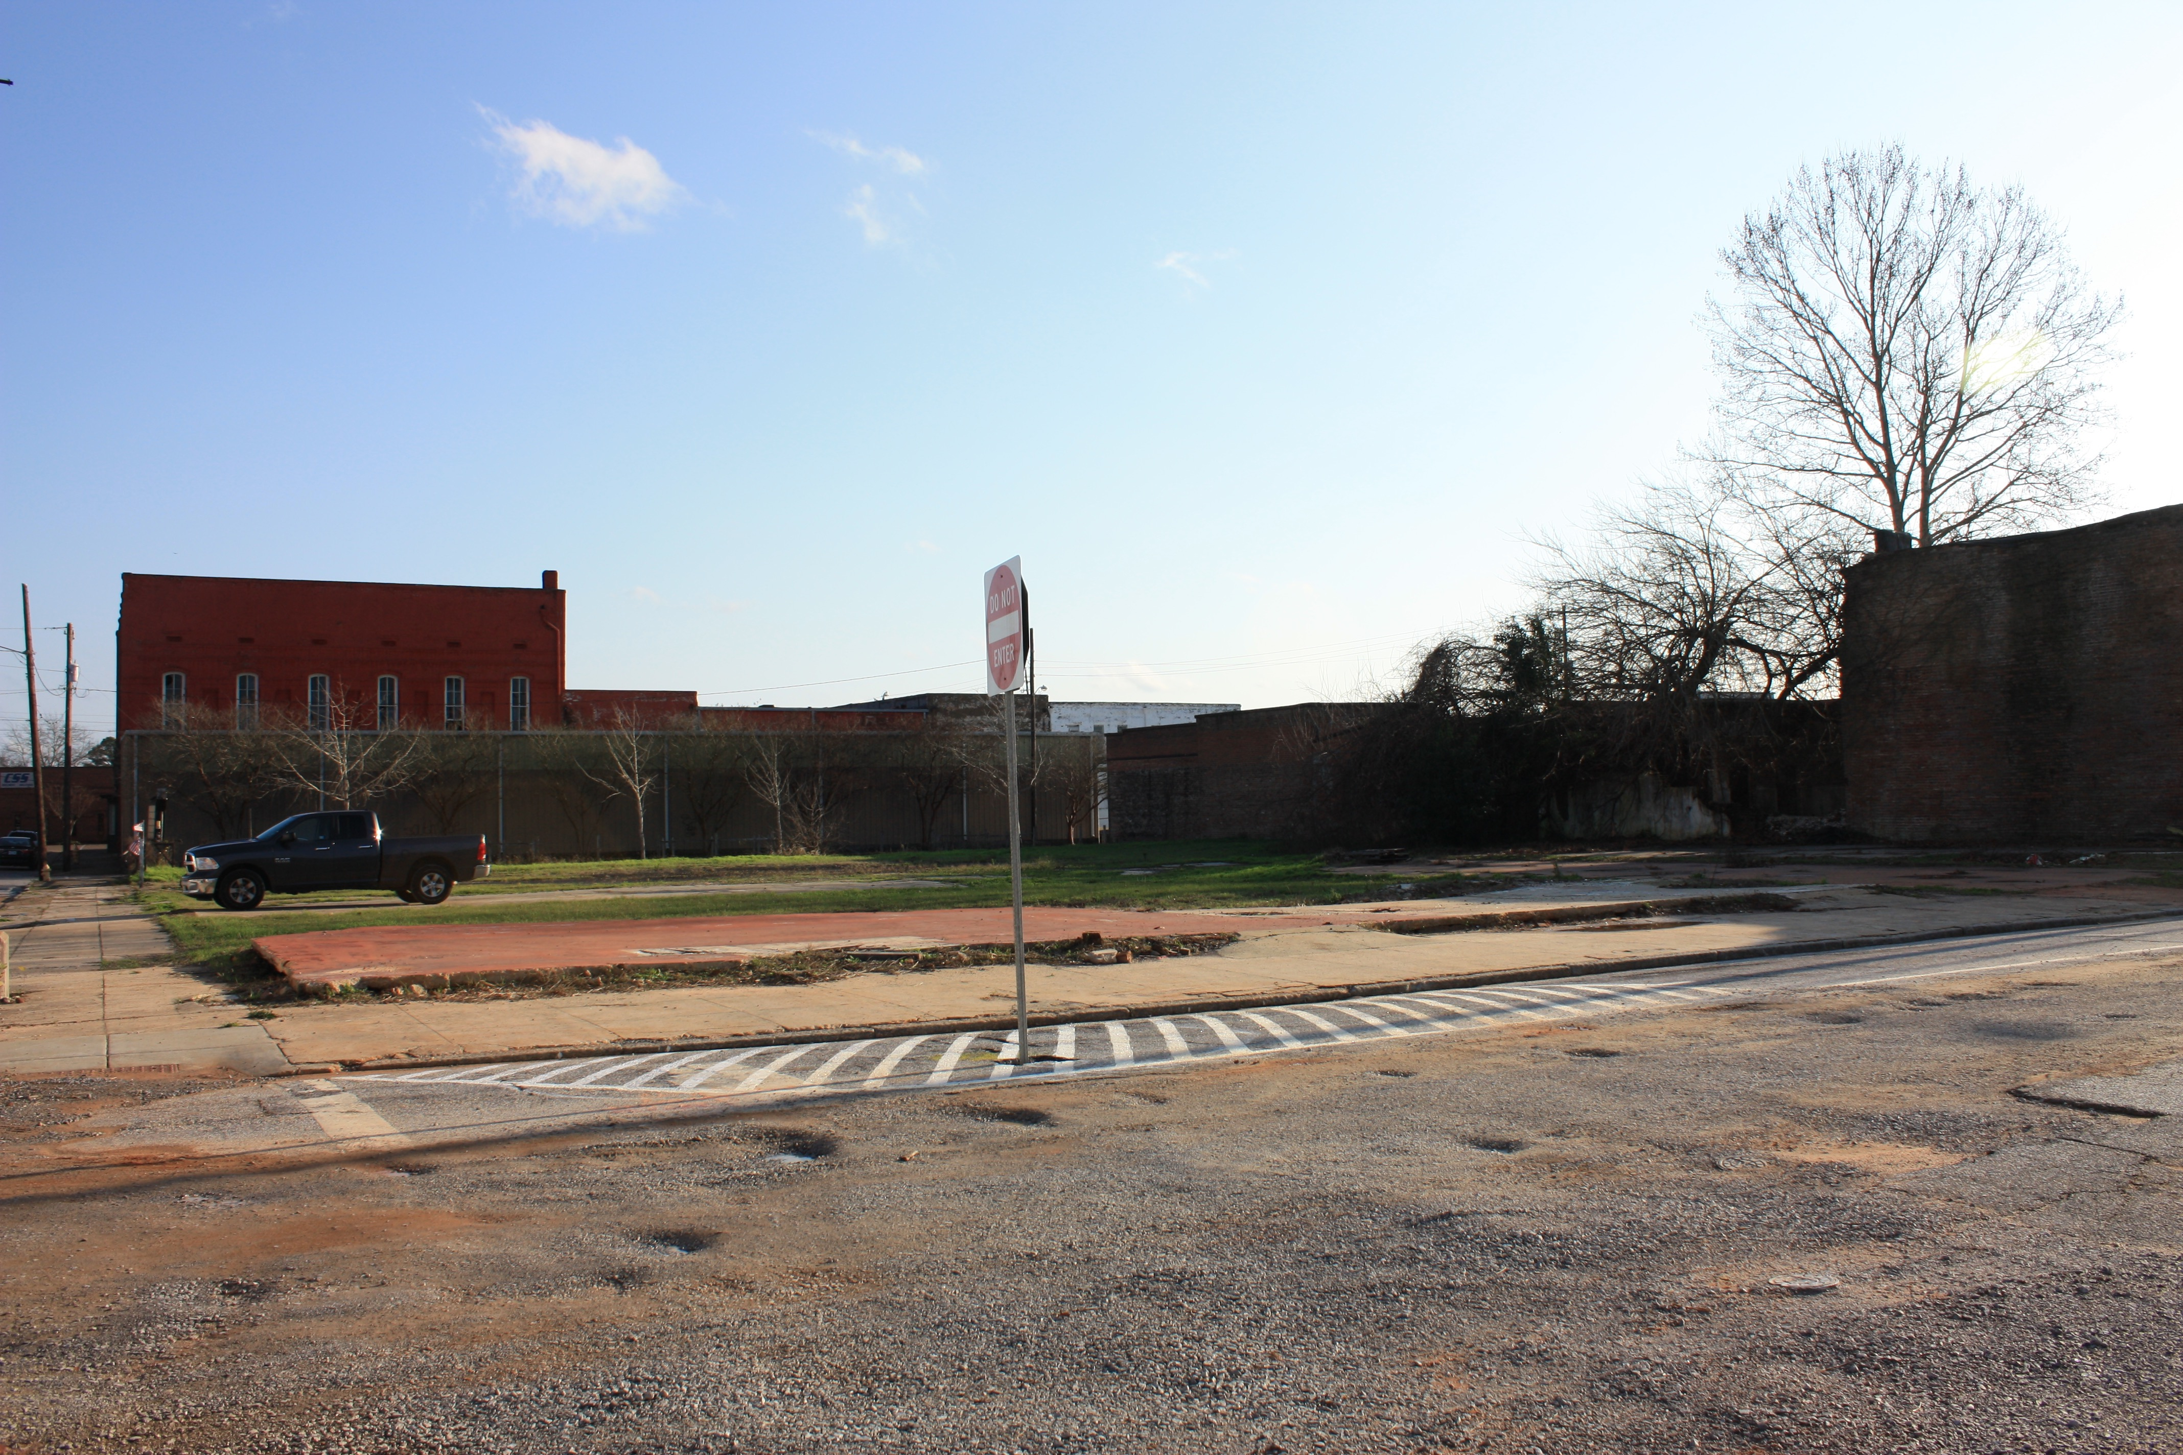

Slide 25
Demolition by Neglect

Slide 26
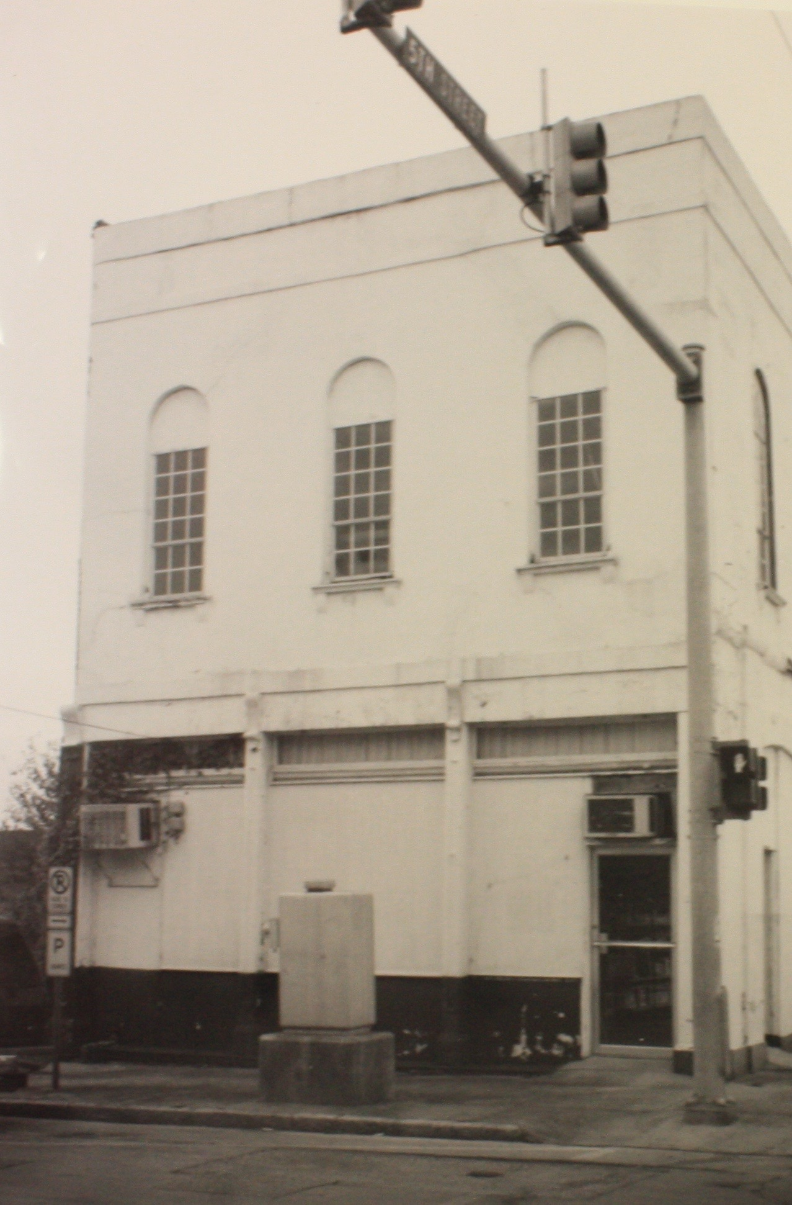
COFO Building
Image courtesy of Mississippi Department of Archives and History

Slide 27
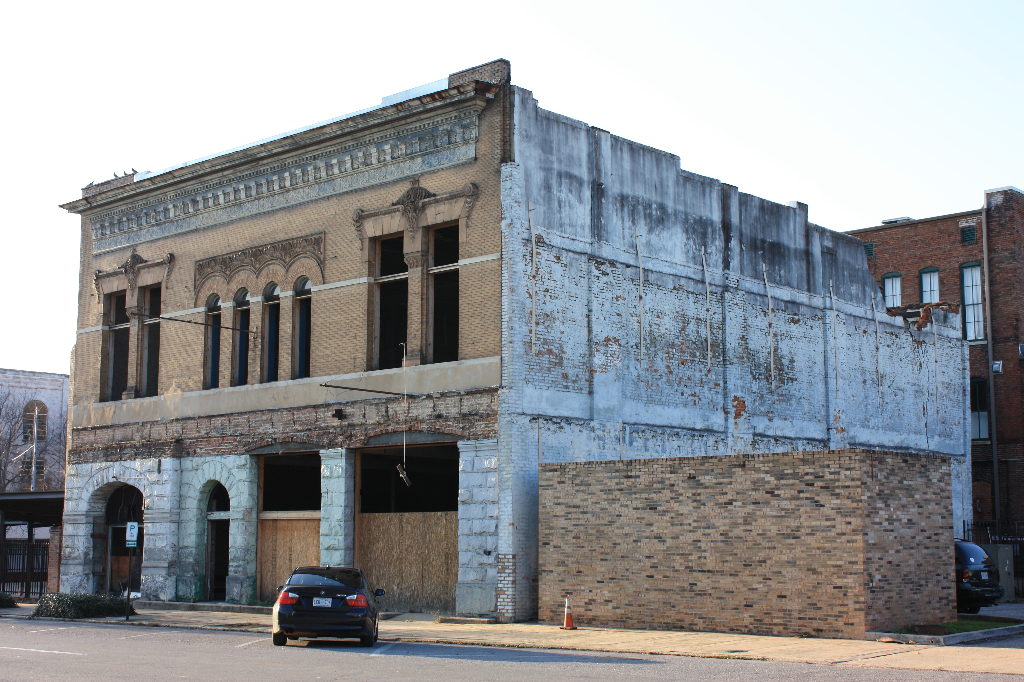
Original Citizens National Bank Building

Slide 28
Recommendations

Slide 29
Focus on small-scale, incremental development as opposed to large “silver bullet” projects
Image courtesy of Mississippi Arts and Entertainment Center

Slide 30
Make sensitive preservation and revitalization
of the African American Business District a priority

Slide 31
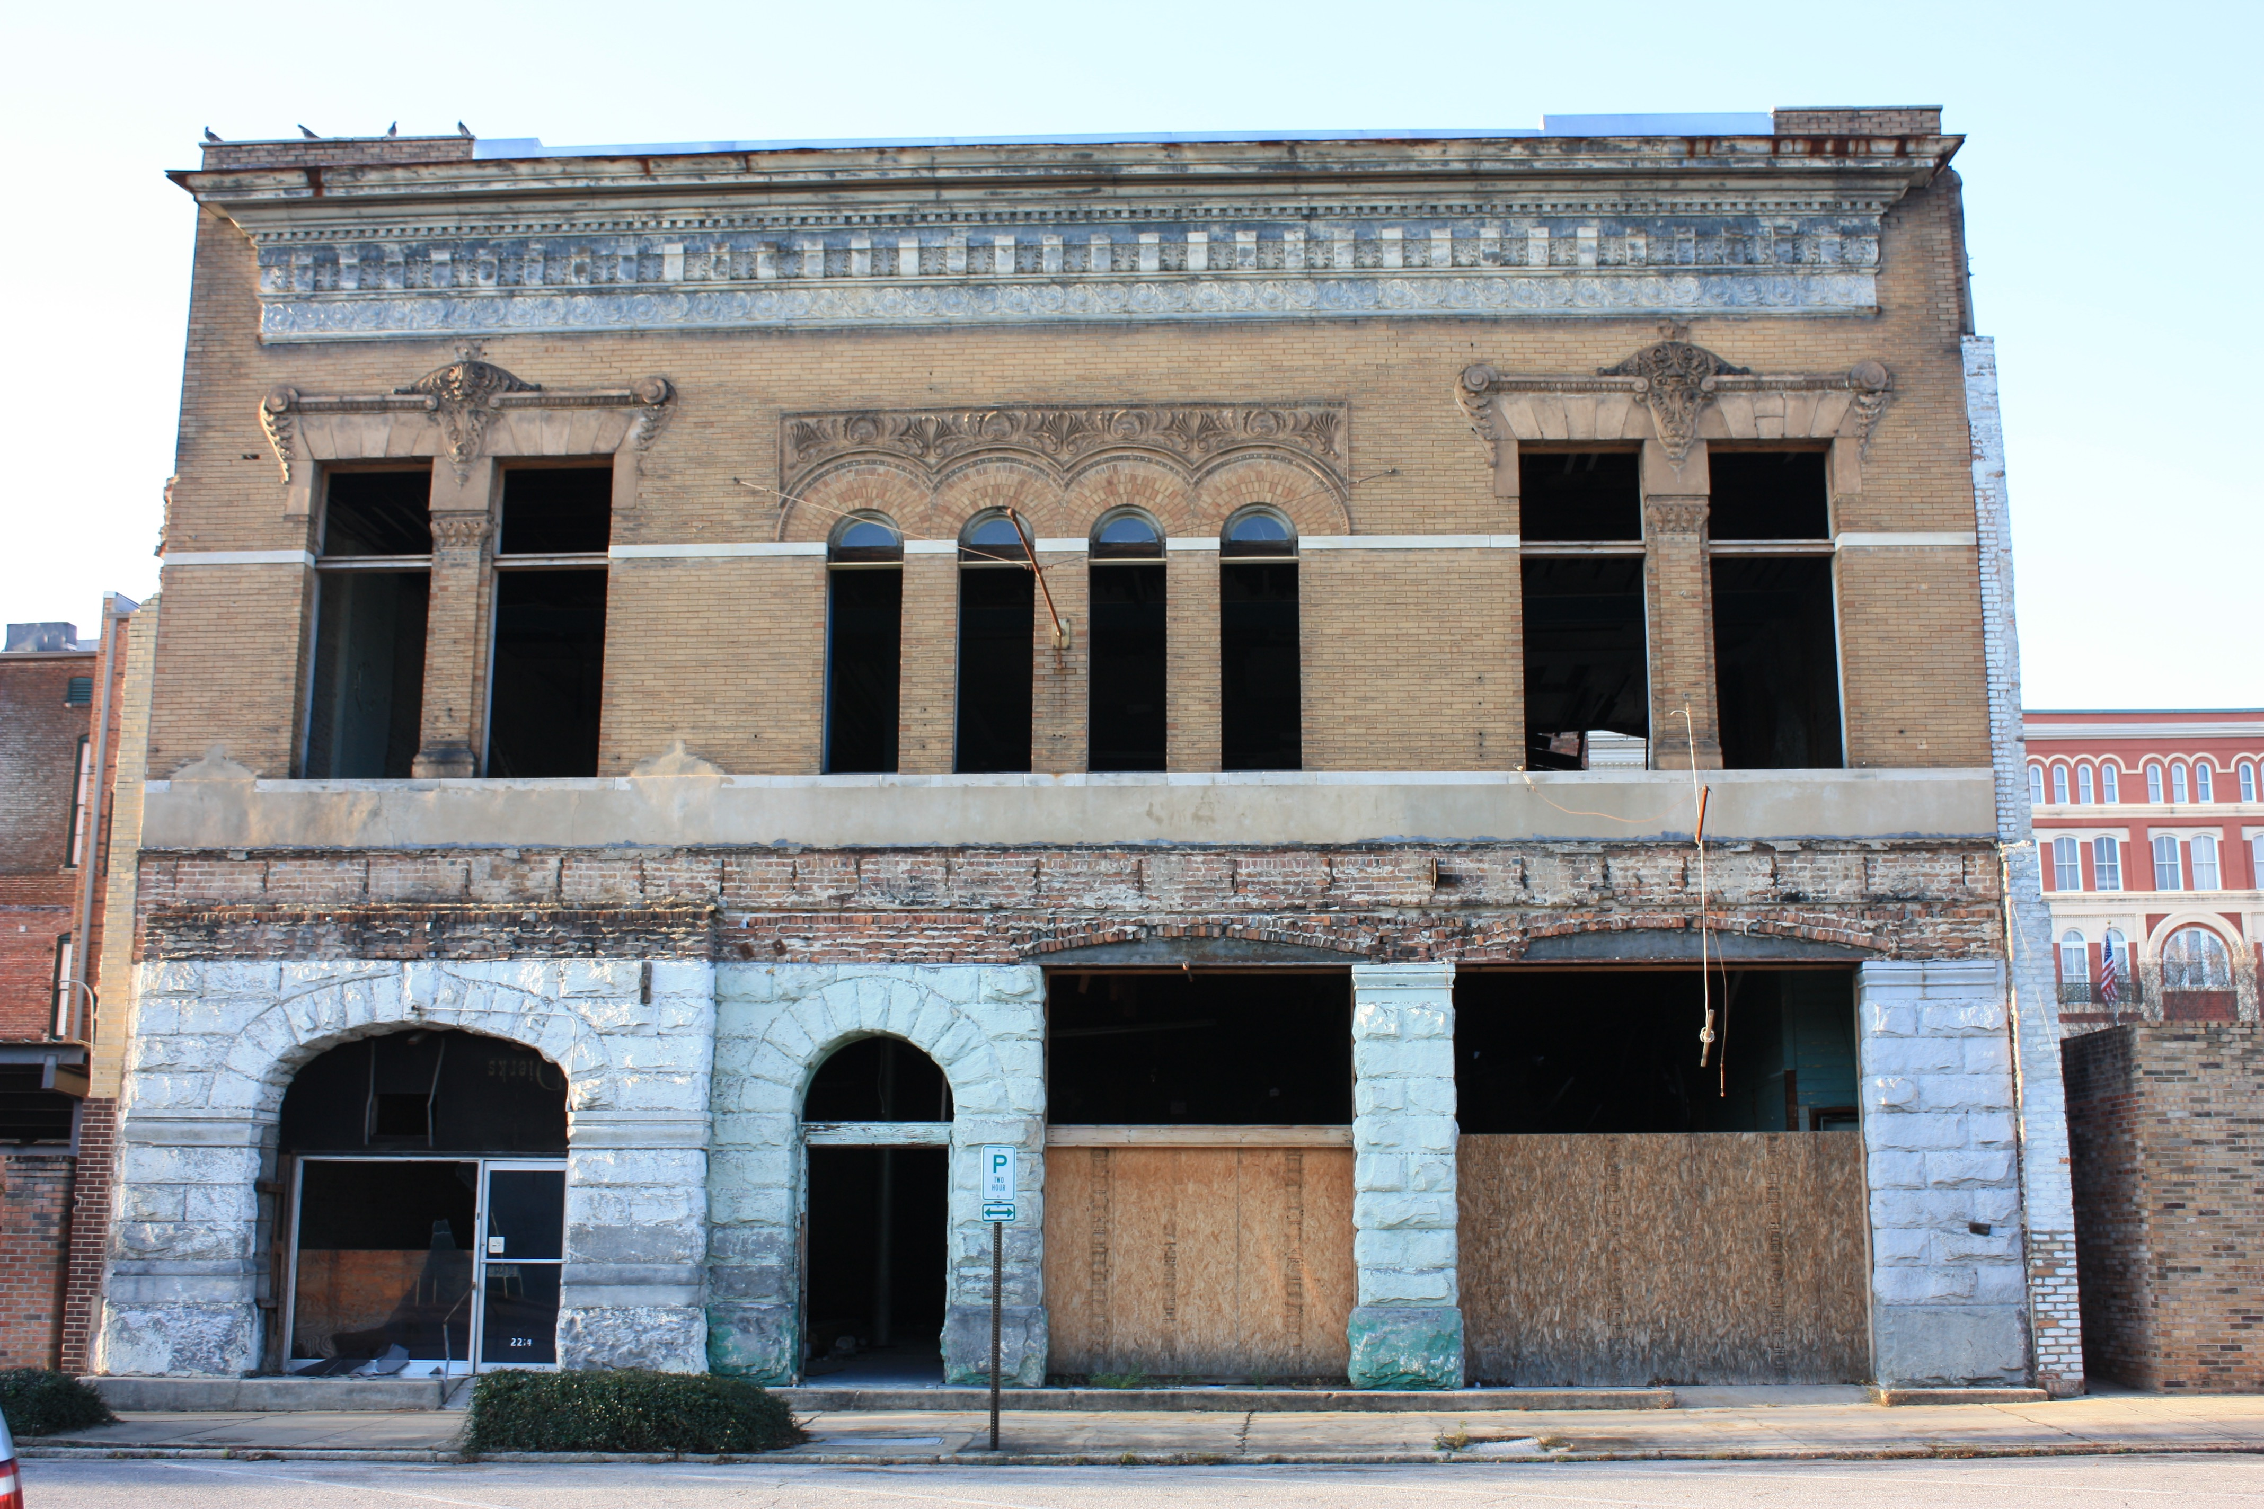
Clarify and strengthen the demolition by neglect ordinance

Slide 32
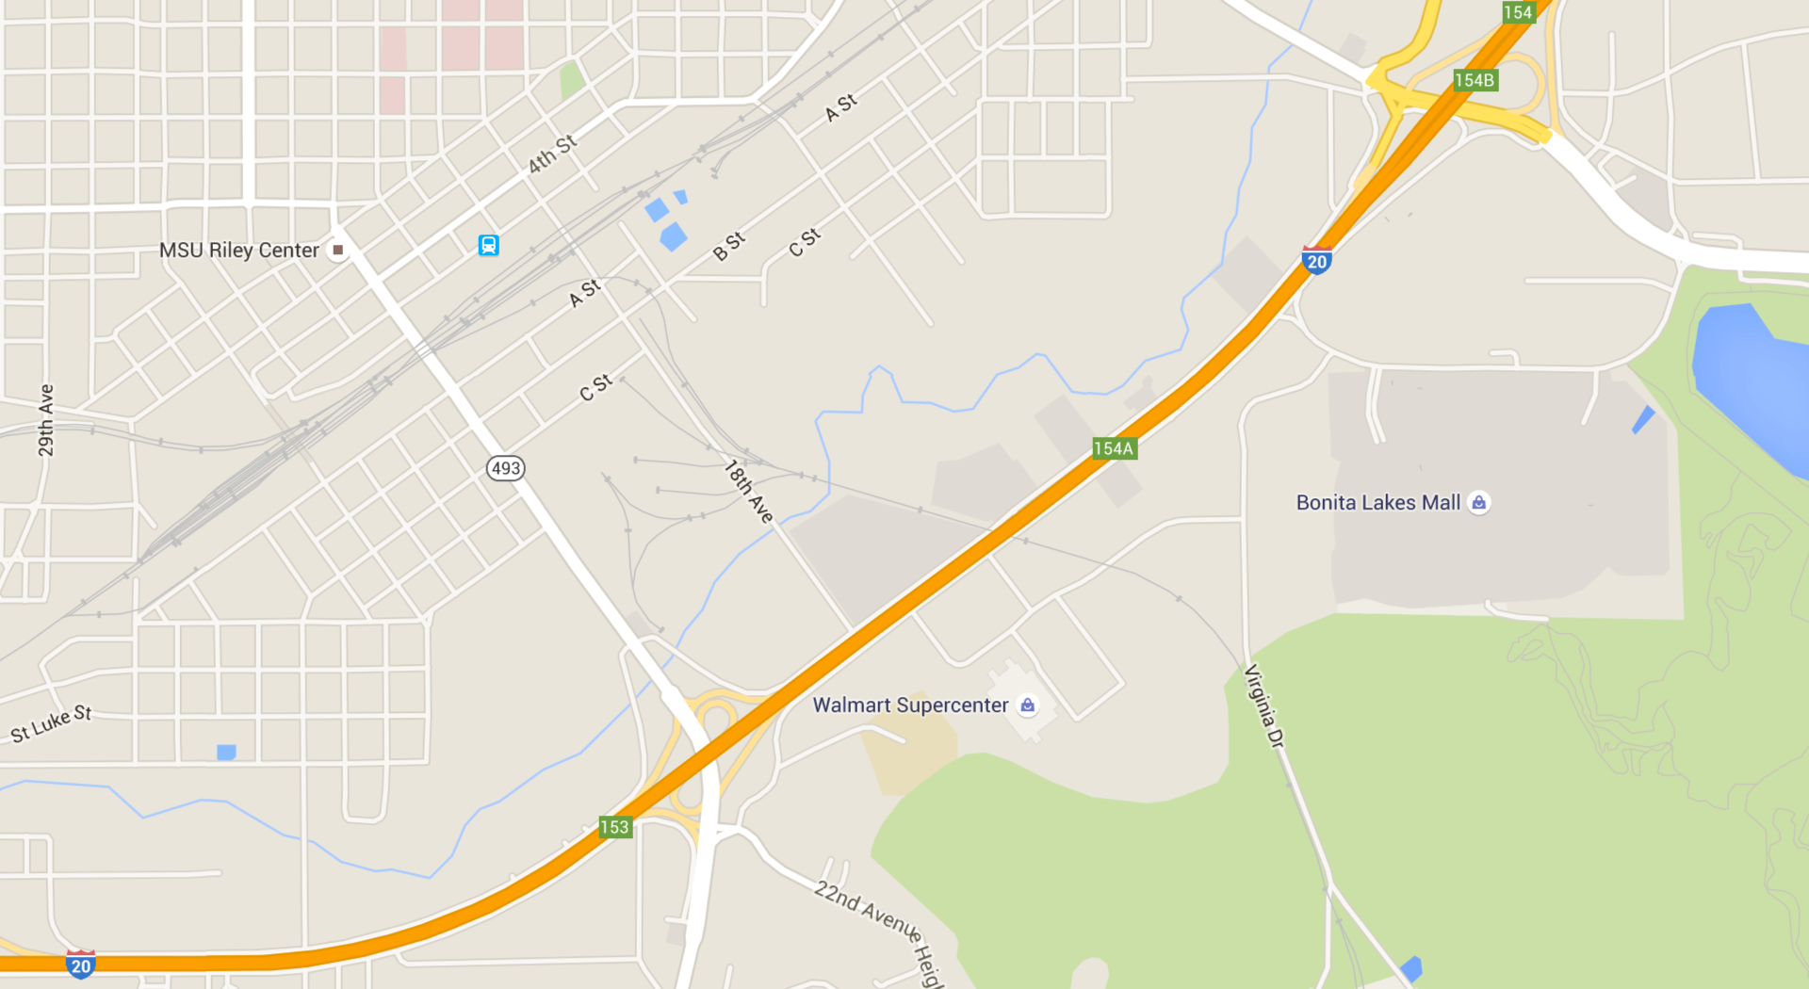

De-incentivize urban sprawl

Slide 33
Can the Center Hold?
Image courtesy of veryshareimg.com
Grappling with the decline of a small-city downtown in Meridian, Mississippi

