Slide 1
Economics of Preservation
Trends, Tools, and Challenges
Dave Traggorth
www.traggorthcompanies.com
April 1, 2016

Slide 2
Traggorth Companies
Historic portfolio

Slide 3
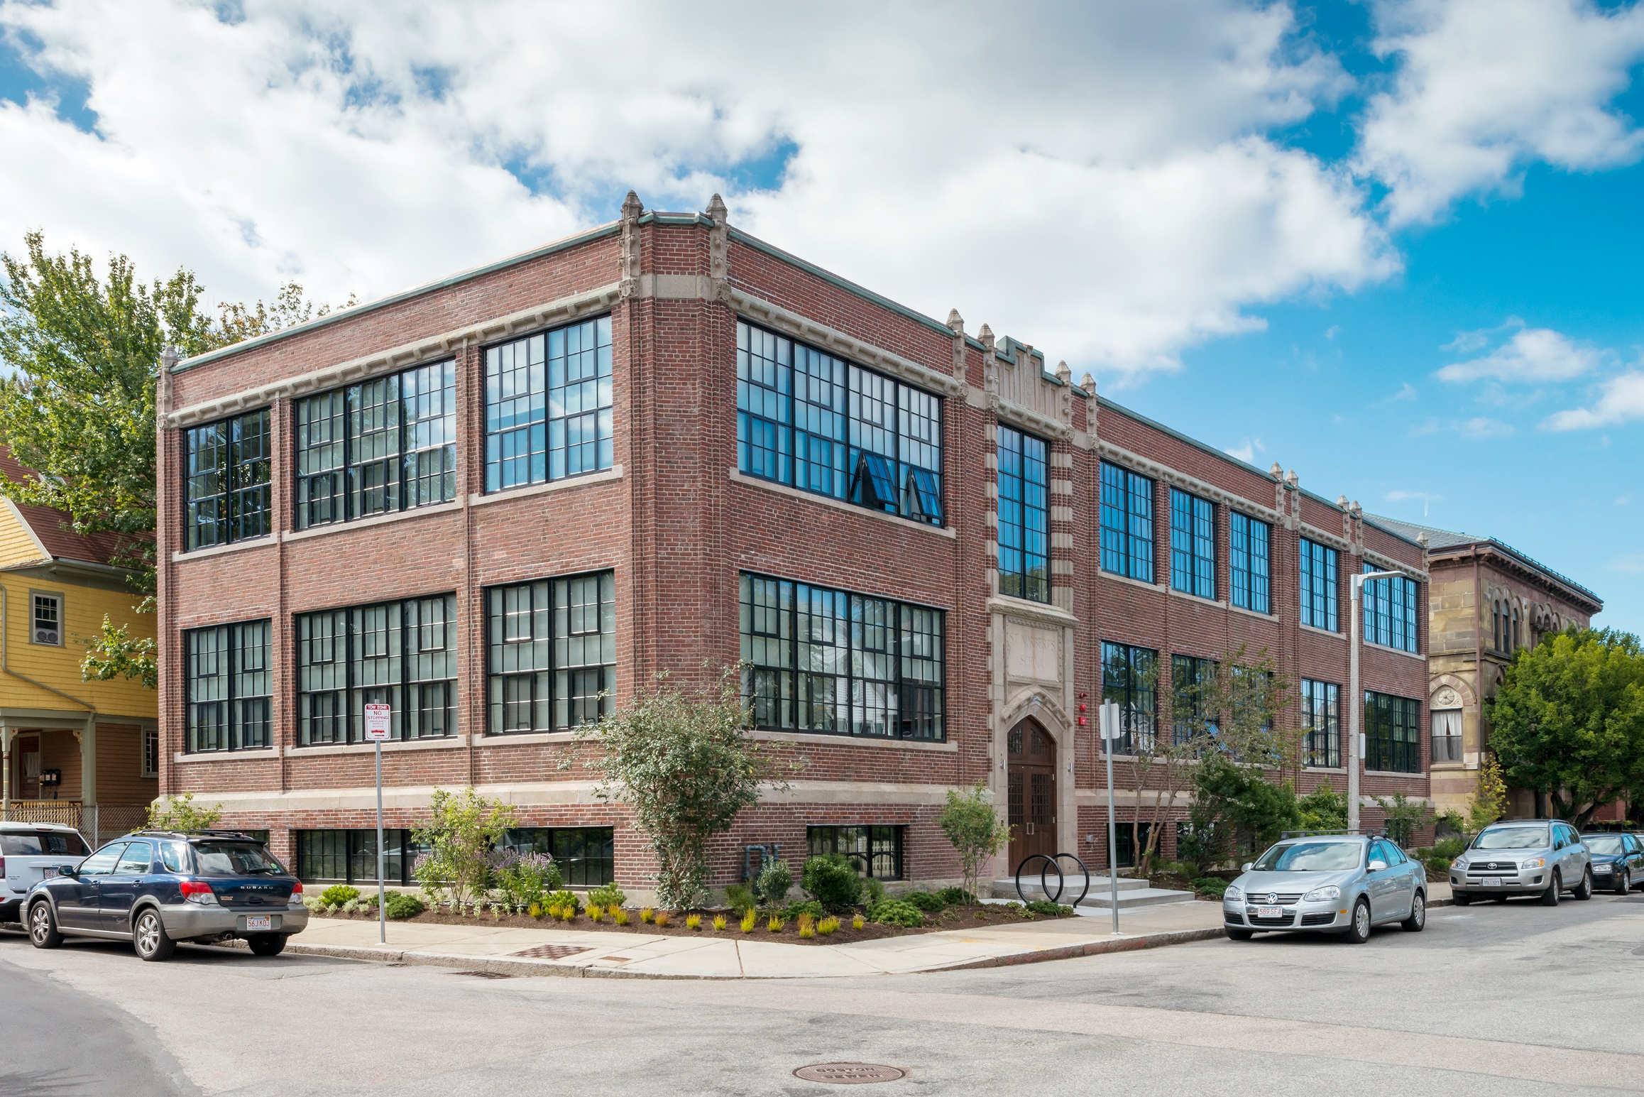

Slide 4
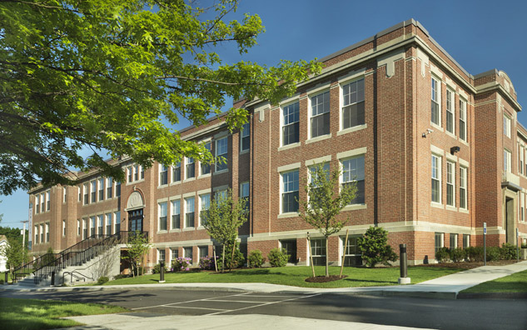

Slide 5
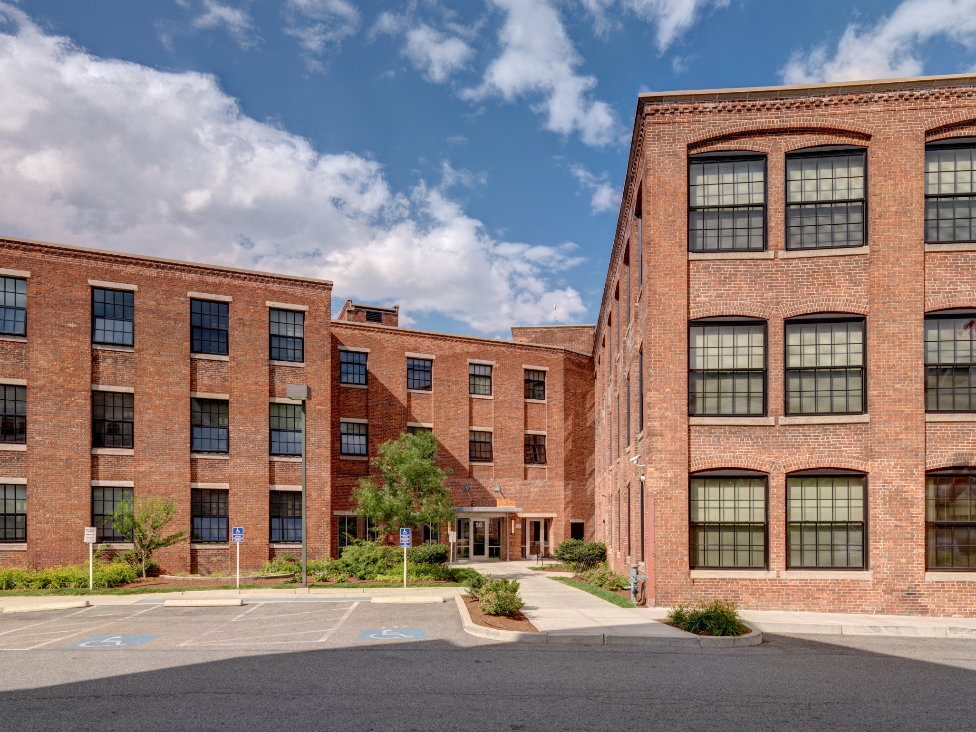

Slide 6
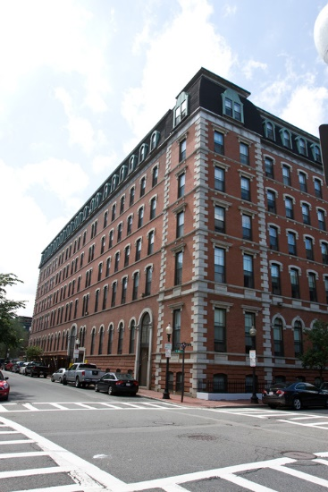


Slide 8
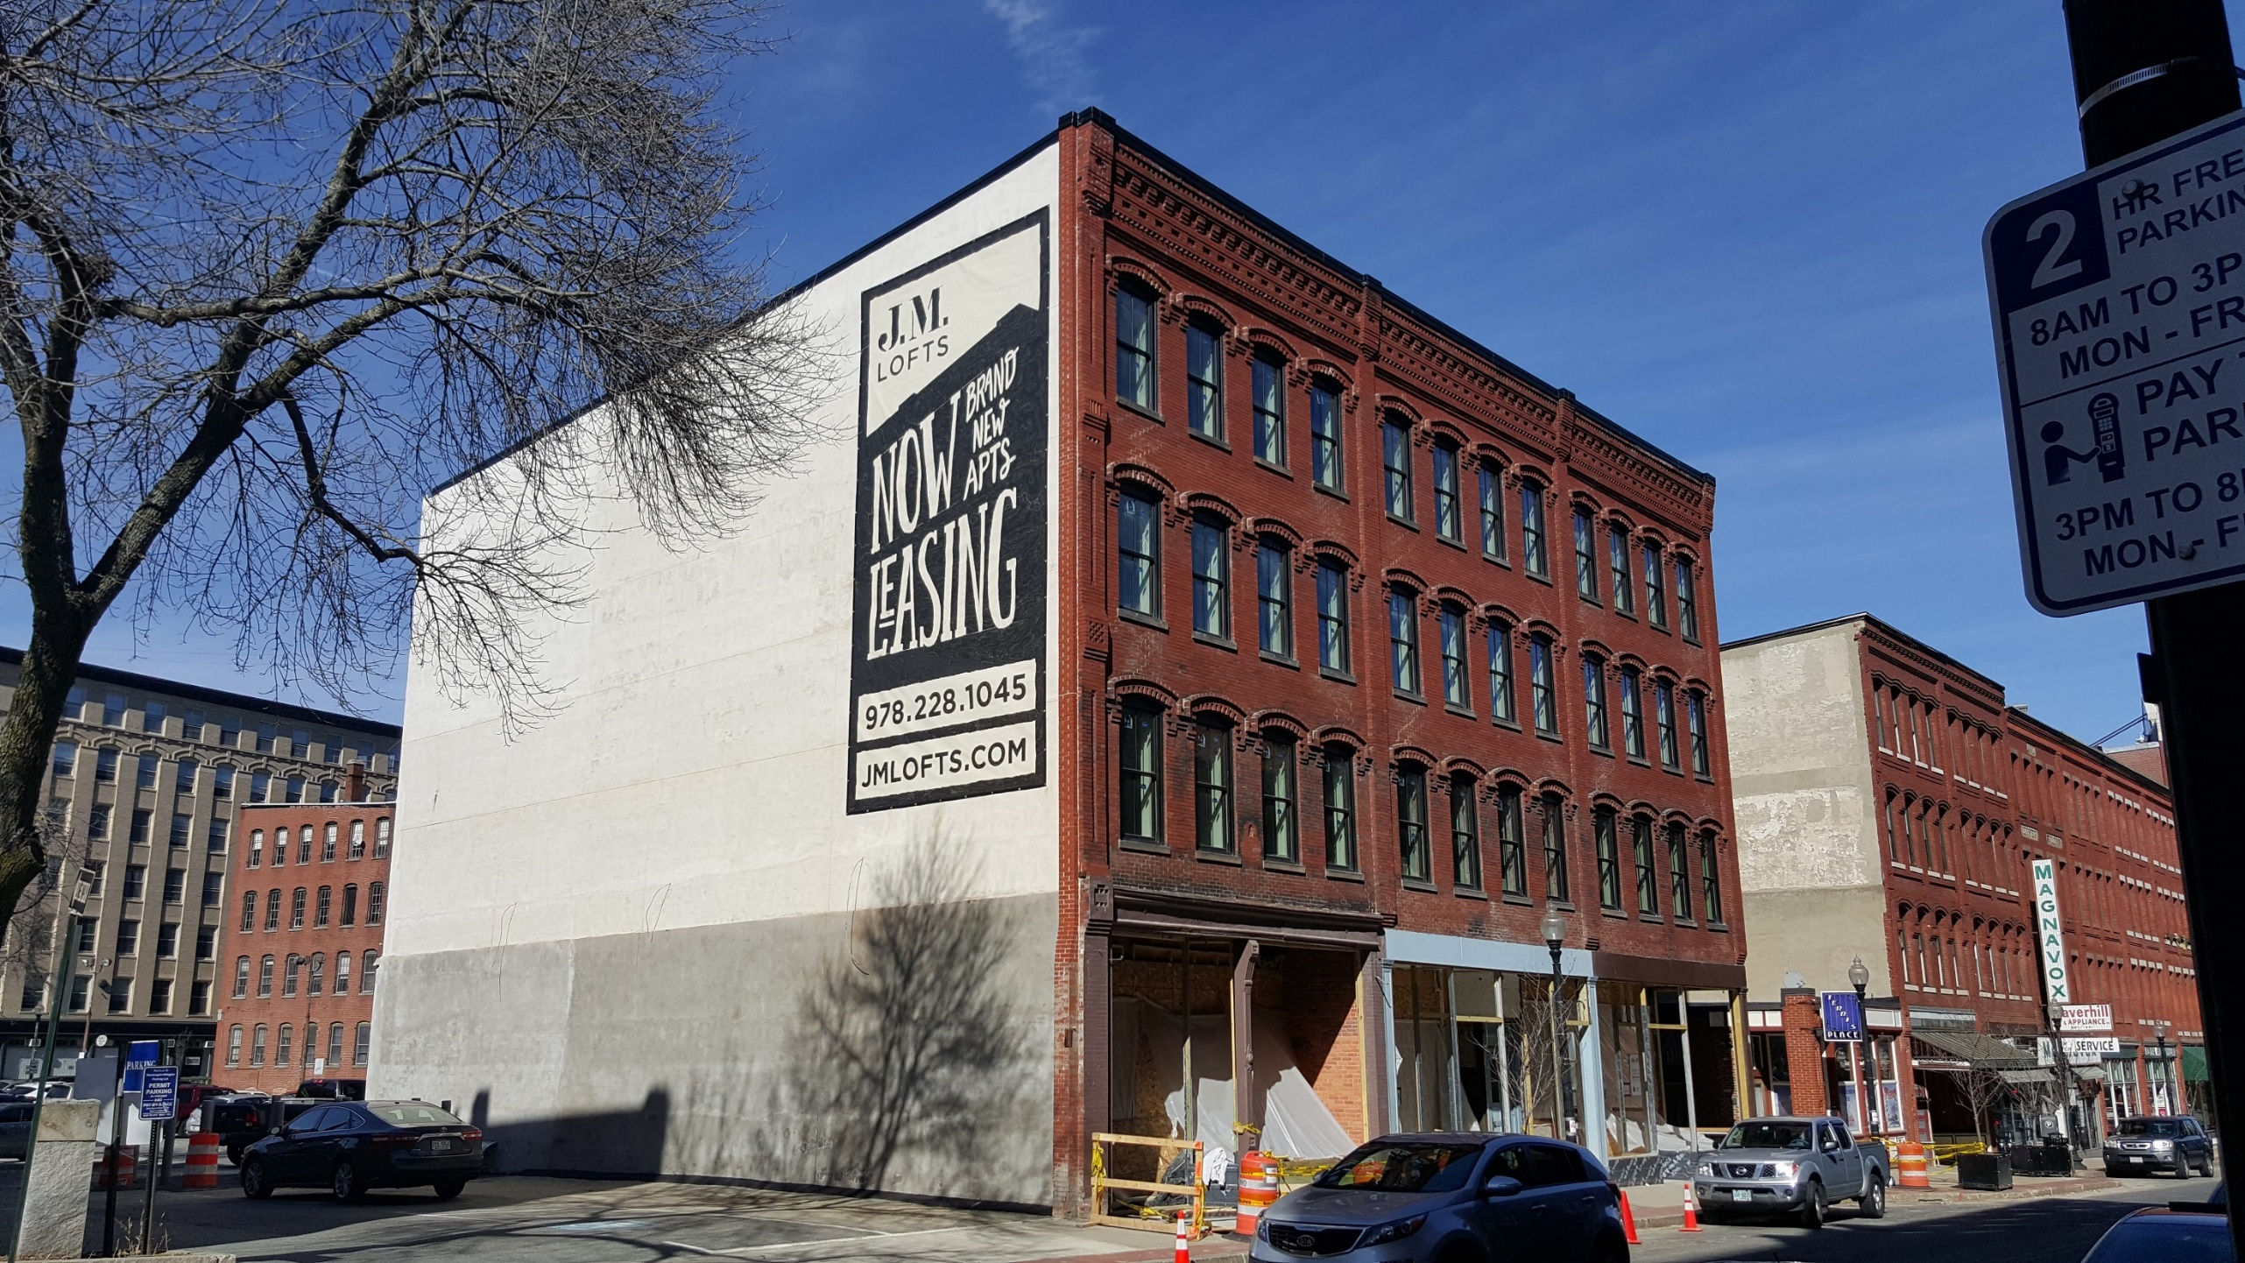

Slide 9
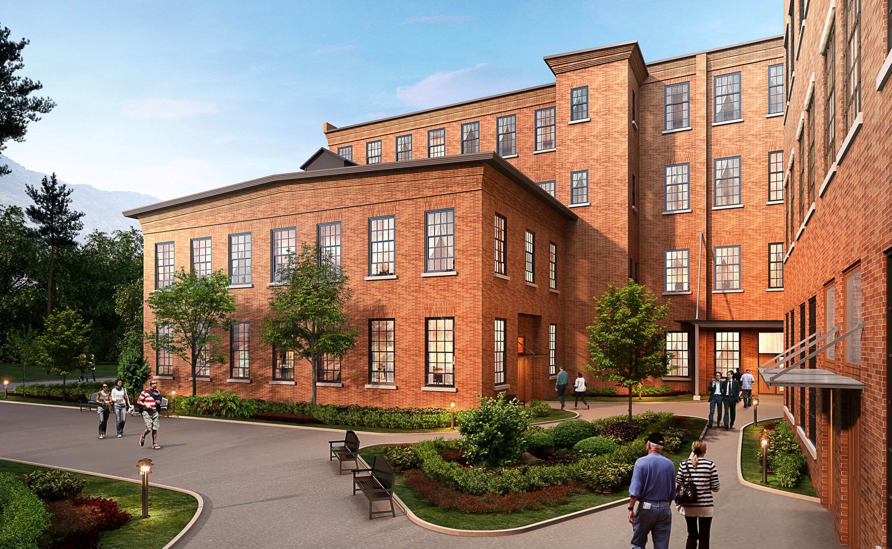

Slide 10


Slide 11
Macro Real Estate Trends
General real estate market opportunities and challenges

Slide 12
Prices are high, interest rates are low, influx of foreign capital investing in commercial real estate and buying single families
Construction prices are at an all-time high
  2010 buy out for wood frame $160/SF
  2013 buy out for steel frame $330/SF
  2015 buy out for wood frame $200/SF
Federal level support of affordable housing is low, State/City working to pick up the slack
Changes in type of housing stock, tenure, location
Major challenges: land & costs

Slide 13
Economics of Preservation
Financing, building, and marketing historic properties

Slide 14
Universal market appeal of historic buildings
  Aesthetic, Density, Location, Quality
Preservation doesn’t save on construction costs, increases soft costs
Each building and location is unique
  Core vs non core markets --- mandate and incentives
Mandates
  Demo delay, historic review, etc.
Incentives
  Tax credits (HTC, NMTC, LIHTC, Brownfields), CPA

Slide 15
Challenges to the Economics of Preservation
  Design/Layout
  Length of time for transactions
  Transactional costs – complexity and scale
  Conflicting policy goals: building codes, green, ADA, affordable housing
  Amount of resources
Final Thoughts

