Slide 1
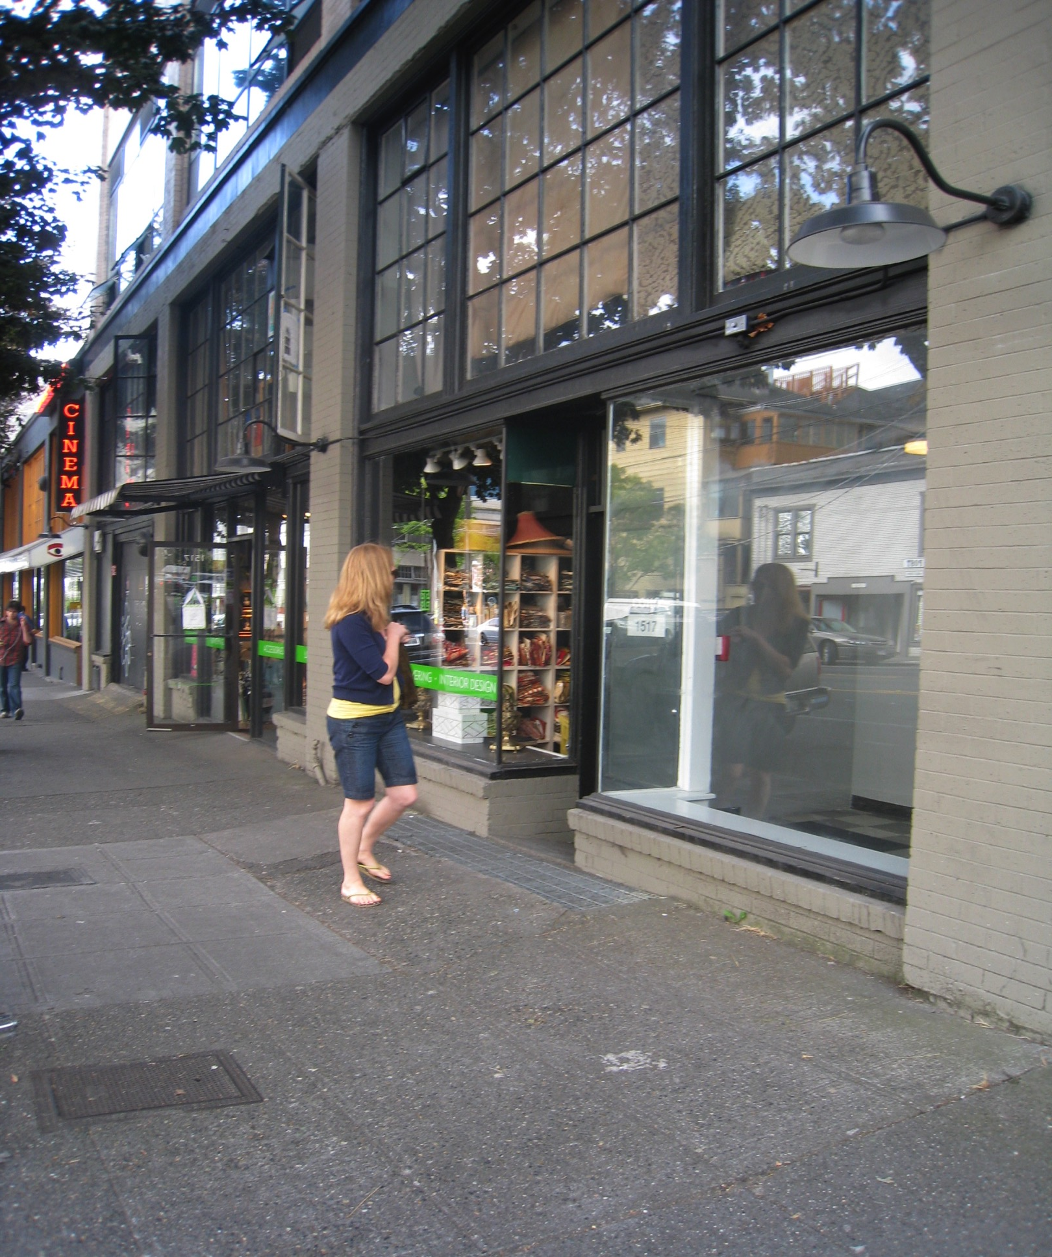
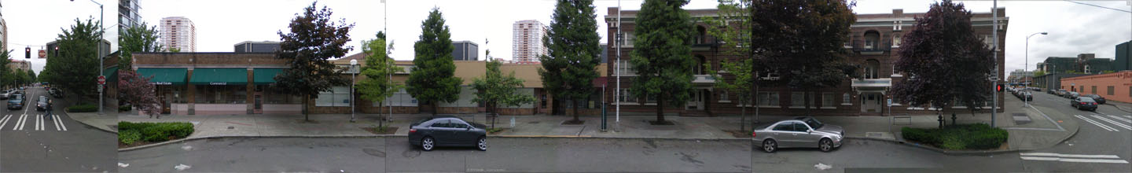
Tactical Urbanism
Beyond the categorical distinctions of urban preservation, design and sustainability
Kathryn Rogers Merlino
Associate Professor of Architecture
University of Washington
Seattle, Washington
Notes:
Introduction
Current trends of urbanization across the country are focusing on increased density in our cities. While the idea of living at higher densities can combat sprawl and be effective in other ways, this paper investigates how new increased construction for density affects existing, older neighborhoods in the United States, and looks specifically at Seattle, Washington neighborhoods for investigation. Many new buildings built for high density lack a sense of historic character and uniqueness of place, and cover entire blocks that don’t lend themselves to a quality pedestrian experience. Most of all, they demolish and replace the historic and character buildings that have a scale and texture that older buildings typically contribute to the street and neighborhood. to the city street. Density must be combined with livability if we are to make quality cities that make successful places for people.

Slide 2
Jane
Jacobs
Cities need old buildings so badly it’s probably impossible for vigorous streets and districts to grow without them.
Old ideas use new buildings;
New ideas use old buildings.
Notes:
Preservationists know instinctively that older buildings play a crucial role in contributing to the livability of cities and local economies.
Long accepted the book The Death and Life of Great American Cities in which mass-scale demolition and replacement of older buildings with large new structures drains the life and vitality from urban neighborhoods.
50 years after the book’s publication, preservationists and still fighting to conserve older neighborhoods, hampered by outdated zoning regulations, overly prescriptive building and energy codes, misdirected development incentives and limited financial tools

Slide 3
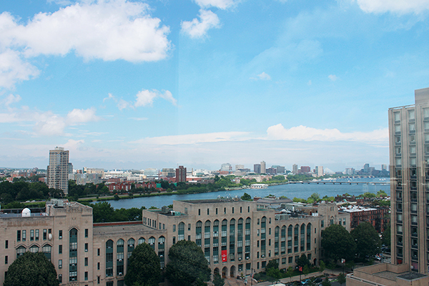
Buildings have inherent environmental value.
Notes:
As we know, preservationists need new tactics and tools in our arsenale We need to look at buildings diffferenty in an age of resource conservatoin.
I am a preservationist, but I also am an environmentalist. I come from a city where we built the greenest, net zero, new building, The Bullit Center. And a AND A PLACE WHERE NEW CONSTRTUCTION THAT’S BUILT LEED PLATINUM OR NET ZERO IS COMMON.
EXISTING BUILDINGS ARE DISAPPERAING AT AN ALARMING RATE IN OUR CITY AND ABROAD. However, I still argue that reusing excising buildings will always be greener. I’m not talking ‘historic’ with the capital “H” but yes, some of those, others banal, utilitarian or vernacular, some new and sleek. I would argue that the aggregate of a neighborhood is what makes it vibrant, and I will show you how we tried to prove this is the case.

Slide 4
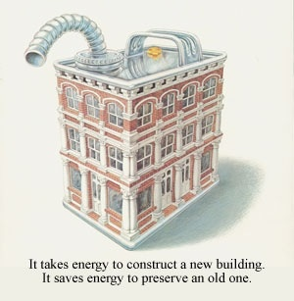
“We cant build our way out of climate change”
  -The Sustainability Initiative, National Trust for Historic Preservation
Notes:
Currently in Seattle, known as one of America’s “greenest cities, “ a one mile long train with 100 cars loaded with waste, travels six times a week to a massive landfill in Arlington, Oregon, near the Columbia River,— 25 of these filled with demolition waste from buildings.7 With current estimates, this means that 7800 train cars a year filled construction debris are sent to a massive landfill, with a bill to the City of Seattle that extends to 225 million dollars for construction debris alone.
Preservation of the vernacular; Since 1973, Seattle has designated more than 350 individual sites, buildings, vehicles, vessels, and street clocks as landmarks subject to protection by city ordinance. On average, this is about ten nominations per year that are protected under city ordinances.

Slide 5
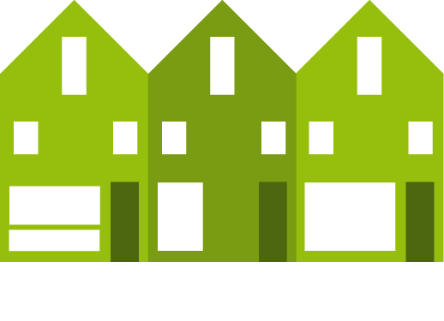
A 2004 report from the Brookings Institution projects that by 2030, we will have demolished and replaced 82 billion square feet of our current building stock.
Notes:
Why does this matter environmentally? We are much too inclined to think of our buildings as disposable rather than a renewable resource.
A recent study by the Brookings Institution reported if the United States continues with national trends of teardowns, by 2030 we will have demolished and rebuilt nearly one-third of our entire building stock – a staggering total of 82 billion square feet. The energy required to do so would power the entire state of California – 37 million people – for a decade. In addition, demolishing buildings rather than restoring them has profound impacts on our landfills. On a national scale, the total building-related annual construction and demolition waste is estimated to be 135.5 million tons, an estimated total of 30% of all landfill volume. The average building demolition yields 155 pounds of waste per square foot (Monroe, 2008) and the average new construction project yields 3.9 pounds of waste per square foot of building area. By reusing our historic buildings rather than replacing them, less debris ends up in our landfills and our environment is healthier.

Slide 6
Since it is estimated that there are about 300 billion square feet of space in the United States today, that means we anticipate
demolishing nearly 1/3 of our building stock in the next 20-25 years.
Notes:
Since it is estimated that there are about 300 billion square feet of space in the United States today, that means we anticipate demolishing nearly 1/3 of our building stock in the next 20-25 years. The report also estimated that the energy it takes to demolish 82 billion square feet of space would power the entire state of California – and 36 million people – for a decade. All types of buildings are susceptible to this continuing trend. The National Trust for Historic Preservation has been publishing surveys of residential tear down communities in the United States. State by state, they have identified communities suffering from a rapid rate of residential teardowns and what is frequently called the ‘mcmansion’ phenomena of tearing down older homes to replace with newer, larger ones. Denver alone has torn down 1000 residential structures to in the past 5 years, which is an average of 200 houses lost a year, replaced with larger – and not necessarily greener – homes.

Slide 7
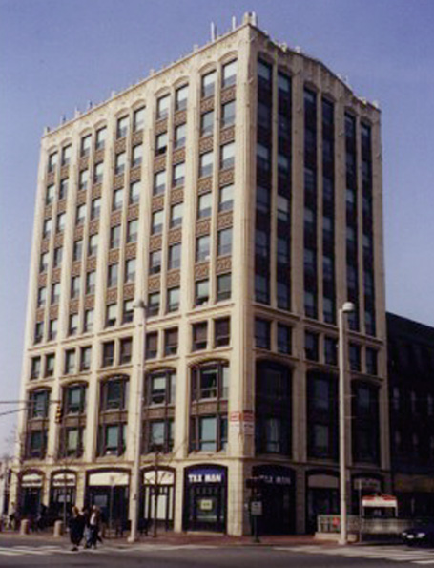
If one person threw away
46 aluminum cans a day
365 days a week
for 80 years
to create the same volume of landfill one average ten story commercial building measuring approximately 25 feet by 100.
The average embodied energy in existing buildings is five to 15 gallons of gasoline per square foot. The average embodied energy in a 250,000 square-foot office building is 3.75 million gallons of gasoline.
.
Recent calculations indicate that it takes 35-50 years for an energy efficient new building to save the amount of energy lost in demolishing an existing building
Notes:
Recycling efforts are big in this country.
I don't know about Boston, but we get charged a fee if we put any compostable material in our garbage cans.
We recycle everything.
Recycle receptacles are everywhere.
But why not buildings

Slide 8
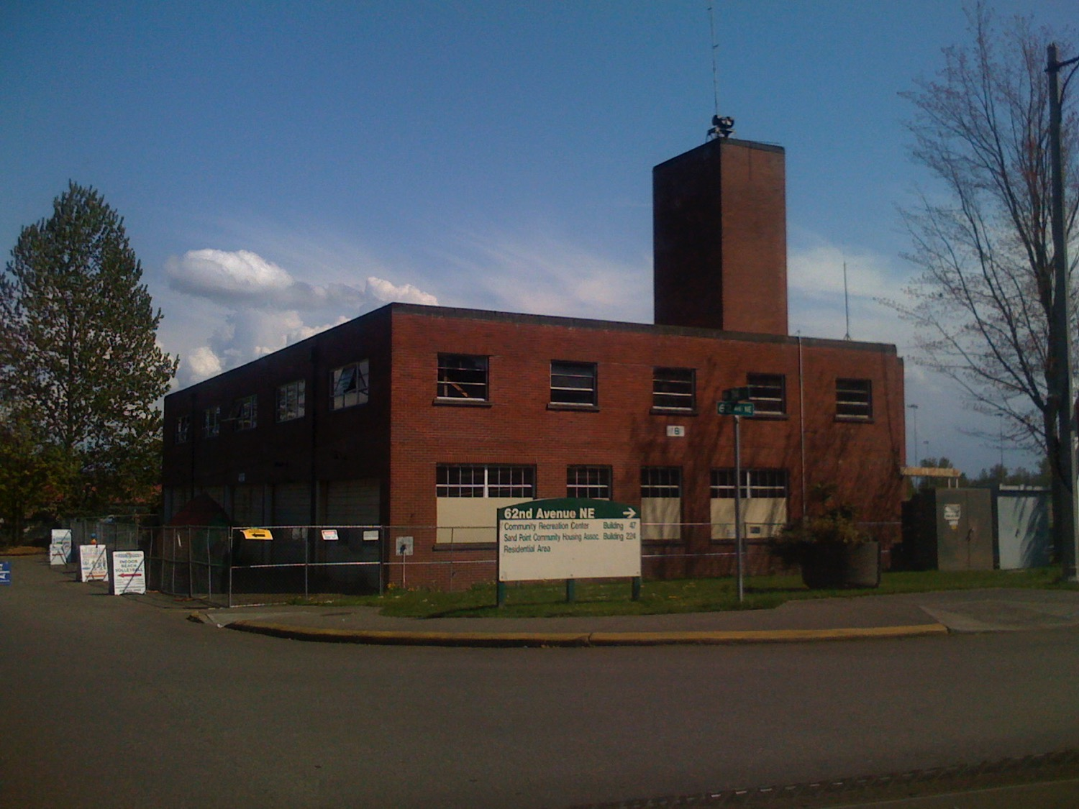
= the recycling efforts of 1,972,830 aluminum cans
=carbon sequestered by either 427 tree seedlings
for a decade or 3.8 acres of pine forest annually
= YOU landfilling 4.6 pounds of trash per day for 1,444 years
=1212 tons of construction and demolition (c&d)waste in a landfill
= the gasoline consumed driving a (fuel efficient)
car every day, 365 days a year, for over 200 years
Notes:
This past week, the City of Seattle and Seattle Parks and Recreation submitted a SEPA Checklist and Determination of Non-Significance in order to prepare all the paperwork to demolish Building 18, the Fire Station Building, at Magnuson Park. In a case to save this building, I'm going to start with an argument that doesn't attempt to prove it's historic significance. I'm going to start with the environment. The U.S. EPA reports that "In 2006, US residents, businesses, and institutions produced more than 251 million tons of municipal solid waste, which is approximately 4.6 pounds of waste per person per day." If Building 18 is demolished - a solid brick and steel building of approximately 14,013 square feet - 1212 tons of construction and demolition (c&d) would be put into a landfill. That's as much waste as it would be for a single person putting his or her 4.6 pounds per day into a landfill for 1,444 years! Even if part of the building was recycled, the energy expended to demolish, load, haul and recycle is astounding.
http://www.epa.gov/epawaste/nonhaz/municipal/index.htm, (accessed July 14, 2009).
Every building is a storehouse of non-recoverable energy and can be considered by its "embodied energy". This is the energy that has been spent in its construction, manufacture and transportation of materials. When a building is torn down, more is lost than the built resource (and its associated heritage)— embodied energy is lost, and more energy is expended for the demolition, loading and hauling of the debris. The amount of gasoline this represents in a singular building can be helpful to understand the impact - for Building 18 alone the embodied energy is the equivalent of driving your (fuel efficient) car every day, 365 days a year, for over 200 years. Tear down Building 18? We have now wiped out the entire environmental benefit from the last 1,972,830 aluminum cans that were recycled. We’ve not only wasted perfectly good building, we’ve wasted months of diligent recycling by the people of Seattle. In addition, it is also equivalent to carbon sequestered by either 427 tree seedlings for a decade or 3.8 acres of pine forest annually. Aren't we a green City?
http://www.epa.gov/cleanrgy/energy-resources/calculator.html These are based on initial calculations of embodied energy from www.thegreenestbuilding.org, (accessed July 14, 2009)..

Slide 9
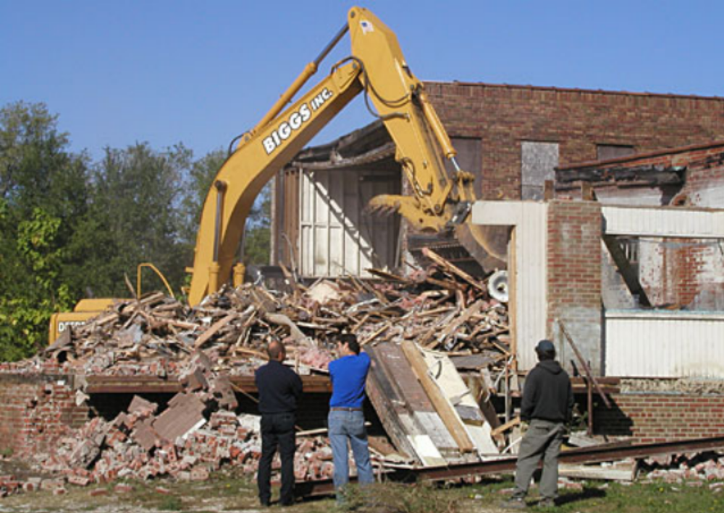
Building demolition contributes 30% or more of all landfill material.landfills
Notes:
One of the biggest issues with this unsustainable phenomenon is the enormous construction waste produced from demolition of buildings that is typically hauled off to distant landfills. In the United States, construction debris currently accounts for 25-30%% of the municipal waste stream each year.
Currently in Seattle, known as one of America’s 堵reenest cities, � a one mile long train with 100 cars loaded with waste, travels six times a week to a massive landfill in Arlington, Oregon, near the Columbia River, - 25 of these filled with demolition waste from buildings. With current estimates, this means that 7800 train cars a year filled construction debris are sent to a THIS landfill, with a bill to the City of Seattle that extends to 225 million dollars for construction debris alone.

Slide 10
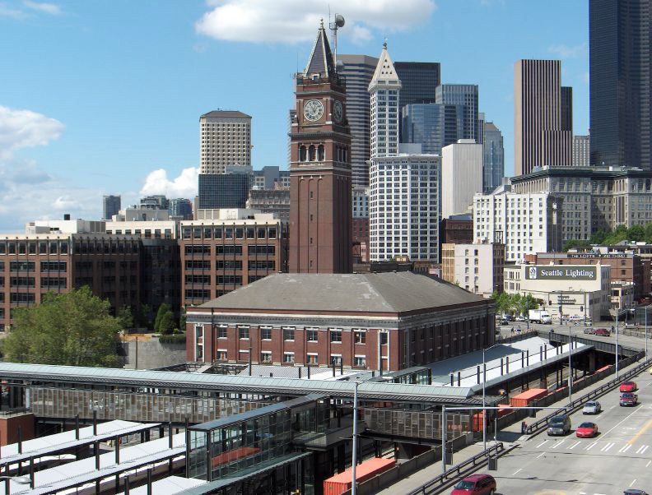
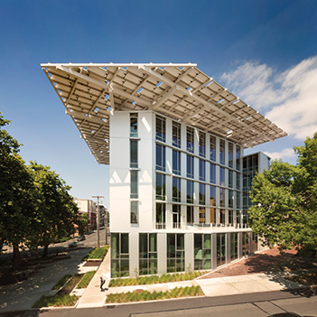
King Street Station
LEED™ platinum, 38 EUI
Bullitt Center (Living Building Challenge)
Net zero water/energy 32 EUI

Slide 11
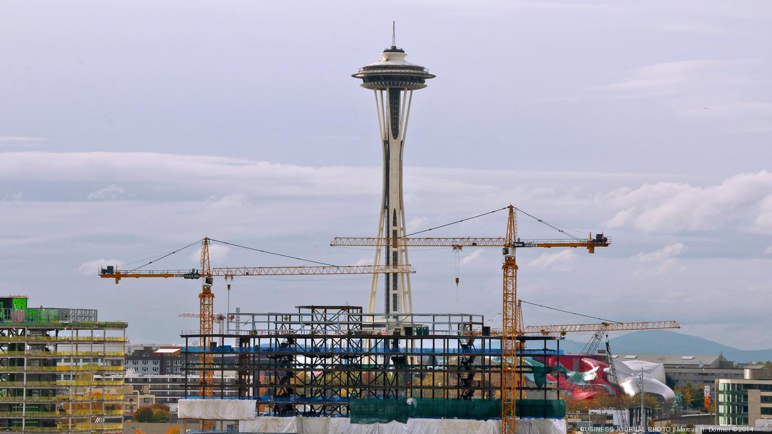
Expedia
Boeing
Microsoft
Google
Amazon
Starbucks
Adobe
Preservation Crisis: Seattle led the country in the fastest growing/ building year 2015.
Notes:
Seattle is changing
, Seattle’s skyline is populated with cranes. It is rare to walk down a block in the Capitol Hill or South Lake Union neighborhoods without passing a construction site. With every building that is demolished to make way for a new development, the urban fabric changes irrevocably—the old making way for the new. While much is being made of Seattle’s growth, what about its related casualties? What of all the torn down buildings and the aspects of Seattle’s culture they may have represented? Is all the new development changing Seattle’s culture, and if so, how?

Slide 12
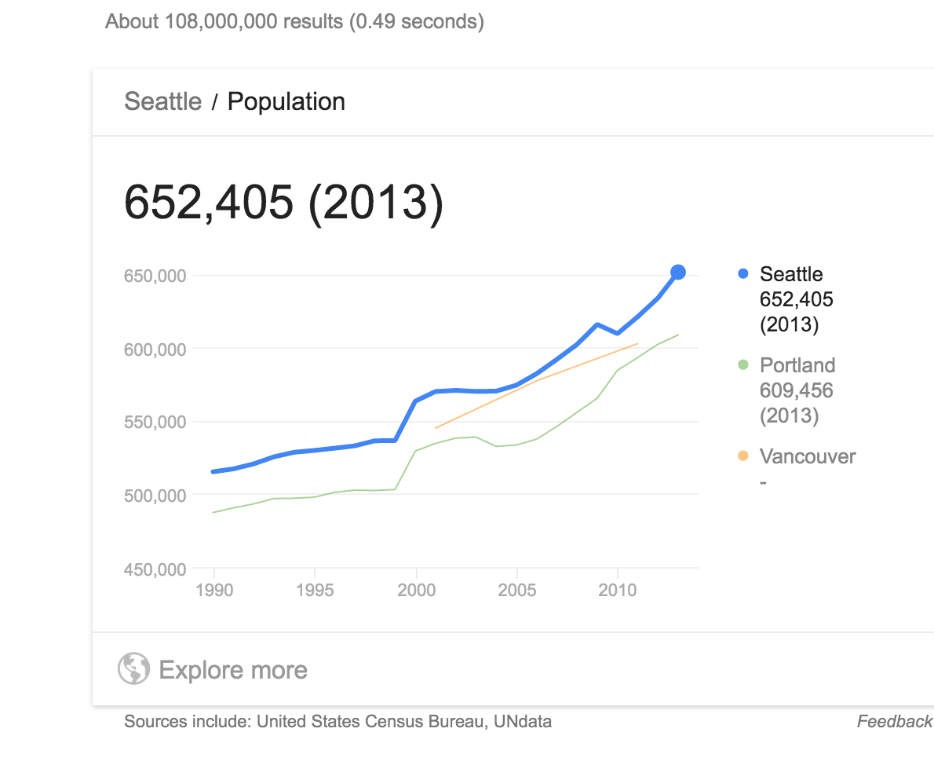
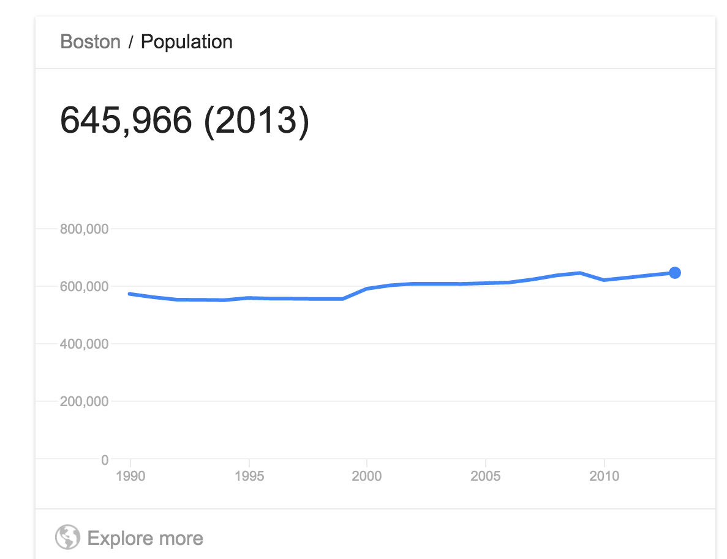

Slide 13
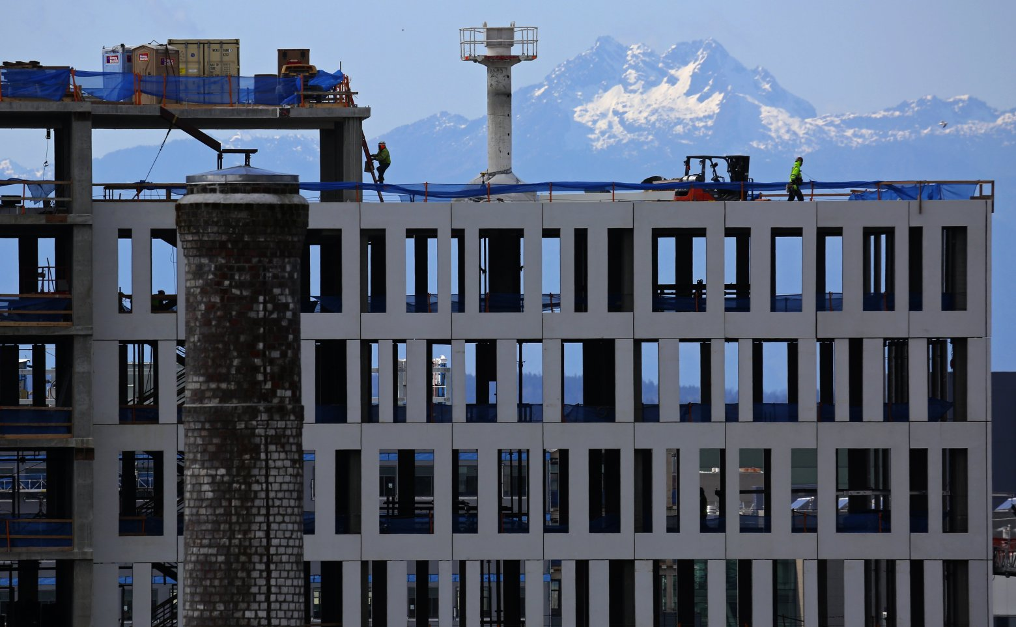
The Brothers Olympic Mountains peak serves as a backdrop to 400 Fairview, a mixed-use project in South Lake Union. In the foreground is a capped brick stack, a remnant of the old industrial neighborhood.
Notes:
Large scale developments in historic areas that had a district fabric and scale, and we are losing these quicker than is imaginable due to development pressure.

Slide 14
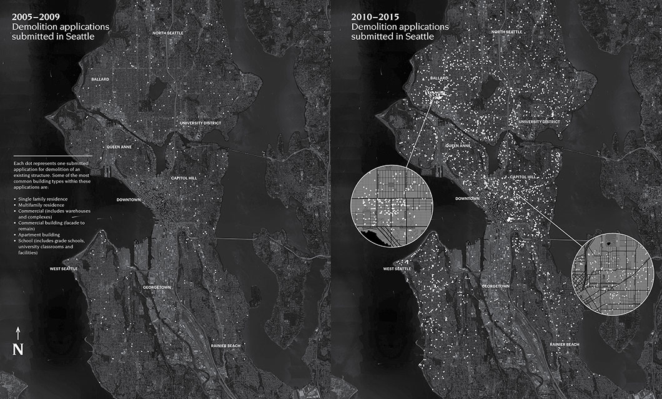
Historic building being demolished
Building demolition permit applications in Seattle 2005-2009 (left) 2010-2015 (right)
Notes:
Each dot represents one submitted application for demolition of an existing structure. Some of the most common building types within these applications are:
Single family residence, multifamily residence, commercial (includes warehouses and complexes), commercial building (facade to remain), apartment building
and school (includes grade schools, university classrooms and facilities).
The map represents a version of Seattle now destined to become history. But it also indicates potential. Whatever fills these voids will shape the Seattle of tomorrow.

Slide 15
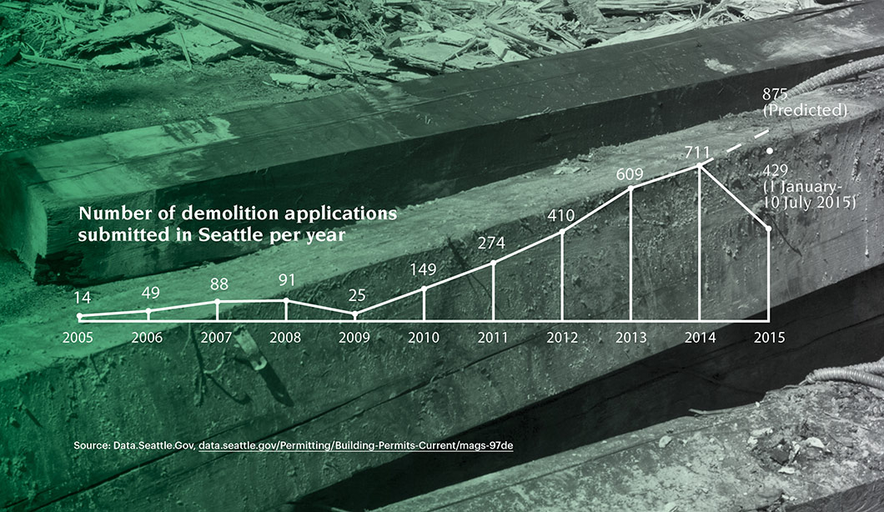

Slide 16
What is the future of preservation
in the face of a building boom and increased density?
Notes:
What’s the result?

Slide 17
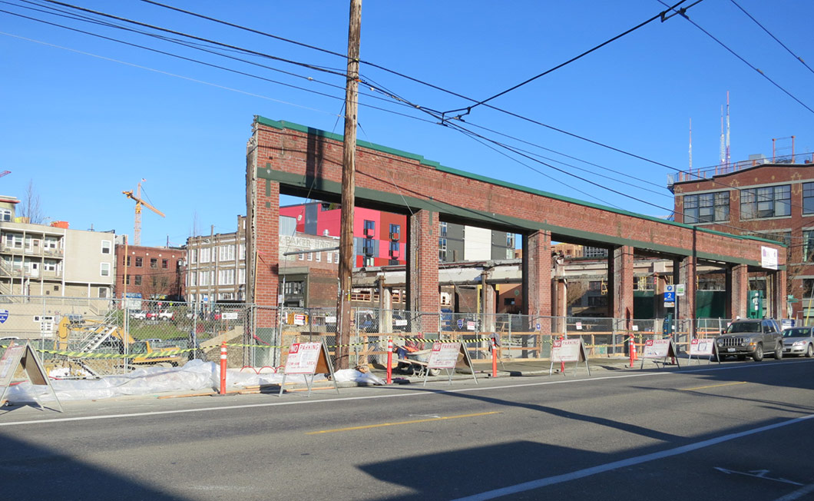
Facadism isn’t preservation.
Notes:
Façadism doesn’t happen by accident. In some cases, it is actively encouraged. In the Pike-Pine Conservation Overlay District, for example, saving pre-1940 “character” façades was written into the rules. If an old building’s exterior is deemed to have architectural and contextual character, a developer can get additional height for a new structure in exchange for saving the façade. In other words, extra density and square-footage is dangled as an incentive to save an original exterior.

Slide 18
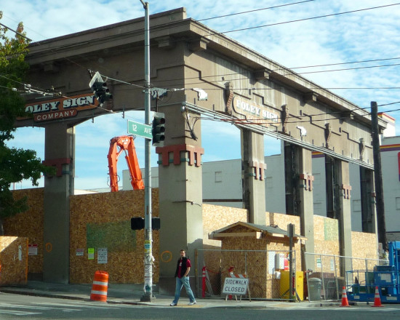
Notes:
Façadism doesn’t happen by accident. In some cases, it is actively encouraged. In the Pike-Pine Conservation Overlay District, for example, saving pre-1940 “character” façades was written into the rules. If an old building’s exterior is deemed to have architectural and contextual character, a developer can get additional height for a new structure in exchange for saving the façade. In other words, extra density and square-footage is dangled as an incentive to save an original exterior.

Slide 19
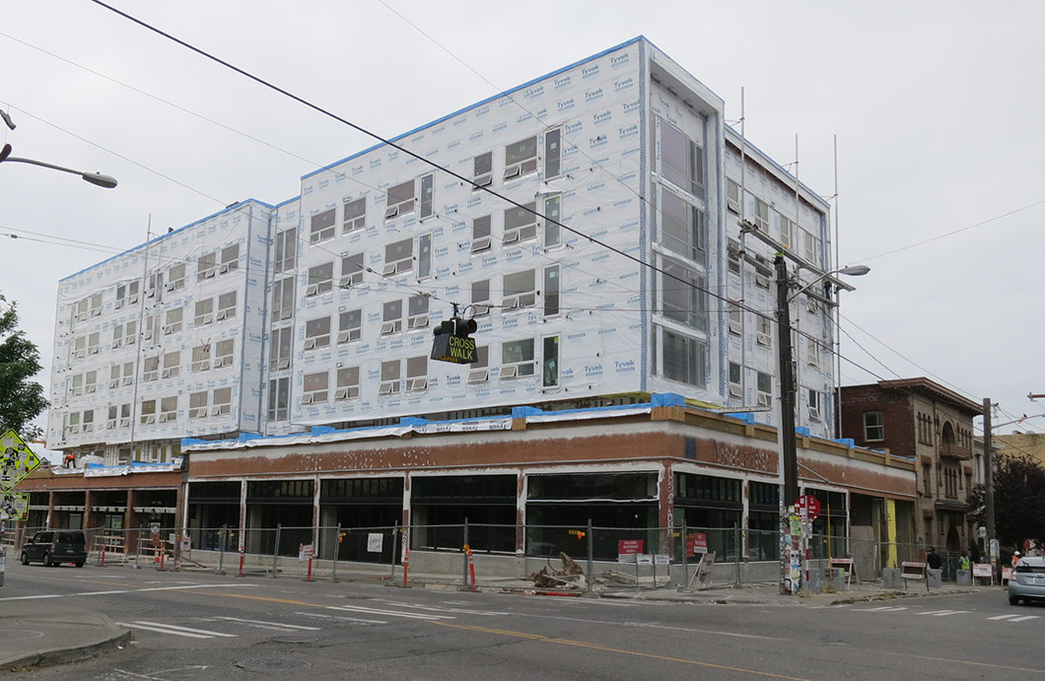
Notes:
Pike Pine area – Character structure” means a structure on a lot within the
boundaries of the Pike/Pine Conservation Overlay District that has been in existence for at least 75 years, thereby contributing to the established scale, development pattern, and architectural character of the area.

Slide 20
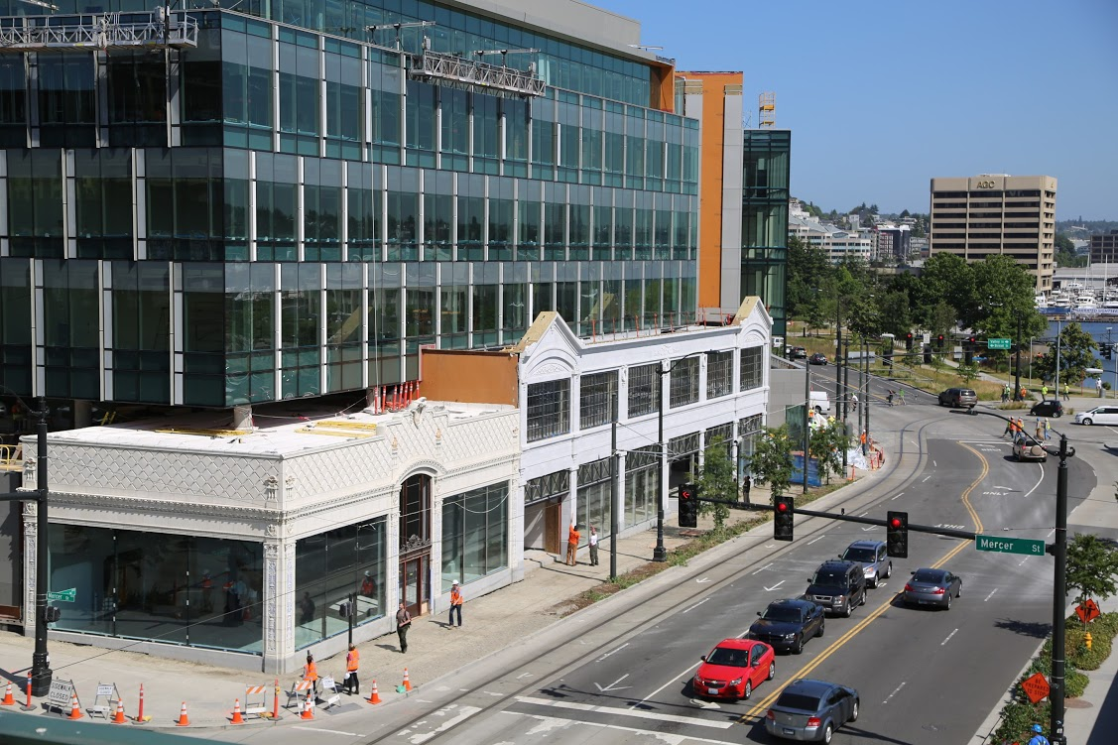
The new Paul Allen center for research

Slide 21
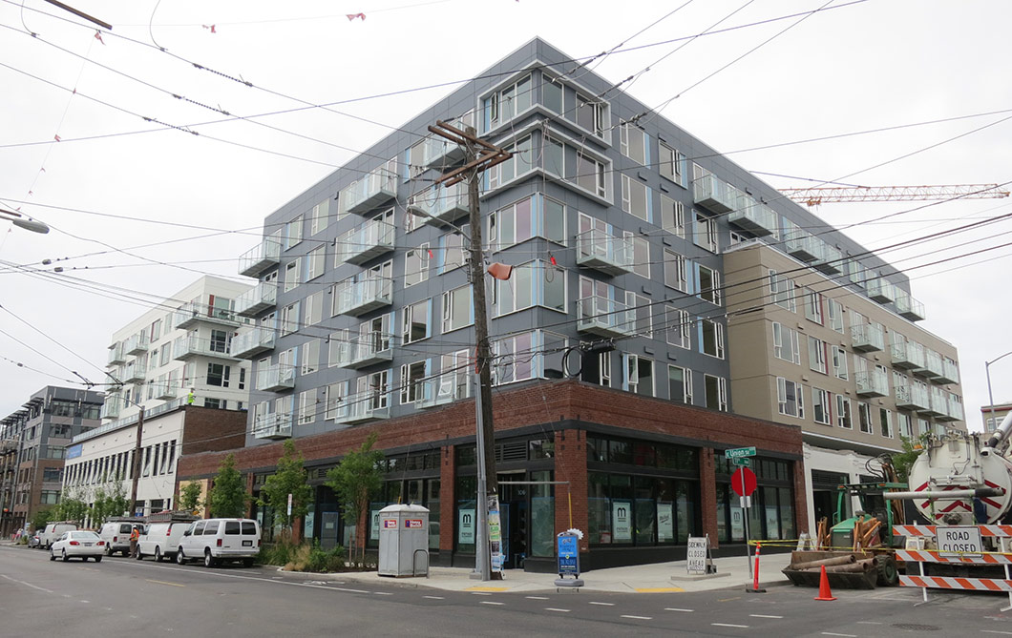

Slide 22
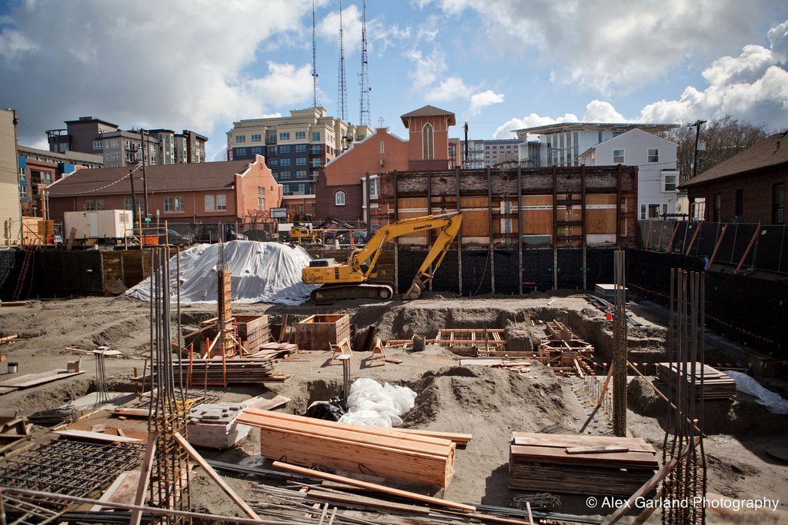

Slide 23
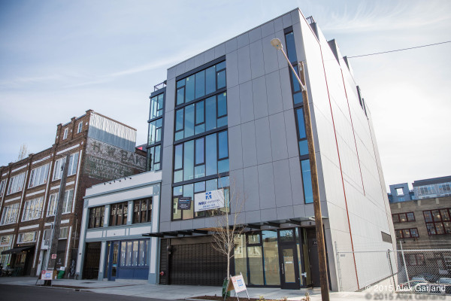
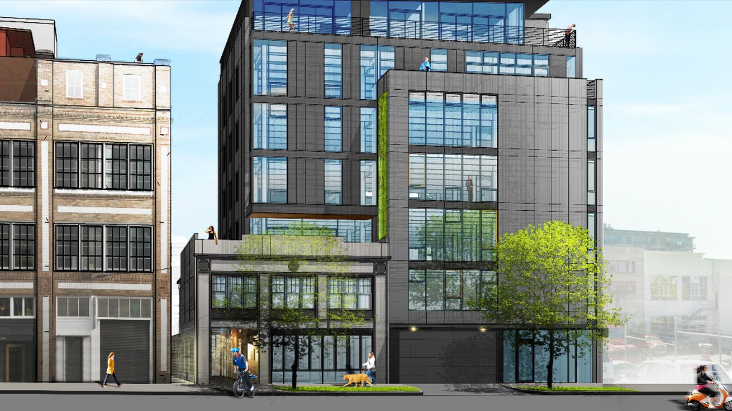
chophouse
Chophouse Row, Seattle
Notes:
Chophouse row

Slide 24
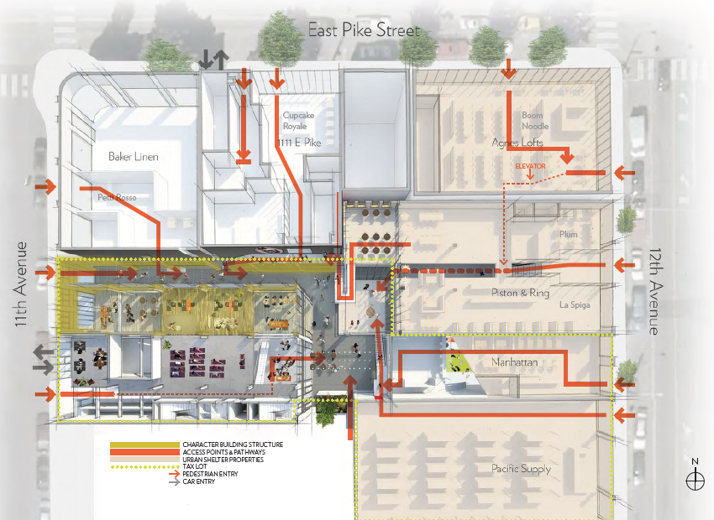
Notes:
Chophouse Row: Smallness, weaving buildings together, some additions

Slide 25
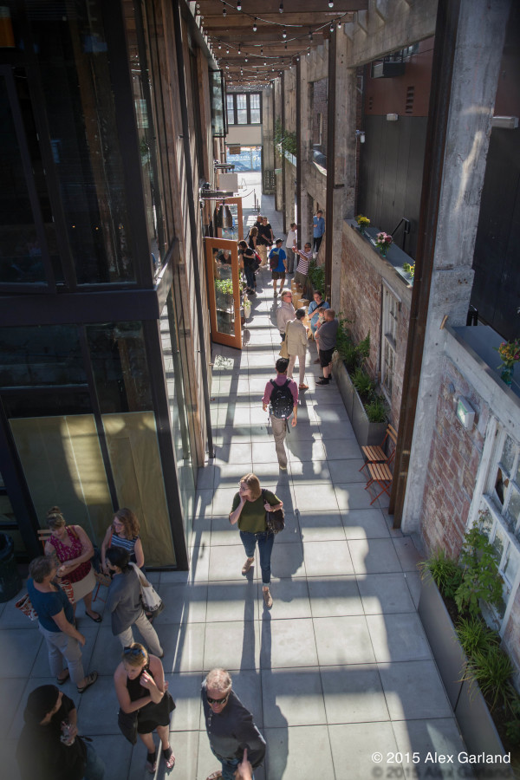
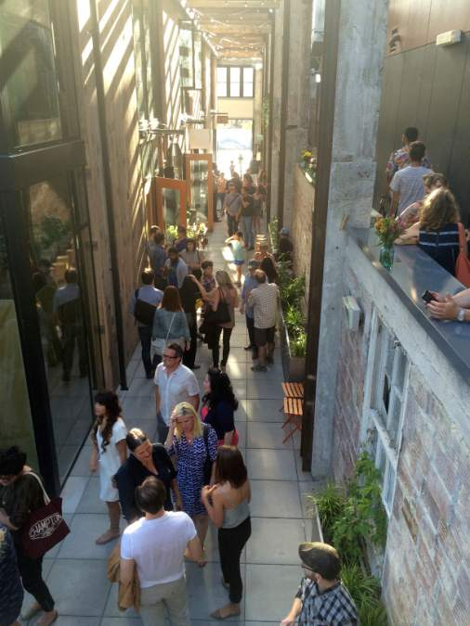
chophouse
Notes:
This may be the best form of preservation facing development; small scale new insertions, new and old coexisting, with incentives for keeping entire historic structures.

Slide 26
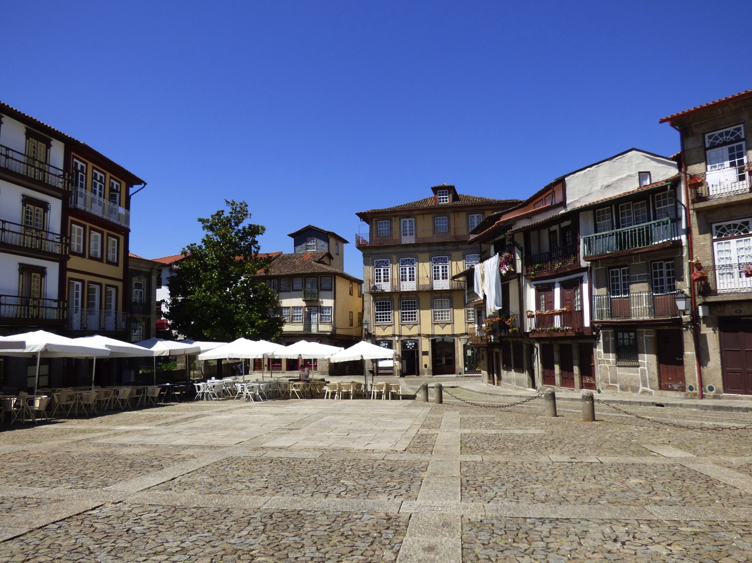
URBAN GRAIN defines neighborhood vibrancy by ‘smallness’ and human scale.
It can be understood by human behavior of walking, leaning, sitting, resting, playing and other activities tat create human interaction with their environment.
Notes:
The tools for implementing these ideas are not fully developed in many cities, however. Outdated zoning regulations, overly prescriptive building and energy codes, misdirected development incentives, and limited financing tools continue to make it difficult to reuse older structures and to retain the human scale of older blocks and neighborhoods. In addition, and perhaps more significantly, some leading urban thinkers have recently raised fundamental questions about the validity of Jacobs’ ideas for today’s world. Where do older, smaller buildings fit within cities trying to compete in the global economy?
Are the lessons of Jacobs’ 1961 book still valid in the 21st century? What have we learned from more than 50 years of experience? What does the growing mountain of data reveal
about the contributions of older buildings to successful urban places?

Slide 27
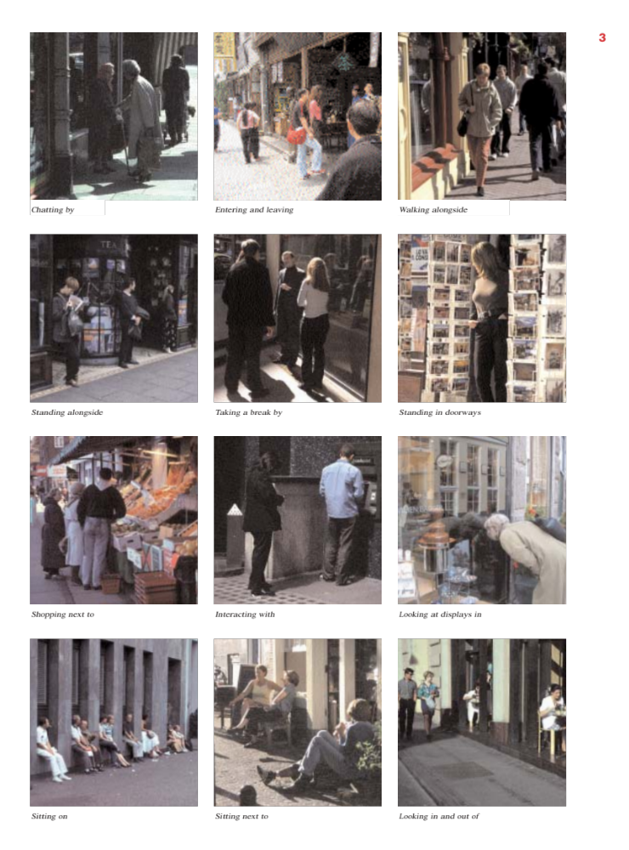
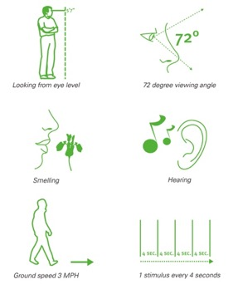
BUILDINGS + PEOPLE
Fine urban grain creates places that create visual interest; places to stop, look, stand, sit, pause, shop, talk and interact. By measuring the traffic of pedestrians and the activities of pedestrians and measuring against the building metrics, we can begin to understand why or why not blocks are vibrant and successful or passive and not successful.
Notes:
THEN WE STUDIED, OBSERVED AND RECORDED PEDESTRIAN ACTIVITY: THE PEOPLE
WE LOOKED AT places to stop, look, stand, sit, pause, shop, talk and interact. By measuring the traffic of pedestrians and the activities of pedestrians and measuring against the building metrics, we can begin to understand why or why not blocks are vibrant and successful or passive and not successful

Slide 28
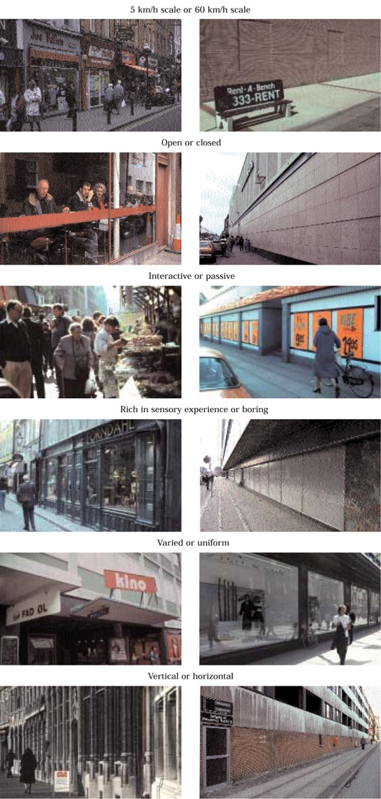
BUILDINGS + PEOPLE
By measuring the quality of the building and the block, we had metrics to understand the quality of the built environment.
Is the street experience open or closed? Interactive or passive? Interesting and varied or uniform? Is in of good durable materials or poorly constructed? Does it relate to a sense of ‘smallness’ – or human scale, or is it out of scale with the pedestrian?
Notes:
FIRST WE LOOKED AND MEASURED THE BUILDINGS AND THE AGGREGATE OF BUILDINGS IN A SINGLE BLOCK
‘Urban grain’, in this context, is observed on two scales: individual building and entire block. A set of metrics was established to measure the quality of grain within each neighborhood block. Buildings were measured on a scale of one to five according to age, number of functions at ground level, quality and maintenance of materials, variety and texture of a surface, human proportion, and the visual and physical interaction between the inside and outside. A second set of metrics measures the grain of the overall block, accounting for number of functions, continuity of the street wall, average width of a façade, and a cumulative score of the individual buildings.
By measuring the quality of the building and the block, we had metrics to understand the quality of the built environment.
Is the street experience open or closed? Interactive or passive? Interesting and varied or uniform? Is in of good durable materials or poorly constructed? Does it relate to a sense of ‘smallness’ – or human scale, or is it out of scale with the pedestrian?
Preliminary results of the study suggest idea that a finer grain building or block correlates with increased pedestrian activity and therefore neighborhood vibrancy. The use of quantitative measurements, GIS data mapping and descriptive graphics produces a dynamic and innovative research strategy that measures older and existing neighborhoods and suggests why they are valuable assets in the sustainable urban landscape.

Slide 29
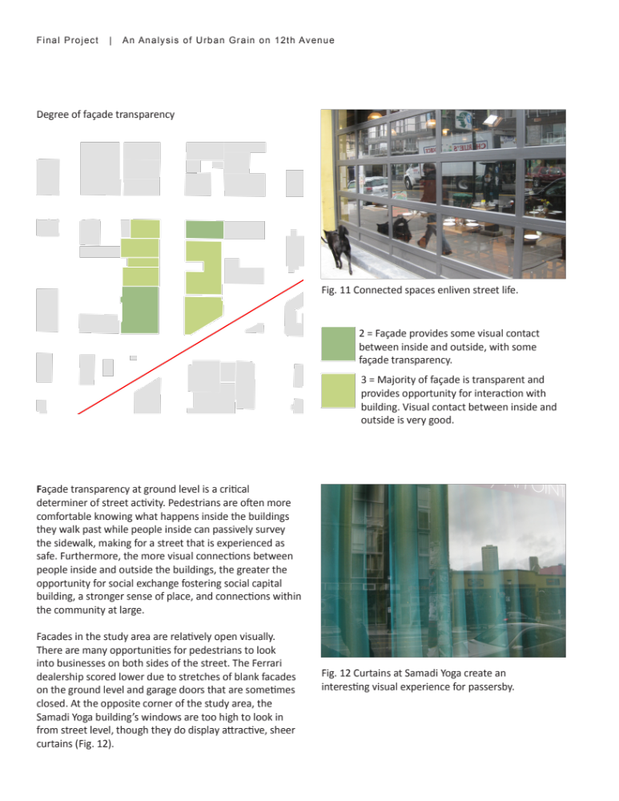
Notes:
These were some of the early tests of what we wanted to consider critical elements of the physical building and block. For examples, how much visual contact does the façade provide between inside and outside? How much transparency allows for views in and out, producing visual interest that attracts viewers, pedestrians, customers and invokes safety?

Slide 30
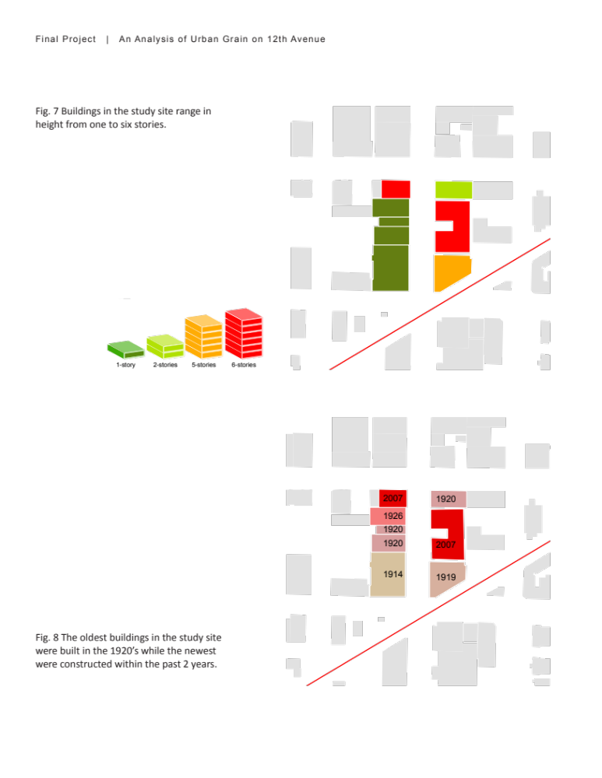
Notes:
We also considered the height of the building, which at this location varied from one to six stories. While scale of building had some affect on the scores, most evaluation scored were derived from the ground level facades at the pedestrian scale. We also mapped the age of the building into our GIS database to cross-reference how age, scale and grain are related.
When it comes down to it, we are pedestrians at the street level, and the quality of the neighborhood greatly relies on this experience.

Slide 31
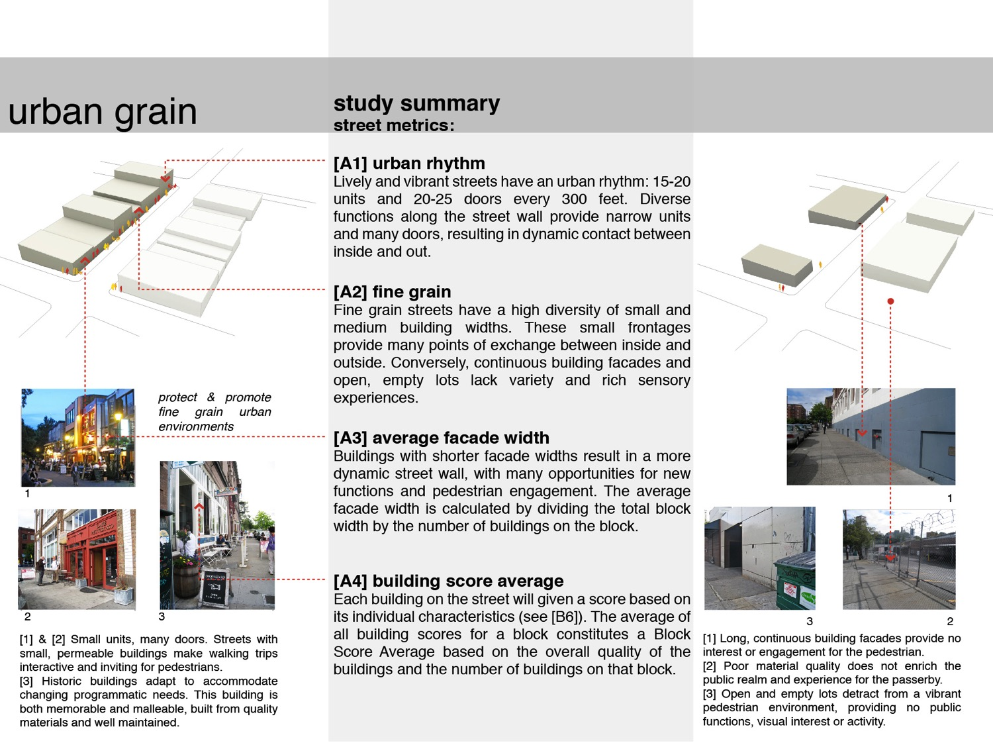
Notes:
A set of metrics was established to measure the quality of grain within each neighborhood. Buildings were measured on a scale of one to five according to age, number of functions at ground level, quality and maintenance of materials, variety and texture of a surface, human proportion, and the visual and physical interaction between the inside and outside.
A second set of metrics measures the grain of the overall block, accounting for number of functions, continuity of the street wall, average width of a façade, and a cumulative score of the individual buildings. Pedestrian counts were conducted to show the relationship between activity and building. Results were entered into a GIS database, which was turned into a set of graphics that could quantify and qualify the blocks vibrancy and success at different levels.
Preliminary results of the study suggest idea that a finer grain building or block correlates with increased pedestrian activity and therefore neighborhood vibrancy. The use of quantitative measurements, GIS data mapping and descriptive graphics produces a dynamic and innovative research strategy that measures older and existing neighborhoods and suggests why they are valuable assets in the sustainable urban landscape.
Scoring facades based on rhythm seeks to capture the degree to which pedestrians feel visually stimulated when walking along the edge of a façade. Many units and vertical divisions add to a sense of variety. A minimum of 10 units per 300 feet provides an interesting façade and a vertical façade expression that compresses the perception of distance. Rhythm scores were based on how often a pedestrian encounters a new function as she walks along the ground floor of the facade.
How accessible, or open, a façade feels to the pedestrian depends on the number and types of openings as well as the number and types of functions taking place inside the building. Therefore, a score for accessibility captures an amalgamation of transparency, public functions, and rhythm. Facades with the greatest accessibility should provide the most street activity observable by noting the number of people who interact with the facade, by looking or staying nearby.

Slide 32
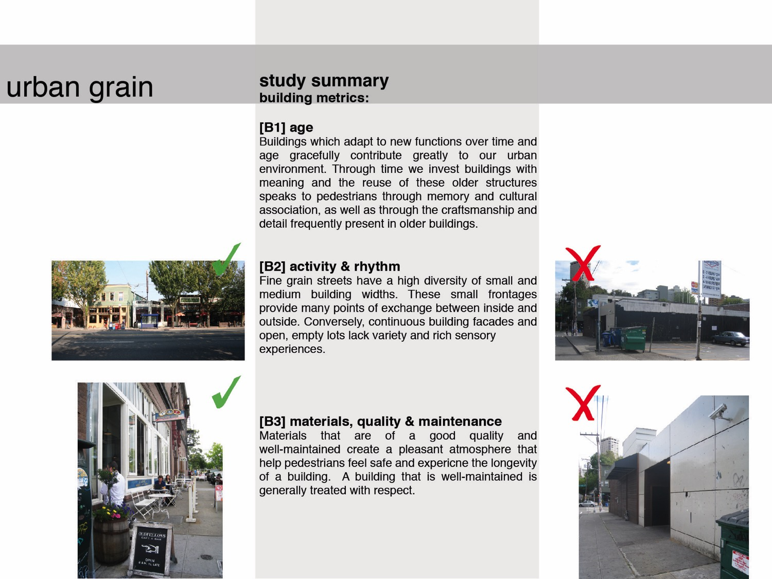

Slide 33
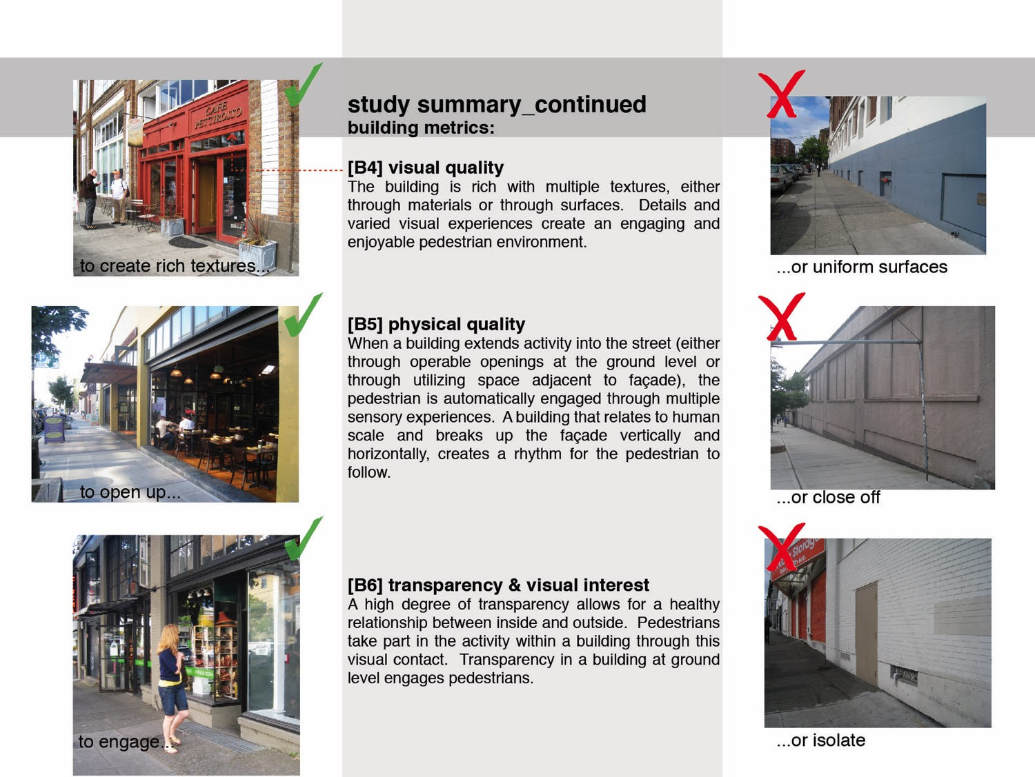
[B7] building score average
B1-B6 divided by 6 for an average score.
Notes:
How accessible, or open, a façade feels to the pedestrian depends on the number and types of openings as well as the number and types of functions taking place inside the building. Therefore, a score for accessibility captures an amalgamation of transparency, public functions, and rhythm. Facades with the greatest accessibility should provide the most street activity observable by noting the number of people who interact with the facade, by looking or staying nearby.
Scoring facades based on rhythm seeks to capture the degree to which pedestrians feel visually stimulated when walking along the edge of a façade. Many units and vertical divisions add to a sense of variety. A minimum of 10 units per 300 feet provides an interesting façade and a vertical façade expression that compresses the perception of distance. Rhythm scores were based on how often a pedestrian encounters a new function as she walks along the ground floor of the facade.

Slide 34
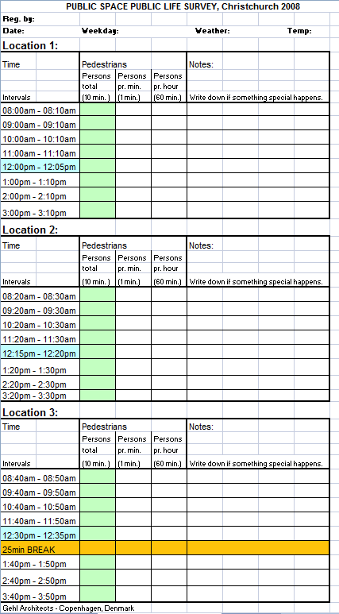
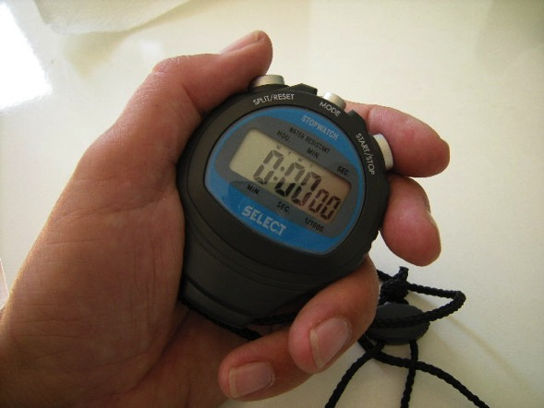
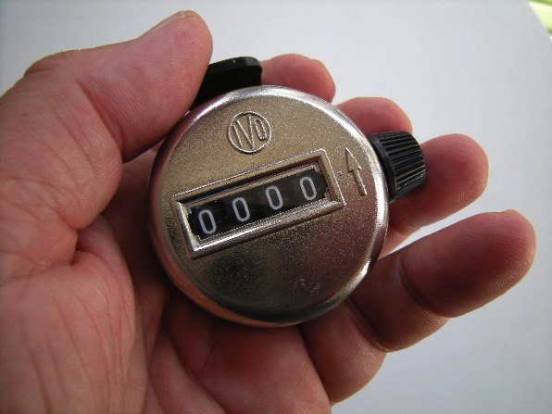
Coatning pedestrians
Notes:
Pedestrian counts were conducted to show the relationship between activity and building. Results were entered into a GIS database, which was turned into a set of graphics that could quantify and qualify the blocks vibrancy and success at different levels.

Slide 35
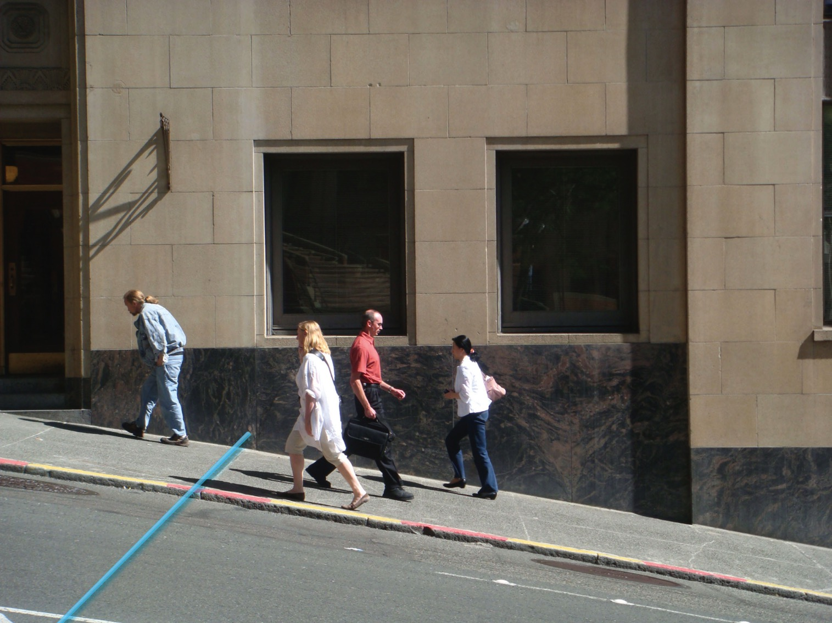

Slide 36
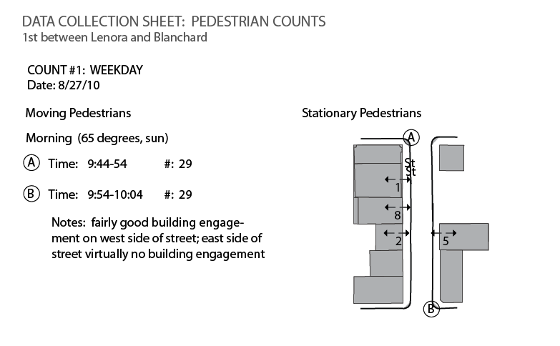

Slide 37
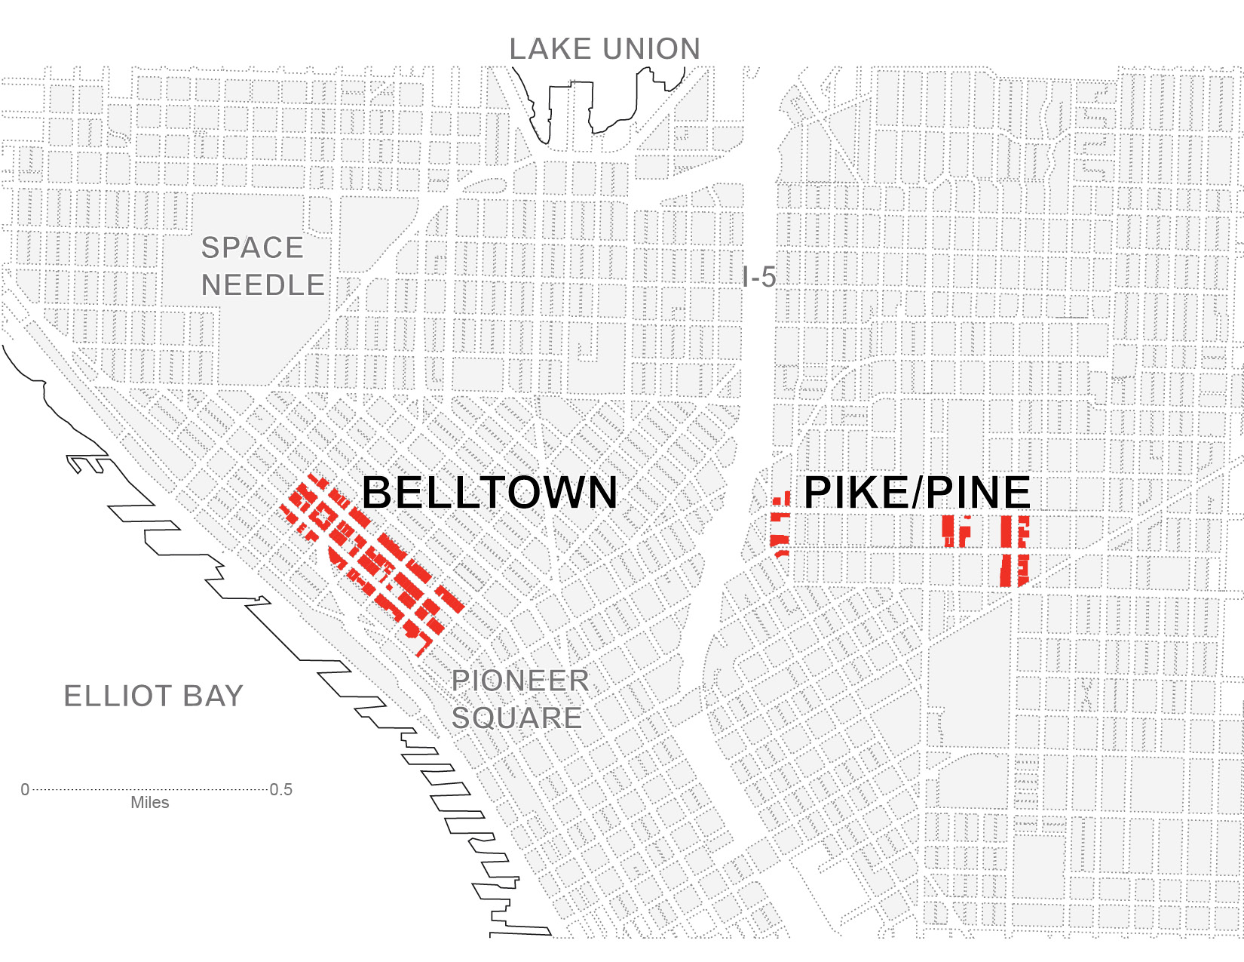

Slide 38
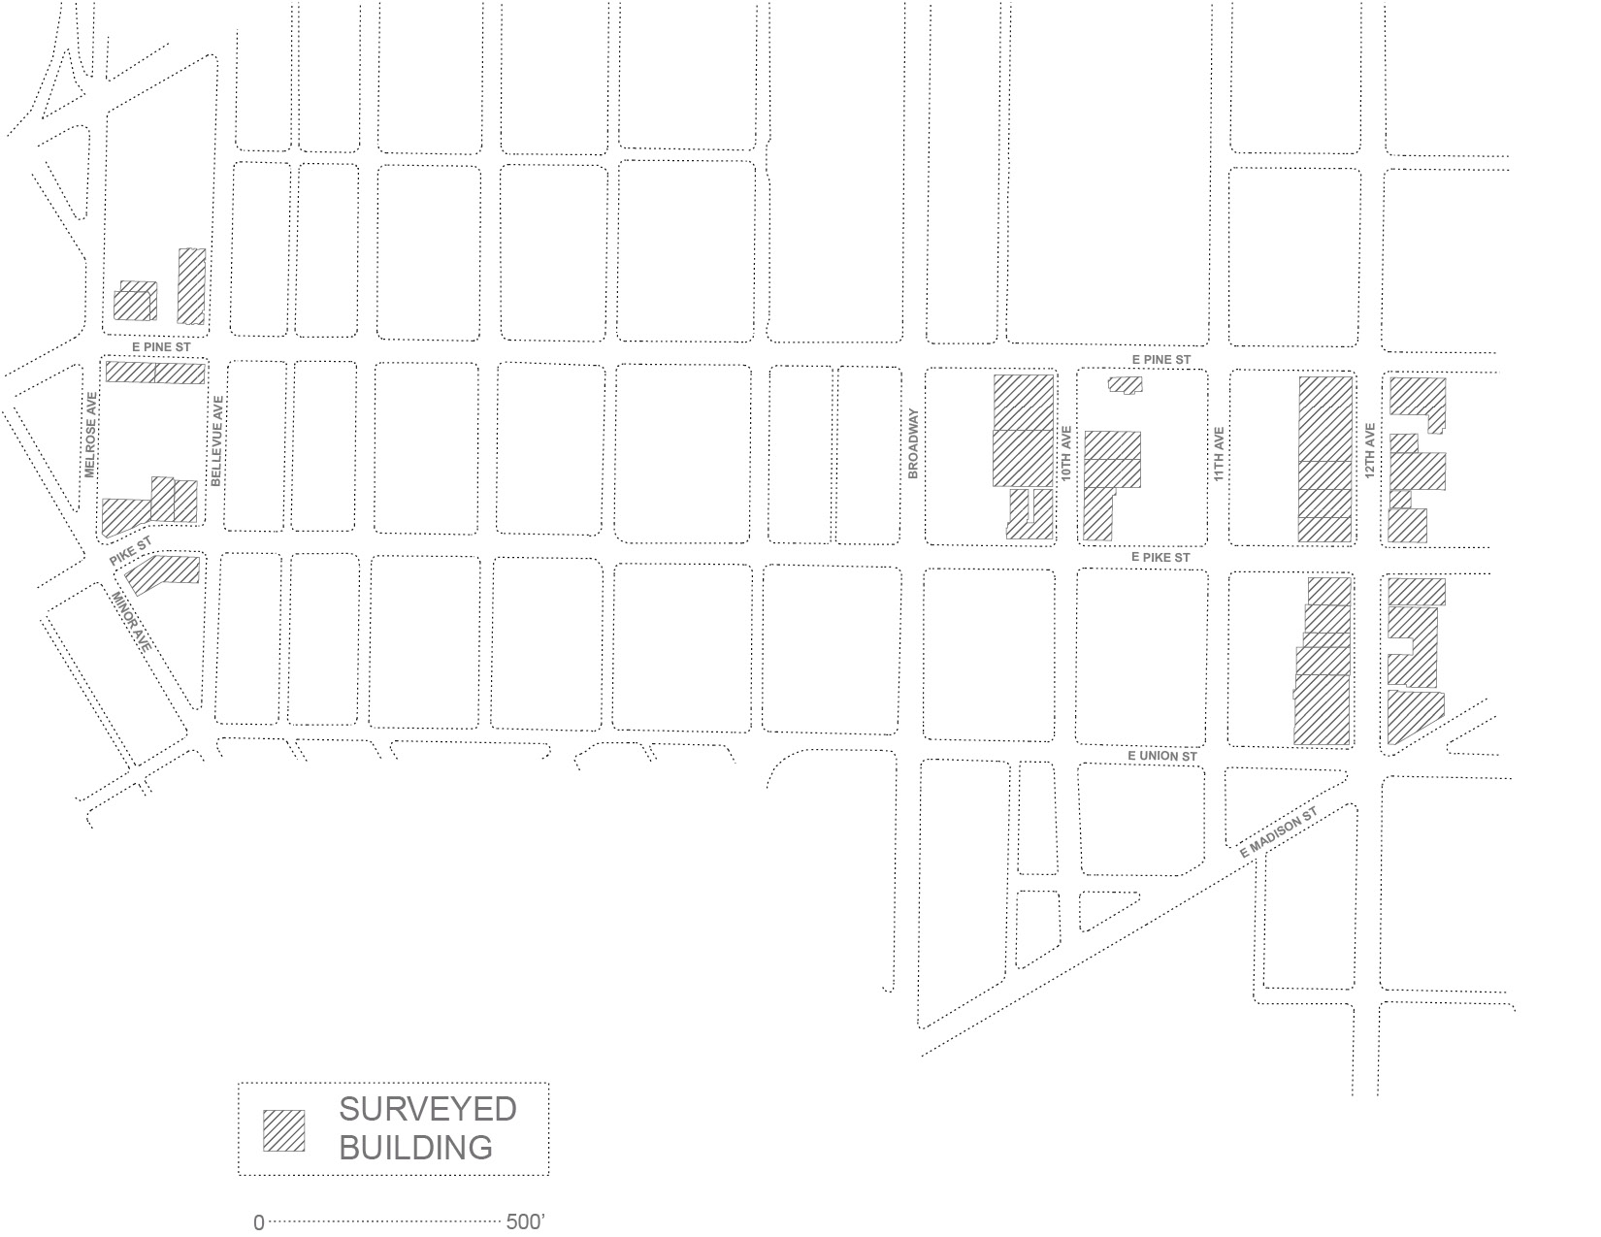
12TH AVENUE BETWEEN PIKE AND UNION
Notes:
Case Study: 12th at Pike and Pine
The Pike Pine Neighborhood is an eclectic low-rise neighborhood just east of downtown Seattle. In 1998, the neighborhood created design guidelines out of concern for the scale of downtown development creeping into the neighborhood. In recent years, despite the current zoning and design guidelines, development pressures have begun to accelerate changes that alter the character of the neighborhood including the demolition of the existing building stock and construction of new buildings out of scale with the urban grain. Like many developing neighborhoods in Seattle and across the US struggling with new urban population growth, the community is balance the desire for density and development with that of physical and cultural continuity in order to accommodate the need for increased residential and commercial capacity. This context made it a good urban studio for the measurement of urban grain and neighborhood vibrancy.
The Pike/Pine corridor has an eclectic mix of older buildings, many of which are vernacular with no formal historic designation. Of a total of 278 buildings within the Pike/Pine study area, 165 (59.4%) are more than 85 years old. Forty-six buildings (16.5%) were built between 1923 and 1945, 51 (18.3%) were built between 1946 and 1995, and 16 (5.8%) were built from 1995 to 2007.2 The Pike/Pine neighborhood developed as a commercial corridor just east of downtown Seattle and south of the Capitol Hill neighborhood. Through there were residences early on, the neighborhood quickly became a commercial hub of automotive uses known as “auto row” in the early part of the 20th century. The automotive uses established a collection of distinct building types consistent to the neighborhood. The open span 1-4 story concrete and brick buildings held auto-related showrooms, offices, repair, and parking. The open structural bays framed large industrial windows along the street letting in light (along with skylights) and establishing high visibility into the businesses. Over the years some of the automotive uses left and were readily converted to office, retail, and residential uses, though many still define the neighborhood. With the construction of 1-5 in the 1960s, the neighborhood began to decline, but became more populated starting in the late 1970s/early 1980s, and
accelerating in the 1990s. Substantial population growth between 1990 and 2007 (21.3%), accompanied by a similar increase in the number of housing units (21.2%), shows its conversion to a mixed use neighborhood, with a large population increase projected for the next twenty years.

Slide 39
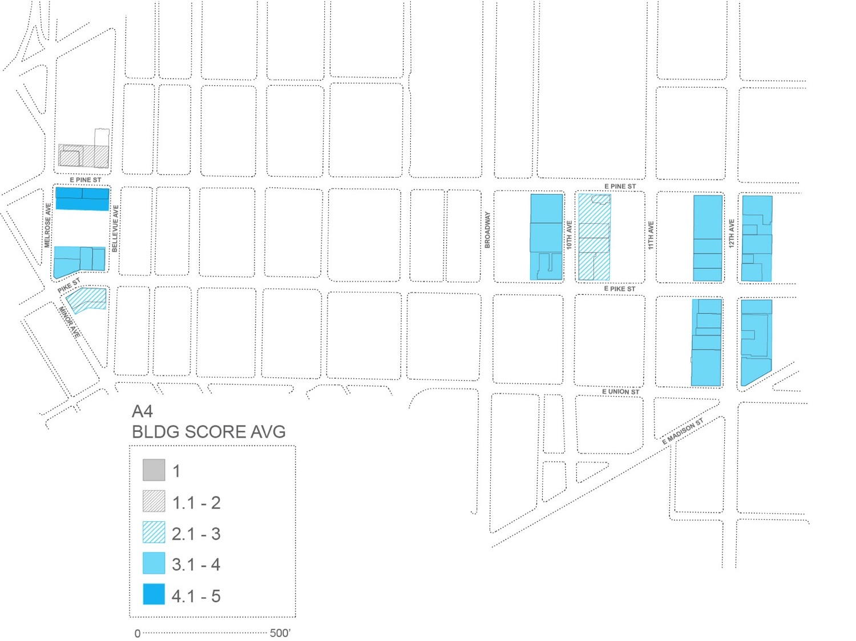

Slide 40
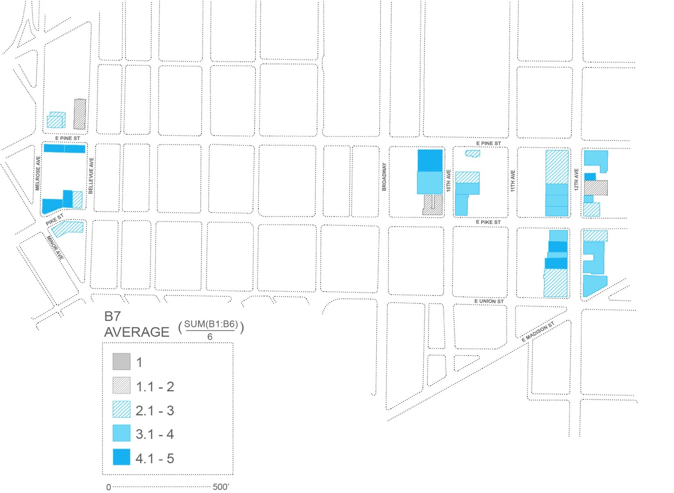

Slide 41
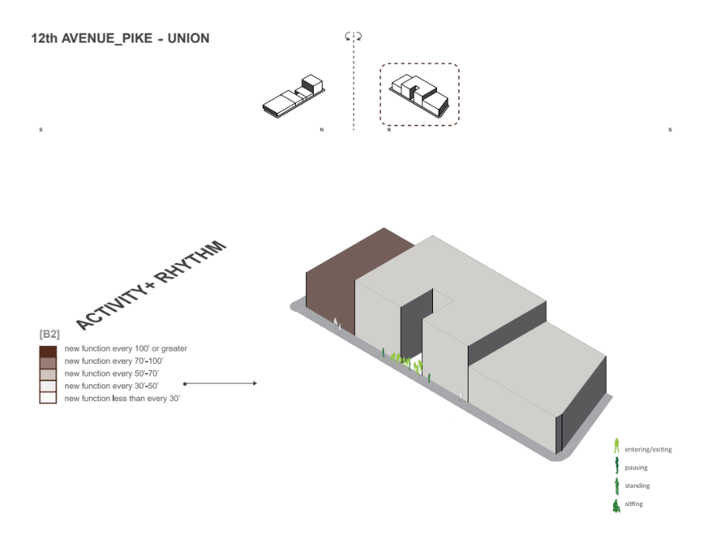
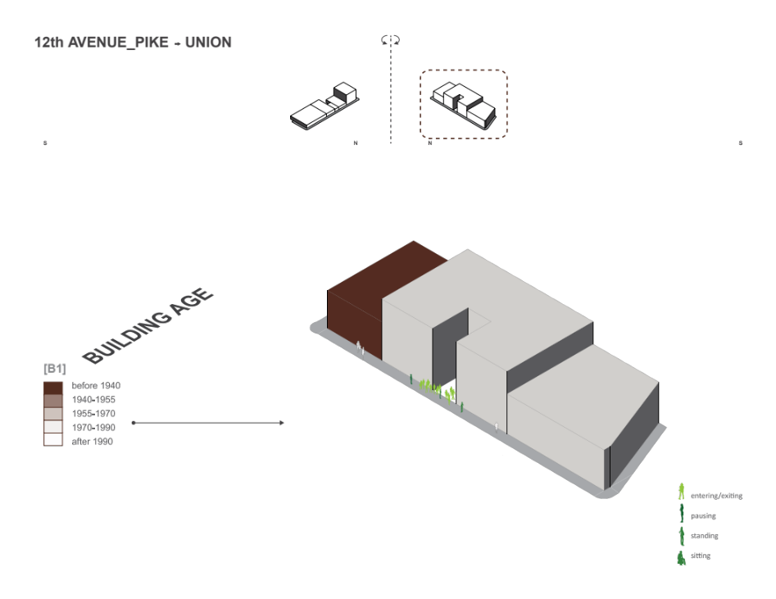
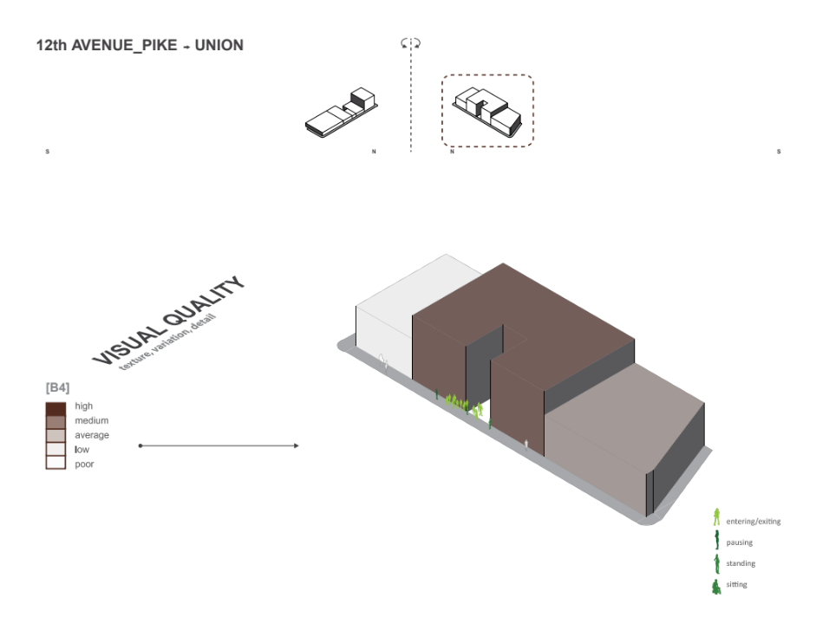
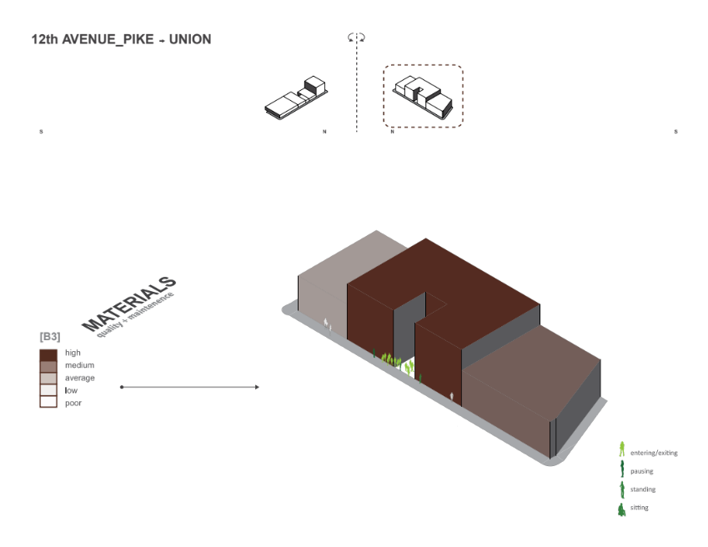
Notes:
The second set of people measurements measured how people interacted with the building façade; whether pausing/standing, entering/exiting or sitting. Mapping of stationary pedestrians occurred by standing at the same location as moving counts, for 30 minute intervals, morning and evening, weekend and weekdays. Researchers gathered data at both end of the streets and recorded pedestrian activity entering and exiting buildings, standing, pausing, leaning and sitting. Each of the movements were recorded on maps with notations (Figure 7), and then graphically expressed next to the building and street data through diagrams (Figure 8). Each figure represents exactly one pedestrian in each drawing, the shade corresponding to their activity. This set of diagrams were the most revealing in comparing the specific quality and quantity of pedestrian activity to the quality of building and block data (Figure 9).

Slide 42
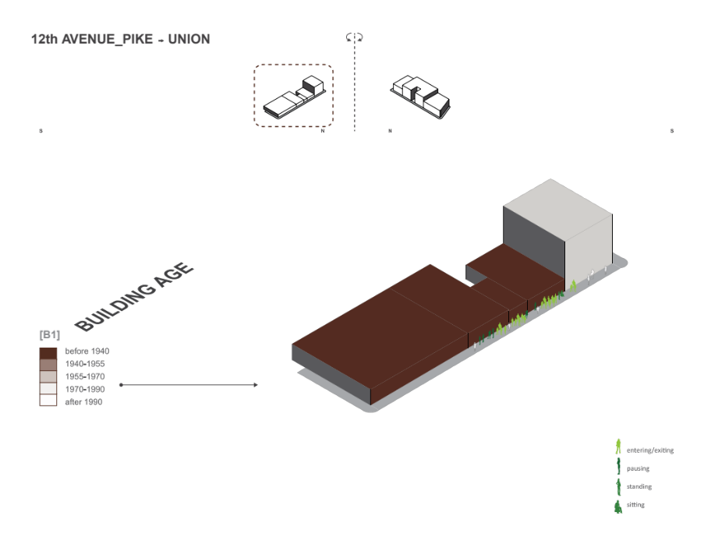



Notes:
Of the many streets studied for this research, the block between Pike and Pine on 12th Avenue summarizes preliminary findings the study most clearly (Figure 9). As seen in the diagrams that combine building and street metrics with pedestrian activity, the east side of 12th was the more utilized and active side of the street (Figure 10). As traffic flowed from all four corners of the block, pedestrians tended to cross to the western side to move through the street. Even though both sides of the street were filled with similar functions, the west side with older buildings, finer grain and narrower AT FIRST GLANCE SEEMED TO HAVE MORE pedestrian activity sitting, standing, entering and exiting and pausing on the street. This block also rated highest for granularity, fine grain and older building age.

Slide 43



Slide 44


Slide 45


Slide 46


Slide 47


West side of 12th Avenue, which scored lower of the two blocks.
Notes:
CONCLUSION IN THIS BLOCK COMPARISON IS WITHIN A SINGLUAR BLOCK, DATA SUGGESTS:
46% MORE PEDESTRIANS RNTER/EXIT, STAND, PAUSE AND SIT ON THS BLOCK RATED HIGHEST FOR GRANULARITY, FINE GRAIN AND BUILDING AGE. WHAT DOES NOT SEEM TO MATTER AS MUCH IS MATERIAL QUALITY, VISUAL QUALITY AND TRANSPARNACY, AS THESE CAN BE MORE INTEGRATED INTO NEW AND OLDER BUILDINGS.

Slide 48


46% more stationary pedestrians and 48% more moving pedestrians preferred the side of the street in the block that rated highest in FINE GRAIN, RYTHMN + ACTIVITY AND OLDER BUILDING AGE, as seen here in the east side of 12th avenue which scored much higher
Notes:
These preliminary results indicate that better textured, aged and finer grained streets provide more interesting routes and street activity. Building texture of older buildings provides good sensory experiences through wealth of details and quality of materials, and varied surfaces are permissive in that they invite sensorial interaction. In addition, façade transparency at ground level is a critical determiner of street activity. Pedestrians are often more comfortable knowing what happens inside the buildings they walk past while people inside can passively survey the sidewalk, making for a street that is experienced as safe. Furthermore, the more visual connections between people inside and outside the buildings, the greater the opportunity for social exchange fostering social capital building, a stronger sense of place, and connections within the community at large.

Slide 49

12th avenue East (lower scoring)
12th avenue west (high scoring)
Notes:
While the east side of the street measured relatively high due to the quality of new construction, it clearly was less occupied – even during the afternoon hours when the building had better quality sunlight. As a newer building, two items rated the building on the low side: building quality and texture, and activity along the street. As seen in the image, the building in the center takes up over 50% of the street façade with a continuous façade of new construction, which in age, grain and texture, rated much lower than its older peers. These characteristics were typical of newer projects which were out of scale with the older fine grained buildings that the made up the historic neighborhood (Figure 11). What did not seem to affect ratings were measurements of material quality, visual quality and transparency, as these can be more integrated into new and older buildings.

Slide 50

Notes:
This research initially began with a collaboration with the National Trust for Historic Preservation’s Preservation Green Lab, a think tank of the National Trust, which is the largest American privately funded organization dedicated to preserving important American places.
Part of this research that will not be discussed here can be seen in another study I worked on, a report recently published by the Preservation Green lab of the national trust, which takes this research's and uses Baseman, a data science and visualization consultancy focused on mapping data in a human context and matching indicators to actions.
This study demonstrates the unique and valuable role that older, smaller buildings play in the development of sustainable cities. Based upon statistical analysis of the built fabric of three major American cities, this research finds that established neighborhoods with a mix of older, smaller buildings perform better than districts with larger, newer structures when tested against a range of economic, social, and environmental outcome measures.
.

Slide 51


Slide 52


Slide 53


Slide 54


Slide 55


Slide 56


Slide 57

Notes:
recommendations

Slide 58


Slide 59


Slide 60


Slide 61


Slide 62


Slide 63

Outcome based energy codes
Notes:
Energy consumption in both new and existing building could be cut by an estimated 30-50 percent by 2020 through readily available technology's, design, equipment, alternative energy generation and most significantly, by changes in how buildings are operated and in the behavior of their occupants.
importance of historic neighborhoods as economic engines

Slide 64

How to get there:
Utilize repots that show quantifiable data to incentivize
Promote Outcome Based Energy Codes that make historic buildings easier to adapt to code levels.
Create conservation rules that are tried and tested to get the outcome you want.
Building permits are expensive and require approval; demolition permits for older buildings should be more rigorous and costly.

Slide 65

Successful cities rely on buildings that relate to human scale, have a variety of activities and building types, and buildings that have varied age and texture and can be easily adapted into new uses and stories that retell over generations. (Graphic by Gehl Architects)
Notes:
In her book The Death and Life of Great American Cities, Jane Jacobs wrote “we need texture and age in our cities,” referring to the need for vibrant neighborhoods that can incorporate the past as well as establish a successful future. The successful neighborhood experience is intimately tied to the small details that compose a building as well as the neighborhood block. The built environment must be of such a high quality that it supports the way that people live, whether they are sitting, working, playing, walking, talking, or eating. Older neighborhoods with a mixture of historic building types lend themselves to a sense of what can be referred to as “smallness” – or the relationship of the building to the human scale. Smaller, fine grained streets with an variety of buildings not only is sustainable through preservation of our existing resources, but also creates a more vibrant pedestrian experience.
Our bodies and senses have not changed much through modern times, and the basic needs of people remains consistent across cities, and across cultures. The human is a walking being, moving with an average speed of 3 miles per hour and experiencing life through delicate senses. The everyday world is viewed at an average angle of 72 degrees from eye level. When walking through a neighborhood, therefore, the things at ground floor—or eye level—will be most likely to hold someone’s attention. The quality, arrangement, and function of these things are crucial to the legibility of a neighborhood and to our overall impression of the quality of life. The battle for neighborhood quality is won or lost at the small scale. Successful cities rely on buildings that relate to pedestrian activity, and. neighborhoods that have a variety of activates
OUR GOAL WAS TO MEASURE THE VIBRANCY OF THE STREET AT THE PEDESTRIAN LEVEL.
AS DISCUSSIONS AROUND DENSITY AND URBANIZATION OF CITIES ESCALATES, EXISTING CITY BLOCKS WITH OLDER BUILDINGS, RICH TEXTURES, PATINA OF TIME AND PALMPSEST OF THE CITY IS GETTING LOST TO NEW DEVLOPMENT THAT TYPICALLY RESULTS IN LARGER MIXED USE BLOCKS WITH LESS URBAN GRAIN AND TEXTURE.

Slide 66
Jane
Jacobs
Cities need old buildings so badly it’s probably impossible for vigorous streets and districts to grow without them.
Old ideas use new buildings;
New ideas use old buildings.
Notes:
Preservationists know instinctively that older buildings play a crucial role in contributing to the livability of cities and local economies.
Long accepted the book The Death and Life of Great American Cities in which mass-scale demolition and replacement of older buildings with large new structures drains the life and vitality from urban neighborhoods.
50 years after the book’s publication, preservationists and still fighting to conserve older neighborhoods, hampered by outdated zoning regulations, overly prescriptive building and energy codes, misdirected development incentives and limited financial tools

