Slide 1
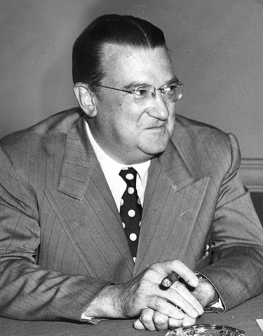
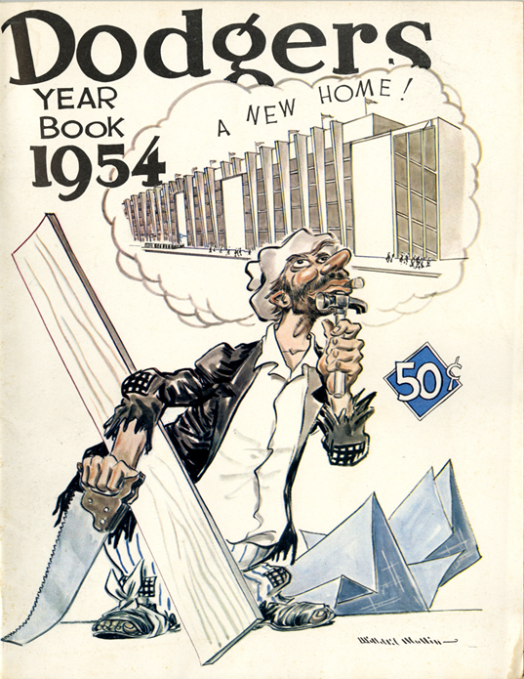
O’Malley’s Pleasure Dome:
The Modern Stadium, Urban Renewal, and the American City

Slide 2
Overview
O’Malley’s attempt first to present the stadium as an urban renewal effort.
Overview of O’Malley’s efforts
Changing context of 1950s
Cementing the stadium as an urban renewal piece

Slide 3
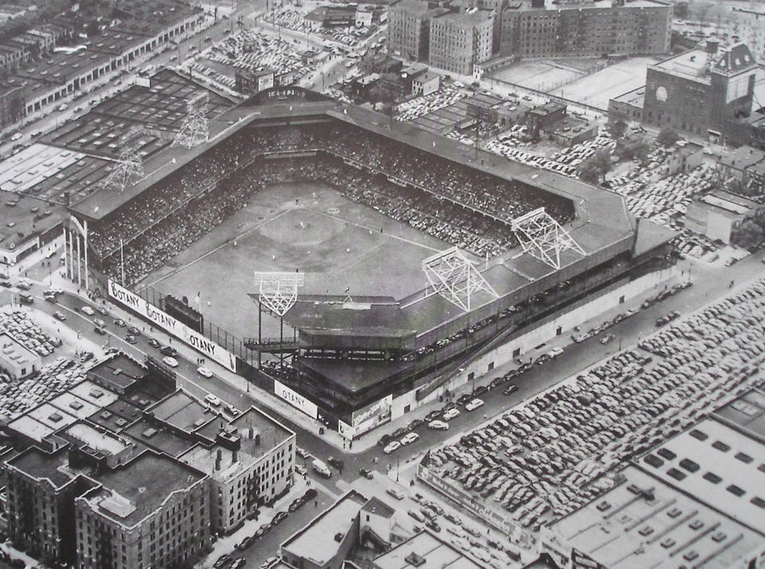
Ebbets Field in Brooklyn, 1950s

Slide 4
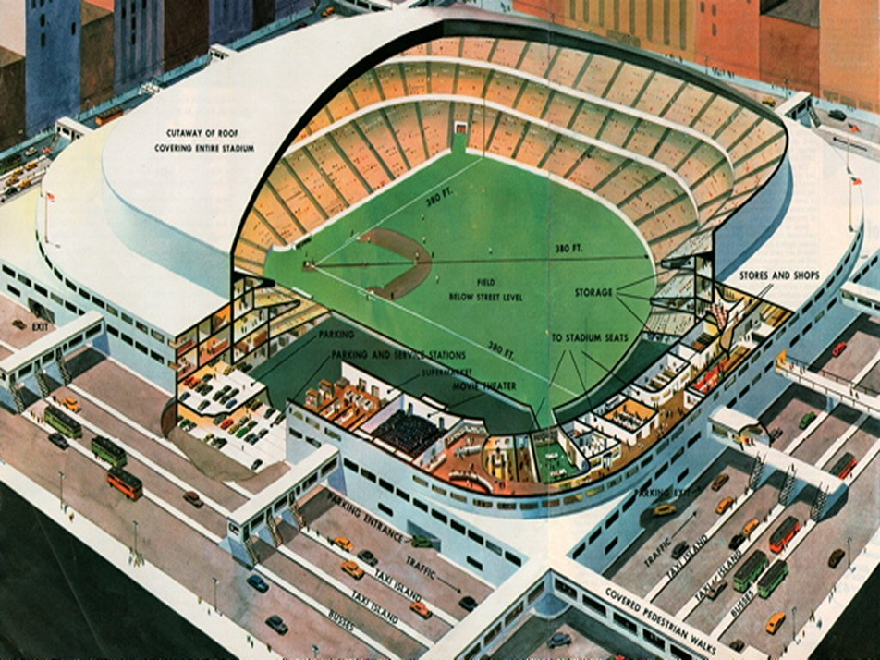
Design for new Dodger Stadium, 1952

Slide 5
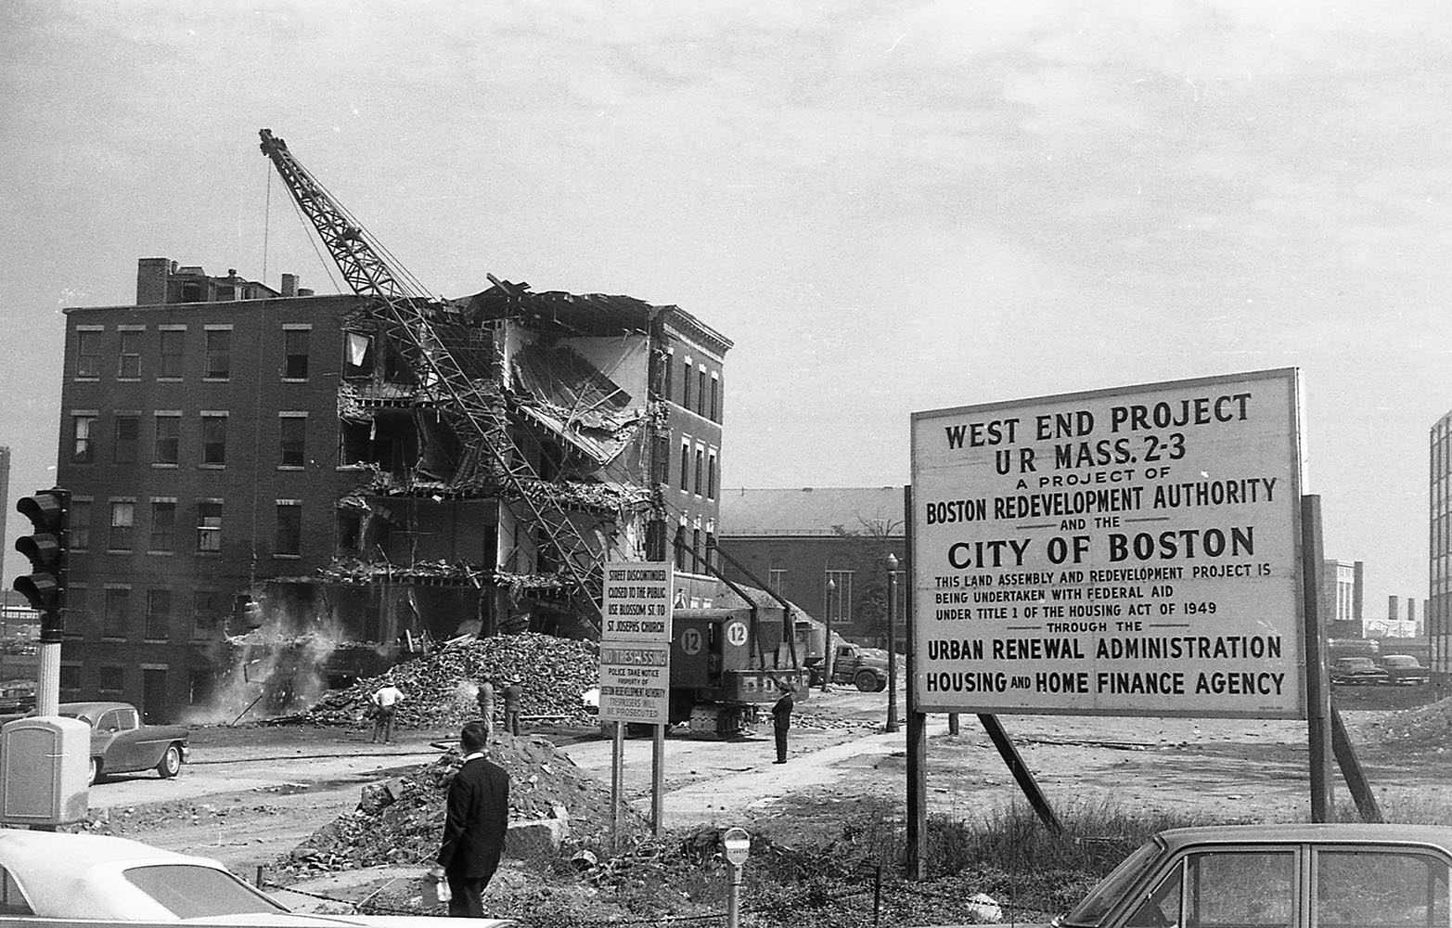
Urban Renewal in Boston, 1950s

Slide 6
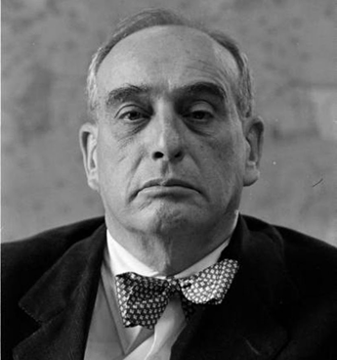
Robert Moses, New York’s “Master Builder”

Slide 7
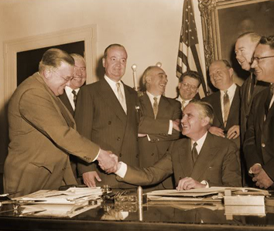
Establishment of the Brooklyn Sports Center Authority, April 21, 1956

Slide 8
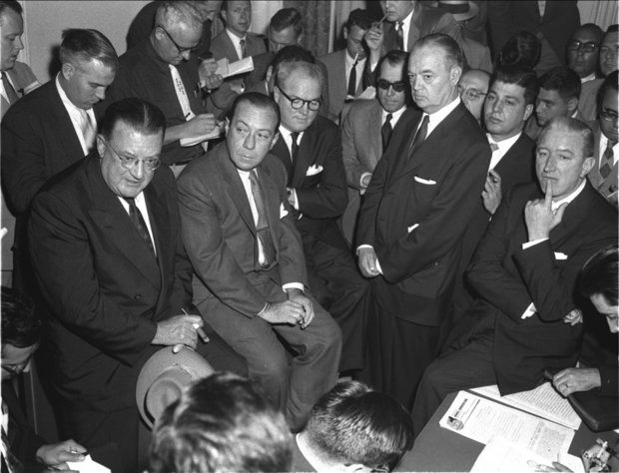
Walter O’Malley,
June, 1957

Slide 9
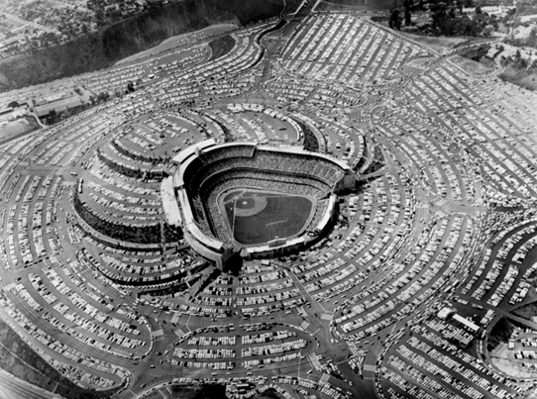
Dodger Stadium, 1963 World Series

Slide 10
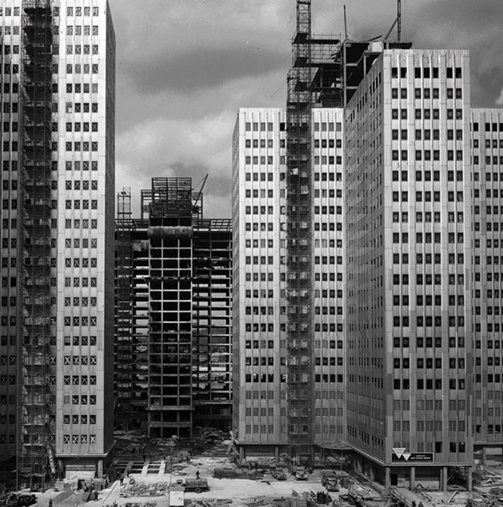
The Gateway Complex, Pittsburgh, PA, 1952

Slide 11
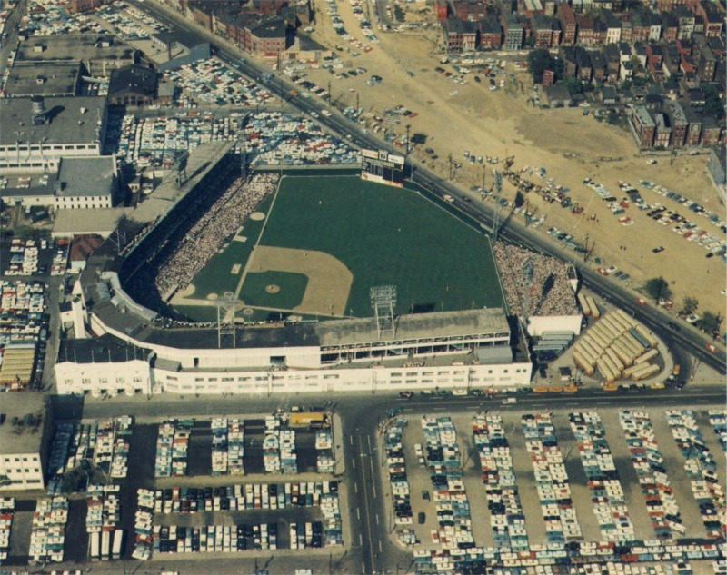
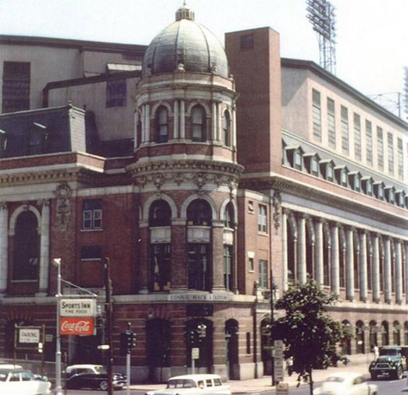
Crosley Field, Cincinnati, OH
Shibe Park, Philadelphia, PA

Slide 12
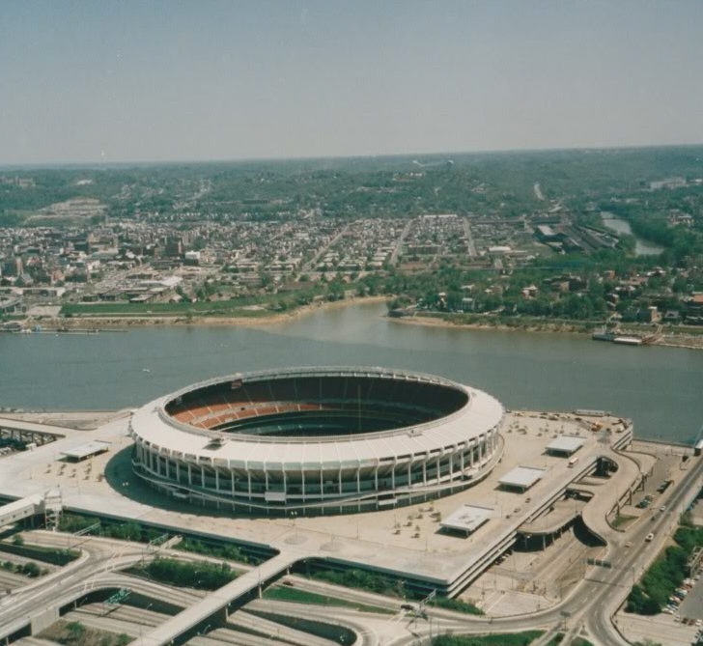
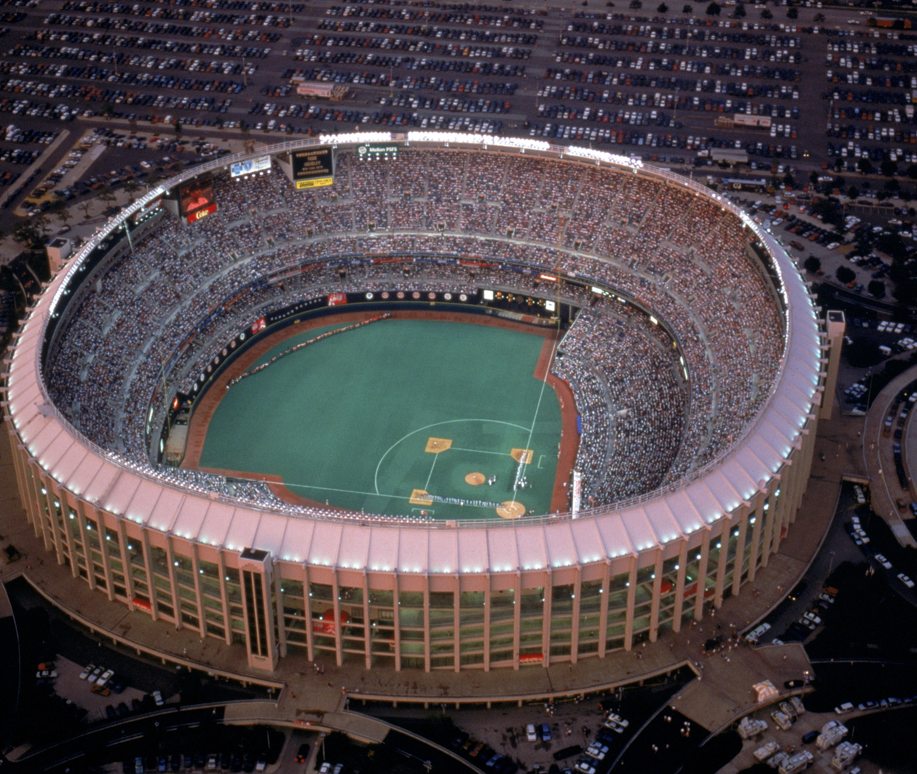
Riverfront Stadium, Cincinnati, OH
Veterans Stadium, Philadelphia, PA

Slide 13
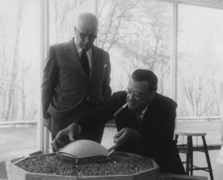
Walter O’Malley with R. Buckminster Fuller and a model of the proposed Dodger Stadium, 1956

Slide 14
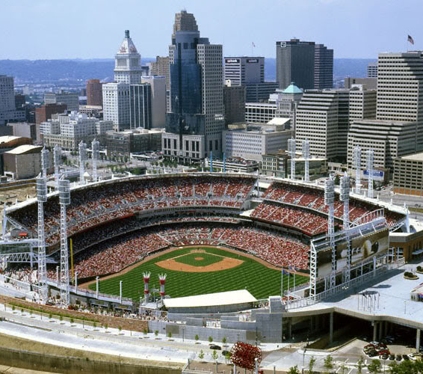
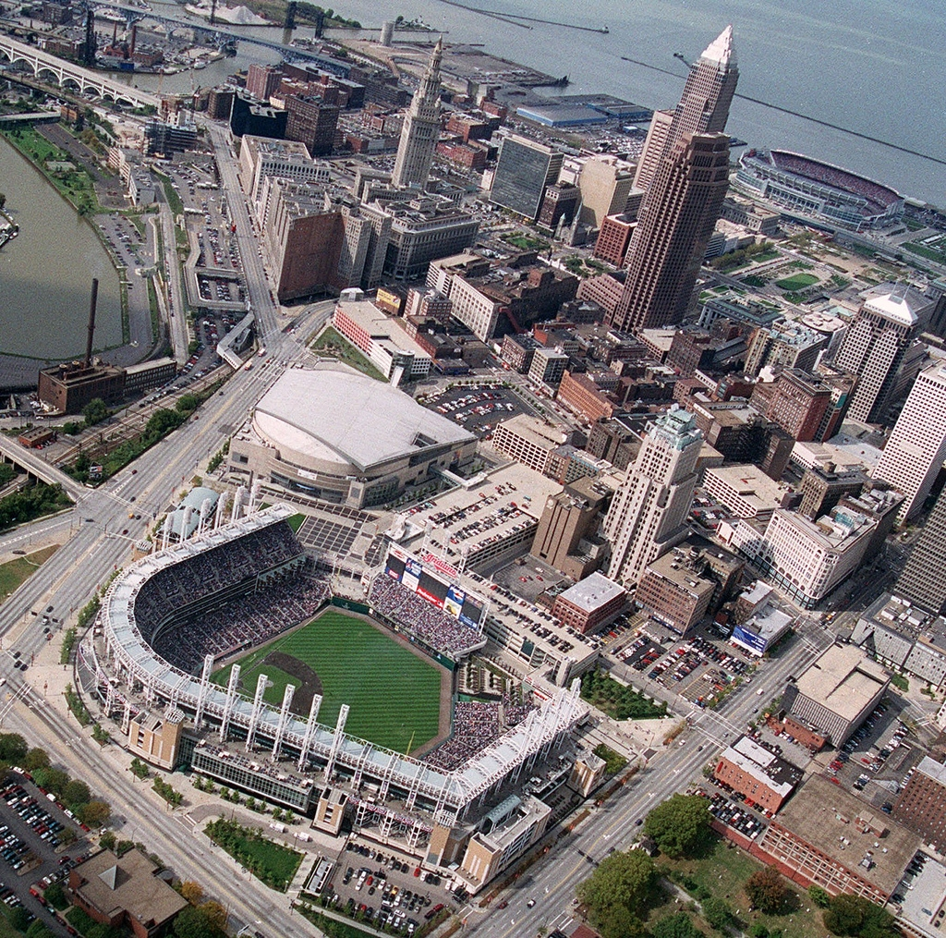
The Great American Ballpark, Cincinnati, OH
Progressive Field, Cleveland, OH

Slide 15
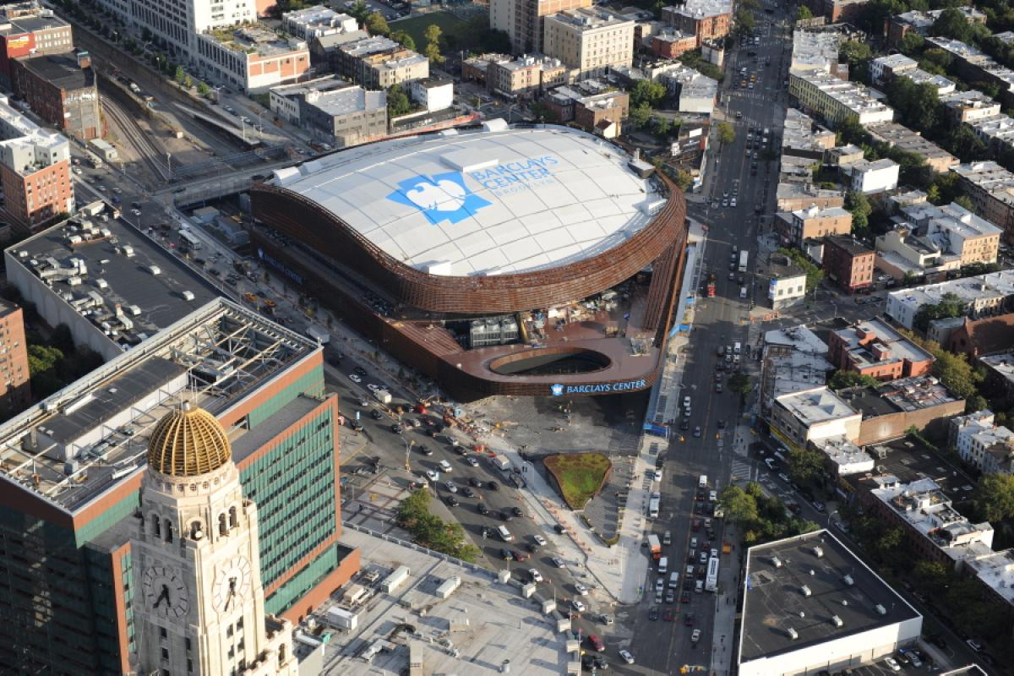
Barclays Center, Brooklyn

