Slide 1
Holyoke Revitalization:
A Developer’s Perspective

Slide 2
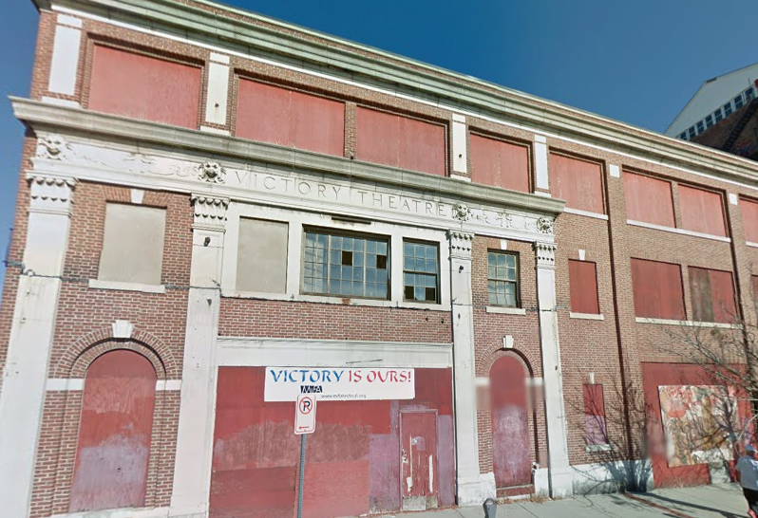
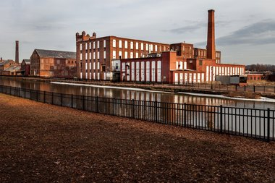
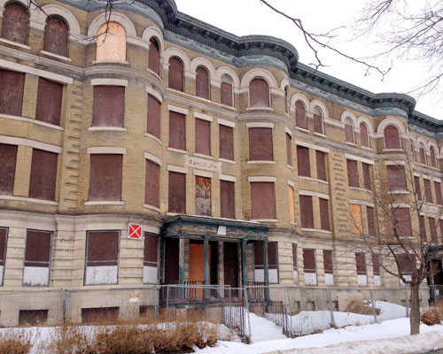
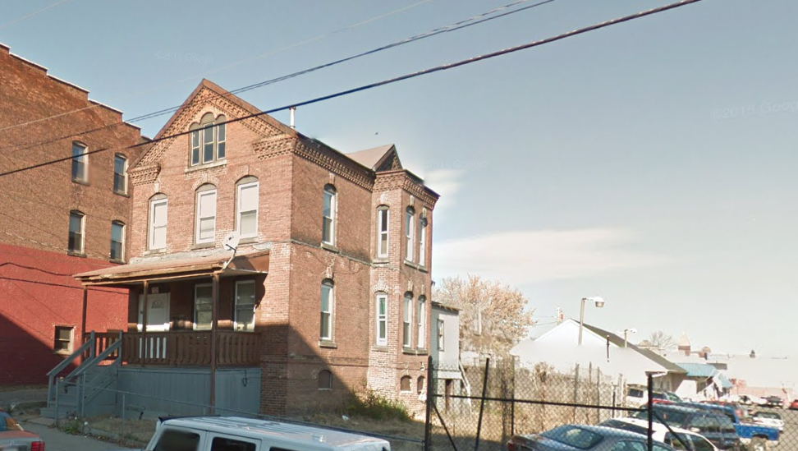
Site Selection
TOO COMPLEX!
TOO LARGE!
JUST RIGHT!
MAYBE?
TOO DAMAGED!

Slide 3

The Financing “Gap”
Realistic expectations: it’s not enough to love a building
  good location
  usable space
  profitability – how will construction and operating costs get paid?
  “Someone should fix up this building!”
    Who? With what money?
What financing can rents produce?
  Development Costs – Fair Market Value = GAP
Fill the Gap:
  Historic Tax Credits
  Low Income Tax Credits
  New Development Tax Credits – not available for places like Holyoke, primarily commercial income needed

Slide 4
Leveraging Historic Tax Credits
At a macroeconomic scale:
  Urban Land Institute found that for every dollar in historic tax credit, the state got an additional $1.20 in tax revenue.
At a local scale:
  Increased tax revenue, increased local employment (funding requirement), local craftsmen get used, increased comparables for market studies
  Used in conjunction with other local funds, like CDBG and HOME money. Holyoke is currently getting a push for Community Preservation Act (CPA) money – new tax on property.
At a project scale:
  FIRST Historic Tax Credit
  20% of eligible development costs x ONE year
  THEN Low Income Housing Tax Credit
  9% or 4% of eligible development costs x TEN years

Slide 5
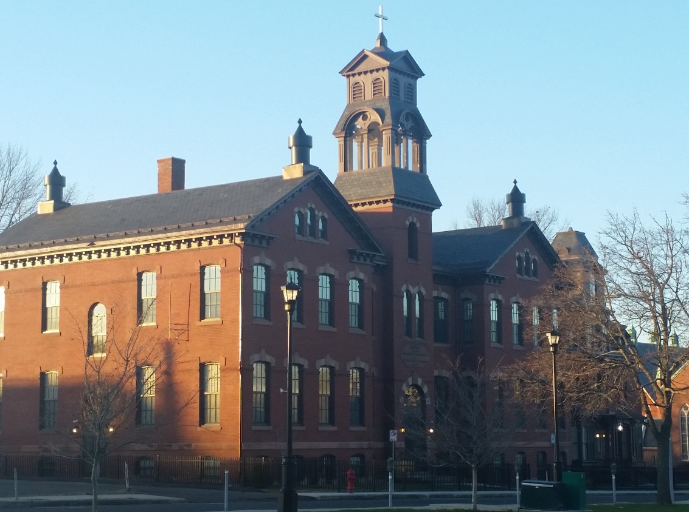
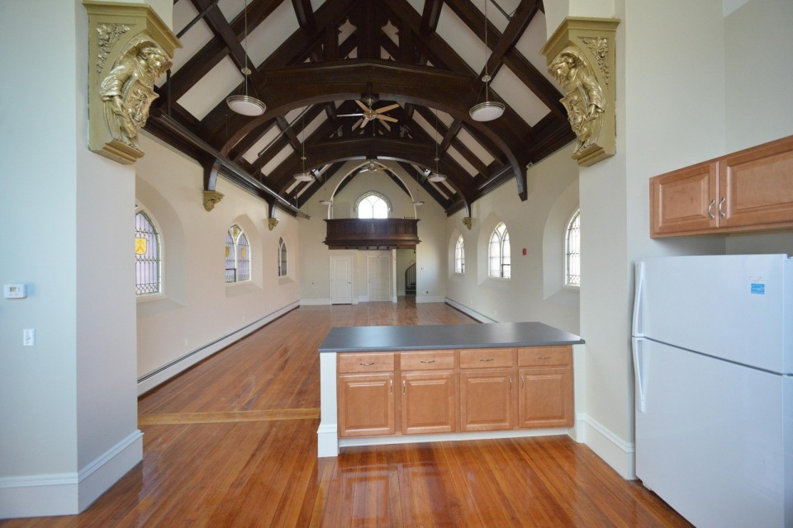
Holyoke Catholic Building
WELD MANAGEMENT - DEVELOPER
$19+ Million Total Development Costs
Less than $17 Million were tax-credit eligible
11 years after closing down
9 years after land purchase
8 Sources / Contracts / Negotiations!
Historic Tax Credits $5,475,489
(Fed + State)
Low Income Housing Tax Credit $9,794,892
(Fed + State)
City of Holyoke - HOME $ 750,000
Affordable Housing Trust Fund: $1,250,000
Housing Stabilization Fund: $ 694,534
Permanent Debt (Bank) $ 785,000

Slide 6
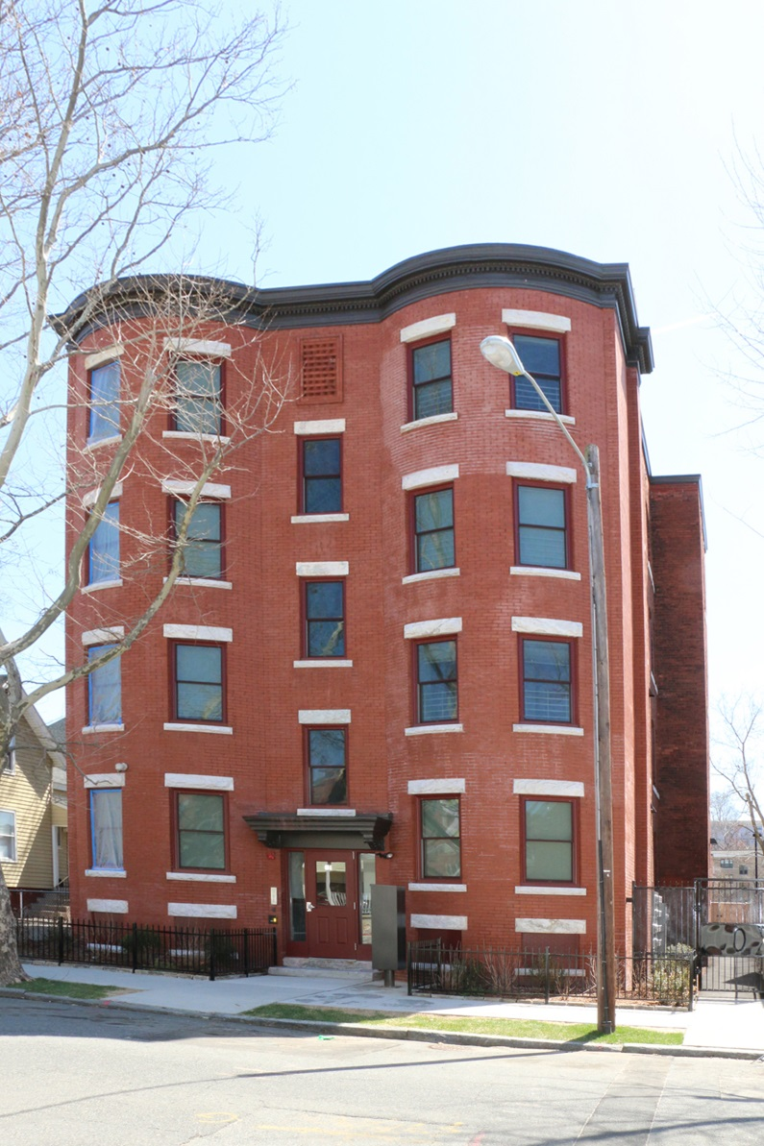
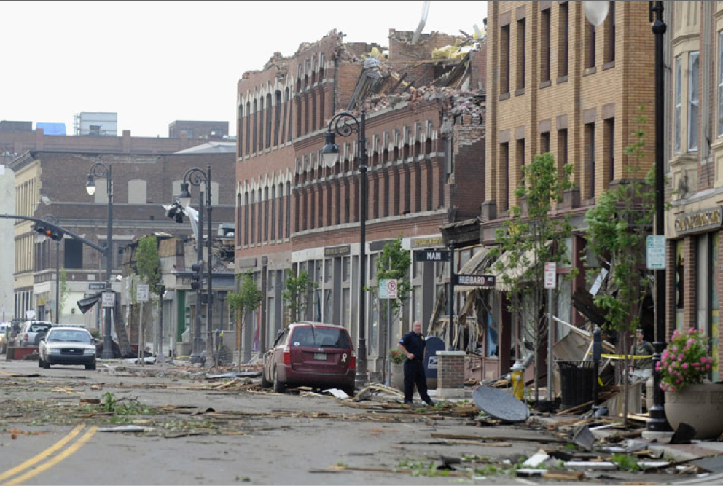
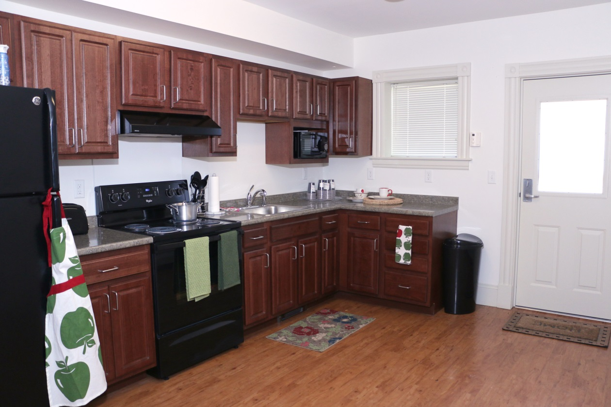
Cross Town Corners
Cross Town Corners
HOME CITY HOUSING - DEVELOPER
$14+ Million Total Development Costs
2 years after tornado damage
9 Sources / Contracts / Negotiations!
Historic Tax Credits $2,946,565
(Fed + State)
Low Income Housing Tax Credit $8,010,752
(Fed + State)
City of Springfield (NSP &HOME) $ 79,156
Affordable Housing Trust Fund: $1,000,000
Insurance Proceeds: $1,167,825
Subordinate Debt: $1,308,669

Slide 7
Common Challenges
Abandoned/Old buildings
  Structural issues
  Ownership issues
  Brownfield development
  Unusual footprints – too big or too small
  High construction costs / design requirements
PRE-pre-development costs
  no financing for feasibility studies, unpredictable development costs
Mixed Use Development is HARD

Slide 8
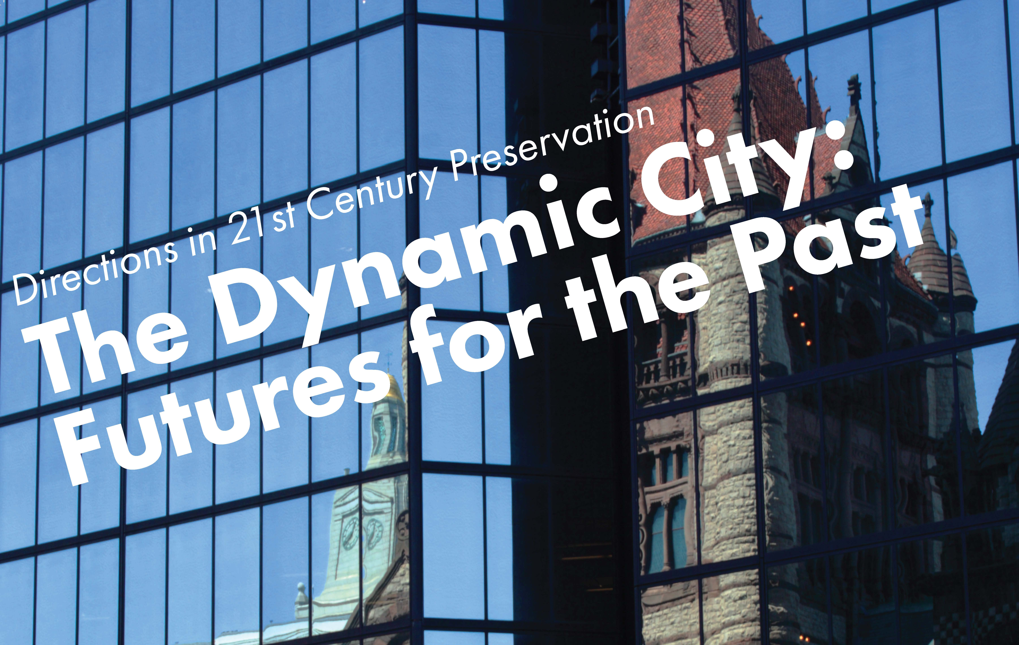

#DynamicCity
@BUonCities
@HistoricNE
Hosted
By:

Slide 9
Green Space and Close Quarters:
Bromley Park and Housing Density in Jamaica Plain
Aaron Ahlstrom
Boston University
The Dynamic City: Futures for the Past
April 1, 2016

Slide 10
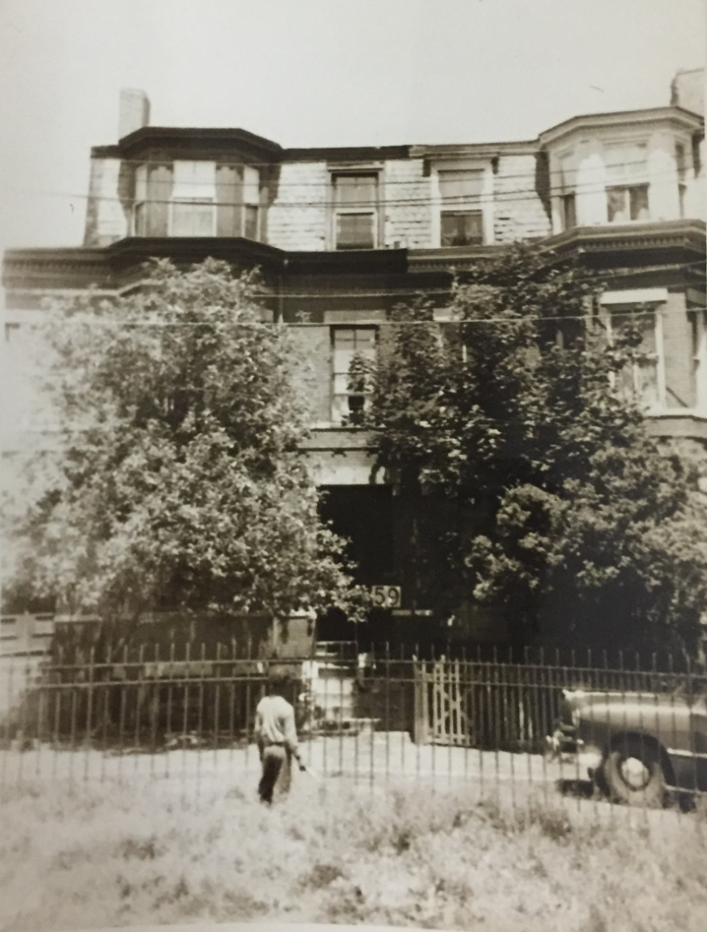

Slide 11
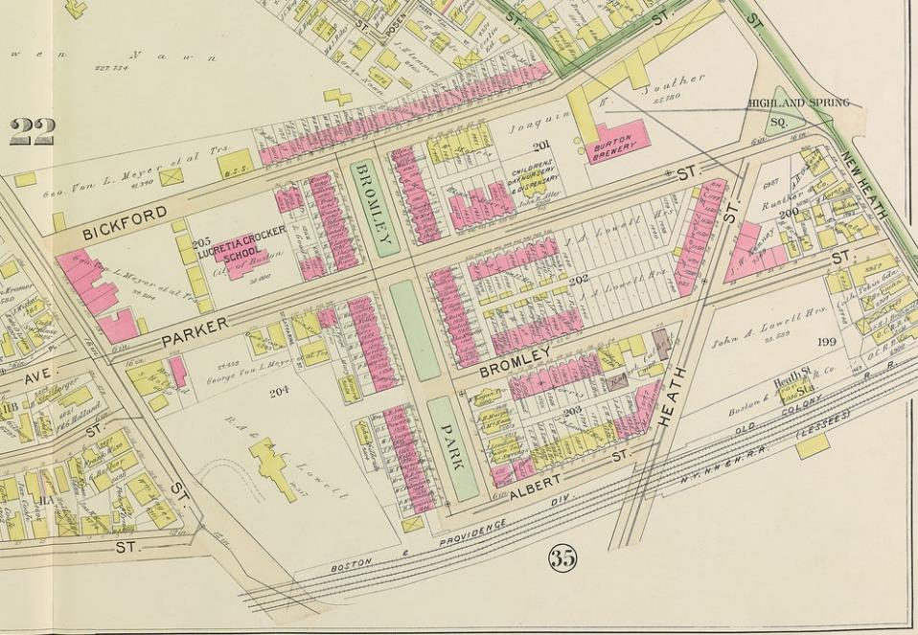

Slide 12
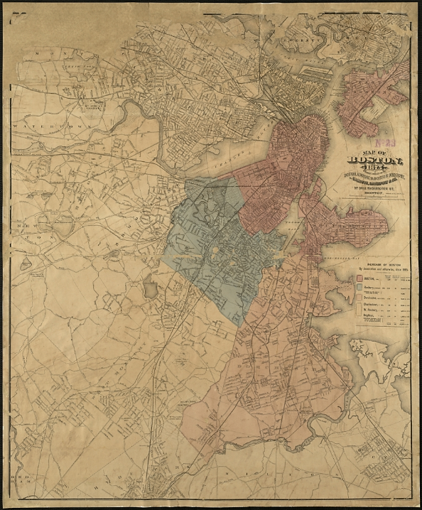
Bromley Park

Slide 13
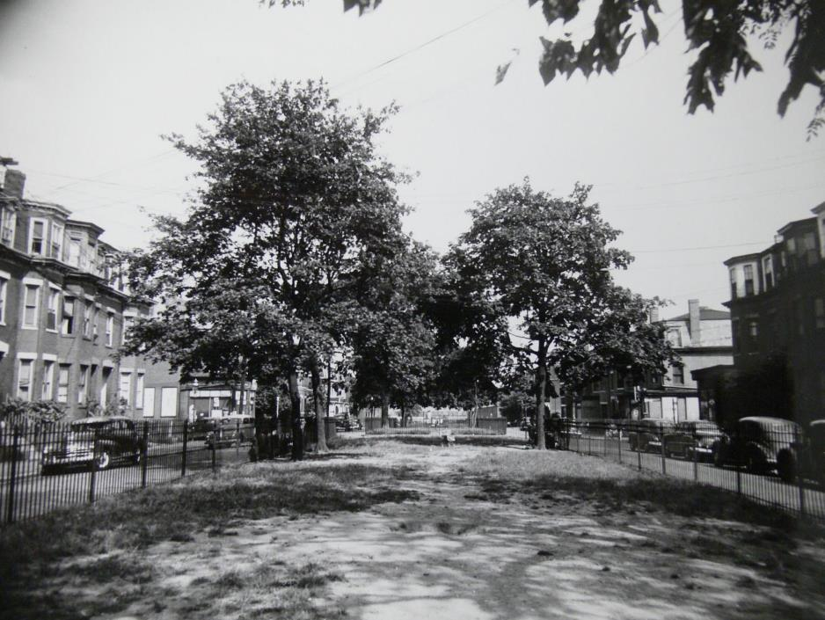

Slide 14
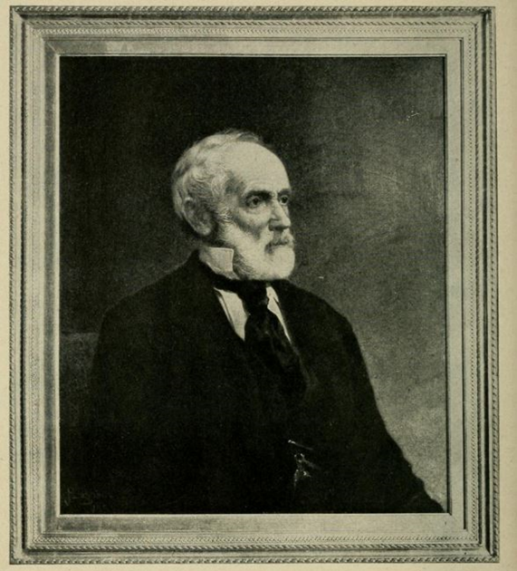
John Amory Lowell (1798-1881)

Slide 15
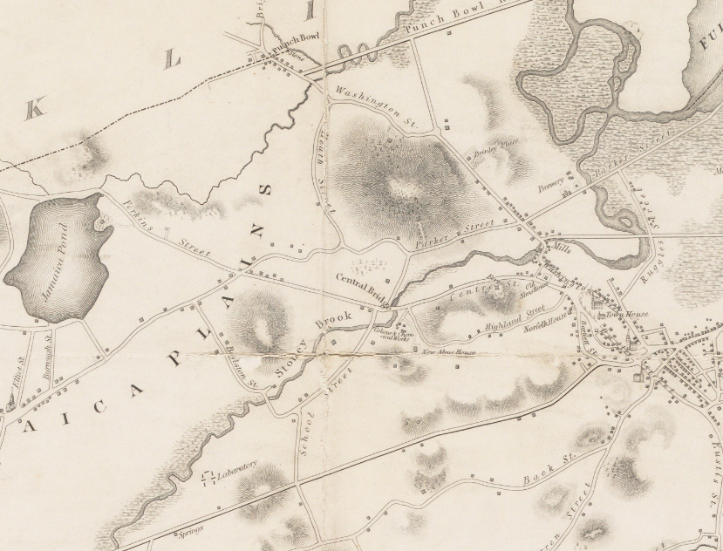
1832

Slide 16
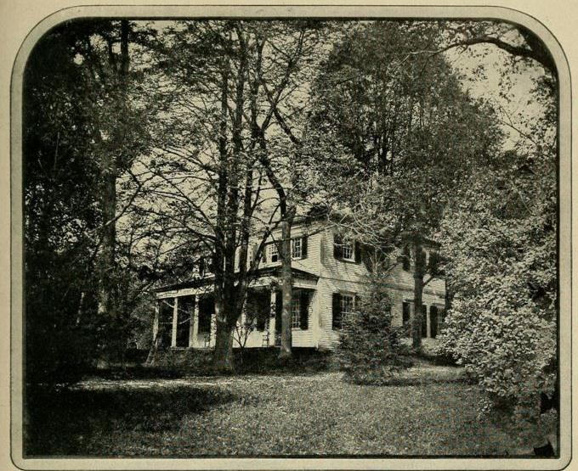
Bromley Vale

Slide 17
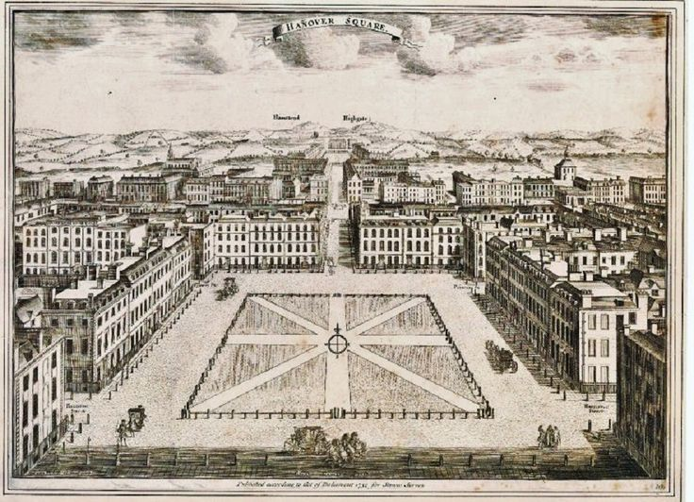

Slide 18
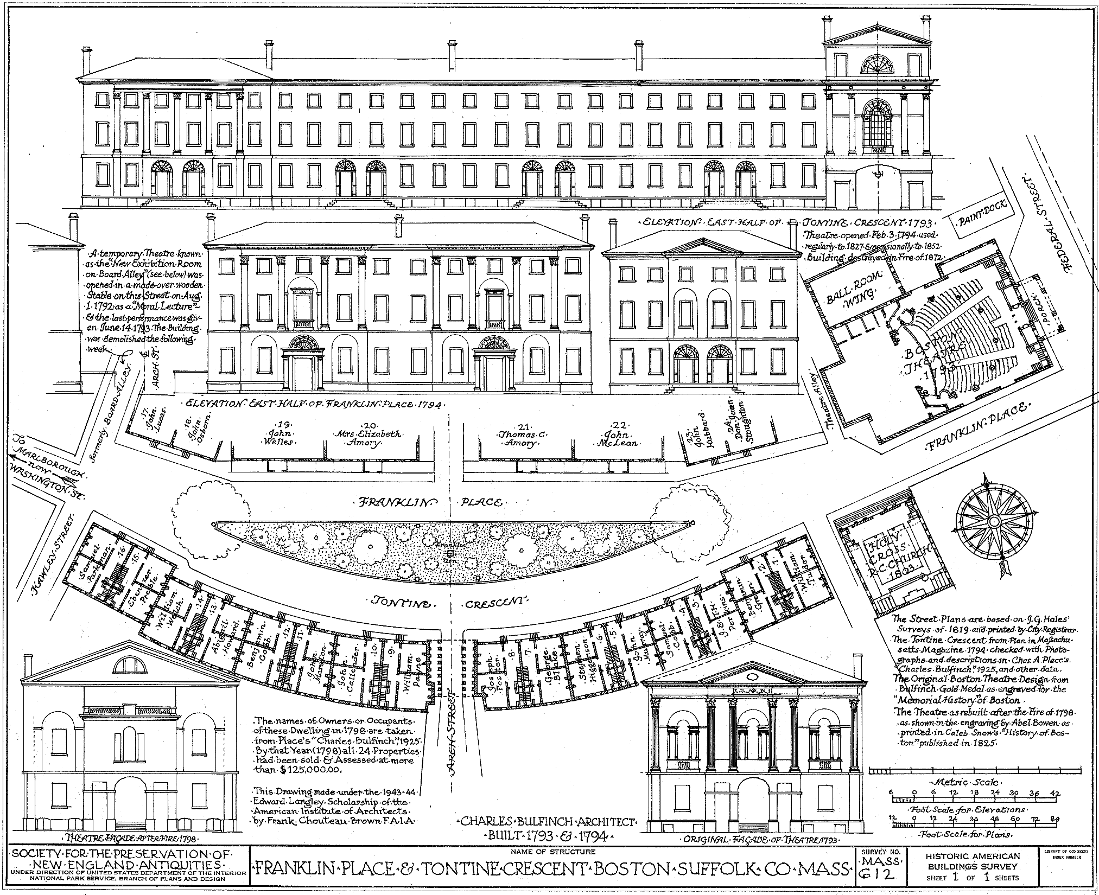

Slide 19
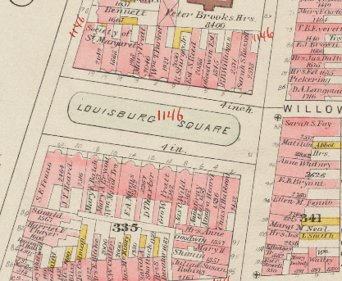
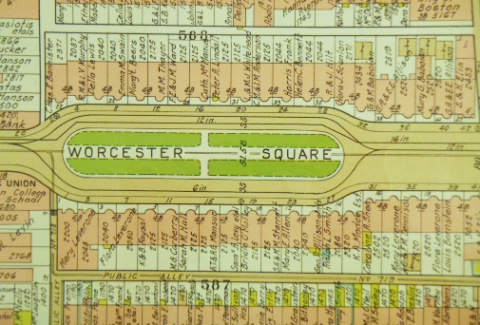

Slide 20
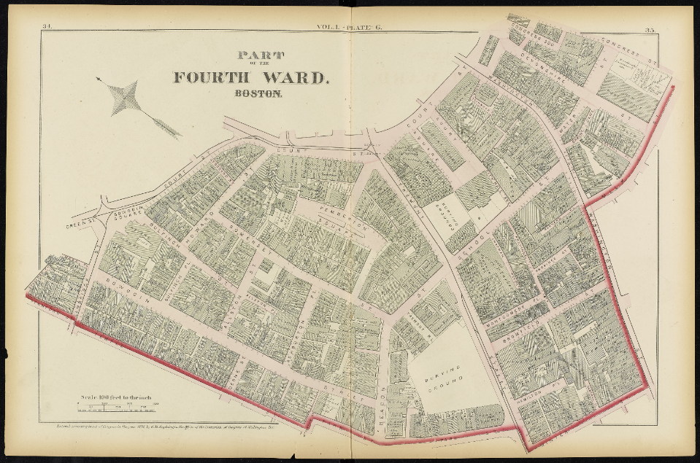

Slide 21
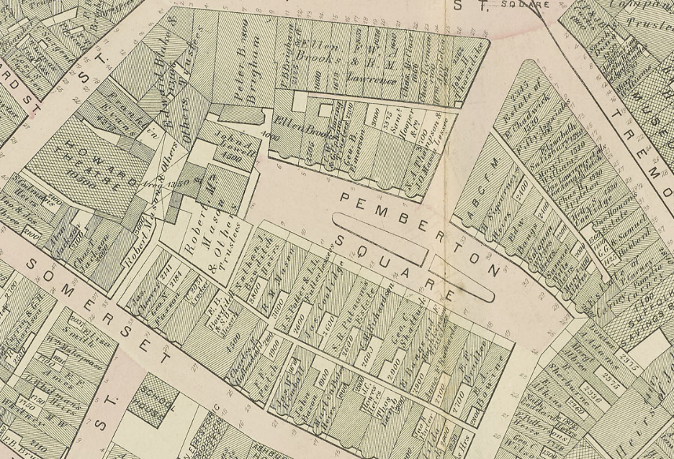

Slide 22
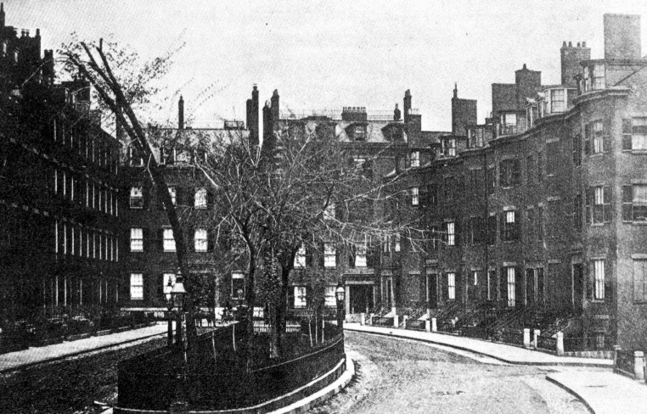
Pemberton Square, Boston

Slide 23
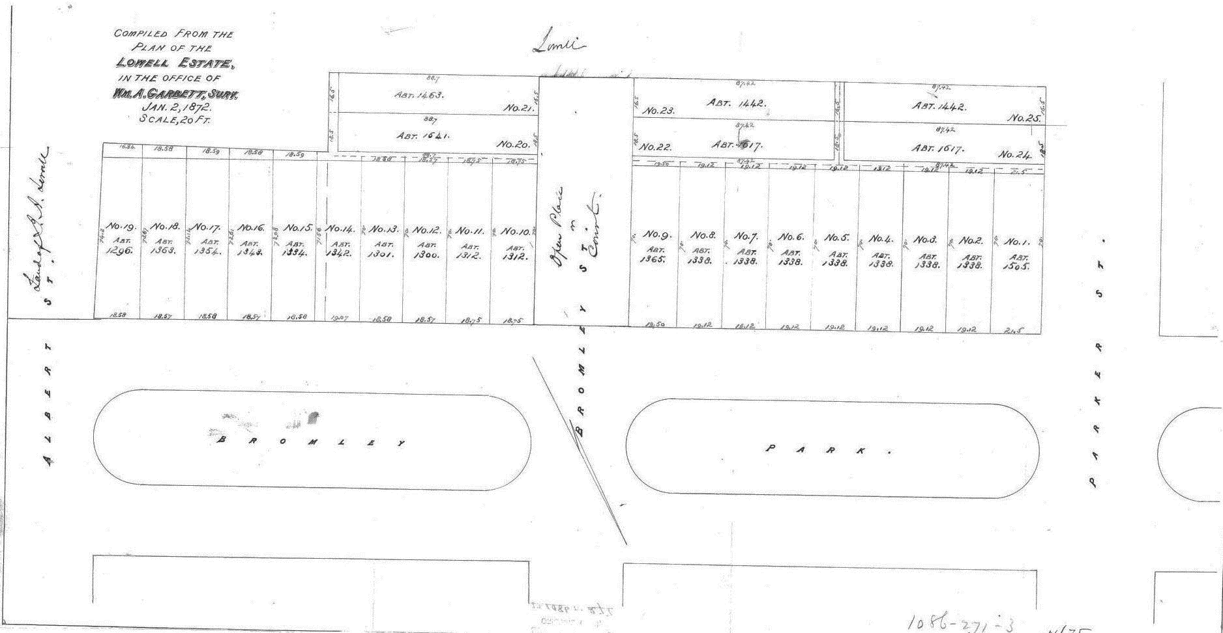

Slide 24
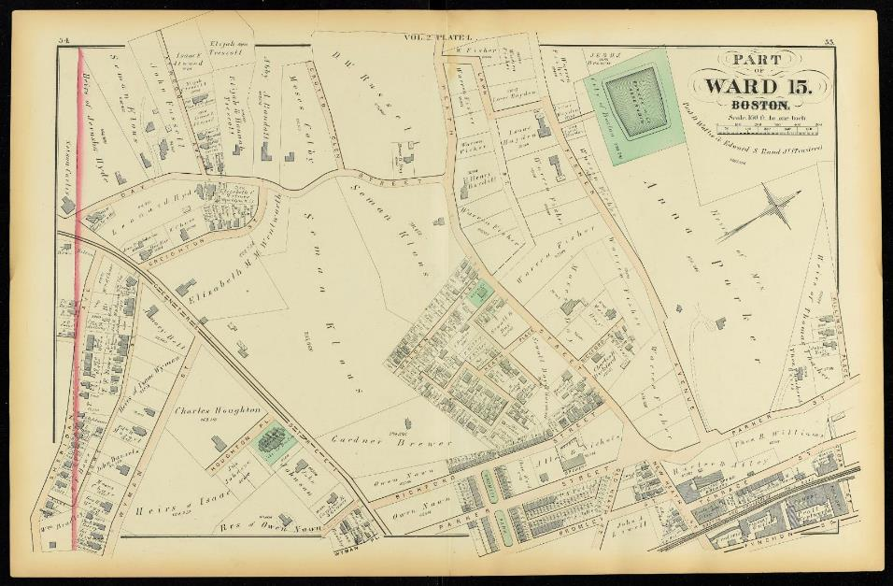
1873

Slide 25
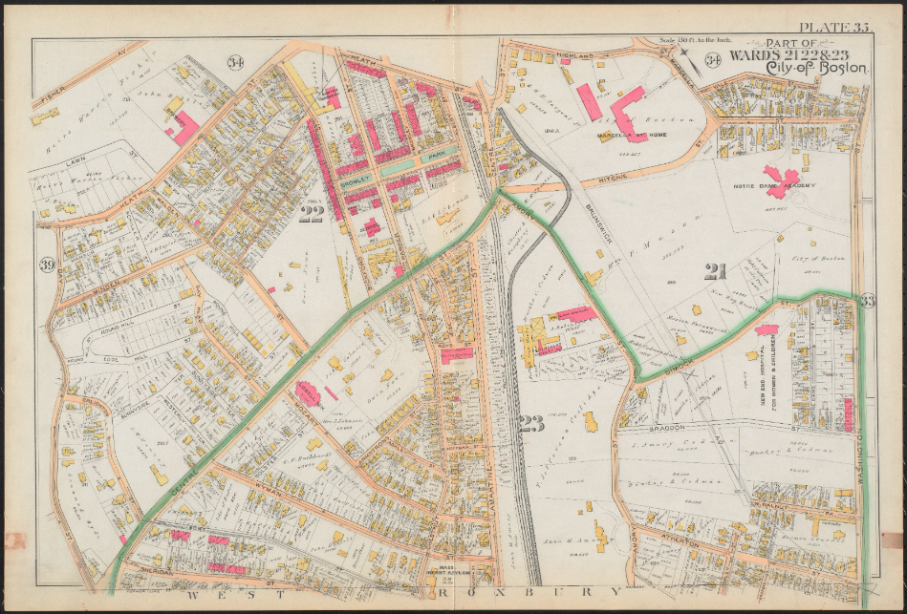
1890

Slide 26
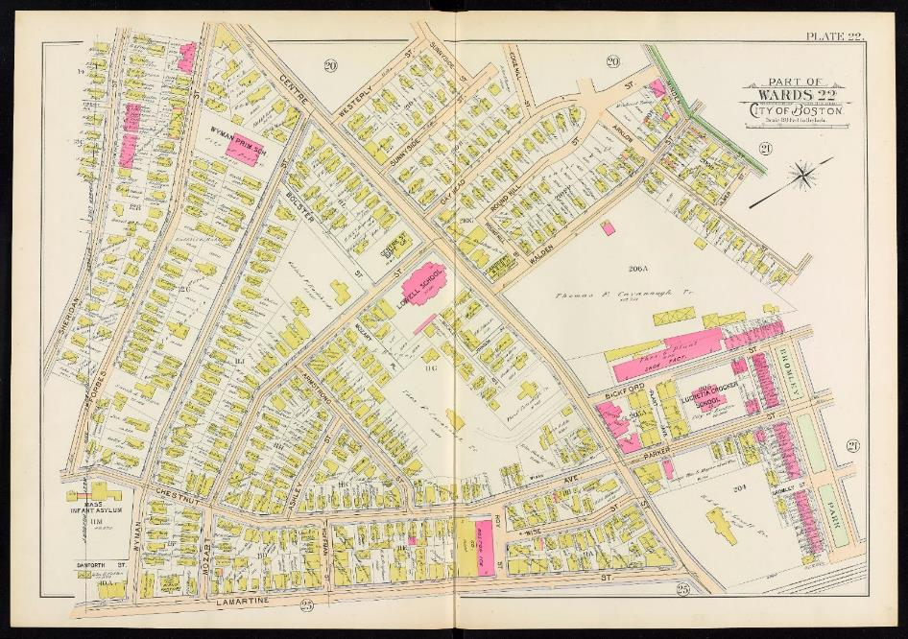
1899

Slide 27
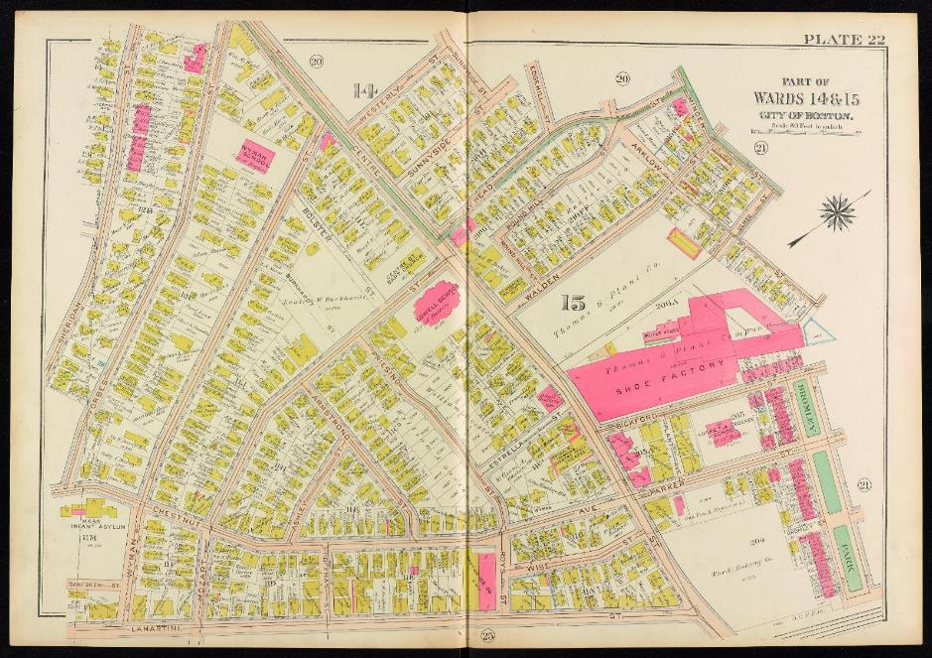
1915

Slide 28
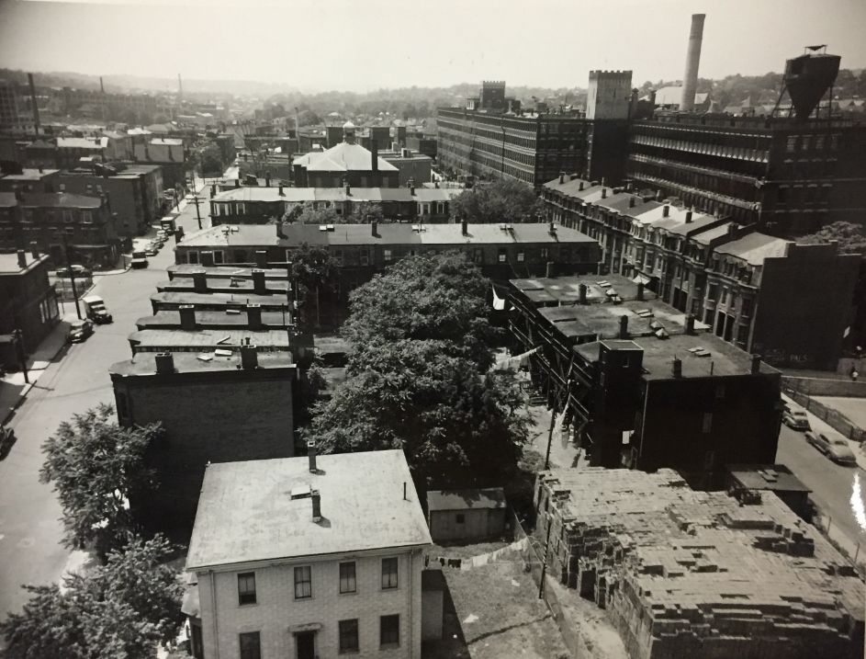

Slide 29
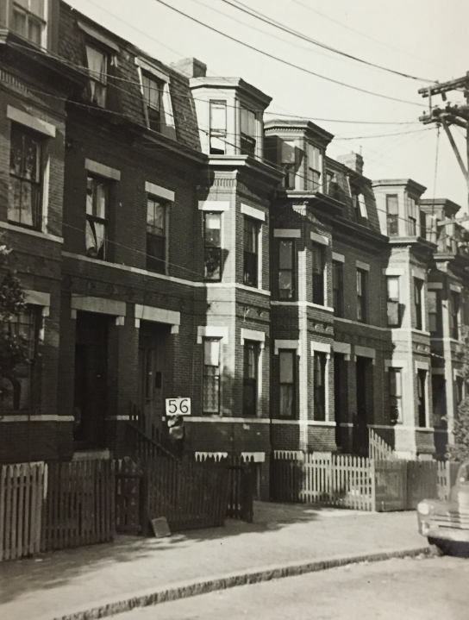
21-37
Bromley Park

Slide 30
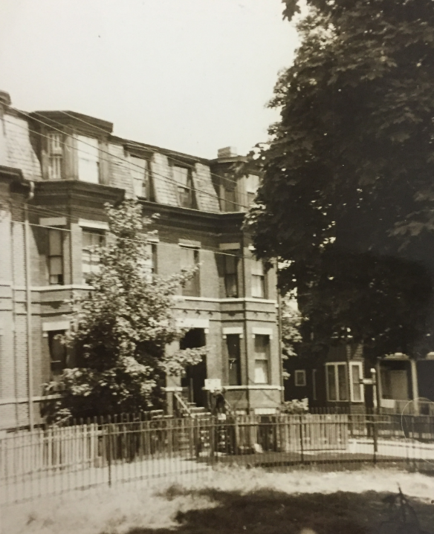
21
Bromley Park

Slide 31


Slide 32
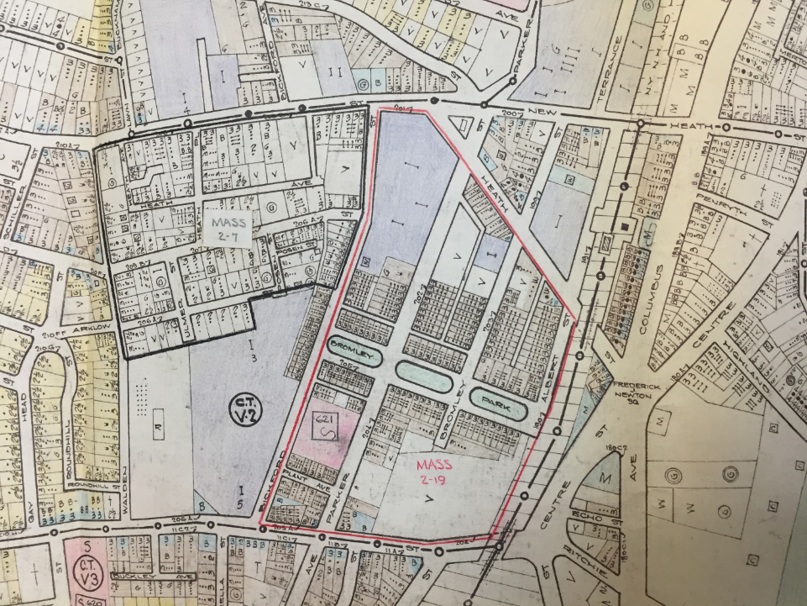

Slide 33
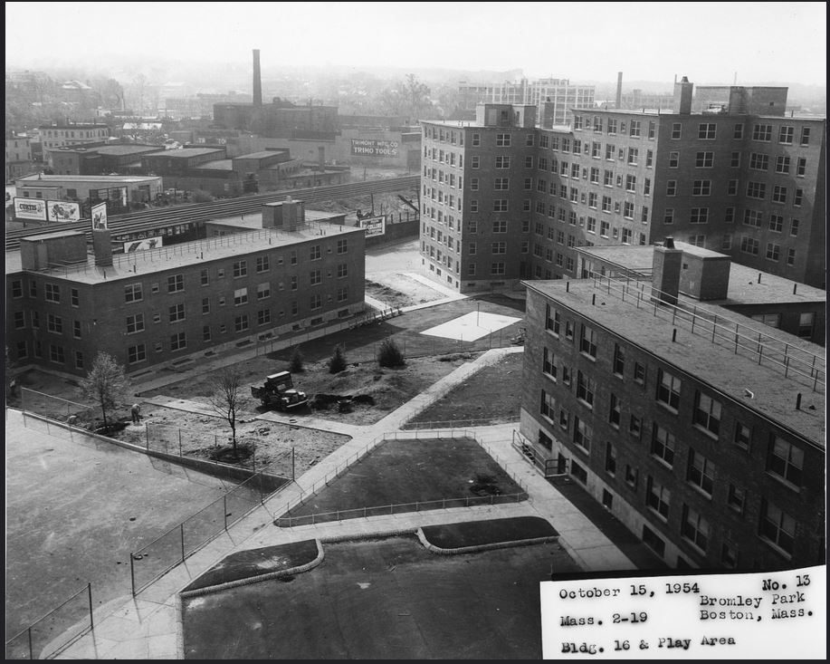

Slide 34
