Slide 1
Dynamic Cities
Revitalizing Commercial Zones
Sample List of Presenters

Slide 2
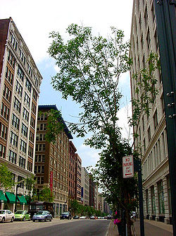

Slide 3
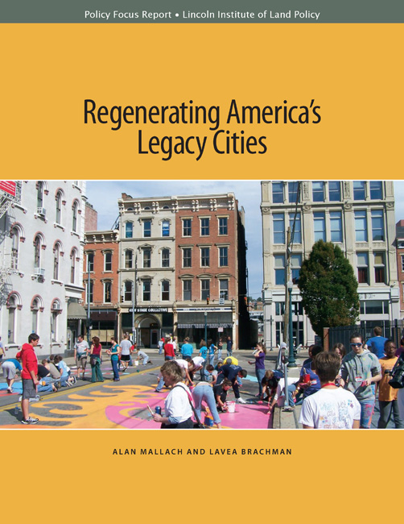
http://www.lincolninst.edu/pubs/2215_Regenerating-America-s-Legacy-Cities

Slide 4
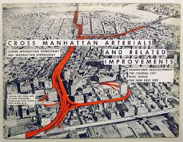
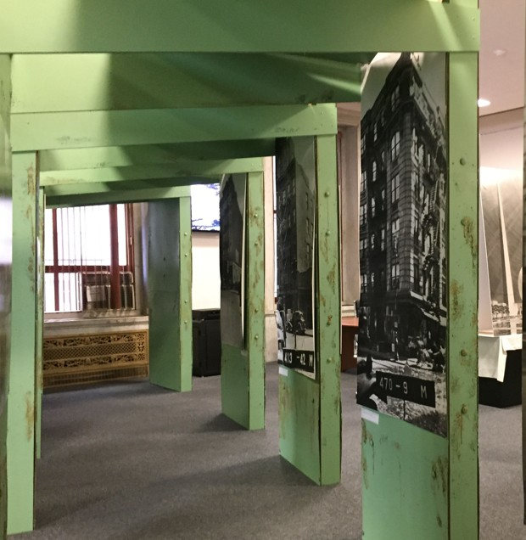
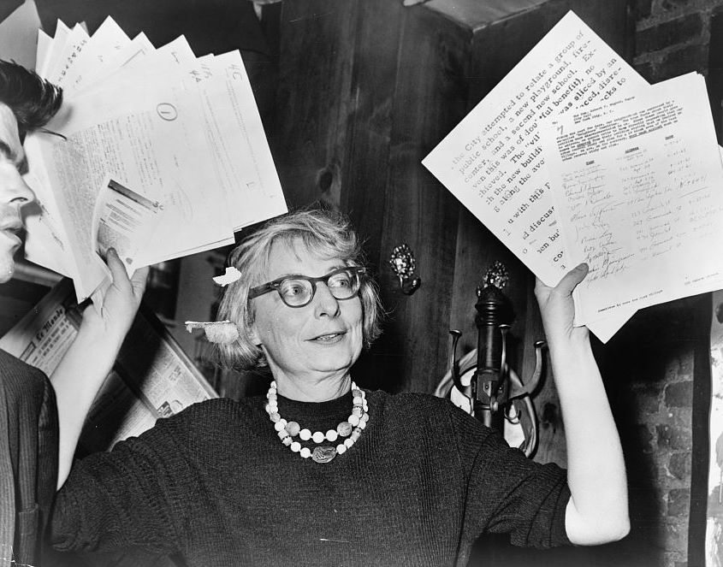

Slide 5
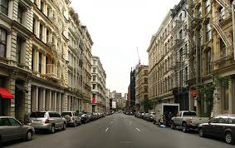
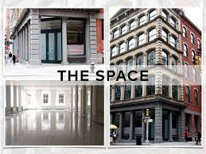
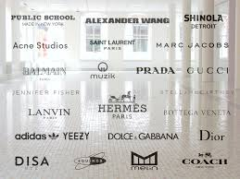

Slide 6
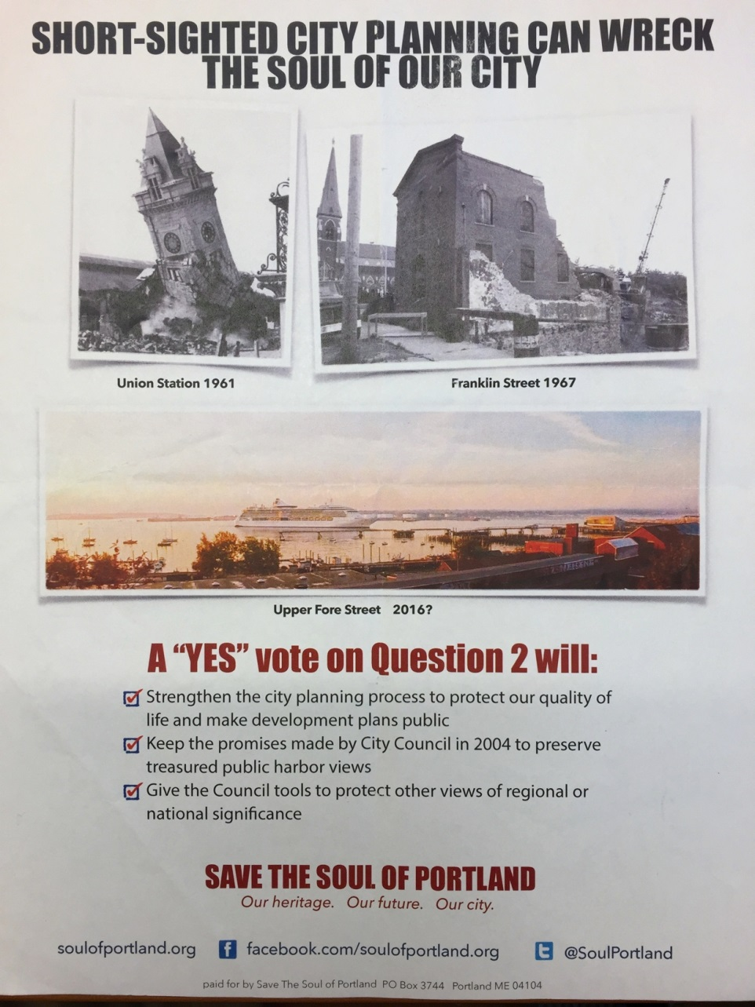

Slide 7
Anthony Flint
Fellow
Lincoln Institute of Land Policy
anthony.flint@lincolninst.edu
@anthonyflint
113 BRATTLE STREET CAMBRIDGE MA 02138 LINCOLNINST.COM @LANDPOLICY

