Slide 1
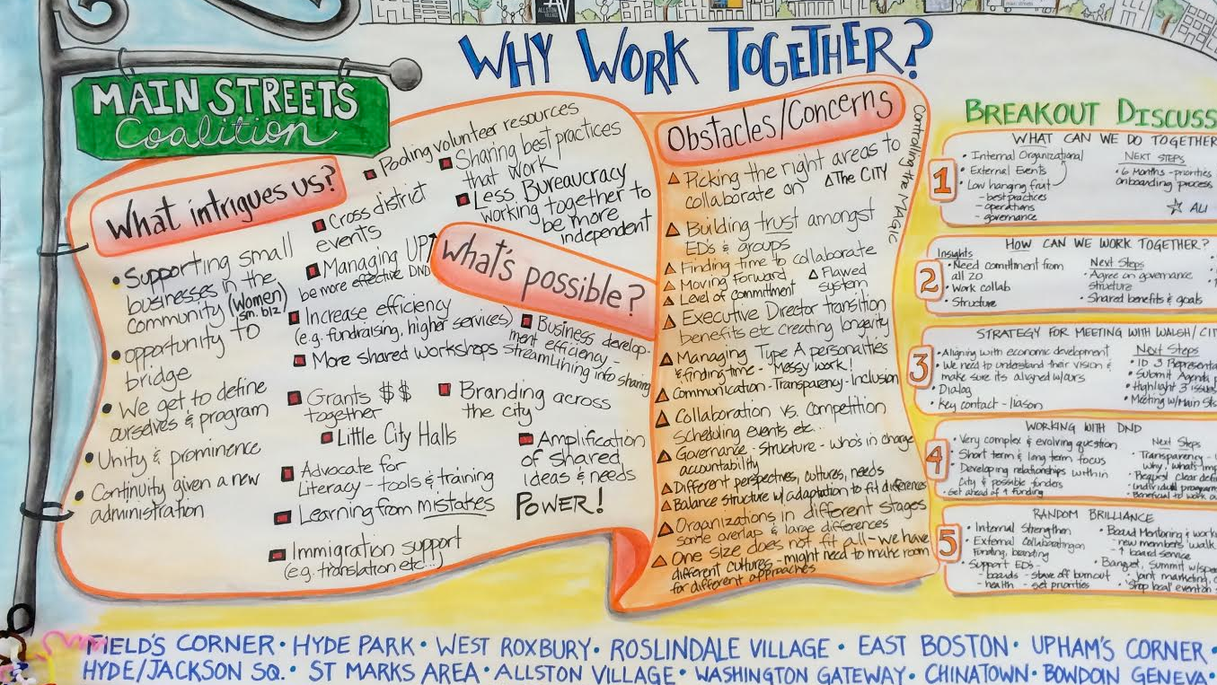
Backstage on main street
Negotiating Change in Boston’s Latin Quarter
Notes:
The title of this presentation is Backstage on Main Street: Negotiating Change in Boston’s Latin Quarter. The Main Street program is a national model of commercial revitalization that offers residents, business owners, and representatives from community organizations tools to rebuild the economic strength of neighborhood commercial districts. Boston is home to 20 Main Street programs which operate as non-profit organizations within the city office of business development, serving as an award winning model of what an urban based version of the program could look like. In what I can only describe as a stroke of luck, I was invited to the monthly city-wide Main Street director’s meeting where the city’s first small business plan was shared with the group of directors. As the plan was passed around the room that only minutes before was filled with a cacophony of voices, the group of directors fell silent, digesting the goals and recommendations outlined on the pages. After a few minutes the group started to ask general questions about the process, they seemed to be building up to something. Finally one of the director’s posed a more pointed question: does anything in this plan threaten our work? (next slide)

Slide 2
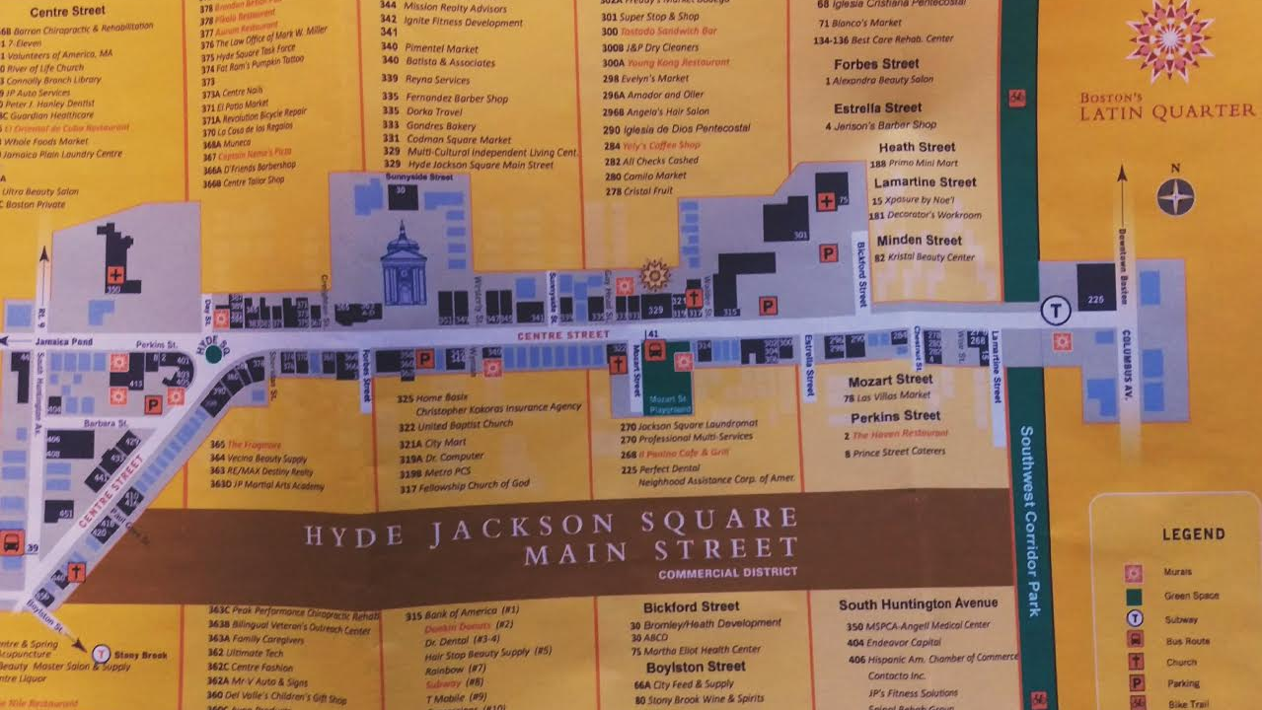
Site: Boston's LATIN QUARTER
Notes:
While the answer to that question was no, coupled with an explanation of how the plan actually supports the role of the Main Streets, that moment speaks to a growing concern Main Street programs negotiate, that is a sense of uncertainty about what the future holds.
Over the past seven months I have conducted participant observation in two Main Street districts in Boston: Hyde Jackson Square and Egleston Square. In this presentation I will focus my attention on Hyde Jackson but it is important to acknowledge the spatial proximity of the Main Street districts in JP.

Slide 3
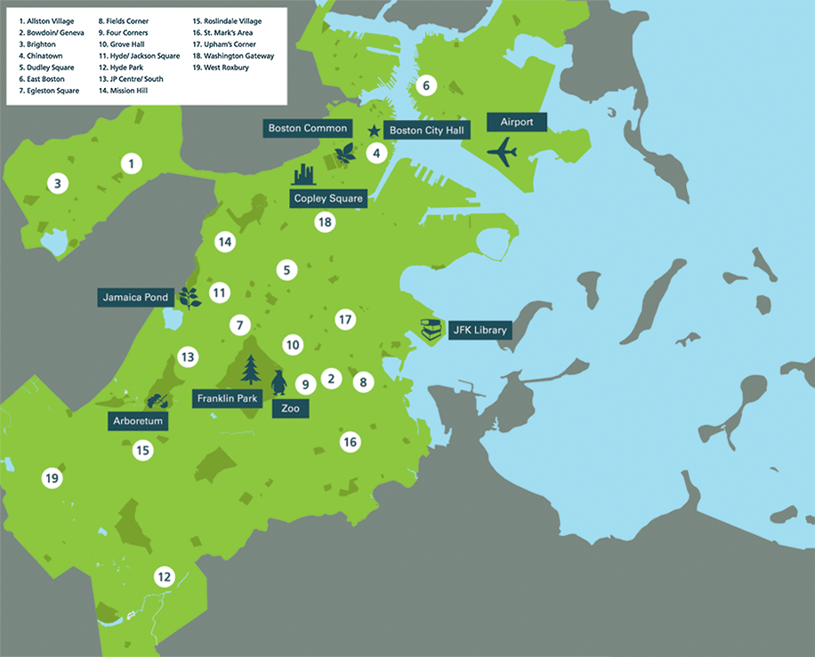

MAP OF BOSTON MAIN STREET DISTRICTS
7: Egleston Square
11: Hyde/Jackson Square
13: JP Centre/South
Notes:
Jamaica Plain is one of the three Boston neighborhoods with multiple Main Street programs. Two of the districts divide up Centre Street, one of the major streets in the neighborhood, two of the districts also share parts of Columbus, a street that many refer to as the dividing line between Jamaica Plain and the neighborhood of Roxbury. The Hyde Jackson Square is sandwiched in the midst of this divided landscape. Go one direction down Centre Street and you will enter JP Centre/South Main Streets, a space marked by boutiques, trendy restaurants, and commercial landmarks like JP Licks. Go the other direction down Centre and make a right on Columbus, you will enter Egleston, affectionately called Hyde Jackson’s “sister district”. The smell of Starfish Market and the site of barbershops, will greet you. Hyde Jackson Square, a district promoted as “Boston’s Latin Quarter”, faces gentrifying pressures in both the residential and commercial landscape which places tension on the district’s celebration of the past and calls into question its future identity.

Slide 4
Research Question
How does a community based organization engage with a neighborhood’s past while planning for the future?
Notes:
In 2011, this district lost Hi Lo Supermarket, a grocery which catered to Latino communities both inside and outside of the neighborhood.. Hi Lo was replaced with a Whole Foods and four years later a new restaurant who described its offering as low country southern joined a street filled with Cuban and Dominican restaurants, becoming only the fifth restaurant out of 20 in the district to offer beer and wine. In the face of this broadening range of commercial experiences I felt compelled to pose the following question: how does a community based organization engage with a neighborhood’s past while planning for the future? (Next Slide)

Slide 5
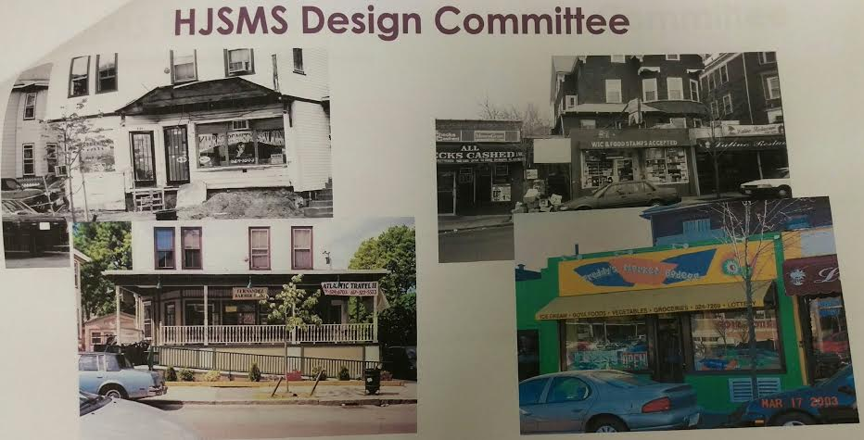
Case Study and Methods
Research Site
  Hyde Jackson Square Main Street (Jamaica Plain, MA)
Methodology
  7 months participant observation
  12 in-depth interviews
Notes:
I spent much of my time with Hyde Jackson observing board meetings, committee meetings, and neighborhood events. The neighborhood Main Street program consists of four committees: design, promotions, economic development and organizations and most of my time was spent in the first three. One of the main responsibilities of the design committee is store front improvement projects, and the picture shows a snapshot of the organization’s catalogue of storefront improvement projects in the district.
In meetings I paid particular attention to the ways in which participants attached meaning to different symbols and how they framed the district’s narrative. In addition to my observation, I also interviewed staff from the city-run program and the board and executive director of the neighborhood main street district.

Slide 6
Diversity and Moral Ownership
“When local shops change from one type to another, longtime residents and users experience a wrenching sense of loss. They have lost their “moral ownership” of the street, a sense of belonging that goes beyond legal property rights, and is based on a deep identification with the culture of the space.” (Zukin, Kasinitiz, and Chen 2015: 24)
Notes:
Beyond what the closing of a longtime Latino grocery store and the opening of a upscale Southern themed restaurant tells us about how a neighborhood is changing, I wanted to situate this work and my questions within broader concerns around how urban spaces are lived, produced and imagined. I engage with the concept of moral ownership, focusing on how Main Street both helps to create and negotiate a sense of belonging that goes beyond legal property rights, based on deep identification with the culture of the space, hopefully avoiding a wrenching sense of loss among long time residents and business owners.
An attention to moral ownership, leads me to focus on how actions and symbols create a sense that certain groups “own” the street, a state that comes at the exclusion of others. I approach moral ownership as a dynamic process that helps us to understand how in some moments it is empowering for marginalized communities, promoting spaces where their bodies, tastes, and way of being in community are celebrated but in another moment moral ownership can threaten these same marginalized communities, when more affluent neighborhood actors challenge their claims to the streets. I set about a task of unpacking this narrative path, asking how local identities and social diversity are put at risk

Slide 7
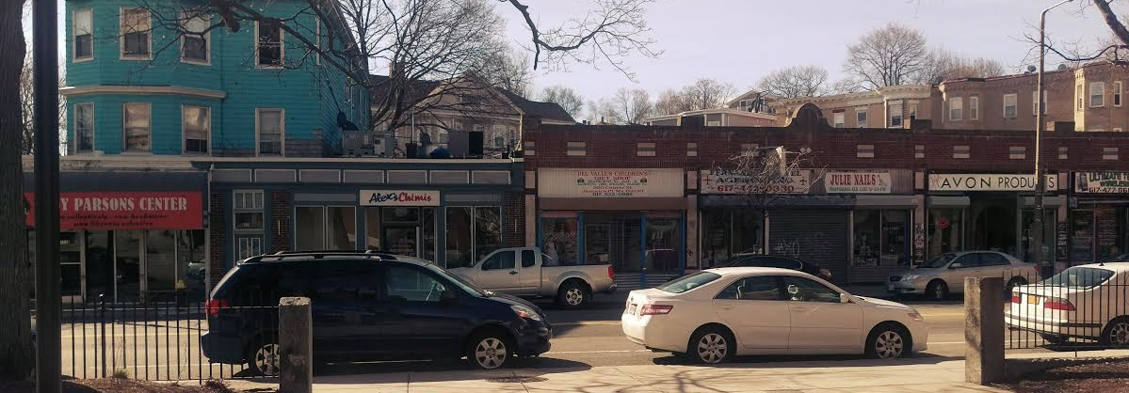
Neighborhood Past, Present, and Future
Notes:
Every neighborhood organization has to in some way wrestle with the past, present, and future visions of place. The past can lay the foundation of who to preserve and offer the beginnings of a neighborhood reputation. The future can operate as a thought experiment or wish list, where a group answers the question of: what do we want this place to look like. And the present is perhaps the most difficult, where in this moment organization’s must decide what they want to do about both the past and the future right now.
As I mentioned before, Hyde Jackson Square Main Street is sandwiched between two other Main Street districts. In my conversations with three board members who lived in the neighborhood as children and the executive director, each identified Egleston Square as the district Hyde Jackson once was. The director described how many of the people that shopped at Hi-Lo, a Latino grocery store that once served as a bookend for the district, would also frequent Egleston, painting a piece of two districts that shared a customer base. This is quickly followed by a comment about how economic pressures have changed Hyde Jackson more so than Egleston, turning these once similar landscape into distinct streets.

Slide 8
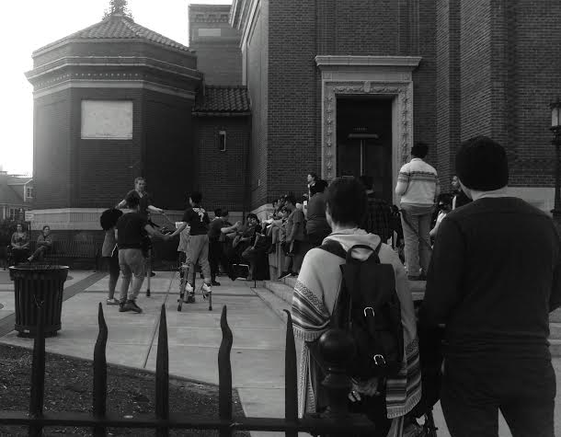
Constructing the Past
I mean that is our culture, that is you know, the people playing dominoes, the cars passing by with music, and you don’t see that anymore. – HJSMS Board Member
Notes:
Once referred to as the “cocaine capital of New England” by police, Hyde Jackson Square experienced a renaissance not dissimilar from other urban neighborhoods, where communities joined together to reclaim their streets. The picture featured captures one of the spaces the community has rallied around, the Blessed Sacrament Church, a once active religious institution that now serves as the backdrop for summer arts performances.
One way in which members of the Main Street organization reflect on the neighborhood’s past is through a focus on public space, a domain at the center of many neighborhood run initiatives to combat decline and crime. Throughout my interviews board members described informal gatherings that took place in abandoned lots, parks, and sidewalks. They recalled a time when adults would congregate on the sidewalks while kids ran in and out of stores, suggesting a fluidity between private space and the street. In various settings, board members identify the ways in which this use of public space is culturally significant and marked the district as one for Boston’s Latino community. During an economic development meeting a board member brings up Del Valle’s, a children’s clothing store that sells religious attire for baptisms and communions, commenting on how the loss of the Blessed Sacrament Church and the large Latino congregation severely crippled the store. Similarly describing a divergence from the past, after I asked a board member to tell me about her favorite memories in the district, she described how many of the street scenes from her childhood were erased, saying: “I mean that is our culture, that’s just you know, the people playing dominoes, the cars passing by with music, and you don’t see that anymore.” For this board member, the experience of the commercial district was not communicated through the shoppers and their aesthetic perception of the area, but rather it was created through informal interactions between people hanging out in public spaces.

Slide 9
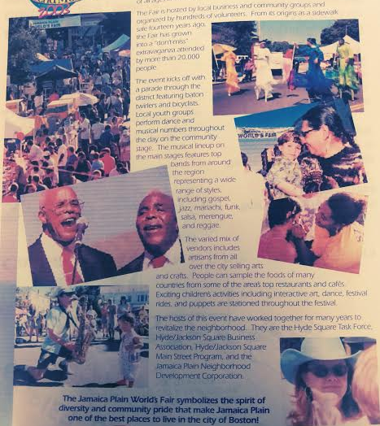
Preservation narratives
There used to be a time when people would go back and forth between Pimentel Market and Old Havana – HJSMS Director
Notes:
This sense that the street used to not only look different, but operated differently, echoes throughout my observation. In the process of identifying the clusters present in the commercial district, the executive director occassionally brings up the ways in which services and business in the district once complemented each other. During another economic development meeting Del Valles comes up again, this time as a space which benefited when Sonia’s Bridal, a store specializing in quinceria dresses, operated across the street and sent them customers. Now Sonia’s is closed, an absence that affects several other districts in the immediate vicinity. After describing the shared customers of Del Valles and Sonia’s, the director goes on to identify another complementary business relationship that no longer exists, saying: (QUOTE)

Slide 10
Imagining the future
And I would like, I would like it to be more…that’s why I thought the sidewalk sale would be a nice idea. Because I suggested that the sidewalk sale and I was going to call it “JP Inside Out” because I think that if things are outside and you get to see things and get to meet people, you don’t have to make the commitment of going into a shop. You see the stuff on the outside and you see the people and it’s less intimidating. Then maybe afterwards you feel more comfortable going into the shops. –HJSMS Board Member
Notes:
If the past is marked by a significant Latino community in both the residential and commercial spheres, the future is imagined as a time when affluent neighborhood residents will occupy the residential space and groups unfamiliar with Latino businesses will impose new standards of operation and representation for the commercial space. In an interview with a board member whose involvement with the organization is relatively recent, in the past two years, we spent some time reflecting on the businesses in the district he feels comfortable frequenting and why. He tells me about an experience he had entering a tailor in the district, where everyone was speaking Spanish, he describes this event as jarring and uncomfortable. He left wanting to find a way to help others like him feel more comfortable and less intimidated approaching new businesses. In describing his imagined solution he says, (QUOTE)
This board member, and several others, anticipate a future where many more residents and visitors will hold a sense of discomfort entering businesses where they are unfamiliar with the products or the language. Importantly this future is discussed as inevitable, and the organization strives to make it as beneficial as possible.

Slide 11
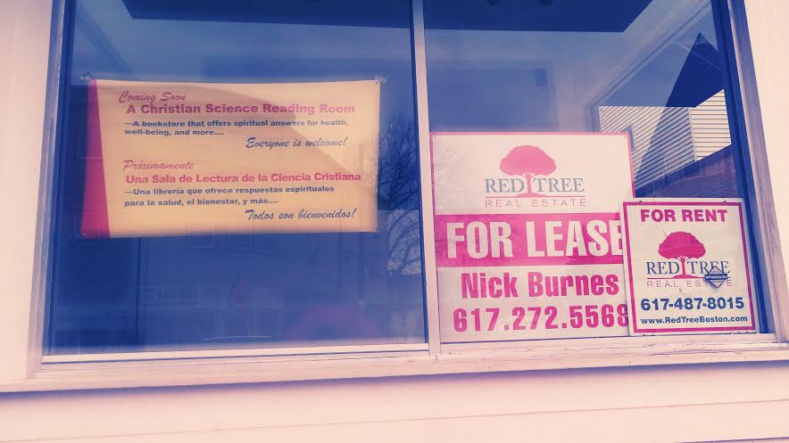
FUTURE NARRATIVES
We don’t want to respond to crisis, we want to get ahead of it” – HJSMS Staff
Notes:
This sense that change is coming and the subsequent speculation of what it will look like, pushes the organization into a strategic mode of operating. The group recently began a year long cultural asset mapping process where they set out to answer the following question: “what are the assets we are going to put our stake in preserving?” This need to get out in front of change is articulated most frequently by the executive director, a position which requires the occupant to steer and continuously motivate a volunteer board in addition to ongoing engagement with business owners in the district. In a meeting where the design committee was brainstorming which buildings the group should work towards preserving the director encouraged the group to think proactively, saying “we don’t want to respond to crisis, we want to get ahead of it.”
This sense that change is on the horizon is reiterated by prospective developers and new businesses looking to enter the district. After listening to a pitch by a fast casual restaurant franchise looking to open at one end of the district, the members of the economic development committee asked why this franchise with locations in California, Behrain and Kuwait, wanted to open another location in Hyde Jackson Square. The franchise owners started to list off the other places where they are hoping to open: Saudi Arabia, Qatar, and New York, before concluding: this is a growing neighborhood and this is a growing franchise.
This prediction that the commercial district is set to change in significant ways, makes it attractive for parties with global interests, and suggests that the future district will reflect a glossier cosmopolitanism similar to global cities.

Slide 12
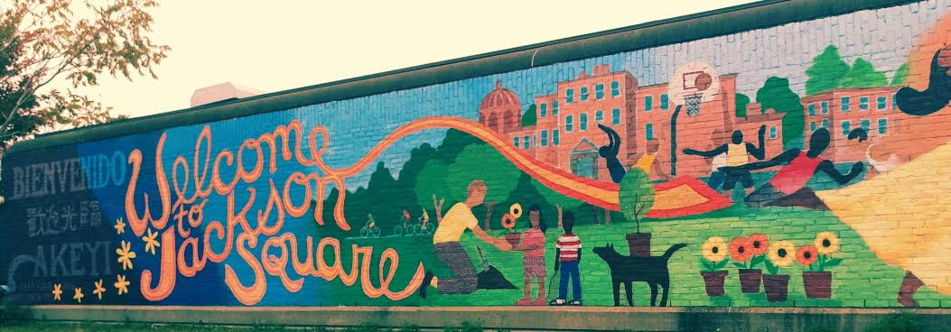
Managing the Present
Notes:
Given this recognition of the street’s past as shaped by a strong Latino community and its future marked by a new population, how then does this organization negotiate the present. In one sense it appears as though the organization has already started the process of moving towards the future. In distinguishing HJSMS from Egleston the director says: “HJSMS is further along in its progression of being rediscovered by the general American population.” This statement draws attention to the broader range of customers the district now caters to. However this forward progression is not uninterrupted. During a meeting with staff from the Main Street districts in JP, one of the directors brings up several violent incidents that occurred in HJSMS over the past few months, saying “I’m scared, it is hot right now.” While the incidents occurred in public spaces, such as a parking lot and in front of the T station, the commenter suggests that this could serve as the beginning of another downward spiral. This type of comment highlights the enduring quality of the neighborhood’s past reputation, where moments of violence draw attetnion the precarious nature of the district’s current identity as a Latin Quarter and space that is attractive to different groups of people.
Uncertain, precarious
The director immediately defends against these comments, explaining how these were not random incidents and how it was unfair to suggest the neighborhood was somehow going backwards to what it used to be.

Slide 13
UNCERTAIN MORAL OWNERSHIP
HJSMS Staff: That is the promotions piece that is the trickier piece right now because there is the idea of “Boston’s Latin Quarter” but there is no secondary thing and um we all need to learn what that is.
TC: What do you mean secondary thing?
HJSMS Staff: Well there is no other thing there is no other options. Right now it is only “Boston’s Latin Quarter” or I call it Hyde Jackson Squares, which is a slightly better ring than Hyde slash Jackson square. So there is a void in information and strategy in how we market the neighborhood. Maybe we are “Boston’s Latin Quarter” and that’s what we call ourselves.
Notes:
In the present the district is not only susceptible to doubts about its safety but also concerns over the legitimacy and accuracy as the Latin Quarter. While other cities have demonstrated the success of marketing diversity, and Boston itself has a famous example in the form of the North End, the organization finds the tension between the past and the future, as somehow crippling, calling into question their present strategies for promoting the district. In an exchange with the director he communicates how the uncertainty plays out in marketing: (QUOTE)
While the past is clear in the sense that the district once belonged to Latino communities and the future is generally outlined as belonging to a diverse cosmopolitan clientele, the present is immensely complicated and precarious, making moral ownership of the district up for question and debate. Like many other neighborhood commercial districts, Hyde Jackson Square, demonstrates how the identities and ownership of urban places are continuously transformed by actions such as the opening of new businesses, and symbols like the presence or absence of certain populations in public spaces. As organizations not only confront but live in this ecosystem that is constantly shaped and reshaped processes of gentrification they highlight how commercial streets, as the public face of community, answer the question of whose Main street is it?

Slide 14

Notes:
While the past is clear in the sense that the district once belonged to Latino communities and the future is generally outlined as belonging to a diverse cosmopolitan clientele, the present is immensely complicated and precarious, making moral ownership of the district up for question and debate. Like many other neighborhood commercial districts, Hyde Jackson Square, demonstrates how the identities and ownership of urban places are continuously transformed by actions such as the opening of new businesses, and symbols like the presence or absence of certain populations in public spaces. As organizations not only confront but live in this ecosystem that is constantly shaped and reshaped processes of gentrification they highlight how commercial streets, as the public face of community, answer the question of whose Main street is it?

