Slide 1
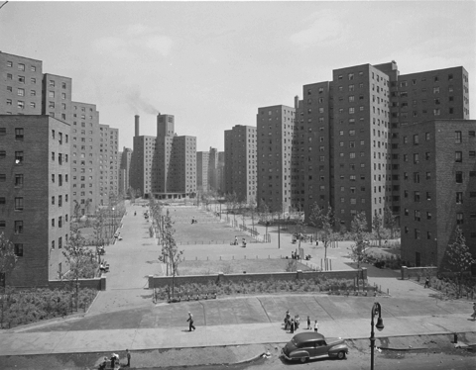
Architecture of Containment: Gender Production and Resistance in the Public Housing of Postwar New York
Jacqueline Brandon
M.A. Candidate, The History of Women and Gender
New York University

Slide 2
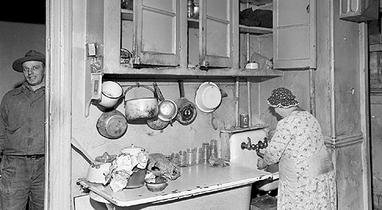
An East Village tenement, 1945

Slide 3
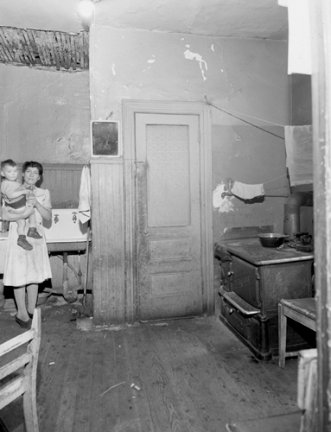
“A woman and her infant pose in their slum kitchen in the Navy Yard section of Brooklyn, February 27, 1948. These buildings were cleared away to build the 1952 Farragut Houses.”

Slide 4
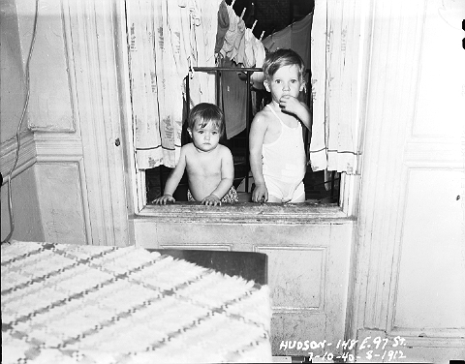
“Hudson family kids in their tenement apartment at 148 East 97th street, another East Harlem block considered for slum clearance but on which no projects were built, 07/01/1940. The Hudson family was relocated to the new Vladeck Houses in Lowers Manhattan.”

Slide 5
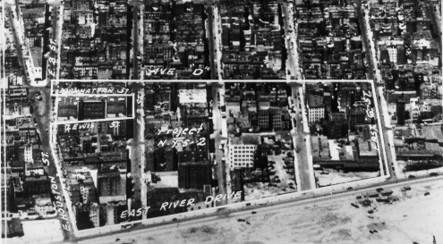
Lillian Wald Houses Before

Slide 6
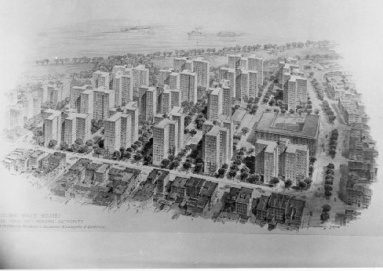
Lillian Wald Houses Architectural Plans

Slide 7
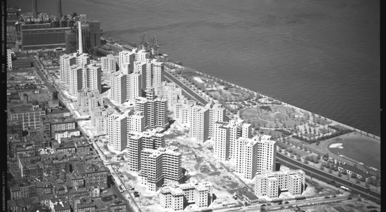
Lillian Wald Houses After

Slide 8
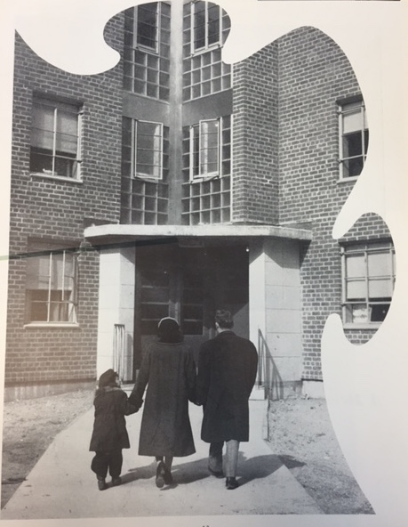
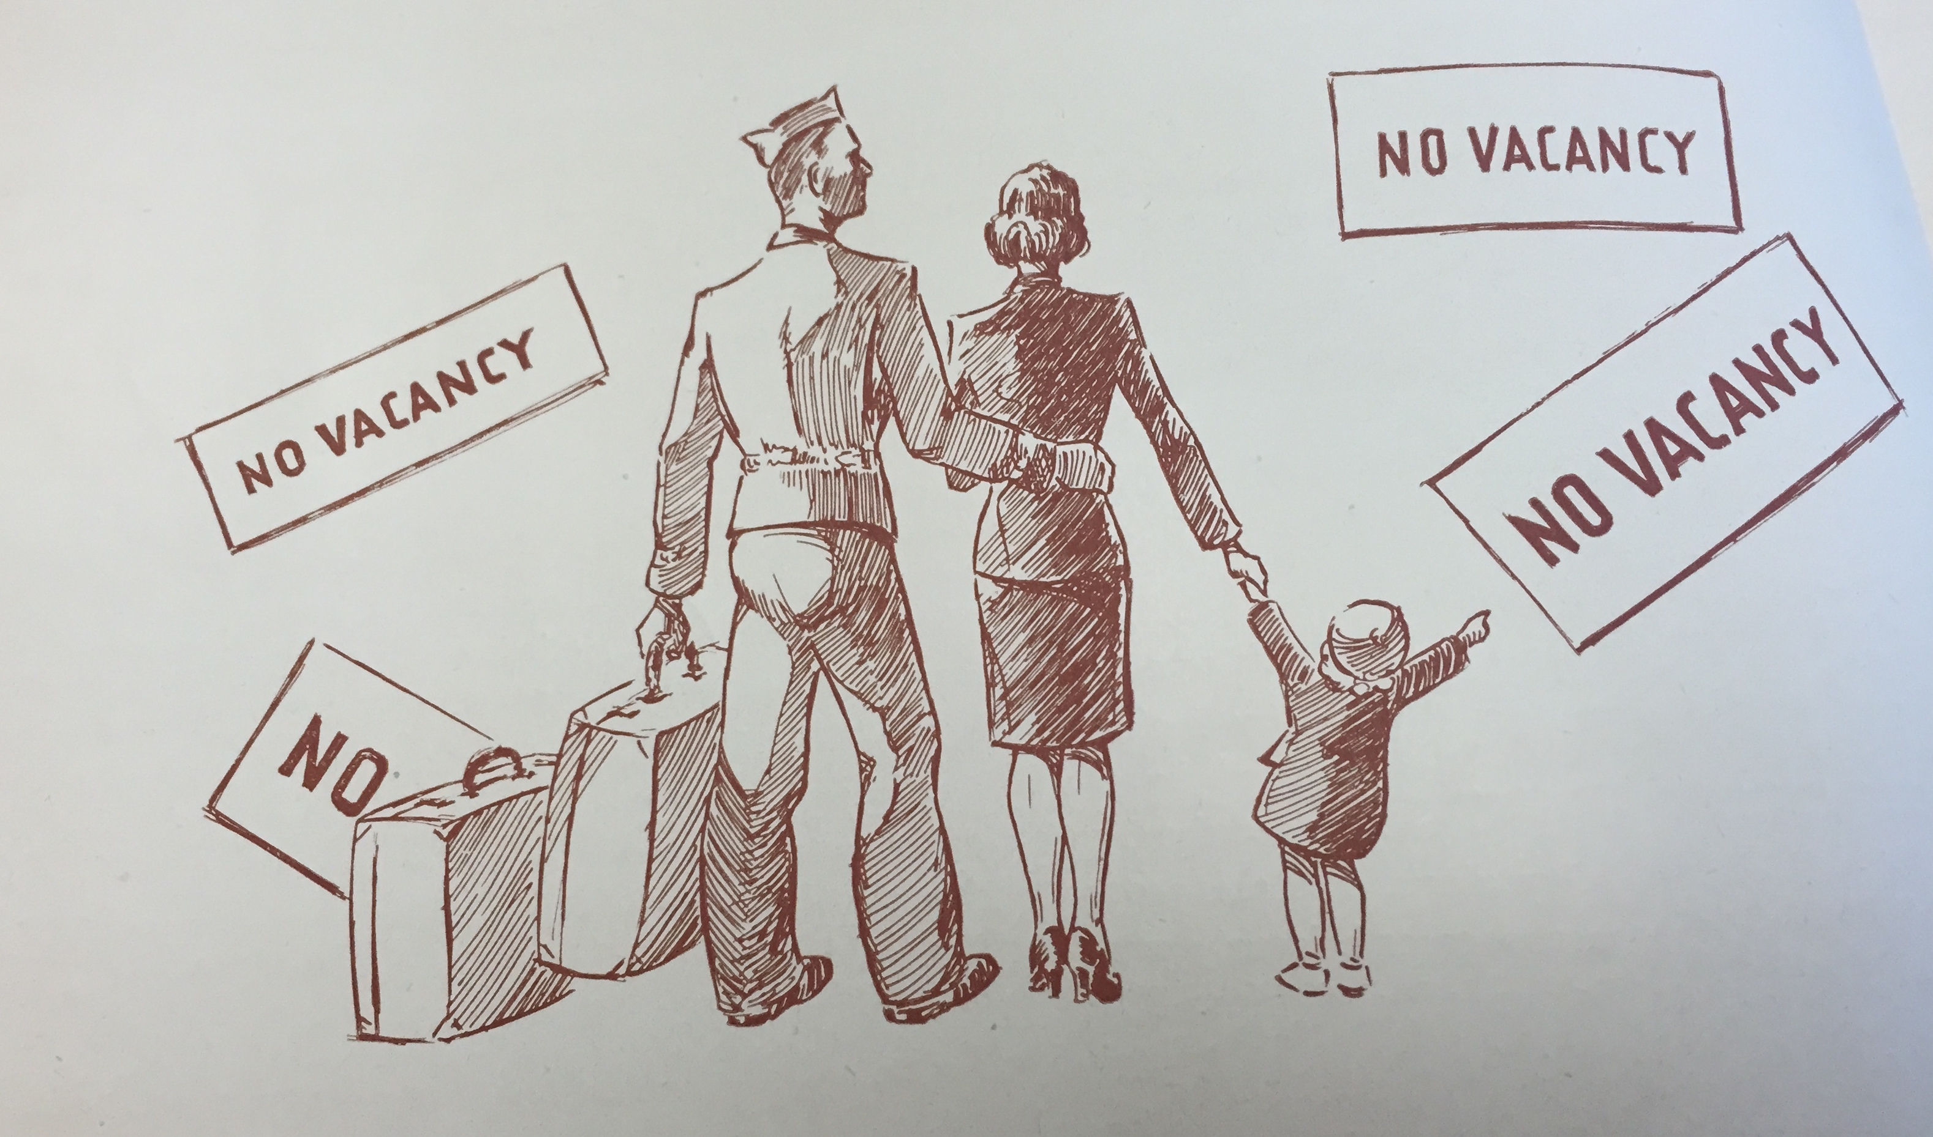

Slide 9
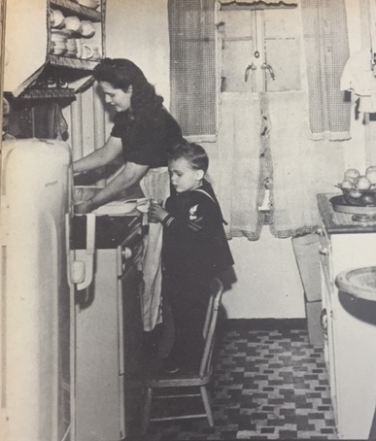
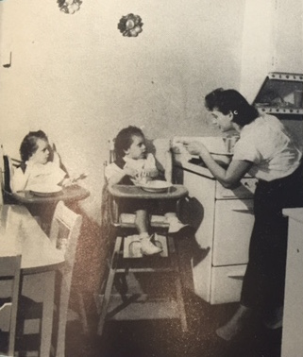

Slide 10
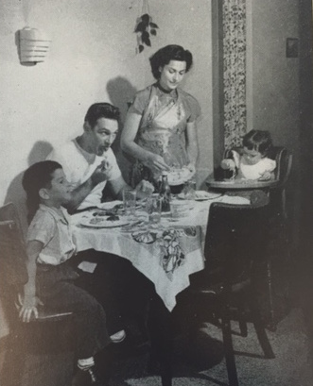
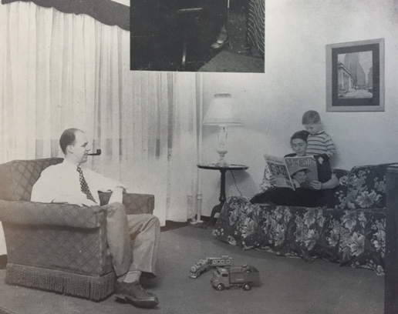

Slide 11
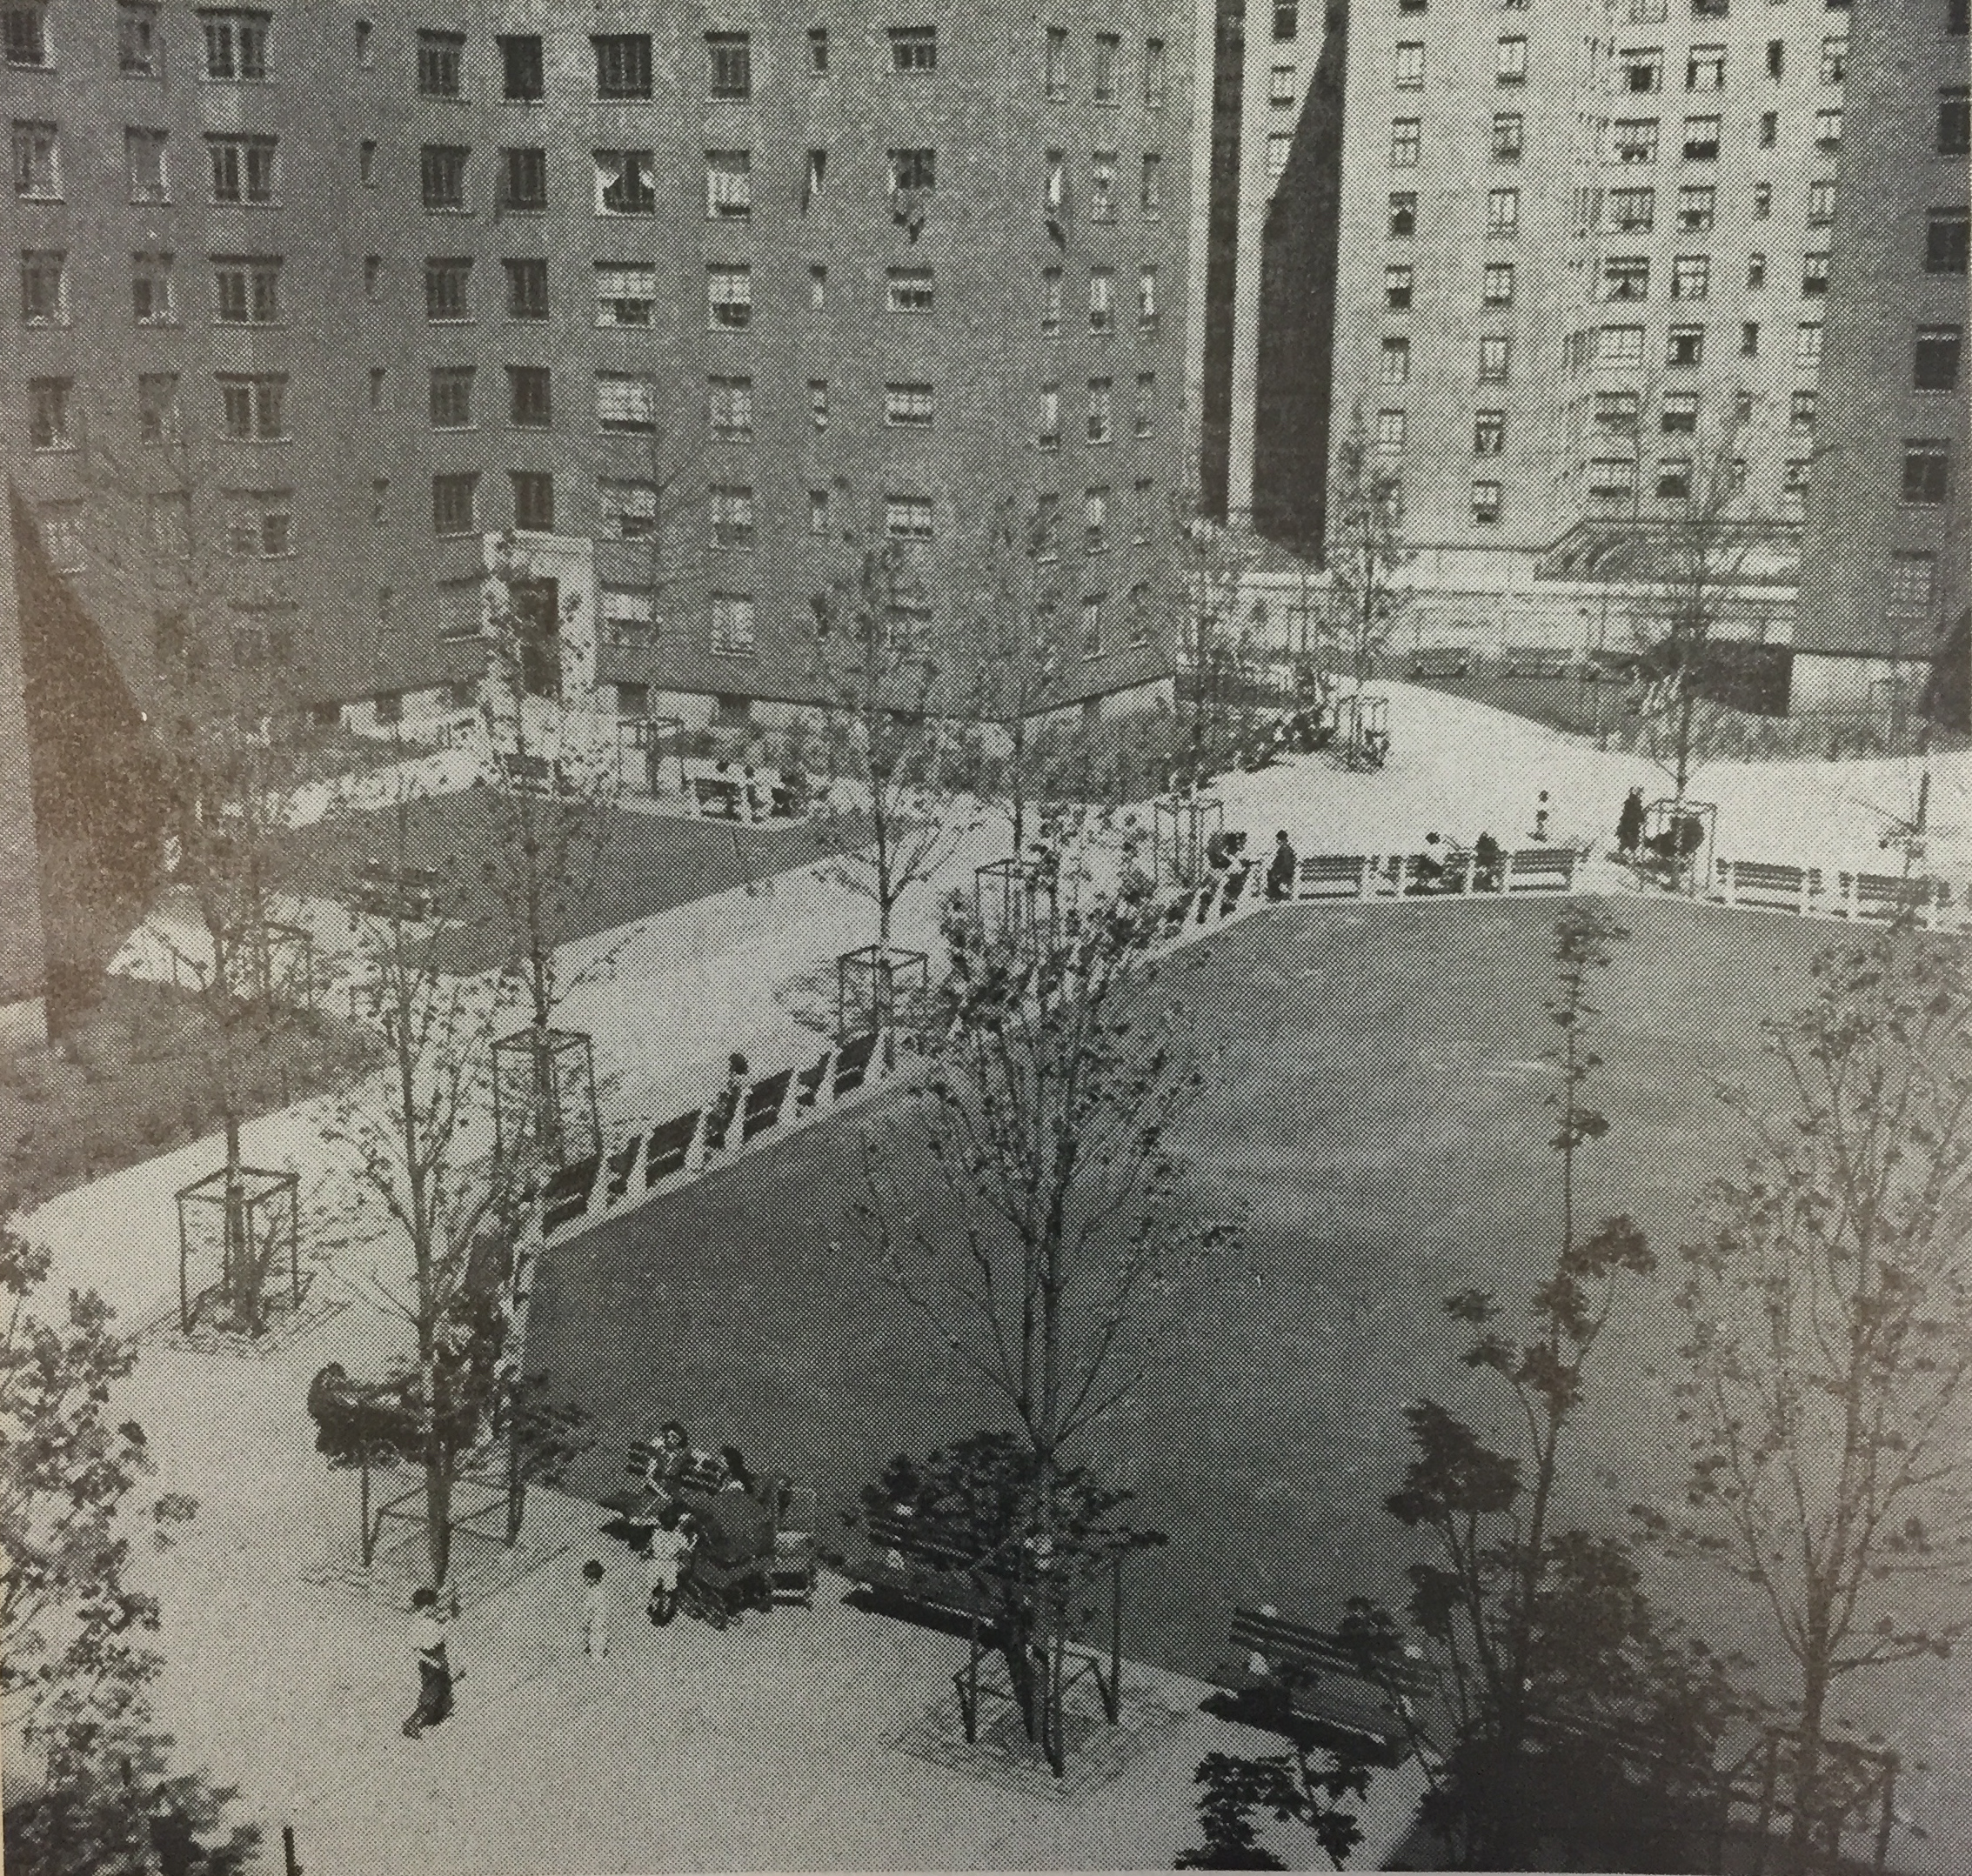
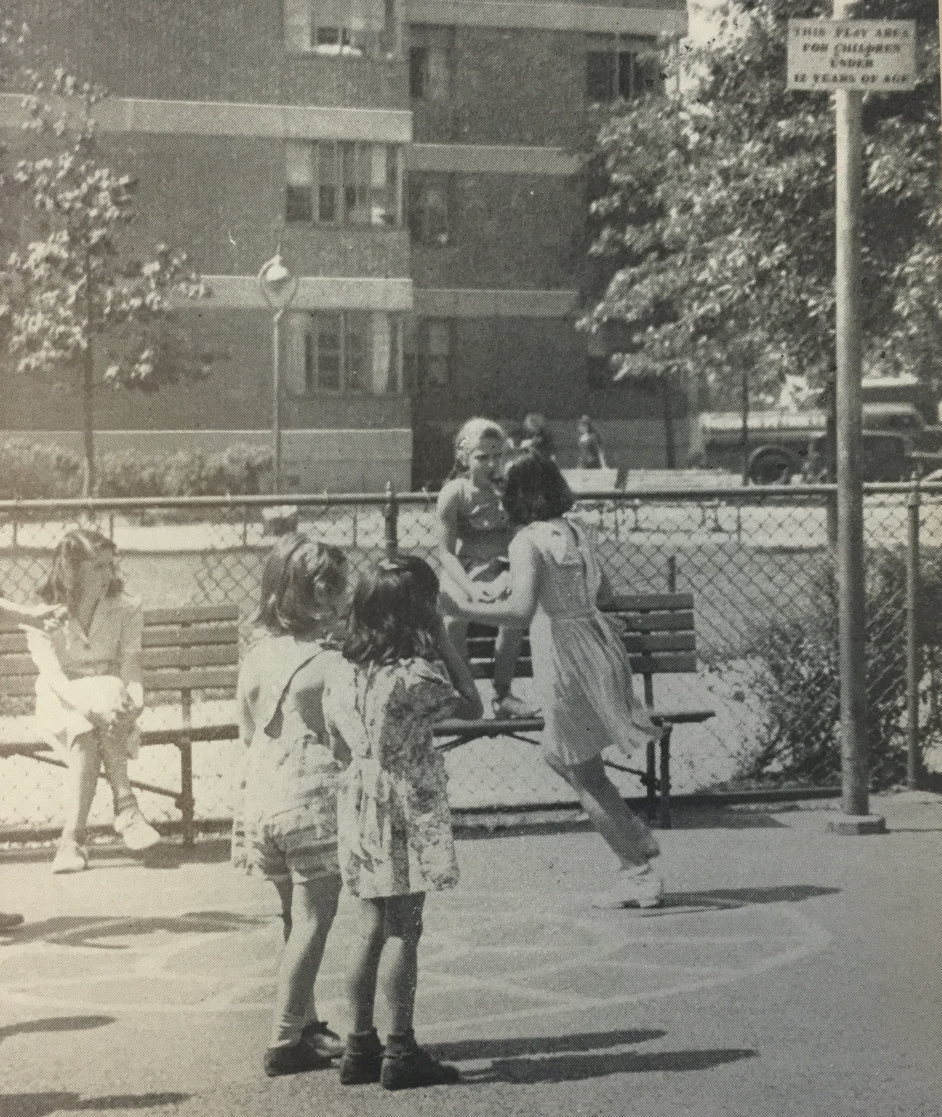
NYCHA 1947 Annual Report: “Fort Greene Houses—A Notorious Brooklyn Slum Just a Few Years Ago

Slide 12
Jacob Riis Houses

Slide 13
NYCHA 1953 Tenant Selection Policy
Birth of out-of-wedlock
Separations of husband and wife
Single parenthood
Parents under 19 years old
Lack of parent control over children
Unmarried couple together less than two years
Poor housekeeping

Slide 14
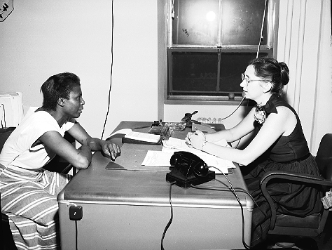
“A Tenant at Jacob Riis Houses Apparently Being Interviewed By NYCHA Manager,” Circa May 1954

Slide 15
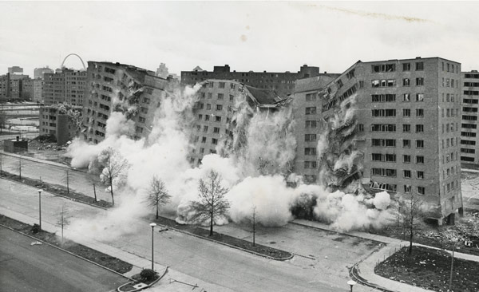
1972 demolition of the Pruitt-Igoe Houses in St. Louis

Slide 16
“Once upon a time, we thought that if we could just bulldoze the slums and build shiny new housing for low income people, all social problems involving these people would virtually disappear. That has turned out to be not so.”
–Mayor Wagner, 1962

Slide 17
Sources
Slum photo East Village: http://www.laguardiawagnerarchive.lagcc.cuny.edu/PHOTOS/nycha/photos/02.003.05871.jpg
Slum photo Farragut:
http://www.laguardiawagnerarchive.lagcc.cuny.edu/PHOTOS/nycha/photos/02.003.07855.jpg
Children in Slums:
http://www.laguardiawagnerarchive.lagcc.cuny.edu/PHOTOS/nycha/photos/02.002.01912.jpg
Lillian Wald Before:
http://www.laguardiawagnerarchive.lagcc.cuny.edu/PHOTOS/nycha/photos/02.015.16078.jpg
Lillian Wald Plans:
http://www.laguardiawagnerarchive.lagcc.cuny.edu/PHOTOS/nycha/photos/02.015.14709.jpg
Lillian Wald After:
http://cdn01.boweryboogie.com/content/uploads/2014/01/nyc-aerial-jacob-riis-lilian-wald-houses.jpg
Nuclear Family Slide 1:
NYCHA 1951 Annual Report, 13 and NYCHA 1947 Annual Report, LaGuardia Wagner Archive, Box 98D1, Folder 7, 14
Nuclear Family Slide 2: NYCHA 1944 Annual Report, 64 and NYCHA 1949 Annual Report, 27
Nuclear Family Slide 3: NYCHA 1951 Annual Report.
Lawn and playground: NYCHA 1947 Annual Report, 40 .
Tenant Selection Policy Slide: Nicholas Dagen Bloom, Public Housing That Worked: New York in the Twentieth Century, Appendix B, 277-278.
Tenant Being Interviewed Slide: LaGuardia and Wagner Digital Archive, Photo # 02.003.21200.
Pruitt-Igoe Slide: https://thoughtcatalog.files.wordpress.com/2014/05/screen-shot-2014-05-08-at-8-28-40-pm.png?w=800
Wagner Quotation:
Mayor Wagner, Address to the National Conference on Social Welfare May 27, 1962, quoted in Bloom, 124.

