Slide 1
Different Speeds:
A History of Obsolescence and Preservation Together
“A city in which there were not at all times
some worn-out or obsolete parts
would not be a dynamic city.”
Miles Colean (1953)
Daniel M. Abramson
Boston University
The Dynamic City: Futures for the Past conference
1 April 2016

Slide 2
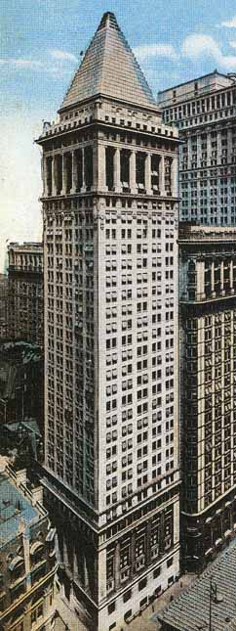
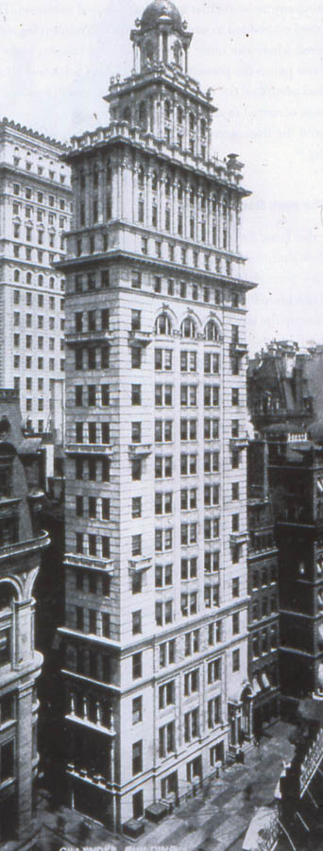
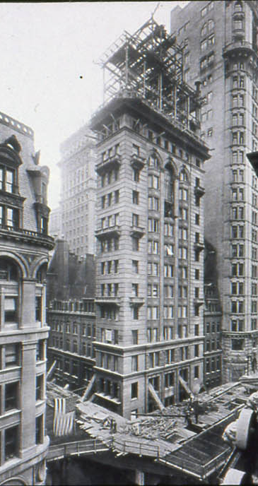
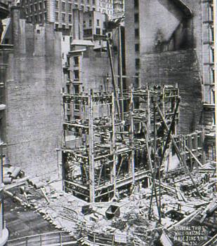
Gillender Building, New York, built 1896, demolished 1910 . . . . . . . . replaced by Bankers Trust Building

Slide 3
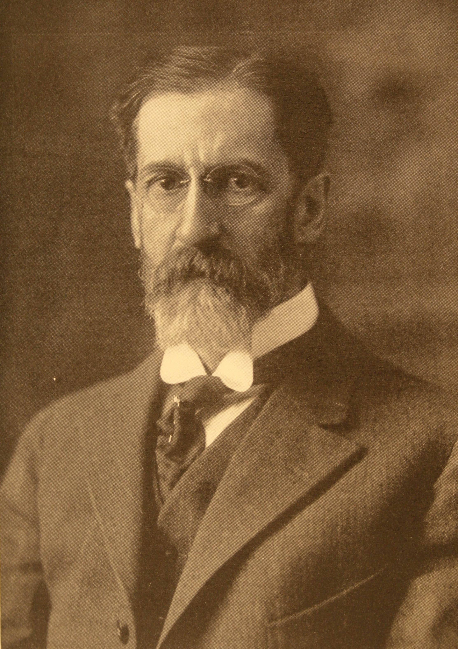
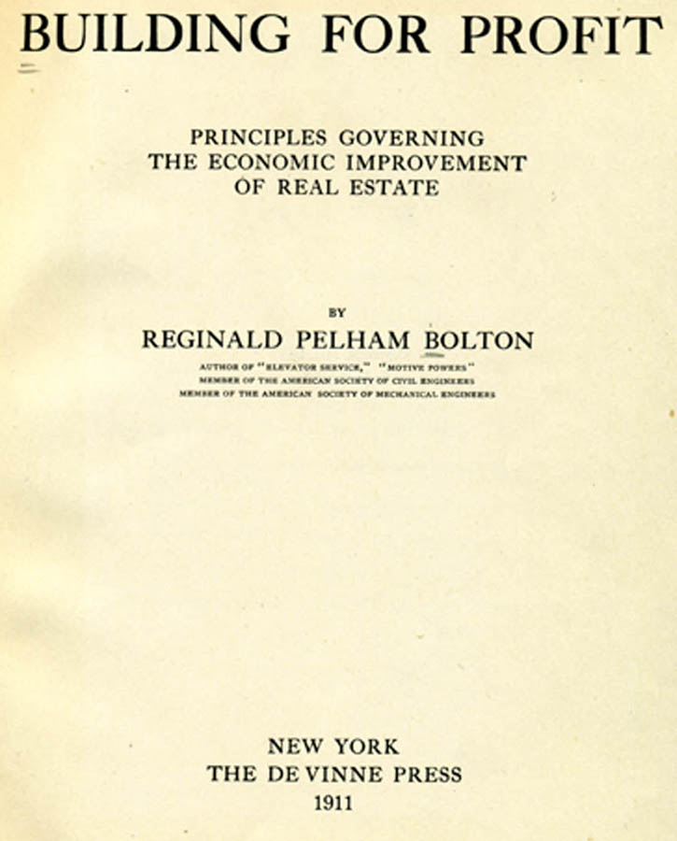
Gillender Building, New York, built 1896, demolished 1910 . . . . .

Slide 4
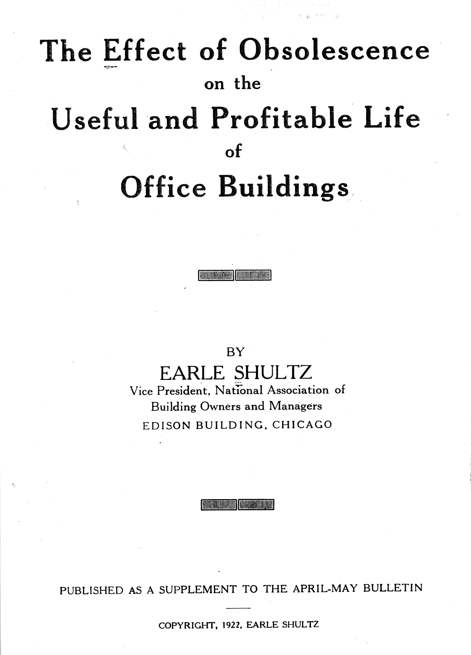
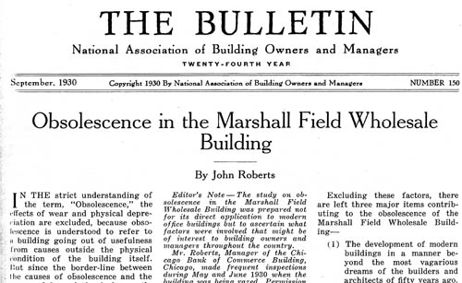
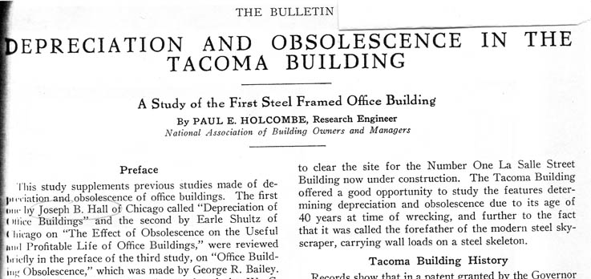
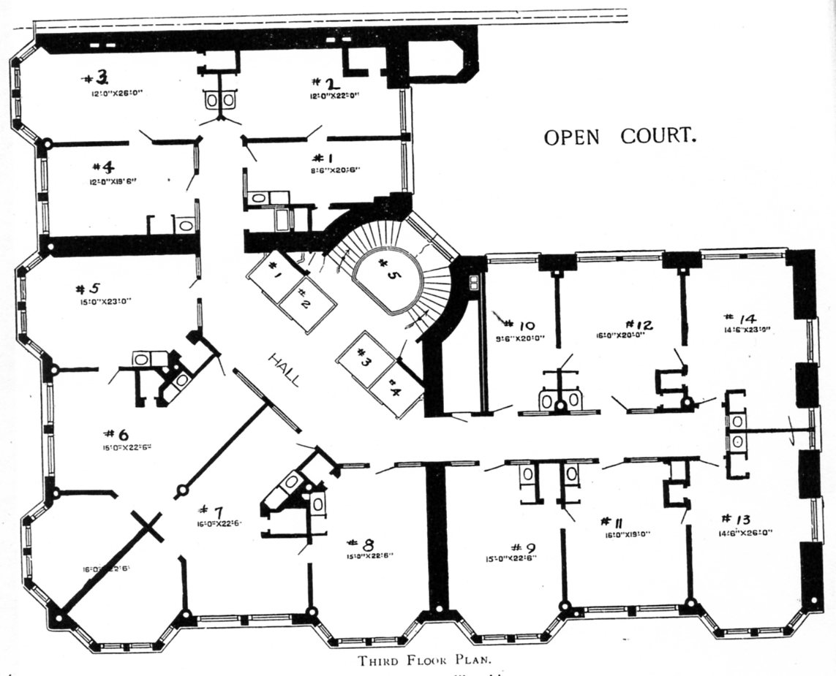
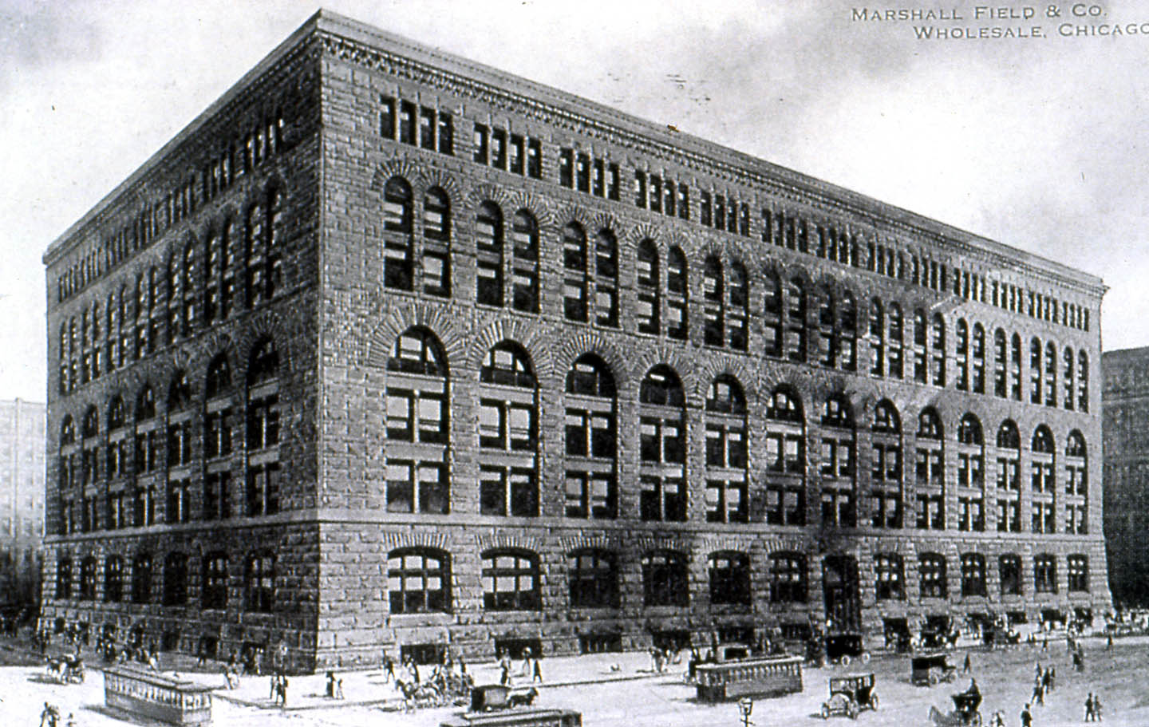
National Association of Building Owners and Managers (NABOM), Obsolescence Studies, 1922-32

Slide 5
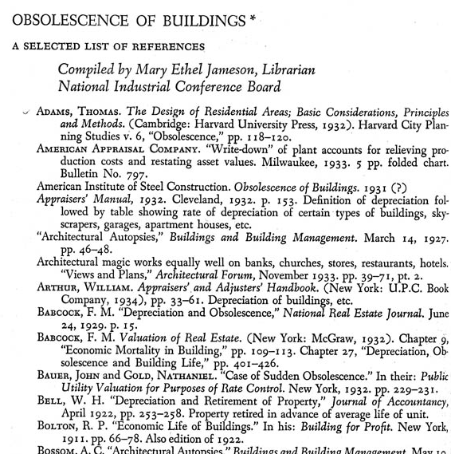
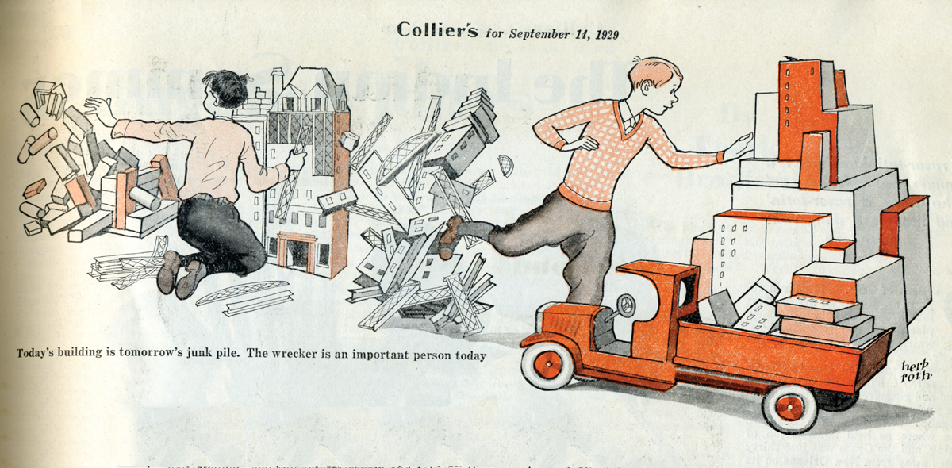
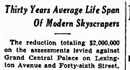
National Association of Building Owners and Managers (NABOM), Obsolescence Studies, 1922-32
New York Times, 1931
“Today’s building is tomorrow’s junk pile . . . “ Collier’s 1929
J. of the Am. Institute of
Real Estate Appraisers, 1935

Slide 6
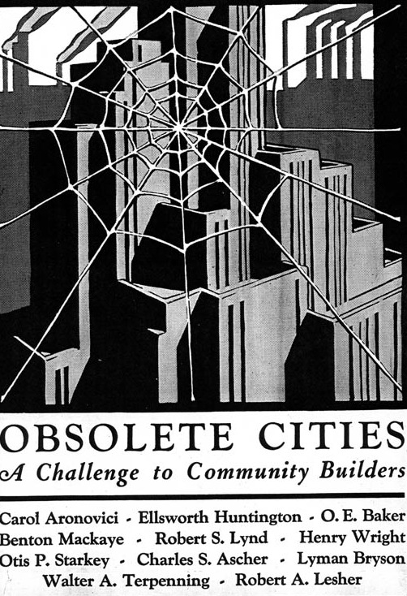
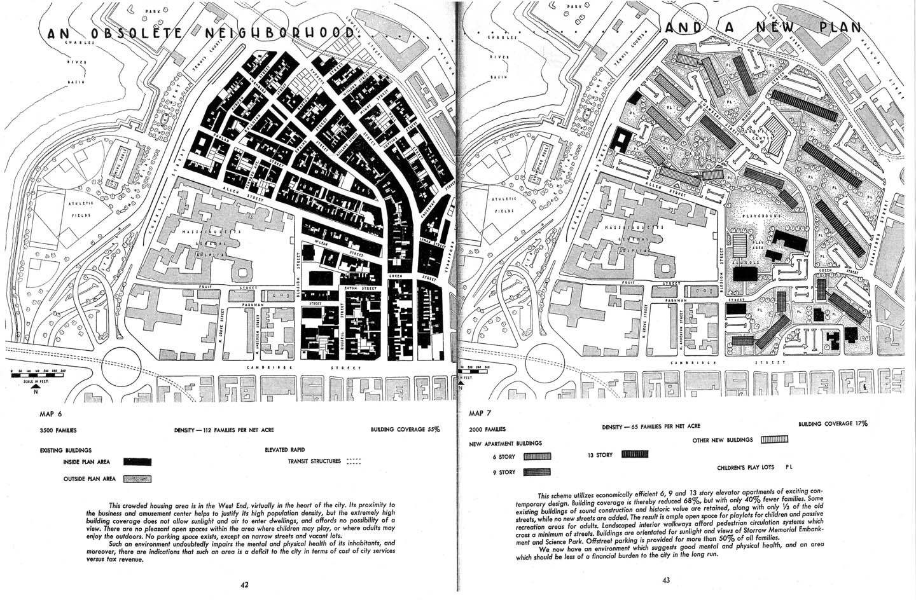
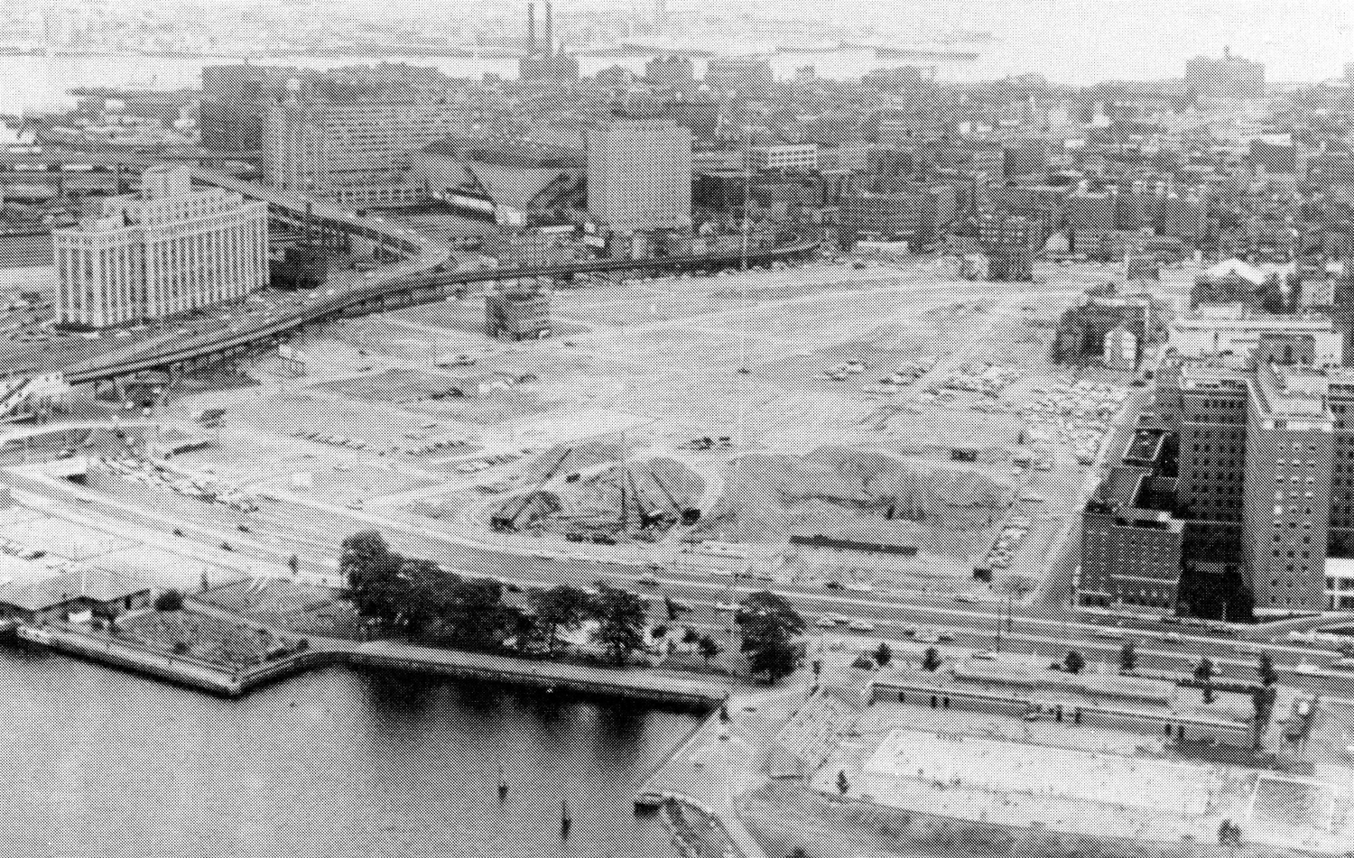
Graphic Survey, 1932
General Plan of Boston, 1951
West End demolished, 1960

Slide 7
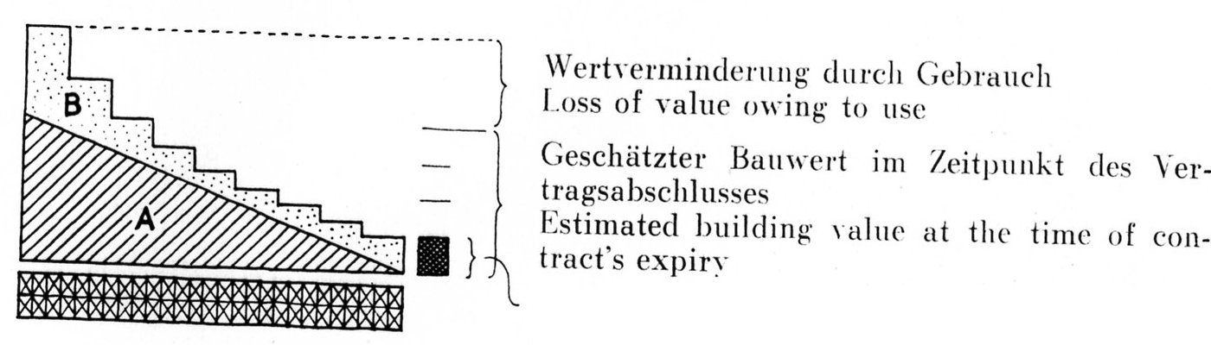
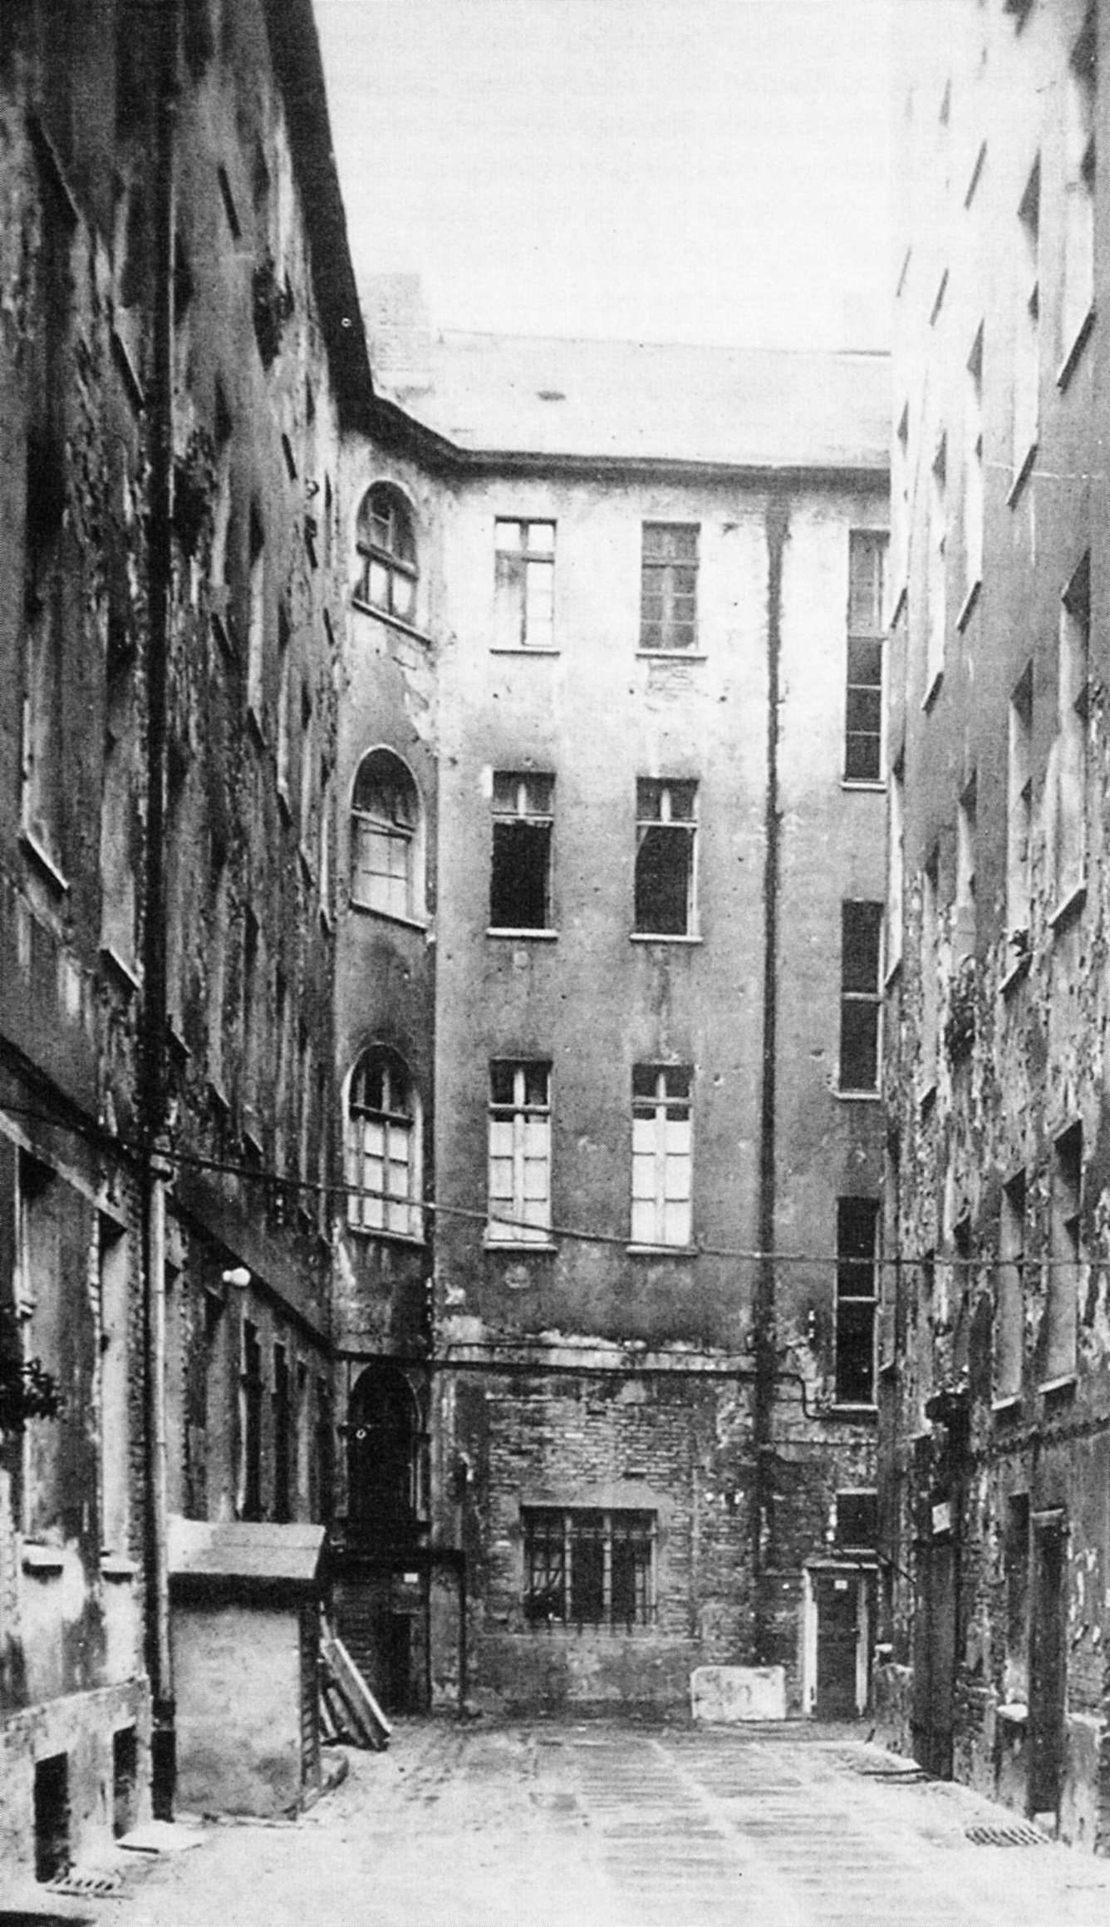
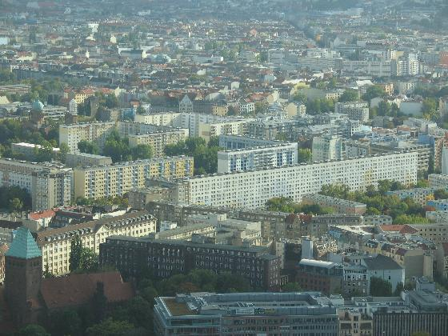
Graphic Survey, 1932
General Plan of Boston, 1951
West End demolished, 1960
80 years later disintegration commences once more.
Hans Bernoulli, Die Stadt und Ihr Boden, 1946
East Berlin

Slide 8
Graphic Survey, 1932
General Plan of Boston, 1951
West End demolished, 1960
The annual model, the disposable container, the throwaway city have become the norms.
James Marston Fitch, American preservationist
80 years later disintegration commences once more.
Hans Bernoulli, Die Stadt und Ihr Boden, 1946
East Berlin

Slide 9
Graphic Survey, 1932
General Plan of Boston, 1951
West End demolished, 1960
A city in which there were not at all times some worn-out or obsolete parts
would not be a dynamic city. Miles Colean, 1953
80 years later disintegration commences once more.
Hans Bernoulli, Die Stadt und Ihr Boden, 1946
East Berlin

Slide 10
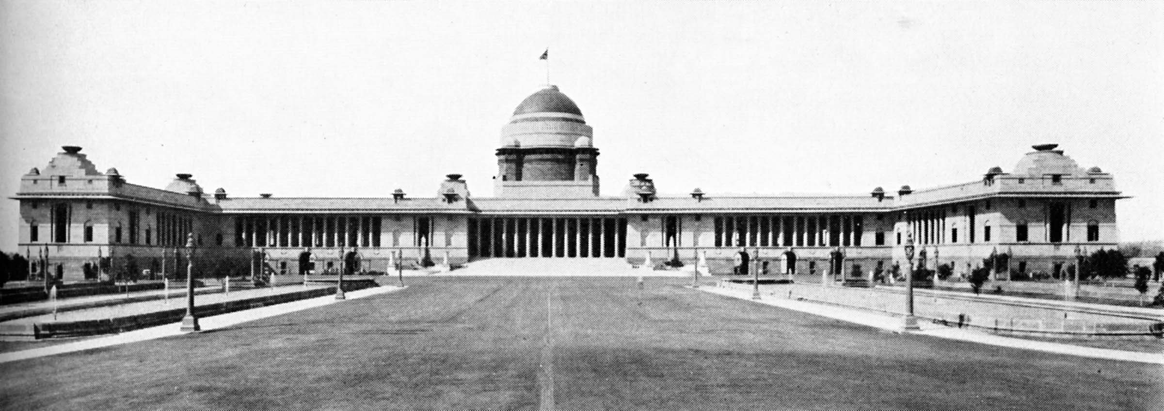
Viceroy’s House, New Delhi (India), Edwin Lutyens, 1913-13

Slide 11
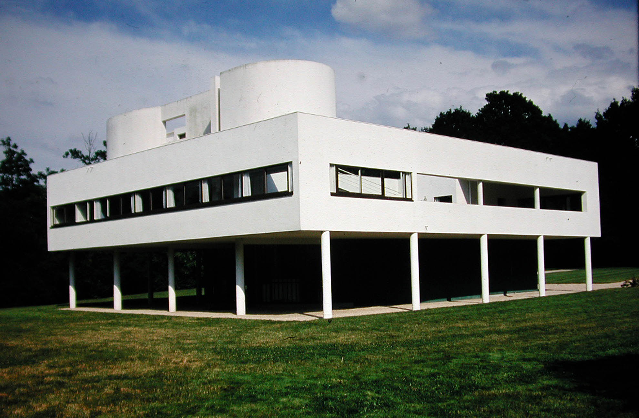
Viceroy’s House, New Delhi (India), Edwin Lutyens, 1913-13
“a profound projection of harmony . . . a sure and permanent home . . .
a state of perfection” Le Corbusier
Villa Savoye, Poissy (France), 1928-31, Le Corbusier

Slide 12
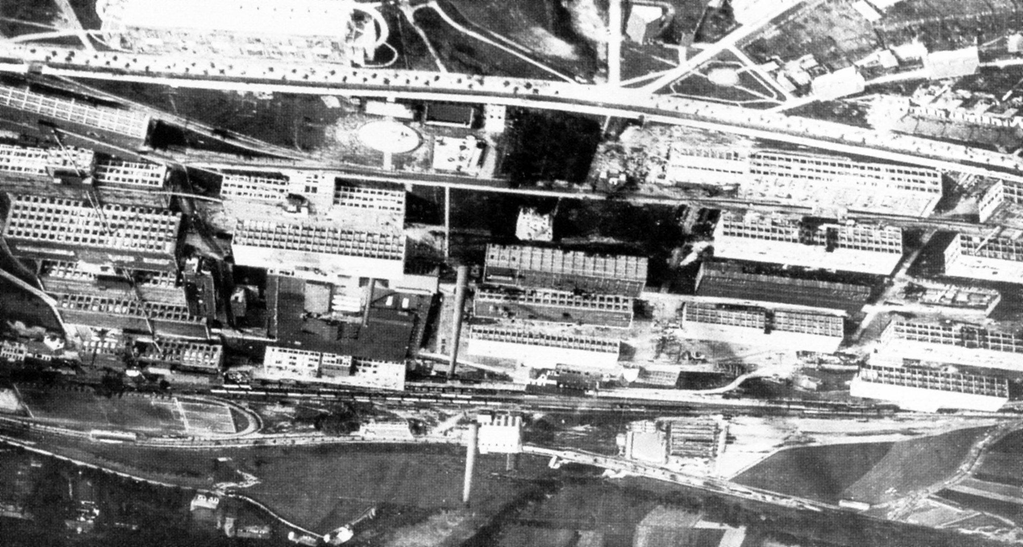
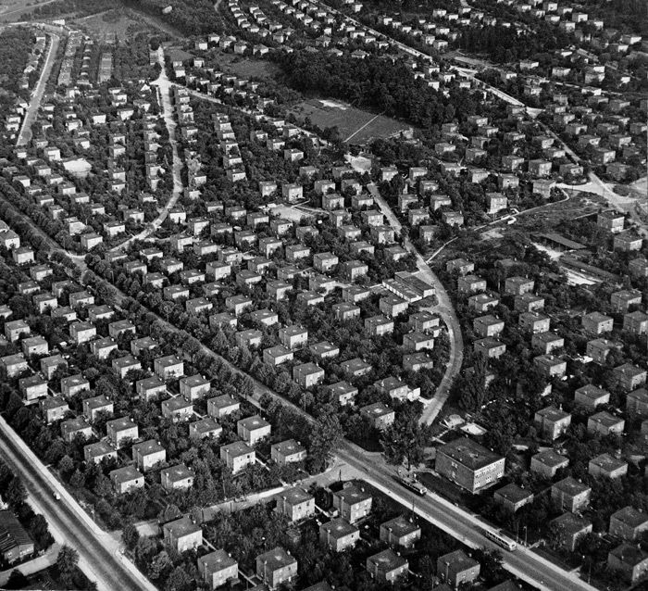
Batà Factory Works, Zlín (Czechoslovakia), F. Gahura and other, 1923-36

Slide 13
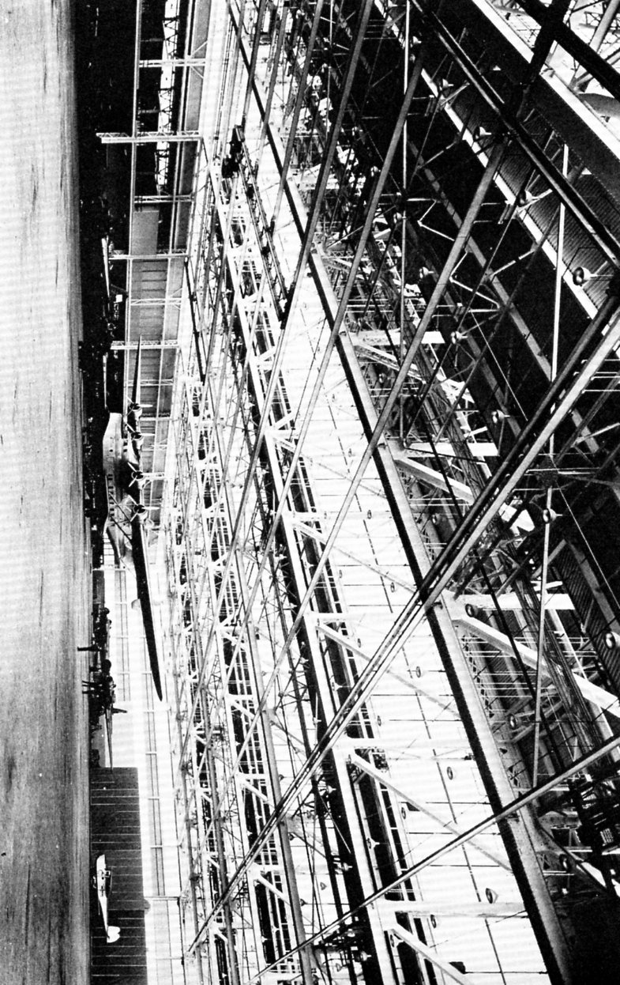
Glenn Martin Assembly Building, Baltimore, 1937

Slide 14
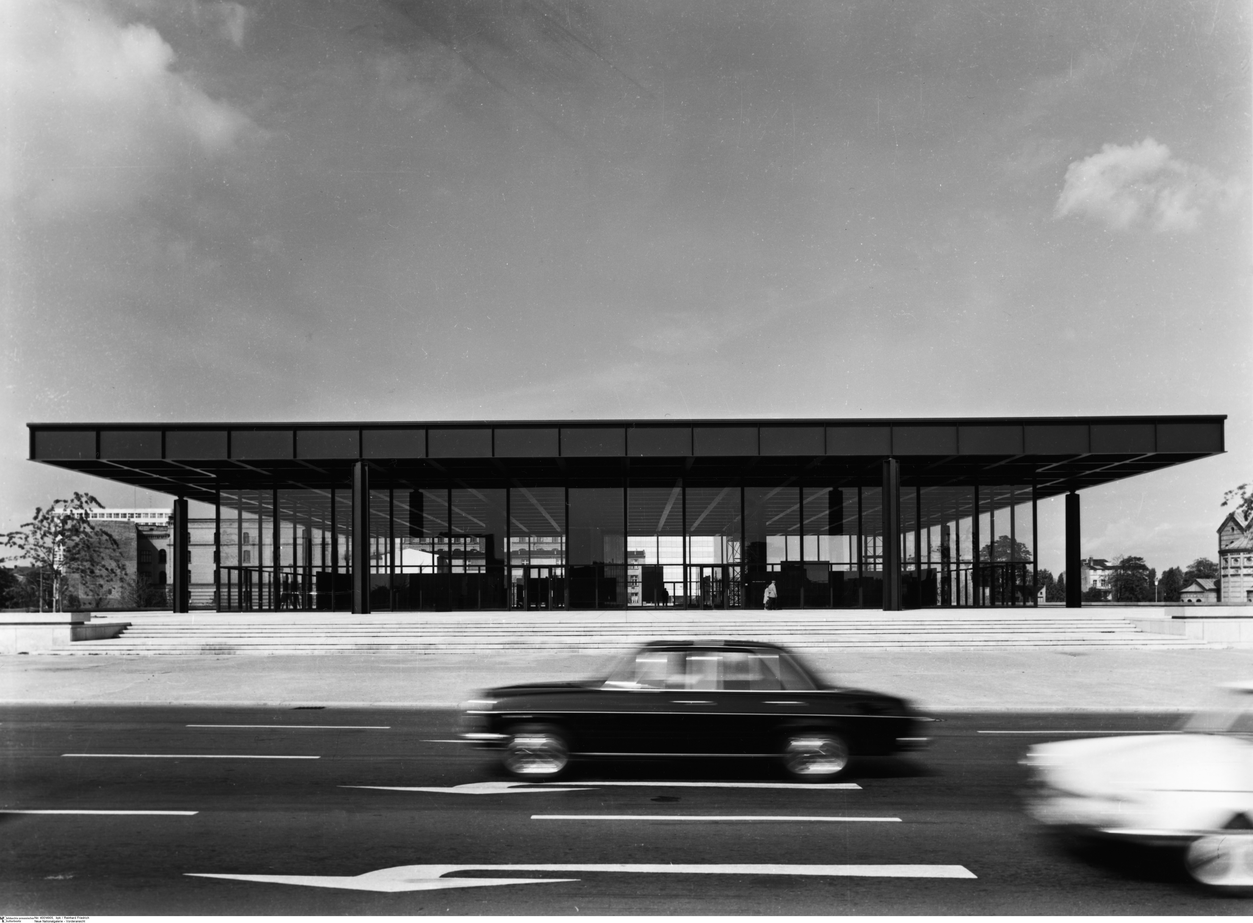
Glenn Martin Assembly Building, Baltimore, 1937
New National Gallery, Berlin, L. Mies van der Rohe, 1962-68

Slide 15
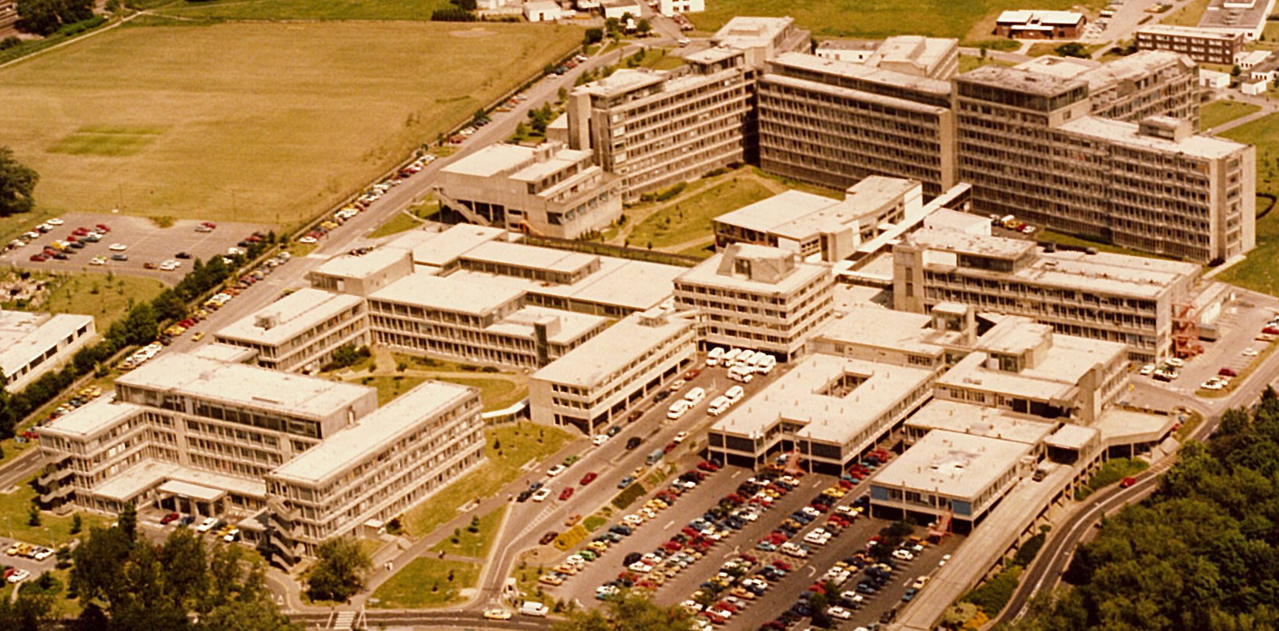
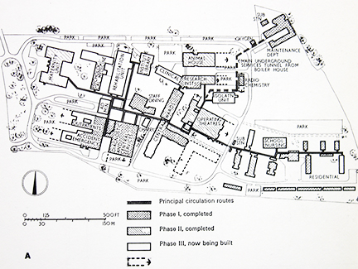
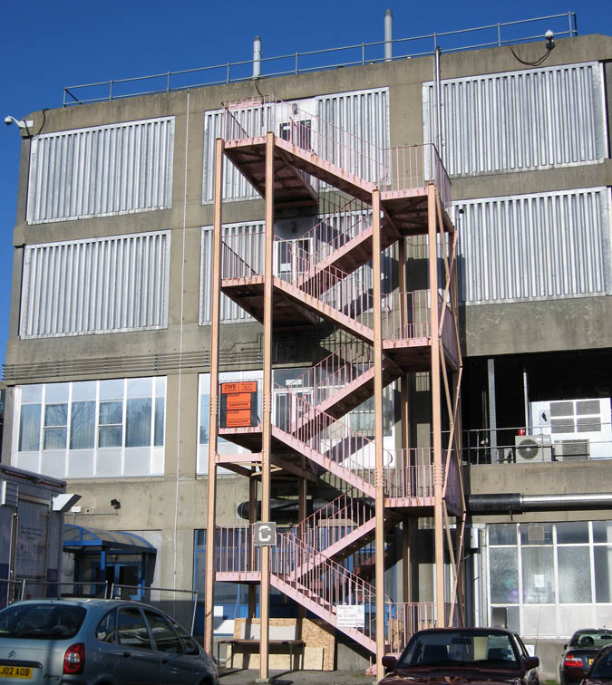
Northwick Park Hospital, Harrow (England),
R. Llewelyn-Davies + J. Weeks, 1961-76

Slide 16
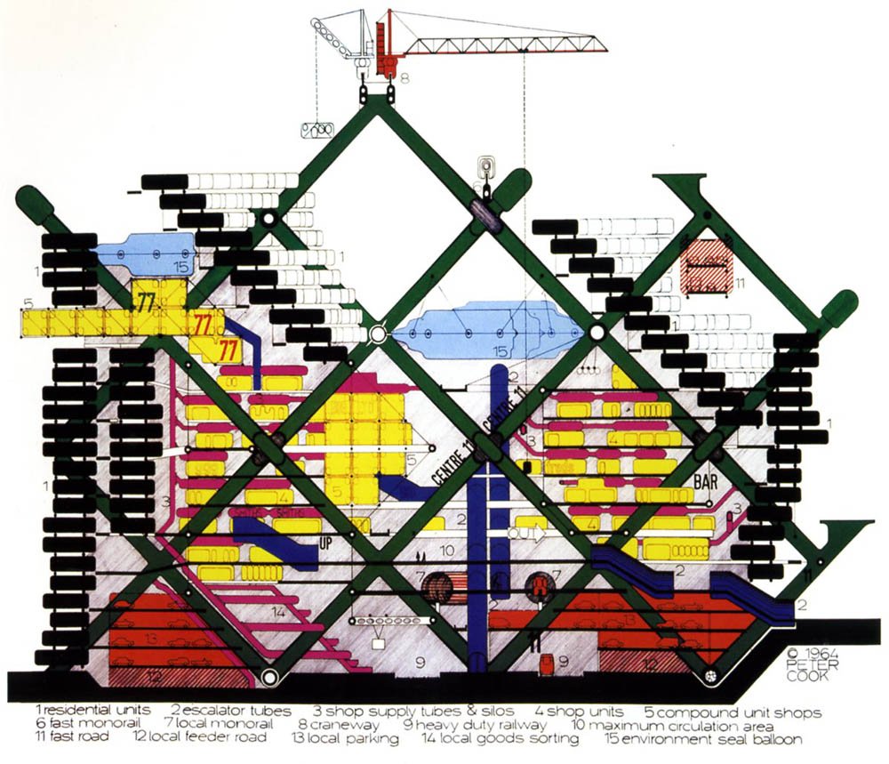
Plug-In City project, Peter Cook, 1964

Slide 17
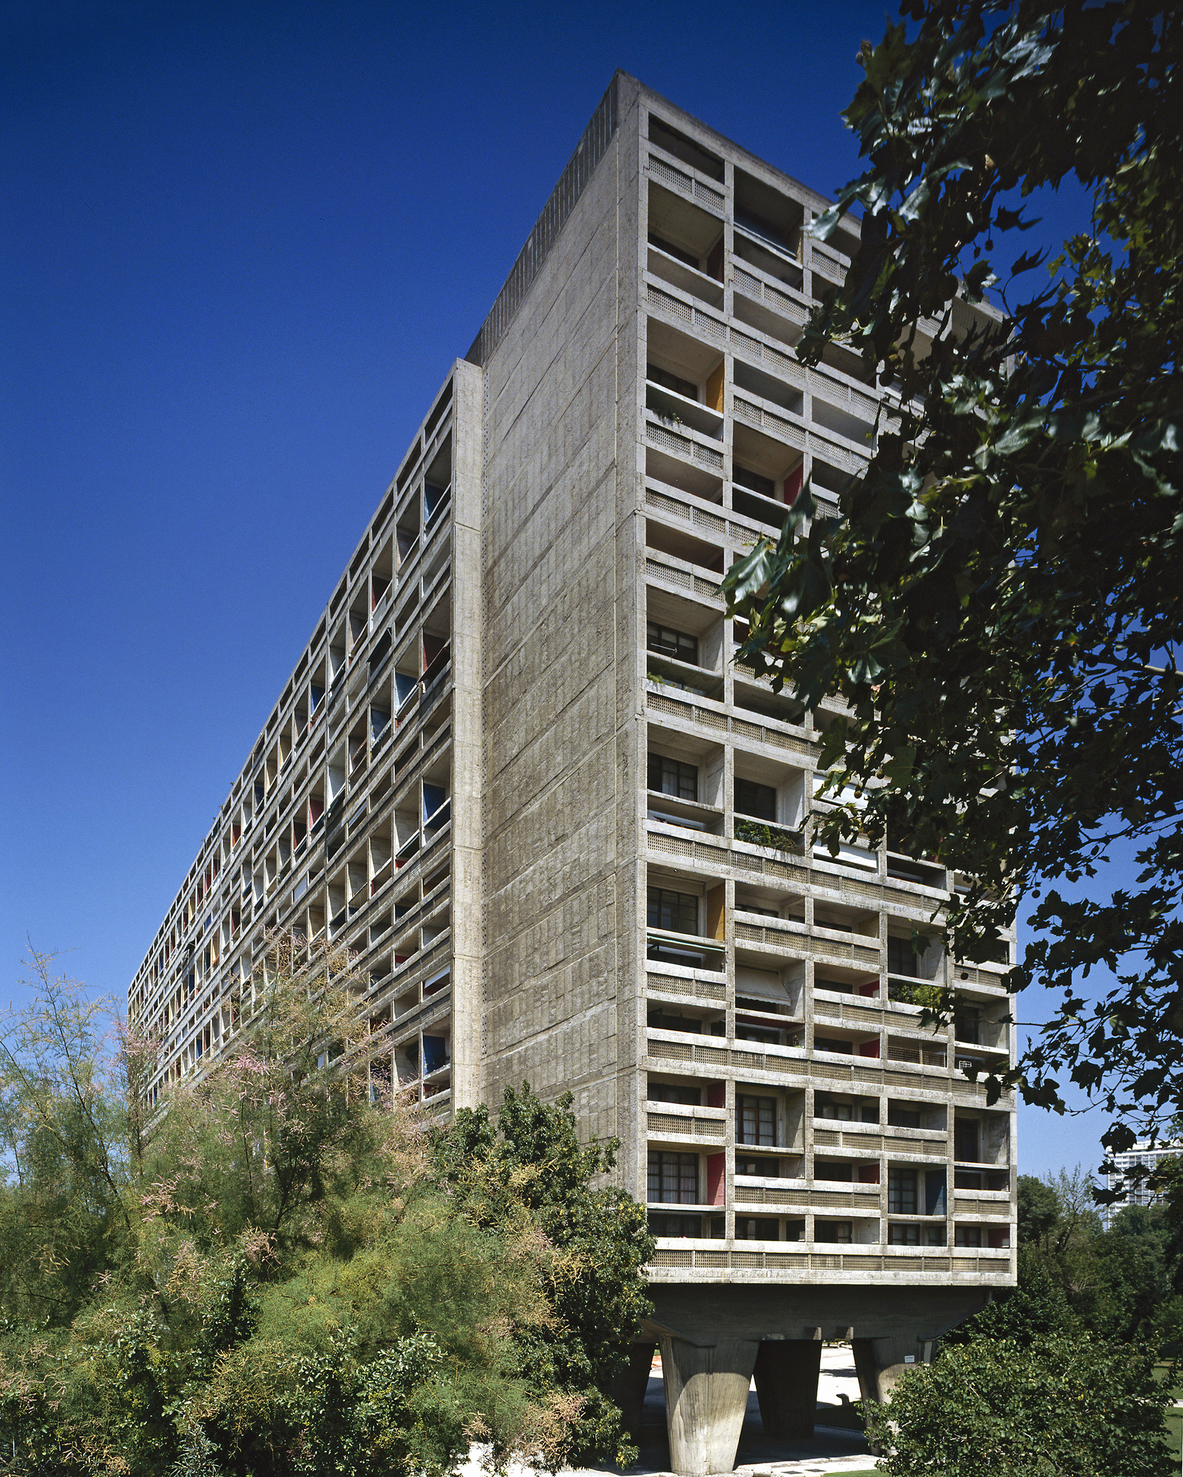
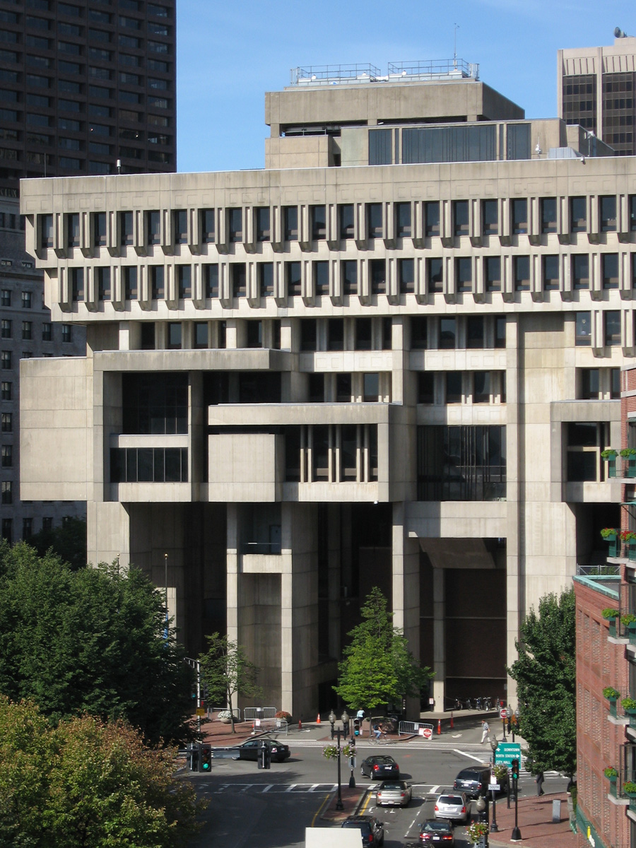
Unite d’habitation, Marseilles, Le Corbusier, 1946-52
City Hall, Boston, Kallmann, McKinnell & Knowles, 1962-68

Slide 18
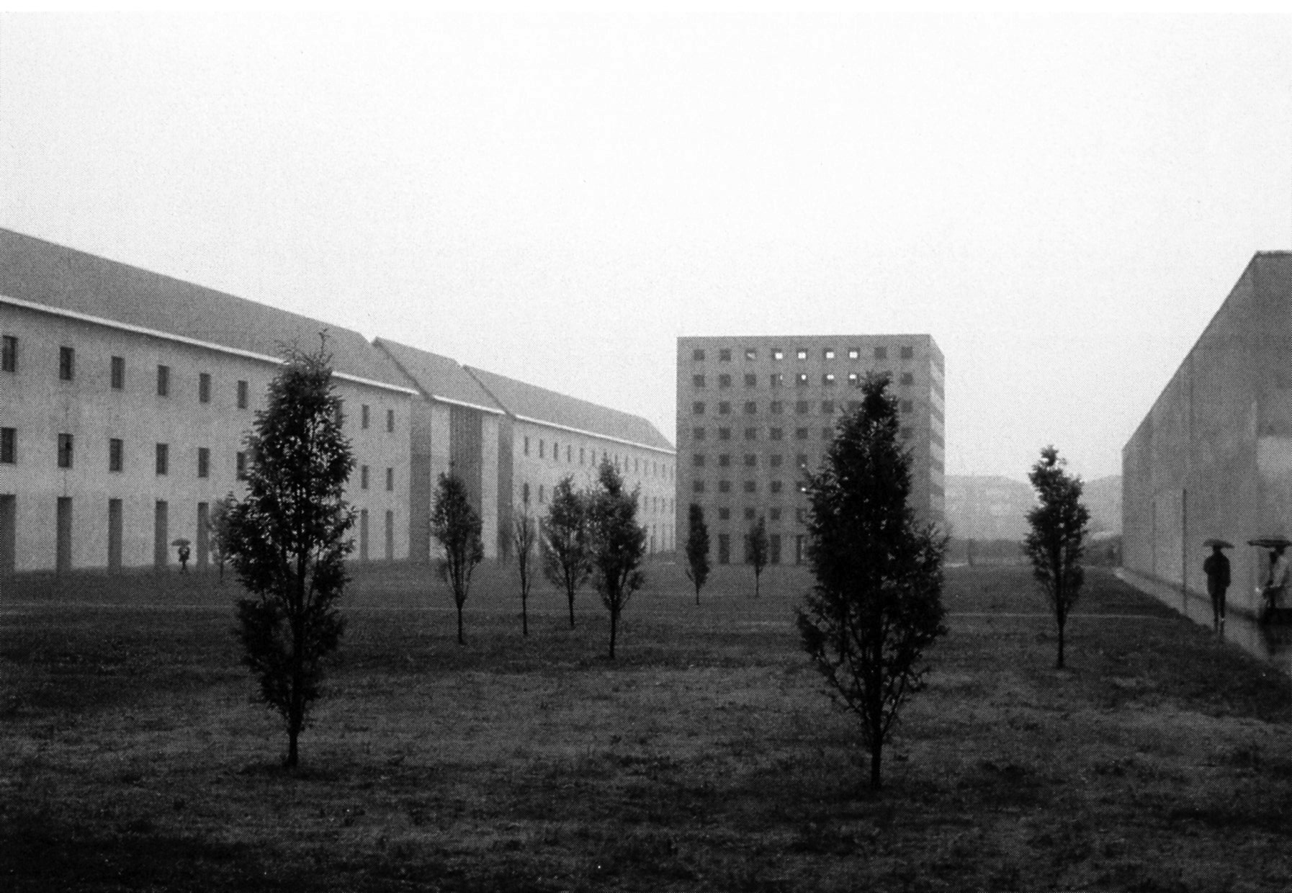
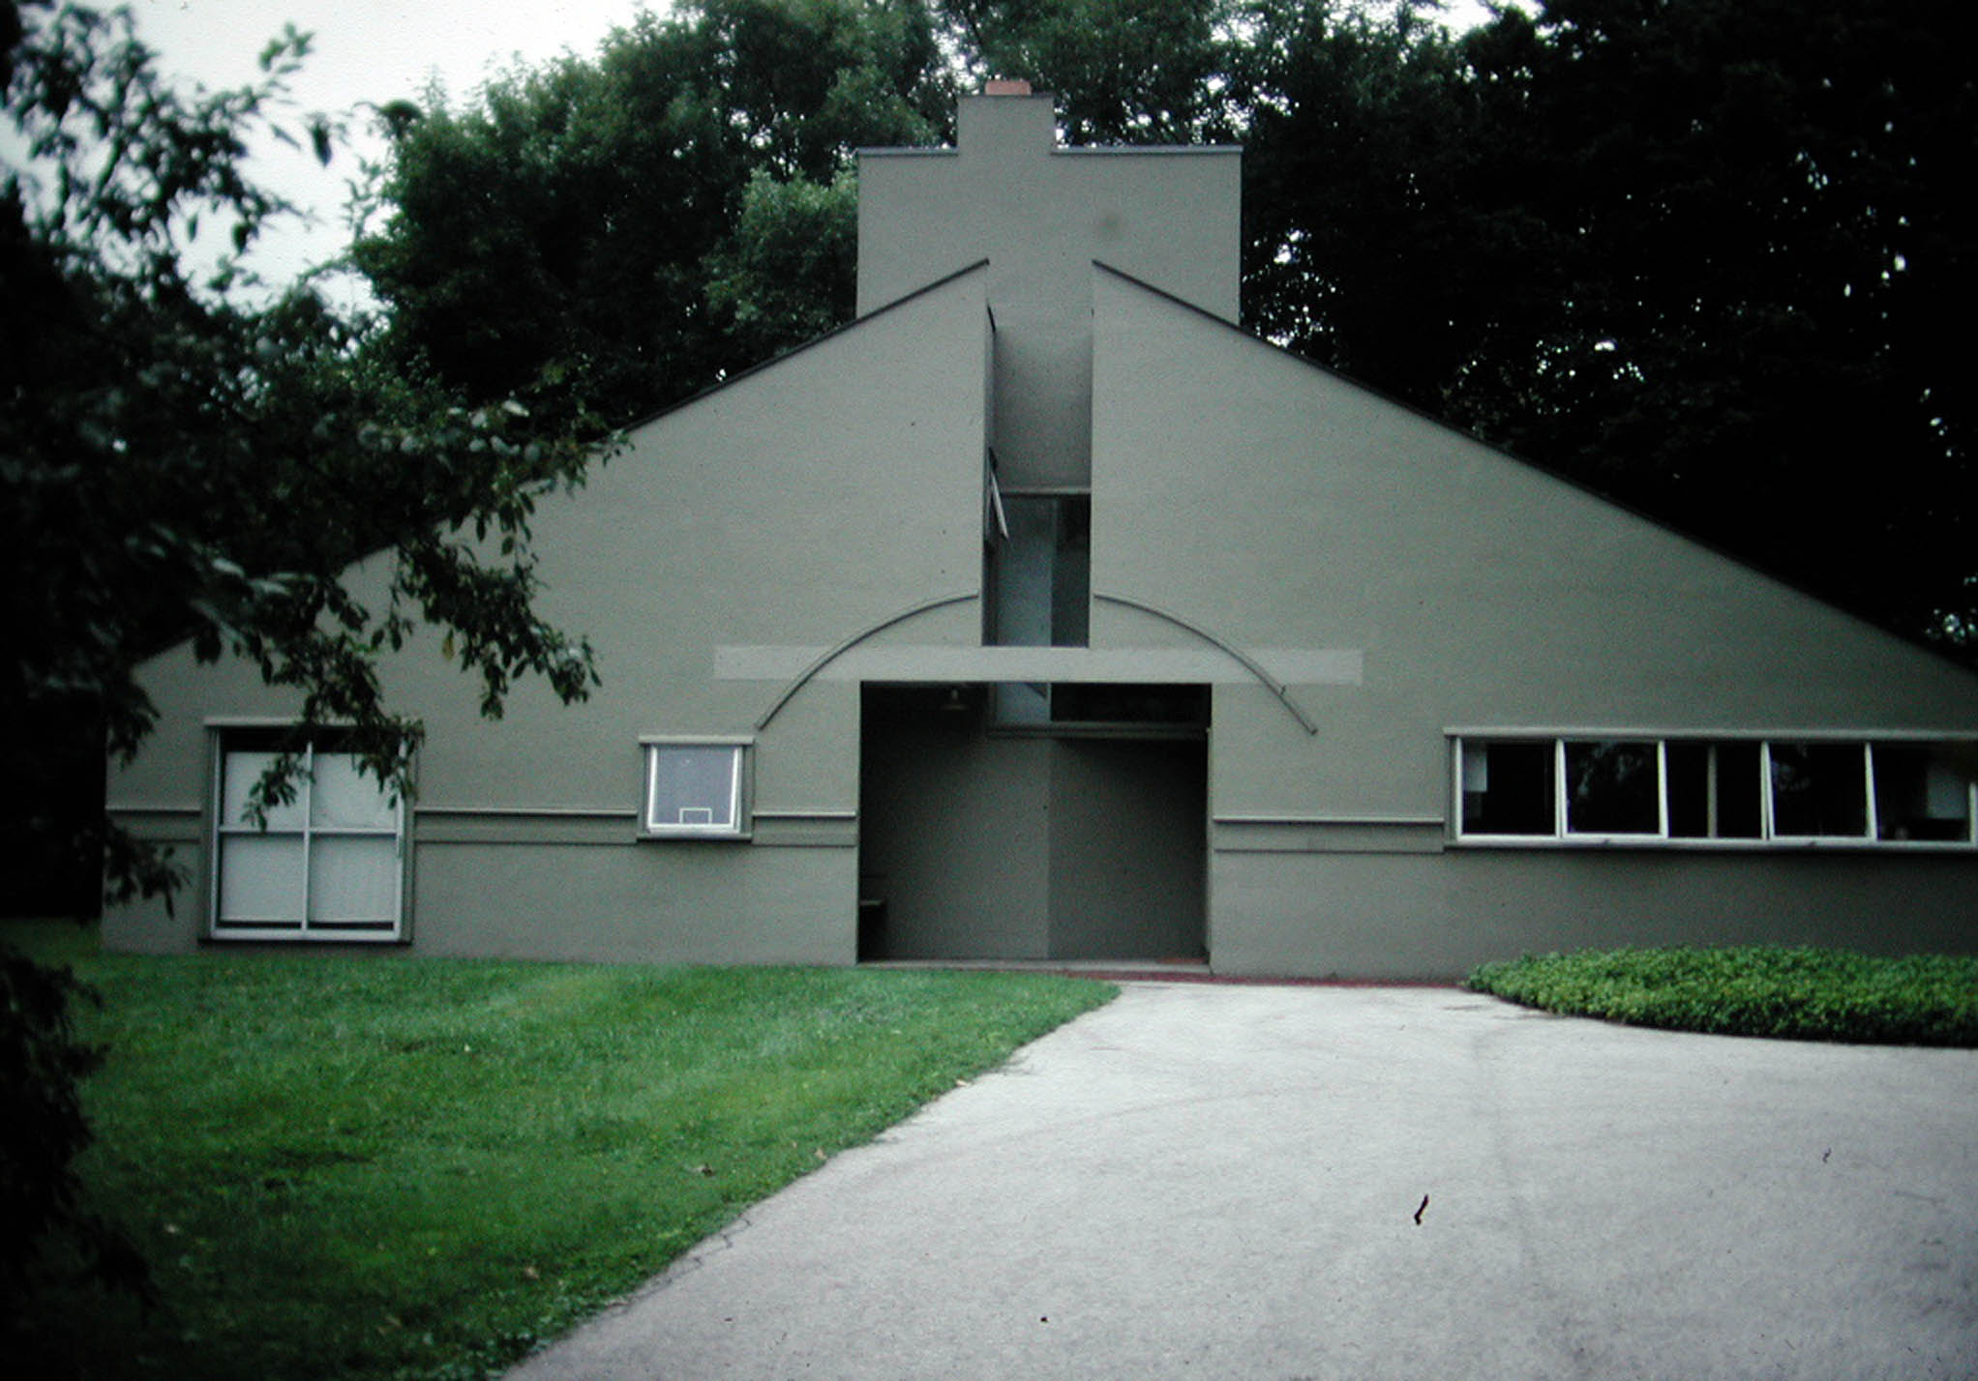
San Cataldo Cemetery, Modena (Italy), begun 1971, Aldo Rossi
Vanna Venturi House, Chestnut Hill (Penn.), R. Venturi, 1961

Slide 19
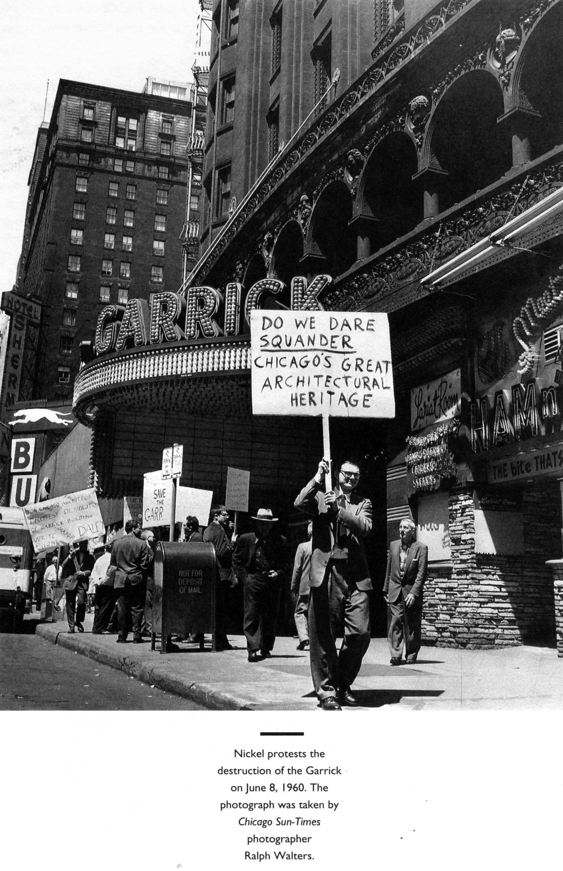
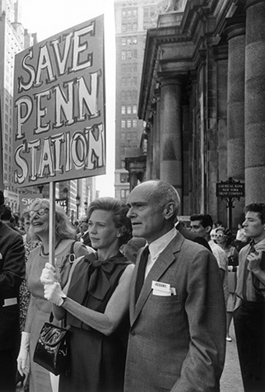
Protesting demolition of Garrick Theater (Chicago), 1961
Protesting demolition of Penn Station (New York), 1962

Slide 20
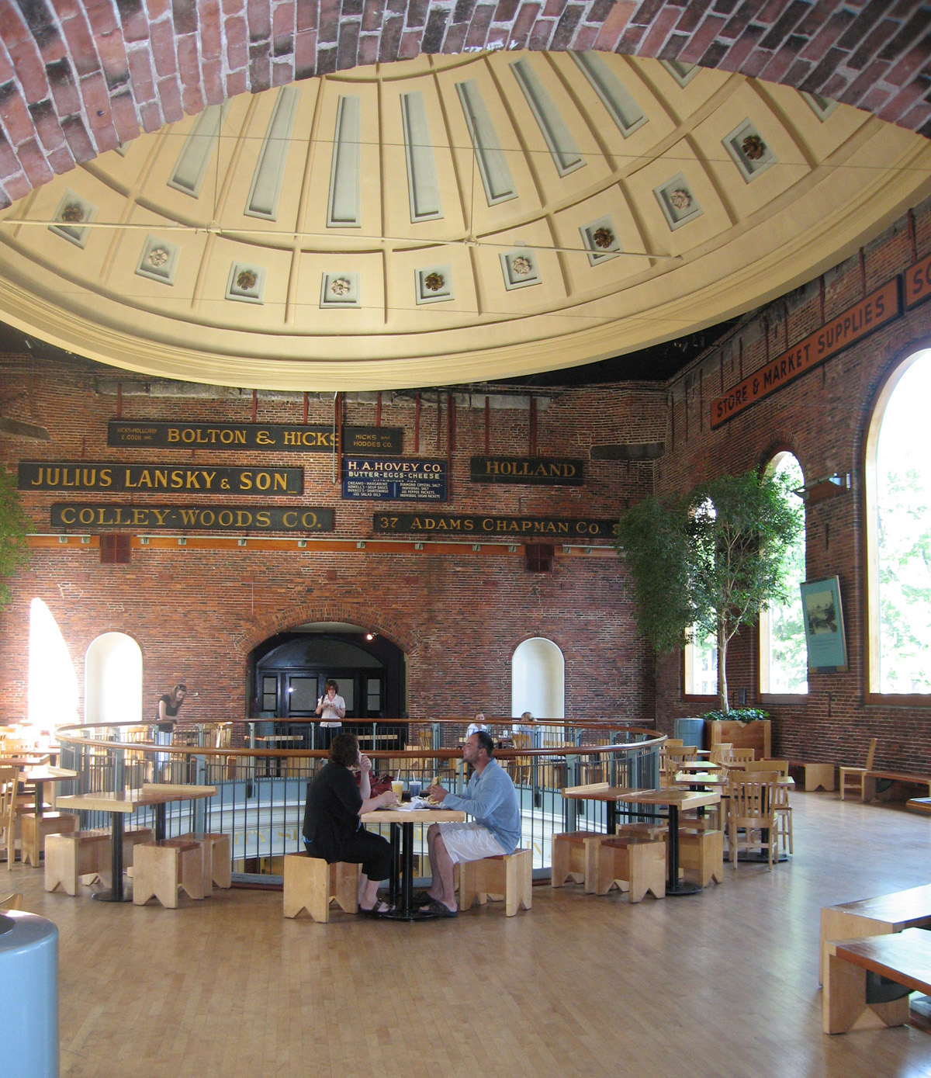
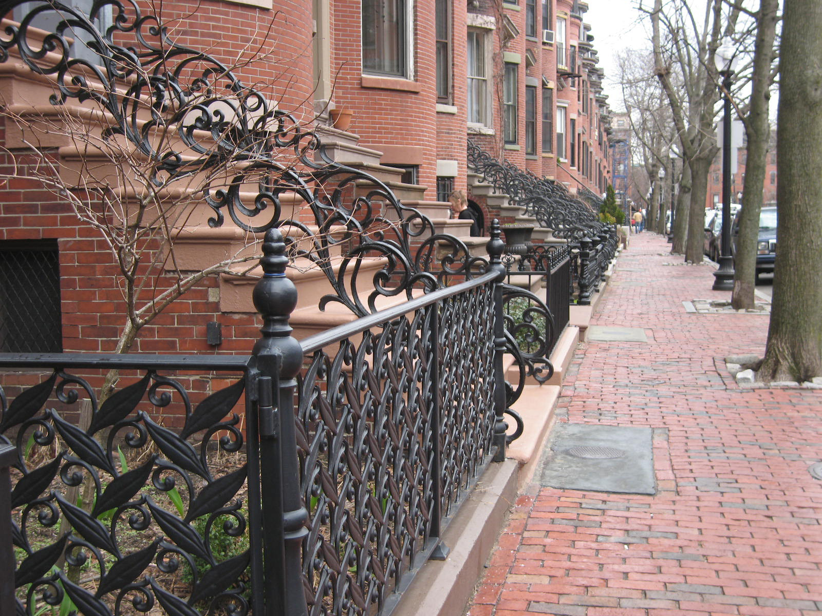
Quincy Market, Boston, B. Thompson, renovated 1975
Protesting demolition of Penn Station (New York), 1962
South End, Boston

Slide 21
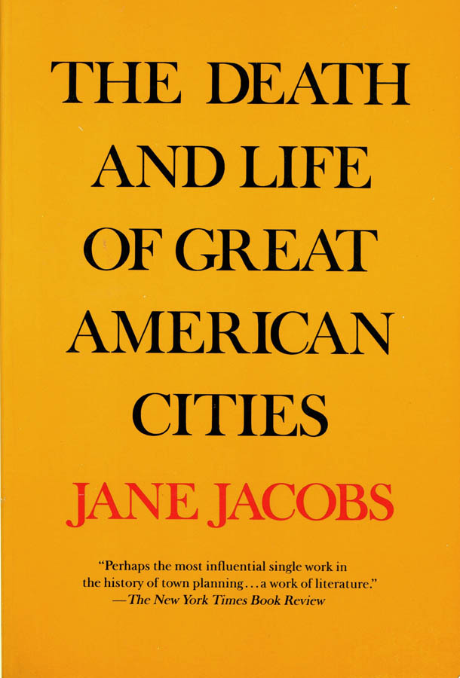
Quincy Market, Boston, B. Thompson, renovated 1975
1961
Protesting demolition of Penn Station (New York), 1962
South End, Boston

Slide 22
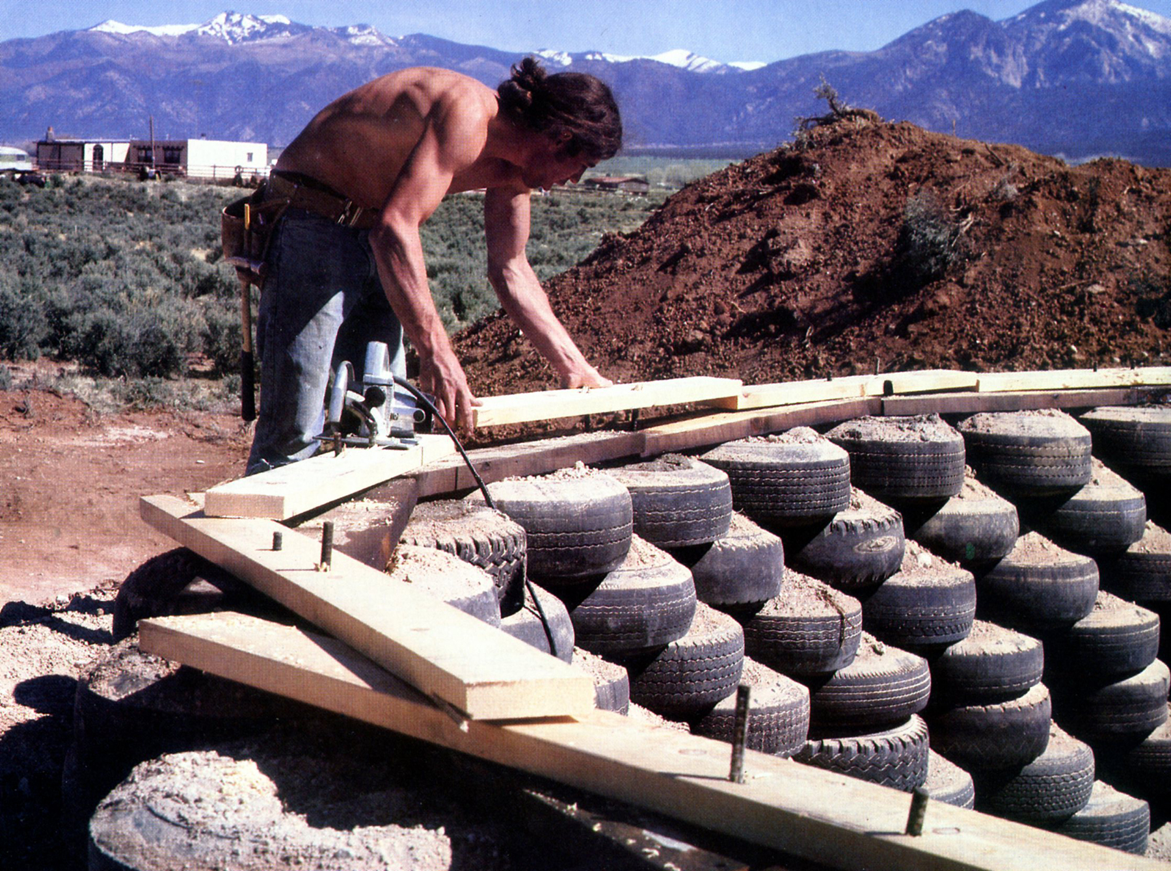
Quincy Market, Boston, B. Thompson, renovated 1975
1961
Protesting demolition of Penn Station (New York), 1962
South End, Boston
Mike Reynolds, 1970s

Slide 23
Quincy Market, Boston,
renovated 1975
Venturi House, 1961
Protesting demolition of Penn Station (New York), 1962
South End, Boston
Mike Reynolds, 1970s

Slide 24
Obsolescence, with . . . .
… against

Slide 25
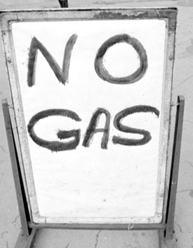

Slide 26
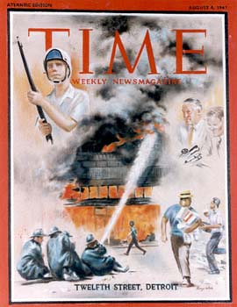

Slide 27
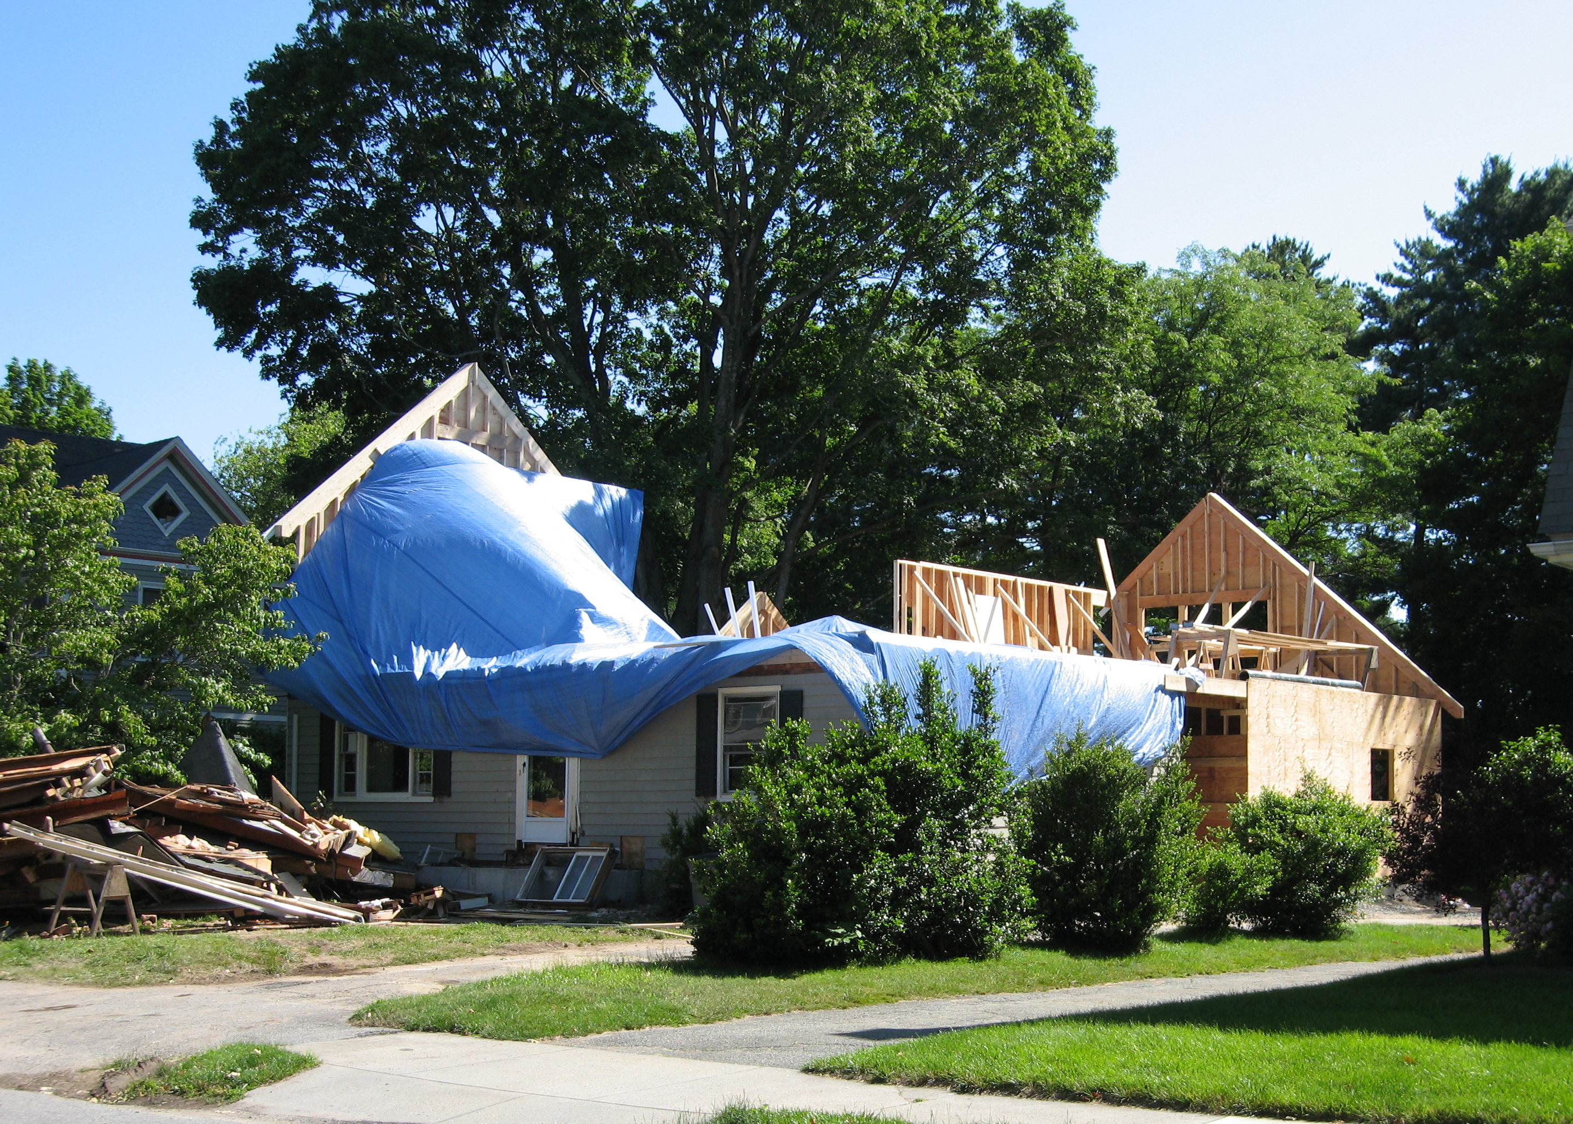
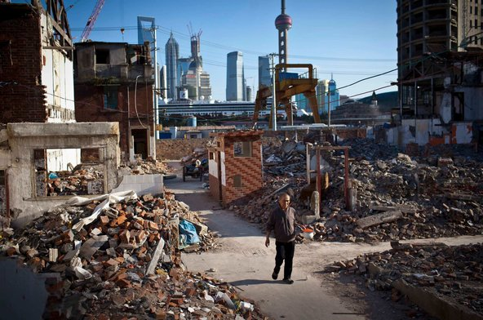

Slide 28



Slide 29
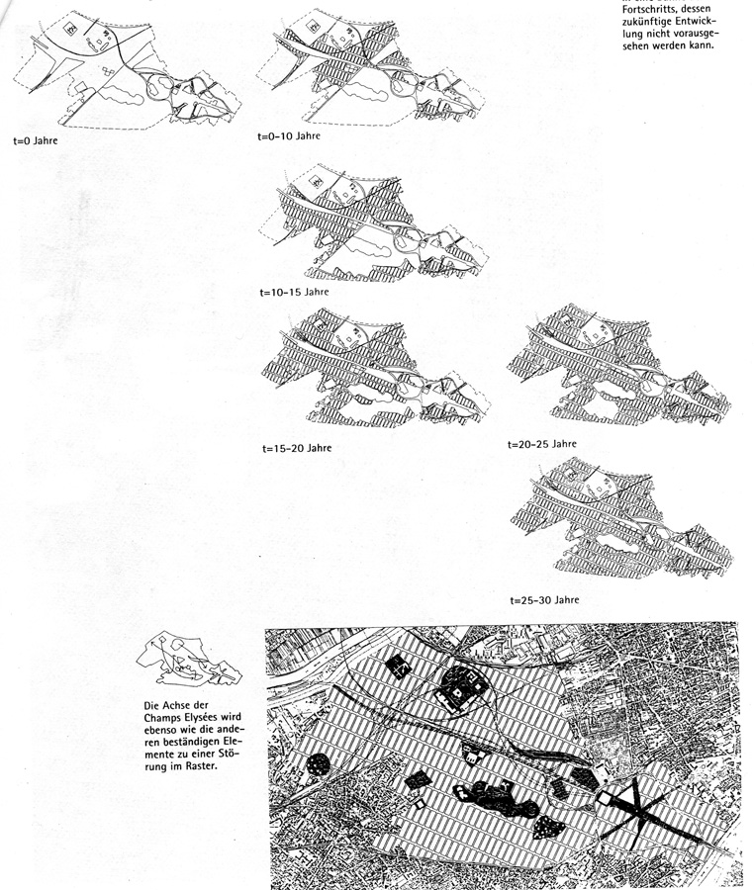
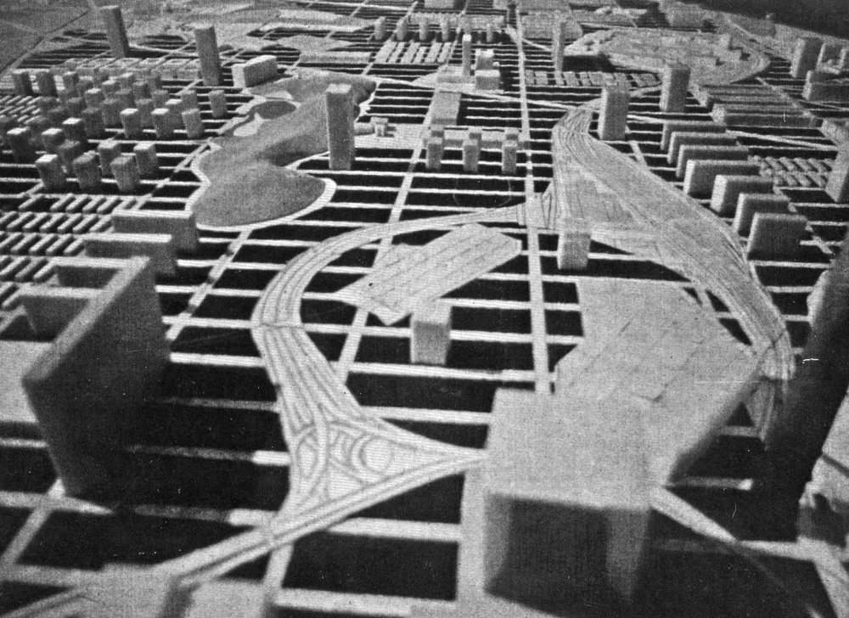
Rem Koolhaas: La Défense (Paris) project, 1991

Slide 30
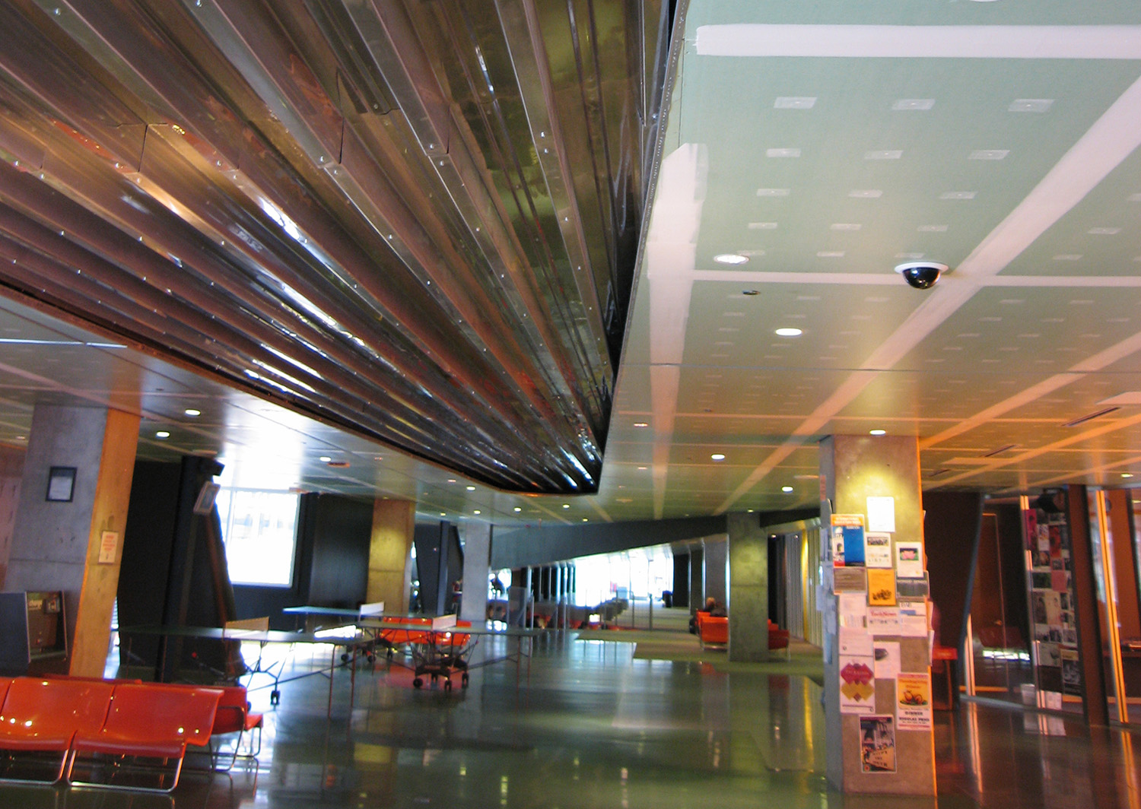
Rem Koolhaas: La Défense (Paris) project, 1991 Campus Center, Illinois Institute of Technology (Chicago), 1997-2003

Slide 35
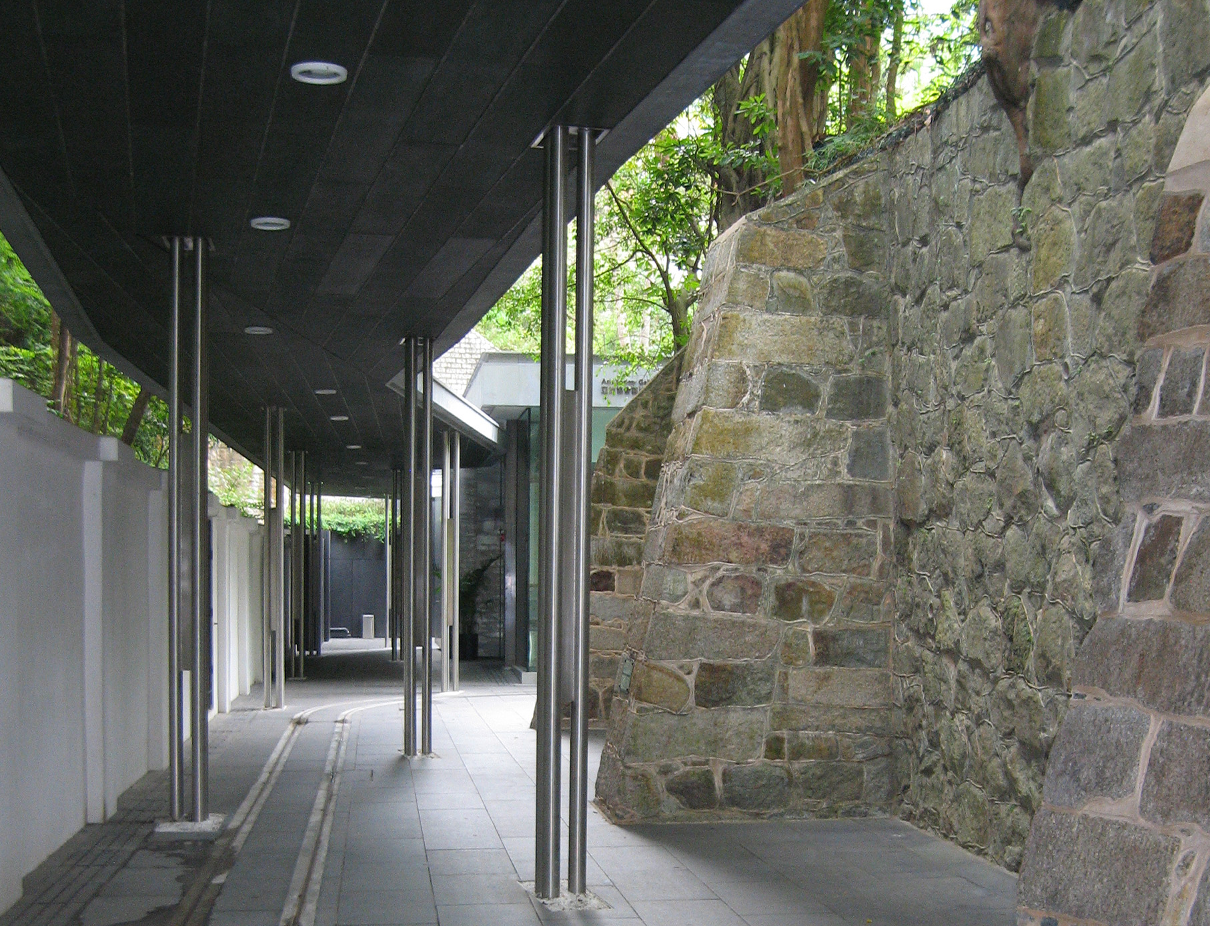
Asia Society Hong Kong Center, Tod Williams Billie Tsien, 2011

Slide 36
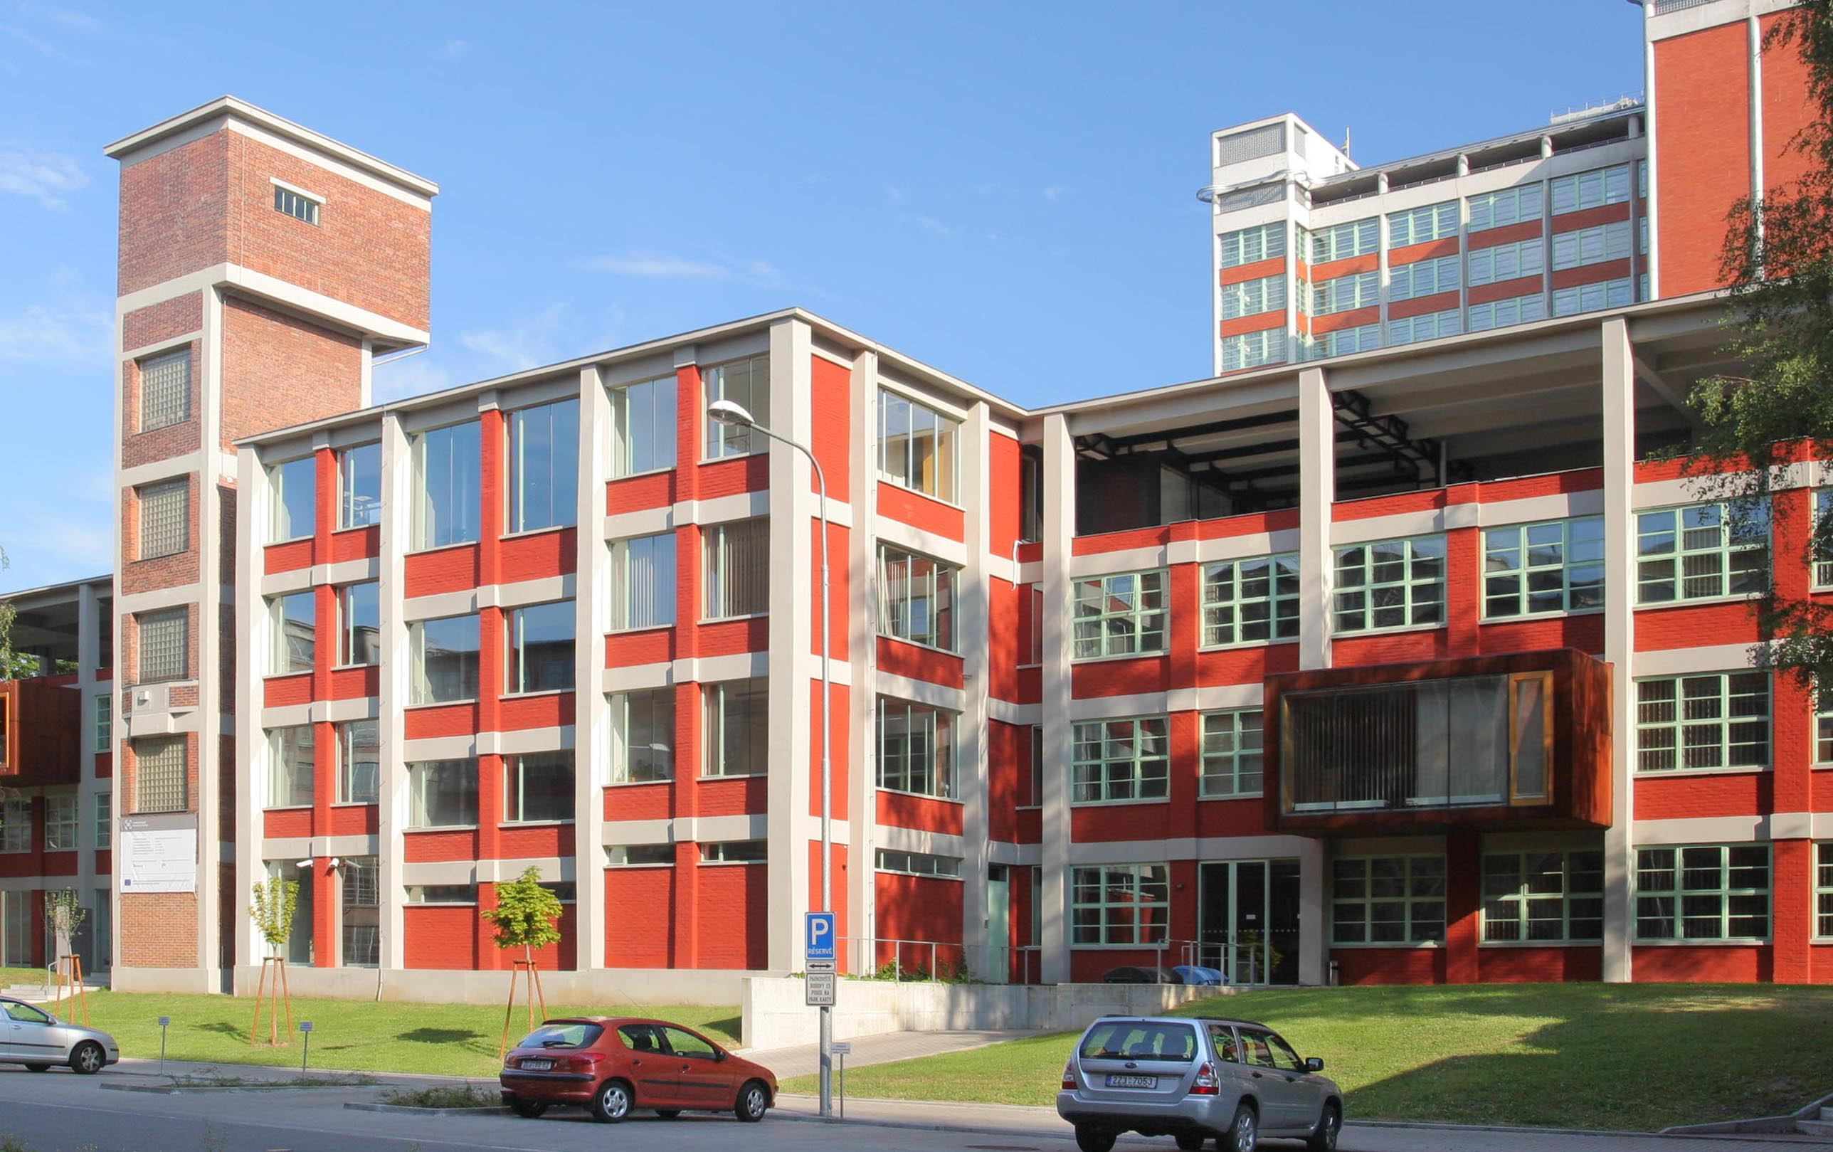
Building 23 rehabilitation, Zlín (Czech Republic), Pavel Mudřík and Pavel Míček, 2006

Slide 37
A city in which there were not at all times
some worn-out or obsolete parts would not be
a dynamic city.
Miles Colean, 1953

