Slide 2

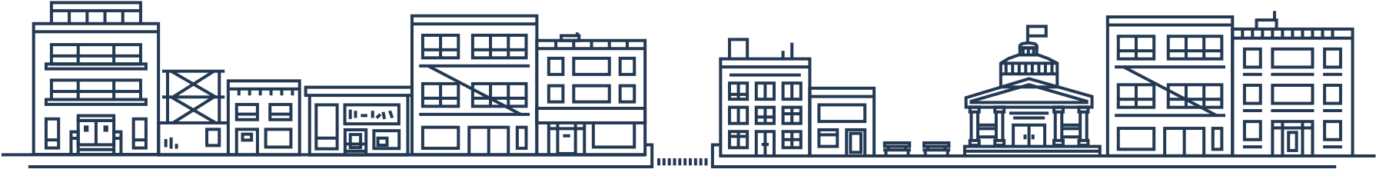
Placemeter is an urban intelligence platform.
We quantify movement in modern cities, at scale.
Placemeter uses proprietary computer vision technology to automatically count people and vehicles, analyze their movement, interactions, speed, using standard video input.
Video Sensors
Self-Serve
Inexpensive
Scalable
Accurate
“We placed our trust in Placemeter to give us that critical intelligence quickly and effectively, and they did not let us down.”
- Mike Flowers, Former Chief Analytics Officer, NYC

Slide 3
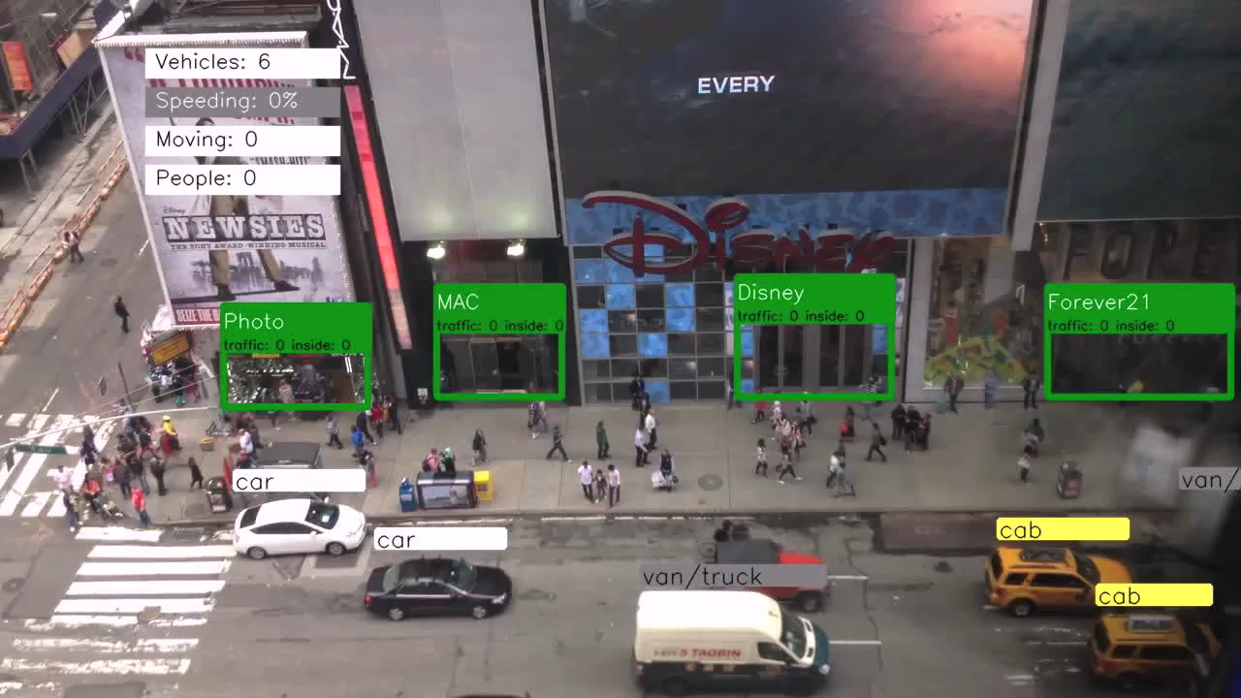

Slide 4
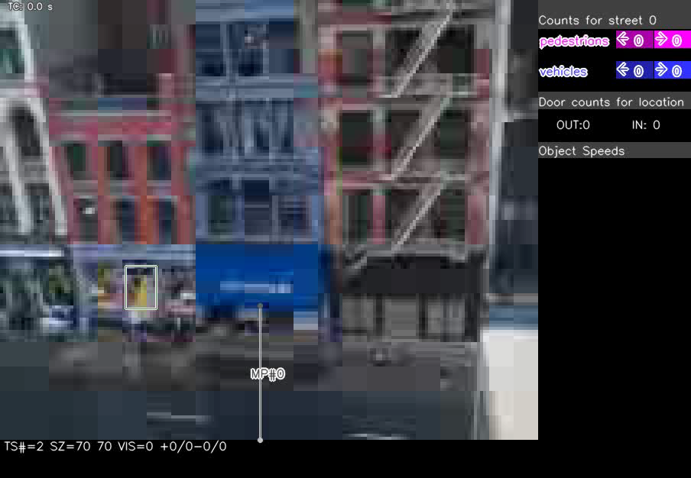
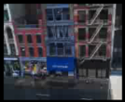
Secret Sauce
144x176
5 fps
90% accuracy
real time
all automated
8 patents pending
Our algorithms are trained to process almost any video quality, angle, bandwidth, weather, lighting conditions,…

Slide 5
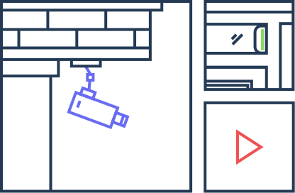
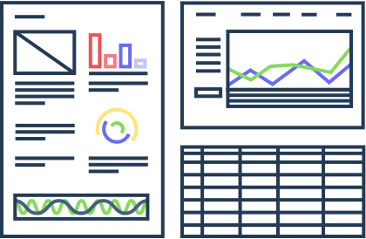
Seamless, self-serve setup
video
a video file or feed
data
in real time, easily
5 mn set-up
Real time updates
Configurable dashboard
Export functions
Notes:
DESIGN LEFT

Slide 6
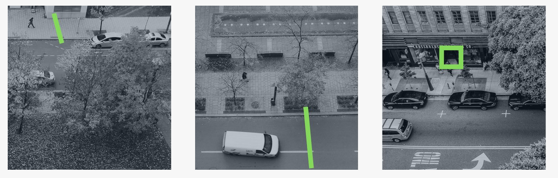



What we measure
“doors”
“turnstiles”
“areas”
counts and directions
per hour
per day
baselines
predictions
conversion
street to store
speed
cars, pedestrians
classification
vehicle types
gender / age
dwell time
in front of store
in amenities
inside stores
trajectory analysis
near misses
collision rate
available in production
available in lab

Slide 7
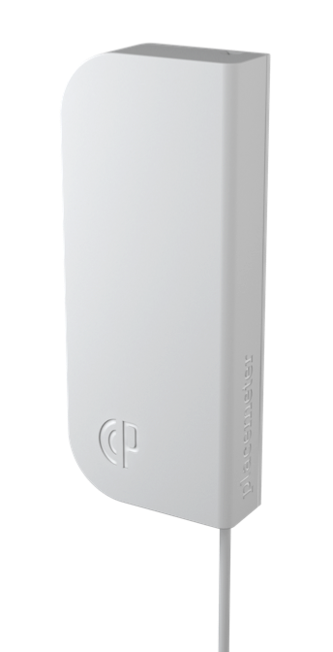

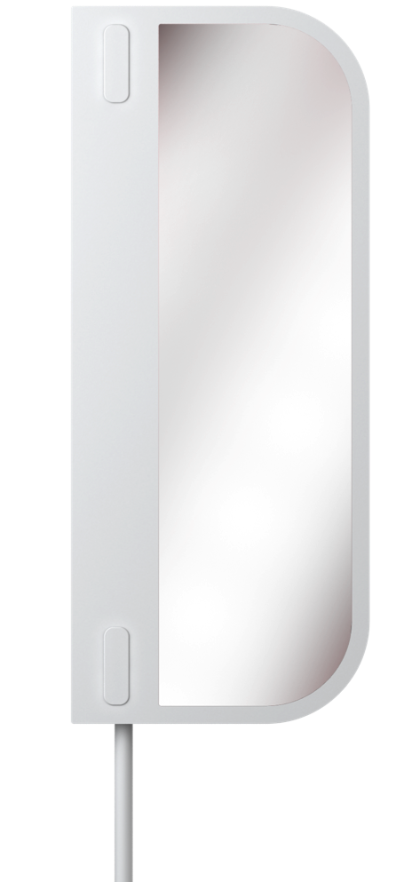
The New
Placemeter sensor
Elegant & discreet design
Local processing, no video streaming
Flexible connectivity (WiFi or 3G)
Shipping October 2015
Pre-order now

Slide 8
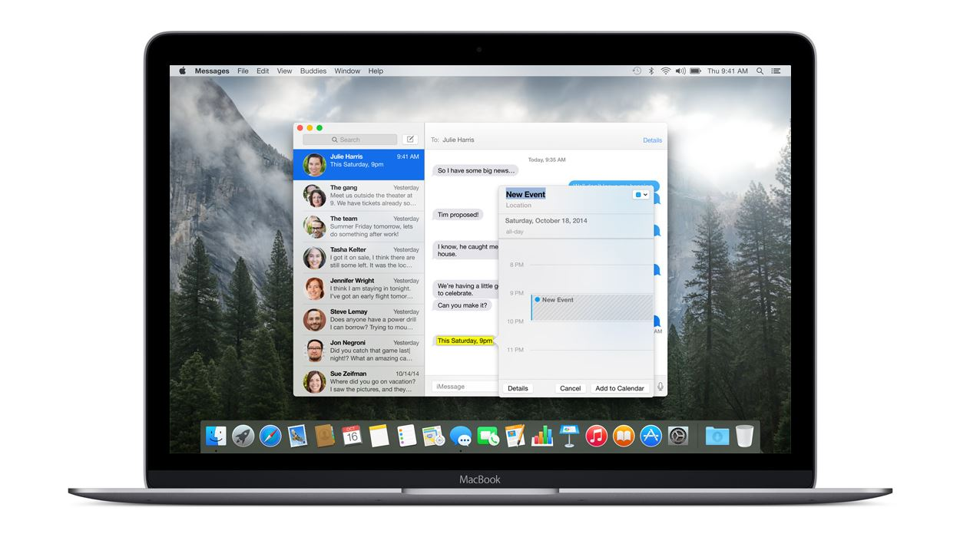
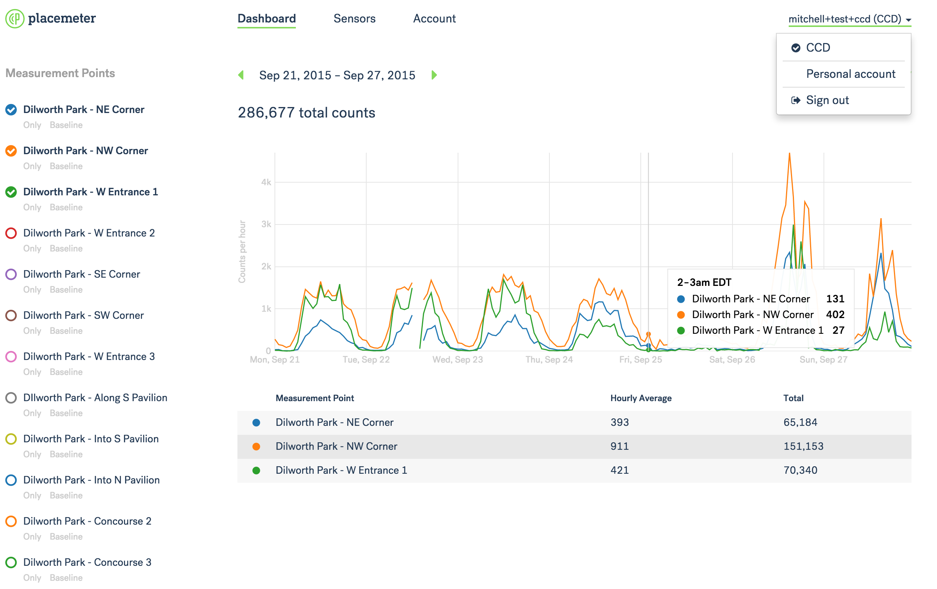
Our dashboard
Easily scroll
through time
Export the data
for further analysis
Add multiple
sensors
Online payments
Compare multiple locations at a glance
Team accounts
Notes:
NEW DASHBOARD

Slide 9
Advanced integration
API for integration into 3rd party applications
Easily combine with other data sources
Select any time resolution or time span
Import into spreadsheets for analysis, charting

Slide 10









Privacy by design
Nicole Wong
Privacy Advisor
Deputy CTO of the US
Legal Director, Privacy
We don’t identify people.
We don’t record video.
We conduct regular audits of our privacy policies and practices.
VP, Deputy General Counsel, Privacy
Notes:
NICOLE WONG Safe Harbor compliance

Slide 11
Current Use Cases

Slide 12
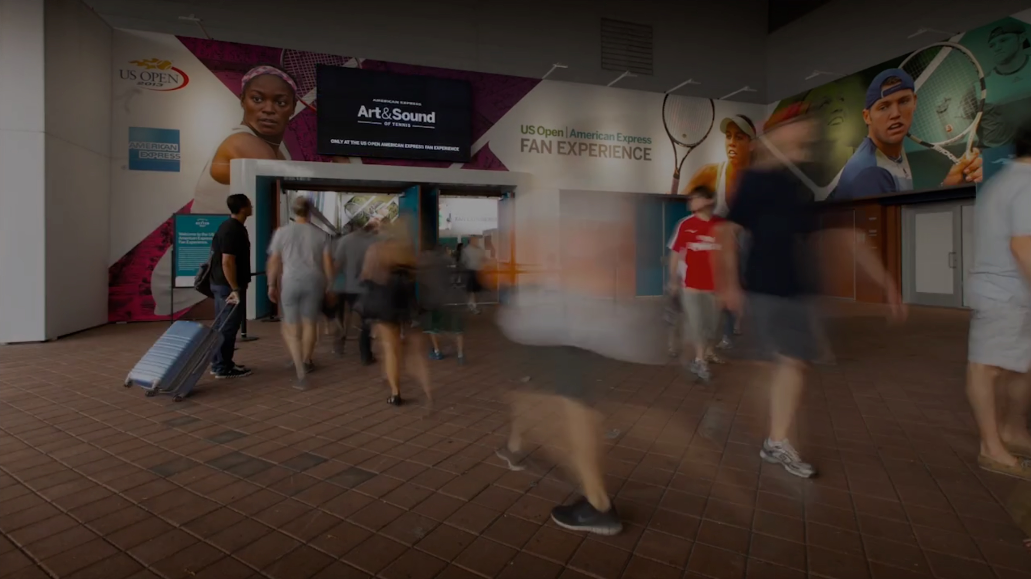


Understanding City Hall Occupancy
New Urban Mechanics
3 months
3 cameras
6 Measurement
Points
measured and reported use of ticket windows
monitored building entrances and exits
calculated breakdown of users by path (escalator vs. stairwell)

Slide 13
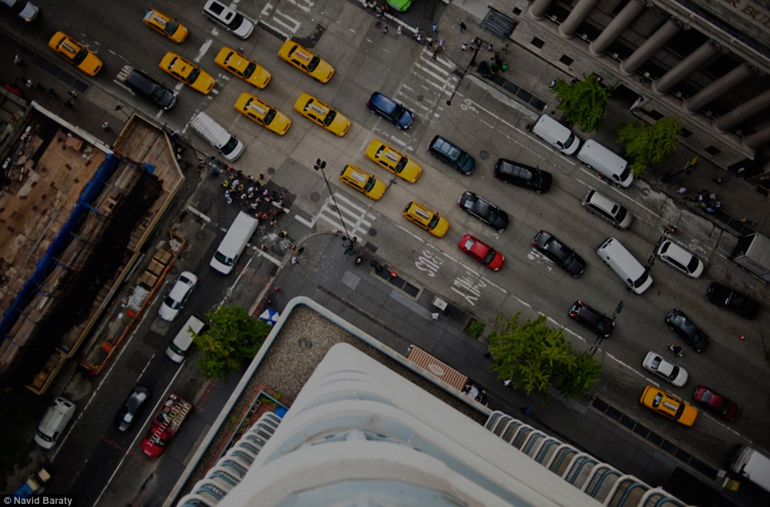
Understanding Multi-Modal Traffic
New Urban Mechanics
3 months
2 cameras
10 Measurement
Points
2 intersections, 3 months, vehicles, pedestrians
continuous counts and baselines
leveraging existing cameras

Slide 14







Know how people use your streets
transportation
Accurate and scalable automated pedestrian, vehicular and cycle counts
Precise measurement of the safety of crossroads and crosswalks
Spot or continuous counts for a fraction of the cost of manual counts

Slide 15
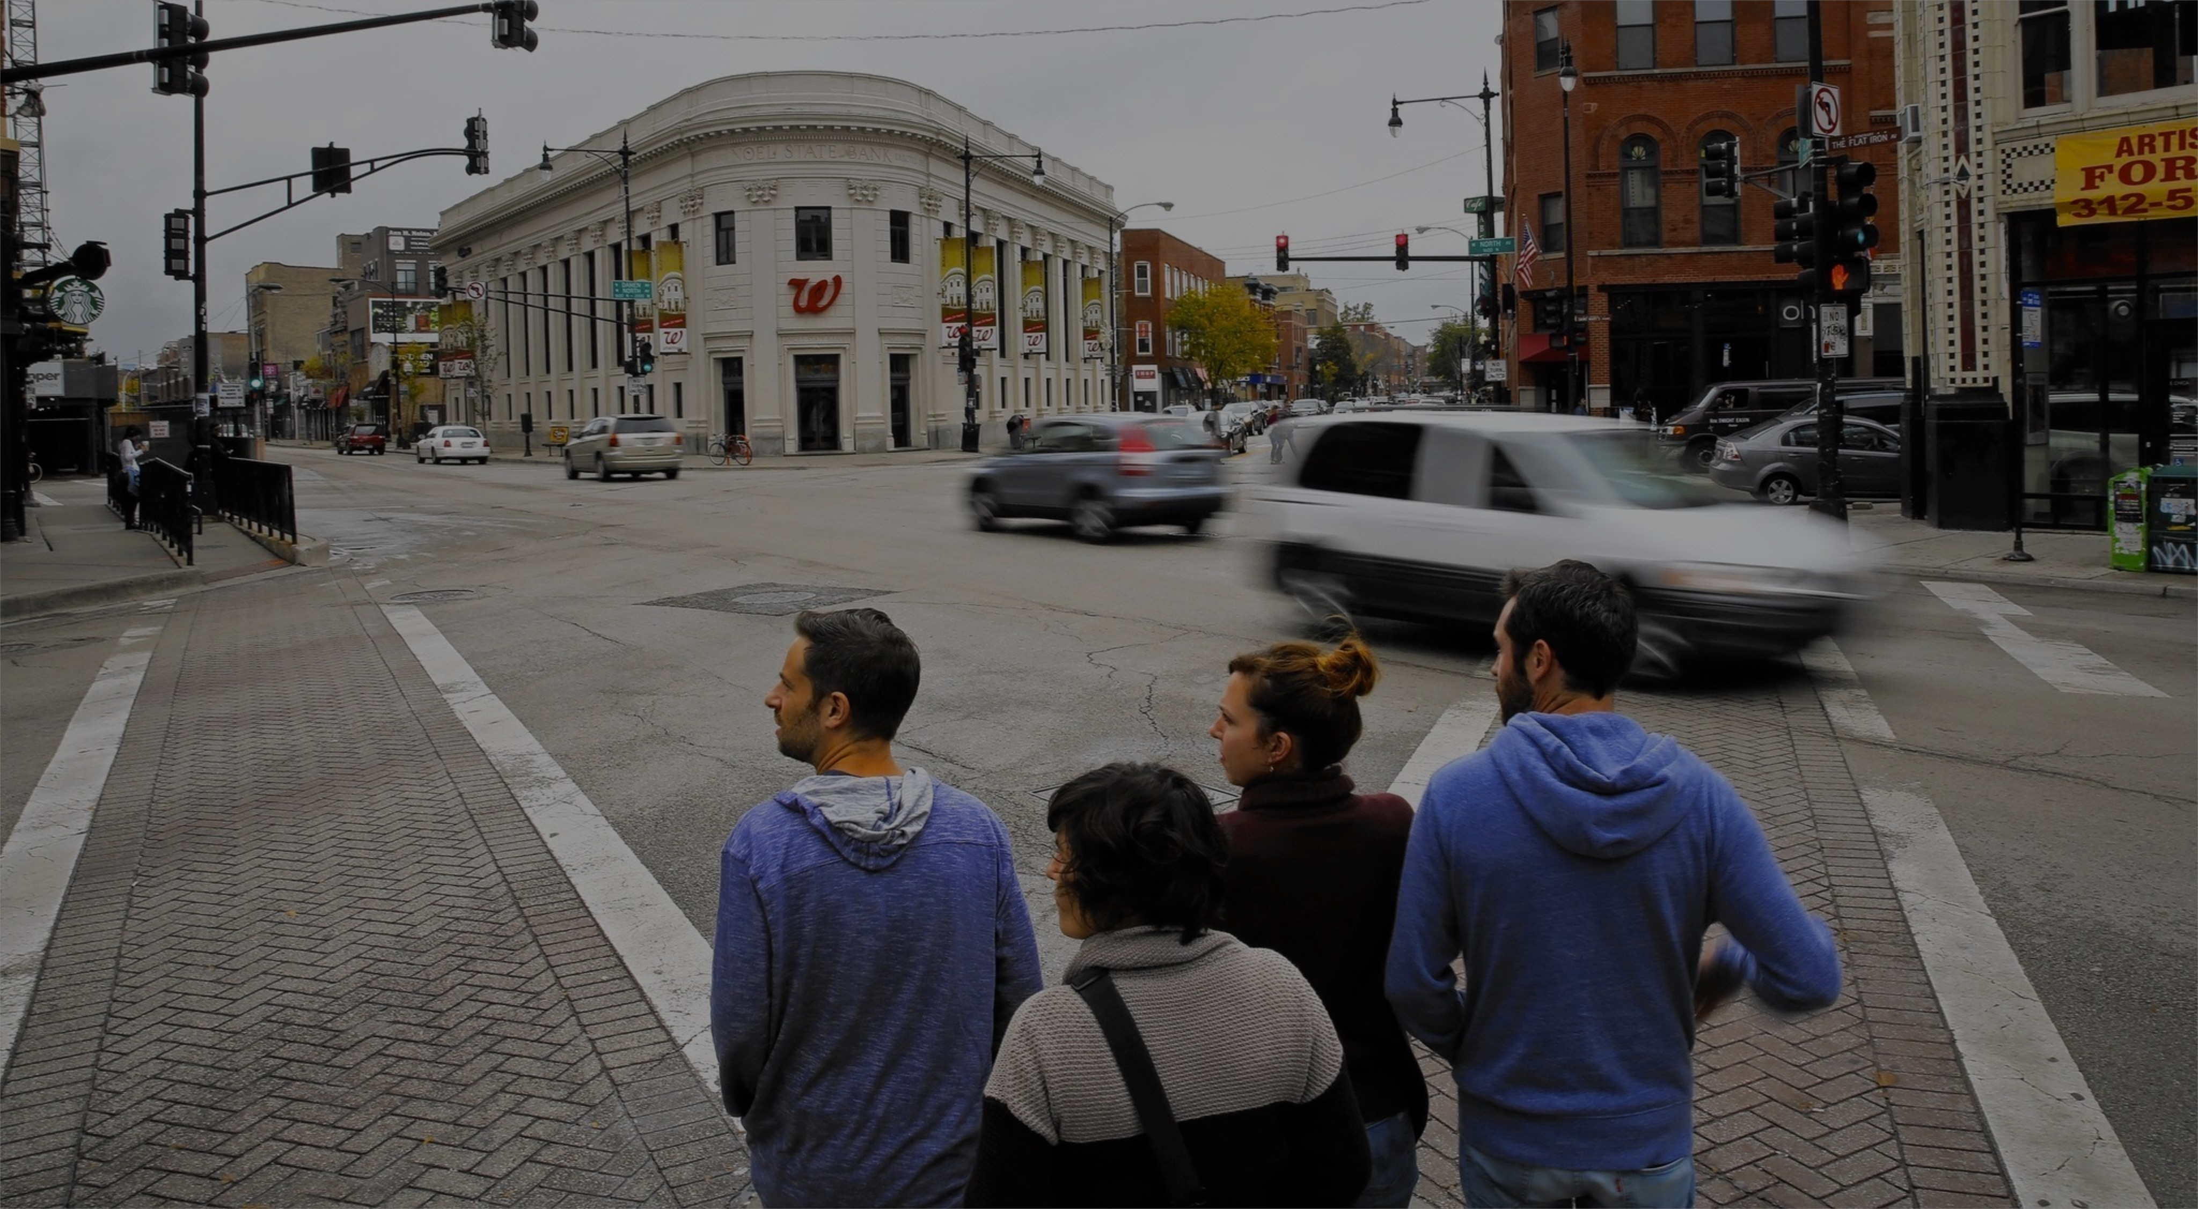







Measure the impact of urban design
urban design
Analyze primary flow paths and most-utilized features
Rapidly test how alternate designs impact usage and movements
Create historical benchmarks to use with future design models

Slide 16
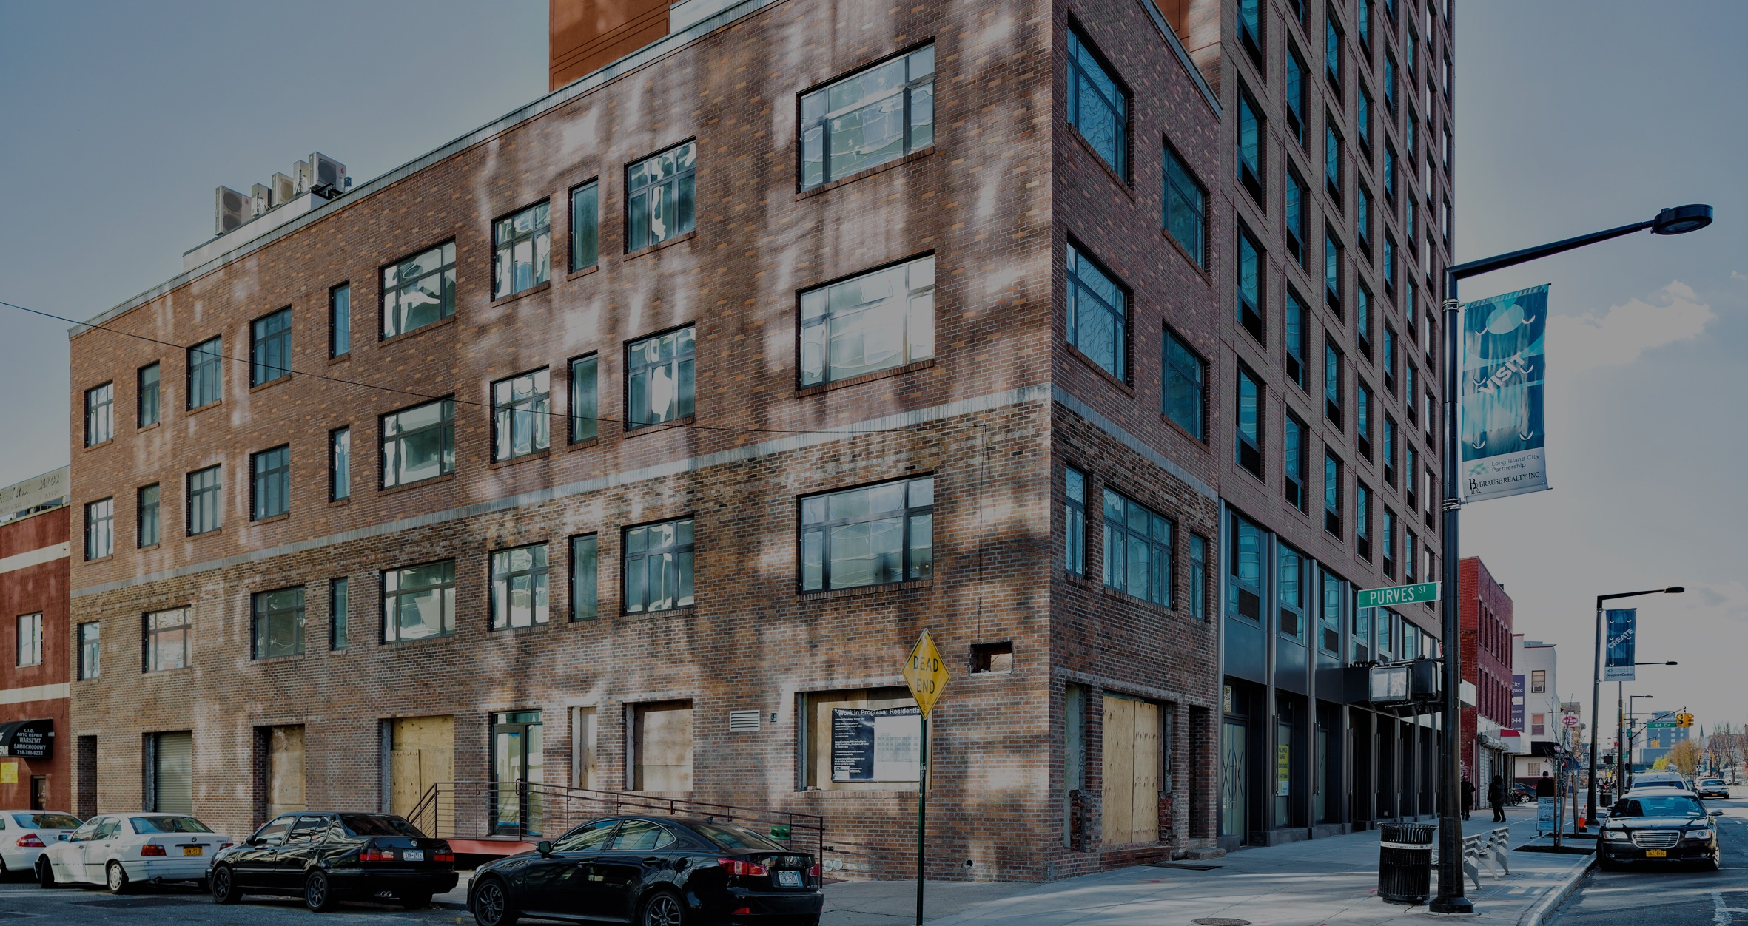



Gauge the value of your properties
commercial RE
Give prospective tenants comprehensive data about future foot traffic
Know typical visitor profiles for a location based on traffic patterns
Zero-in on the most valuable investment opportunities in your city

Slide 17
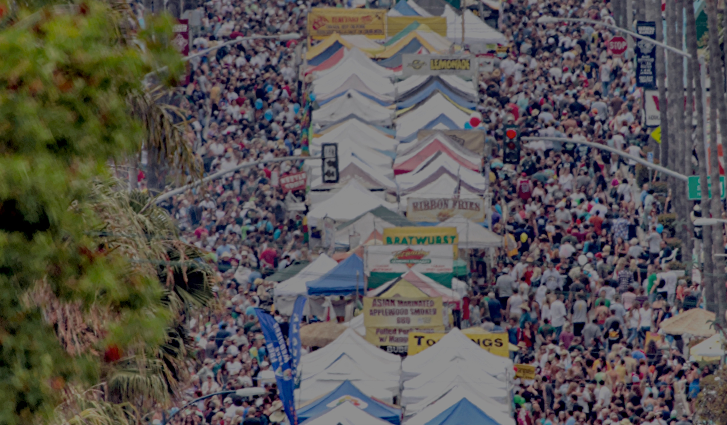







Optimize your business district
BIDs
Give prospective tenants comprehensive data about future foot traffic
Know typical visitor profiles for a location based on traffic patterns
Zero-in on the most valuable investment opportunities in your city

Slide 18
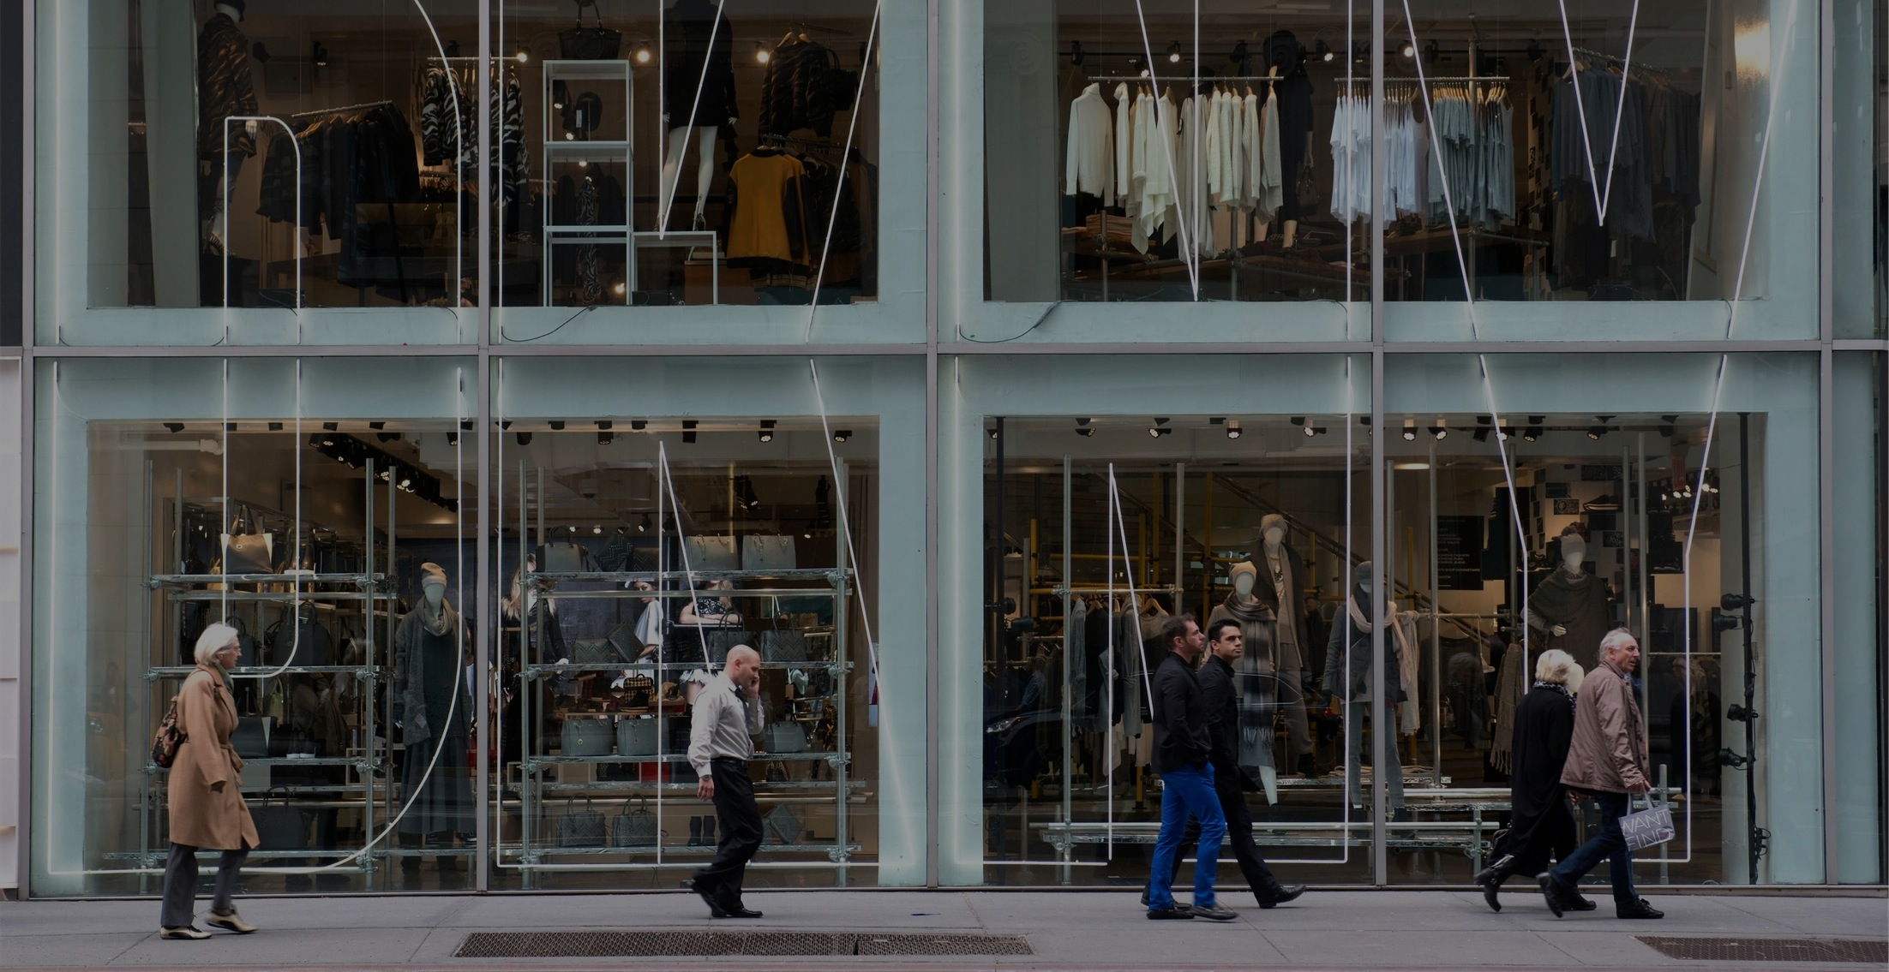









Understand foot traffic to a store
retail
Measure sidewalk-to-store conversions to test storefront strategies
Select new locations using accurate and long term foot traffic measures
Get to know your visitors through behavioral segmentation

Slide 19
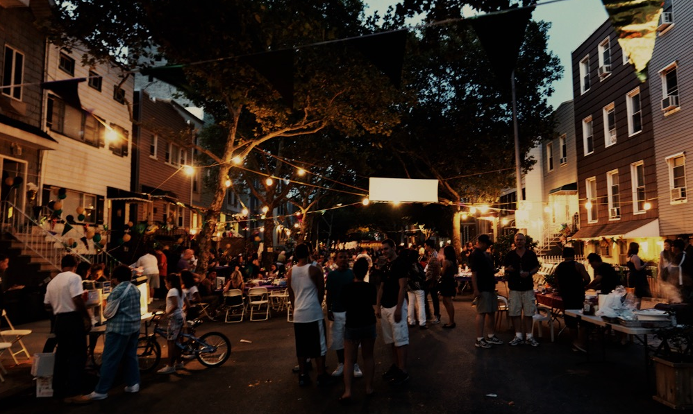


Quantify your neighborhood
civic hackers
Measure overall foot traffic trends to negotiate infrastructure improvements
Collectively improve street safety by measuring / publishing car speed data
Measure the impact of new developments on your block

Slide 20




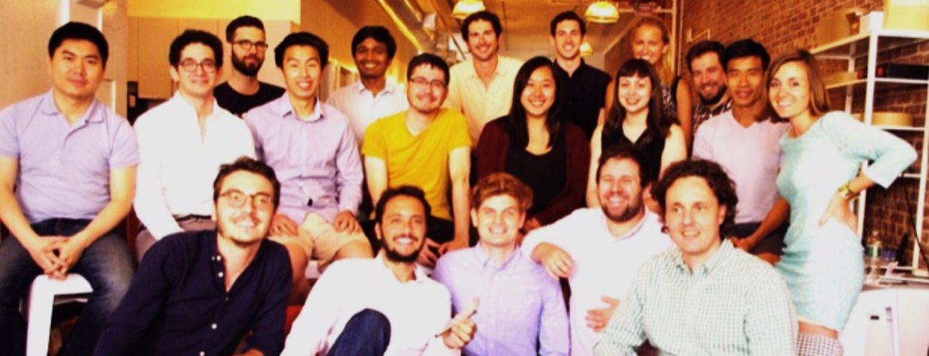






some of our customers
some of our investors
Founded
2012
Employees
27
NYC
and Paris
Patents
9
some press
A team of PhD’s, AI engineers, city planners and urban enthusiasts backed by Silicon Valley investors and operating worldwide.

Slide 21
Thank you
Alexandre Winter | alex@placemeter.com
Florent Peyre | florent@placemeter.com

Slide 22
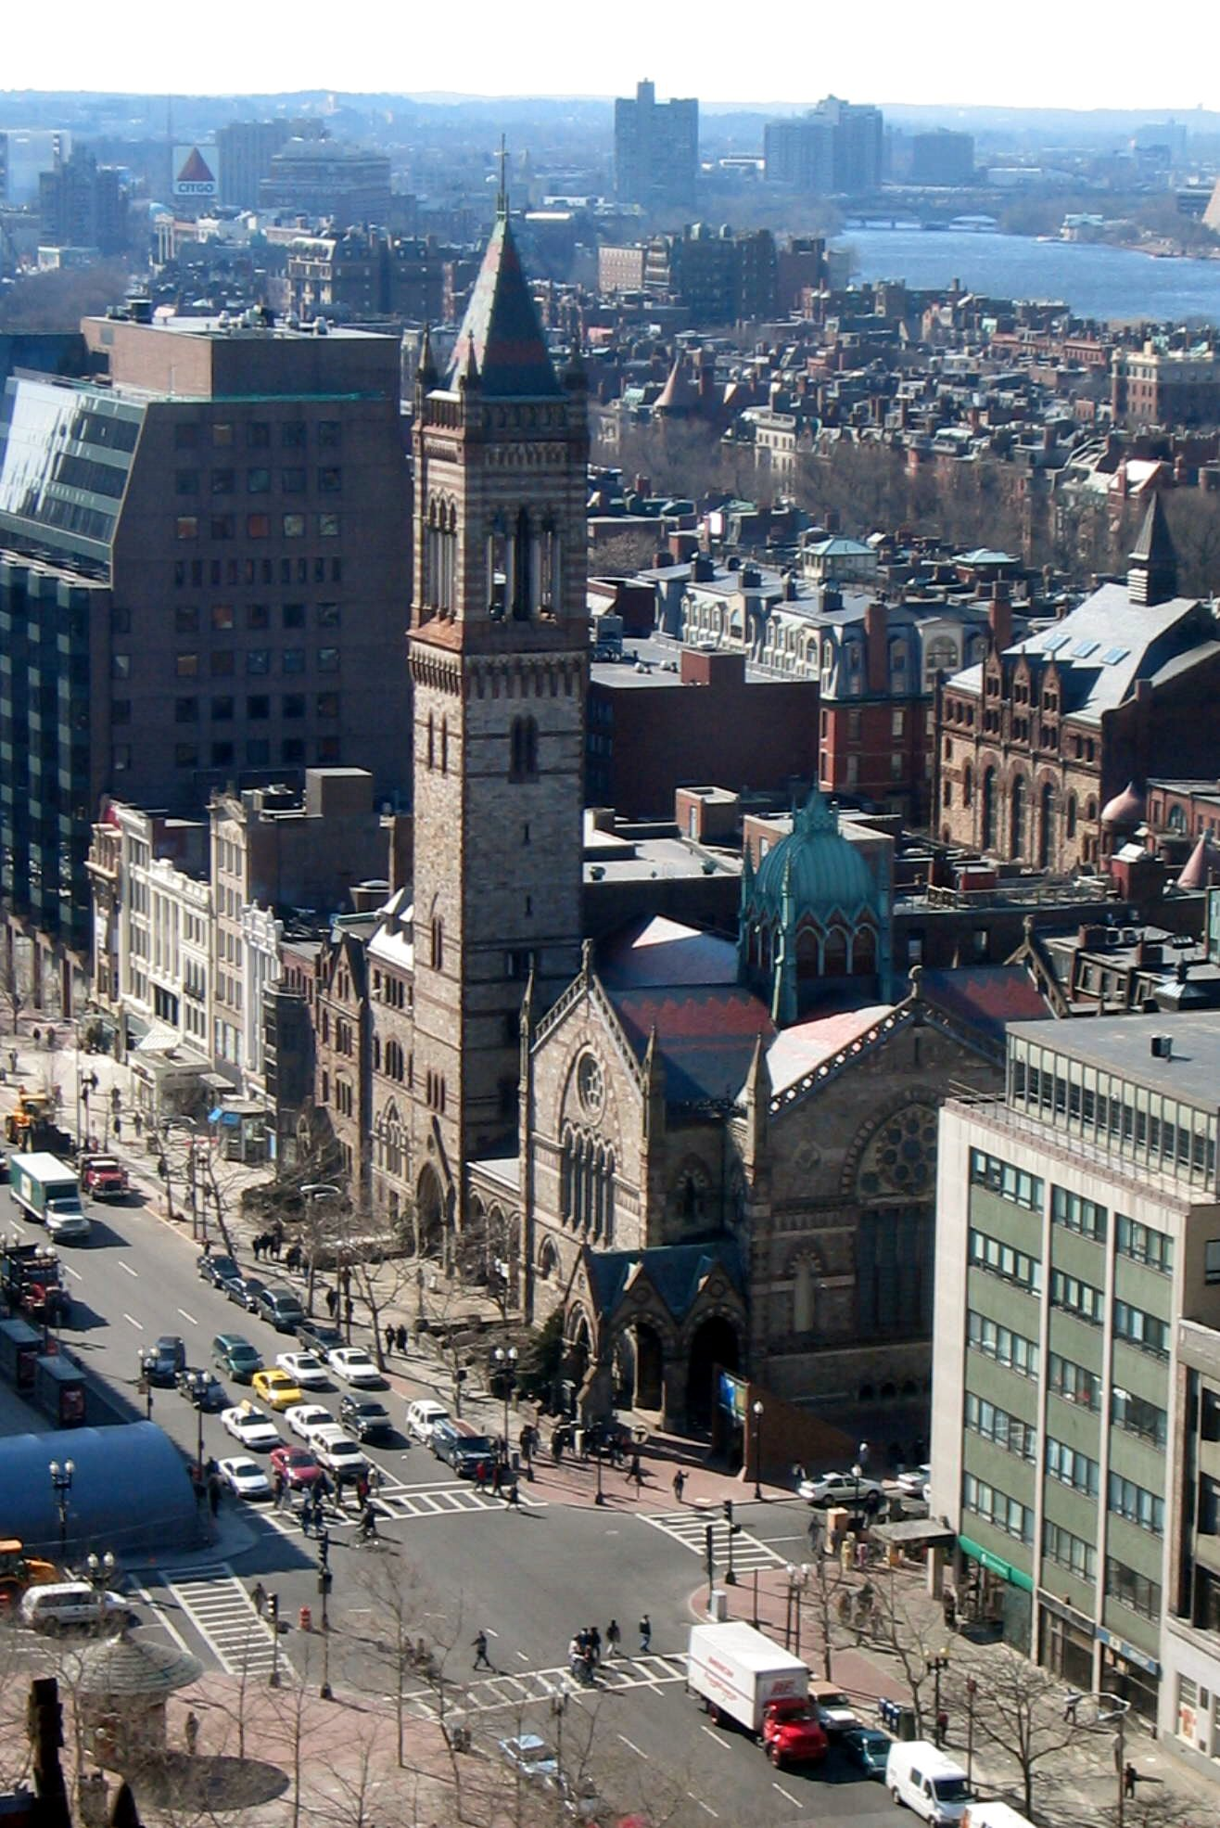

Case study: City of Boston
City of Boston used Placemeter to measure pedestrians, bicyclists, and vehicles in multiple locations throughout downtown Boston.
How we helped
Placemeter provided data to streamline city operations, using our real-time urban intelligence platform to:
Learn daily user behavior: City of Boston determined that pedestrians opted to travel different routes and use different ticket windows depending on the time of day and day of the week.
Compare and benchmark use by mode: with Placemeter data, City of Boston was able to get an accurate reporting of the types of traffic in different major corridors broken down by mode – all in real time.
Allocate resources dynamically: Using the ongoing measurements we provide, coupled with other data sources such as internal and weather data, the city can forecast expected foot traffic, and allocates resources like police, traffic signals, or trash collection, accordingly.

Slide 23

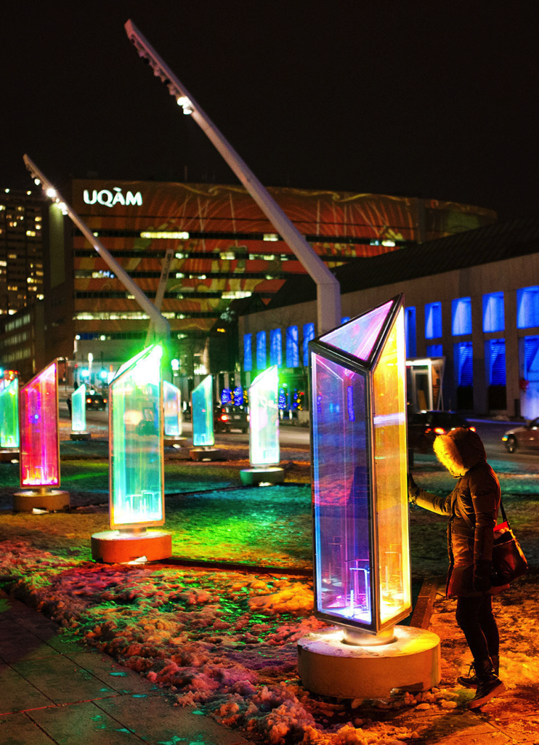

Case study: Quartier des Spectacles
The Partenariat du Quartier des Spectacles in Montreal represents over 60 key stakeholders in Montreal’s most vibrant entertainment district downtown. It plays a crucial role in managing public spaces and facilities, developing business interests, and organizing cultural activities in the neighborhood.
How we helped
Placemeter gathered data about a popular subway station in the area to measure in and out traffic by day and time, and an outdoor art installation so that QDS could measure visitors to the site.
Subway station: QDS was able to use the data to quantify people’s habits in the area by arrival and departure patterns. Additional Placemeter analysis helped the group make conclusions on types of people (e.g., commuters, nightlife visitors) visiting the neighborhood, giving them an interesting look into how people view the neighborhood.
Art installation: Data about the installation helped QDS better understand the impact of the installation on the neighborhood. Placemeter revealed insights about the varied weekday vs. weekend behaviors of visitors around the site, as well as distinctive week-over-week changes in behavior due to changes in weathers and events.

Slide 24
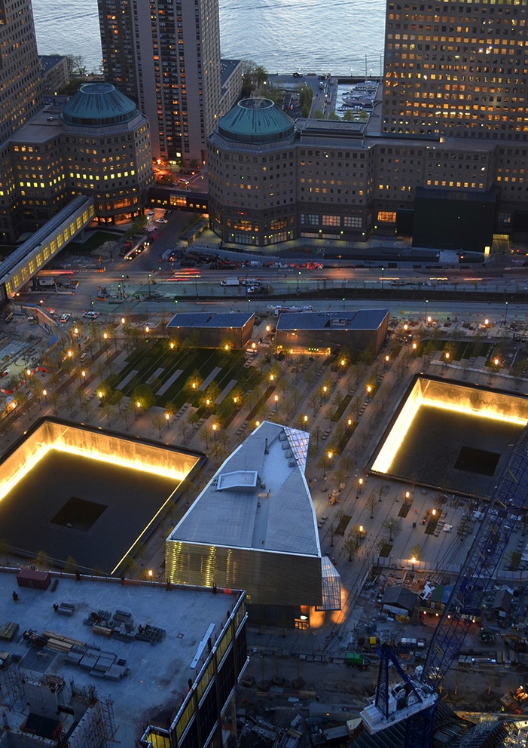
Case study: 9/11 Memorial
The 9/11 Memorial is an eight-acre public landmark in lower Manhattan honoring the victims of the terrorist attacks of September 11, 2011.
How we helped
Placemeter gathered data using an installed camera in a window of the 9/11 Memorial’s office to count the number of people entering and exiting the memorial plaza.
By creating a virtual turnstile at the entry corridor, Placemeter’s computer vision analytics system could detect pedestrians’ directional movement.
Placemeter’s technology lets you customize your data aggregation at the specific point you need it, so you can pinpoint what are the entry or exit points you care most about.
Knowing how many people are entering or leaving your space by date and time allows you to more accurately plan your operations and if you choose to share that information with your visitors in real-time, let them know the optimal time to visit and avoid crowds.

Slide 25

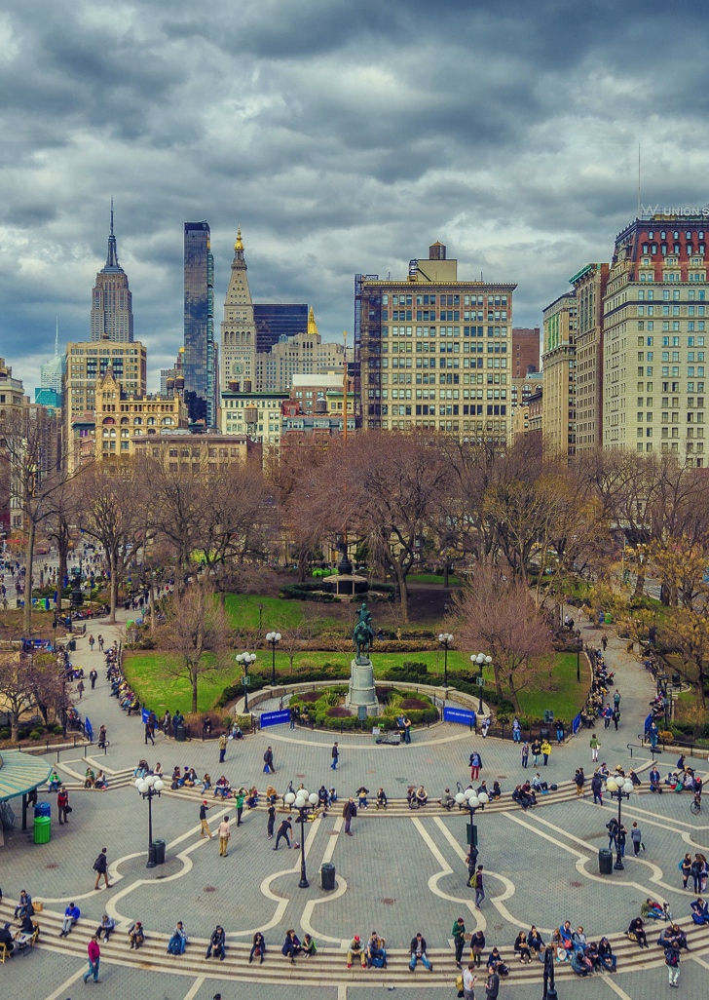
Case study: New York City DOT
New York City’s Department Of Transportation manages the safe and efficient transport of people and goods in NYC. With an annual operating budget of close to $1B, the DOT oversees NYC’s streets, highways, bike lanes, sidewalks, bridges, tunnels, and more.
How we helped
Placemeter processed data from both DOT third-party videos and smartphone video sensors, to determine pedestrian counts at a walkway and plaza.
Walkway: Placemeter data helped the DOT quantify how many people used the walkway daily, with discernible differences from week to week. The results allowed the DOT to better plan walkways in the area based on usage and crowdedness throughout the day.
Plaza: Walk-by traffic at the plaza was compared with overall traffic at the intersection and used to identify how peak times in traffic flow impacted pedestrian spillover from other available pathways. Data also revealed spikes in usage during special events, which the DOT could use for planning around similar events leading to added foot traffic.

Slide 26
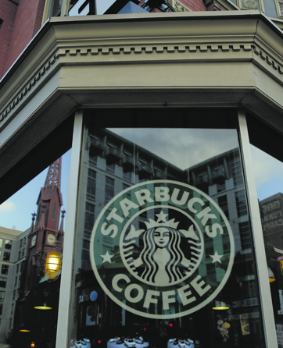
Case study: Starbucks
Starbucks is using Placemeter to measure foot traffic and conversion rates at several of their coffee shops’ locations in NYC.
How we help
Placemeter provides data to streamline store operations, using total traffic and conversion rates to:
Compare and benchmark multiple locations: with Placemeter data, Starbucks is able to get a real sense of multiple coffee shop’s performances relative to their sidewalk capture rate.
Allocate store resources dynamically: using the ongoing measurements we provide, coupled with other data sources such as internal and weather data, Starbucks forecasts expected foot traffic, and allocates resources like staffing, facilities or inventory accordingly.
Learn daily customer behavior: Starbucks determined that their stores had a higher capture rate when the foot traffic had a particular distribution.

