Slide 1



Rewarding Better Behavior
December 7, 2015

Slide 2
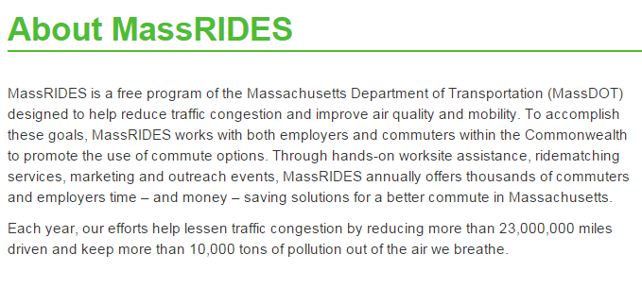
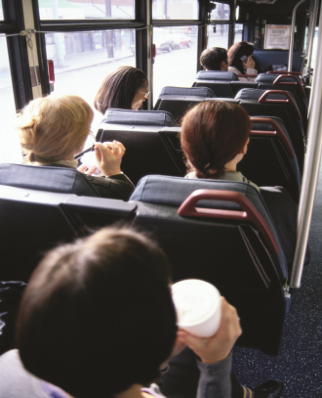
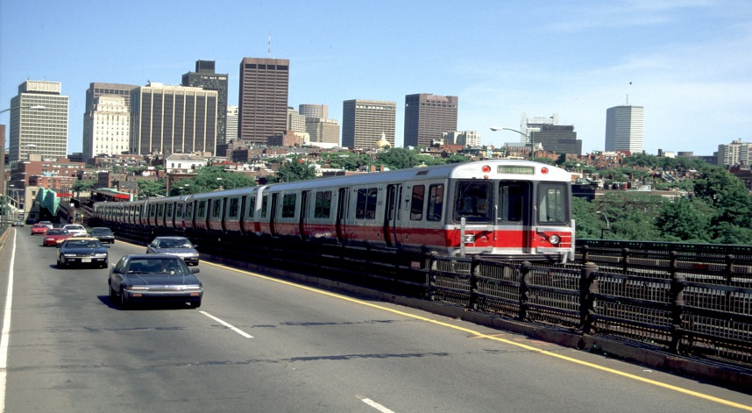

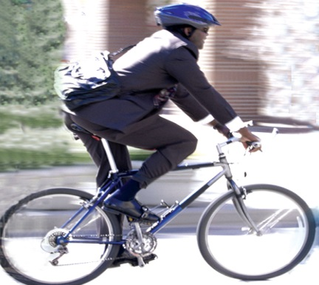
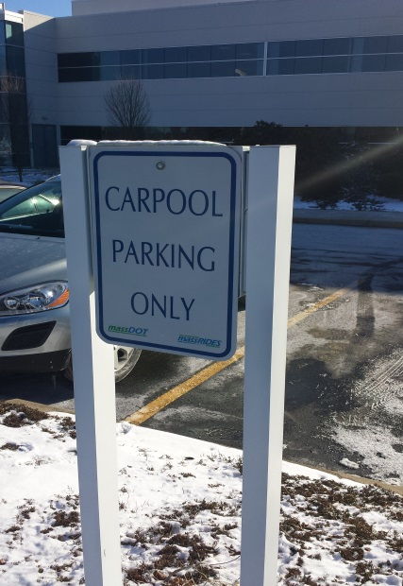
W-*
What is MassRIDES?

Slide 3


















What is MassRIDES?
350+ partner organizations
  Large employers, colleges/universities
600,000+ commuters
Stakeholder organizations
  14 Massachusetts TMAs
  Transportation providers
  Municipalities

Slide 4
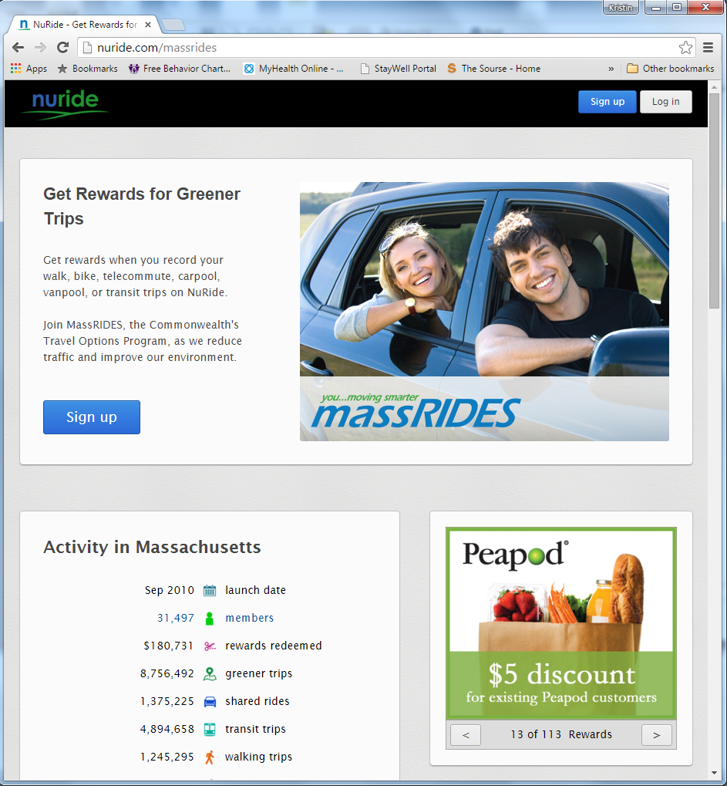
Ridematching & Rewards
NuRide.com/MassRIDES
Notes:
Key service offering
Vendor-provided service
NuRide

Slide 5
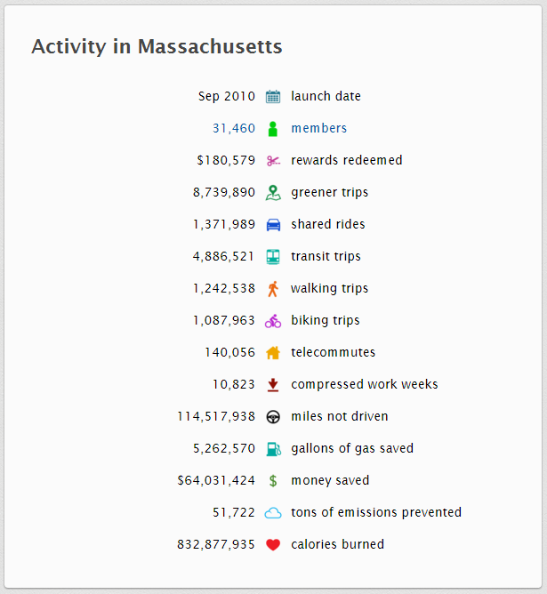
Ridematching & Rewards
NuRide.com/MassRIDES
Notes:
Key service offering
Vendor-provided service
NuRide

Slide 6
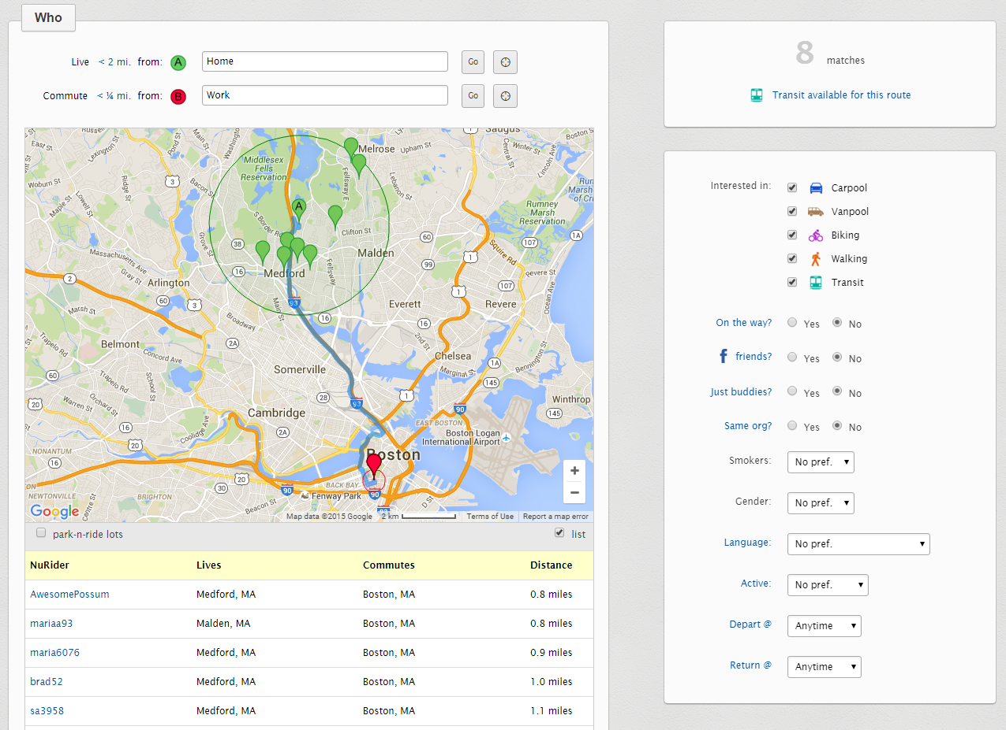
Ridematching
Carpool & vanpool matches
Adjust parameters
Additional modes
Preferences

Slide 7
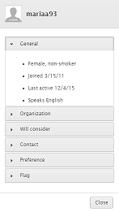
Ridematching

Slide 8
Ridematching
“I was truly astonished at how well the MassRIDES / NuRide websites worked out for me…I found a ride immediately, from a location close to my home, directly to my employer. My car-pool buddy's cubical is STEPS from my own.
Everyone has his/her own reasons for being in a carpool. In my case, I needed a hard-stop to help me leave the office in a timely fashion at the end of the day. Now my family sees more of me in the evening, AND I am saving the planet AND I am saving money/car wear-and-tear. Plus, my carpool is very flexible. On the days that I need the car for an errand, my carpool buddy and I just skip one day.
It is interesting that it took me 5+ years to making this decision, and now it is all so easy.
This is truly a win-win-win situation!”
--- Kathy B., Software Quality Engineer, EBSCO, Ipswich, MA

Slide 9
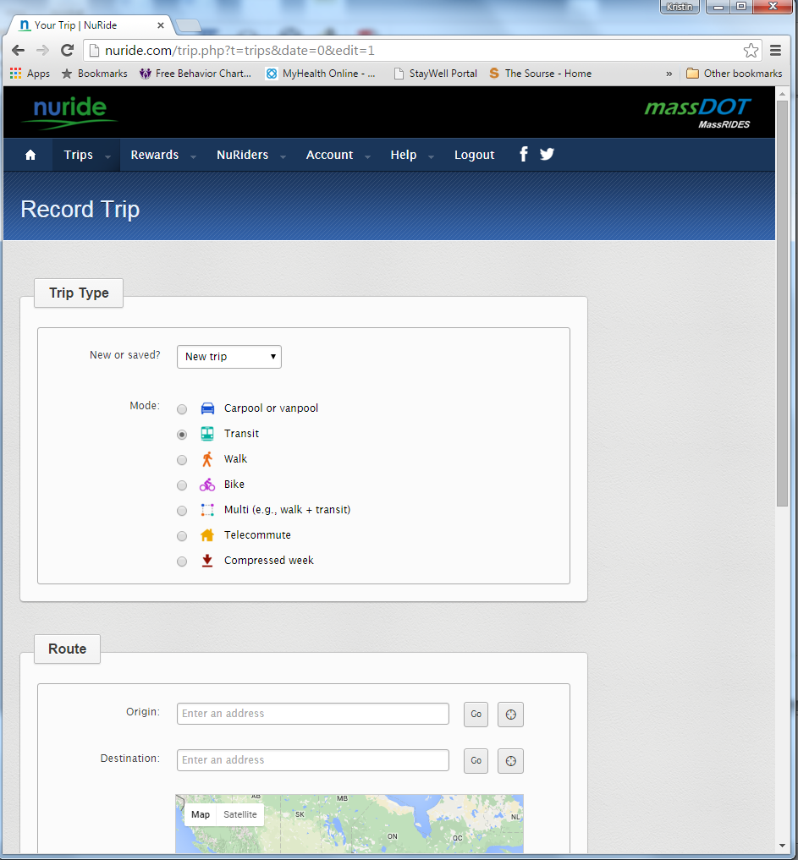
Trip Tracking

Slide 10
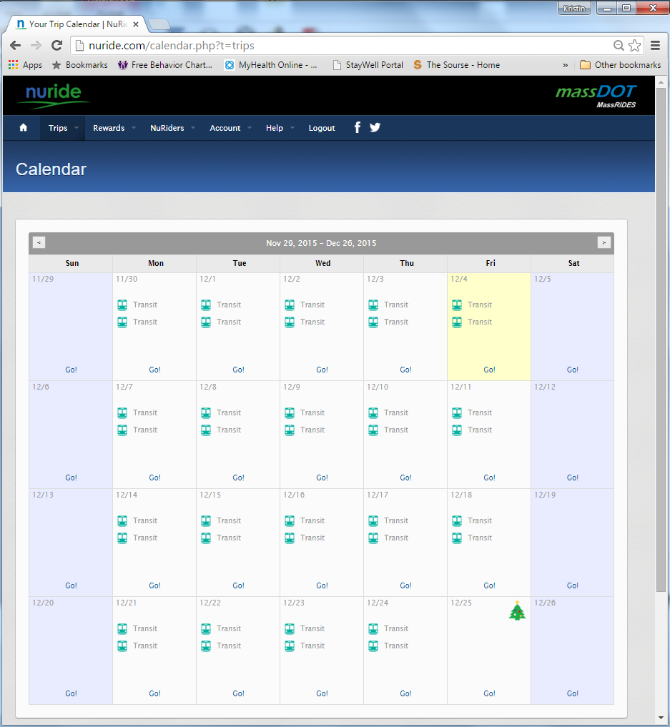
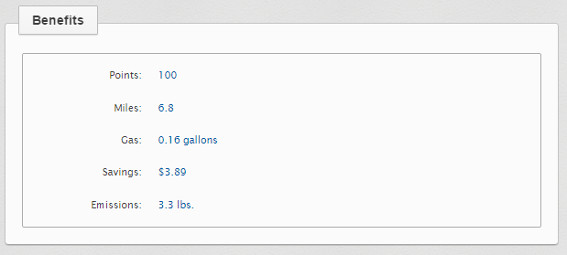
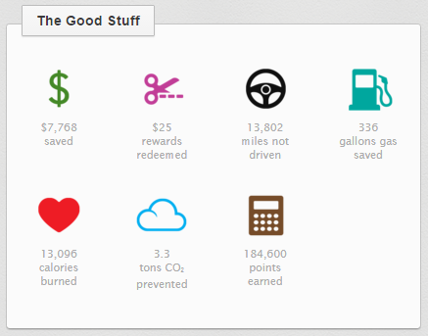
Trip Tracking

Slide 11

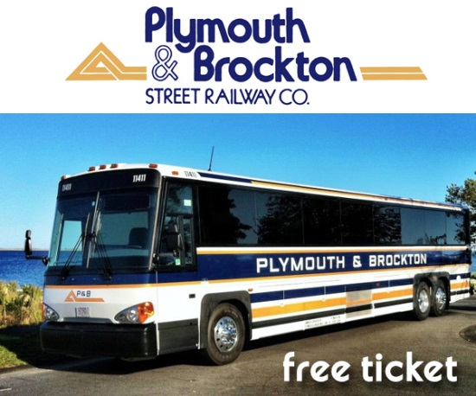


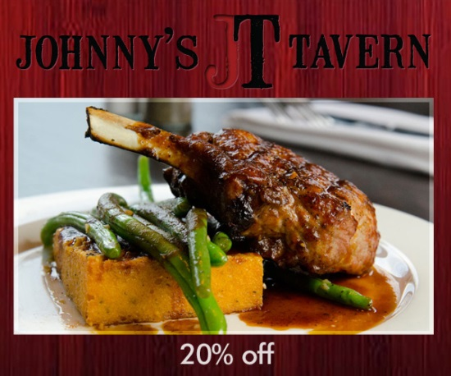


Rewards
Incentives, recognition, gamification

Slide 12
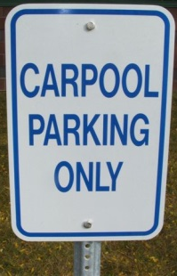



Rewards
Top NuRide Reward Redemptions in 2015
Smuggler’s Notch – Summer
Smuggler’s Notch – Winter
Dave & Busters
King Richard’s Faire
Fajitas & ‘Ritas
Advanced Auto Parts
Cambridge Brewing Co
Pedal Power Raffle
Plymouth & Brockton
From You Flowers
Peapod – offer 1
Back Deck
Fuller Craft Museum
Omaha Steaks
Peapod – offer 2
Zinneken’s
Rock Bottom Brewery
Gardener’s Supply Co
From You Flowers
Verizon Wireless
Rewards redeemed in 2015
  3,064 - $39,153
  44% return
Total rewards redeemed
  $180,635
  37% return
Incentives, recognition, gamification

Slide 13
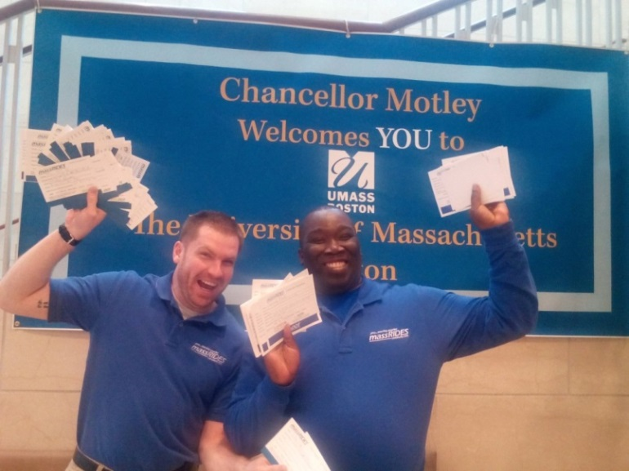
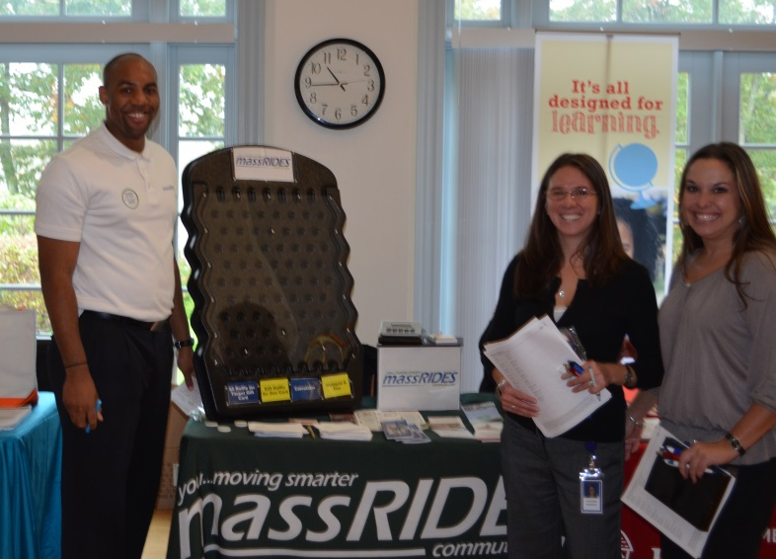
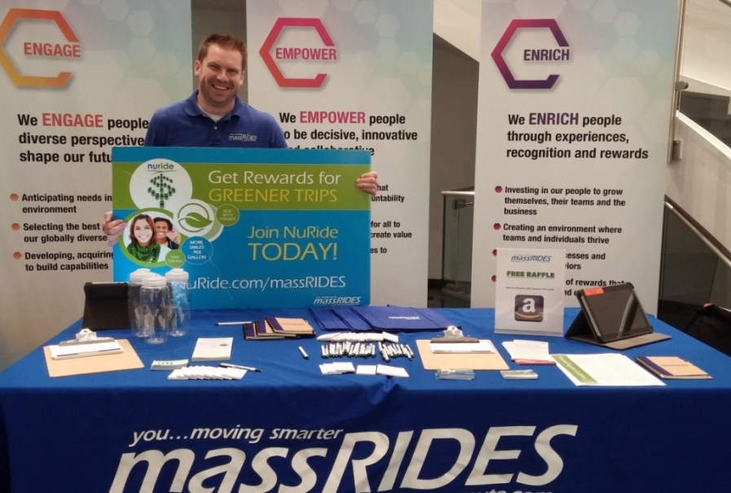




Generating Participation

Slide 14
Generating Participation
Series of Nudges
  Start conversation
  Consider options
  Give it a try
  Added frequency
  Keep it up
  Spread the word

Slide 15
Questions & Discussion
Thank You!

