Slide 1

Measuring Change in Boston

Slide 2
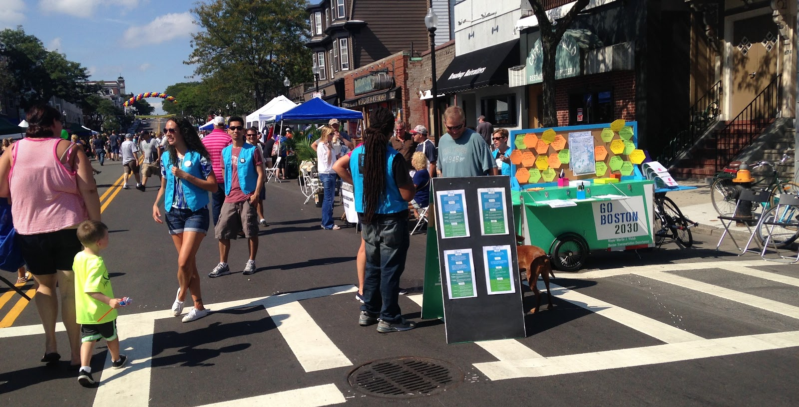
Go Boston 2030

Slide 3
Nine Key Themes
Safety
Health
Experiential Quality
Reliability
Sustainability & Resiliency
Tech & Innovation
Accessibility
Affordability
Governance

Slide 4
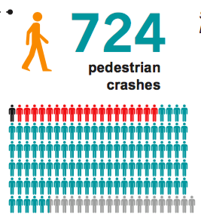
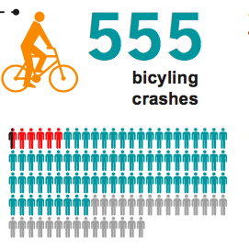
Key Theme: Safety

Slide 5
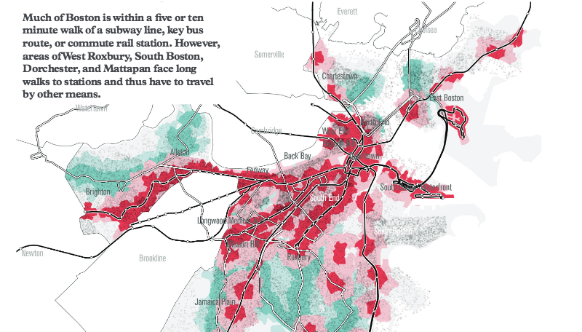
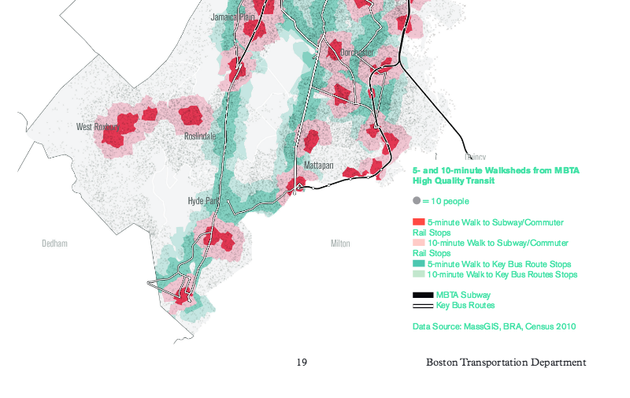
Key Theme: Accessibility

Slide 6

Key Theme: Reliability

Slide 7
Priorities for Measurement
We’re developing measures that help us to:
1. To Gauge Progress
2. To Learn & Improve
3. To Inform & Empower

