Slide 1
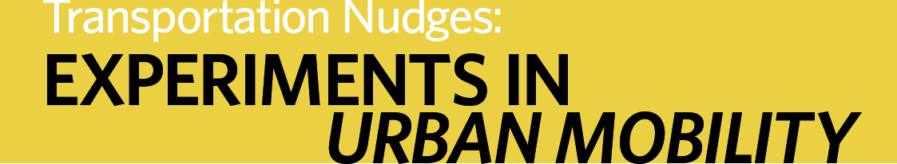
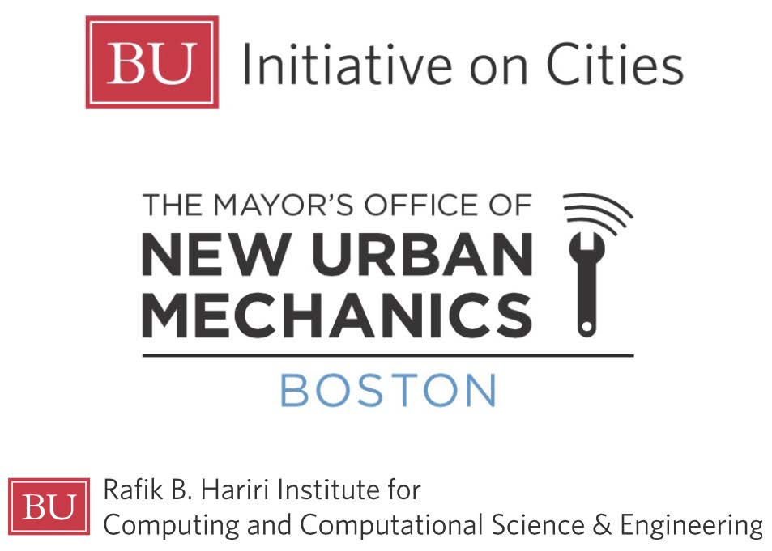

Hosted by:

Slide 2


Discouraging Poor Choices
Pricing, enforcement, and education efforts in Seattle
Transportation Nudges | Boston
December 7, 2015
Scott Kubly, Seattle Department of Transportation

Slide 3
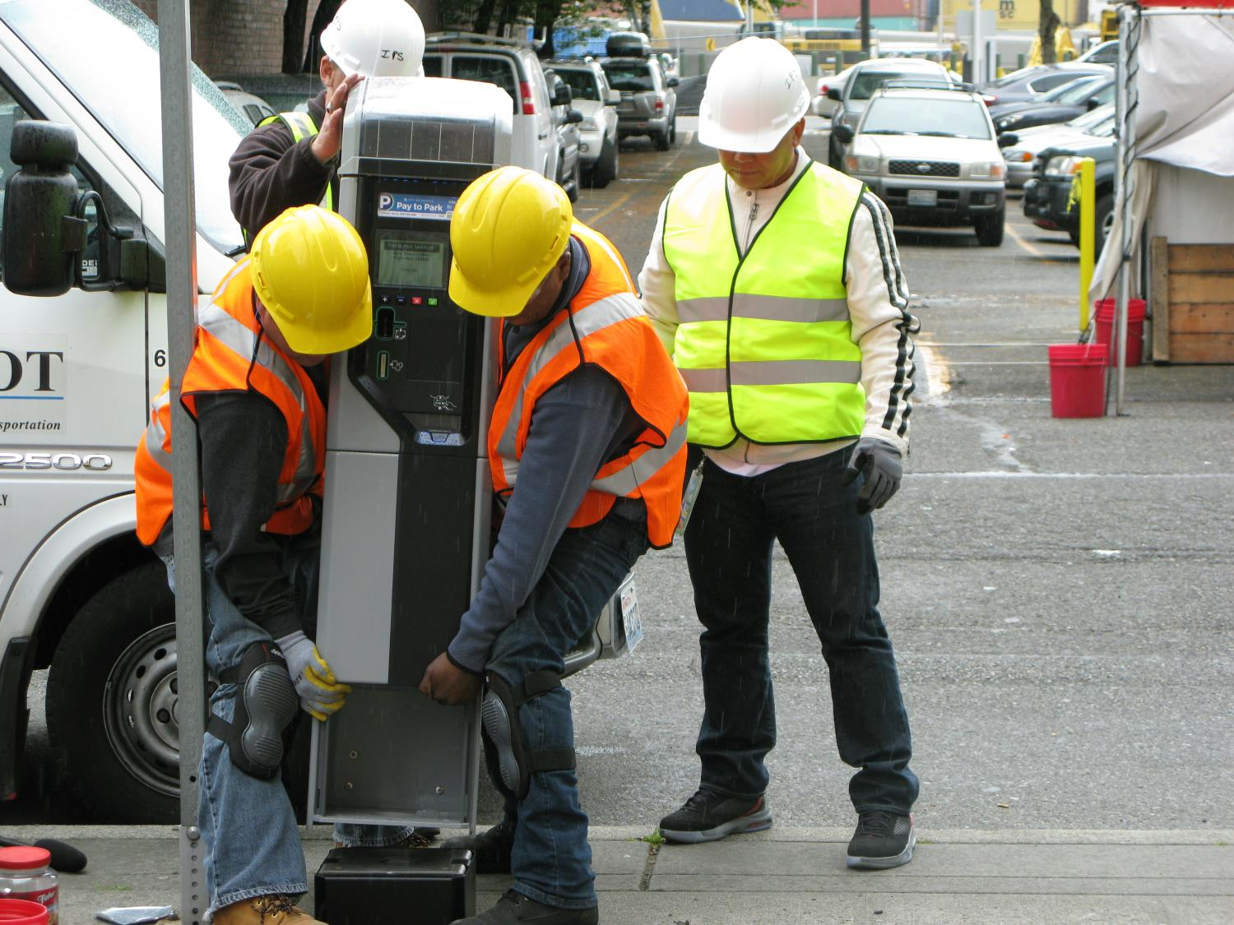
Notes:
New pay stations:
time of day pricing, to allow for lower parking rates in the morning or other times of less demand

Slide 4
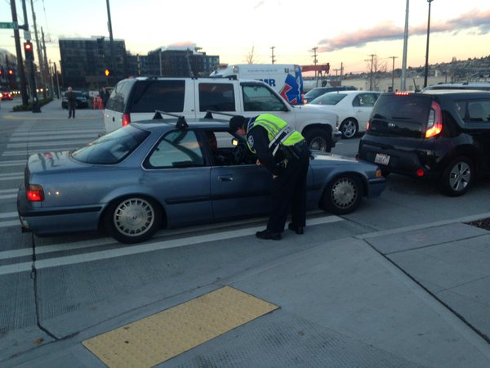
Notes:
Block the box enforcement – targeting people who block the crosswalk and/or get caught in the middle of an intersection
Big issue on a major arterial like Mercer St
135 – 238 = avg blocking incidents (AM and PM rush hour) on a few intersections along/near this corridor

Slide 5
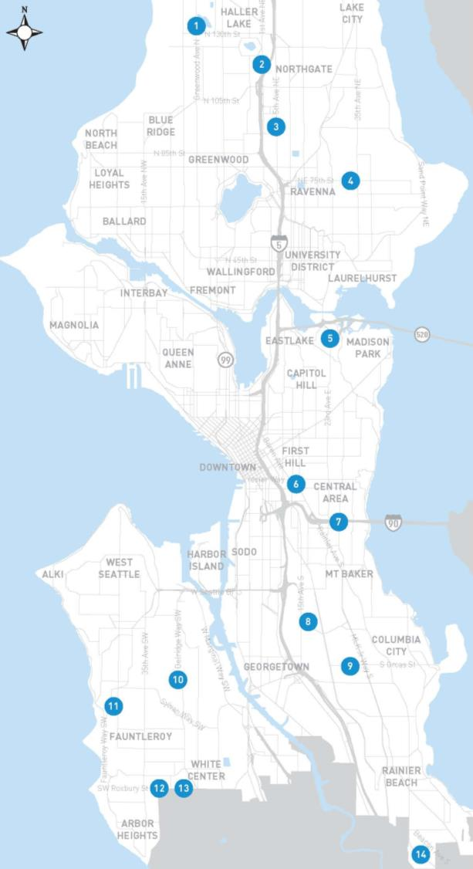
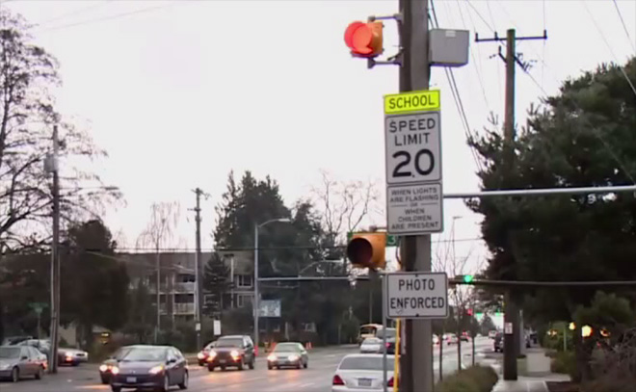
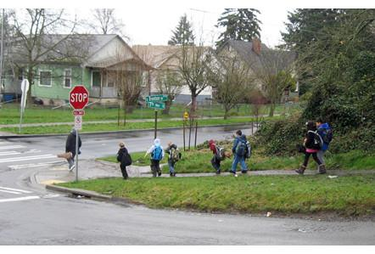
Notes:
School zone speed safety cameras
Results
average number of traffic violations per camera per day has dropped 64% and average speeds have decreased by 4%
90% of speeders in Seattle do not get a second ticket
Background/addl data
Program started in December 2012 at 4 schools with 8 cameras
Currently 28 cameras at 14 schools
135,520 total citations as of the end of August 2015
School zone cameras issue far more citations than officers annually.
Cameras issued 24,336 citations between December 10, 2012 and April 27, 2013
In all of 2012, SPD issued 20,135 moving violations
Generated approx. $27M in revenues, total life to date (as of 9/8/15) – 60 – 80% goes back to our Safe Routes to School program

Slide 6
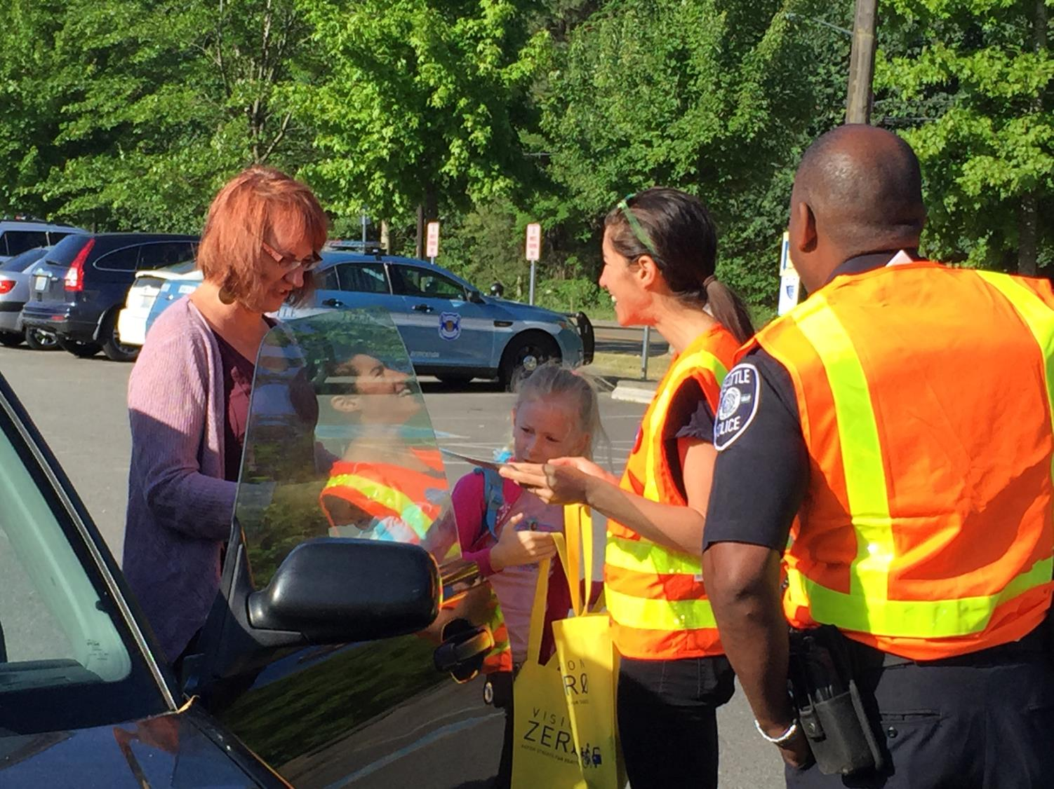
Notes:
Vision Zero re-enforcement patrols
VZ outreach opportunity
Acknowledge Seattle’s strong safety record and reward people for good behavior
Goody bags to kids (did this one at an elementary school)
Reward parents/adults with a $5 coffee card
Positive press

Slide 7
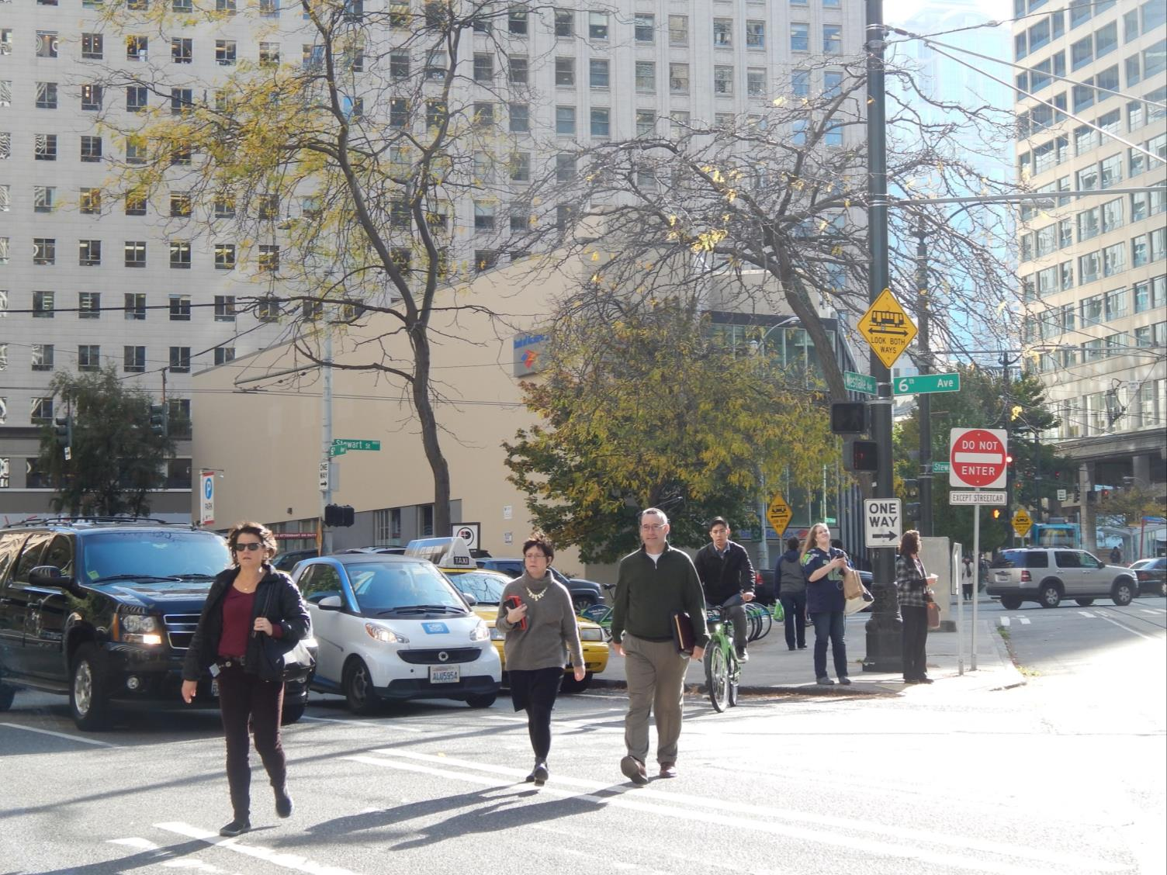
Notes:
Car2go and shared use mobility
Close to 70,000 car2go members
8% have sold their car = 5,000ish fewer cars on the road; replaced with smaller shared vehicles
Shared mobility planning and new players coming on board in 2016 (Drive Now)
It’s about offering variety of services/options to meet people’s diverse travel needs (encourage good behavior by offering the right tools)

Slide 8




Questions?
scott.kubly@seattle.gov | (206) 684-5000
www.seattle.gov/transportation

Slide 9
Hosted by:

