Slide 1



Hosted by:

Slide 2
Parking, pricing, and psychology:
The impact on mobility
City of Boston
Transportation Department
December 7, 2015

Slide 3
Parking: the lost consideration in mobility planning
Adequate and fair enforcement ensures payment and turnover
Effective mobility strategy
Demand
pricing
ensures
meters are available
Congestion mitigation
and modal alternatives

Slide 4
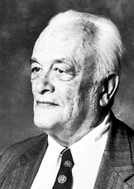
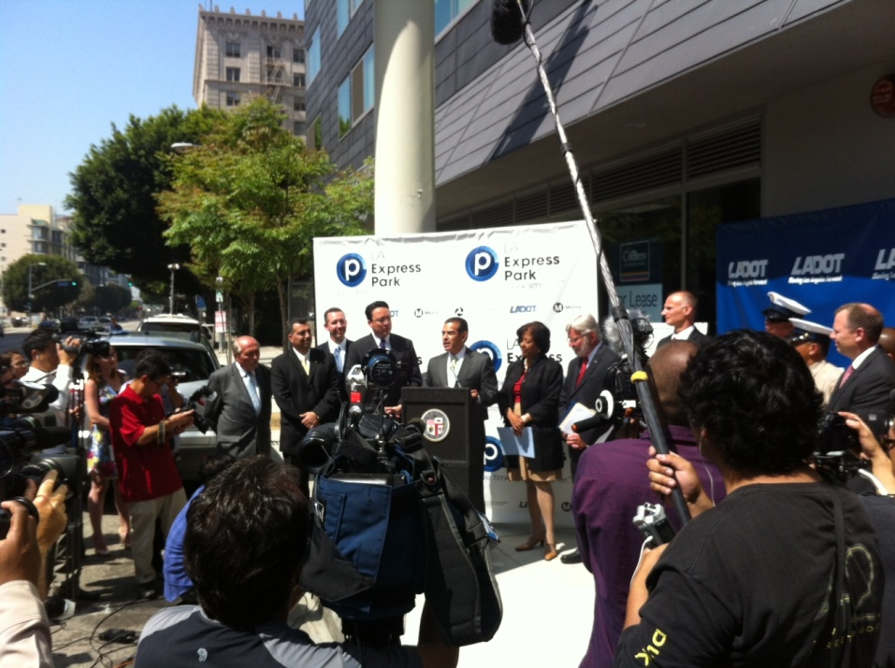
Demand-based pricing: how it works
1954
2012
Not a new idea, but inadequate technology.
Manage limited supply and heavy demand by charging the right hourly rates at the right time.
Internalize decisions and solve the externality problem.
William Vickrey
SF Park and LA Express Park
Vickrey, W.S., 1954, "The Economizing of Curb Parking Space," Traffic Engineering Magazine, Nov. Reprinted in Journal of Urban Economics 36, (1994), 56-65.
Focused on reducing congestion through curbside dynamic pricing

Slide 5
Requires more than a “finger in the air” approach to pricing
What is the right increment to influence behavior?
Paid use does NOT equate to occupancy. How do we gather data in an effective and sustainable way?
How can we maximize the effectiveness of segmented pricing without confusing customers?
How do we communicate changes to motorists? Wayfinding apps?
How do we deal with blocks with wildly fluctuating occupancy?
How many segments should we use in a day?
Goal: change behavior and create satisfied customers, not hostages

Slide 6
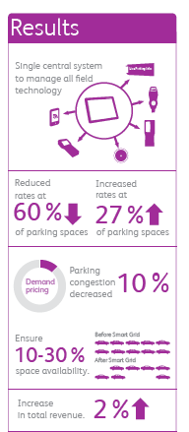
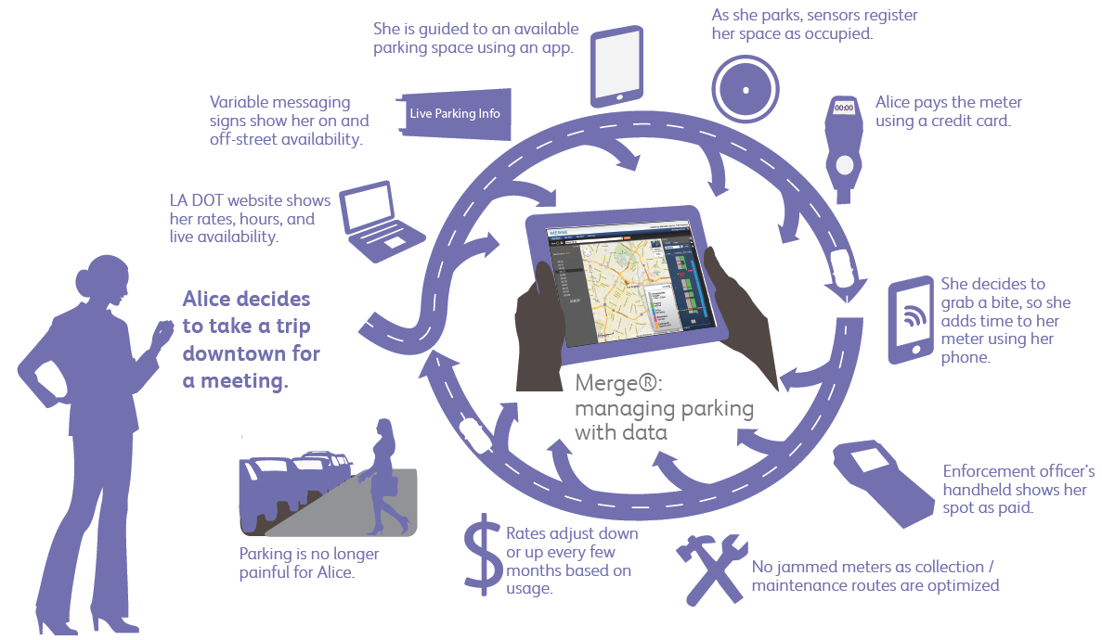
Los Angeles Case Study

Slide 7
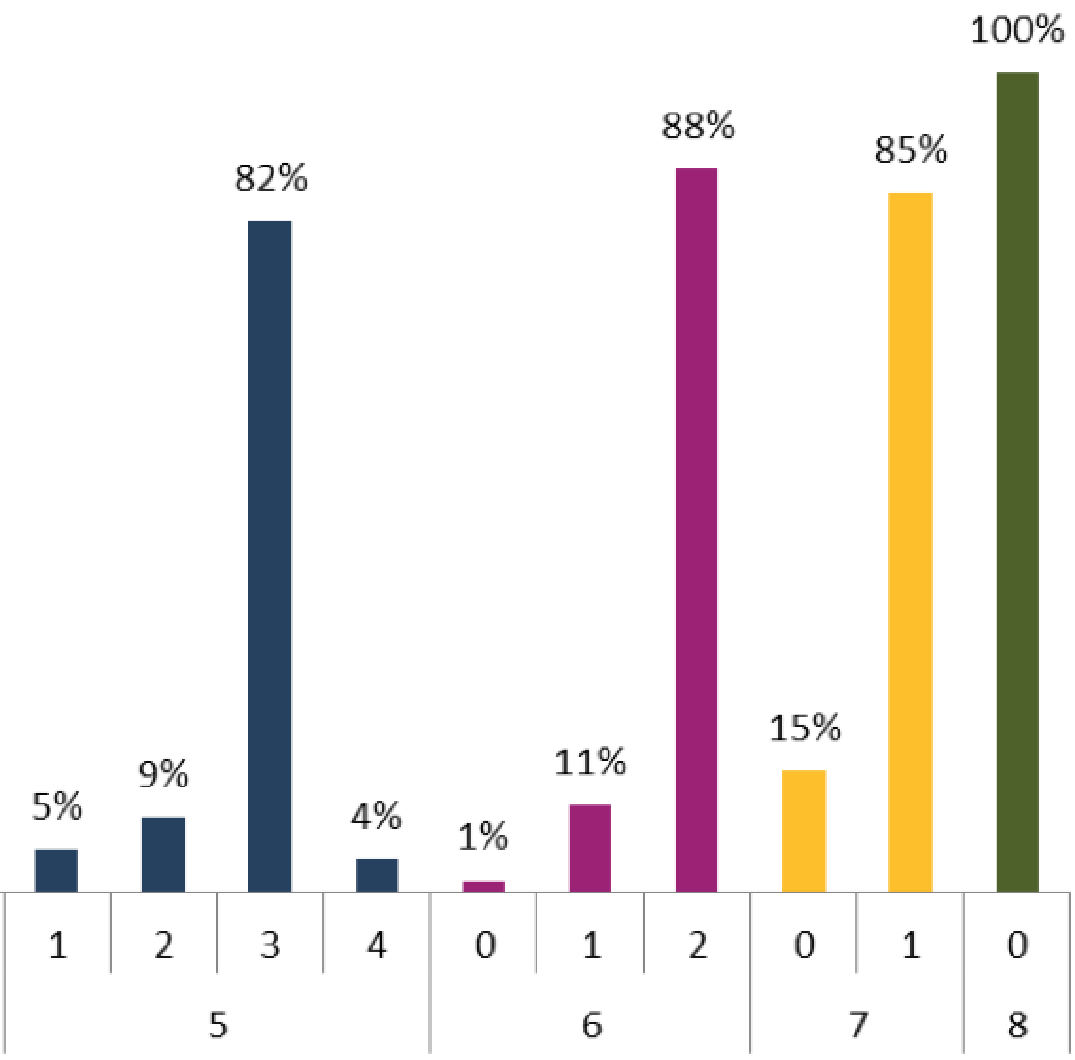
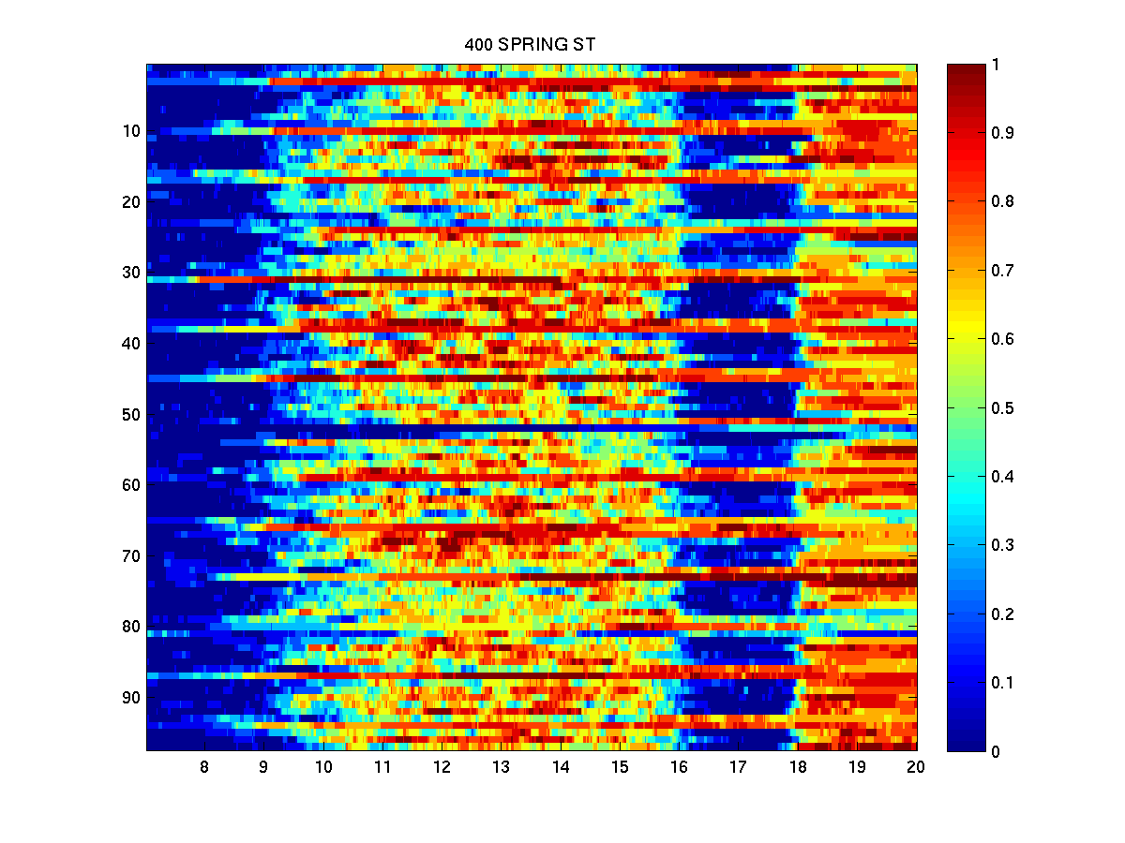
The psychology of parking spaces
Myth: free flow environments create more space than marked spaces, allowing more customers to park.
Fact: studies show that people don’t park in the most efficient manner:
In a large east coast city, one space was lost 60% of the time during the most occupied hours
In DC, full occupancy could not be achieved 80% of the time
Motorists parking in free flow spaces walk farther to their destination
Problems of perception and occupancy detection

Slide 8
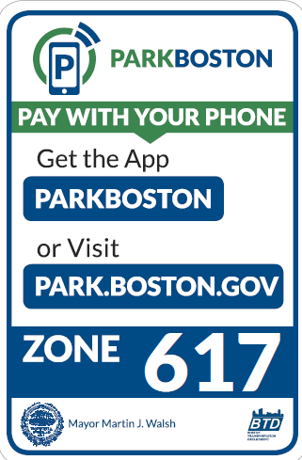
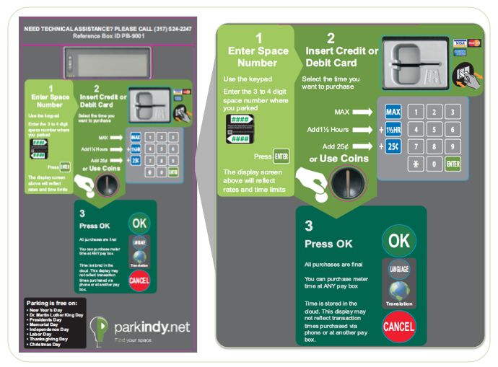
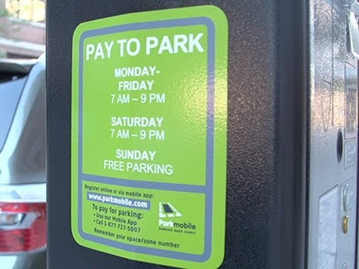
Communication and Branding
Where do I pay?
How do I pay?
When do I pay?

Slide 9
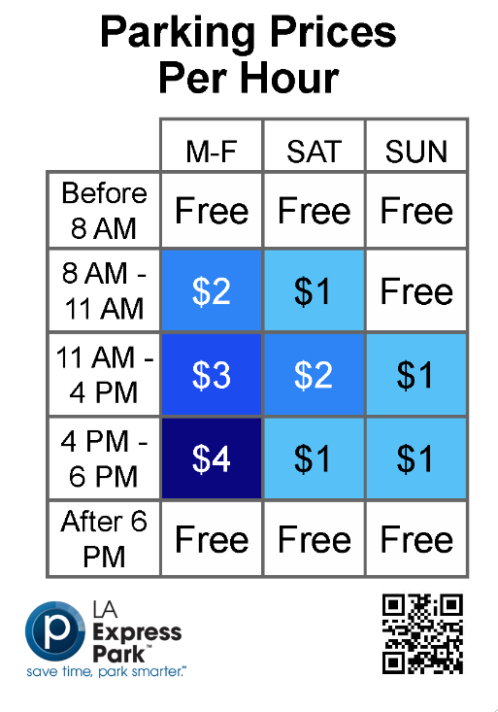
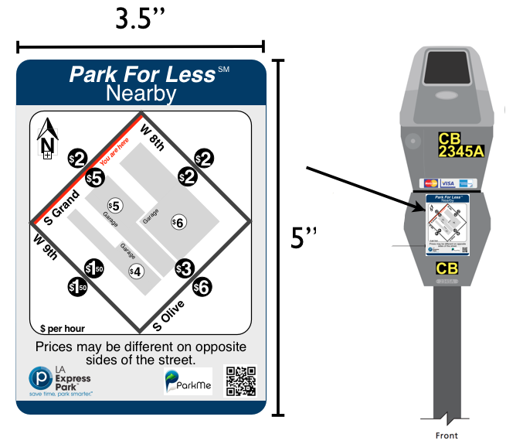

Dynamic Signage
What do I pay?

Slide 10
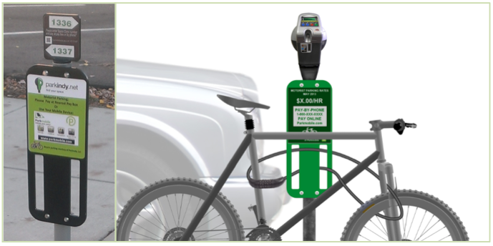
Even bicycle racks can convey driver information

Slide 11
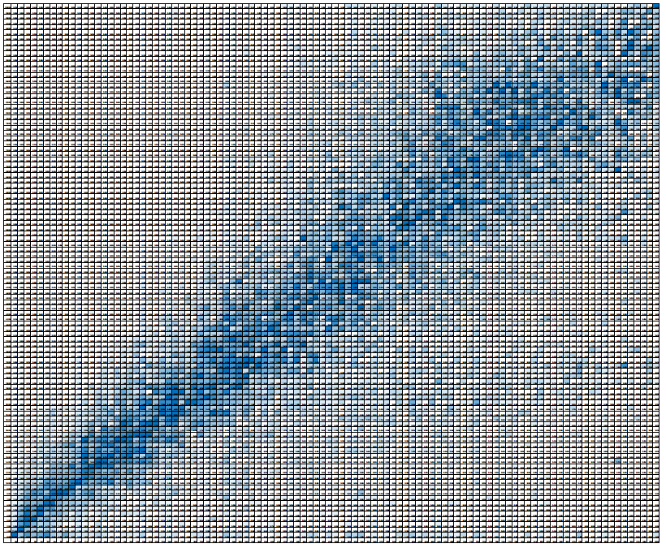
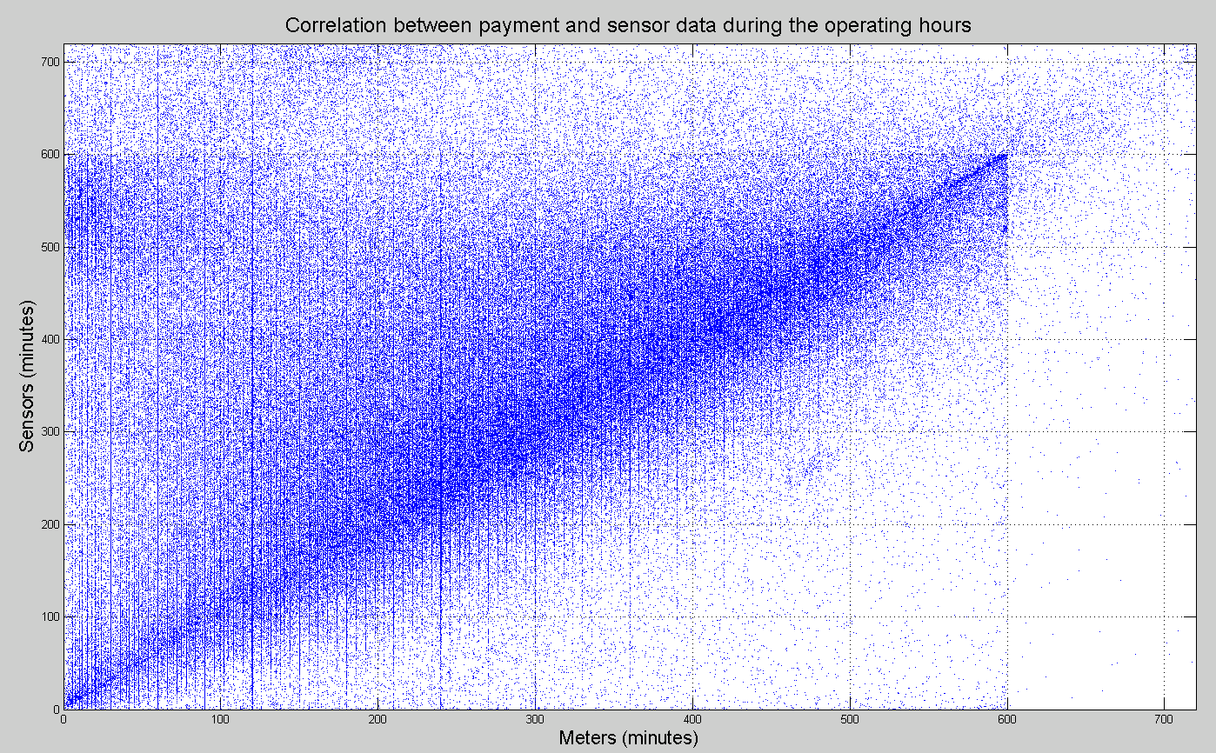
Enforcement and the correlation between occupancy, payments
Indianapolis (.984 correlation)
Increased from .70
High compliance, predictive enforcement
Also improves correlation between fines and meter revenue (.89)
Other West Coast City (no real correlation)
Low compliance
Inadequate enforcement

Slide 12
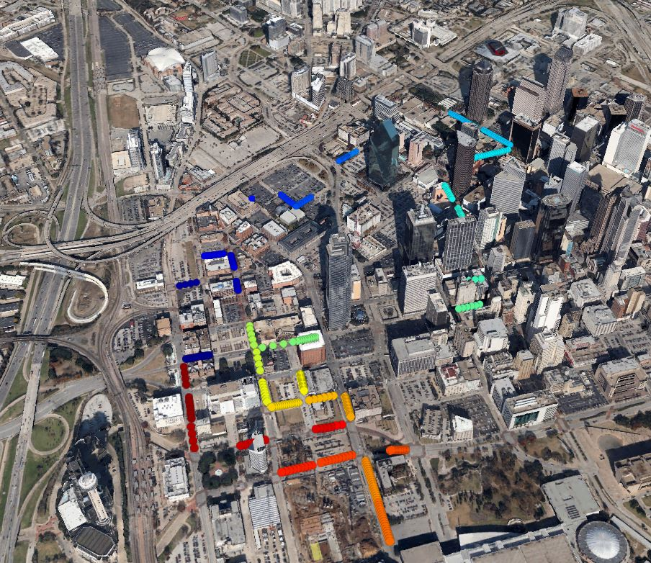
Predictive enforcement versus “gotcha” ticketing
Targeting motorists as soon as a meter expires using sensors is less productive
Fewer citations
Less likelihood to pay
Better methodology: predicting where violations are going to occur using historical data and routing personnel as appropriate
16 to 20% improvement in cities

Slide 13
Hosted by:

