Slide 1

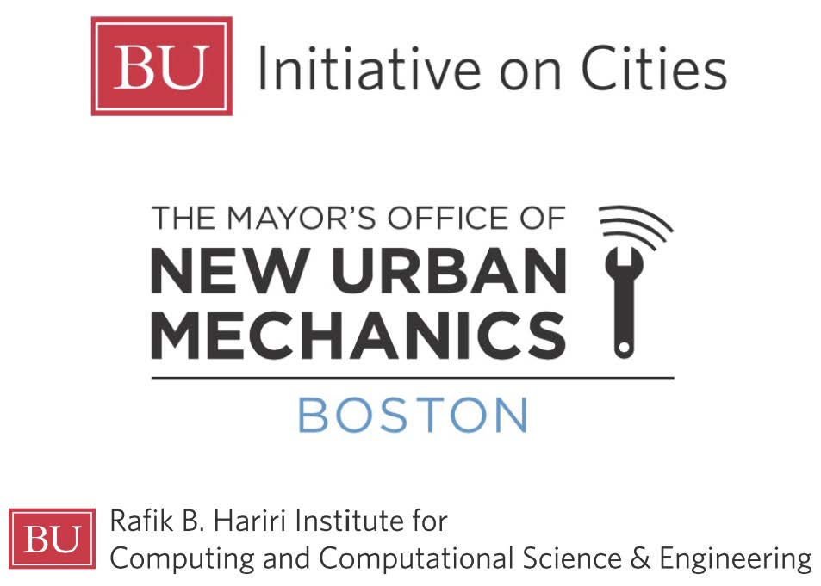

Hosted by:

Slide 2
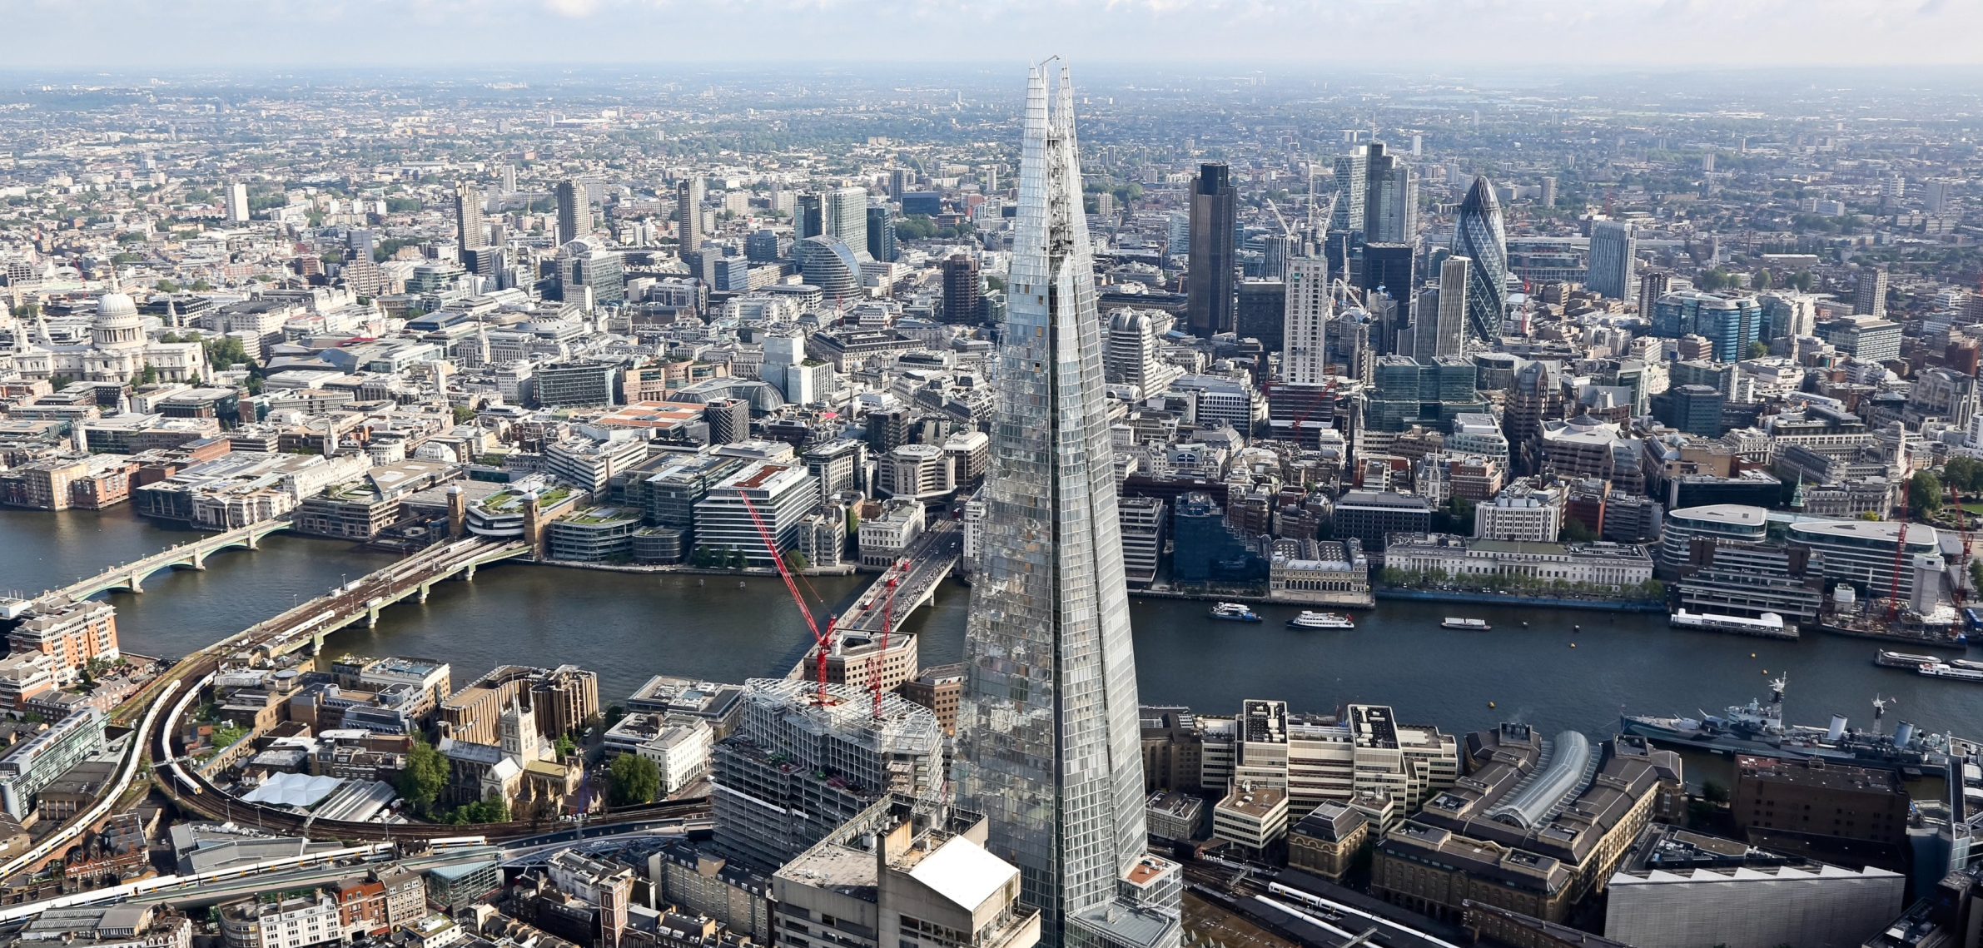
KEEPING LONDON MOVING
Garrett Emmerson
Chief Operating Officer - Transport for London, Surface Transport
Boston University – 7 December 2015

Slide 3
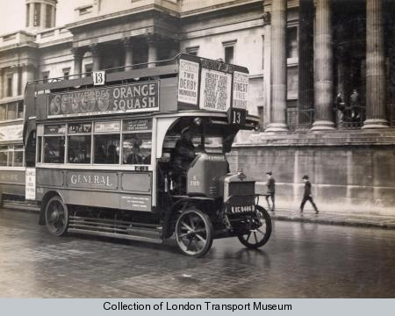
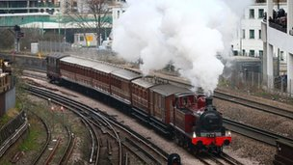
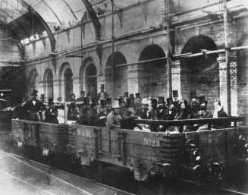
Transport for London’s long and rich history
Private companies provided bus and train services
1863: First underground railway (150 years of Tube)
1933: Bus and Underground brought together as recognisable predecessor - London Transport - in various guises
1947-62: Reported to Central Government - conjoined with newly nationalised British Railways
1963: Separated again – still under Central Government
1970: Transferred to newly formed Greater London Council
1984: GLC abolished, taken back under Central Government control
2000: TfL formed – combined (for the first time) with roads, taxis, river, traffic management, coaches, cycling (Underground followed 2003).

Slide 4
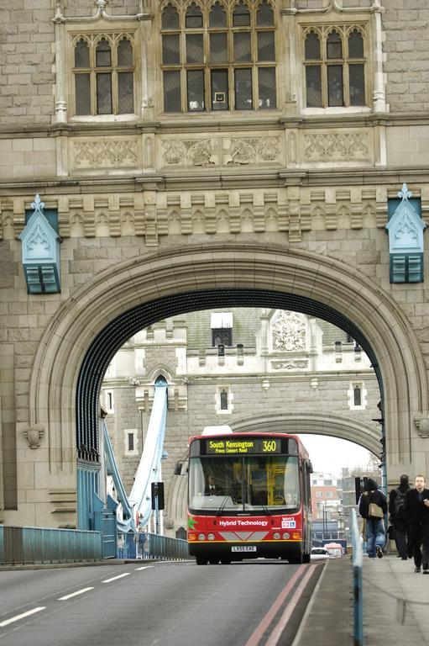
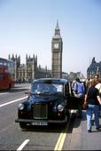
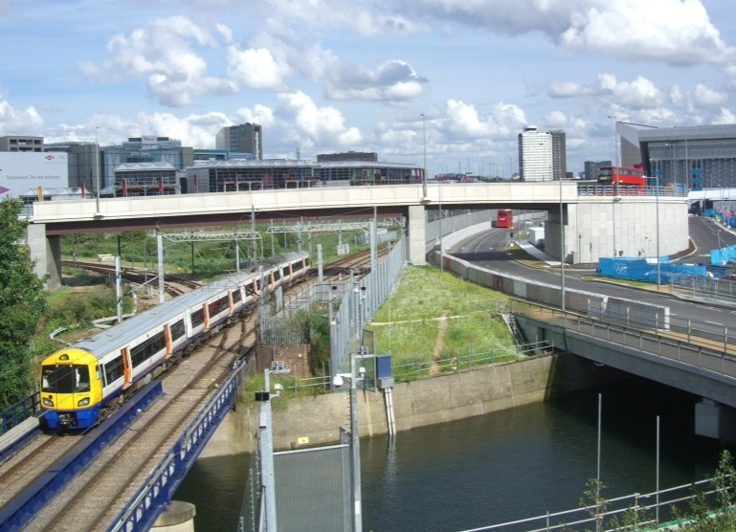
TfL today: An integrated transport system
TfL has a unique breadth of responsibilities including: the Tube, DLR, London Overground, Emirates Air Line, Tramlink, Buses, Barclays Cycle Hire, Taxis, Rivers and London Streets
Every day over 31m journeys are made across Greater London:
    6.7 million on London’s buses
    3.8 million on the Underground/DLR
    6.4 million on foot
    0.6 million by bicycle
    0.4 million by taxi
    10 million car / motorcycle trips

Slide 5
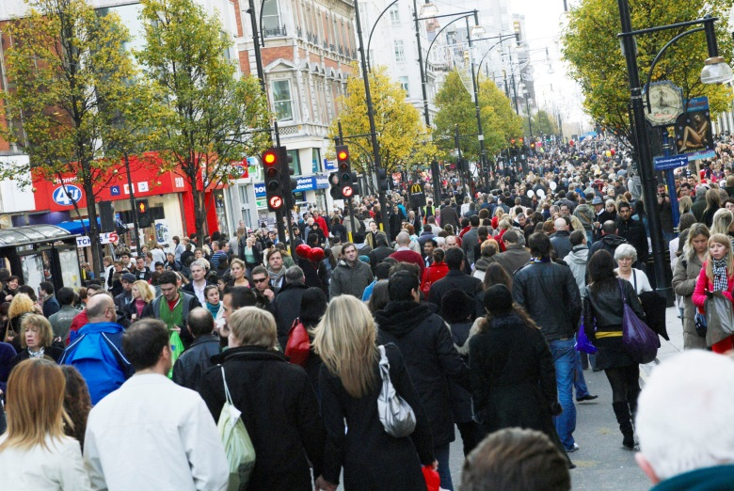
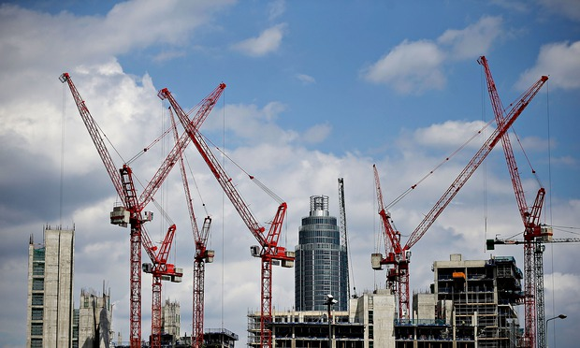
London is booming!
London’s population is now 8.6m – its highest ever level - forecast to rise to 10m by 2030
London’s GDP growth was 3.9% in 2014, compared to 2.8% for the UK as a whole
Construction activity is booming in London
There is more and more demand for travel

Slide 6
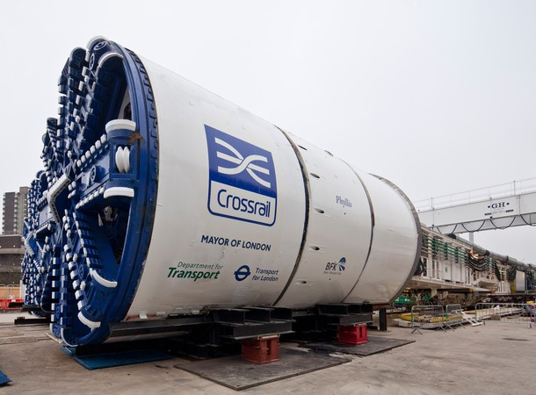
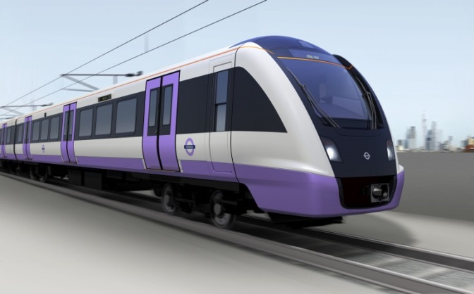
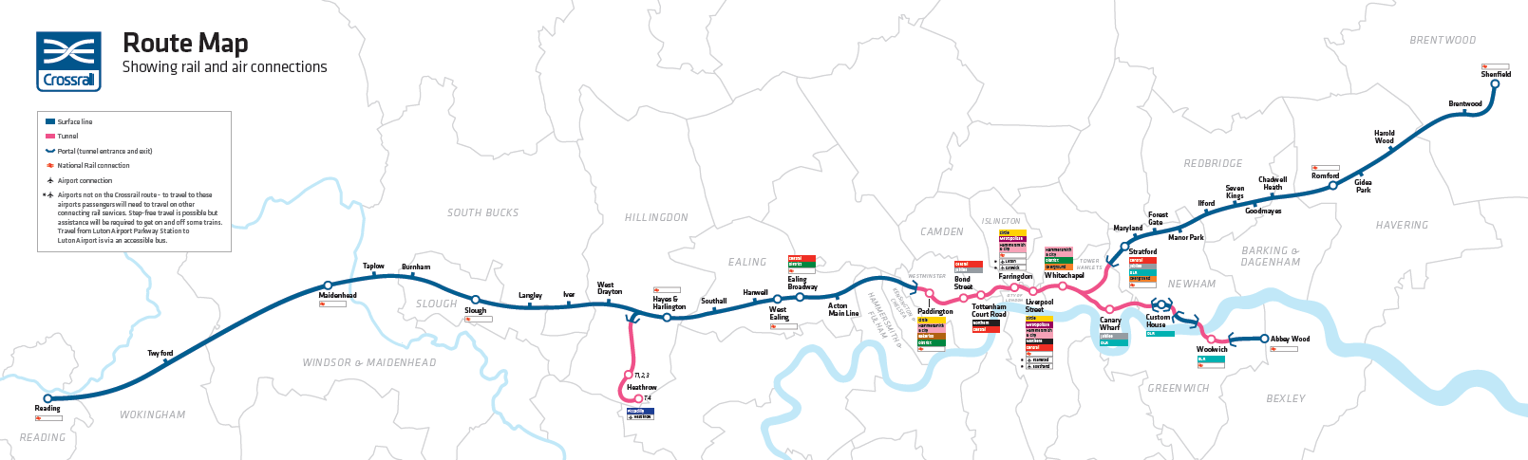
Continued investment in rail
Crossrail

Slide 7
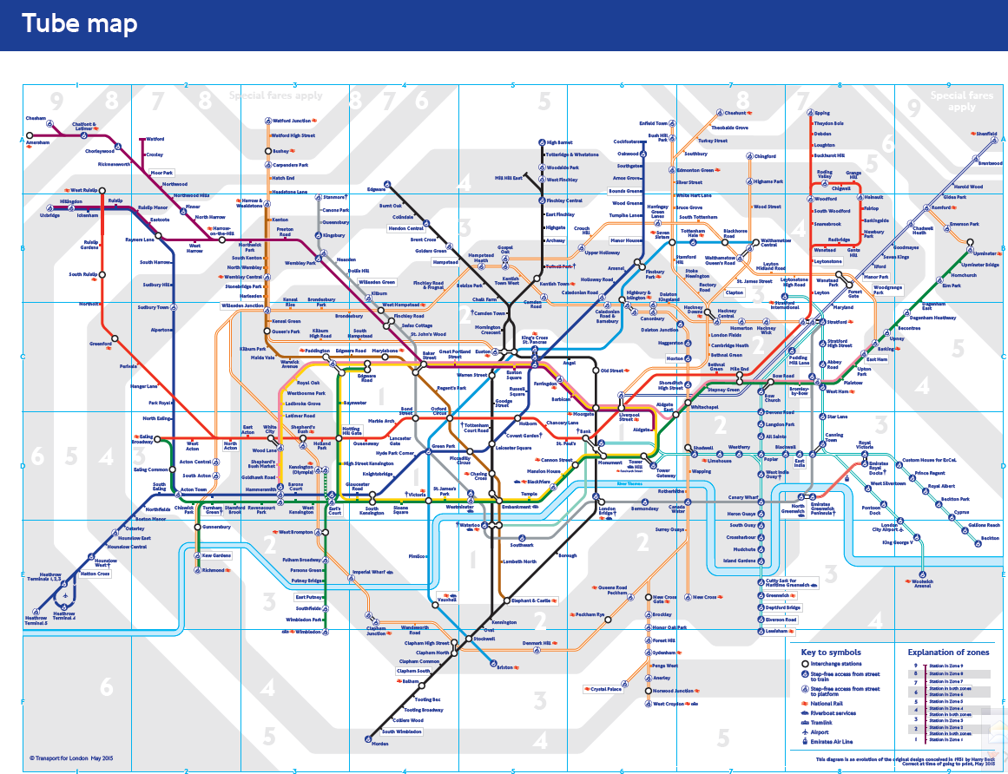
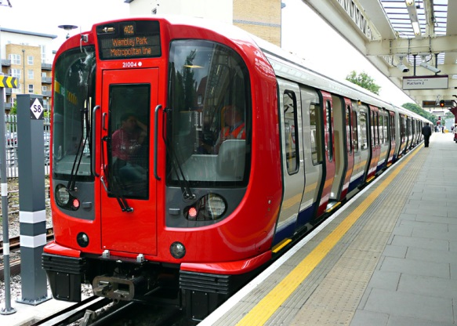
Continued investment in rail
Crossrail
Tube upgrades

Slide 8
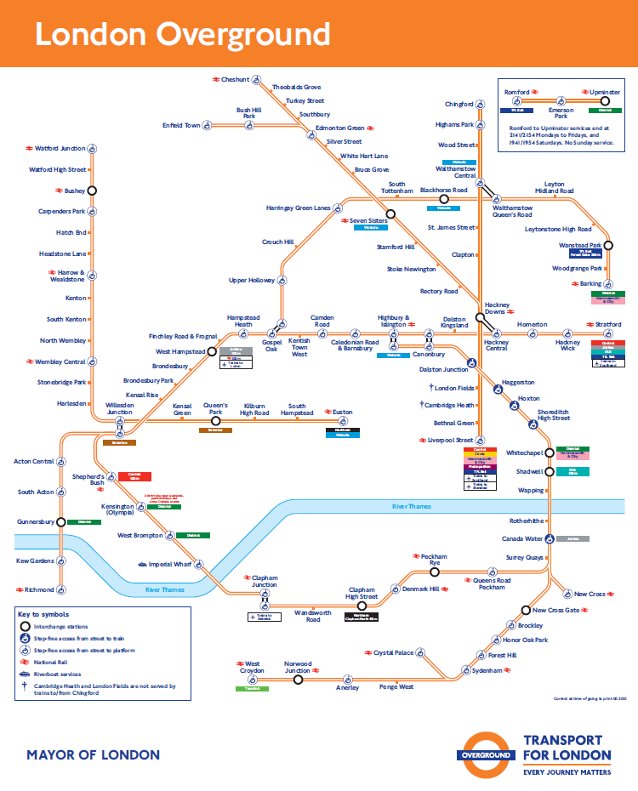
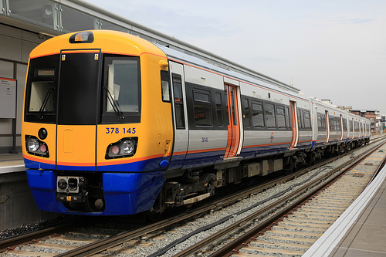
Continued investment in rail
Crossrail
Tube upgrades
London Overground

Slide 9
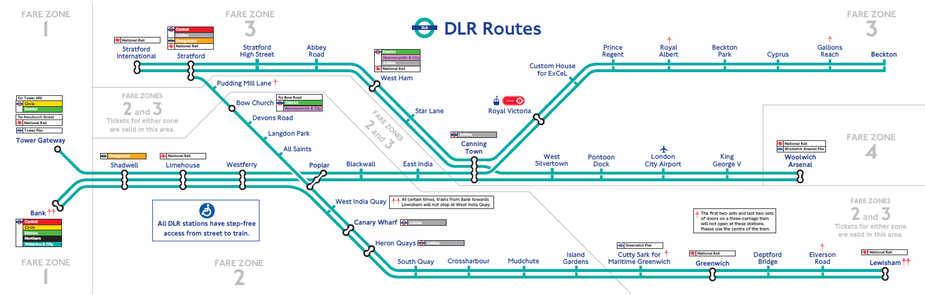
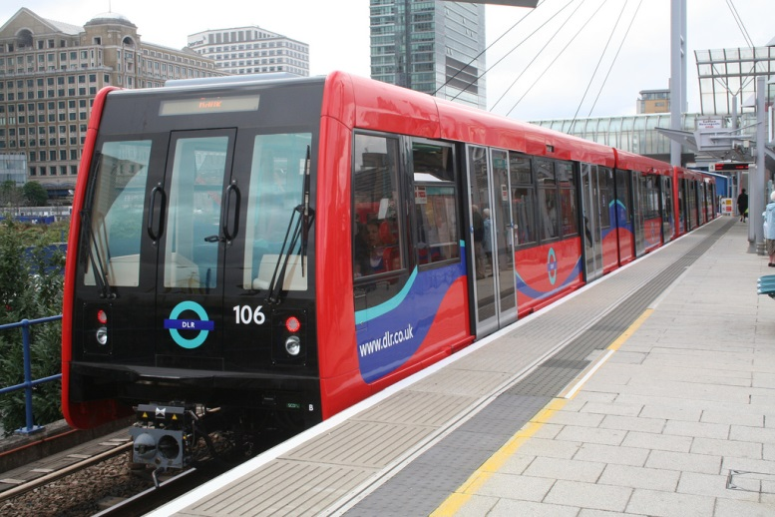
Continued investment in rail
Crossrail
Tube upgrades
London Overground
DLR expansion

Slide 10
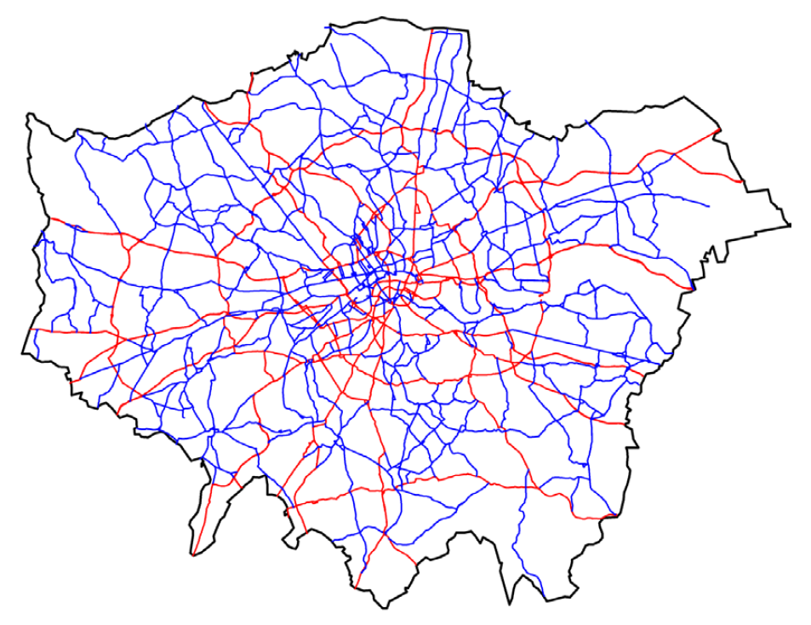
Importance of the road network
While TfL’s rail network is vital to public transport, over 80% of passenger trips and 90% of freight is on the road network
London’s streets are therefore very busy and getting busier
We don’t have the extensive grid road capacity of New York or the wide boulevards of Paris
Every day each stretch of London’s main A-roads carry an average of 55,000 people in vehicles, in addition to catering for millions of pedestrian trips
  71,000 for the TLRN and 45,000 on the BPRN
TfL Road Network (red) and Borough Principal Road Network (blue)

Slide 11
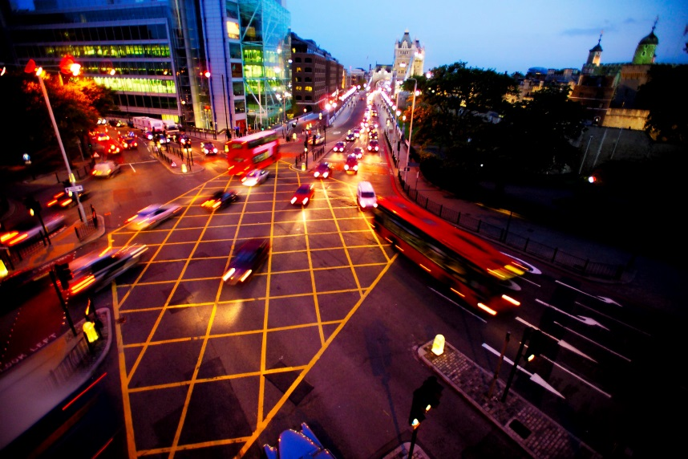
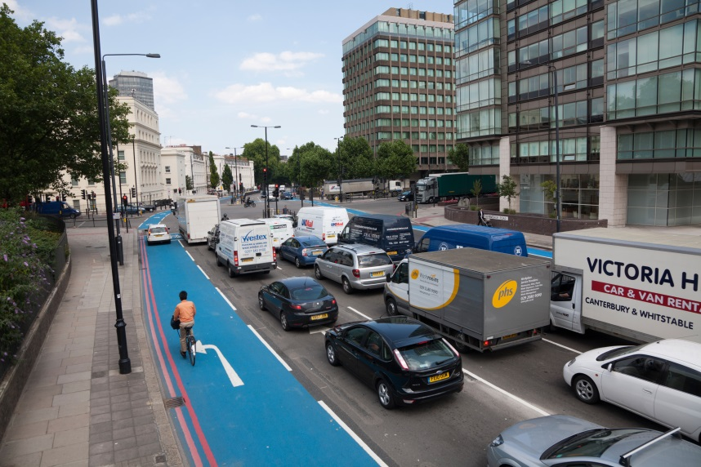
The challenge London faces
With a finite road network, our challenge is ever more efficient use of existing road space

Slide 12
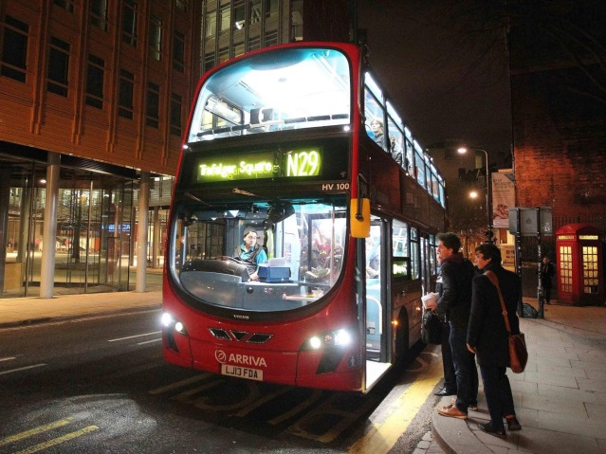
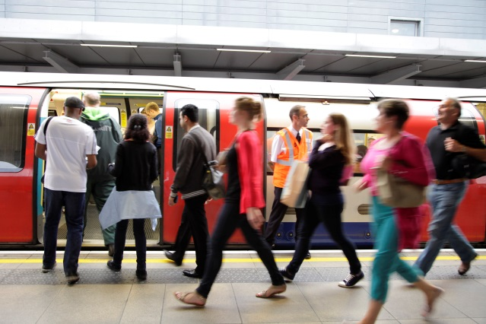
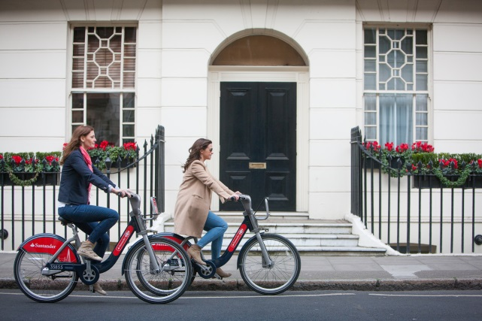
We have a good track record already
Since 2000, we’ve seen a 10.5% mode shift away from private car use, with significant increases in the public transport network:
81% increase in bus passenger journeys
33% increase in tube passenger journeys
125% increase in cycling journeys

Slide 13
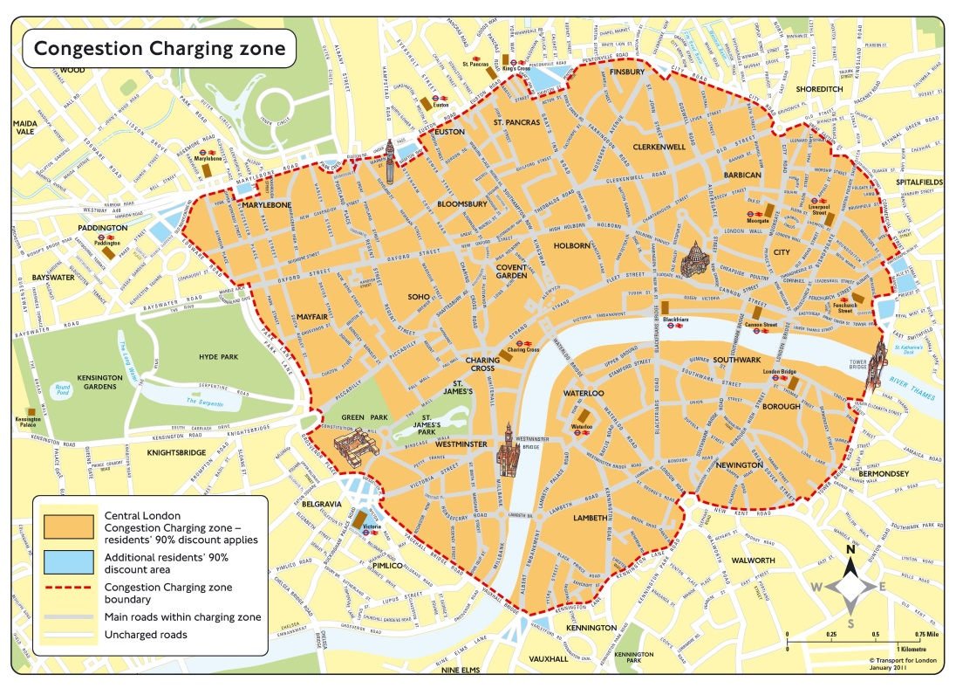
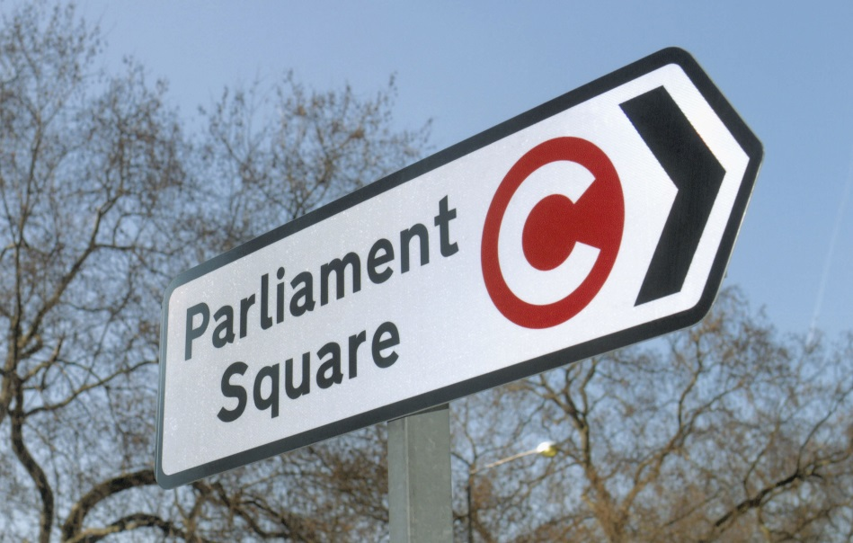
This is supported by demand restraint in Central London
Reduction of 30% in traffic volumes entering the Congestion Charging zone since it was implemented in 2003
...but this is hardly enough to keep pace with demand for road space
...not just for travel, but also for urban realm improvements and developments

Slide 14
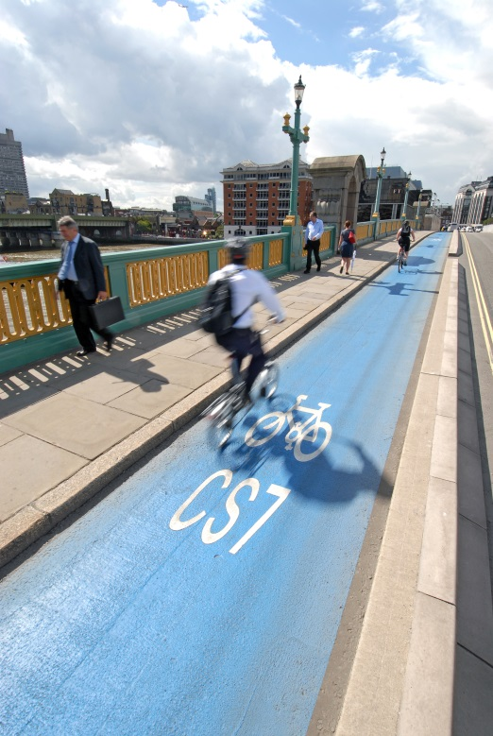
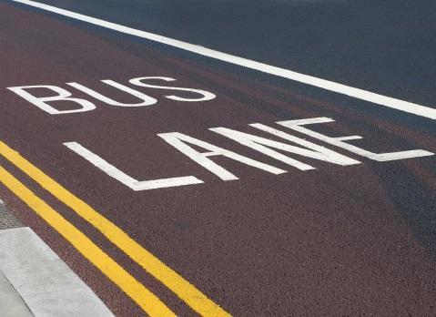
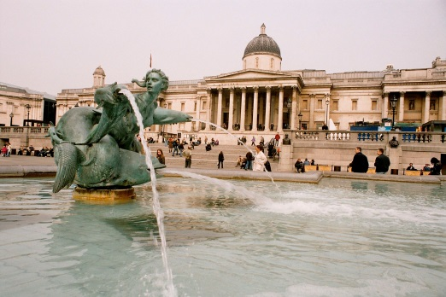
Loss of road space
However, as well as the reduction in traffic volumes in Central London, we’ve lost an estimated 30% of Central London road space from traffic operational use. This is due to:
Bus Priority measures
Cycling facilities
Pedestrian facilities
Enhanced urban realm e.g. Trafalgar Square
Development

Slide 15
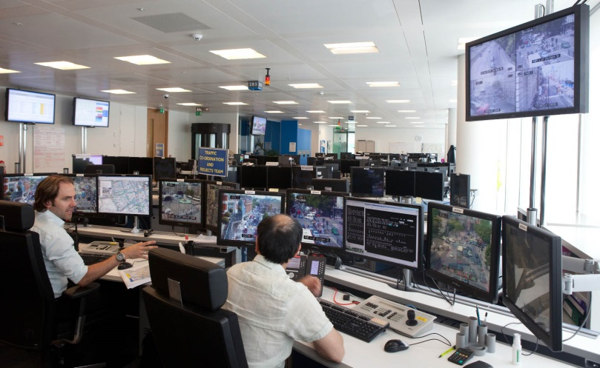
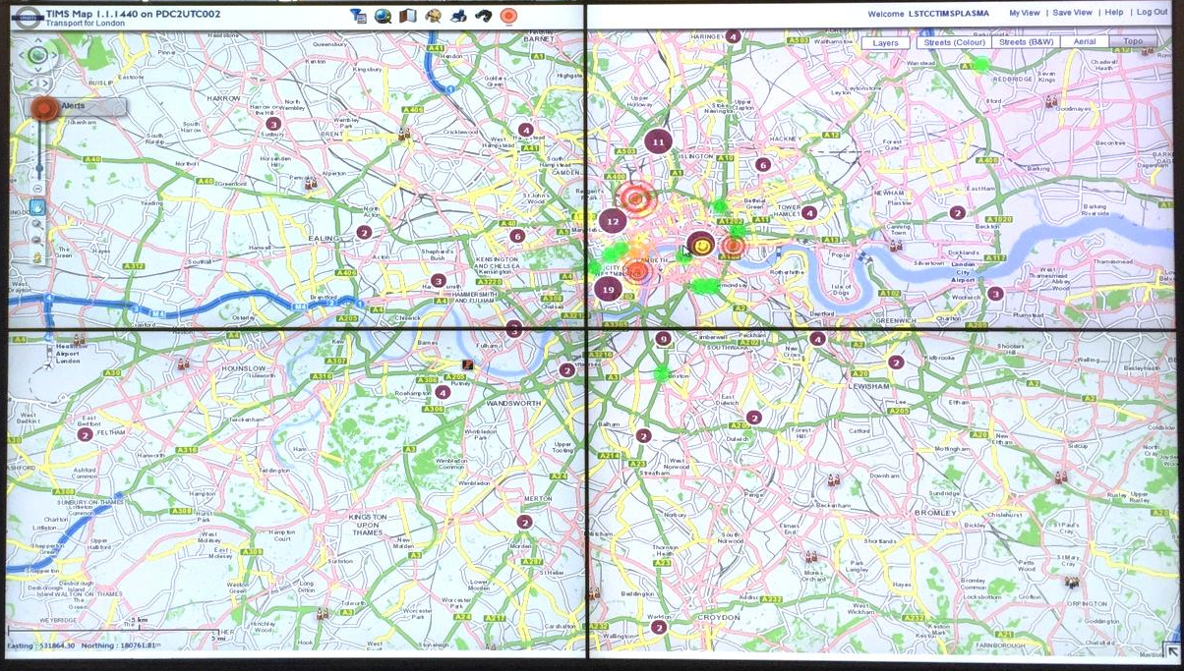
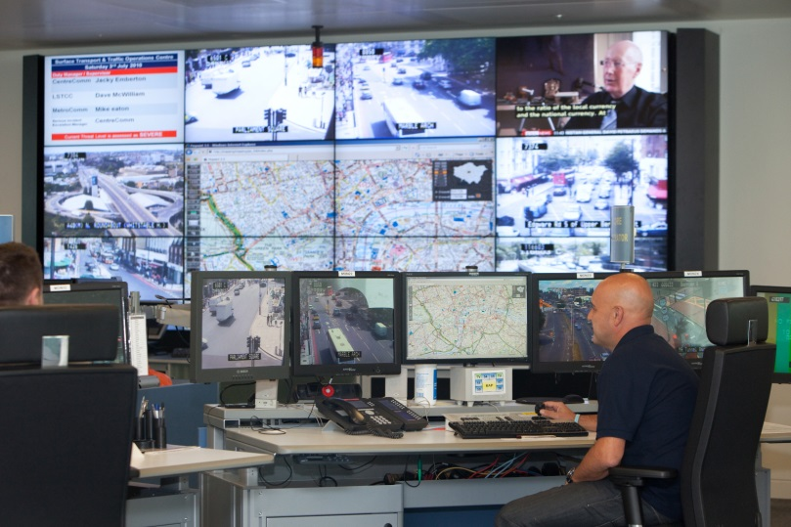
Maximising efficiency
We must continue to find new ways to extract more efficiency from finite road space
We are doing this through increased use of technology

Slide 16
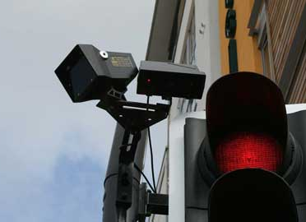
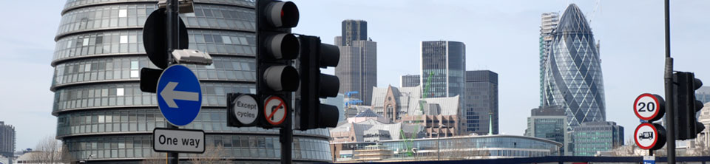
Dynamic Traffic Signal Control
The SCOOT system, operating at around two thirds of London’s 6,000 traffic signal sites, helps to reduce delays by 12-13% at sites where implemented
We are now exploring it’s use for pedestrians and cyclists

Slide 17
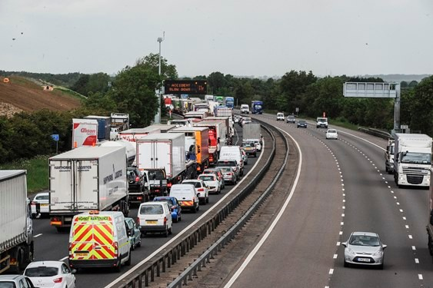
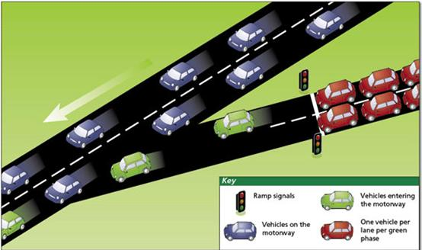
Active Traffic Management (ATM)
Managing traffic in Outer London to avoid gridlock in Central London
Slow in, fast out principle
More control, ramp metering
Variable speed limits, dynamic lane use
Mini-tunnels – one way out tunnels

Slide 18
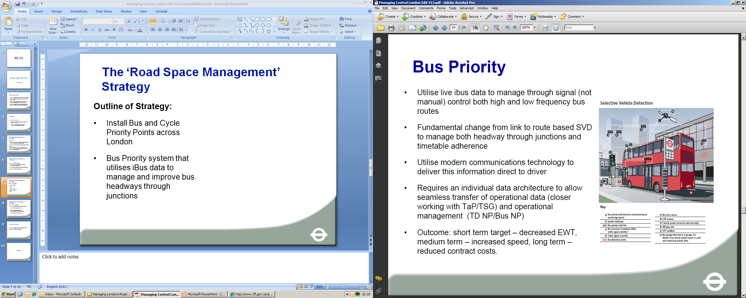
SCOOT/iBus integration

Slide 19
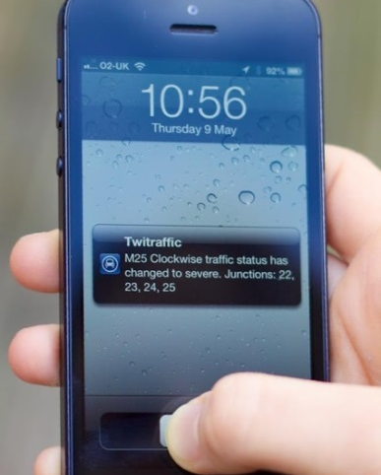
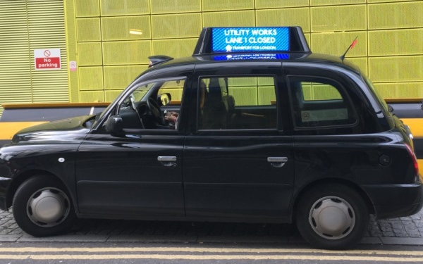
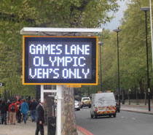
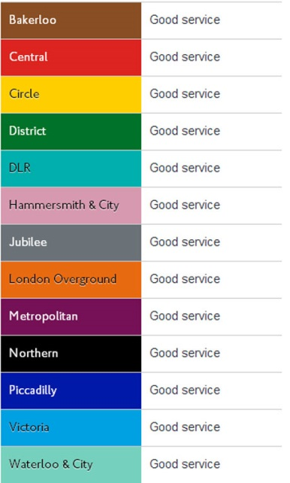

Better customer information
Measures to influence the customer decision making process
Check before you travel
  Twitter
  TfL Website
  Push notifications before journeys
On route messaging
  Tube-style good service boards
  On-bus and on-taxi geo-fenced messaging
  Satellite navigation systems

Slide 20
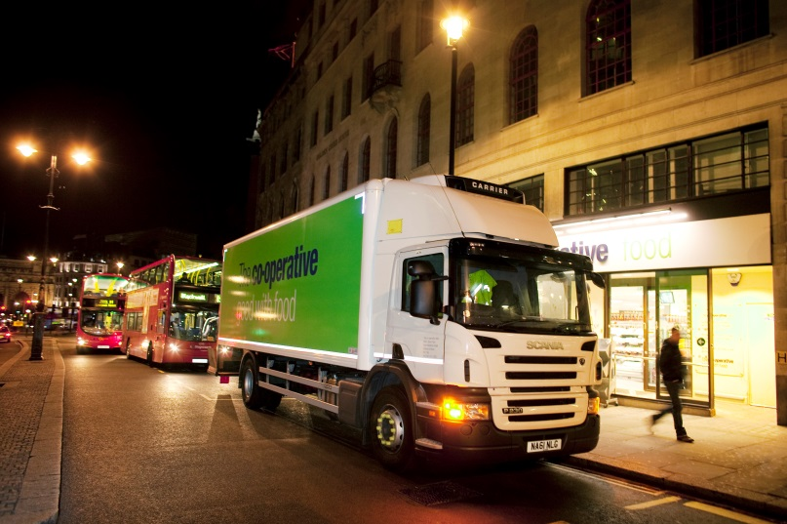
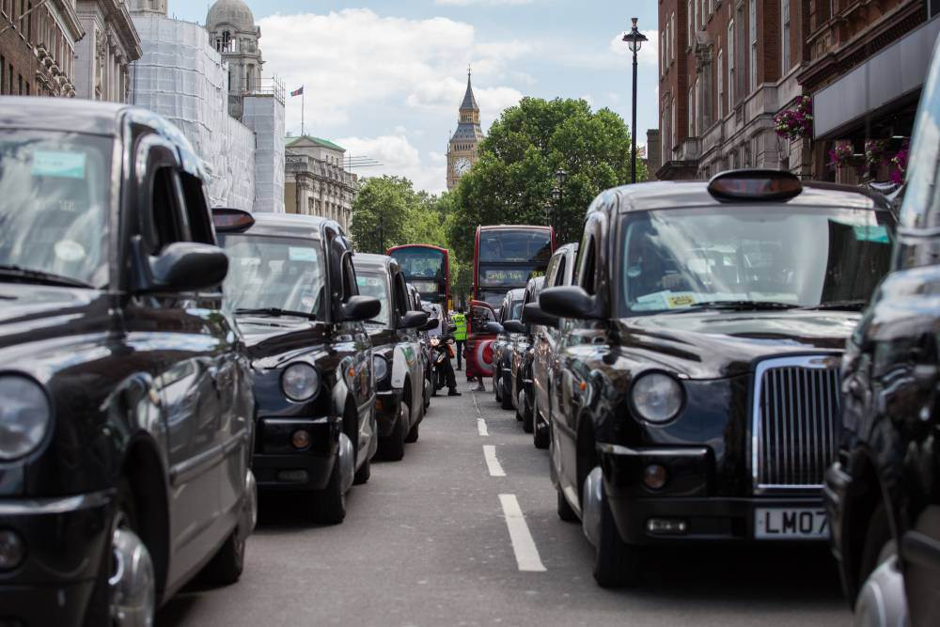
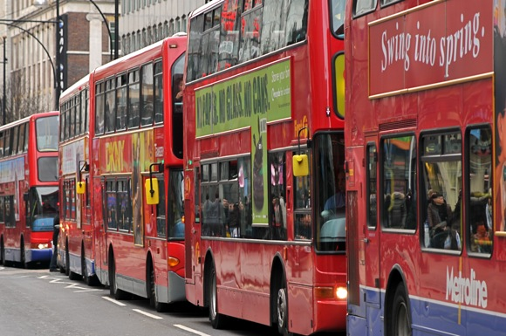
Further demand management?
Freight
  Retimed deliveries?
Buses
  Network planning?
Taxi and Private Hire
  Quantitive restrictions?

Slide 21
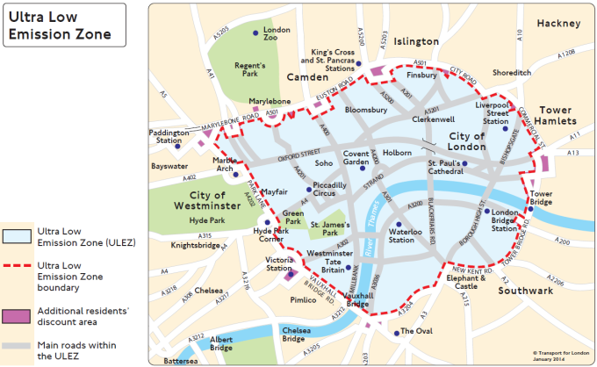
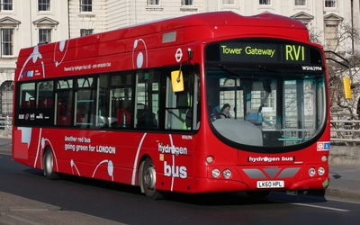
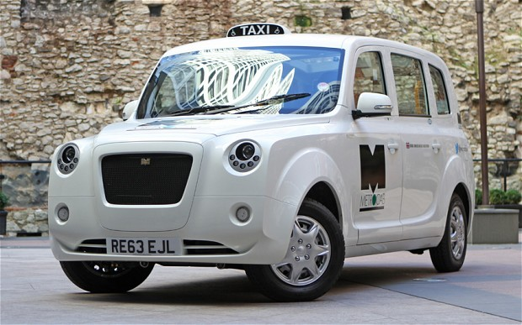
Air quality
ULEZ
  By 2020, first in the world
Cleaner buses
  Continued roll out of hybrid and zero-emissions buses
Taxi and private hire vehicles
  Age limits
  Zero emission capable taxis by 2018
  £70m fund

Slide 22
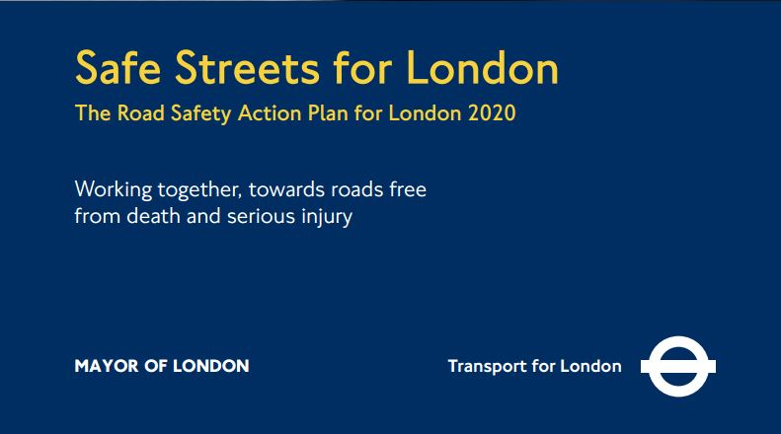
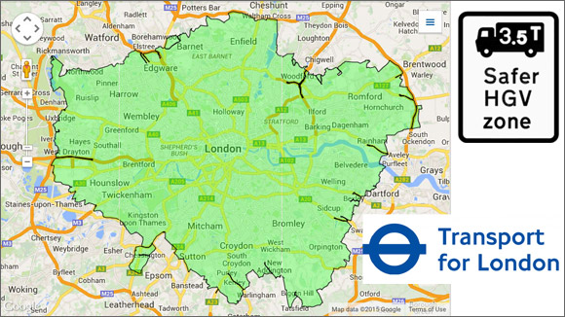
Safety
Achievements to date
  Target of 40% reduction in KSIs against 2005-2009 baseline achieved early
  Vulnerable road user action plans
Safer lorries
  New regulations for London
  Vision standards
New targets
  Revised stretch target of 50% reduction in KSIs by 2020
  Taking lorry vision standards further

Slide 23
Questions
Questions?
GarrettEmmerson@TfL.gov.uk
www.TfL.gov.uk

Slide 24
Hosted by:

