Slide 1

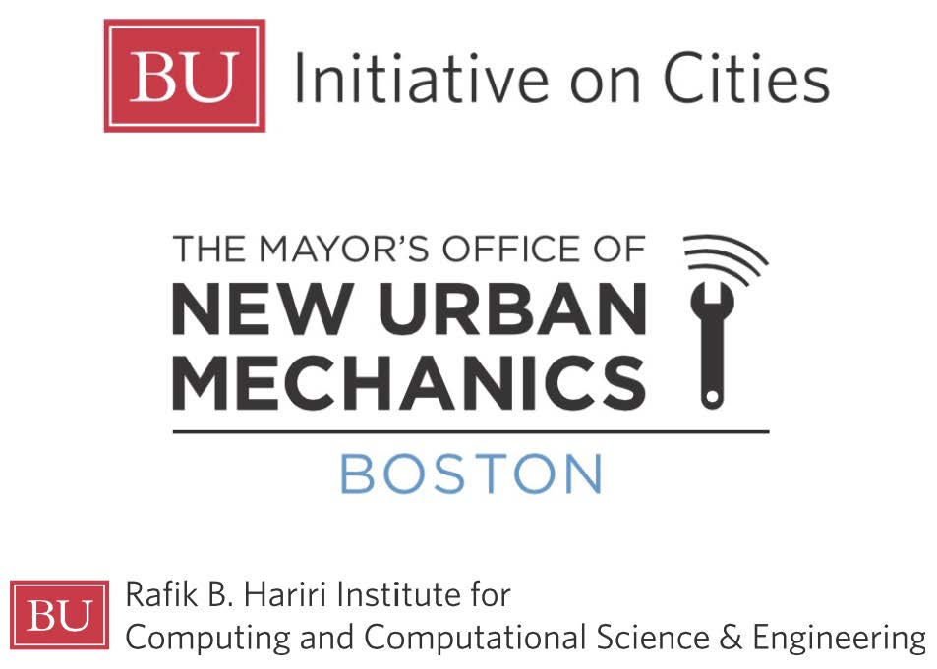

Hosted by:

Slide 2


C. G. Cassandras
Division of Systems Engineering, Dept. of ECE
Center for Information and Systems Engineering
Boston University
LOW AND HIGH TECH REMEDIES TO EASE CONGESTION AND IMPROVE SAFETY
Christos G. Cassandras
CODES Lab. - Boston University

Slide 3
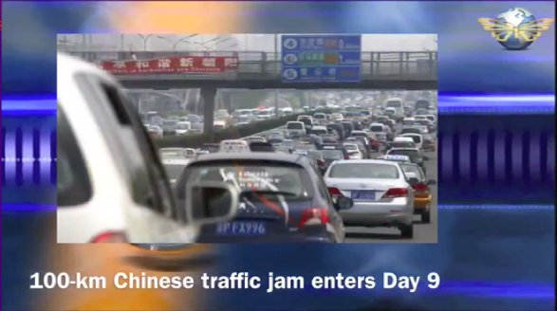
TRAFFIC NETWORKS:
WHY IS IT SO HARD
TO CONTROL THEM?

Slide 4
BECAUSE…
Not enough controls (traffic lights, tolls, speed fines)
→ No chance to unleash the power of feedback!
Not knowing other drivers’ behavior leads to poor decisions (a simple game-theoretic fact)
→ Drivers seek individual (selfish) optimum,
not system-wide (social) optimum
Christos G. Cassandras CISE - CODES Lab. - Boston University

Slide 5
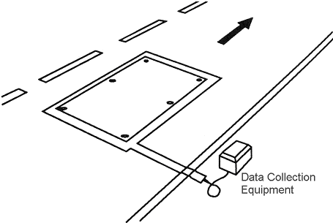
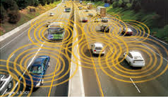
HELP IS HERE OR ON THE WAY…
INFRASTRUCTURE
NO INFRASTRUCTURE
INDUCTIVE LOOP
DETECTORS
GPS DEVICES, ACCELEROMETERS
(IN MOBILE PHONES, VEHICLES)
CAMERAS/
IMAGING BASED
Knowledge of every vehicle’s state (position, velocity, destination, fuel/battery status)
Christos G. Cassandras CISE - CODES Lab. - Boston University

Slide 6
SHORT TERM
NUDGES…

Slide 7
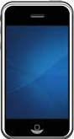
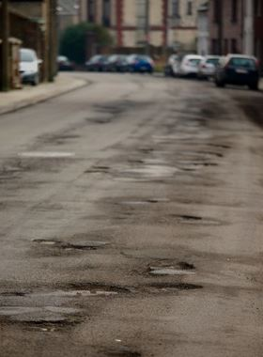
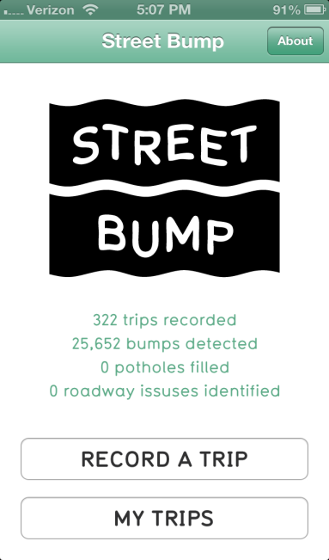
STREET BUMP:
DETECTING “BUMPS”
THROUGH SMARTPHONES
+ DATA ANALYTICS
iPhone app
2014 IBM/IEEE Smarter Planet Challenge prize

Slide 8
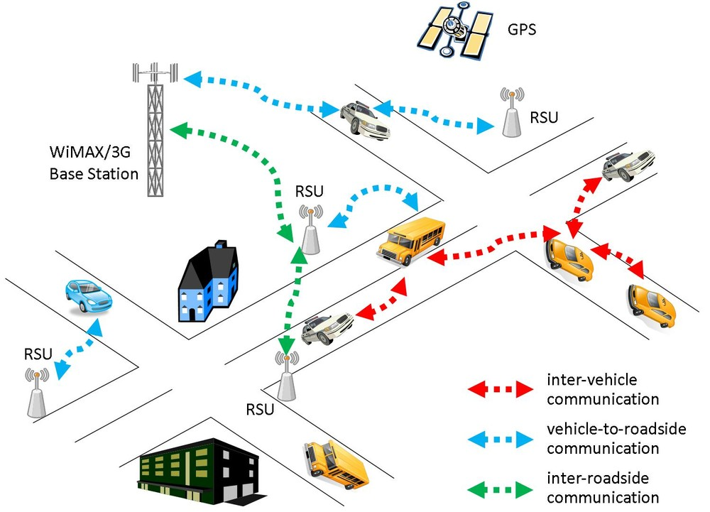

Let the DATA SPEAK: Less $$ Hardware, More Intelligence
TRADITIONAL SENSING:
Expensive (hence, few) very reliable sensors
vs
MODERN TREND:
Many cheap sensors + Intelligent
Information Processing
Vehicular Sensor Network
Minimal
(or No)
Infrastructure
Faster
Repairs
Minimal
Cost
Better Coverage:
Crowd Sourcing
Incentives for further citizen participation
(‘thank you’ message, free city services, lotteries)
Citizen
Participation !

Slide 9
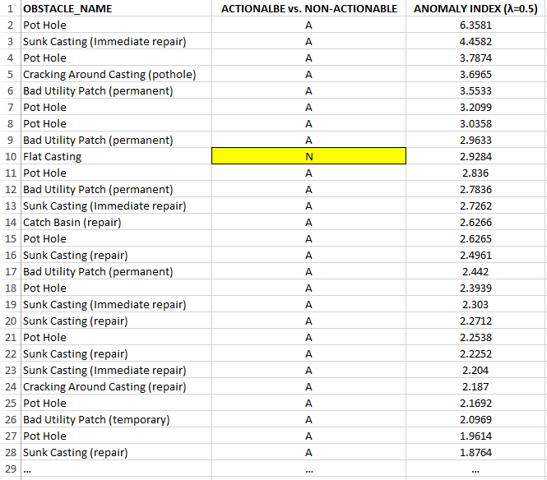
PRIORITIZED LIST OF BUMPS
TOP-20 ACTIONABLE
OBSTACLES:
ONLY 1 FALSE ALARM

Slide 10
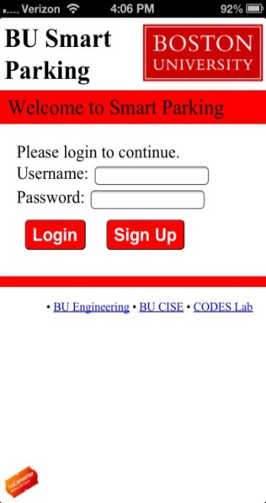
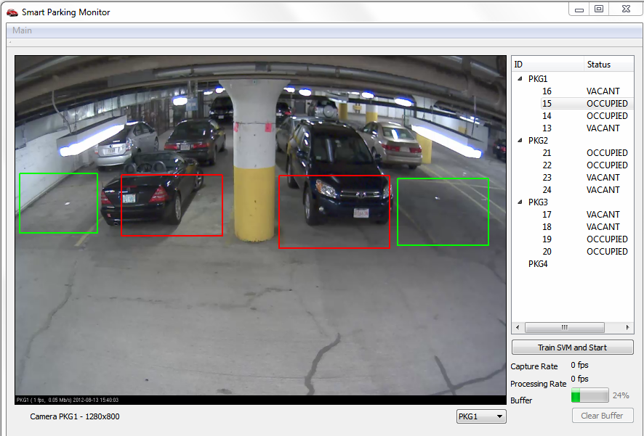
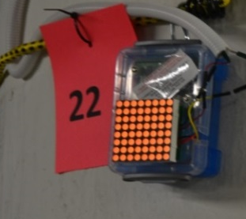
SMART PARKING
2011 IBM/IEEE Smarter
Planet Challenge prize
iPhone app

Slide 11
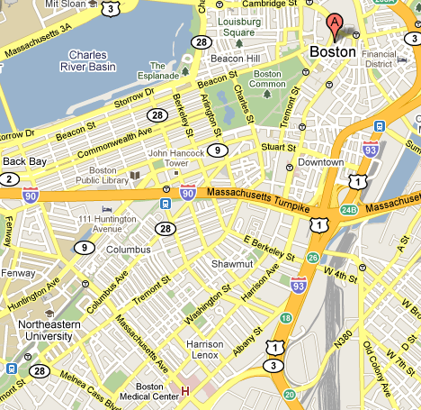

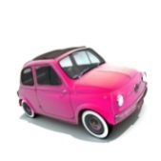
SMART PARKING
BEST
PARKING SPOT
Find best parking spot for DESTINATION A
LEAST DISTANCE from A
+
LEAST COST
+
RESERVE IT
[Geng and Cassandras, IEEE Trans. on Intelligent Transportation Systems, 2013]
Christos G. Cassandras CISE - CODES Lab. - Boston University
Notes:
11
11

Slide 12
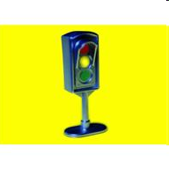
SMART PARKING – IMPLEMENTATION
Parking space availability
detection
Vehicle localization
System-Driver
communication
Parking reservation
Standard sensors
(e.g., magnetic, cameras)
Wireless sensor networking
GPS
Smartphone
Vehicle navigation system
Red/Green/Yellow light system
Christos G. Cassandras CISE - CODES Lab. - Boston University

Slide 13
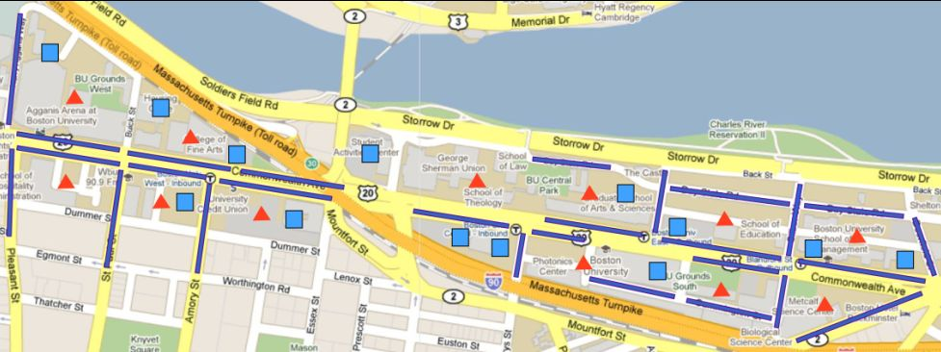
SIMULATION CASE STUDY
On-street parking spaces
Off-street parking spaces
Points of interest
Christos G. Cassandras CODES Lab. - Boston University

Slide 14
KEY CONCLUSIONS
10-20% higher parking utilization
⇒ HIGHER REVENUE,
LOWER CONGESTION
2. % drivers searching for parking (wandering) < 2%
⇒ HIGHER REVENUE,
LOWER CONGESTION
3. 50% reduction in parking time under heavy traffic
⇒ LOWER CONGESTION,
LESS FUEL,
DRIVER COMFORT
Christos G. Cassandras CODES Lab. - Boston University

Slide 15
LONGER TERM
NUDGES…

Slide 16
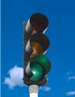
ADAPTIVE
TRAFFIC LIGHT
CONTROL

Slide 17
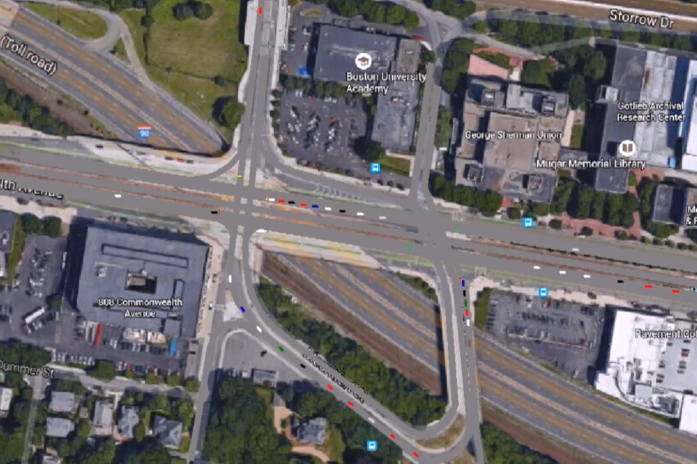
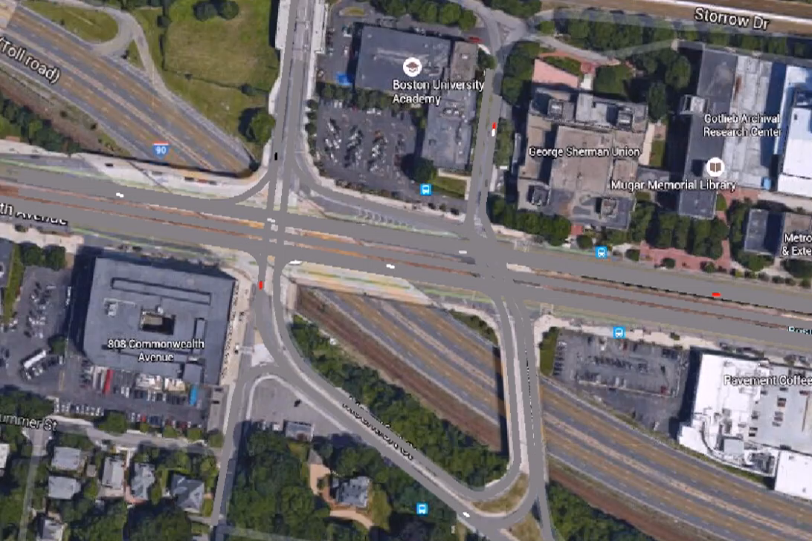
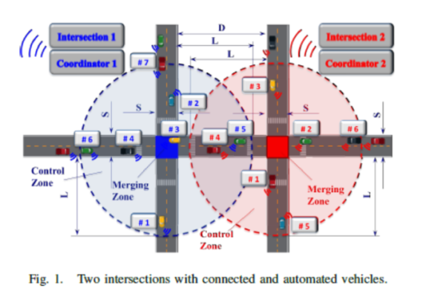
WHO NEEDS TRAFFIC LIGHTS ?
With traffic lights
With control of Connected Autonomous Vehicles
Christos G. Cassandras CISE - CODES Lab. - Boston University

Slide 18
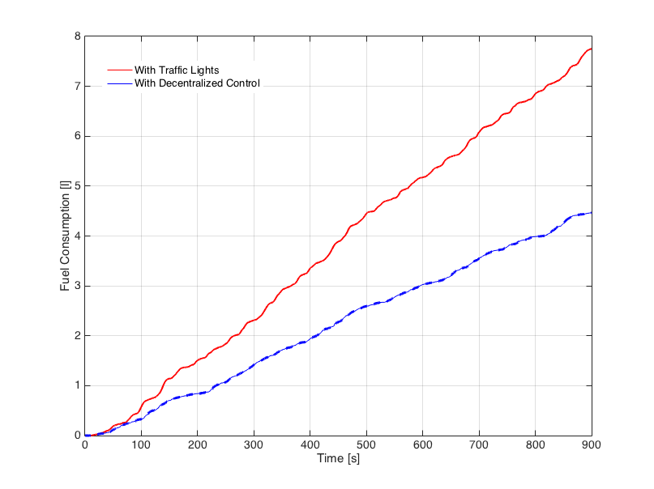
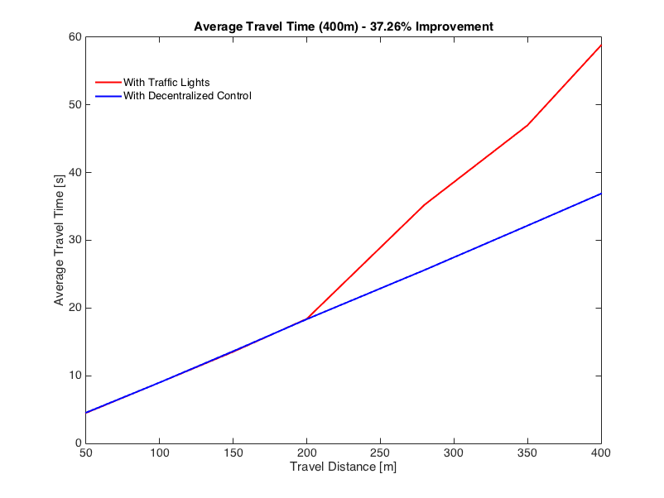
IMPACT ON FUEL CONSUMPTION AND TRAVEL TIMES
448 vehicles crossed the intersection
Fuel consumption 42% improvement
Travel time 37% improvement
WIN-WIN
Fuel Consumption [l]
Average Travel Time [s]
Travel Distance [m]
Time [s]
Christos G. Cassandras CISE - CODES Lab. - Boston University

Slide 19
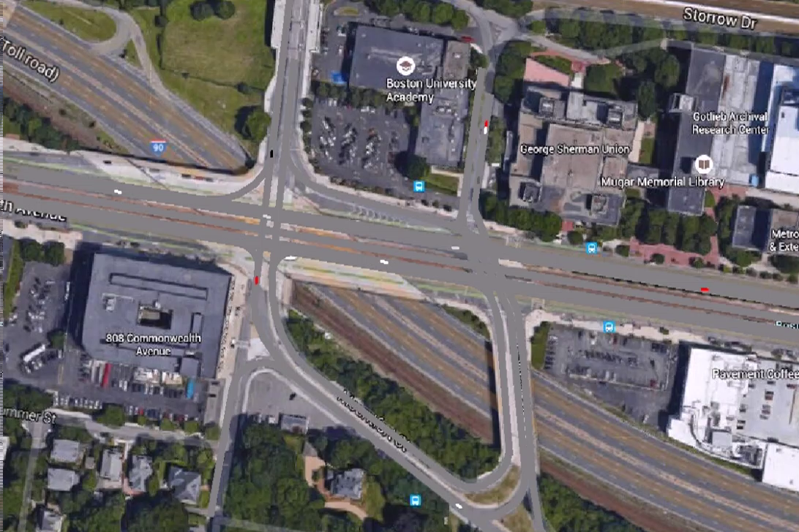
WHO NEEDS TRAFFIC LIGHTS ??
How about
pedestrians?
Christos G. Cassandras CISE - CODES Lab. - Boston University

Slide 20

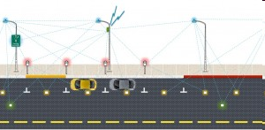


xxxx
WHAT IS REALLY “SMART” IN “SMART _____” ?
COLLECTING DATA IS NOT “SMART”
- JUST A NECESSARY STEP TO
BEING “SMART”
INFO
PROCESSING DATA TO MAKE GOOD DECISIONS IS “SMART”
ACTION
INFO
Christos G. Cassandras CISE - CODES Lab. - Boston University
Notes:
20
20

Slide 21
Hosted by:

