Slide 1
How Should We Be Measuring Urban Mobility?
Towards an Urban Mobility Index
Azer Bestavros
Founding Director, Hariri Institute for Computing
Professor, Computer Science Department
Boston University

Slide 2
How do we define a Mobility Index?
Approach #1: From city data to mobility index
  What data do we have?
  Define a mobility index based on what can be computed from data
  Use the index as a benchmark to evaluate/track various processes
Pros/Cons:
  Easy
  What happens when we get new types of data?
  May not be the best metric for what needs to be evaluated/tracked
  May lead to “design-to-metric” bias – Lessig’s “Code is Law” trap

Slide 3
How do we define a Mobility Index?
Approach #2: From city application to mobility index
  What processes/applications do we need a metric for?
  Define a mobility index that reflects the metric of interest
  Identify best way to calculate the index based on available data
Pros/Cons:
  Most accurate
  May not be possible to calculate; need to explain “approximations”
  What happens when we get new types of data?
  Limited applicability beyond target application.

Slide 4
How do we define a Mobility Index?
Approach #3: Don’t… Provide the means to define many!
  Build a platform for defining many indices subject to a template
  Provide proper APIs to manipulate existing metrics
  Provide a library of recipes (algorithms) to derive new metrics
Pros/Cons:
  Inclusive of both approaches #1 & #2; sidelines the tussle
  Extensible by design for new data and new applications
  Avoids the “design-to-metric” bias
  Not a panacea…

Slide 5
Mobility Index: Framework
A Proposed Template
The mobility index (M) for a geographical locale captures the degree with which residents in the locale are able to partake in various aspects of urban life, subject to a set of requirements.
Examples
Number (or average salary of) jobs available within one mile
Average distance to nearest public school (or hospital, shelter, …)
Number of movie theaters within a 30-minute public transit
Average rush-hour slowdown (or evacuation capacity) to/from other locales

Slide 6
Mobility Index: Evaluation
Model: Evaluation of mobility index M requires specification of
  A geographical locale (L) over which index M is to be calculated, e.g., set of locations specified using zip codes, neighborhoods, etc.
  A utility value (V) for each location accessible from L, capturing the reward from traveling to that location, e.g., # of shops, jobs, etc.
  A set of travel options (T), which can be a single mode such as walking, taking bus, or driving or any combination thereof.
  A set of metrics (R) to assess connectedness between two locales, e.g., travel time/cost between two locations using options in T.
  A multi-graph model of the city (G). The nodes G are locations and the edges are labeled by the metrics in R.
Given above model, one can use graph algorithms to evaluate M

Slide 7
Mobility Index: Realization
“A smart city is a software-defined city, which can be programmed and reconfigured to adapt to multiple contingencies, stakeholders, and technologies, etc.” –Azer Bestavros
Need to expose the variety of data, in addition to managing the “big data” volume/velocity/veracity challenges
Need scalable and flexible computational platforms that extend from the backend to the edge to support a spectrum of analytics/applications
Need a sustainable, economically viable solution, consistent with agile software and business development best practices
An “Open Cloud” offers the best hope for meeting the above requirements

Slide 8
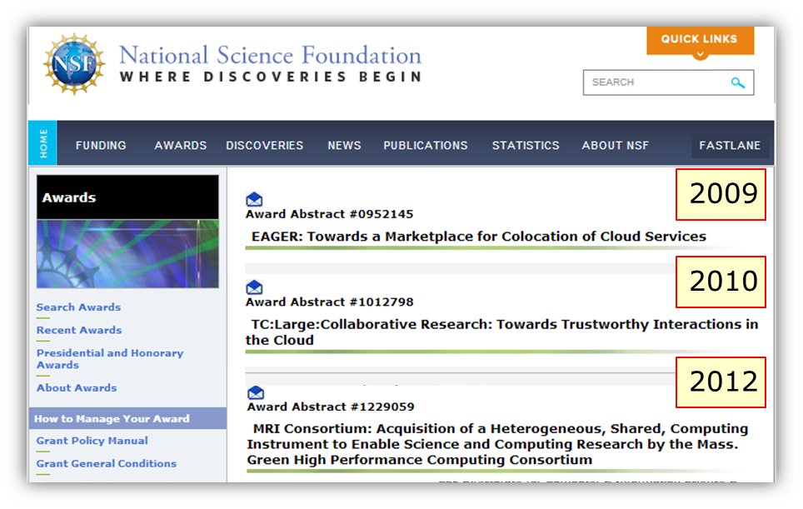
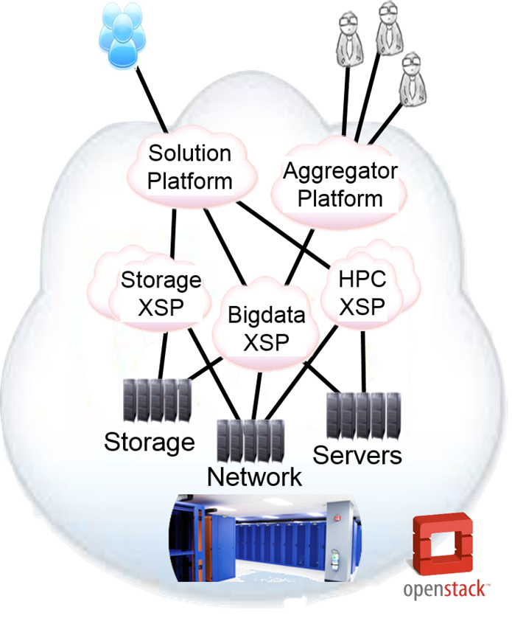



The Open Cloud eXchange
OCX
Notes:
Multiple “partners” participate in implementing and operating cloud: eXchange Service Providers (XSP)
Each XSP determines how to charge for her services
Operational data visible to stakeholders
Customers can select and move between services
Domain specific intermediaries:
provide customers with simple model
enable optimization
Multi-sided marketplace

Slide 9

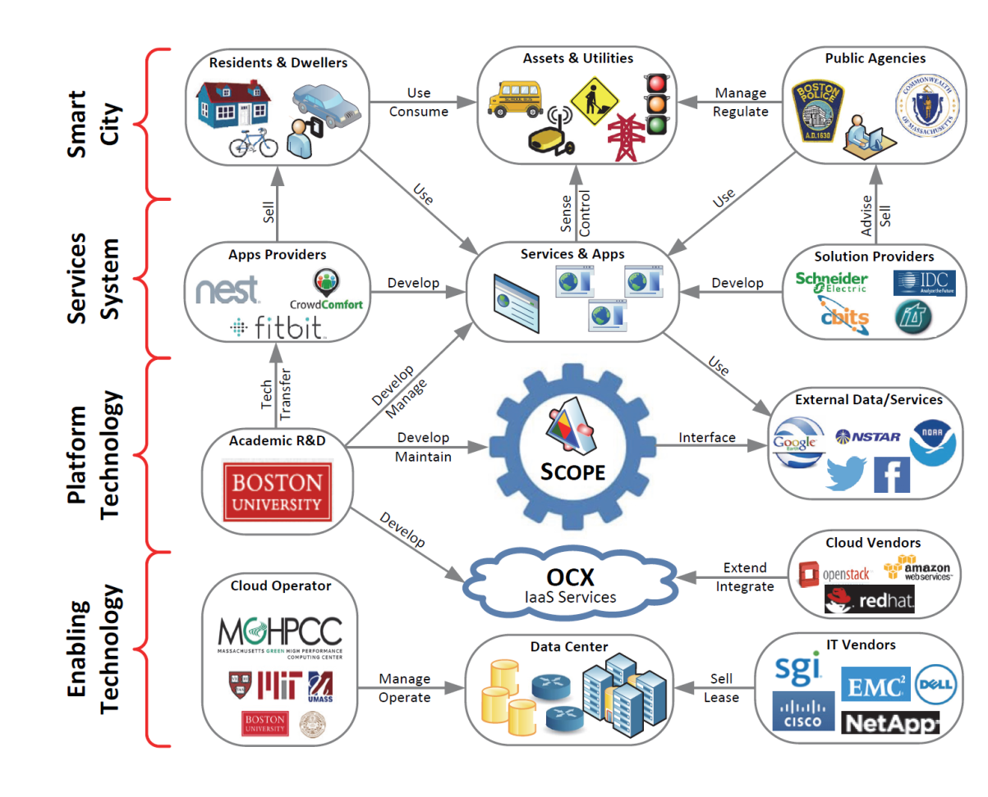

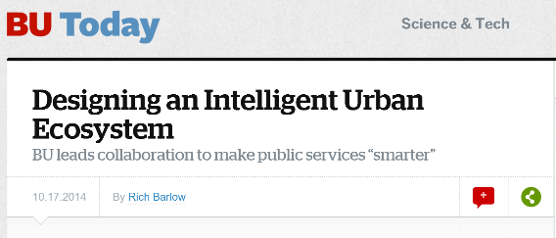
Proof of Concept: SCOPE

Slide 10
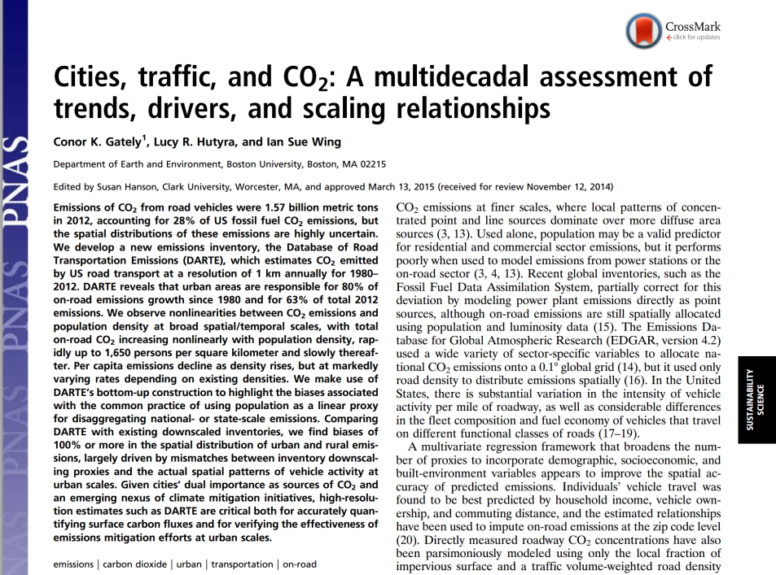
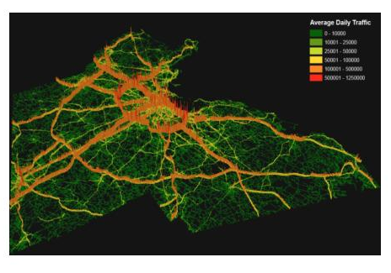

Mining mobility data for Hi-resolution
CO₂ Emission Models
Traffic volume / 15 minute

Slide 11


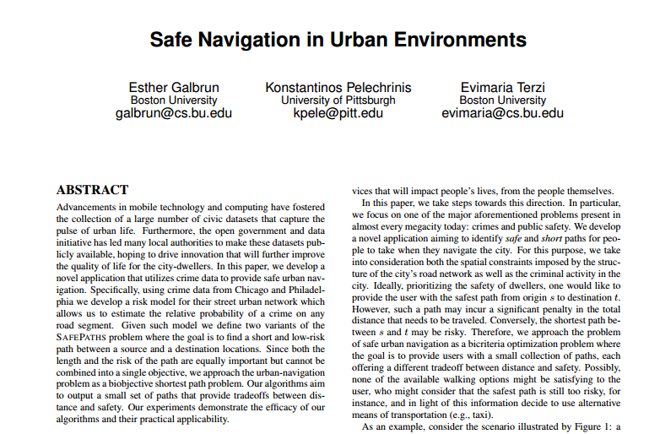
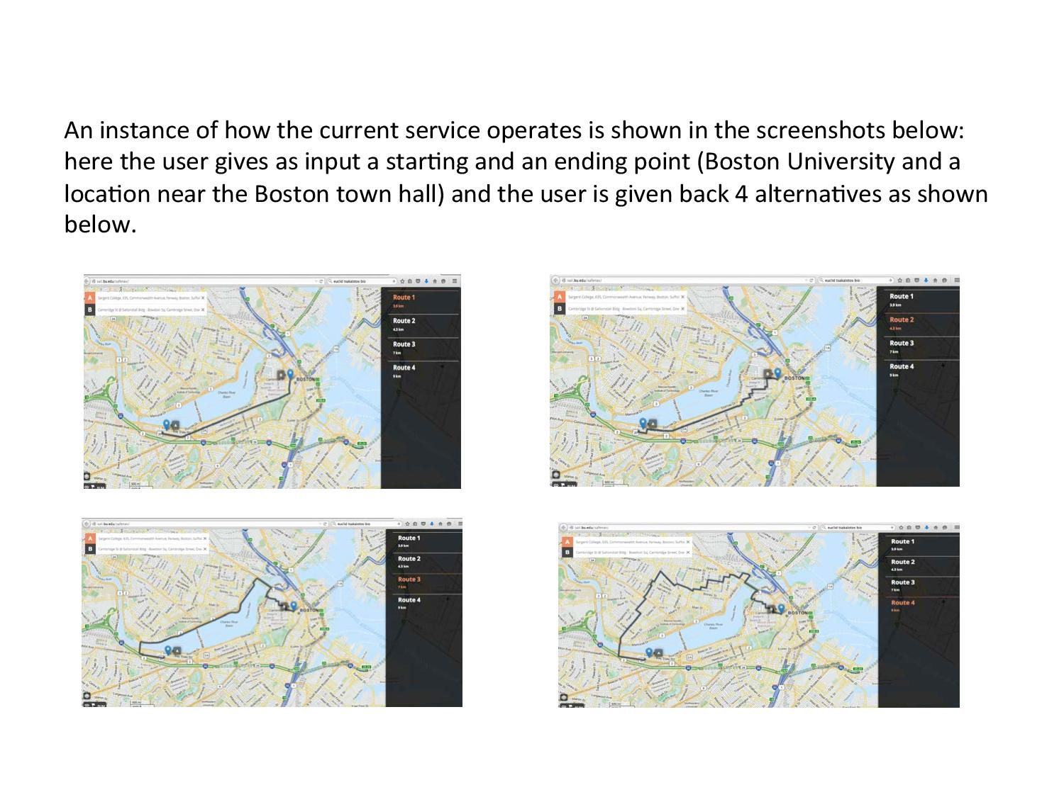
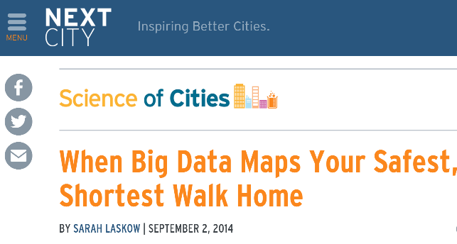
Safe Urban Navigation
SafeNav = +

Slide 12
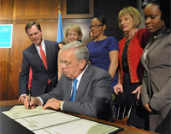
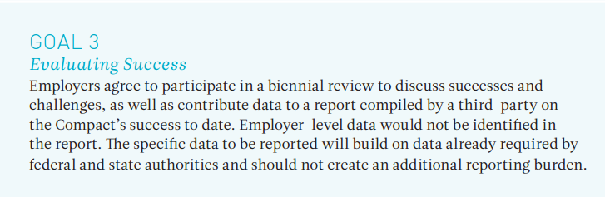



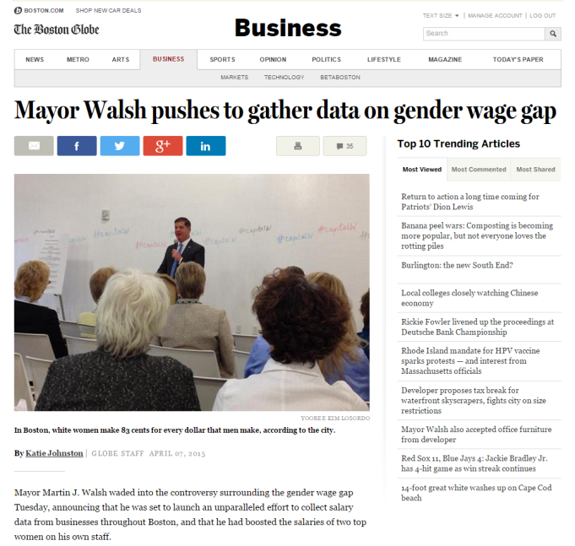


Multi-Party Analytics on Private Data
Exposing the Wage Gap

