Slide 1
City Learning: Where Cities Obtain Their Policy Information
Professors Katherine Levine Einstein and David Glick
Fiscal Leadership Summit
April 28, 2015

Slide 2
Outline
Federal fiscal background
Survey of Mayors
Sources of mayoral policy information

Slide 3


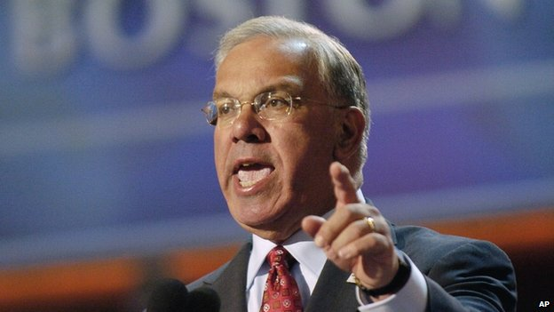
First
Some important acknowledgements

Slide 4
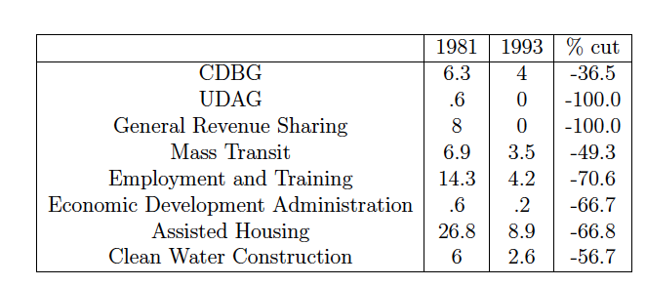
Federal Cuts to Cities
Reagan Retrenchment: Federal Funds for Cities 1981-1993 (constant 1993 billions of dollars). Data from the U.S. Conference of Mayors and reproduced from Eisinger (1998).

Slide 5
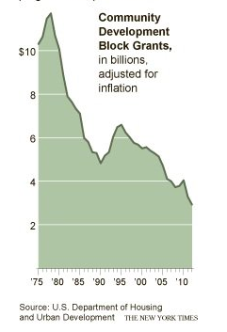
Decreased Federal Funding: The Case of the CDBG

Slide 6
Cities’ Response?
In the context of federal government cutbacks and devolution, mayors looking for increasingly innovative policy ideas
  But, where do they get their info…

Slide 7
The IOC Project
Novel, rigorous survey of mayors across a variety of topics
Recruited mayors from cities of all sizes
Nationally representative sample (n=72)
  18 cities with population >300,000

Slide 8
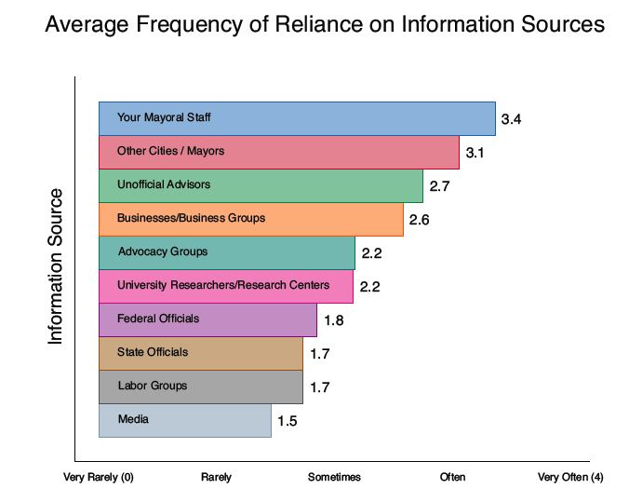
Reliance on Sources of Policy Information
Official and Unofficial Advisors
Other Cities / Mayors
University Researchers/Research Centers

Slide 9
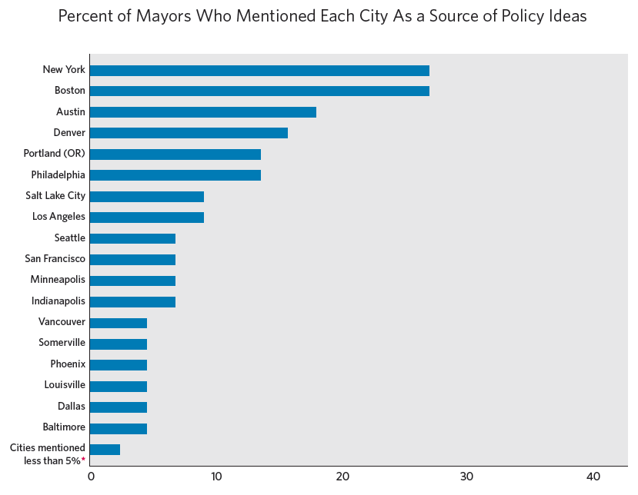
Learning From Other Cities
Asked for three cities to which they often look

Slide 10
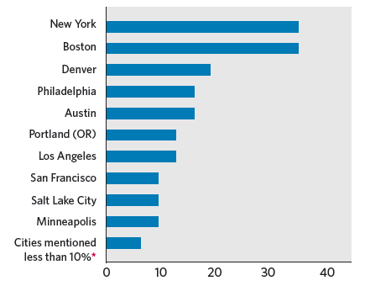
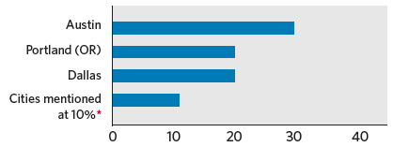
Variation in where they look: Partisanship
Democrats
Republicans

Slide 11
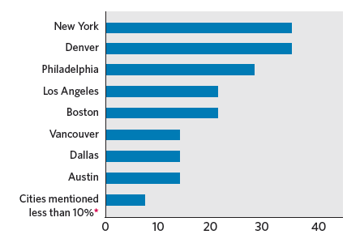
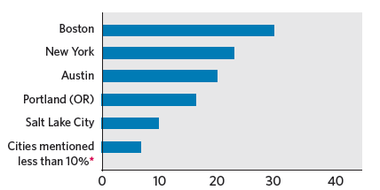
Variation in where they look: City Size
Big Cities
Small Cities

Slide 12
More general findings
Mayors look to cities that are:
  Closer
  Similar, but, on average, slightly bigger and wealthier
  Higher capacity and more successful

Slide 13
Other sources of variation
Our qualitative interviews suggest that mayors learned policies from other cities through:
  Public talks
  Conferences
  Grant competitions
  Friendship networks

Slide 14
Information Summary
Looking to other cities is important
Some more than others, but no “dominant” influencers
More to understand, but interesting and thoughtful variation
Mayors noted a wide variety of policies they adopted from other cities

