Slide 1

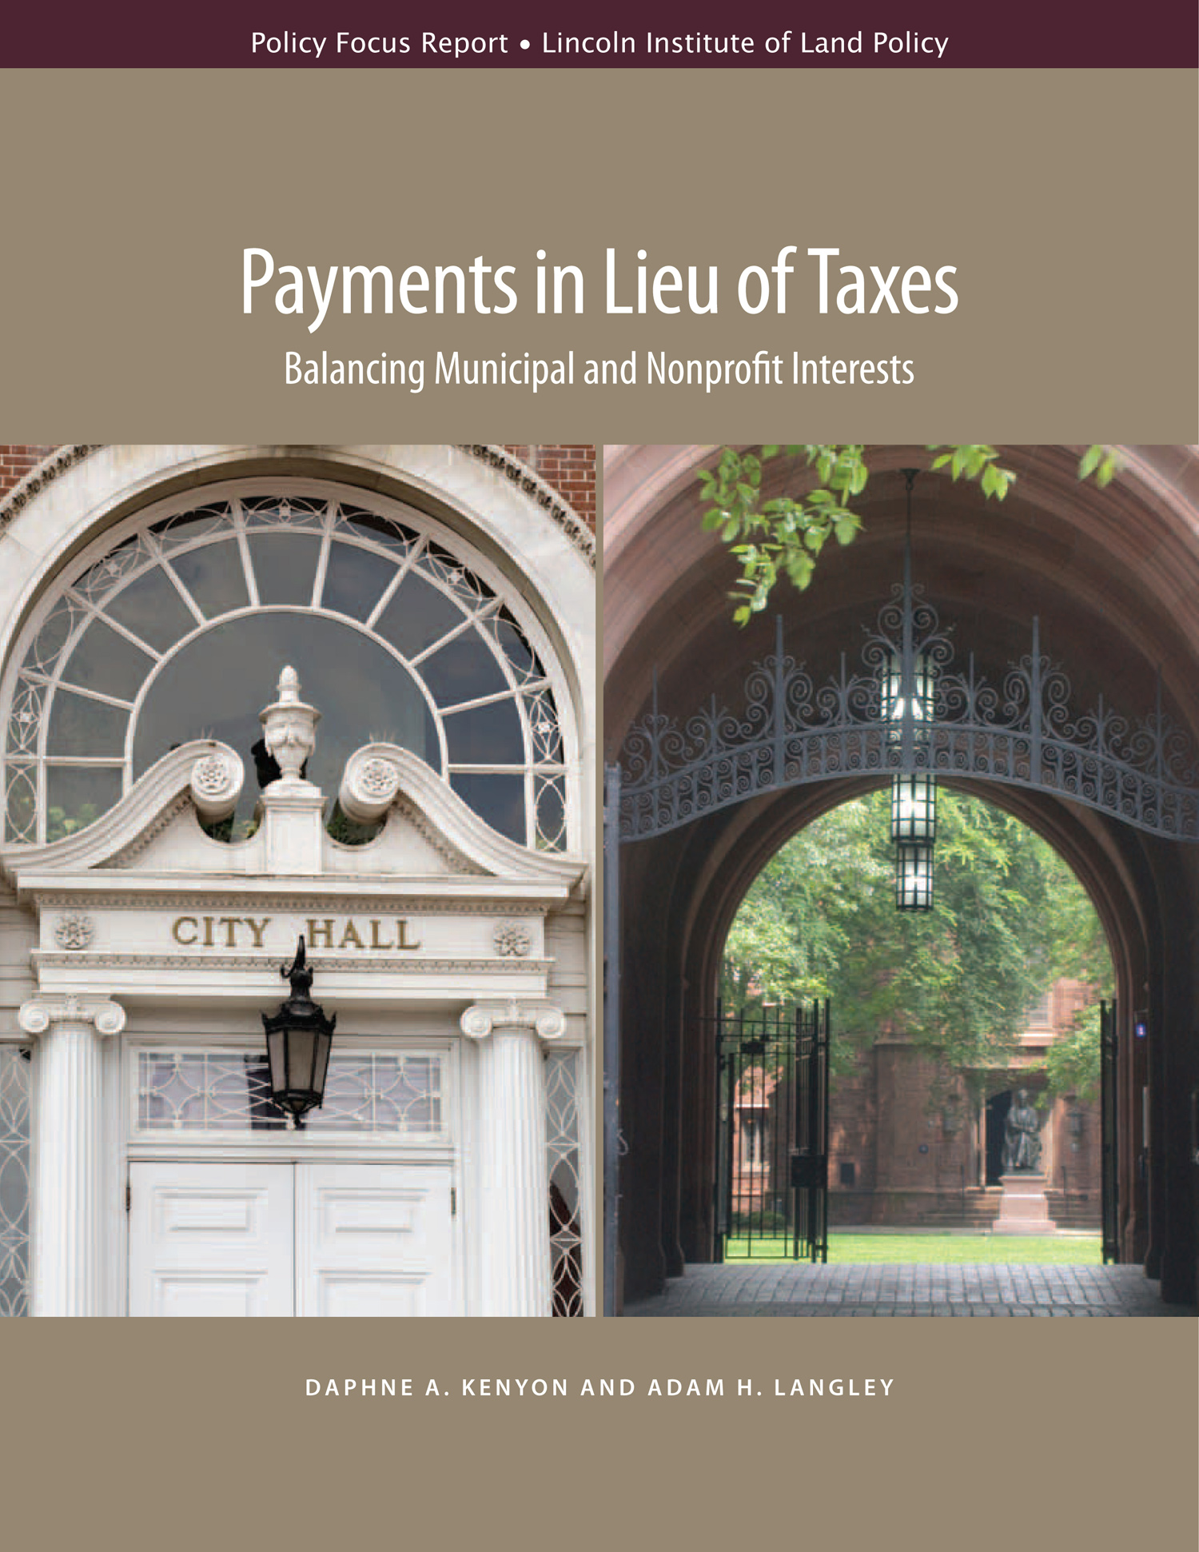
Payments in Lieu of Taxes by Nonprofits
Daphne A. Kenyon
Fellow
Lincoln Institute of Land Policy
Fiscal Leadership and the Modern City
April 28, 2015
Boston University
www.lincolninst.edu

Slide 2
Definition of PILOT
Payments made voluntarily by tax-exempt nonprofits as a substitute for property taxes
Report excludes payments from public institutions (public universities and public authorities) and state governments or businesses
www.lincolninst.edu
www.lincolninst.edu

Slide 3
Definition of PILOT
Payments typically result from negotiations between local government officials and individual nonprofits, but exact arrangements vary widely both in terms of regularity of payments and
  PILOTs may be formal long-term contracts; routine annual payments, or irregular one-time payments
  Payments may go to general fund or be directed to specific programs
www.lincolninst.edu
www.lincolninst.edu

Slide 4
Heightened Interest in PILOTs
Press accounts suggest growing interest in PILOTs since early 1990s due to:
  Revenue pressures faced by municipalities
  Growing scrutiny of the nonprofit sector
  Anti-tax climate
www.lincolninst.edu
Notes:
4

Slide 5
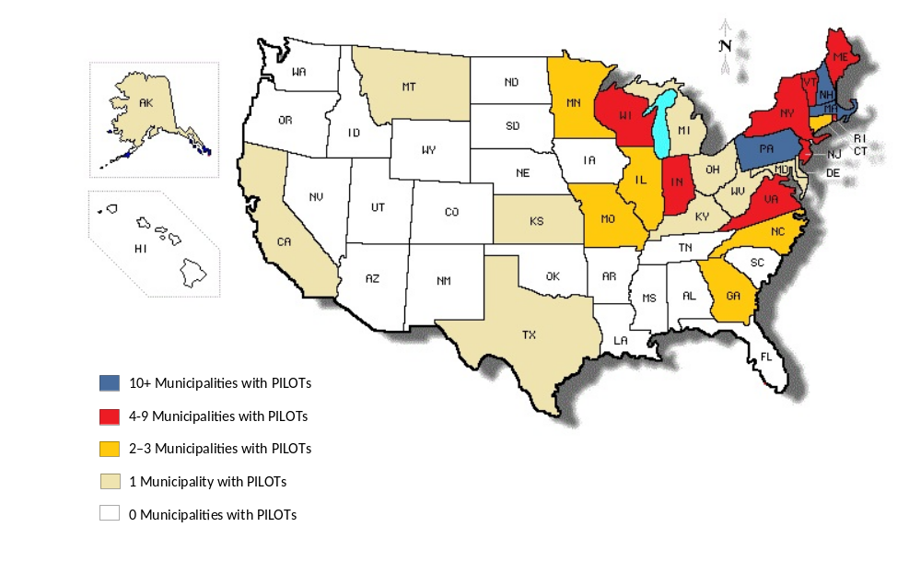
States with Jurisdictions Collecting PILOTs
www.lincolninst.edu
www.lincolninst.edu
Notes:
5

Slide 6
Overview of PILOTs
Since 2000, 218 jurisdictions in 28 states have received PILOTs
Over 420 nonprofit institutions make voluntary contributions to cities, towns, counties, and school districts
Collectively these payments are worth more than $92 million per year
www.lincolninst.edu
www.lincolninst.edu
Notes:
6

Slide 7
PILOTs by Region
Census Region | % Localities | % Nonprofits | % PILOT Revenue
Northeast | 80% | 73% | 83%
South | 7 | 13 | 7
Midwest | 12 | 13 | 2
West | 1 | 1 | 8
www.lincolninst.edu
www.lincolninst.edu
Notes:
7

Slide 8
PILOTs by Region
The Northeast comprises 80% of the localities that receive PILOTS, 73% of the institutions that make PILOTs, and 83% of PILOT revenue generated by PILOTs
The most likely reasons for the prevalence of PILOTs in the Northeast are:
  High reliance on the property tax
  Large nonprofit sector
  Copy cat behavior within the region
www.lincolninst.edu
www.lincolninst.edu
Notes:
8

Slide 9
Mainly Higher Ed and Hospitals
Type of Nonprofit | % PILOT Revenue | % of Nonprofits
Arts/Culture | 0 | 4
Higher Educ. | 67% | 24%
Hospitals | 25% | 22%
Housing | 2 | 16
Religious | 1 | 13
Social Services | 0 | 5
Other | 4 | 16
www.lincolninst.edu
www.lincolninst.edu
Notes:
9

Slide 10
Sources of PILOTs
“Eds and meds” account for 92% of PILOT revenue, and 46% of organizations that make PILOTs
Universities and colleges contribute over two thirds of total PILOT revenue
www.lincolninst.edu
Notes:
10

Slide 11
PILOTs are Small Share of Revenue in Most Places
www.lincolninst.edu
www.lincolninst.edu
Notes:
11

Slide 12
PILOT Revenues Highly Concentrated
Top 10 localities receive 74% of total revenues
  Boston, New Haven, Providence, Palo Alto, Baltimore, Watertown (MA), Cambridge, Erie (PA), Pittsburgh, Princeton (In order of PILOT revenues)
Top 10 nonprofits contribute 52% of revenues
  Harvard, Yale, Stanford, Brown, Boston Univ., Mass General Hospital, Dartmouth, Brigham & Women’s Center, MIT, Princeton (In order of PILOT contributions)
www.lincolninst.edu
www.lincolninst.edu
Notes:
12

Slide 13
Arguments in Favor of PILOTs
PILOTs can provide significant, but limited revenue
Nonprofits should pay for the public services they consume
PILOTs can address two problems with charitable property tax exemption: spatial mismatch and imprecise subsidy
www.lincolninst.edu
Notes:
13

Slide 14
Arguments Against PILOTs
PILOTs could lead nonprofits to raise fees or cut services
Limited and unreliable revenue source
PILOTs often ad hoc, secretive, and contentious
PILOTs lead to horizontal and vertical inequities
www.lincolninst.edu
Notes:
14

Slide 15
Two Types of Problems with PILOTs
Problem
Solution
Attempts to Obtain PILOTs Highly Contentious
Collaborative Approach: PILOTs Serve Mutual Interests
Voluntary Nature Leads to Inconsistent Treatment of Nonprofits
Systematic Approach: Provides Framework for Individual Negotiations
www.lincolninst.edu
Notes:
15

Slide 16


Case Study: Providence, RI
In 2012 Providence Mayor Angel Taveras credited the city’s exempt institutions with helping to close the city’s massive deficit and prevent bankruptcy.
www.lincolninst.edu
www.lincolninst.edu
Notes:
16

Slide 17
Case Study: Providence, RI
In FY 2014, the city collected $9.2 million in voluntary PILOTs from nonprofits, which was nearly $1 million more than budgeted
In response to pleas from the city, last year Providence nonprofits pledged an additional $48 million over 11 years
www.lincolninst.edu
www.lincolninst.edu
Notes:
17

Slide 18
Case Study: Providence, RI
All of the city’s major nonprofit institutions contributed
  Brown University pledged $31.5 million over 11 years. In exchange the university obtained certain streets adjacent to its campus and 250 parking permits
  Johnson and Wales promised to triple its PILOT
  The city’s three major hospitals pledged $1.15 million per year
www.lincolninst.edu
www.lincolninst.edu
Notes:
18

Slide 19
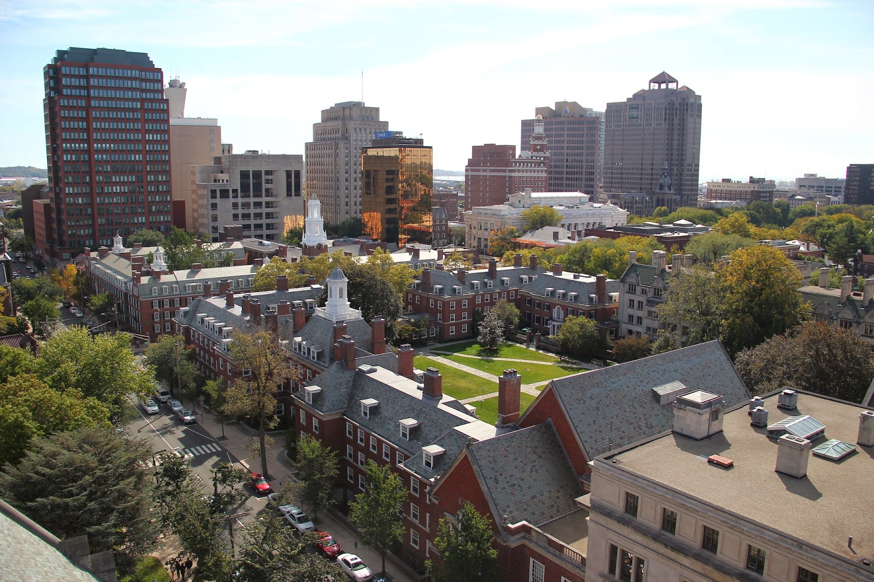
Case Study: New Haven, CT
PILOT agreement reached with Yale University in 1991, with $1.2 million payment that has grown over time
www.lincolninst.edu
www.lincolninst.edu
Notes:
19

Slide 20
Case Study: New Haven, CT
$8.3 million PILOT in 2014
Yale’s contributions go beyond PILOTs:
  Stipend for Yale employees buying homes in city
  Redeveloped several blocks of city’s retail center
  Funds an organization that taps New Haven’s civic resources to address social problems
www.lincolninst.edu
www.lincolninst.edu
Notes:
20

Slide 21
Conclusion
PILOTs are one revenue option for municipalities
Municipalities should work collaboratively with nonprofits when seeking PILOTs
State and local governments should consider alternatives to PILOTs
www.lincolninst.edu
www.lincolninst.edu
Notes:
21

Slide 22
Contact Information
Daphne Kenyon
Visiting Fellow
Dept. of Valuation and Taxation
Lincoln Institute of Land Policy
617-661-3016
DKenyon@lincolninst.edu
Adam Langley
Research Analyst
Dept. of Valuation and Taxation
Lincoln Institute of Land Policy
617-661-3016
ALangley@lincolninst.edu
www.lincolninst.edu
Notes:
22

