Slide 1
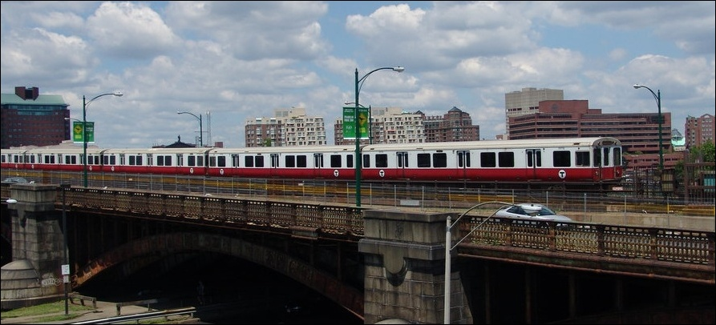

  Local Funding for Transportation
Photo: www.nycsubway.org

Slide 3
Public Transportation Ballot Measures
309 finance measures on ballots between 2000-2010
84% of all transportation measures are finance-related
Sales tax increases or renewals are most common type
Bonds are most successful with 84% approval—but are far more common on statewide ballots than local and regional
Property tax measures are more successful than sales tax measures, with 81% approved vs. 59%

Slide 4
Transportation Measures Win at the Polls
70% Approval Rate for Transportation Measures
Twice the Approval Rate of All Ballot Measures
Success Across Region, Population, Party Affiliation

Slide 5
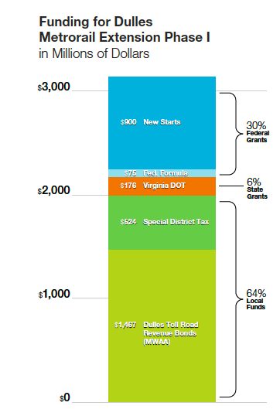
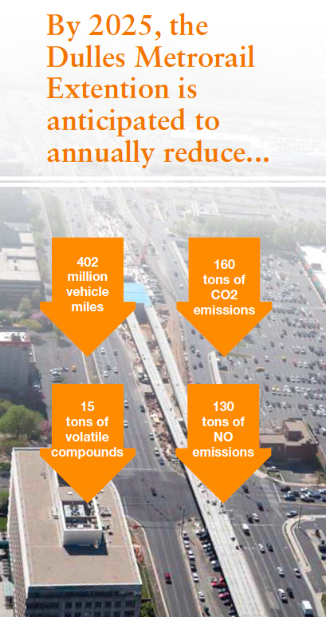

Slide 6
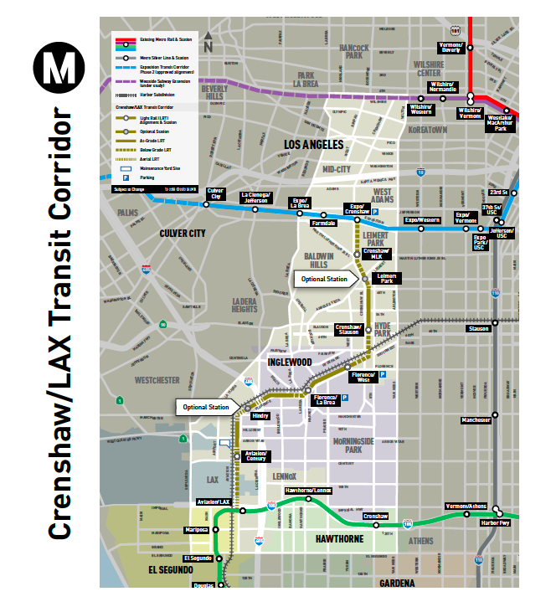
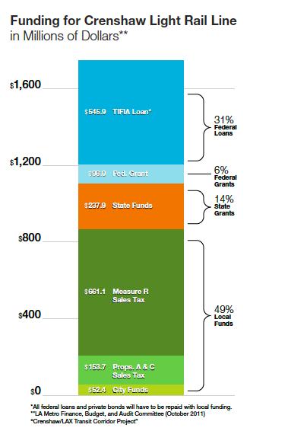

Slide 7
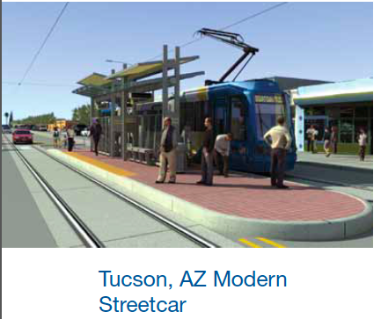
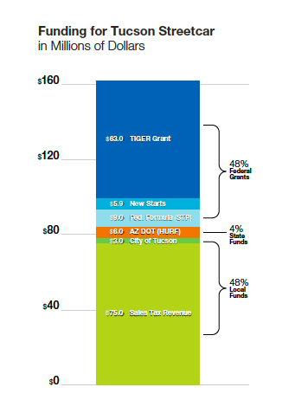

Slide 8
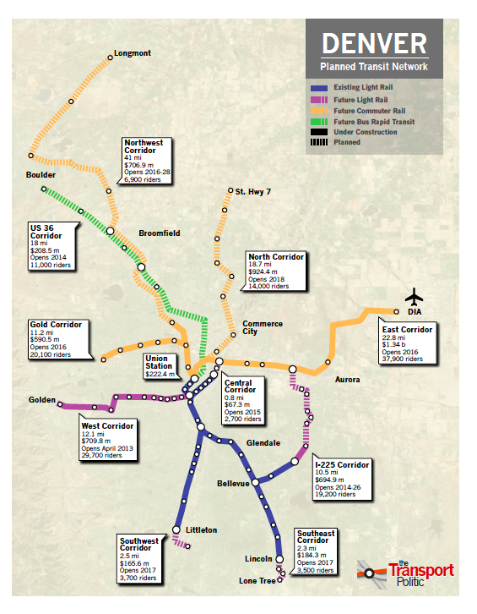
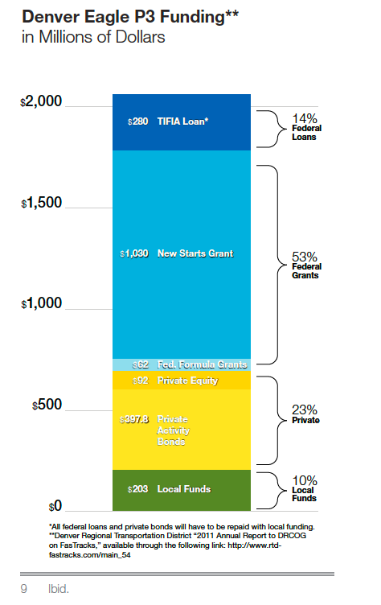

Slide 9
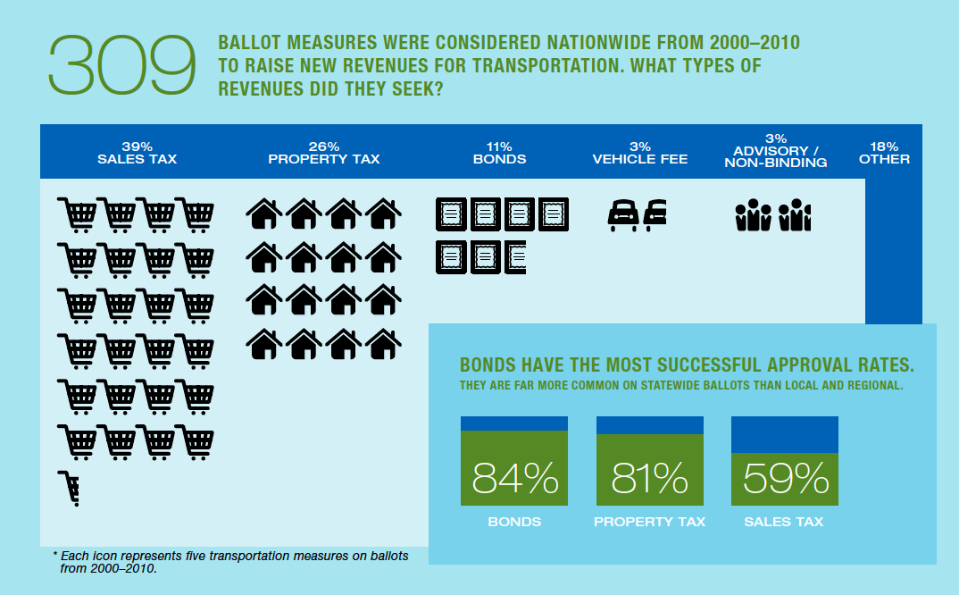

Slide 10
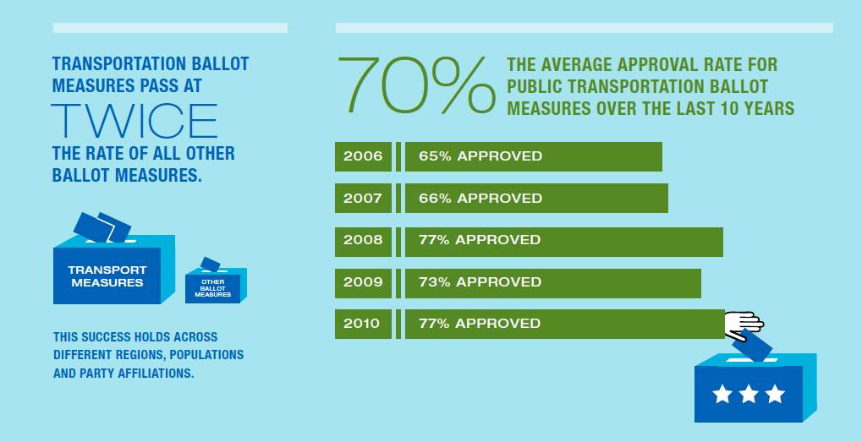

Slide 11
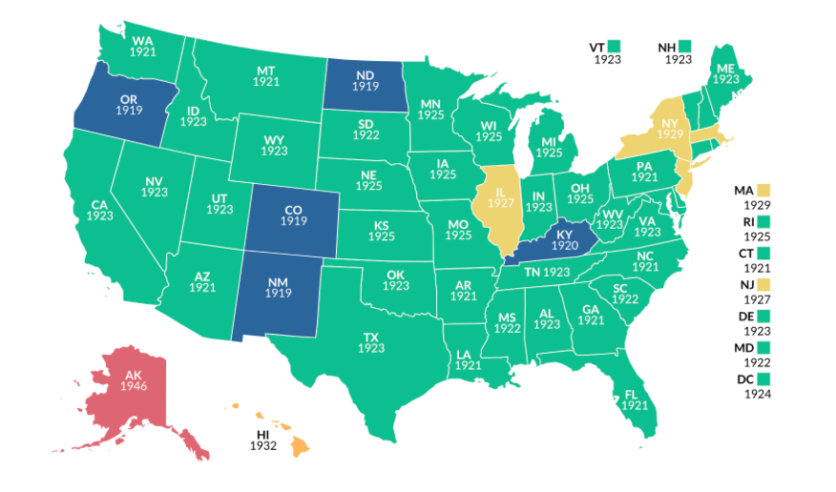
Year Your State Adopted A Gas Tax

Slide 12
Nearly everyone agrees that transportation funding decisions are politically driven.
“Transportation infrastructure funding decisions are based more on politics than on need.”
Total Agree
85%
Key Sub-Groups | Strongly Agree
Men | 62%
Women | 62%
Urban Residents | 58%
Suburbanites | 67%
Rural Residents | 54%
Car Commuters | 60%
Non-Car Commuters | 55%
Do NOT Commute | 65%
62% Strongly Agree
Total Disagree 13%
Don't Know 2%

