Slide 1
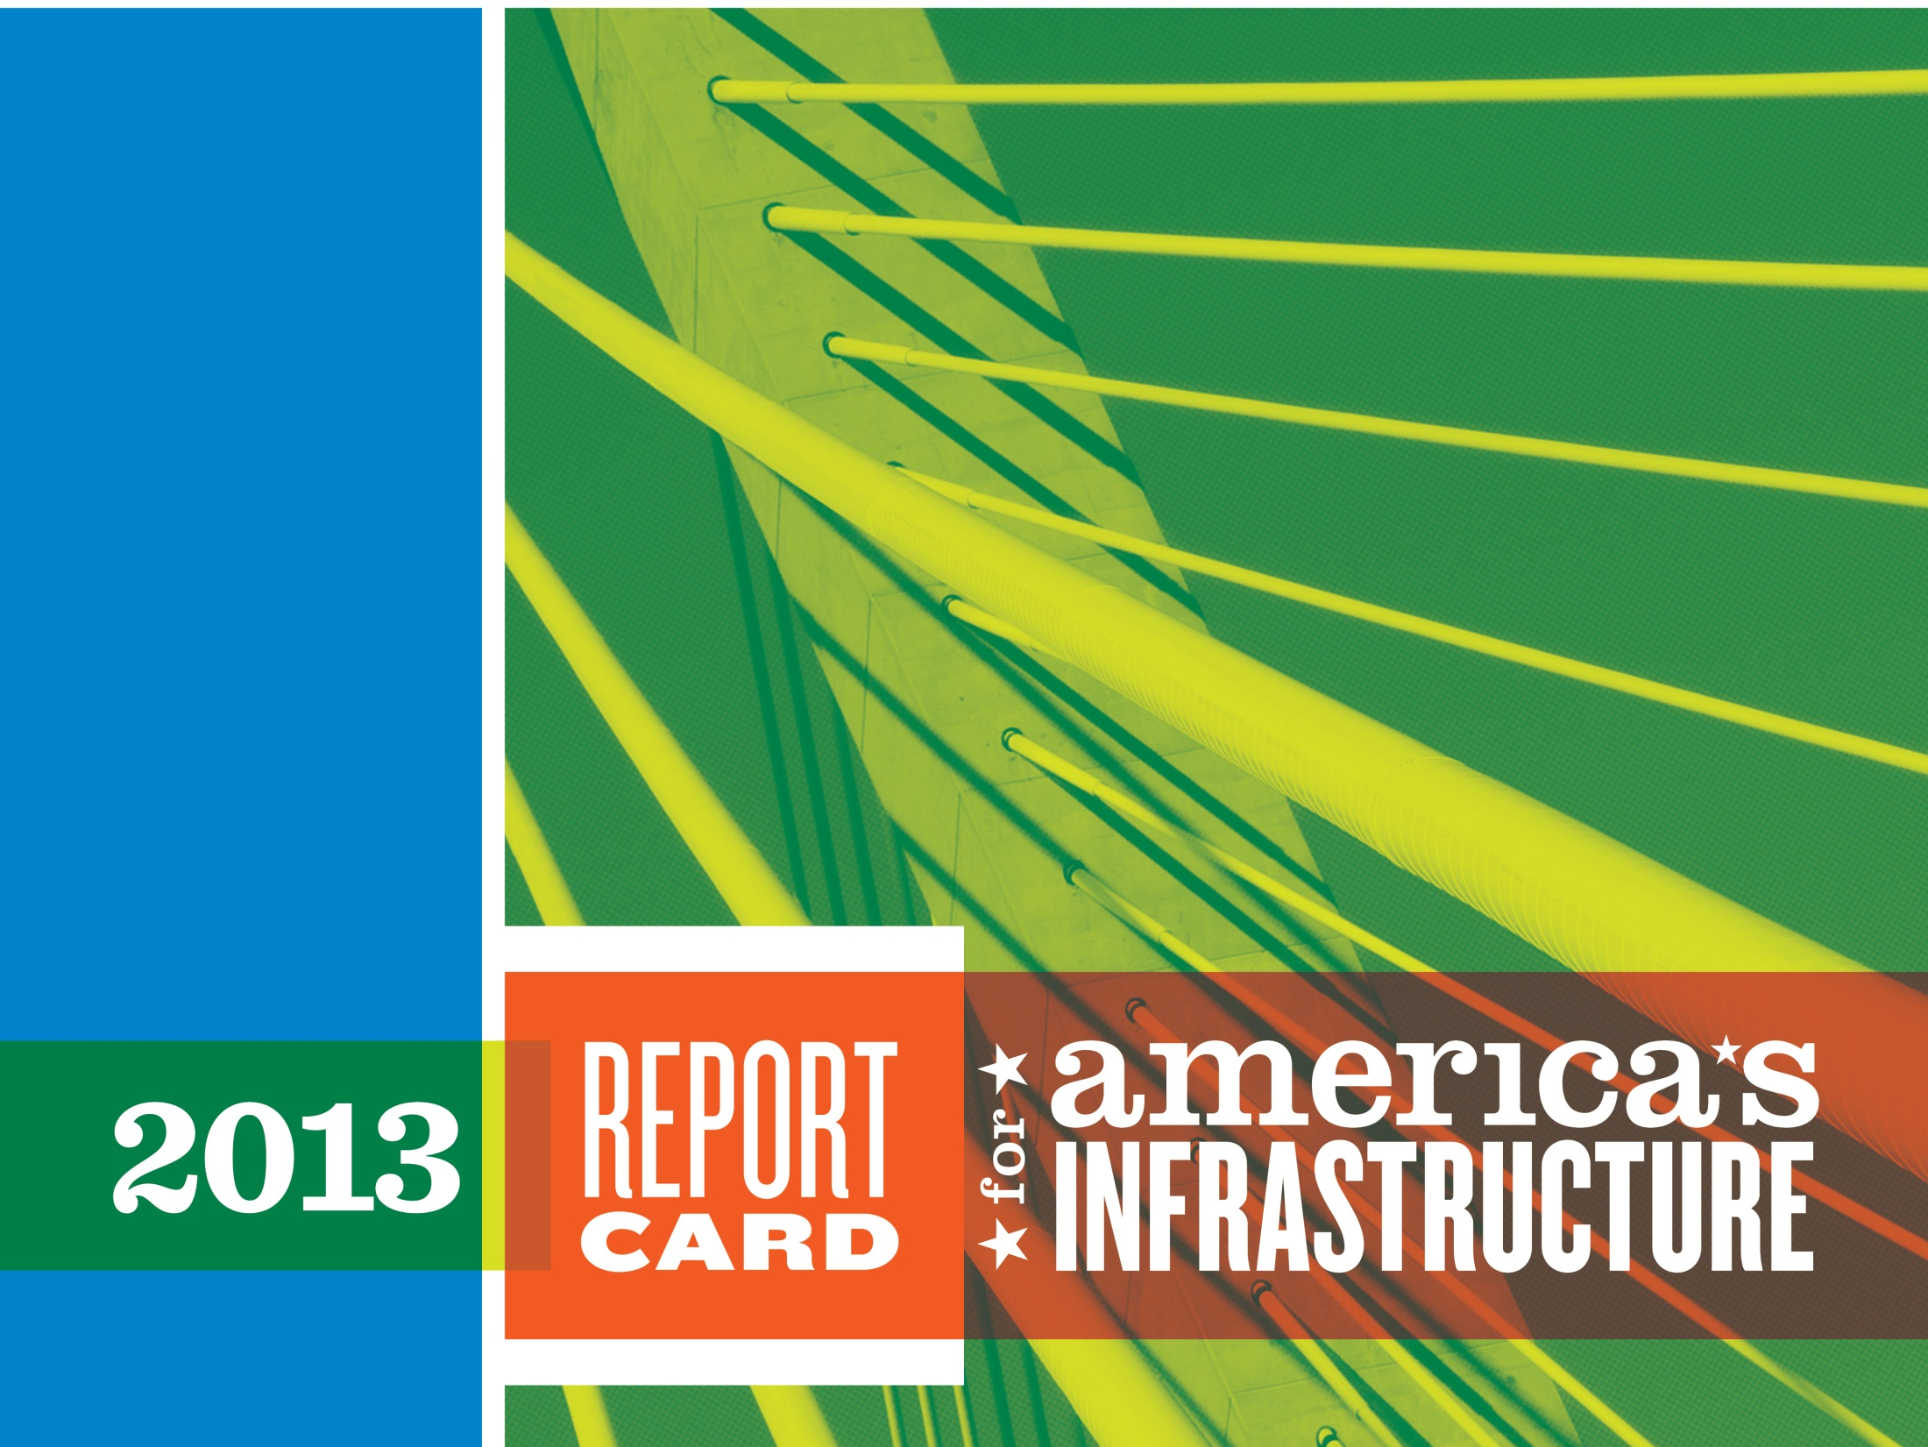

Brian Pallasch
Government Relations and Infrastructure Initiatives
January 29, 2013
Notes:
Thank you for having me here today to discuss the state of America’s infrastructure and ASCE’s Report Card.

Slide 2

THE 21ST CENTURY VISION FOR AMERICA’S INFRASTRUCTURE
INFRASTRUCTURE IS THE FOUNDATION THAT CONNECTS THE NATION’S BUSINESSES, COMMUNITIES, AND PEOPLE, DRIVING OUR ECONOMY AND IMPROVING OUR QUALITY OF LIFE.
IN THE SHORT TERM WE NEED A NATIONAL COMMITMENT TO BRING EXISTING INFRASTRUCTURE INTO A STATE-OF-GOOD-REPAIR, AND IN THE LONG TERM WE MUST MODERNIZE AND BUILD IN A TARGETED AND STRATEGIC MANNER.
BY EMPLOYING STRATEGIES TO USE EVERY DOLLAR MORE EFFICIENTLY AND USING CREATIVE SOLUTIONS TO INFRASTRUCTURE DEVELOPMENT, WE CAN IMPLEMENT THE RIGHT PROJECTS ON TIME AT THE RIGHT PRICE.
Notes:
In conjunction with our Report Card, ASCE spent some time gathering key groups from across the infrastructure sectors to develop a national vision for infrastructure. While the Report Card actually breaks it down into sectors, we recognize that this is a system of moving parts that must work seamlessly. Here’s a little of what we came up with -
In the 21st century, we see an America that thrives because of high quality infrastructure.
INFRASTRUCTURE IS THE FOUNDATION THAT CONNECTS THE NATION’S BUSINESSES, COMMUNITIES, AND PEOPLE, DRIVING OUR ECONOMY AND IMPROVING OUR QUALITY OF LIFE.
For the U.S. economy to be the most competitive in the world, we need a first class infrastructure system — transport systems that move people and goods efficiently and at reasonable cost by land, water, and air; transmission systems that deliver reliable, low-cost power from a wide range of energy sources; and water systems that drive industrial processes as well as the daily functions in our homes.
Yet today, our infrastructure systems are failing to keep pace with the current and expanding needs, and investment in infrastructure is faltering.
IN THE SHORT TERM WE NEED A NATIONAL COMMITMENT TO BRING EXISTING INFRASTRUCTURE INTO A STATE-OF-GOOD-REPAIR, AND IN THE LONG TERM WE MUST MODERNIZE AND BUILD IN A TARGETED AND STRATEGIC MANNER.
This means leadership at the federal, state, and local levels of government, by businesses and individuals, to communicate the importance of our nation’s infrastructure, to craft innovative solutions that reflect the diverse needs of the nation, and to make the investments the system needs.
By employing strategies to use every dollar more efficiently and by deploying creative solutions to infrastructure development such as public–private partnerships, we can implement the right projects on time at the right price.

Slide 3
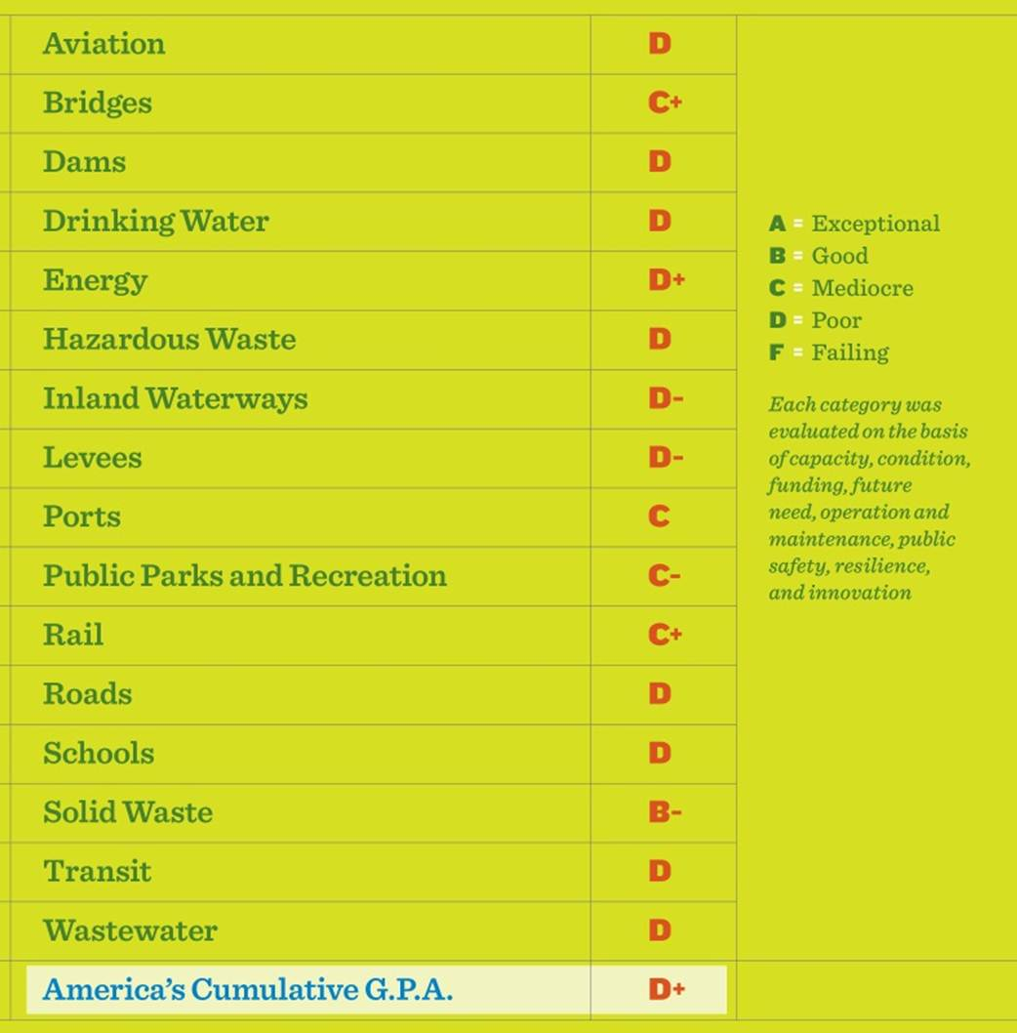
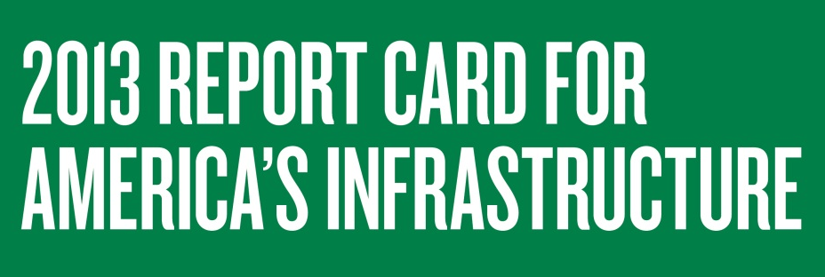
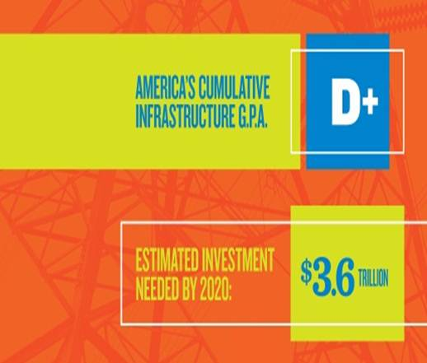
Evaluation Criteria
Capacity
Condition
Operations & Maintenance
Funding
Future Need
Public Safety
Resilience
Innovation
Notes:
Every four years ASCE assembles a team of infrastructure experts across 16 major sectors of infrastructure to evaluate the current condition of our nation’s infrastructure and the amount of investment needed to keep it working for us and for our economy.
The Report Card Advisory Council oversees the data analysis and development of the Report Card and then turns this into an easy to understand format that you’ll remember from your school days – a Report Card. Seen as a national indicator, the Report provides a snapshot in time of infrastructure conditions and funding needs for each sector.
Here’s what we found:
America’s infrastructure received an overall grade of D+ in ASCE’s 2013 Report Card.
We continue to see categories of infrastructure that simply are not seeing the maintenance or investment to improve day to day performance and save money in the long-term.
The backlog of projects to maintain and modernize our infrastructure keeps growing.
We look at condition, capacity, funding, future need, O&M, public safety, resilience, and innovation; and in almost every category there is work to be done.
There overwhelming majority of our grades are Ds and 2 of these were near-failing D- grades – levees and inland waterways.
The Good News is that six sectors saw improvements since 2009.
In spite of the bad grades in many sectors, there are a few bright spots.
There were noticeable and tangible improvements in six of the sectors we evaluated – Roads – Bridges - Solid waste – Drinking Water – Wastewater – Railroads
Communities across the country are collaborating to address some of their most critical infrastructure challenges. We saw greater private investment in several categories, targeted efforts led by cities and states, and several categories benefited from short-term boosts in federal funding.
Why did some sectors improve, while others continued to fall behind?
The answer is simple: in sectors where investment was made – by both the public and private sectors - and innovative solutions pursued, the grades rose.

Slide 4
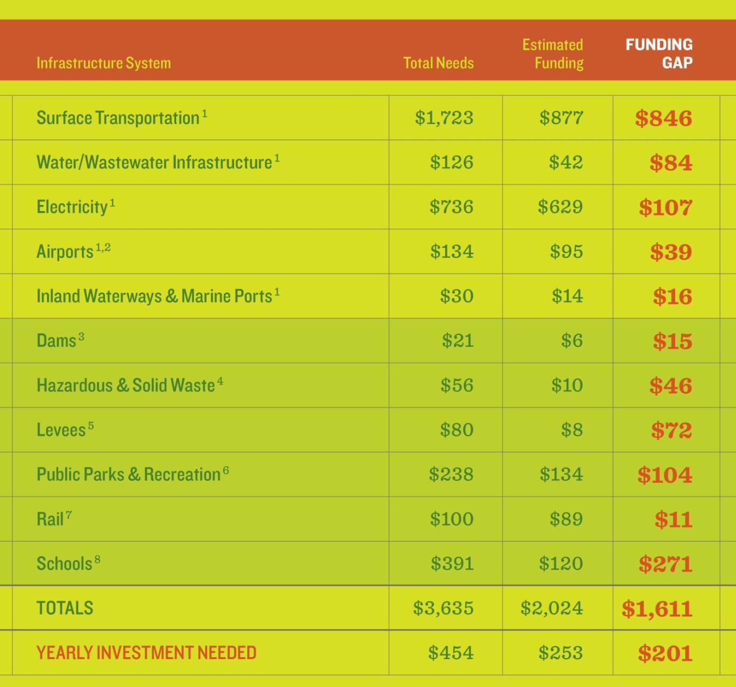


Infrastructure Funding Needs by 2020
$3.6T Investment Needed by 2020
$1.6T
Additional Needed
$2T
Current Spending
Annual additional investment needed to achieve a “B”
Notes:
In 2013, we face a total investment need of $3.6 trillion between now and 2020 across these 16 infrastructure sectors.
We’re already prepared to invest about $2T of the $3.6T we need, but we face a funding shortfall of $1.6T or $200 billion per year for infrastructure.
A few things to note from this chart –
-Surface transportation has the largest total needs and the largest funding shortfall at $846 billion, although you will also see that there is a great deal of funding set aside each year
-Water and wastewater has a much smaller total funding shortfall, but estimated funding covers only about one-third of the total needs
-We are assuming here that this is the total investment needed to get to a grade of “B” or a state of good repair
This number draws from our 4 economic studies, called the “Failure to Act” as well as industry projections of needs for the categories in dark green.
These numbers looks out to 2020 – covering 8 years of infrastructure investment needs which is an appropriate time for planning and action.
Now I will walk through some of key findings from several of our categories…..

Slide 5


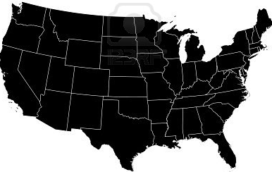
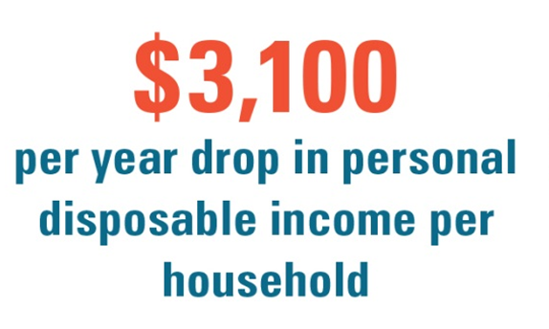
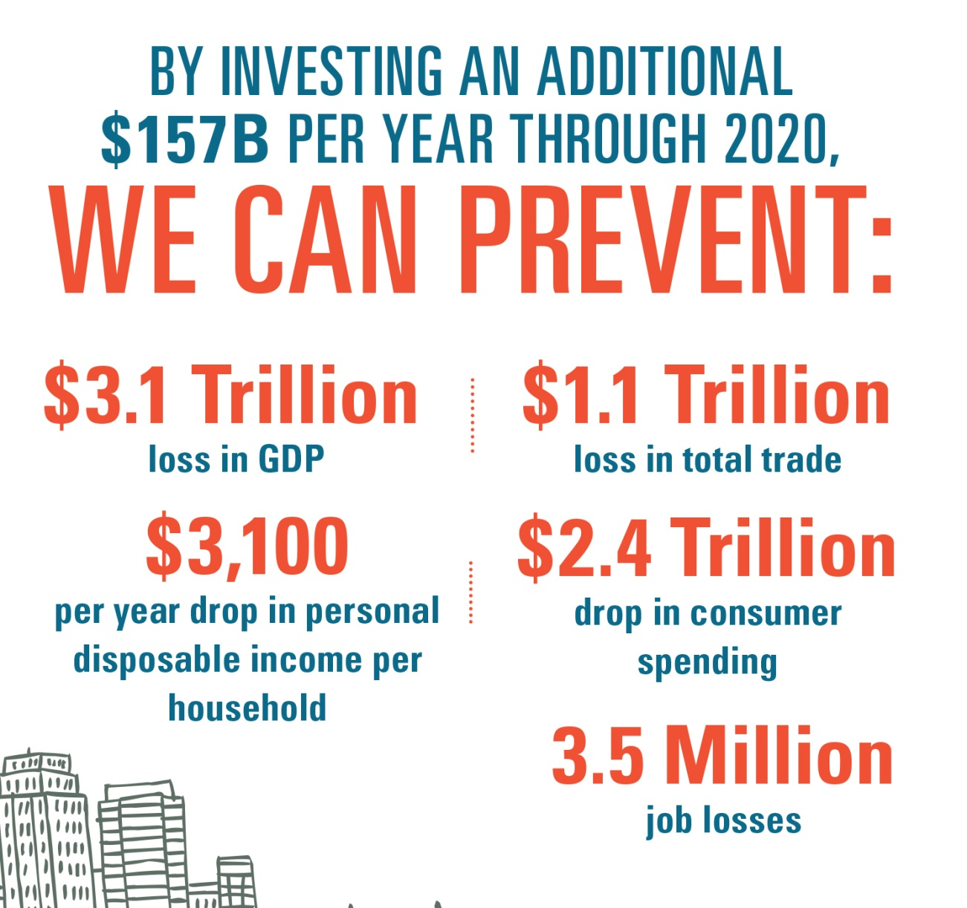
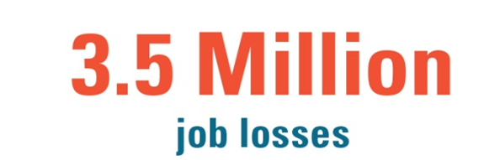

With Investment, We Prevent:
Notes:
So you might ask, “Why do these grades matter?” What does a D+ mean for our country? What we have found is that America’s infrastructure grades have an impact on our bottom line.
Whether the inland waterway system, our ports, or the electrical grid – America is connected by infrastructure. And we know the consequences of neglecting these issues plays out every day. We waste hours sitting in traffic, power outages become more frequent, and we lose billions of gallons of water through leaky pipes – and these impacts cost us money.
ASCE recently completed a series of studies called Failure to Act which show the opportunity cost America is now facing if we continue to let the grades lag in the Cs and Ds. These studies look at current funding levels for major infrastructure sectors, projected to the year 2020, to see what, if any, effect this will have on household income, jobs, GDP, and trade.
We found that if we continue on the same path, we face the following effects by 2020:
A projected loss of $3.1 trillion in GDP, almost the equivalent of the 2011 GDP of France
A loss of 3.5 million jobs in the year 2020 alone
And a drop of $3,100 in disposable income per year, per household
And while the investment needed may seem daunting, the real story is that we can’t afford not to.

Slide 6
Key Solutions
1.
Bold Leadership and a Compelling Vision
2.
Sustainability and Resilience
3.
Prioritize, Plan, and Fund
Notes:
We also believe there are three solutions that will move us forward.
First, America’s infrastructure needs BOLD LEADERSHIP AND A COMPELLING VISION at the national level.
That strong national vision must originate with STRONG LEADERSHIP AT ALL LEVELS OF GOVERNMENT AND THE PRIVATE SECTOR.
Second, WE NEED TO PROMOTE SUSTAINABILITY AND RESILIENCE.
It must be an integral part of improving the nation’s infrastructure.
As infrastructure is built or rehabilitated, life-cycle cost analysis should be performed for all infrastructure systems.
BOTH STRUCTURAL AND NON-STRUCTURAL METHODS MUST BE APPLIED TO MEET CHALLENGES so that future generations can use and enjoy what we build today.
And finally, we must agree on how to prioritize and fund strategic new investments in infrastructure that position our nation for the future.
While infrastructure investment must be increased at all levels, it must also be PRIORITIZED AND EXECUTED ACCORDING TO WELL-CONCEIVED PLANS that both complement the national vision and focus on system-wide outputs.

Slide 7
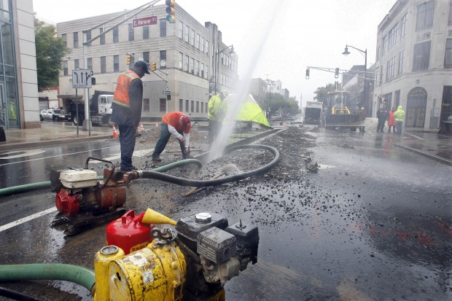
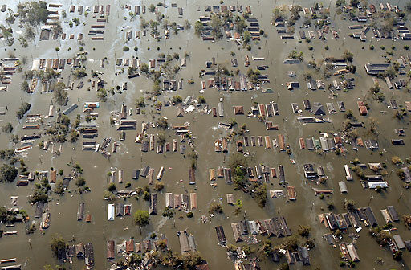
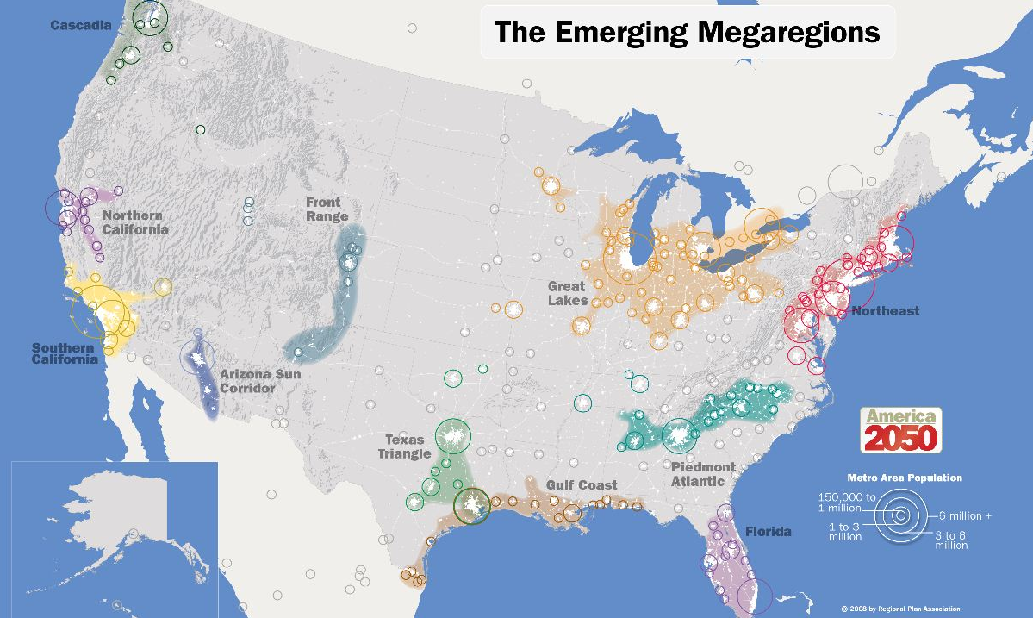
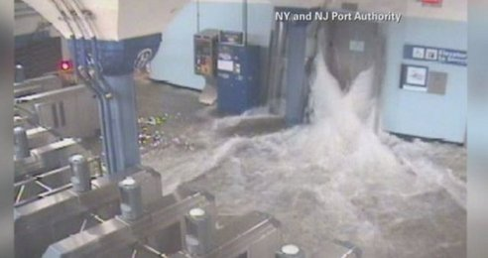
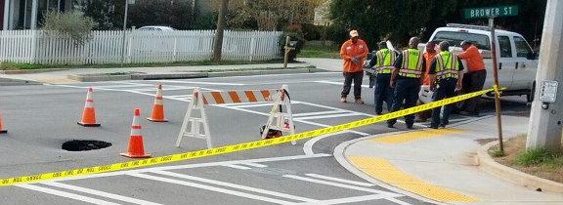
Increasing Demands Require Action
Notes:
We also must acknowledge that the solutions we come up with today cannot fit the needs of the past.
Our once modern infrastructure is aging and maintenance or replacement has not kept pace with its deterioration. While we are entering what the American Waterworks Association calls the “dawn of the replacement era”, we must think about adapting solutions for today’s world.
Shifting demographics and population growth to major urban areas continue to strain and overburden infrastructure that is at or maxing out its capacity.
Superstorms like Hurricane Sandy, which devastated the East Coast, are changing our expectations and showing us how important building resiliency into our infrastructure will be.
The silver lining is that after years of seeing bumpier roads and water main breaks on their street, we believe that the public now is starting to see the crucial link between infrastructure and both a strong economy and a better quality of life.

Slide 8
Issues worth noting
Infrastructure investment/prioritization lacks a national vision within government
Infrastructure spending decreasing relative to other countries
State and local governments take an increasing role, but funding gap persists
Financing cannot replace funding
Notes:
As we wrap up, I thought I would outline some issues we are seeing at the national level that are worth mentioning –
First, there is not a national, unifying infrastructure policy – it is dealt with in sectors, such as transportation and water, and many have argued (including ASCE) that we need a stronger, intermodal vision with corresponding funding.
The United States' global rank in infrastructure has dropped off considerably from where it was four years ago, both in absolute and relative terms. U.S. infrastructure ranks 14th in the world, a full seven slots lower than it was in 2008, according to the Global Competitiveness Report for 2012-2013, which was compiled by the World Economic Forum.
In addition, we see states and local governments taking a larger role in an era of stagnant federal funding. Local and state ballot initiatives for transportation and other infrastructure projects have passed by overwhelming margins, where projects are clearly defined. We think it’s a good thing, but not when it is pointed to as a rationale for devolution. As you saw, states still receive half of their transportation funding from the federal government on average, and a state-led system lends itself to a patchwork quilt of repairs.
Finally, P3s are a tool in the toolbox but cannot replace public funding for infrastructure.

Slide 9

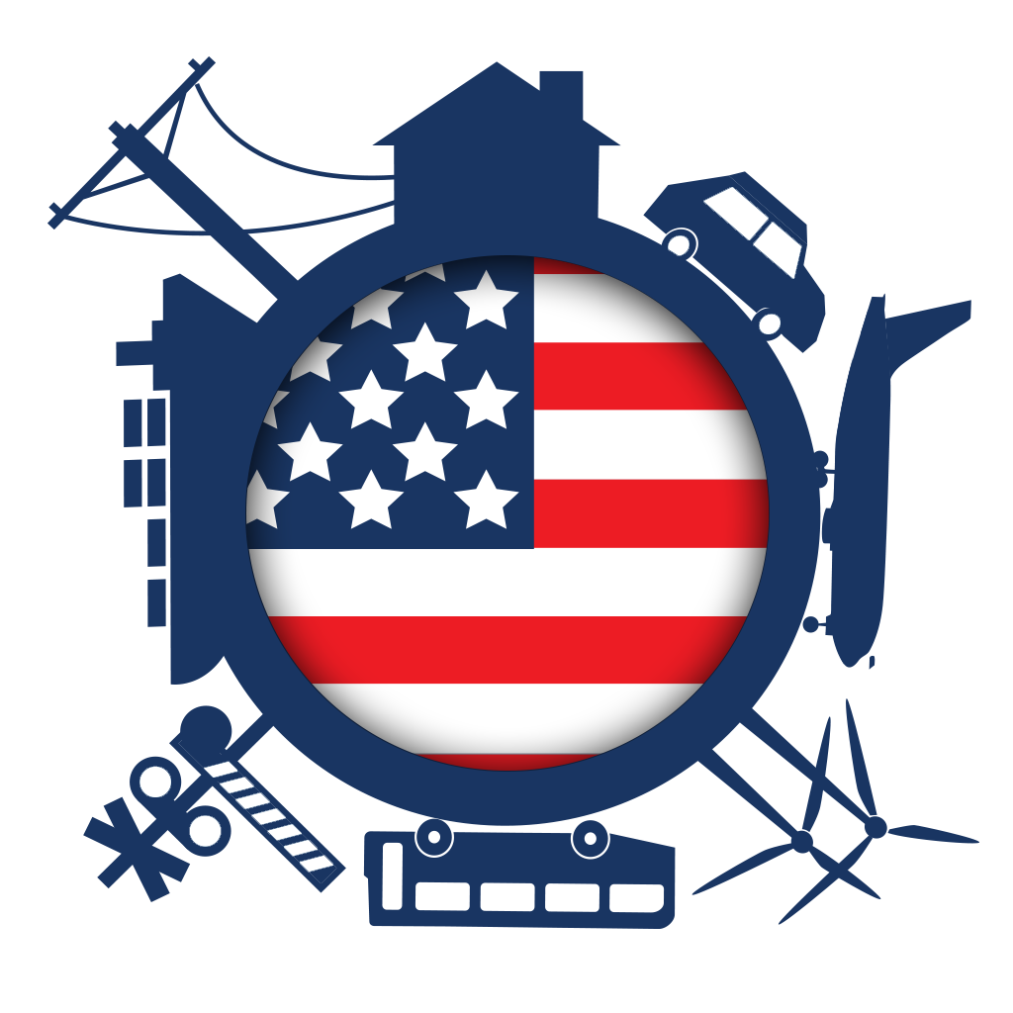
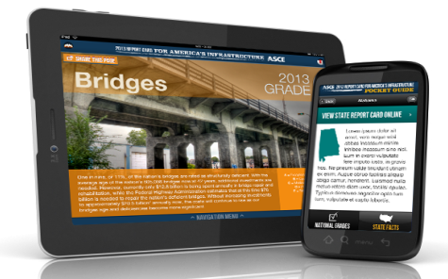
WWW.INFRASTRUCTUREREPORTCARD.ORG
Email us with questions at reportcard@asce.org
Products and images are for illustrative purposes only. ©2012 ASCE
Notes:
And of course, you can find all of this information and much more at www.infrastructurereportcard.org. We are happy to be a resource for you and have ASCE experts for any possible topic related to engineering.
Thanks and we’re happy to take your questions.

