Slide 1
Pension Reform Case Study - Providence, Rhode Island
Fiscal Leadership and the Modern City April 27, 2015
Angel Taveras| taverasa@gtlaw.com | 617-310-6096
37th Mayor of Providence, Rhode Island, 2011-2015

Slide 2
Providence in Peril – March 3, 2011 (2 months into Taveras Administration)
Municipal Finances Review Panel Report
FY2011 deficit - $70M (only 4 months remaining)
Projected FY2012 deficit - $110M
Impending cash flow crisis
  $11M-$16M shortfall in June 2012
  As much as $50M shortfall in July 2012

Slide 3
How Did the Deficit Happen?
Drastic cut in state aid to Providence.
Decrease in city revenues during recession.
Smaller increase in tax revenues because of economic downturn and housing crisis.
Significant percentage of property is tax-exempt.
One-time fixes.
Out of control pension costs due to inadequate funding in past years, guaranteed compounded annual raises (COLAs) for retirees and retirement at an early age.

Slide 4
How Did the Deficit Happen?
Sample of one-time fixes FY2008 - 2011
Class Green | $30M
Street Light Refinancing | $13.3M
PRA Sale of Properties | $12.4M
Transfer from Reserve for continuing appropriations | $6.3M
Transfer from Civic Center Reserve | $2.0M
Decrease in Fund Balance | $13.9M
Re-amortization of Pension Outstanding Liability | $9.0M
Decrease in Fund Balance | $5.0M
Transfer from Capital assets | $6.7M
Transfer from Reserve for continuing appropriations | $12.7M

Slide 5
How Did the Deficit Happen? Pension Trouble
Providence’s pension plan was severely underfunded
  Inadequate funding in prior years.
  Generous cost of living increases.
  Liberal disability pension provisions.
  Ability to collect benefits at an early age.
Annual required contributions were expected to increase dramatically
  By 2039 the annual payment projected at more than $210M (from $58.9M in 2012)

Slide 6
Shared Sacrifice Checklist
DONE
✓Cut Mayor’s pay by 10%
✓ Cut Mayor’s office budget by 10%
✓ Mayor refused elected official pension
✓ Reduced city workforce by over 200 employees
✓ Cut police and fire department budgets by 10%
✓ Closed 5 schools
✓ Close $28 million deficit in school department
✓ Savings through new labor contract with Local 1033 union employees
✓ Savings through new labor contract with firefighters
✓ Savings through new labor contract with teachers
✓ Savings through new labor contract with police
✓ Cut budgets in Finance, IT, Public Safety, Planning and Development, Public Works, Parks and Recreation, Inspections and Standards, Housing Court, Human Services, Board of Canvassers and Vital Statistics
✓ Increase parking rates at metered spaces
✓ Increase parking enforcement
✓ Increase dumpster fees and mattress disposal fees
✓ Increase residential and commercial property taxes
✓ Increase taxable assessment on cars
STILL TO DO AS OF 2012
Prepare for trial to move retirees to Medicare
Negotiate increased support from tax-exempts
Support legislation ensuring tax-exempts pay for critical city services (if negotiations fail)
Support enabling legislation to collect property tax on buildings used for purposes unrelated to tax-exempt’s educational or healthcare mission (if negotiations fail)
Suspend guaranteed annual raises (COLAs) for retirees
Address retiree health care costs

Slide 7
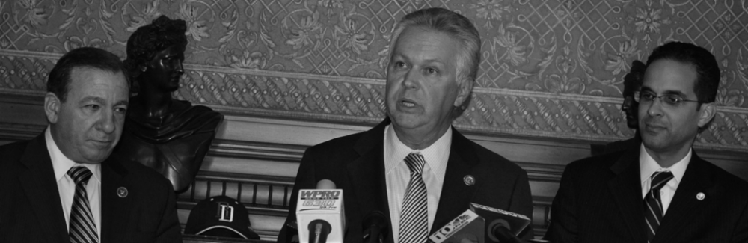
Get Others to Believe in Your Cause
“This is the Ocean State, and we are in this boat. We are not going to be passengers. We want to put our hands on the oars and row. We want to help.”
John Bowen, Chancellor
Johnson & Wales University

Slide 8
State of the City 2012
“We must address our unsustainable pensions and retiree health care costs once and for all. It is time to suspend guaranteed annual raises (COLAs) for all our retirees. This is not only a question of necessity, but one of fairness.”
Providence Mayor Angel Taveras
2012 State of the City Address
February 13, 2012

Slide 9
How Providence Got in Pension Trouble
Providence’s annual required contribution (ARC) before 1989 Retirement Board decision.
1989: Retirement Board approves 6% guaranteed compounded raises (COLAs) for retirees and reduced minimum years of service. Increased annual taxpayer obligation from $12M to $32M.
DID NOT MAKE
FULL ARC PAYMENTS
$12M
Providence’s ARC immediately after 1989 Retirement Board decision.
$32M
Providence’s current ARC.
Guaranteed annual raises (COLAs) make $16.5M of this year’s annual contribution.
Guaranteed Annual
Raises
$58.9M

Slide 10
Impact on Budget: Top 10 Retiree Pensions
Title/Time of Ret. | Annual Salary at Time of Retirement | Current Pension
Fire Chief | $70,496.40 | $196,813.08
Deputy Assistant Fire Chief | $58,163.88 | $162,944.04
Deputy Assistant Fire Chief | $57,732.40 | $161,487.24
Fire Equipment Supt II | $60,291.36 | $156,870.60
Deputy Assistant Fire Chief | $58,380.40 | $148,839.84
Assistant Fire Chief | $64,138.36 | $145,520.88
Fire Equipment Supt II | $53,912.36 | $137,336.04
Lieutenant | $44,262.40 | $135,702.72
Fire Battalion Chief | $51,921.36 | $135,092.28
Captain | $51,705.68 | $129,354.84
The top retiree collected more from Providence than any current City employee was paid.
The 25 highest paid retirees each collected at least $109,000 in retirement.

Slide 11
How Providence Got in Pension Trouble (cont.)
1991, Providence’s pension fund underfunded by $185.8 million and only 57% funded. 2012, Providence’s fund was only 32% funded and the unfunded liability was more than $900 million.
$900M
57%
32%
$185.8M
1991
2012
1991
2012
Percent of Pension Funded
Unfunded Pension Liability

Slide 12
Impact on Budget: Retirees
Immediate cost of retiree pensions
  $58.9 million: Pension annual required contribution (ARC)
    At time, current contracts pension cost (normal cost) = $9.5 million of $58.9 million
  $38 million: Annual cost of retiree medical plans
Long-term cost of retiree pensions
  $900 million: Long-term, unfunded liability of pension
  $1.2 billion: Long-term, unfunded liability of other post employment benefits (OPEB)

Slide 13
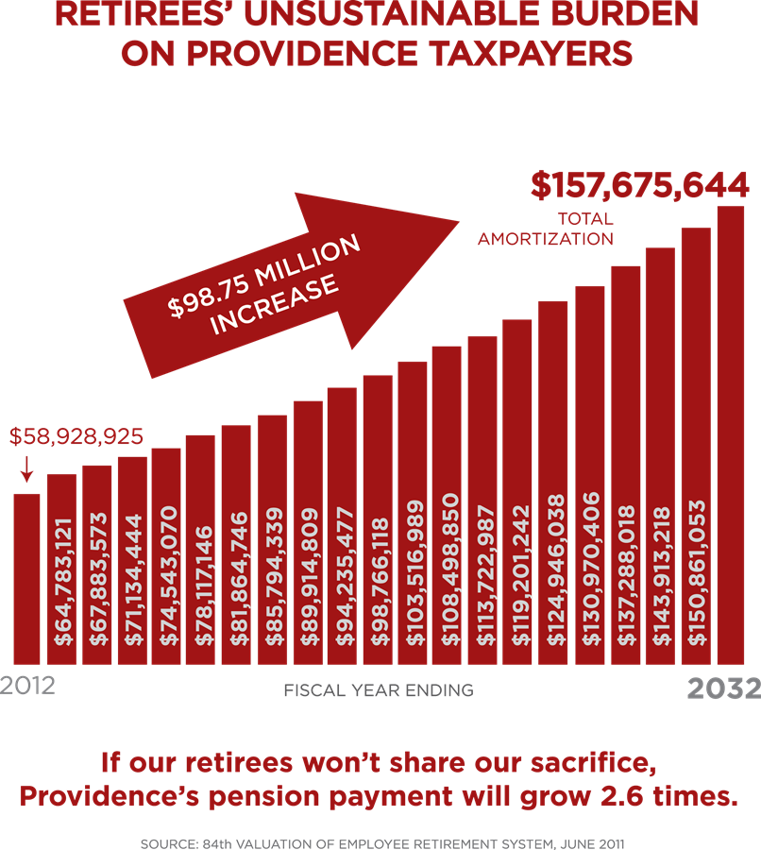
Impact on Budget: Retirees
Without reform, Providence’s annual pension payment would have increased nearly $100 million within 20 years.
Numbers were worse when we did experience study

Slide 14
Providence’s Pension Agreement
Elimination of high-end COLAs. All 5 and 6 percent compounded COLAs were permanently eliminated.
COLA Suspension. All COLAs suspended for 10 years.
  Families of city employees killed in the line of duty continue to receive annual COLA.
  After 10 years, COLAs will only be reinstated for retirees who are under the new pension cap, and COLAs will end when the cap is reached.
Future COLAs Limited. Retirees whose COLAs are reinstated in FY2023 will receive annual raises of 3% compounded or what is called for in their contract, whichever is less.

Slide 15
Providence’s Pension Agreement
Pensions Capped. In FY2023, COLAs will be reinstated only for retirees with pensions less than 150% the state median income OR less than the salary of an incumbent employee of the same rank as the retiree at the time of retirement (police and fire retirees only), whichever is lower.
Sustainable Reforms to Pension Calculations. Future pensions will be calculated based on the 4 highest years of service.
  The prior system calculated pensions based on the highest 3 years.
Continued Pension Contributions. Employees will be required to contribute to the pension system for as long as they earn credit toward a pension.

Slide 16
Providence’s Pension Agreement
One-time Stipend in FY2017. In FY2017 retirees collecting pensions of less than $100,000 will receive a stipend of $1,500.
  This one-time payment will not change their future pension calculations.
Contingent Stipend in FY2020. In FY2020 retirees collecting pensions of less than $100,000 may receive a separate one-time stipend of up to $1,500 if the city achieves savings through the creation of a self-insured dental plan.
  The potential payment would not change future pension calculations
Accidental Disability. Accidental disability pension calculations will be based on 66 2/3 of the employee’s final salary.

Slide 17
Impact of Reform
Reduced unfunded liability by $186 million
Reduced OPEB liability by approximately $180 million
Annually saved close to $18 million (between pension and healthcare changes)
FY2015 retiree healthcare costs reduced more than 25% from FY2013
FY2015 100% of the ARC payment into Providence pension system
The city-side spending increased less than 1% over 4 years (2011-2015; spent less than we did in FY2010)
Avoided bankruptcy (but still have critics)

