Slide 1

The State of Public Sector Retirement Systems
Boston University Initiative on Cities
City Fiscal Leadership
April 27, 2015
Speaker: Greg Mennis

Slide 2
The Pew Charitable Trusts
More than 40 active, evidence-based research projects and campaigns
Projects include public safety, immigration, elections, transportation, pensions, and state tax incentives
All follow a common approach: data-driven, inclusive, and transparent
Pew’s Public Sector Retirement Systems Project
Research since 2007 includes 50-state trends on public pensions and retiree benefits, including funding, investments, governance, and employee preferences
Technical assistance for states and cities since 2011

Slide 3
Overview
Pension Funding and Investments
Case Study: Pennsylvania
Trends in Reform
Principles for Fiscal Sustainability and Retirement Security

Slide 4
Pension Funding and Investments

Slide 5
The Growing Gap in State Pension Funds
Sources: State and pension plan CAFRs and pension plan actuarial valuations

Slide 6
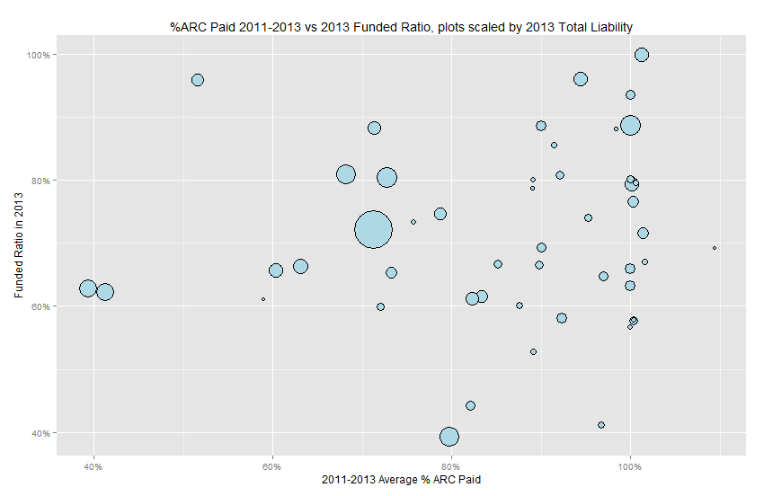
Fiscal Health and Discipline Across States
WI –
NC –
WA
– TN
– ME
INCREASING FISCAL HEALTH
CA
NJ
– WV
PA
50% -
KY
CT
IL
50%
95%
INCREASING FISCAL DISCIPLINE
Sources: State and pension plan CAFRs and pension plan actuarial valuations

Slide 7
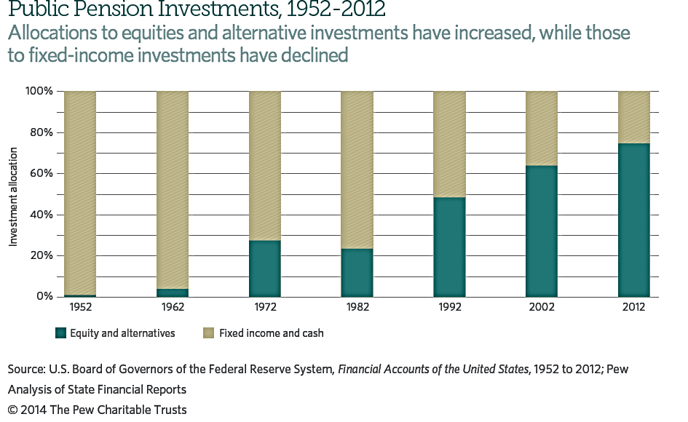
Investments – Key Trends: More in Stocks and Less in Bonds
23%:
Alternatives
50%:
Equities

Slide 8
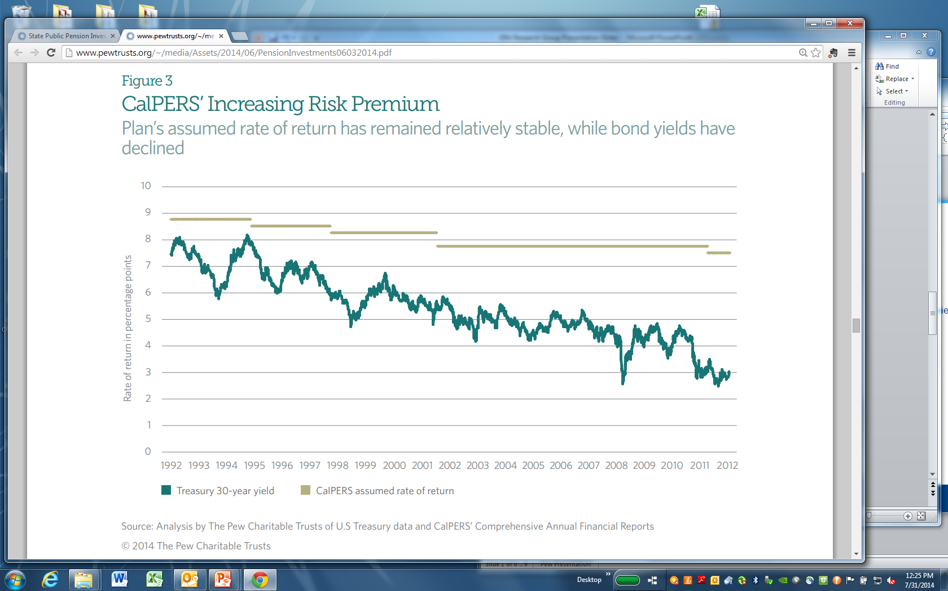
Investments – Key Trends
Increased Risk Premium

Slide 9
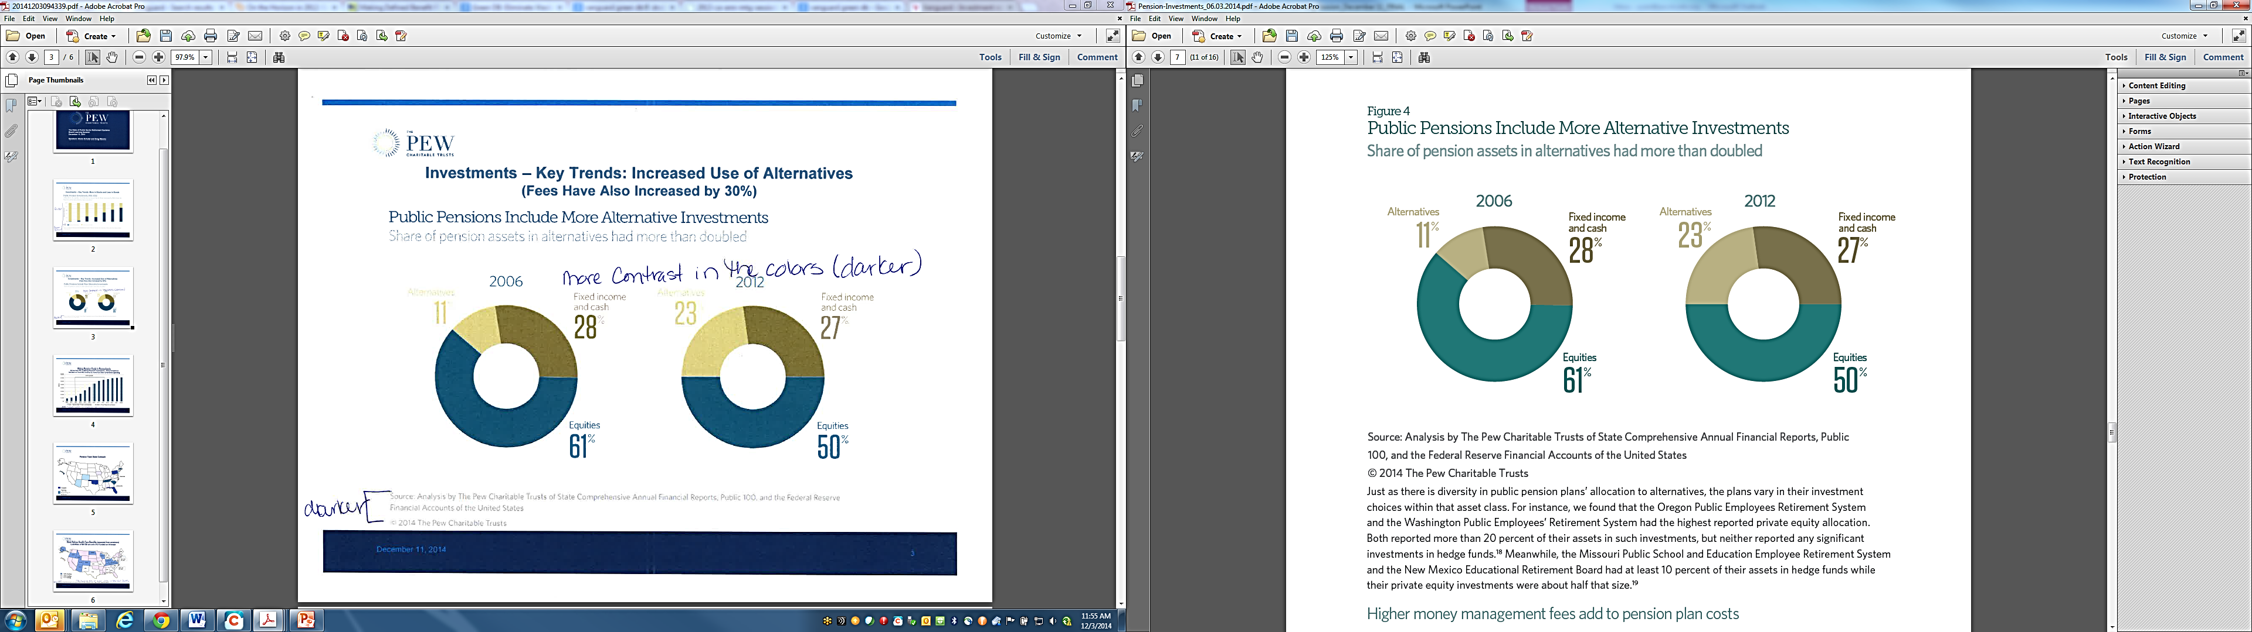
Investments – Key Trends: Increased Use of Alternatives
(Fees Have Also Increased by 30%)

Slide 10
Case Study: Pennsylvania

Slide 11
Pennsylvania Pensions: A $78B Swing in 13 Years – From $20B Surplus to $58B Debt
Sources: SERS and PSERS actuarial valuations and CAFRs. As of 1/26/15, the SERS 2014 AV is not yet available.

Slide 12
PA’s Pension System: From Surplus to Growing Funding Gap
Recognition of
“Tech Bubble” Losses
Recognition of Great Recession Losses
$50B Gap
Benefit Enhancements
for Current Employees
Benefit Reductions for New Employees (Act 120)
Sources: State and pension plan CAFRs and pension plan actuarial valuations

Slide 13
All Three Rating Agencies Downgraded Pennsylvania in 2014
“Pennsylvania faces fiscal pressures in the form of a structurally unbalanced budget, depleted reserves, and a rapidly growing pension cost burden following years of underfunding and market-driven investment declines. Continued inability to address these concerns, or worsening of any of these conditions, over the near term could trigger further negative rating action.” (Fitch)
 | Date | Prior Rating | New Rating
Moody’s | 7/24/14 | Aa2 | Aa3
Fitch | 9/23/14 | AA | AA-
S&P | 9/25/14 | AA | AA-

Slide 14
$5 billion increase

Slide 15
Current Considerations in Pennsylvania (multiple proposals are being evaluated)
Maintaining commitment to fully fund pension promises
  Benefit changes to new workers will not have a significant impact on current pension debt
Managing investment risk and investment fees
Evaluating benefit changes based on cost predictability and retirement security

Slide 16
Trends in Reform

Slide 17
Key Takeaways
There are no panaceas: Fiscal health and retirement security depend on funding policy and practices. Even well-funded states have taken steps to improve.
Increased attention to managing investment risk and fees: CalPERS, Dallas Police and Fire, Montgomery County Pennsylvania
No one-size-fits-all approach on benefit design
  DB plans with substantial employee risk-sharing (AZ, WI)
  Side-by-side hybrid with DB and DC components (GA, OR, RI, TN, UT, VA)
  Cash balance plans for new employees (KS, KY, NE)
  DC plans (AK, MI, OK)
  Recent / Current examples in cities: Atlanta, Jacksonville, Memphis
Successful reform efforts have been data-driven, transparent, and inclusive of stakeholder views

Slide 18
Pension Promises in Other States – No One Size Fits All
ME:
Constitutional amendment for full funding in 1997
Improved funding from 63% to 80% since 1997
WI:
99% funded DB plan
Full ARC payment made since 2003
COLA benefits adjusted based on funding
MI:
State employees are in a DC plan; teachers are in a hybrid
Unfunded liability for legacy DB plan has grown to over $30B
WA:
95% funded
Optional hybrid plan started in 1978
RI:
2011 reform transitioned workers to hybrid plan
Underfunded despite making ARC payments in recent years
Reform reduced pension debt by approximately $3 billion*
NE:
Switched from DC to cash balance plan in 2002
Change from DC was to improve worker retirement security
WV:
From 1997 through 2013 put in more than required contribution
Improved funding from 45% to 65% since 2000
UT:
Hybrid or DC option for new workers
Fixed employer contribution of 10%
NC:
Final average salary DB plan.
Funding dropped to 94% following Great Recession but now picking up
TN:
95% funded
Hybrid plan for new workers
Total employer contribution of 9%
Strong funding practices and cost control features on DB
KY:
State plan just 23% funded with a history of missed payments
2013 reform increased contributions
New workers in cash balance plan
Twenty-two states have implemented a hybrid, cash balance, or defined contribution plan for some workers. Fourteen states have implemented alternative designs that are mandatory for certain groups of workers, while eight states have plans that workers may choose as an option to the traditional defined benefit plan.
*Aspects of the Rhode Island reform are being litigated..

Slide 19
Retirement Security Principles
No one-size-fits-all solution, but key principles can guide any reform process
Fiscal sustainability principles
  Commit to fully funding and paying for pension promises.
  Manage investment risk and cost uncertainty.
  Follow sound investment governance and reporting practices
Retirement security principles
  Target sufficient contributions and savings to help put employees on a path to a secure retirement.
  Invest assets in professionally managed, pooled investments with low fees and appropriate asset allocations.
  Provide access to annuitization (lifetime income) in retirement.

Slide 20
Questions?

Slide 21
Appendix

Slide 22
Pennsylvania’s Contribution Shortfalls
Since 2003, PA has made only 40% of its annual required contributions (ARC)
PA ranks 49th in ARC payments in recent years
US Average (excluding PA and NJ) = 87%
Sources: State and pension plan CAFRs and pension plan actuarial valuations (SERS and PSERS)
Note: As of 1/26/15, the SERS 2014 AV is not yet available. According to PSERS’ 2014 AV, the 2014 PSERS ARC was $3.41B, of which $1.99B was actually contributed (58%).

Slide 23
Plan Type Definitions
Defined Benefit Plan (DB): traditional pension plan with a fixed retirement income benefit based on age, years of services, and worker’s salary
Defined Contribution Plan (DC): 401(k)-style plans with retirement benefits based on accumulated employer and employee contributions, and returns on those investments
Hybrid Plan: combines elements of DB and DC plans
  Stacked Hybrid: DB plan is the primary benefit up to specified income level, then DC covers additional higher income for employees above the threshold
  Side-by-Side Hybrid: All employees get both smaller DB and a DC benefit that each apply to their entire salary
Cash Balance Plan (CB): portable, pooled, professionally-managed pension plan with a guaranteed minimum annual investment return

Slide 24
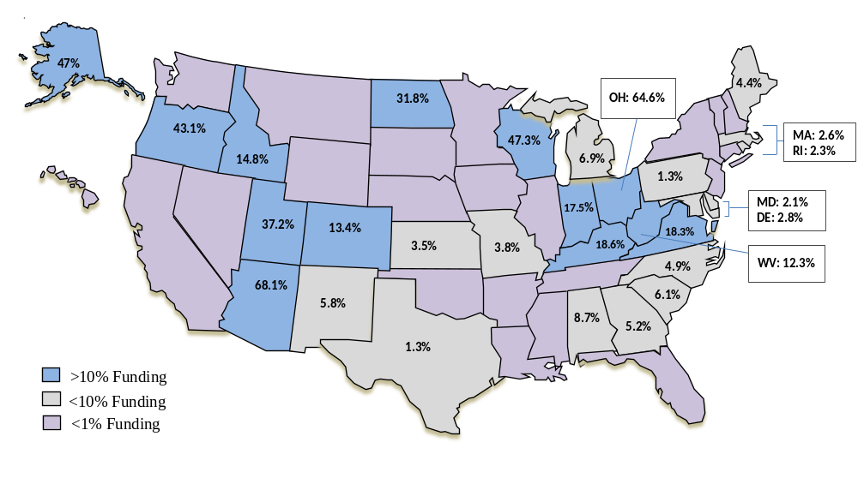
State Retiree Health Care Benefits (separate from pensions)
Liabilities of $613B are only 5% Funded on Average
Sources: Annual financial reports and actuarial valuations for state OPEB plans; Pew’s Fiscal 50: State Trends and Analysis.
December 11, 2014

