Slide 1
The Fiscal Health of the American City
Fiscal Leadership and the Modern City
Initiative on Cities, Boston University, April 27, 2013
Andrew Reschovsky
Fellow, Lincoln Institute of Land Policy and
Professor Emeritus, University of Wisconsin-Madison
reschovsky@lafollette.wisc.edu
Notes:
1

Slide 2
What Do We Mean by Fiscal Health?
Much of the recent discussion of fiscal health has focused on the risk of insolvency and bankruptcy
Bankruptcy is and will remain a rare phenomena
Most cities are at little risk of insolvency, but many may be in very weak fiscal health

Slide 3
Structural Fiscal Health
The quality of life of city residents flows from the goods and services provided by local governments
Cities are in good fiscal health if government revenues are sufficient to allow them to meet their public service responsibilities at reasonable rates of taxation
Assessing fiscal conditions of cities requires that we focus on spending on behalf of city residents and businesses and the public services they receive

Slide 4
Factors Contributing to Weak Fiscal Health
Weak economic base
  Loss of jobs and population
  Declining housing prices
  Deteriorating physical infrastructure
Limited financial assistance from the state and federal government
High expenditure needs
  A broad list of public services responsibilities
  Concentration of poor residents and/or “dependent” residents
    In Detroit, 59% of population is either under 18, over 65, or disabled
  Historical or physical factors that drive up the costs of delivering core public services

Slide 5
Fiscal Health in Large Central Cities
5
Comparing central cities is complicated because of the wide variation across the country in government structure
  Municipal governments have different public service responsibilities

Slide 6
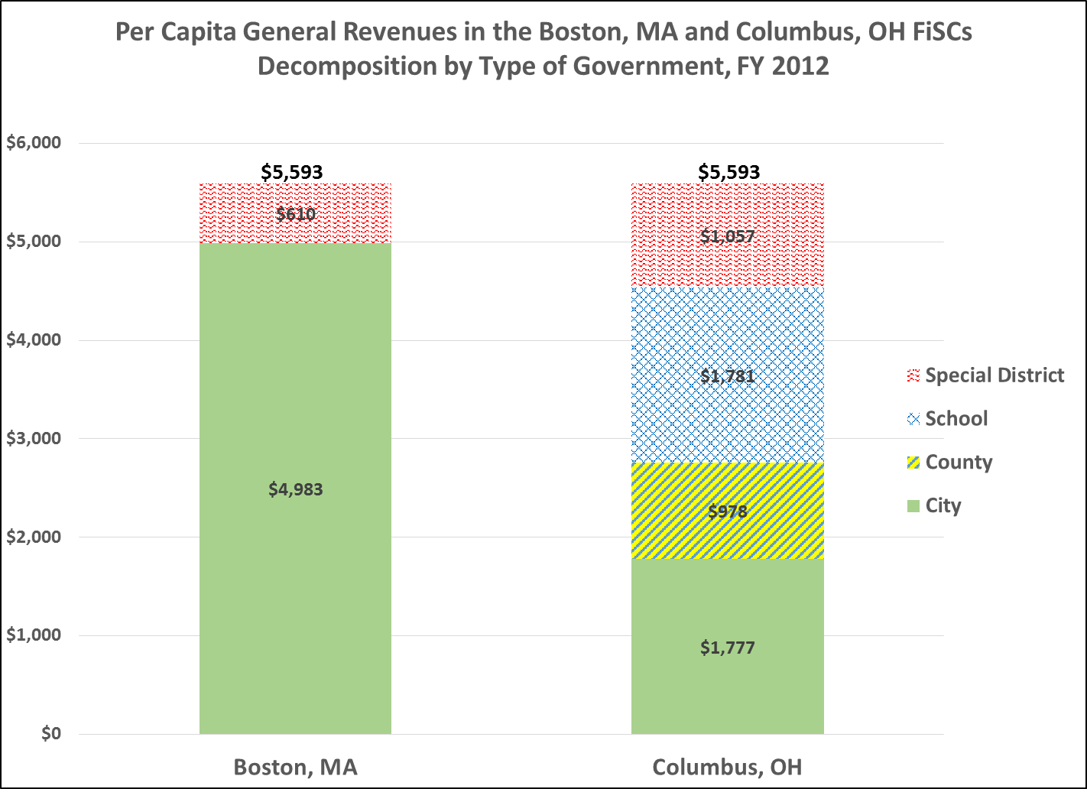

Slide 7
Fiscally Standardized Cities (FiSCs)
We construct FiSCs by combining Census data on revenue and expenditures of city (municipal) governments with an appropriate share from overlying county governments, school districts, and special districts
  Allocations to FiSCs based on share of population and students within central city boundaries
FiSC dataset includes 112 large central cities with data from 1977 through 2012
Public access to data at:
http://www.lincolninst.edu/subcenters/fiscally-standardized-cities/

Slide 8
The “Great Recession” and the
Fiscal Condition of Cities

Slide 13
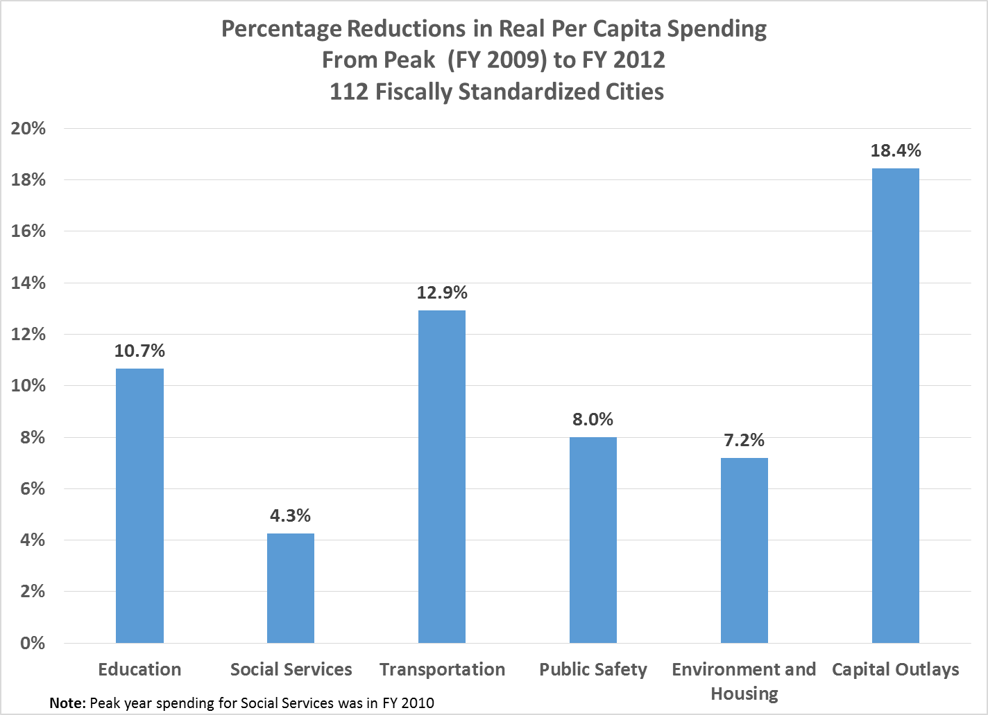

Slide 14
Fiscal Prospects for Cities
Will Revenues be Sufficient to Meet Cities’
Public Service Responsibilities?

Slide 15
Locally-Raised Revenues
Taxes, User Charges and Fees
Growth in locally-raised revenues depends on
  the strength of the local economy
  the mix of taxes used
  a well-functioning property tax system
  the creative use of fees and charges
  the presence of state-imposed property tax levy limits or other tax limitations
    e.g. new levy limits with super-majority override provisions in NY
    e.g. continuation of levy freezes in Wisconsin

Slide 16
The Influence of State and Federal Policies
on the Fiscal Prospects of Cities

Slide 17
Intergovernmental Assistance
The Future of State Aid to Cities
% cuts in state aid to FiSCs during and after recession were proportional to % cuts in state tax revenues, but
  Some states chose larger cuts, e.g. Rhode Island, Nevada
Prospects for growth in state aid to cities
  At end of FY 2015, real state tax revenues will still be below pre-recession peak (NASBO)
  State tax policies are slowing state revenue growth in a number of states
    Income tax cuts enacted or proposed in Kansas, Wisconsin, Ohio, Louisiana, Maine, Arkansas
    With growing use of internet and more spending on services, sales tax growth is sluggish

Slide 19
What Policies Can City Leaders Pursue?
Increase locally-raised revenues
Adopt cost-cutting and service-enhancing policies
  Even small policy changes make a difference

Slide 20
What Policies Can City Leaders Pursue?
Push for metropolitan area/regional cooperation
  Try to convince suburbanites that a strong central city will spur regional growth
  Exploit scale economies and sell services to smaller communities
Exploit low interest rates to invest now in maintaining and improving cities’ capital infrastructure
  Failure to invest will sacrifice the future well-being of city residents and reduce prospects for economic growth

