Slide 1
City Fiscal
Structures and Conditions
Christiana McFarland, NLC Research Director
April 2015

Slide 2
Cities-State Fiscal Structure
Municipal Taxing Authority
Own-Source Revenue Reliance
State Aid
Tax and Expenditure Limits

Slide 3
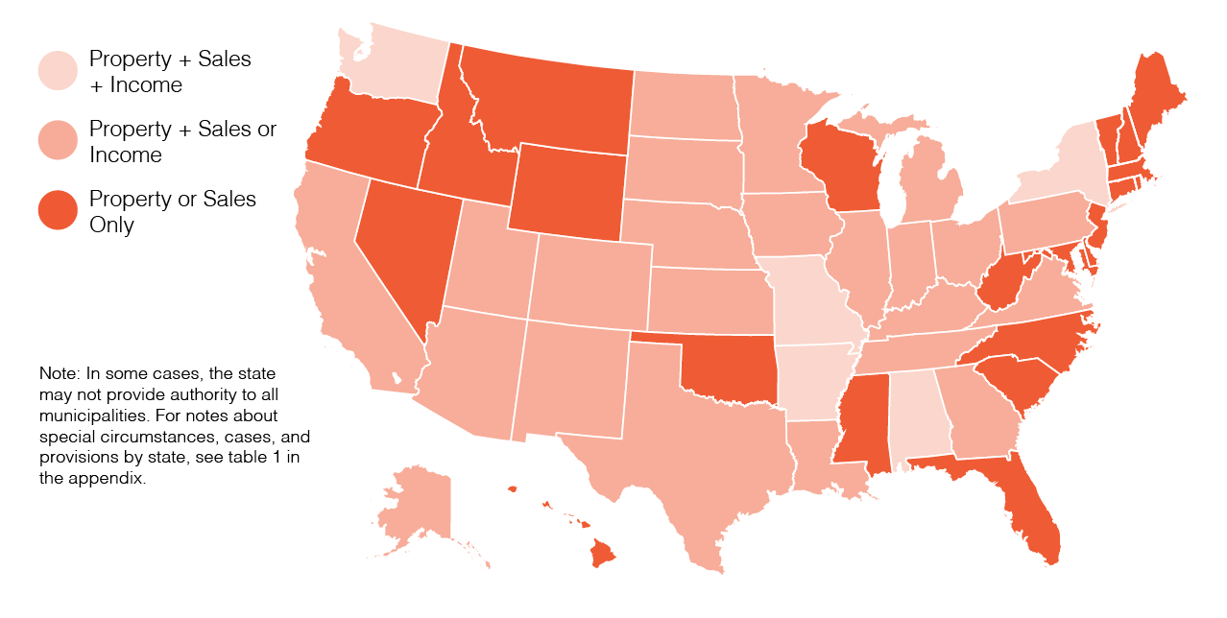
Municipal Taxing Authority
Cities and State Fiscal Structure 2015, National League of Cities

Slide 4
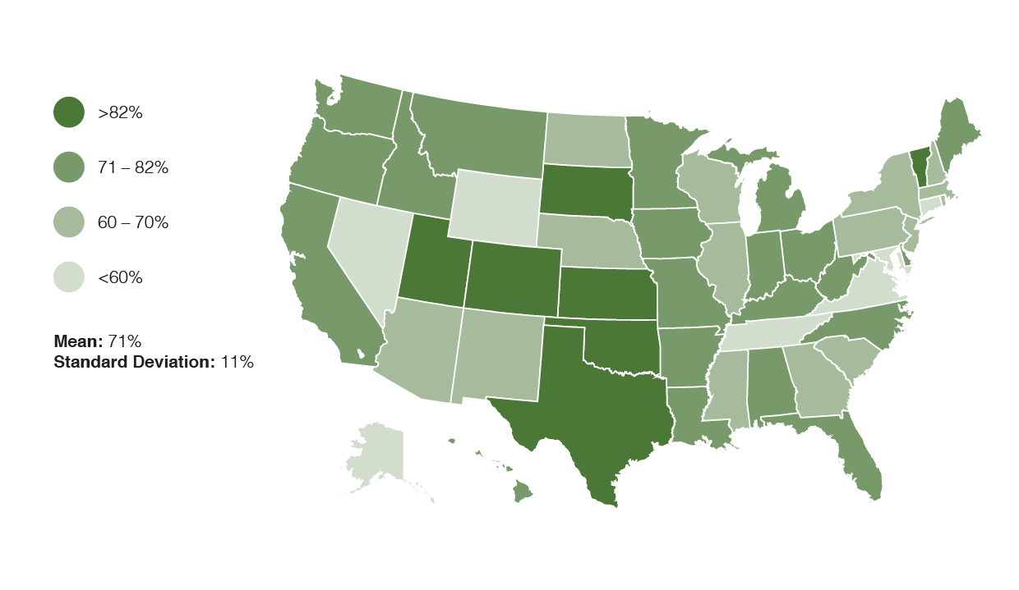
Own-Source Revenue Reliance
Cities and State Fiscal Structure 2015, National League of Cities

Slide 5
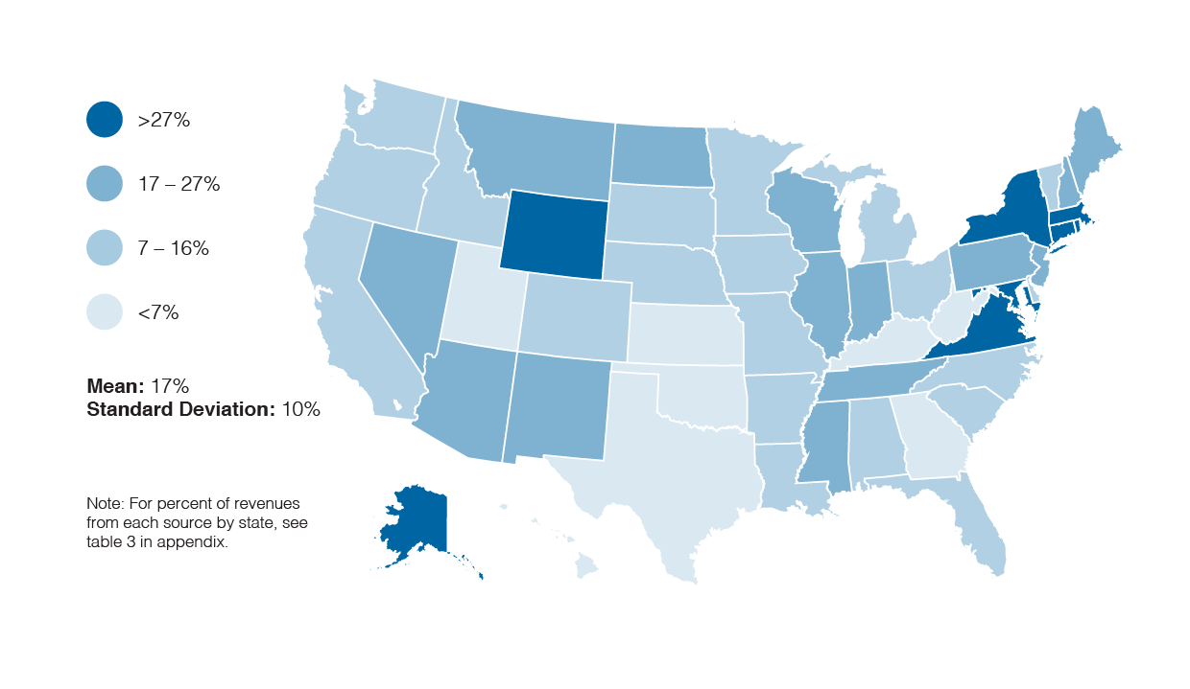
State Aid
Cities and State Fiscal Structure 2015, National League of Cities

Slide 6
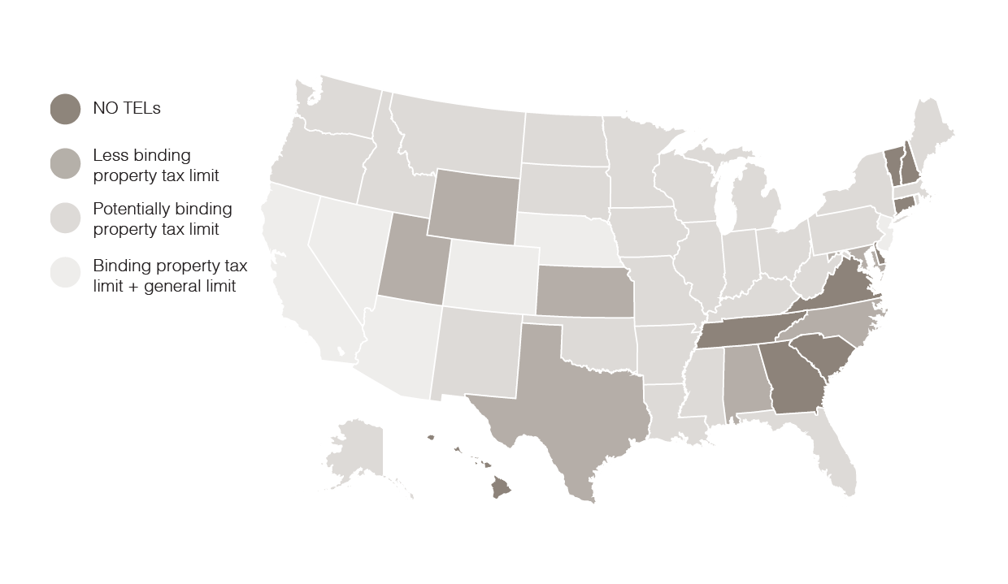
Tax and Expenditure Limits
Cities and State Fiscal Structure 2015, National League of Cities

Slide 7
City Fiscal Conditions Survey
THE HEALTH OF OUR NATION RESTS ON THE HEALTH OF OUR CITIES
A UNIQUE WINDOW INTO ECONOMIC RECOVERY
ONLY SOURCE OF ANNUAL FISCAL DATA FOR MUNICIPAL SECTOR

Slide 8
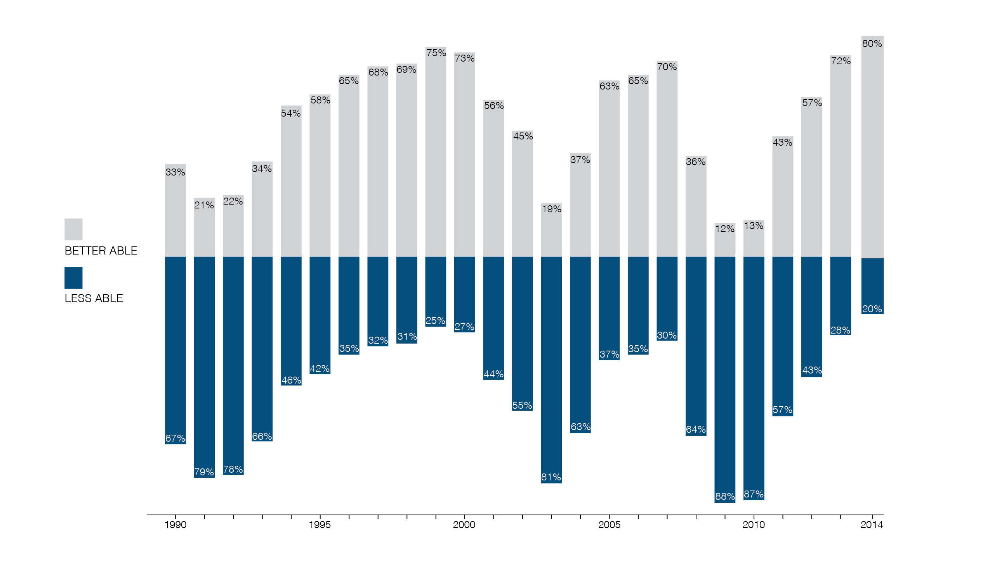

Outlook: Percent of cities “better able/less able” to meet financial needs

Slide 9
Recovery of General Fund Revenues
2006=100
2007=99.78
2008=98.60
2009=95.86
2010=91.36
2011=89.57
2012=88.07
2013=90.87
2014=90.40

Slide 10
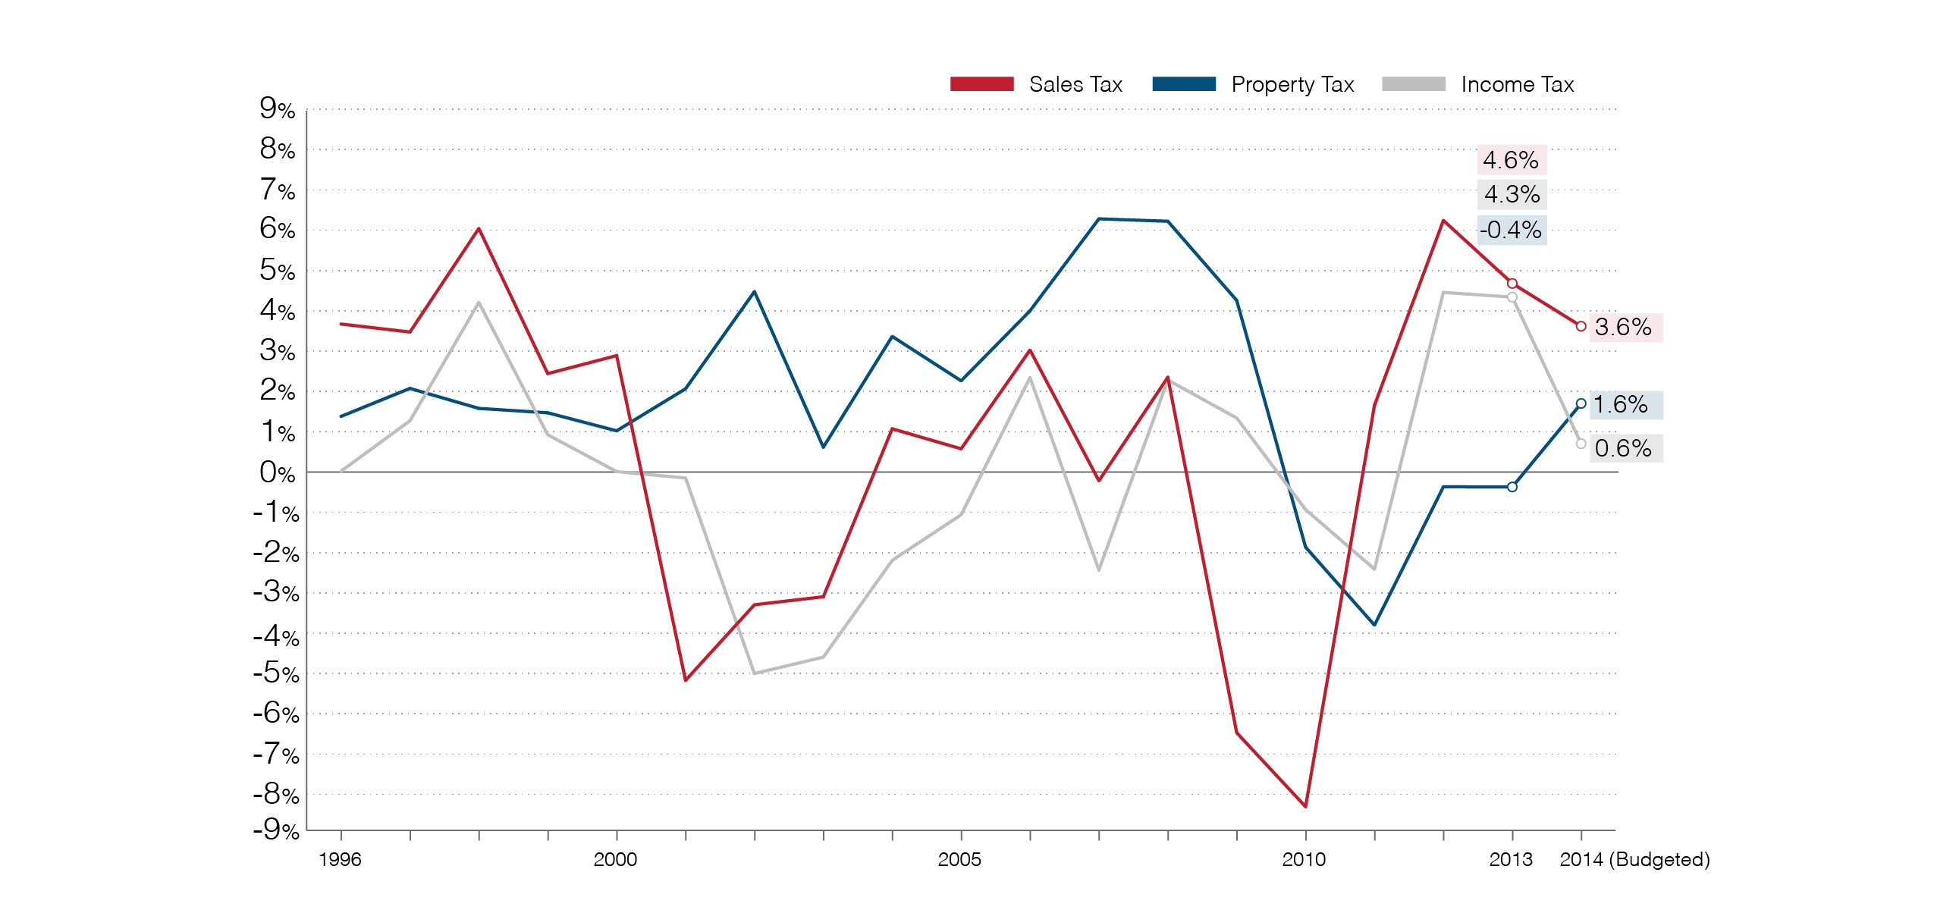
Year-to-year change in general fund tax receipts (constant dollars)

Slide 11
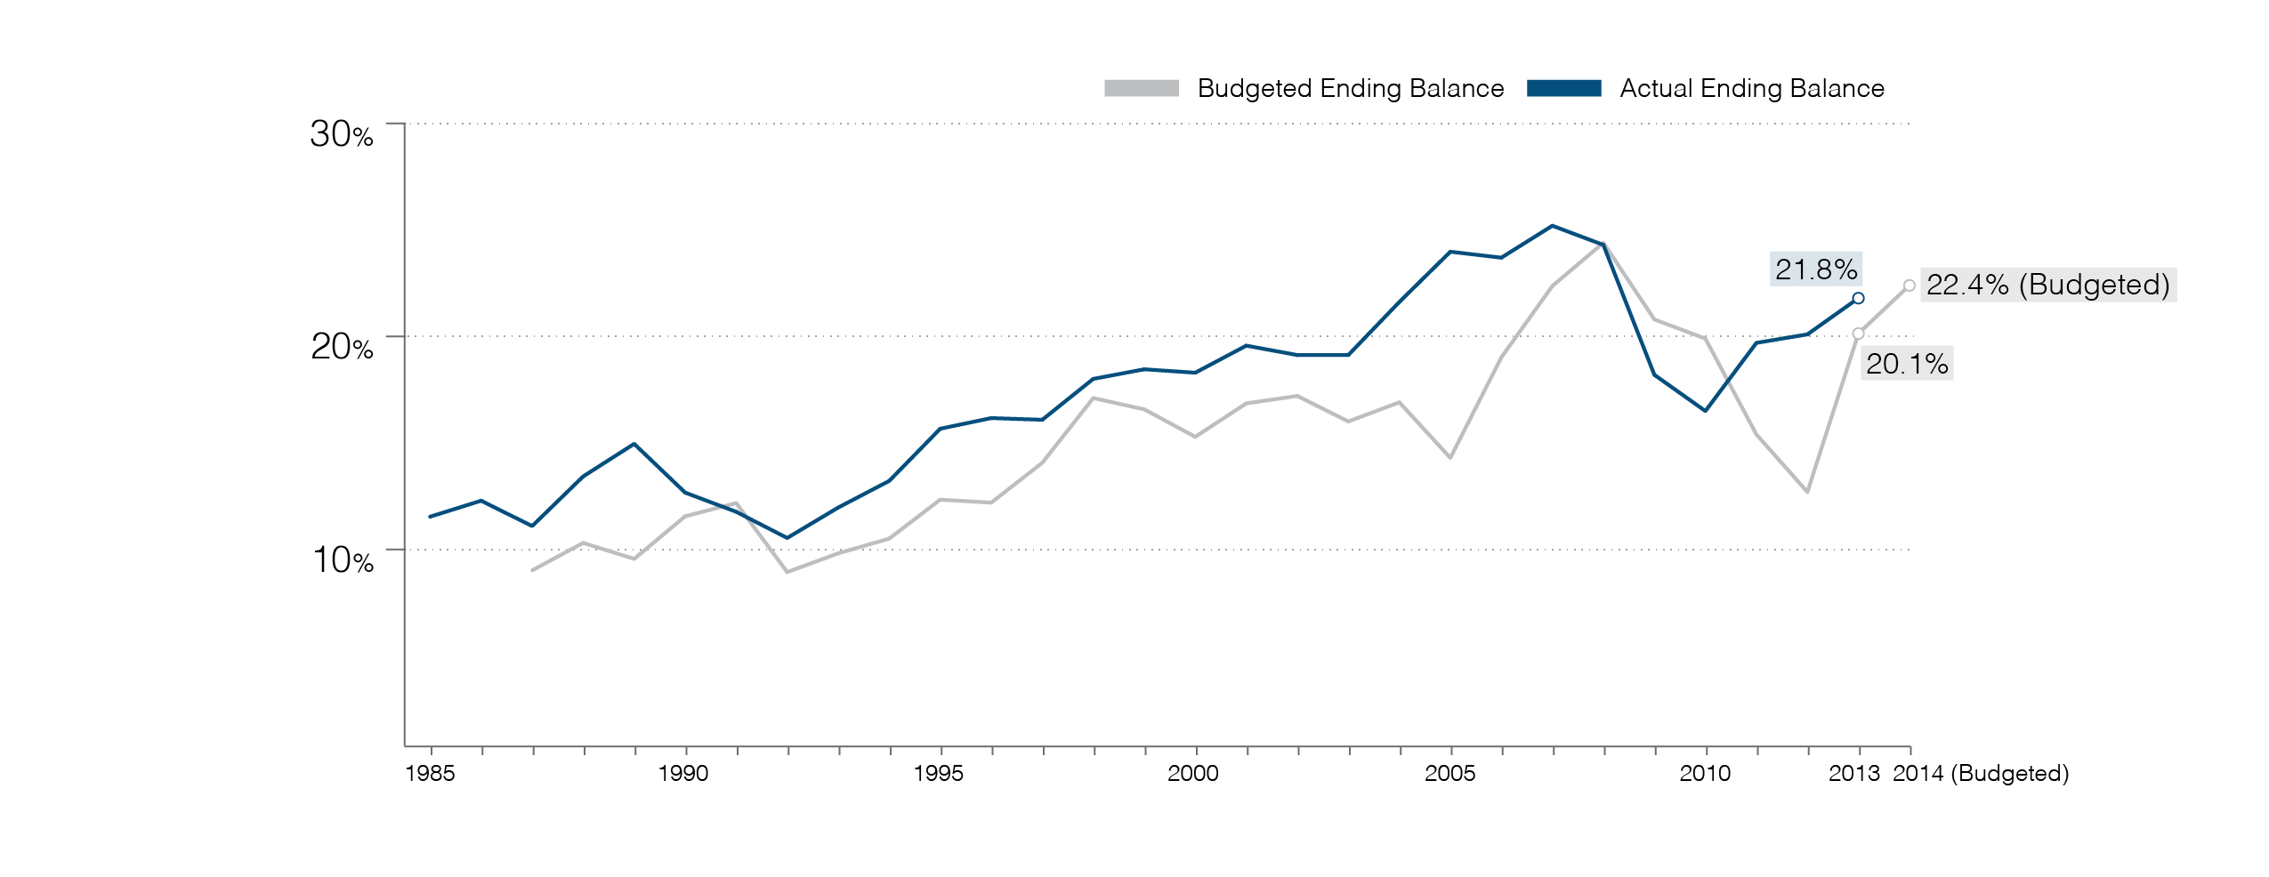
Ending balance as a percentage of expenditures (general fund)

Slide 12
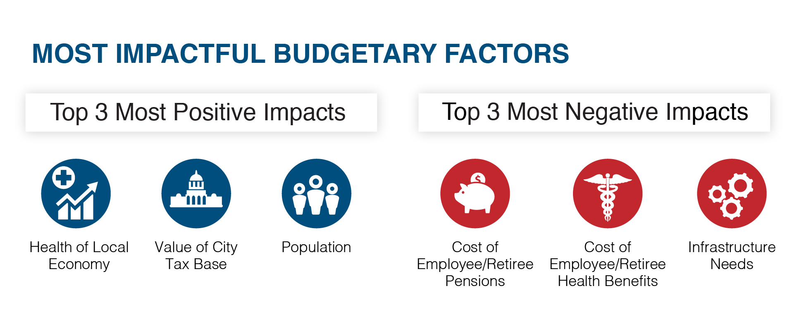
Factors with most positive and negative impacts

Slide 13
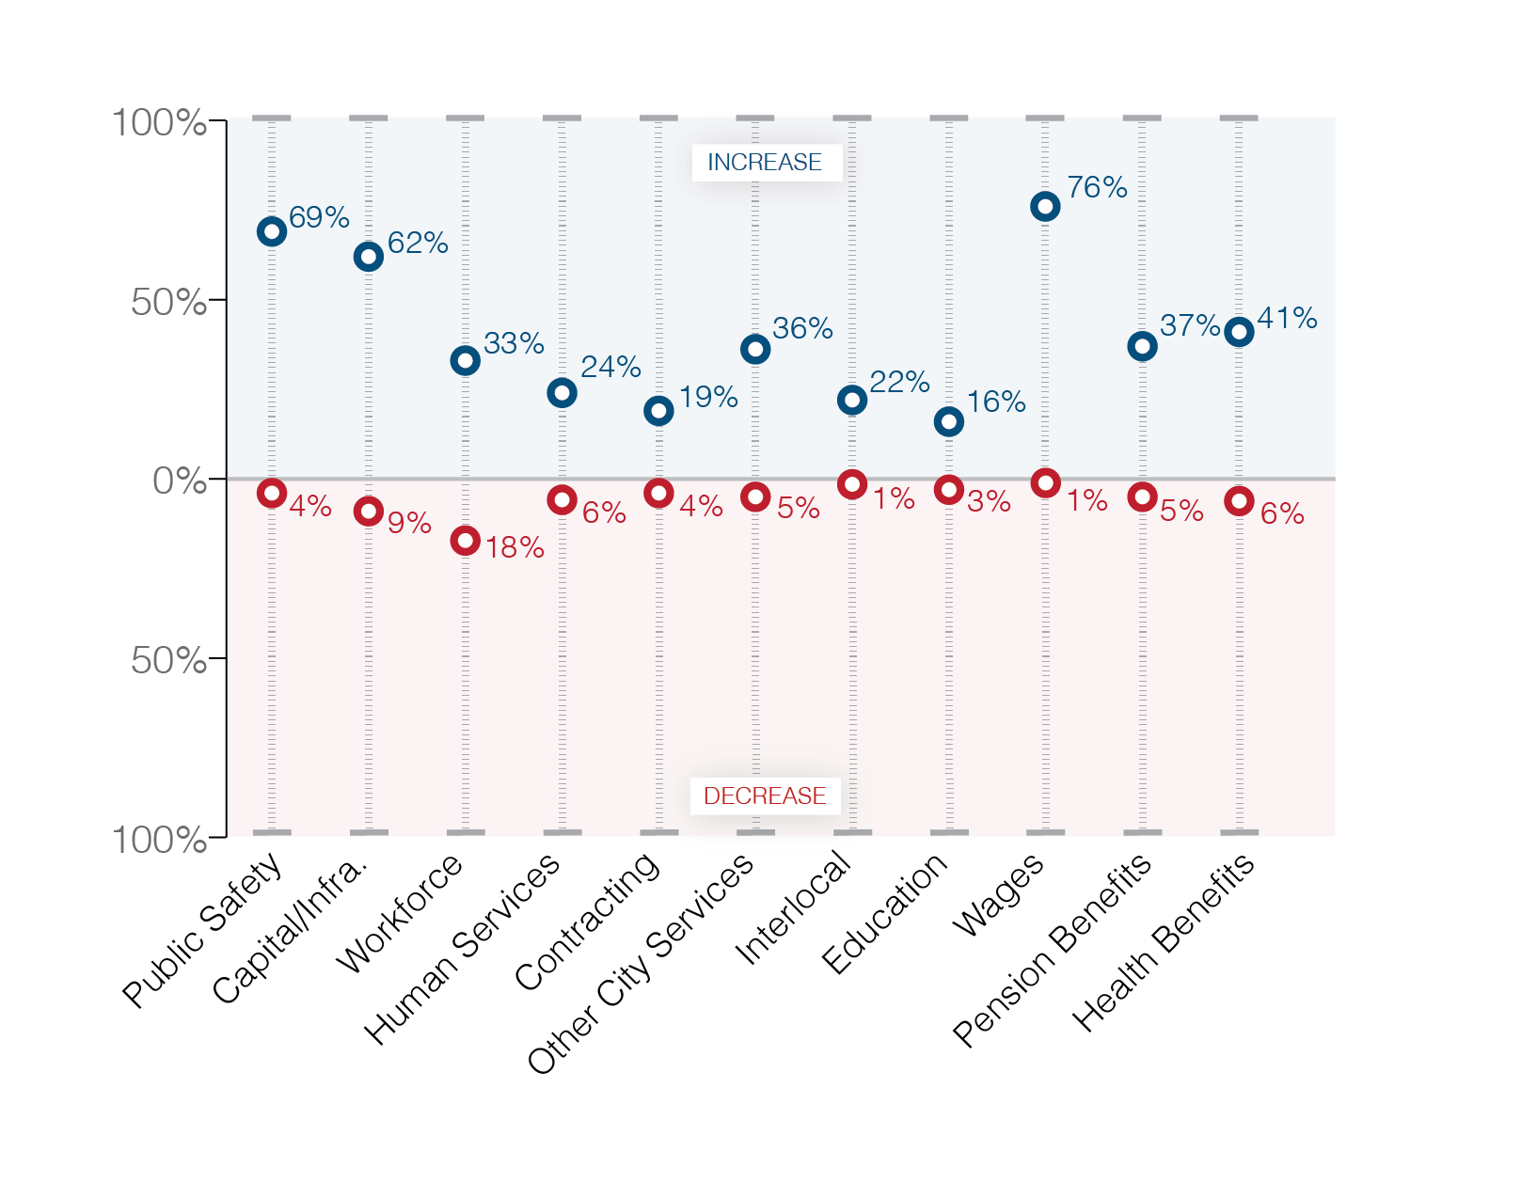
City Expenditure Actions

Slide 14
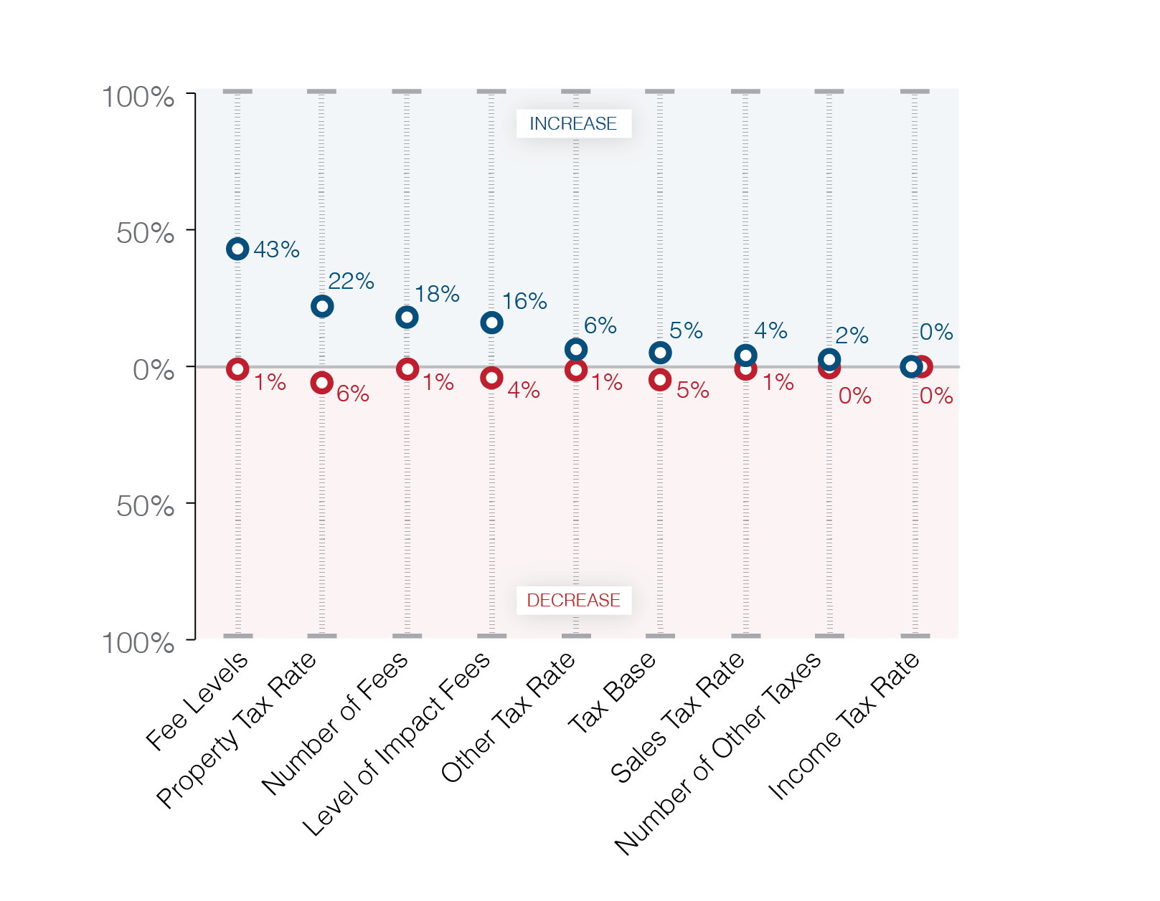
City Revenue Actions

Slide 15



Stay Connected
CitiesSpeak.org
@LeagueofCities @ckmcfarland
National League of Cities
Christiana McFarland mcfarland@nlc.org

