Slide 1
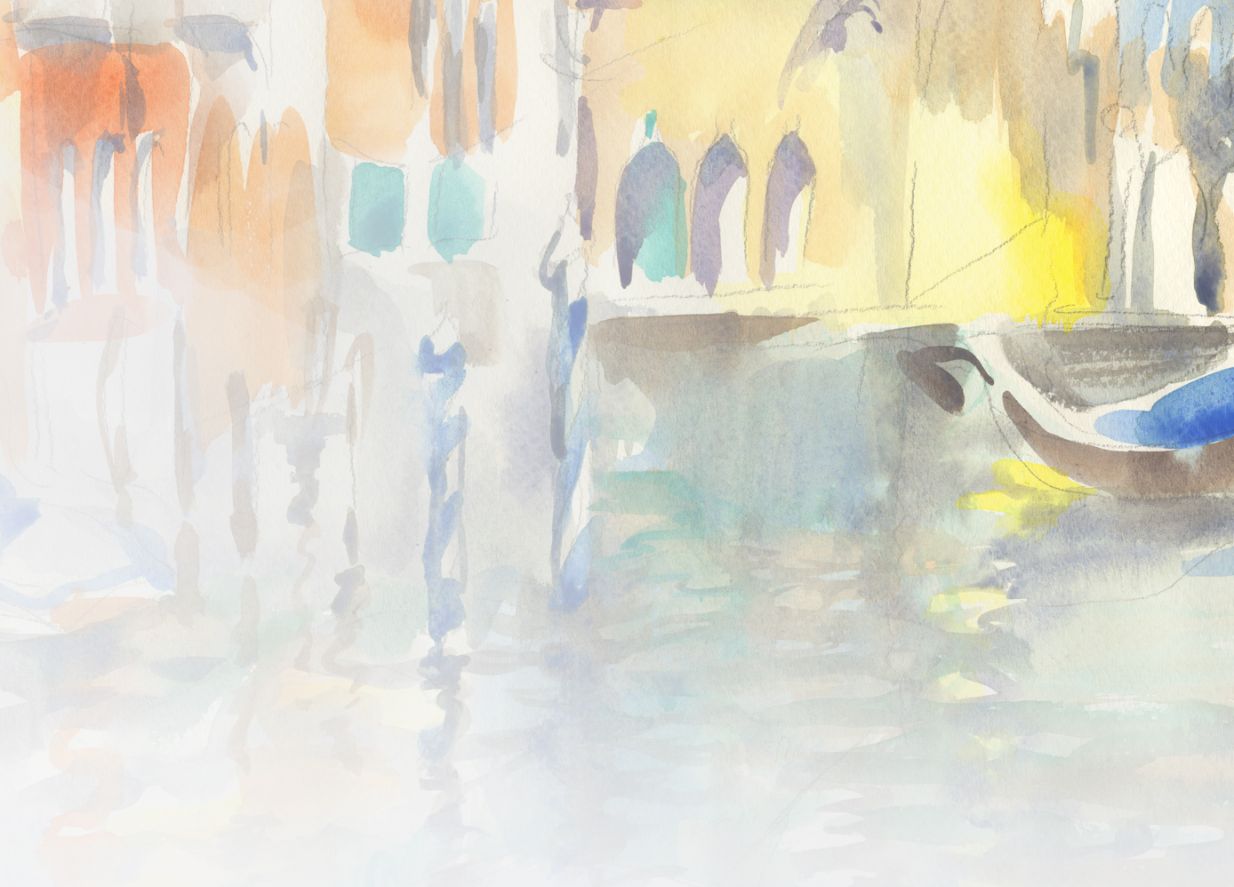
Maria Rosina Jaakkola
Landscape architect
Visual artist
Head of Environmental Office,
Helsinki City Planning Department
Finland
Notes:
Nice to meet you everyone, this is me, We are talking about water today - This is a city that will have problems with water in the future, but this is also to show a way that I enjoy water – I make watercolors and this is one of them of the city fo Venice in Italy...

Slide 2
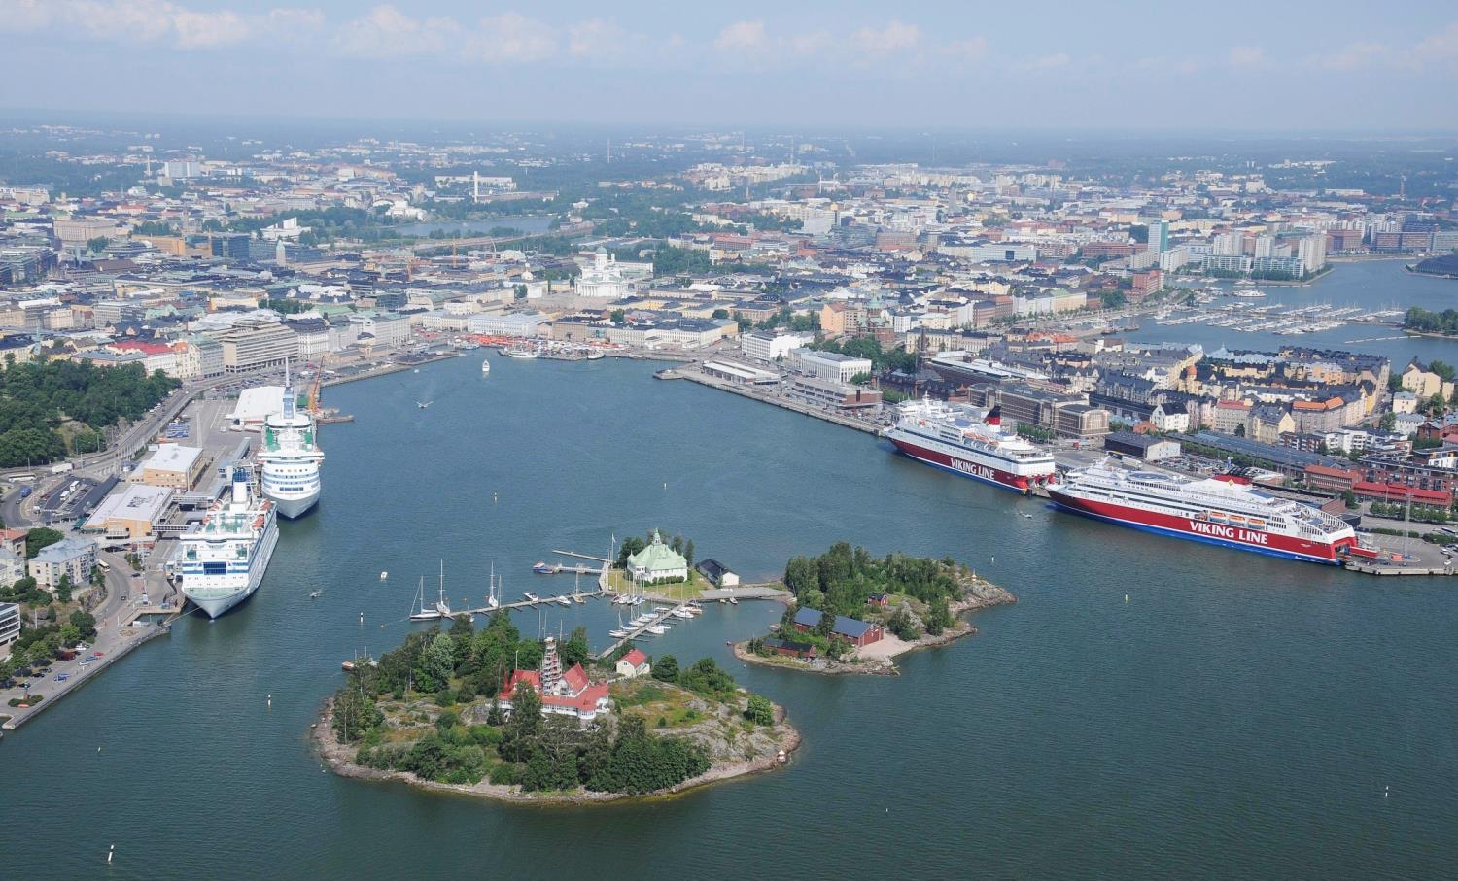
HELSINKI
- PLANNING THE GREEN AND BLUE CITY
Notes:
But the city that I am supposed to be tlaking about is this - For the past 12 years I have worked for the city of Helsinki....

Slide 3
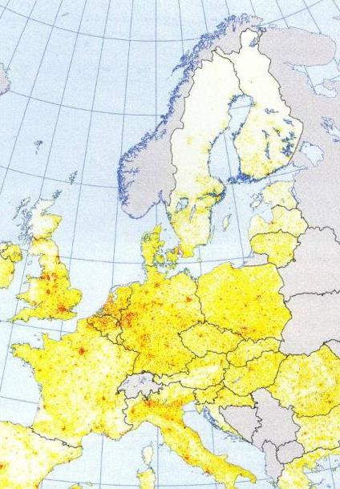
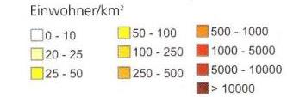
Finland
5,45 million people
17 people per sq. km (x2,56 = 44 per sq.mi)
72% forest (in EU average 37%)
Helsinki
616 042 inhabitants (capital region 1,4)
2882 people per sq. km (7377 per sq.mi)
green areas 40% of aerial:
  115 sq.m per capita (x11,1 = 1276 sq.ft)
  63% urban forest
water 2/3 of aerial (seascape)
population growth 0,6% (region 1,1%, EU 0,5%)
Notes:
The greater Context... By the Baltic, brackish water, like a bath tub!

Slide 4
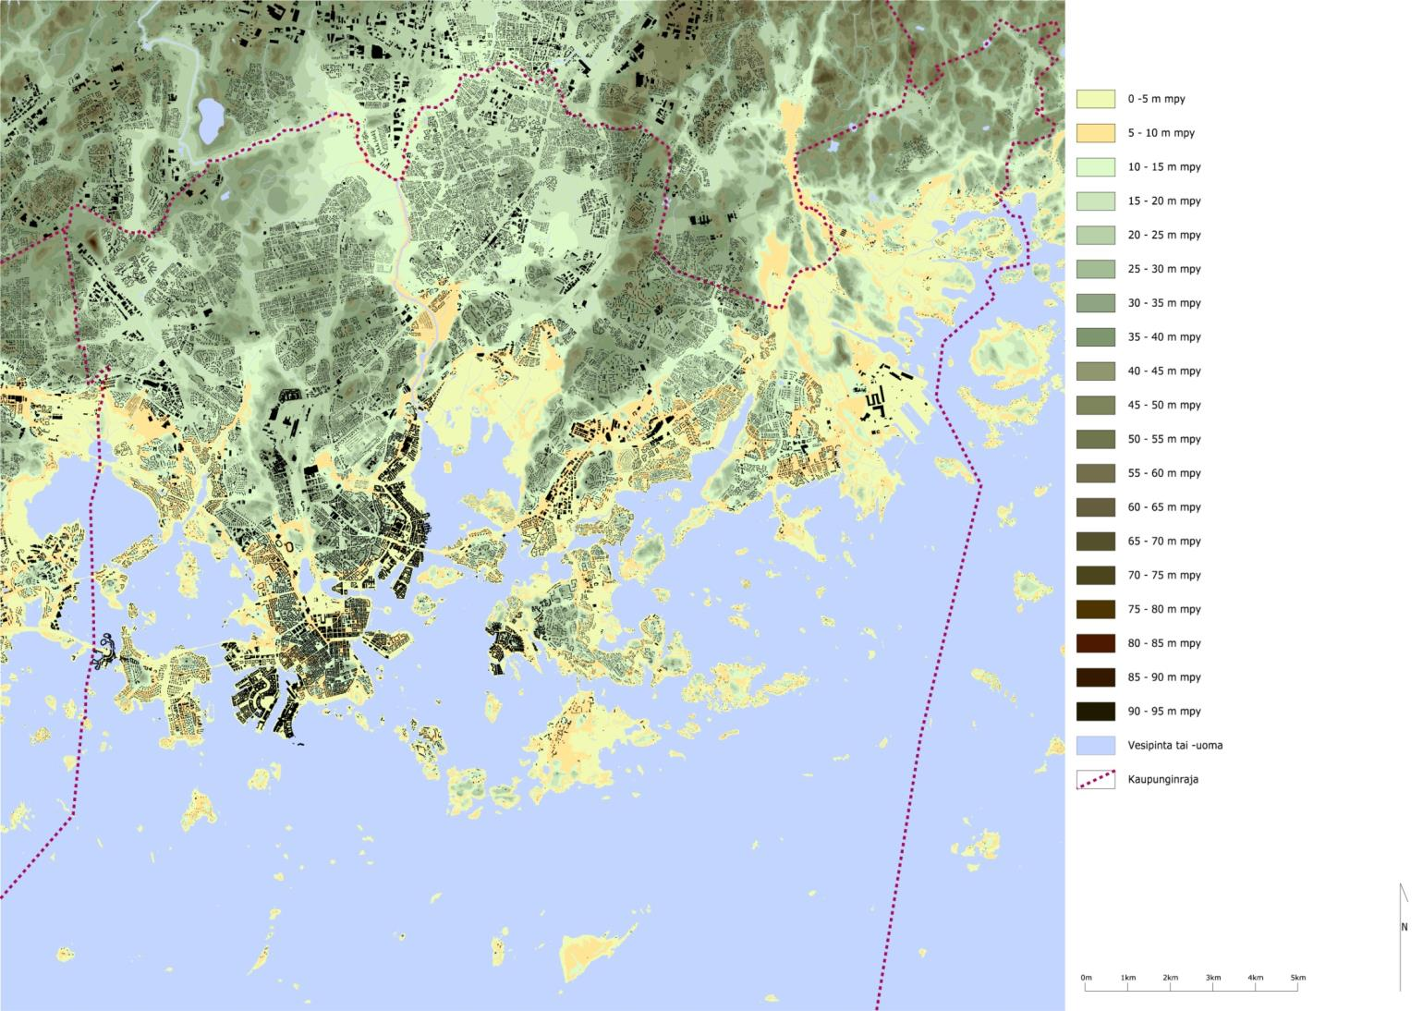
Notes:
The landscape context, the landforms created by geomorphology are the shoulders that carry the stratifyiing layers of nature and culture... and the people whose tendency seems to seek the proximity of the sea... That’s where the densest city structure is...

Slide 5
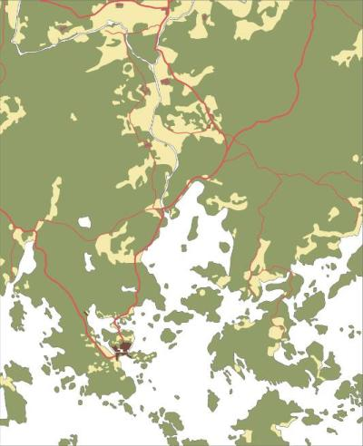
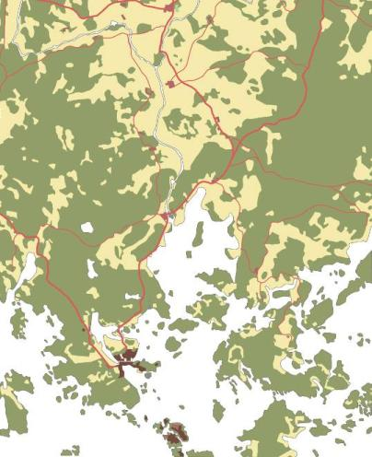
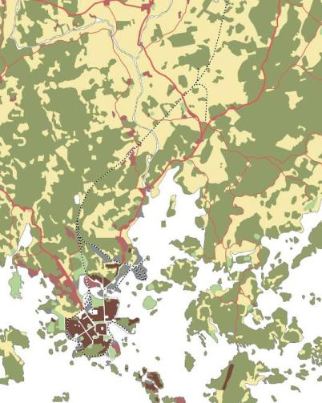
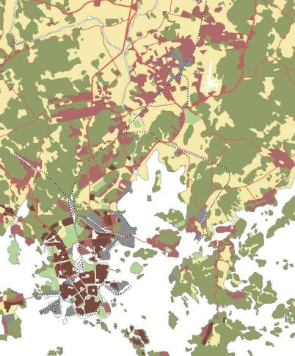
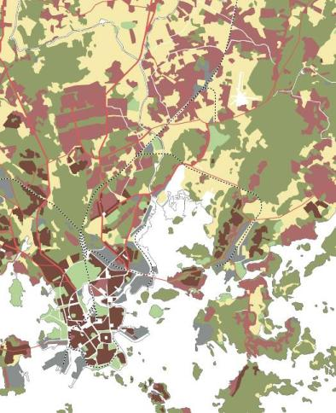
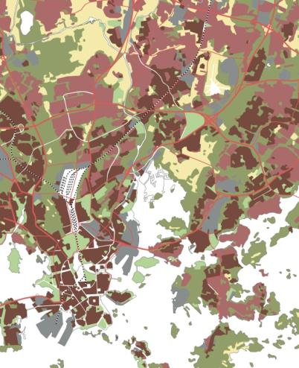

year 1700
year 1800
year 1900
year 1940
year 1960
year 2009
Notes:
As we can see, the olderst city structure and most of the cultural heritage is situated by the sea as well…

Slide 6
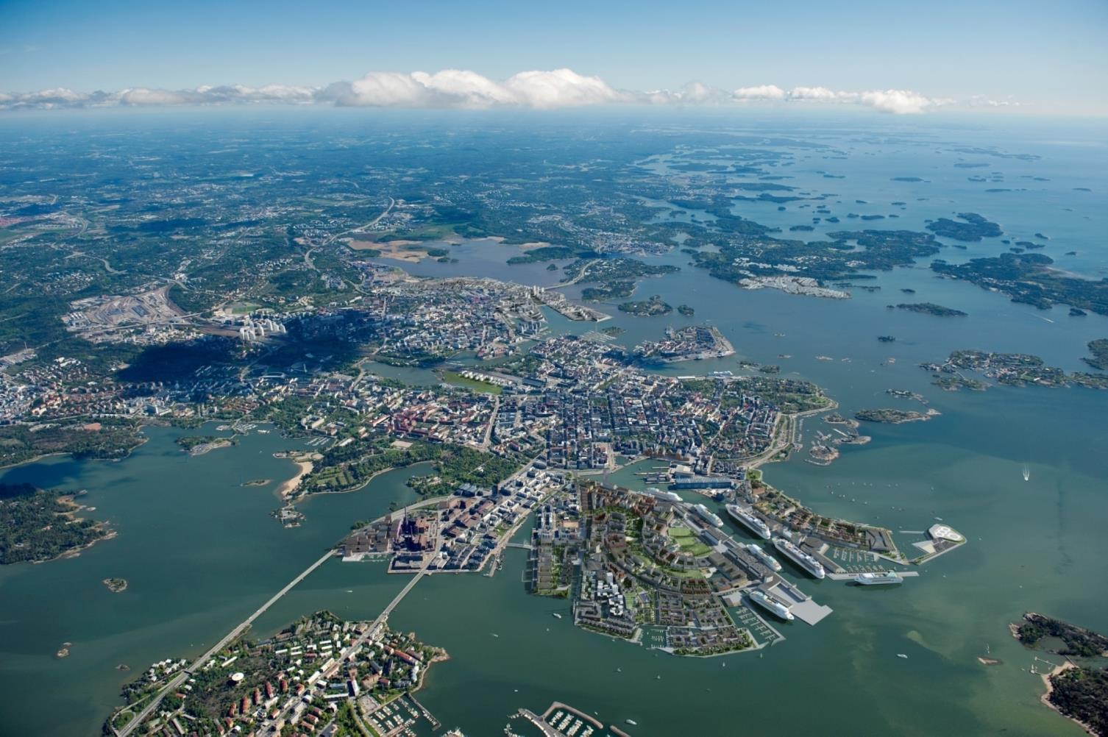
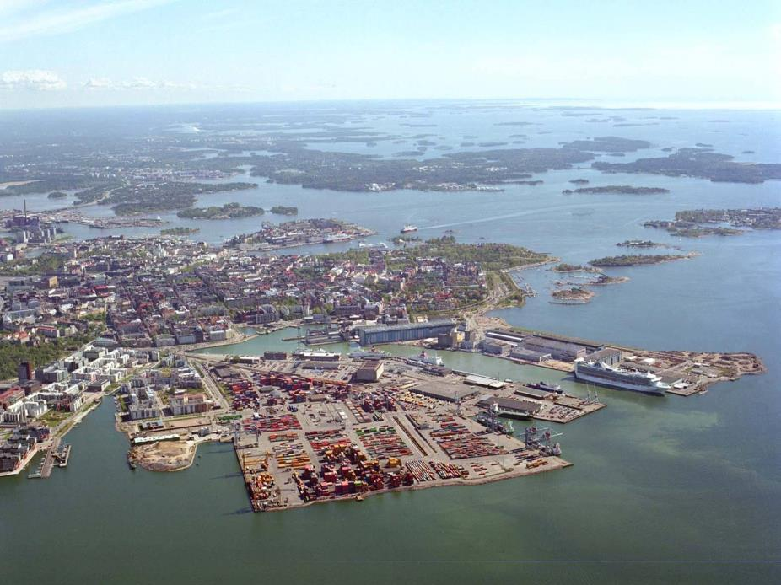
Notes:
.. Especially now that the transformation of the former harbor areas…

Slide 7
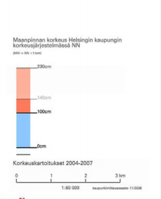
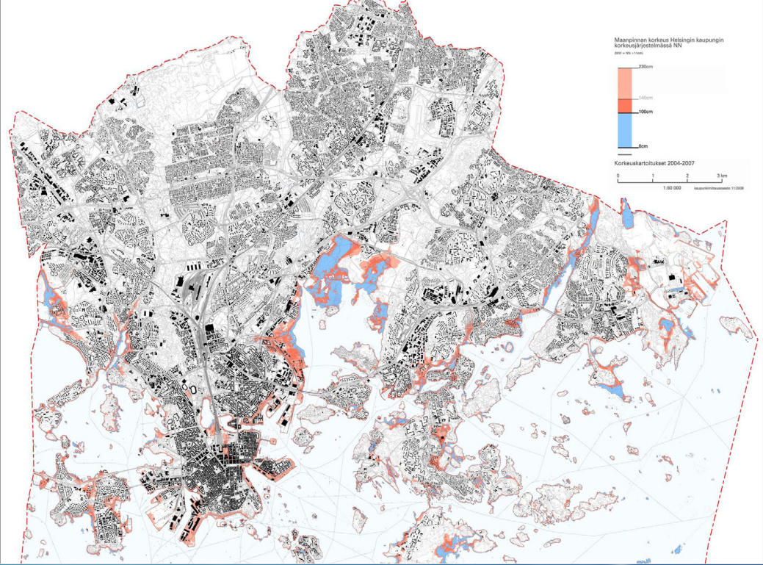

Flood risk areas
2,3 m (appr7 ft)
1 m (3,5 ft)
Notes:
..which makes it vulnerable when the sea rises in the future. Red area once in 200 years (can get more frequent), 1 m (once in 50 years)
.. And that is also the place where the floodrisk is the greatest

Slide 8
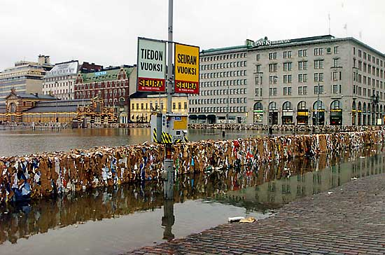
Flooding in Helsinki:
Coastal – increased frequency and sea level rise
Heavy rain – increased frequency and intensity
River – increased winter flooding
(Pipeline – increased urban density)
Worst case scenario:
Kauppatori market place January 2005
+1,5 m (5 ft, MWteor)
for 10 hours
west wind and surge
atmospheric pressure
seiche phenomenon
water mass in the Baltic
Notes:
Coastal
normal fluctuation – 2 ft to =3 ft
– Baltic pool and oscillation, post ice age land uplift stopped compensating in the 90’s, many factors together
- Highest waterlevels are rising
Heavy rain
Stormwater management system overflow
River
winter, no evaporation! No infiltration (frost!)
Pipeline (dirstict heating, hot water!)
Land owner’s responsibility! (Helsinki city 70 per cent)
Flood strategy 2007, stormwater strategy 2010, regional adaptation strategy, national a.s. 2014
When all factors come together…

Slide 9
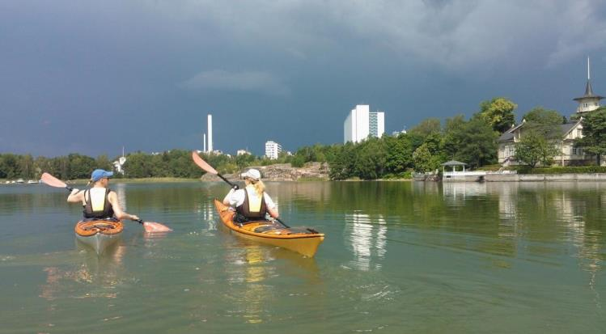
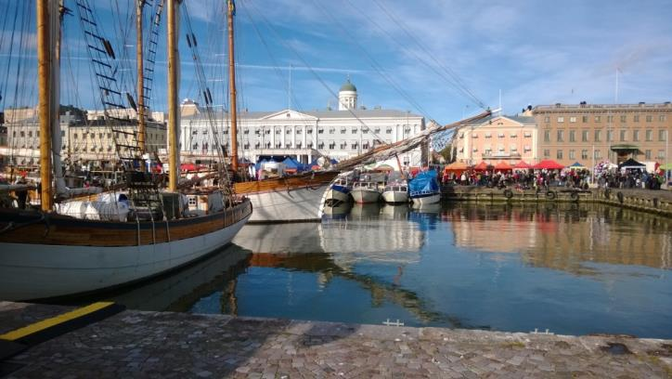
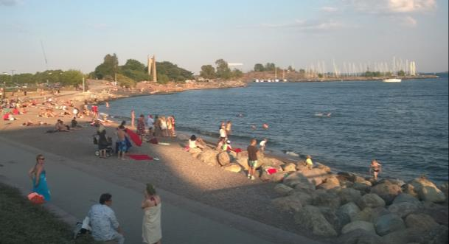
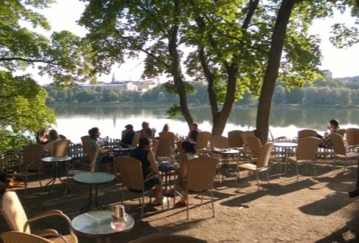
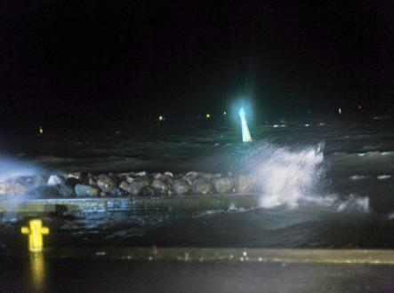
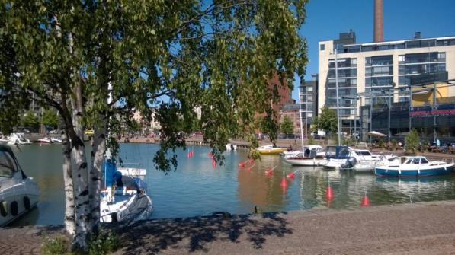
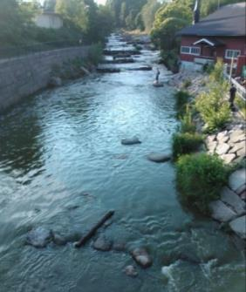
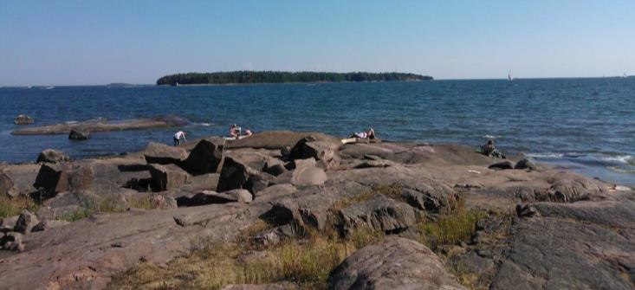
Notes:
But living with water is better than living without… in fact sweetwater is a prerequisite of life… and also seawater can be pretty enjoyable and experientially rich…

Slide 10
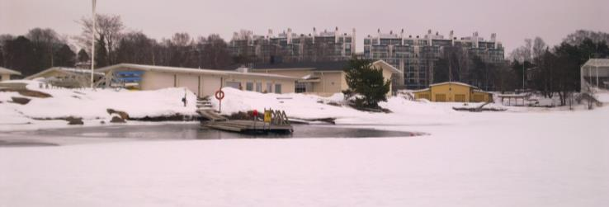
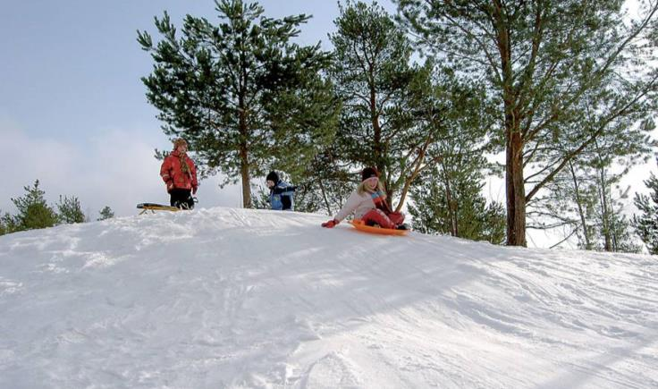
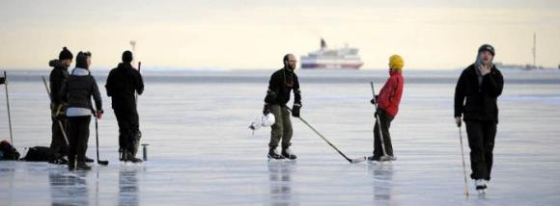
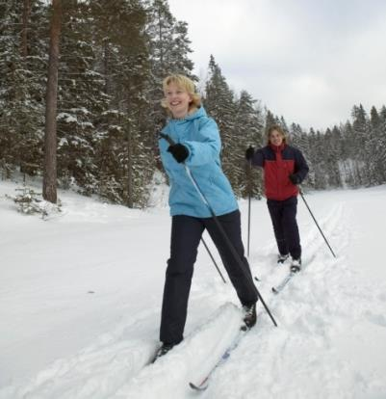
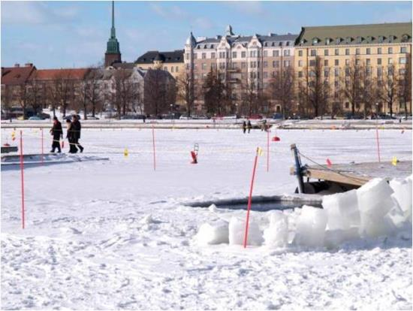
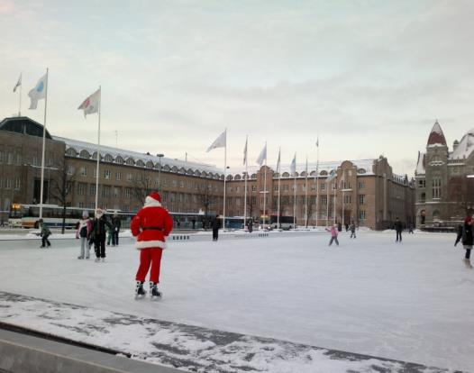
Notes:
..in all its forms...

Slide 11

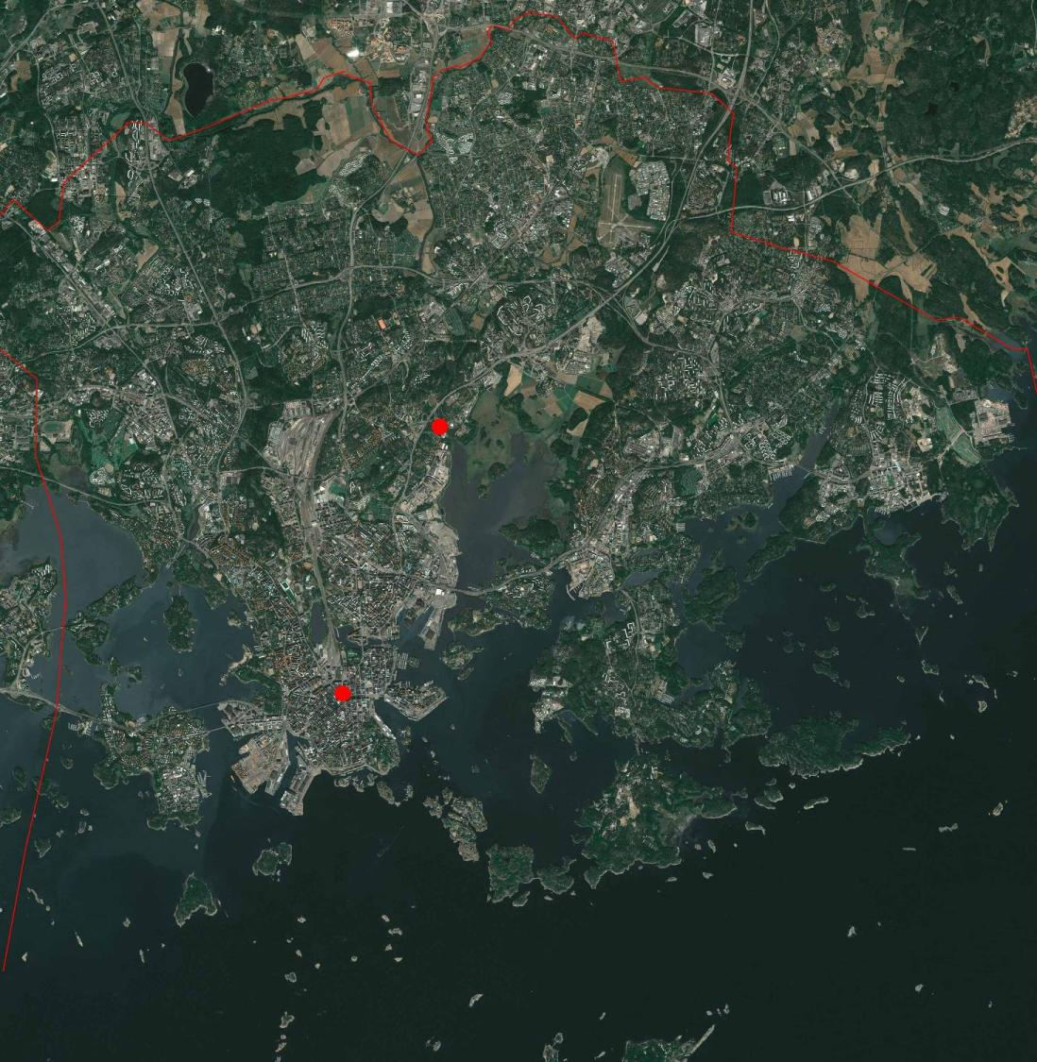
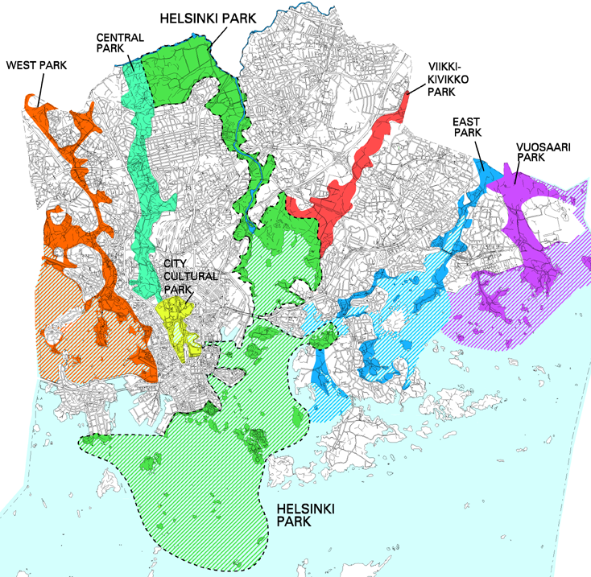
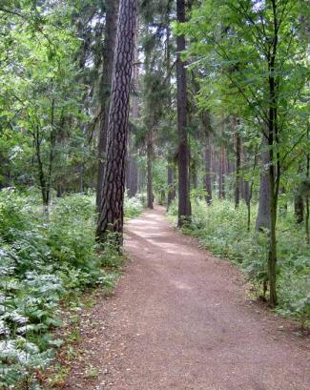
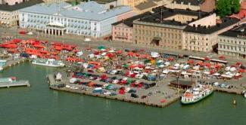
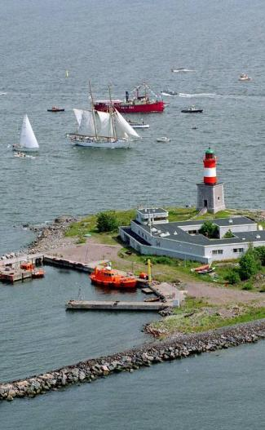
Notes:
..and the green fingers..

Slide 12
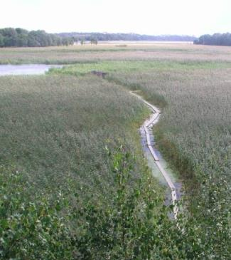
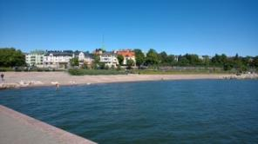
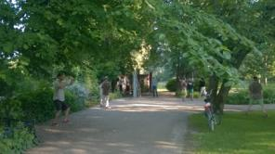
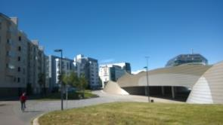
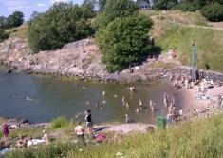
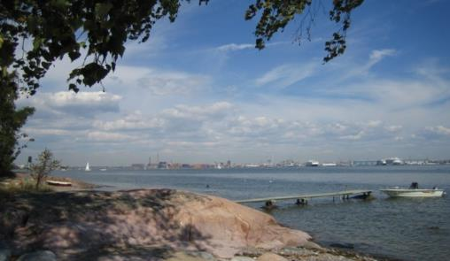
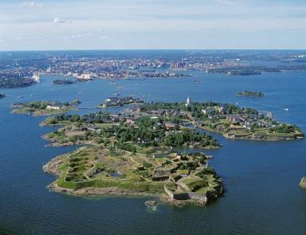
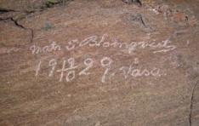

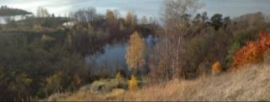
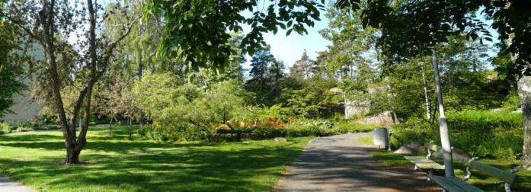
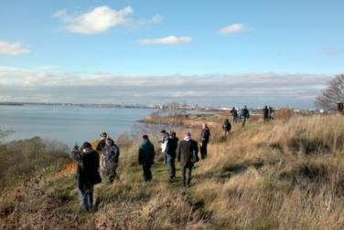
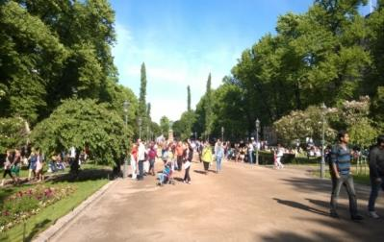
”Green Fingers” and ”Blue Palm”
Notes:
..make up the essence of Helsinki’s identity.

Slide 13
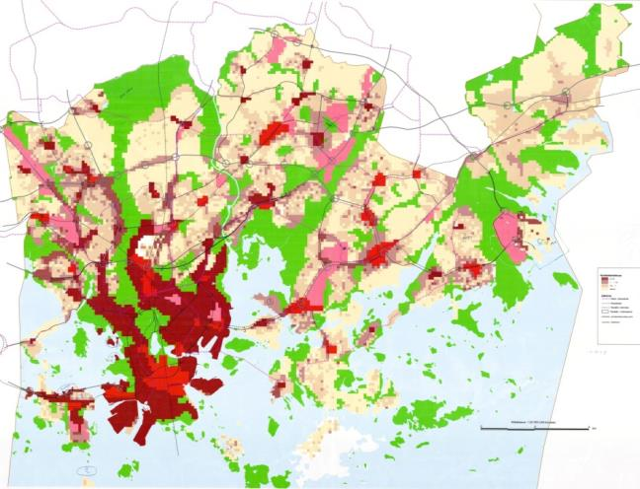
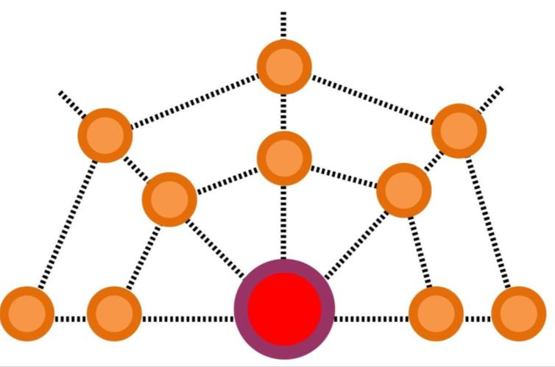
Current challenges in planning 2
Polycentricism
Public transit
Suburbia -> Urbanism
860 000 (39%) new habitants by 2050
along the rail lines and new traffic connections
Expanding inner city
Strong participation
Integrated traffic and land use planning
Network city
DRAFT IN PROGRESS
Strategic Planning Division
Notes:
..and the cultural, ecological and recreational landscape values embedded in those is what we aim to preserve when the city will be densified along with the new master plan..

Slide 14
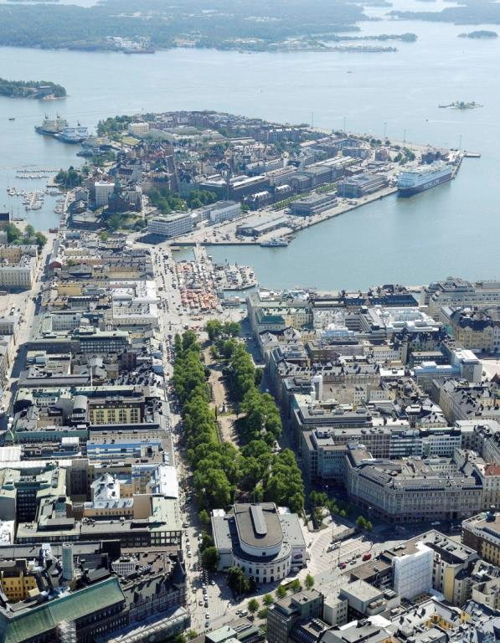
VIST(R)A
Viher- ja virkistysalueiden strateginen kehityskuva –
Green Areas Strategy
(Vol. 1: Objectives,
City Planning Committee 9/2013
Vol. 2: Recreational network, draft City Planning Committee 10/2014, along with the draft for the new Master Plan)
Notes:
..and that is why we initiated the green areas strategy, to define the green network city of the future.

Slide 15
Accessible and interconnected
green areas network - Good city,
promotes health; mobility and outdoor life
Landscape and green areas
- Important for city identity and livability,
promotes experiences of beauty and belonging
Green areas – Sustainable city
promotes resilience and adaptation to climate change
Notes:
.. It is based on these principles and approaches: 1. the recreational perspective aiming to define the ”density limit for good life” so to speak, identity perspective and the resilience approach that looks at ecological challenges.

Slide 16
What to do?
bring forward ecosystem service point of view in planning discourse
promote green areas as buffer zones on river corridors and seashores
promote sustainable treatment of stormwater to equalize hydrologic cycle, purify water and prepare for extreme weather
promote urban nature biodiversity and urban forests
cherish natural shorelines
increase green infra and biomass for carbon sequestration
-> flexibility in adapting to climate change
Notes:
..in the last one we arrived at these guidelines for promoting sustainability in green areas...
eans among other things not building too close to river corridors, cherishing natural shoreline...

Slide 17






Malmö, Sweden
Freiburg, Germany
Viikki, Helsinki, Finland Toppilansaari, Oulu, Finland
Notes:
..from which we have many examples... bioswales, rain gardens, cathment ponds, stormwater collecting... To tackle river flooding and heavy rains..

Slide 18





Baana, Helsinki
Paris
High Line, New York
Notes:
..Greening grey infrastructure

Slide 19


Notes:
Human nature…We’ve always enjoyed waterfronts, hopefully still in the future…in Helsinki and in Boston

