Slide 1

The EU’s Non-Linear Path to Welfare State Politics: Is Energy Efficiency a Trojan Horse?
Johan Nordensvärd
Associate professor in Inovation and Technology (KTH) and Political Science (LiU)
Notes:
Thank them for agreeing to participate and by doing so contribute to furthering our understanding of EU policymaking on energy efficiency.

Slide 2

Changes to EU policy
European green deal & “Fit for 55”
  Recast of Energy Performance of Buildings Directive (EPBD)
  Recast of Energy Efficiency Directive (EED)
  Reworking of the EU ETS
  RePower Europe
“Energy efficiency is the first priority for the clean energy transition. However, the current national plans show an ambition gap: 2.8 percentage points for primary energy consumption and 3.1 percentage points for final energy consumption in the EU.” (EC, 2020)
Notes:
Both proposals are

Slide 3

Global CO2 Emissions
The residential and tertiary sector, the major part of which is buildings, accounts for more than 40 % of final energy consumption in the Community and is expanding, a trend which is bound to increase its energy consumption and hence also its carbon dioxide emissions. (EPBD, 2002)
“Buildings account for 40 % of total energy consumption in the Union. (EPBD, 2010)
The proposal is particularly important because buildings account for 40% of energy consumed and 36% of energy-related direct and indirect greenhouse gas emissions. (EPBD proposal, 2021)
This is not a new concern
Legislative efforts have been made
We are supposedly seeing limited progress
Notes:
Global emission from building operations.
-
-
- In the EU, heating, cooling and domestic hot water account for 80% of the energy that households consume.

Slide 4
Publications
von Malmborg, F., Björklund, M. & Nordensvärd, J. (2023) Framing the benefits of European Union policy expansion on energy efficiency of buildings: A Swiss knife or a trojan horse? European Policy Analysis, 9(3), 219-243. https://doi.org/10.1002/epa2.1184
Nordensvärd, J., Björklund, M., von Malmborg, La Fleur, L., Skogsmo, E., and Gamez, D., Reviewing the EU policy nexus of energy efficiency in buildings and social policy, Submitted to Renewable and Sustainable Energy Reviews

Slide 5
E.U. and social policy
An important strand of research on social policy have been to see EU social policy development from a constructivist dimension that is looking at strategies, resources and context factors that enabled EU social policy to find ‘a raison d’être alongside national social policies (Bernhard, 2011).
EU social policy lack not just legitimacy and funding of a national welfare state as European social citizenship pales in comparison to the fully-fledged national social citizenship.
“The rights conferred by EU citizenship remain de facto ‘isopolitical’: citizens are entitled to enter the welfare space of other member states with the guarantee of non-discrimination, but they remain ultimately attached to the entitlements provided by the national welfare state of origin” (Ferrera et al, 2023, p. 494).
Some scholars highlight that EU Social Policy has been developing as a side show or as a spill-over effects from the potentially expansive nature of the integration process (Falkner, 1998).
The main show has been market integration and social measure have generally been seen as market-making and not market compensating social policies.

Slide 6
E.U. and social policy
Streeck has highlighted that EU social policy have aimed to rid barriers and be part of a negative integration (1995).
This has created a weak foundation for more ambitious market compensating EU social policies that according to some scholars have also been hindered by the particular institutional make up and EU’s weak policymaking capacities is intergovernmentalism (Moravcsik, 1993).
Scharpf (1988) brings up institutional barriers to understand why EU social policy lacks efficacy and tend to be technocratic.
Therefore, social policy often leads to a soft-law approach that prevents enforcement of policy measures and sanctioning of non-compliance.

Slide 7
Context of European Social Policy
The Social Pillar have by some been argued to constitute a new phase in EU social policy (Pochet, 2020) when it creates a symbolic framework.
The EU ‘social acquis’ (de la Porte, 2019) has brought with it legislative initiatives in the field of posting of workers, work–life balance and fair working conditions (Garben, 2019a; Zeitlin & Vanhercke, 2018) as well as an overall ‘upward convergence’ of social rights among member states (de la Porte, 2019; Garben, 2019a).
Keune et al. (2023, p. 488) argues that “[t]here has been a diversification of the types of instruments used in the creation of social rights, with a significant return of hard legislation, via Directives and Regulations, the revamp of EU soft legislation, but also an increasing use of hybrid formulas, for example, the adoption of ‘social conditionality’ for accessing EU funds or ‘social guarantees’ in the area of youth and child policies”, and how these “instruments create new roles for and relationships between the various governance levels” .

Slide 8
von Malmborg, F., Björklund, M. & Nordensvärd, J. (2023) Framing the benefits of European Union policy expansion on energy efficiency of buildings: A Swiss knife or a trojan horse? European Policy Analysis, 9(3), 219-243. https://doi.org/10.1002/epa2.1184

Slide 9
Introduction
Various EU policies have been adopted over time and have influenced how energy efficiency in buildings is understood (Economidou, 2020).
Energy efficiency is by nature an ambiguous concept (Dunlop, 2019).
EU policy in this area has continued to expand (EED 2023; EPBD 2024).
What instrumental values are attributed?
Notes:
-
-
- In the EU, heating, cooling and domestic hot water account for 80% of the energy that households consume.

Slide 10
Year Policy document
1970–1980 Council resolutionsa,b,c,d
1993 Directive to limit carbon dioxide emissions by improving energy efficiency (SAVE directive)
2000 Energy Efficiency Action Plan (EEAP 1)
2002 Energy Performance of Buildings Directive (EPBD)
2006 Energy Efficiency Action Plan (EEAP 2)
Energy Service Directive (ESD)
2010 Energy Performance of Buildings Directive (EPBD recast)
2011 Energy Efficiency Action Plan (EEAP 3)
2012 Energy Efficiency Directive (EED)
2015 Energy Union Strategy
2018 Energy Performance of Buildings Directive (EPBD amended)
Energy Efficiency Directive (EED amended)
2020 Renovation Wave Strategy
2021 Energy Performance of Buildings Directive (EPBD recast)
Energy Efficiency Directive (EED recast)
Opinion on the EPBD of the Regulatory Scrutiny Board
Opinion on the EED of the Regulatory Scrutiny Board
2022 REPowerEU Plan
EU “Save Energy Communication”

Slide 11
Four often used benefits
The established use of “multiple benefits” indicate that energy efficiency policy has been conceptualized in several different ways:
(i) energy efficiency as economic policy
(ii) energy efficiency as environmental policy
(iii) energy efficiency as security policy
(iv) energy efficiency as social policy. The latter have been framed in EU policy to achieve reduced energy bills; alleviating energy poverty and improve public health and hereby qualifying as social policy (von Malmborg et al, 2023).

Slide 12
Framing of energy efficiency.
Economic and industry policy aspects | Foster competitiveness; spread of innovative technological solutions and improve the competitiveness of industry in the Union; stimulate the development of a large leading-edge market for energy-efficient technologies and products; smart, sustainable, and inclusive growth; boost economic growth; create opportunities for high quality jobs, employment; create opportunities for regional development; cut energy costs for households and companies; increased economic activity throughout the economy
Environmental policy aspects | Reduce CO₂ emissions; reduce GHG emissions; reduce air pollution; improve air quality
Security policy aspects | Enhanced security of oil supply; enhanced security of energy supply, reduced dependence of energy imports from outside the Union
Social policy aspects | Reduced energy bills; alleviating energy poverty; improve public health
Notes:
-
-
- In the EU, heating, cooling and domestic hot water account for 80% of the energy that households consume.

Slide 13
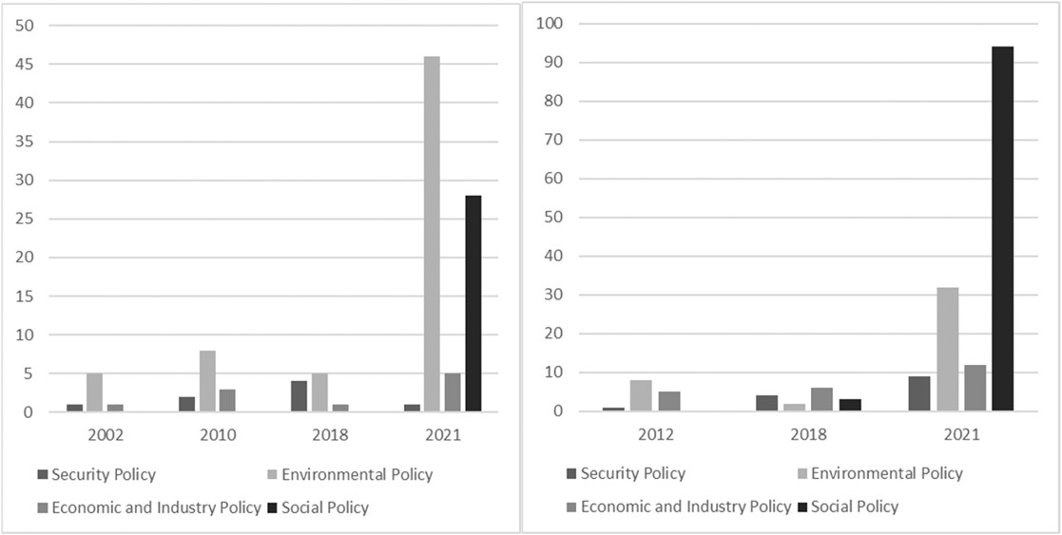
Framing of the benefits of energy efficiency in EPBD and EED.
Notes:
-
-
- In the EU, heating, cooling and domestic hot water account for 80% of the energy that households consume.

Slide 15
Conclusions
The benefits associated with energy efficiency have changed over time.
Energy security – 'Multiple benefits.
'The transition to multiple benefits within the policy area can be interpreted in two main ways: as a 'Swiss knife' or a 'Trojan horse.
The primary rationale behind the social aspects of energy efficiency policies for buildings stems from the belief that improving energy efficiency will reduce household energy expenses, consequently reducing any negative implications such as energy poverty or energy inequality.
Von Malmborg et al. (2023) concludes that including additional benefits connected to social aspects within energy efficiency policy could be seen as either a Swiss knife that could solve multiple issues or like a trojan horse utilized to stealthily extend the competencies of EU into areas of national competencies such as social policy (cf. Garben, 2022).
Notes:
-
-
- In the EU, heating, cooling and domestic hot water account for 80% of the energy that households consume.

Slide 16
Nordensvärd, J., Björklund, M., von Malmborg, La Fleur, L., Skogsmo, E., and Gamez, D., Reviewing the EU policy nexus of energy efficiency in buildings and social policy, Submitted to Renewable and Sustainable Energy Reviews

Slide 17
How did energy policy become social policy
The aim of this article is to analyse how energy has been merged with particular social policy concepts, how this frame merging process have occurred and the impact on our understanding of European social policy.
The methodological approach is inspired by the findings in (von Malmborg et al., 2023) that showed how multiple policy domains are connected to energy policy, among them social policy.
The starting point of our review starts with defining dominant merged frames that consist of strong social policy concepts merged with energy policy/energy efficiency.
Data collection through the EurVOC categorization in the Eurlex database
Looking for keyterms somehow connected to social policy within Energy policy documents
Deeper analysis of documents central to the development

Slide 18
Social Policy concepts | Merged frame | Related keywords to search | Potential Key Documents
New deal | European Green deal | Green deal; New deal | EC: 52013SC0541 (2013) EC: 52020SC0550 (2020)
Justice | Just transitions | Just transition; Fair transition; Climate justice; Social inclusion; Social exclusion; Social protection Marginalised groups; Fairness | EP: 52019IP0079(01) (2021) EC: 52020SC0550 (2020)
Absolute and relative Poverty | Energy poverty and Energy inequality | Energy poverty; Energy poor*; Affordable housing; Affordable energy; Affordable essential services; Poor* households; Cost of living; Vulnerable households; Adequately warm; Inequality Redistributive | EP: 52006IP0603 (2006) EP: 52008IP0306 (2009) EC: 52011SC1569 (2011) EC: 52023SC0646 (2023)
Employment policy/ Unemployment | Green jobs | Job creation; Green job*; New job*; Increased employment; Unemployed Decreased unemployment Employment effect* Vocational education and training | Council: 31980D0067 EP: 51997IP0113 (1997) EC: 52009SC0503 (2009) EC: 52023SC0700 (2009)

Slide 19
The new green deal
There is an overarching idea that the EU can solve both energy poverty/inequality and reduce EU’s impact on the climate simultaneously by pursuing energy efficiency.
This is nothing new as these aspirations can be found in the nexus of social and ecological sustainability – the aim to find the dual purpose of reducing poverty and GHG emissions.
Often there has been attempts to use the symbolism of using Roosevelts New Deal as a way to signal that we need a New Green Deal by combining both social policy, energy policy, climate policy and economic policy into one package such as EU’s European Green Deal (EGD; European Commission, 2019) where the aim is to achieve net-carbon neutrality in Europe by 2050’.

Slide 20
Understainding energy / social policy nexus
Green jobs and Energy justice are dominant in the beginning of the time period while energy poverty related keywords more common later in the time period. The overall pattern before 1995 is solely based on the language used by the Council and the Commission texts are introduced first in 2006.
The one occurrence of the merged frame ‘Energy poverty’ that is found in 1973 relates to biotopes on the countryside and is not clearly connected to social issues. Figure shows the total number of occurrences without relating it to the size of the material in each year.

Slide 22
Conclusion 1
The heuristics connection between energy policy and social policy is evolving over time and in most cases, it is the European Parliament that first make the connection which the Commission then internalize.
A good example of this interinstitutional pattern is the introduction of the concept of energy poverty to the domain of EU energy policy. It is first used in a foreign policy context by the Commission, but a few years later it is introduced by the parliament in a parliament resolution on the energy community treaty in 2006 (European Parliament, 2006).
The concepts of ‘energy poverty’ and ‘just transition’ are themselves a result of the frame merging which is achieved after they first have been introduced separately and kept parallel.
Throughout the years and the documents, energy appears as a dynamic and versatile concept, intertwined with welfare, sustainability, and security thereby contributing to making energy a multifaceted concept and discourse.

Slide 23
Figure 4: The frequency of frames in each of the institutions

Slide 24
Conclusion 2
Even though the social policy aspects of energy policy are cemented by the Commission through the concept of energy poverty, it was the Parliament that first made the connection between energy policy and social policy, mostly because they seem based on our findings to be more engaged in social issues, like equality, justice and redistribution compared to the Commission and the Council.
We can’t show if this is the case more generally but when it comes to introducing social policy aspects into energy policy it seems to be the case.
However, the Commission seem to quickly internalize the social policy aspects of for example energy efficient buildings and uses this strategically to justify further EU policy.
The ambition of increasing the scope of EU social policy is clearer in the Parliament while the motives of the Commission in their preparatory documents is more ambiguous and it can both be understood as realizing the current political vision or a strategic extension of their competence

Slide 25
We can see at least three things on E.U. on Social Policy and energy efficiency
1 Taking a core policy field of E.U. and promoting the competency in other areas – energy efficiency has multiple benefits as economic policy, security policy, environmental policy and social policy
2 We can see that energy efficiency plays into a deeper change in framing E.U. policy as an overarching ecological modernization project with combining welfare and environmental goals.
3 We can also see that while the European parliament and European Commission are driving the social environmental nexus of energy efficiency – the council works the consensus and flexibility of implementing these policies due to different political viabiliy vand building stock in the different countries.

