Slide 1
Living Faithfully in the Anthropocene
Rachel Barton, Dr. Rebecca Copeland
Spring 2023

Slide 2
Hypothesis / Big Takeaway
Hypothesis:
There is appetite for interfaith dialogue and action around environmental justice
Big Takeaway:
Undergraduates have interest in this work, but very limited bandwidth for participating in it, especially in the Spring semester.

Slide 3
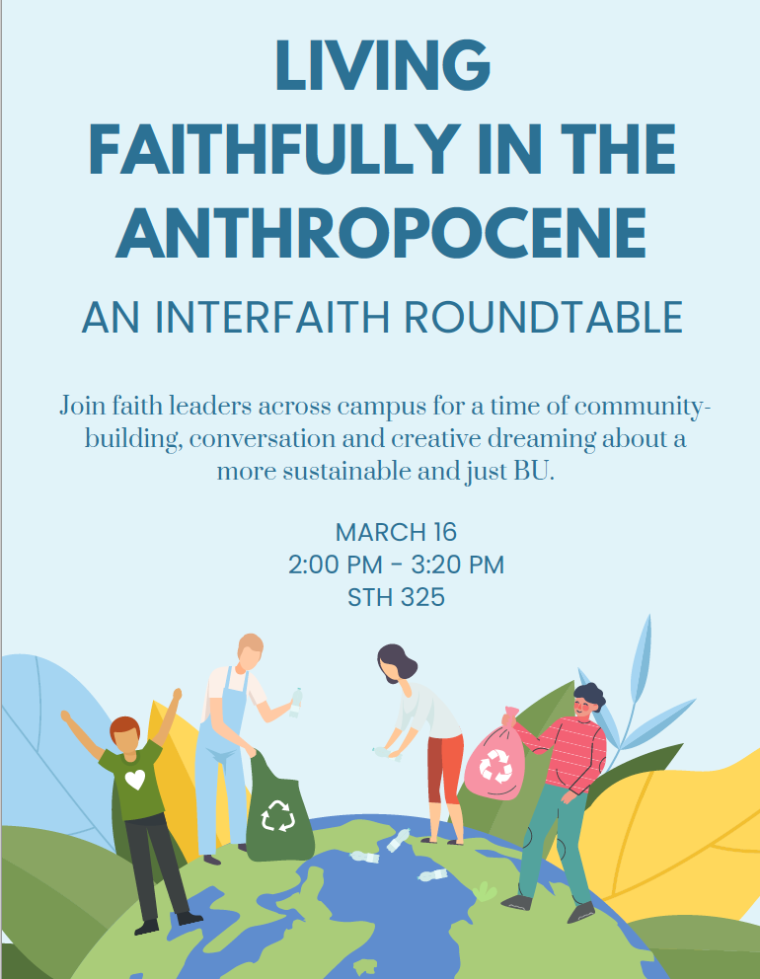
The Dream
Create the conditions for a student-led, interfaith climate action

Slide 4
The (ideal) plan
Campus Climate Lab Application: Apply for Campus Climate Lab funding for a project that:
“[gathers] faith leaders and groups across campus to develop faith-based responses to Climate Change. By bringing leaders from across different faith traditions into dialogue across differences and conversations centered around environmental justice, this project seeks to galvanize faithful commitments to care for the Earth into inter-faith actions that support a more just and whole campus and community at BU.”
Gather climate Leaders: Build a list of faith leaders and invite them to participate in ideation/brainstorming sessions, and then, together, create a collaborative action plan.
Take action for climate justice on campus: support a student-led action.

Slide 5
Plan 1: Collaborative Campus Climate Action
1
What we did/ hoped
2
What happened
3
What we learned
Build a list of Student Faith Leaders and Campus Chaplains
Invite 15 Student Leaders and 10 Campus Chaplains to participate
Hope: Student Faith Leaders would be responsive, and participate in the project.
Student Faith Leaders had interest but very little bandwidth.
8 individuals replied to personal invitations with interest but no availability
0 students attended the gathering
Follow-up with bit.ly calendar not successful
Undergraduate Student Faith Leaders on campus have very little bandwidth for additional engagement.

Slide 6
Plan 2: Interfaith Panel
1
What we did/ hoped
2
What happened
3
What we learned
Invite faith leaders from across the Boston area to participate in a fireside chat and meal
Book space for the chat and meal
Hope: Students might have capacity to participate in an event they did not need to plan.
Faith Leaders in the Boston area have very little time.
Very few responses.
The intersection of Ramadan, Passover and the Easter season meant that faith leaders did not have availability on short notice to participate.
I did not leave enough time for faith leaders to be involved in a panel during the second half of April.

Slide 7
Plan 3: Collaborative Art Project
1
What we did/ hoped
2
What happened
3
What we learned
Create the frame for an art project for students to respond to a prompt
Go where they already are, and have a very small request
Bribe them with cookies
Hope: Students might have capacity to participate in an project they did not plan
Students did have time to participate in this project.
I gathered over 60 responses to the prompt: “Faithful care for the earth to me is:”
These responses provide evidence of the value of this work.
The prompt elicited surprisingly “core” responses: “life,” “love,” “safety,” and “home” were values answers coming alongside responses like “recycling” or “reduce greenhouse gasses.”
This activity got a more representative sample of campus than even the initial hope.

Slide 8
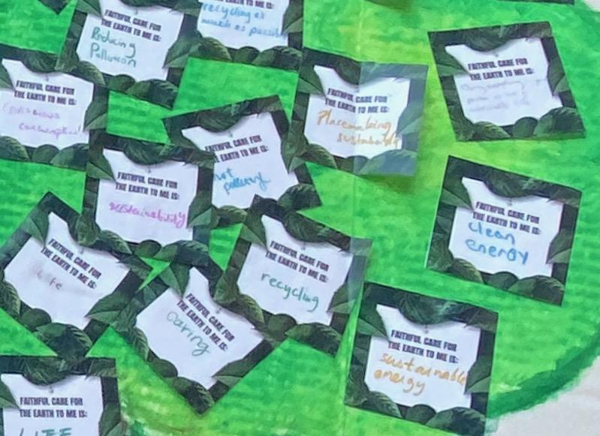
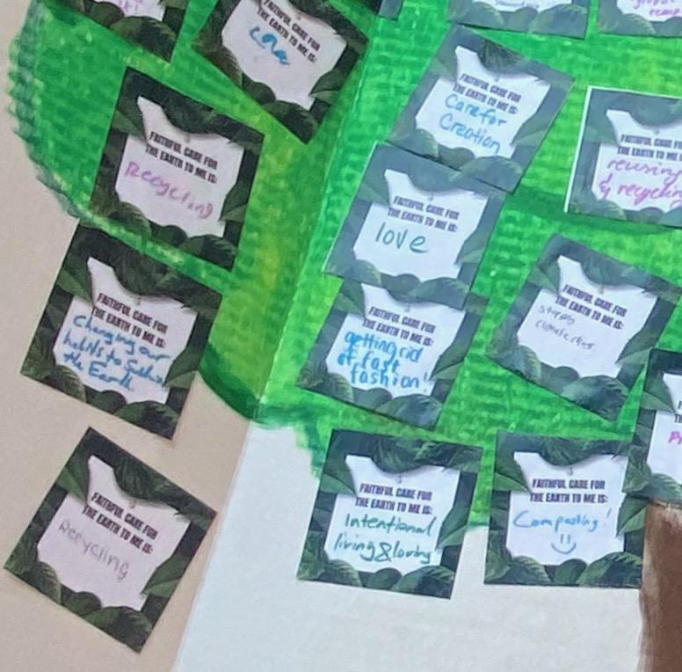
Next Steps
Finish the art piece
Complete the report for Campus Climate Lab
Present at their session in the Fall of 2023
Recommend that if this project were to be tried again, it could:
Start in the Fall
Last the entire academic year
Include a larger team

