Slide 1
Boston University Water Consumption & Mitigation Efforts
Assessing Water Consumption from FY 2006 - FY 2023 to Evaluate Trends and Support Decision Making
Manpreet K. Singh
Rachel Hull
Notes:
Photo Credits: Photo by Sharon Pittaway on Unsplash: https://unsplash.com/photos/water-dropping-on-light-bulb-N7FtpkC_P7o

Slide 2
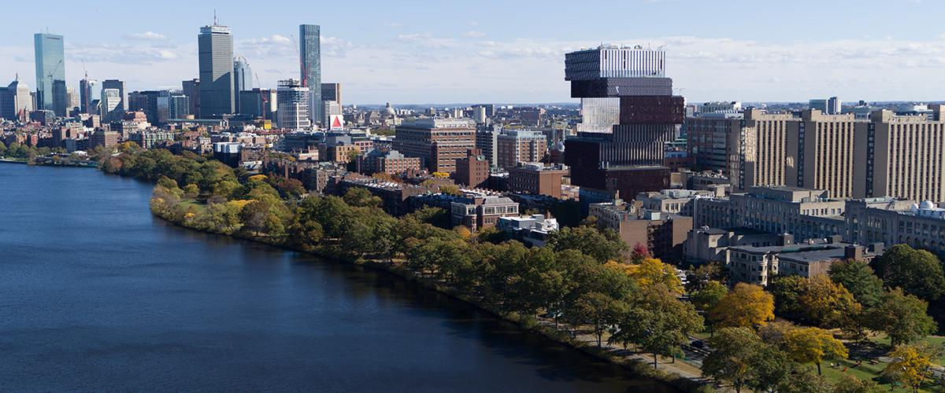
Importance for BU
Support goals set in Climate Action Plan
Scope 3 emissions
LEEDs certification
Notes:
This project is the first to analyze and identify patterns in BU’s water consumption. The importance of this analysis for BU is connected to the following 3 points:
Supports the goals set in BU’s CAP which includes providing insights into sustainable related challenges that impacts BU’s Operations and Facilities specifically as BU grows and develops through retrofitting and renovations.
Sets the foundation for further research to connect water consumption at BU to scope 3 emissions to understand the indirect emissions, especially as BU invests in water efficiency technologies that require energy use and the need for further analysis on wastewater
Supports BU’s goal to ensure that new construction is LEEDs Gold certified in which water management and conservation efforts are measured to certify LEEDs status
Photo Credit: https://www.bu.edu/virtual/

Slide 3
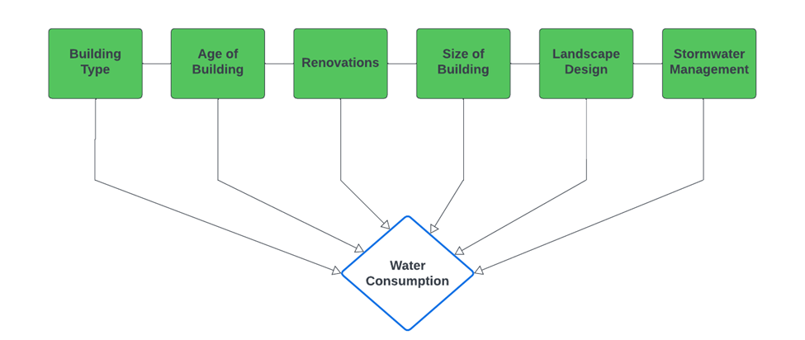
Literature Review & Objectives
Assessment of water consumption for all 3 campus
Identify temporal trends for water consumption and WUI
Create a complete dataset for BU (infrastructure + water consumption)
Provide potential mitigation efforts BU can take in order to reduce and maintain a reduction of water consumption
Notes:
Through our literature review, we identified building type, age of building, renovations, size of building, and stormwater management as driver of infrastructure level water consumption.
These findings, along with the data and information received from the CAP and our operations partner, assisted us to identify the following objectives of our project:
Assessment of water consumption of all 3 campuses
Identify temporal trends for water consumption and WUI
Create a complete dataset for BU including both infrastructure information and water consumption
Provide potential mitigation efforts that can assist BU to maintain and even further reduce water consumption

Slide 4
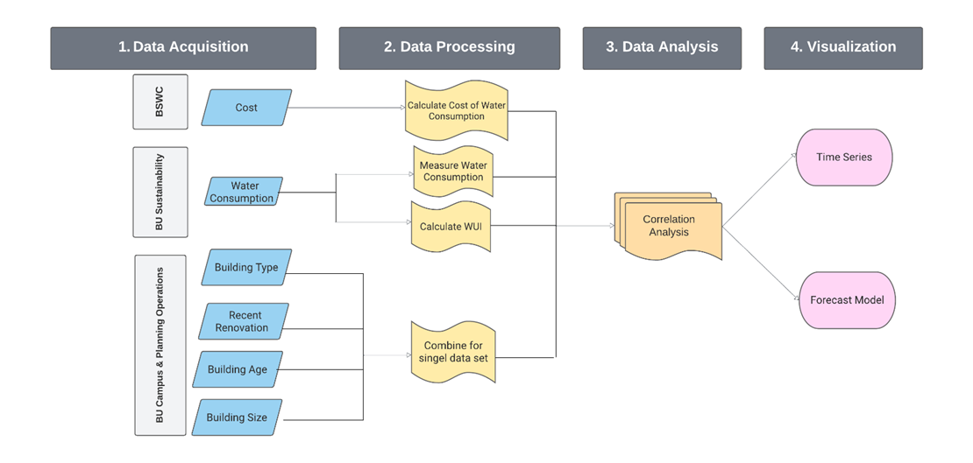
Data Sets, Methodology, Data Processing
dfdsfd
Notes:
Utilizing the infrastructure related data received from Campus Planning & Operations, water consumption from BU Sustainability, and cost of water consumption from Boston Water & Sewer Commission, we processed the data to conduct a time series analysis for water consumption for all 3 campuses which will be the focus of this presentation. Although our project looks at water consumption from FY 2006 to FY 2023, this presentation focuses on to FY 2022 as we recently received FY 2023 data.
In consultation with our faculty mentor, we will be working to create a forecast model to show our operations partners where BU’s water consumption will be going in the next couple years.
From our data analysis, our preliminary results include the following.

Slide 5
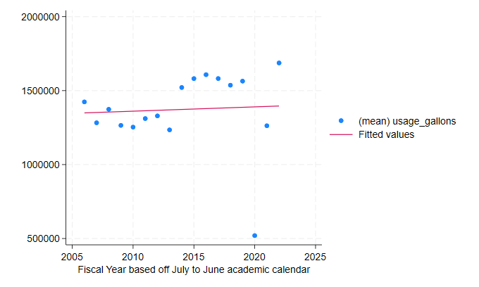
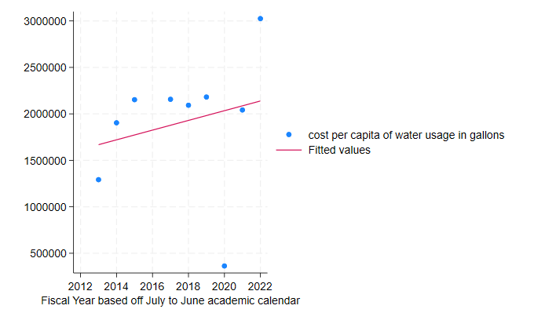
Results: BU Average Water Consumption & Estimated Cost Per-Capita
Average water consumption (gallons)
Estimated Cost Per-capita for water consumption (Dollars)
Number of buildings (as of FY 2022): 360
Gradual increase in water consumption
Note: FY 2020 is an outlier
Used the rate structure found on BWSC website
Increase in cost of water usage per capita with the highest in FY 2022
Notes:
At the broader BU level, we analyzed a total of 360 buildings and found there to be a gradual increase in water consumption from FY 2006 to FY 2022 as shown on your left.
It is important to note that FY 2020 is an outlier in this dataset, as shown in this graph, and this holds true for the rest of the presentation as well. In consultation with our operations partner, aspects of COVIS-19 lockdown and coding issues within the Boston Water and Sewer Commission system played a role during FY 2020. Thus, a large portion of the dataset had to be estimated.
We also looked at the cost per capita in water usage as shown on your right. Using the rate structure found on BWSC website, we looked at the cost per capita cost of water consumption per fiscal year and found there to be an increase in cost of water usage which correlates with the gradual increase found in the graph on your left.

Slide 6
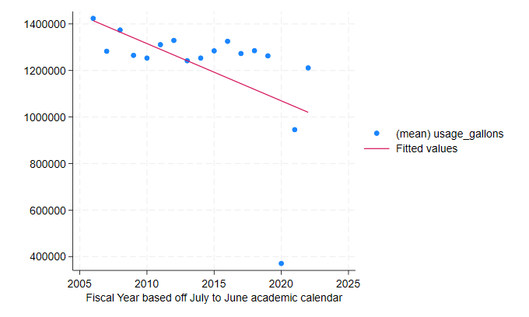
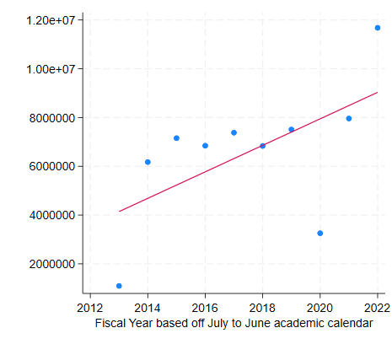
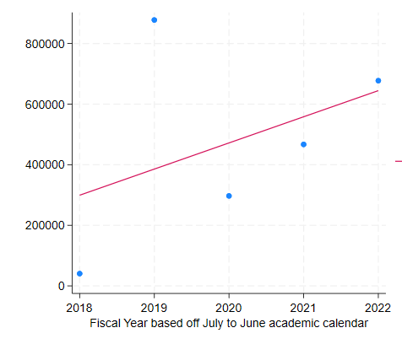
Results: Campus Average Water Consumption
Average water consumption (gallons)
Average water consumption (gallons)
Average water consumption (gallons)
CRC
BUMC
FEN
Legend
Number of buildings (as of FY 2022)
CRC: 321
BUMC: 30
FEN: 9
CRC exhibited a decline
BUMC & FEN exhibited an increase
Limitation: Missing data
Notes:
When collapsing the data for each campus, our preliminary findings include the following:
For CRC, we analyzed 321 buildings and found there to be a decline in water consumption overtime
For BUMC and FEN campus, we analyzed 30 and 9 buildings respectively and found there is an increase in water consumption.
For BUMC, our water consumption data starts from FY 2006 with the total water consumption but this graph only shows from FY 2013 as this was when BU started recording the water consumption data for each building. For FEN, the data starts from FY 2018, which was when BU acquired the FEN campus.
With these preliminary results, it is important to note that there was missing data and buildings that. This means that not every building is included in the dataset. In consultation with our operations partner, a big part of the missing is connected to buildings being connected to a master meter that includes subset of buildings that do not have a submeter. In our technical report, we aim to include a list to identify which buildings are missing from our dataset.

Slide 7
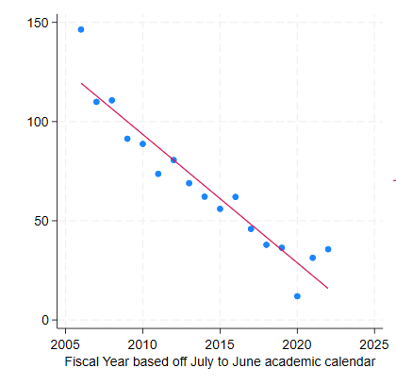
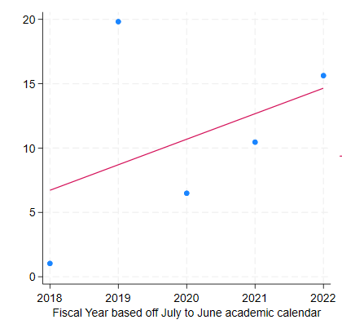
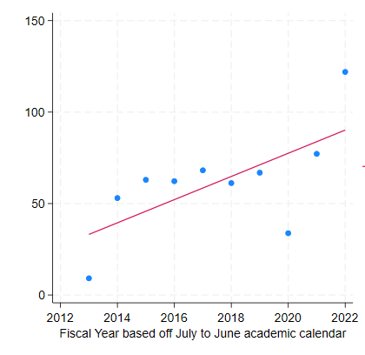
Results: Average Water Usage Intensity (WUI)
WUI = Water usage / Total square footage of a building
Similar to the average water consumption, both BUMC and FEN experience an increase in WUI while CRC experiences a decrease in WUI
Average WUI (gallons)
Average WUI (gallons)
CRC
FEN
Average WUI (gallons)
BUMC
Notes:
We also looked at the water usage intensity in order to identify the rate at which water is being used within a given campus. WUI is standard in water conservation science and is calculated by dividing water usage by total square footage of a building in a given year.
Similar to the average water consumption mentioned in the previous slides, both BUMC and FEN experience an increase in WUI while CRC experiences a decrease WUI. At the broader BU level, there is a decrease in WUI.

Slide 8
Preliminary Findings
Key building characteristics that contribute to variations in water consumption: building type, date of last renovation
Gradual increase in total water consumption at the broader BU level
CRC saw a general reduction in water consumption and water usage intensity overtime
Green certification and water consumption share a important relationship
Notes:
On top of our key preliminary finding that there is a gradual increase in average water consumption at the broader BU level, with CRC seeing a decline and BUMC and FEN seeing an increase, we also found that key building characteristics that contribute to variations in water consumption at BU include building type, age of building, and date of last renovation.
More specifically, residential buildings, which make up the most type of buildings at BU, have the highest water consumption followed by research buildings. Older buildings had the highest water consumption while newer buildings have lower water consumption. Furthermore, LEEDs certification shares an important relationship as buildings that had a LEEDs status had a lower WUI that those that did not.

Slide 9
Future Project Ideas
Creating a geospatial map showcasing hotspots of water consumption across the University
Understanding the role of human behaviour in residential buildings regarding water consumption
Quantifying Scope 3 emissions as related to infrastructure water consumption
Analyzing BU’s wastewater treatment and outdoor water consumption
Notes:
As we work to identify mitigation efforts that BU can take in order to reduce and/or maintain a reduce water consumption, our project helps to set the foundation for project that can be completed by future CCL teams.
This includes creating a geospatial map showcasing hotspots of water consumption across the University. Looking at the role of human behavior, particularly in research or residential buildings, regarding water consumption. Quantifying scope 3 emissions as related to infrastructure which is a crucial part in advancing the goals set by the Climate Action Plan. And finally, analyzing BU waste water treatment and outdoor water consumption, especially as additional CCL projects work to make the campus more green.

Slide 10
Acknowledgement
Faculty Mentor
Dr. Mahesh Karra, Assistant Professor of Global Studies, Pardee School of Global Studies
Operation Partners - BU Sustainability
Stephen Ellis, Director of Data Analytics
Lisa Tornatore, Director
Dennis Carlberg, Associate Vice President
Operation Partners - Campus Planning & Operations
Matthew Walsh, Director of Strategic Planning & Operations
Gregg Snyder, Associate Vice President for Strategic Planning & Operations
This work was supported by the Campus Climate Lab, which is sponsored by the Boston University Institute for Global Sustainability, Boston University Sustainability, and the Office of Research.
Notes:
The researchers would like to thank the collaboration of Boston University Campus Planning and Operations team and the Boston University Sustainability Data Analytics team for their help in their project and for Campus Climate Lab, for funding this project.
Thank you for your time. I will now take questions.

Slide 11
Appendix
Notes:
The researchers would also like the collaboration of Boston University Campus Planning and Operations team and the Boston University Sustainability Data Analytics team.

Slide 12
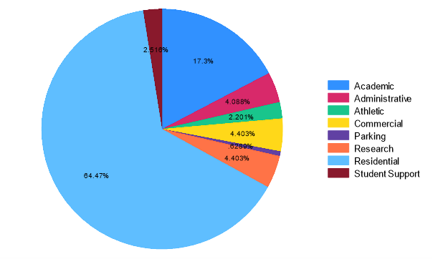
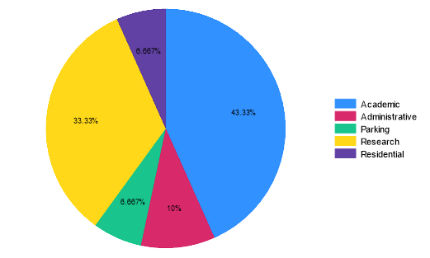
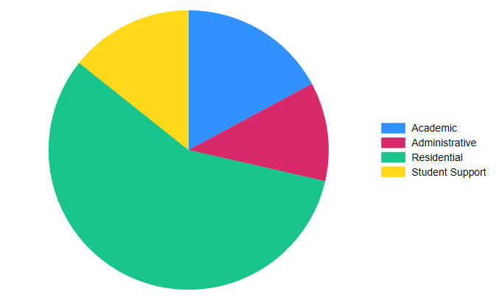
Building Type
CRC
BUMC
FEN

