Slide 1
BU Laundry Facilities as a Source of Microplastics
Project Team: Dr. Raymond Nagem, Lucas Gibbons, Yiyang Jin
Presented by: Lucas Gibbons

Slide 2
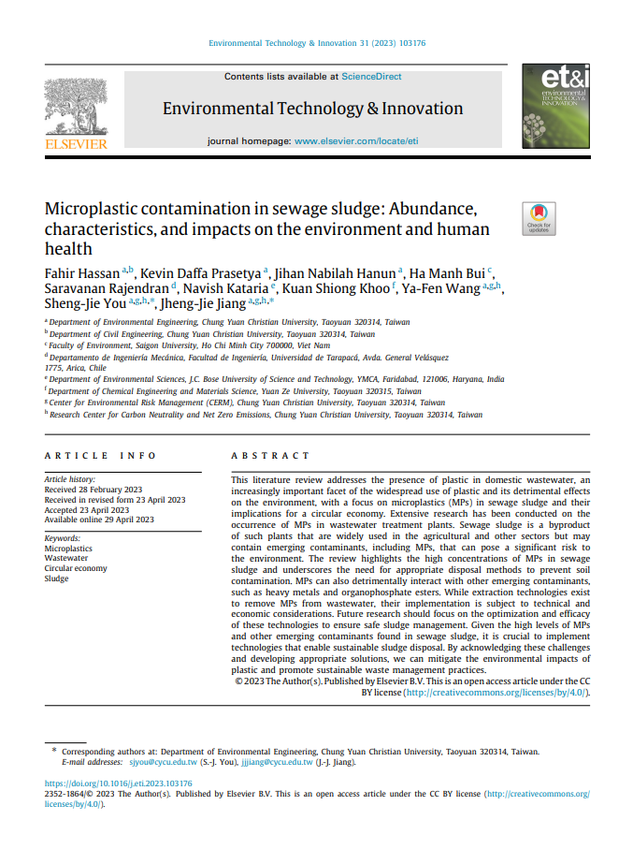
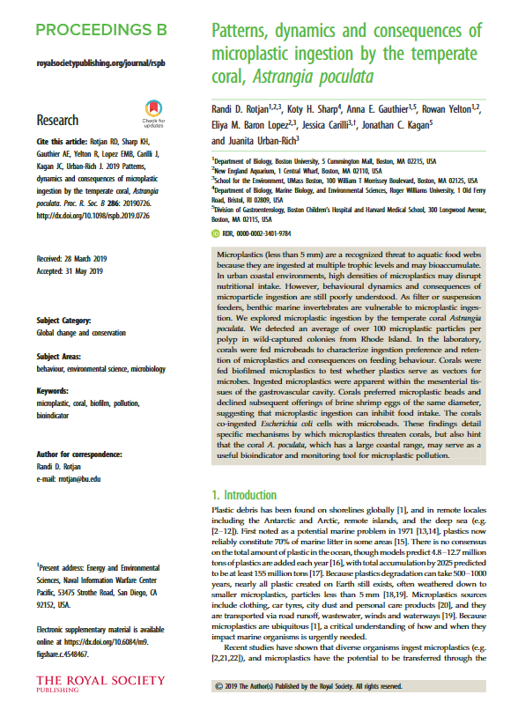
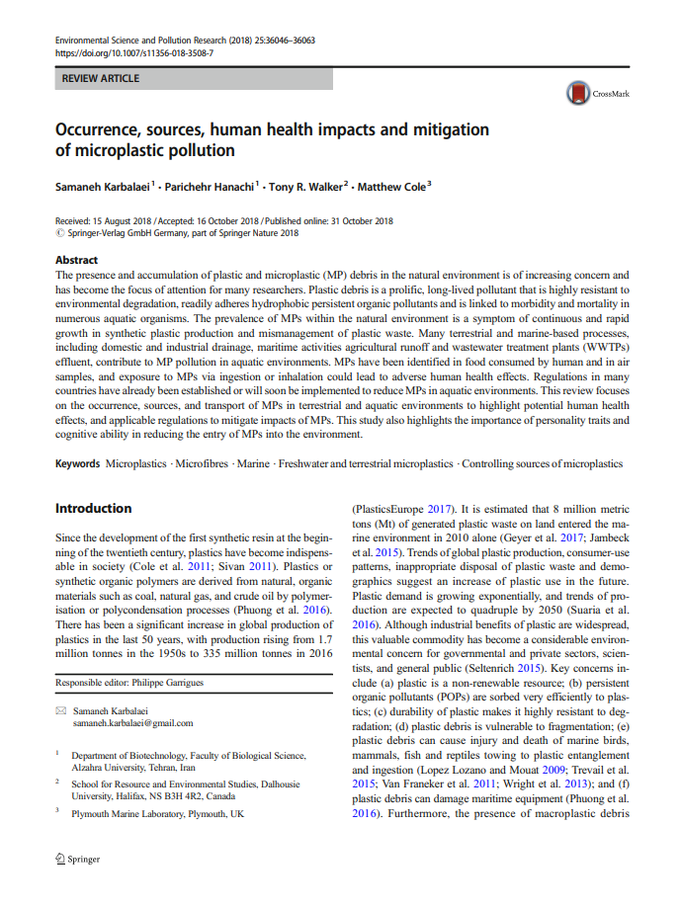
The Problem
Microplastics (MPs) are pieces of plastic less than 5 mm in diameter which have been shown to threaten the environment and human health.
Synthetic textiles used in clothing tend to shed hundreds of thousands of plastic microfibers per wash.
Wastewater treatment plants were not constructed to remove MPs.

Slide 3
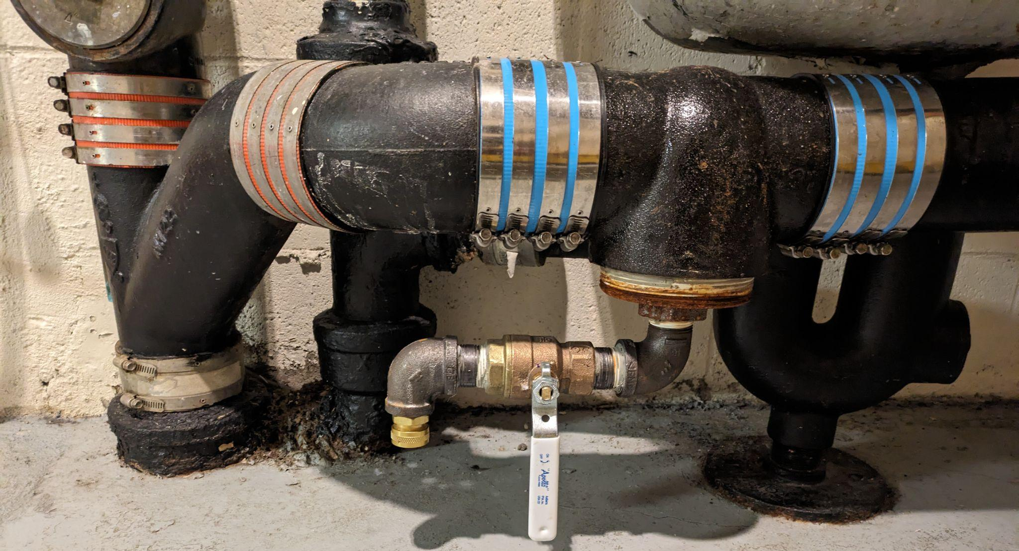
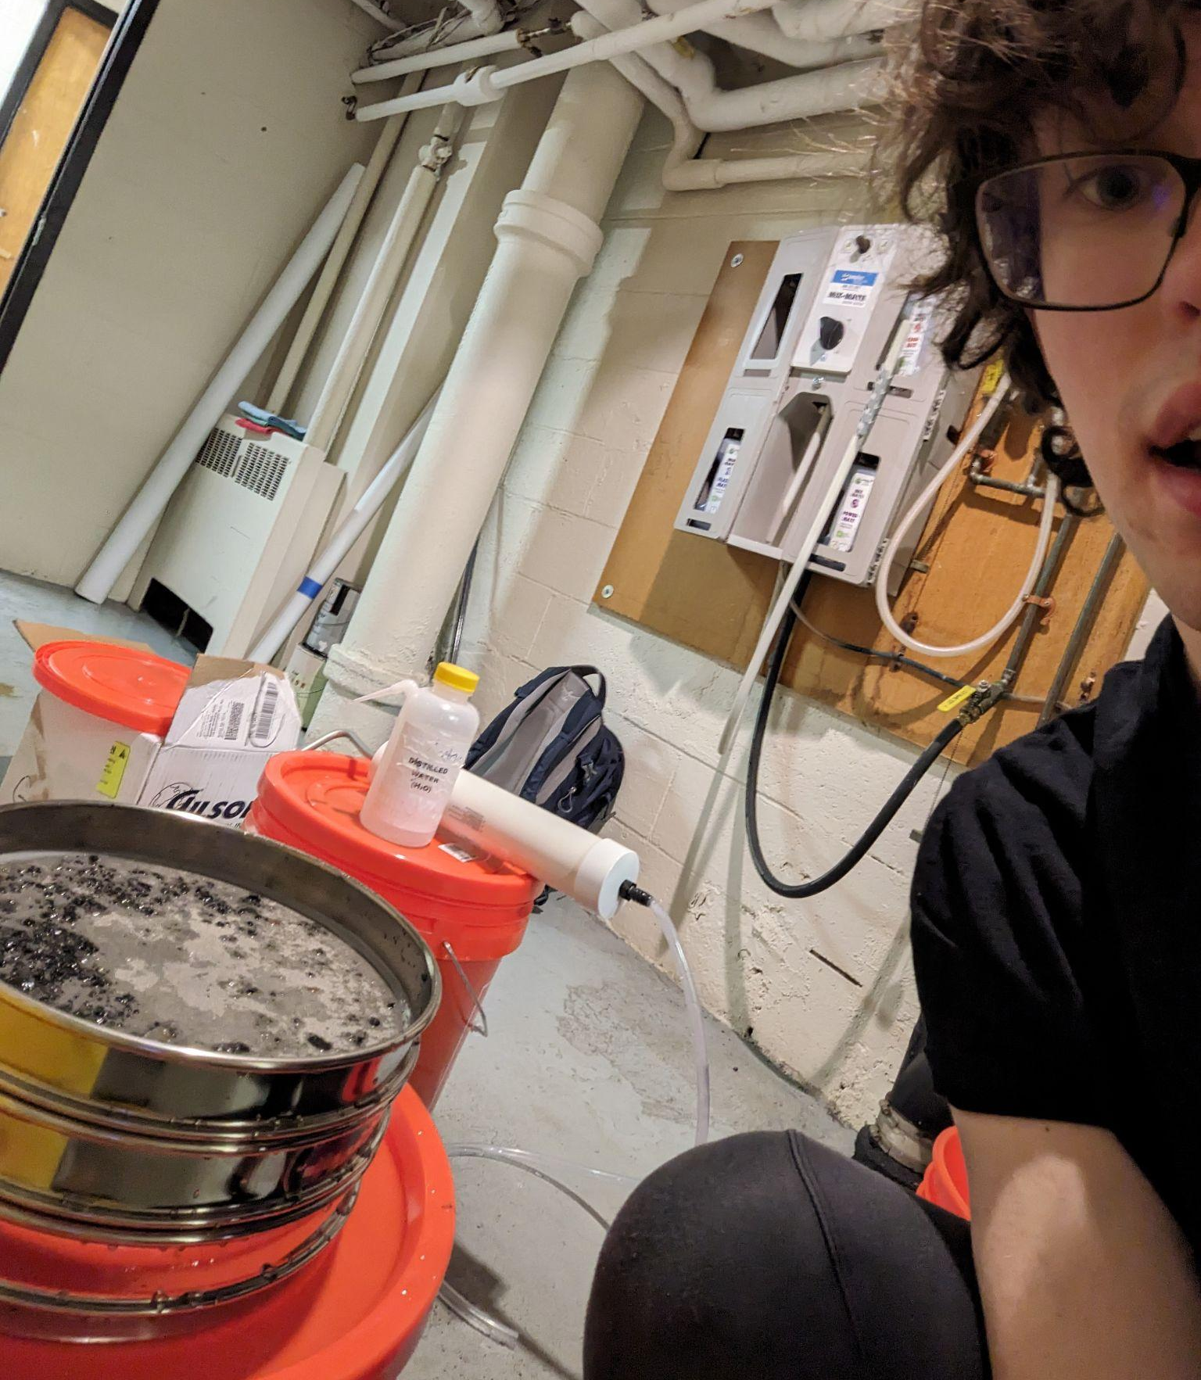
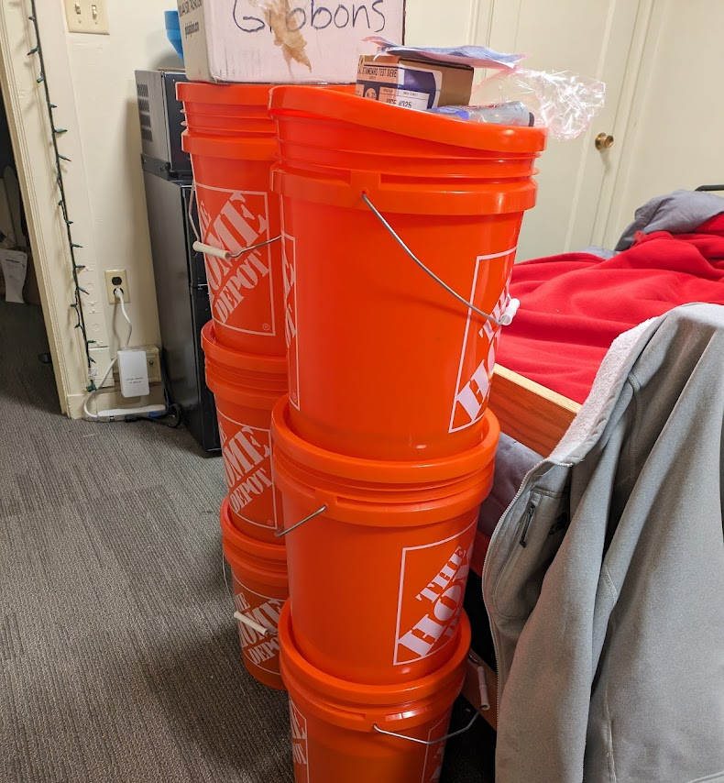
Past Emissions
Wash Cycles Between July 2018 and June 2023: 401,966
Liters of water used to wash clothes: 17,800,000
MP Emission Estimate Based on Preliminary Data: 2640 kg between 150μm and 300μm, 1560 kg between 75μm and 150μm
MP Emission Estimate Based on Existing Research*: between 224 kg and 557 kg
× 23
*https://doi.org/10.1038/s41598-019-43023-x

Slide 4
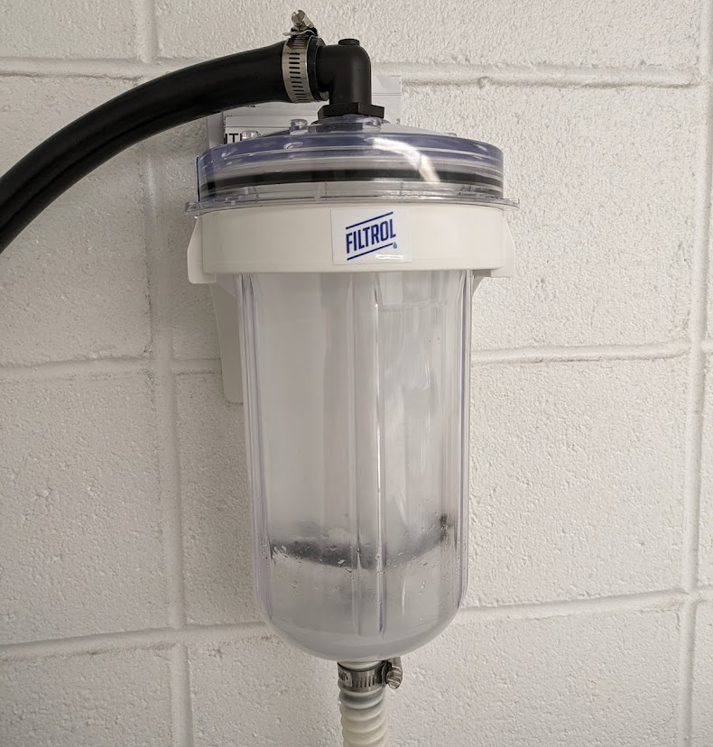
Field Trial of Existing Laundry Filters
Direct laundry filters attach to the drain hose of individual laundry machines.
Directly filter with a mesh bag which requires daily cleaning
Untreated, “wet” mass of intercepted MPs after
14 days: 258.2 g
Extrapolated to the entire Fall and Spring
Semesters: 4 kg

Slide 5
Student Body Microplastic Awareness
In a small survey of students (n=12), a third of respondents did not know what microplastics are.
Current analysis indicates that around 64% of all new textiles are synthetic*
One third of respondents guessed that their wardrobe contained less than 60% synthetic material, and a sixth had no clue.
Only a third of respondents cold wash their laundry, which has been shown to decrease MP shedding.
*https://textileexchange.org/knowledge-center/documents/materials-market-report-2023/

Slide 6
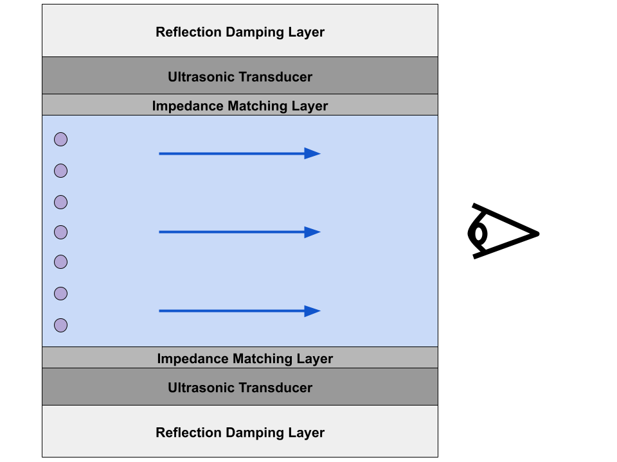
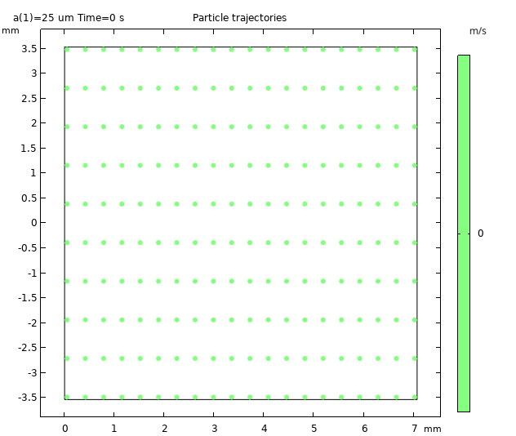
Filtration of the Future
Ultrasound has been explored as an active filtration solution for MPs.
Current research focuses on unmodulated waves used in microfluidic applications.
Amplitude modulation allows for increased
cross-sectional area and throughput.
For a 10 cm section of pipe, this simulation predicts a flow rate of about 39.4 mL/min

Slide 7
Conclusion
Preliminary data indicate that annually, BU emits between 40 kg and 600 kg of MPs
Initial student survey results indicate the need for an MP education campaign.
Laundry filters could be an immediate intervention to curb MP emissions.
Ultrasound as a method of filtration represents a promising path for further research.

