Slide 1
Decision Support for Climate Mitigation Decision Making
BU Campus Climate Lab
10 April 2024
Yura Gao, Anu Dande, Kelly Srivichaiin
Supervised by Prof. Weidman & Prof. Maleyeff
Notes:
Our project is called Decision Support for climate mitigation Decision-making.

Slide 2
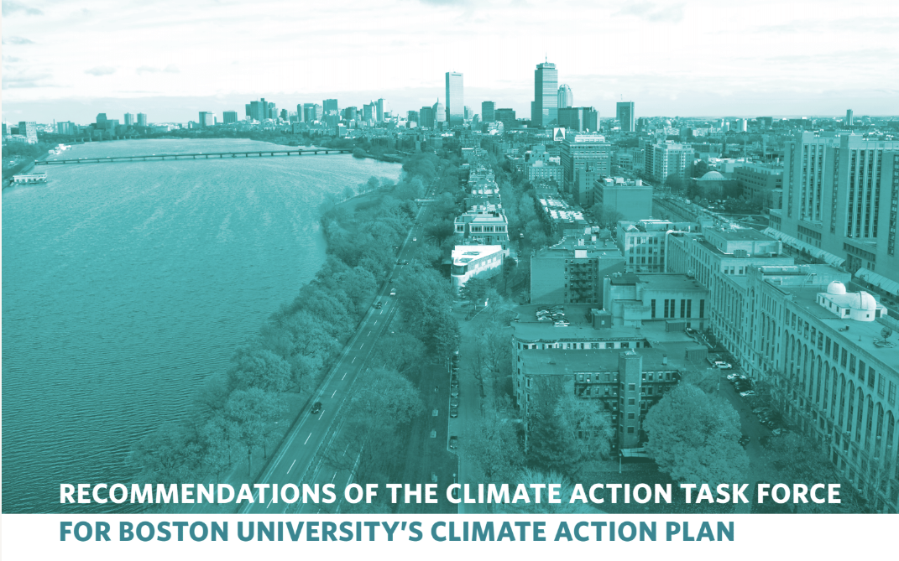
Project Motivation
“decision-making as a process incorporating both rational economics and other aspects of institutional behavior can be both a generator of information and an object of study in its own right.”

Slide 3
Objective and Methodology
We aim to create a decision support system to assist a BU facility manager with making risk response choices in the presence of climate change risks.
Indifference analysis to estimate economic utility of BU activities disruption
Analytical Hierarchy Process (AHP) with pairwise comparisons to rank numerous mitigation options
Color-coded decision aids to illustrate uncertainty

Slide 4
Example: BU Innovation Center
Concern: Window façade on windy Commonwealth Avenue

Slide 5
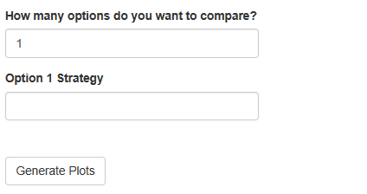
Decision Support System

Slide 6
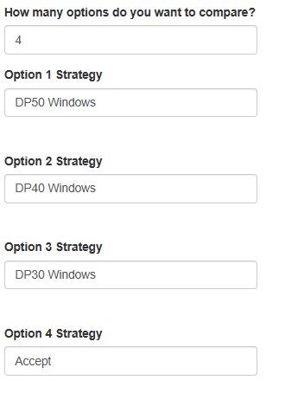
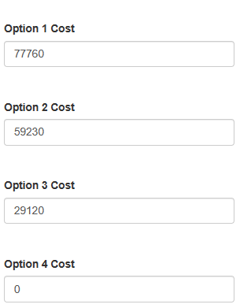
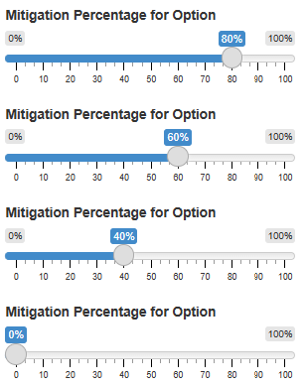
Innovation Center Example

Slide 7
Pairwise Indifference Comparisons
Option 1
Option 2
Option 2
Option 3
VS
VS
Choose Option 1
Choose Option 2
Indifference
Choose Option 2
Choose Option 3
Indifference
Option 1
Option 3
Option 2
Accept
VS
VS
Choose Option 1
Choose Option 3
Indifference
Choose Option 2
Choose Accept
Indifference
Option 1
Accept
Option 3
Accept
VS
VS
Choose Option 1
Choose Accept
Indifference
Choose Option 3
Choose Accept
Indifference

Slide 8
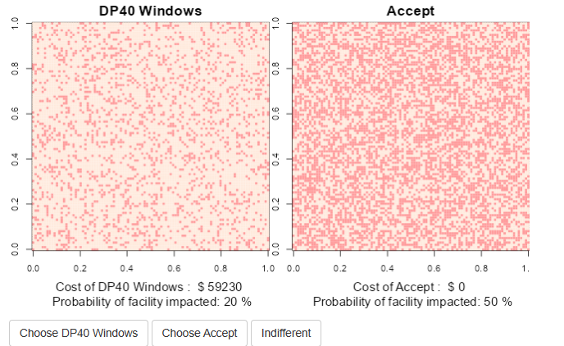
Example Pairwise Comparison - 1

Slide 9
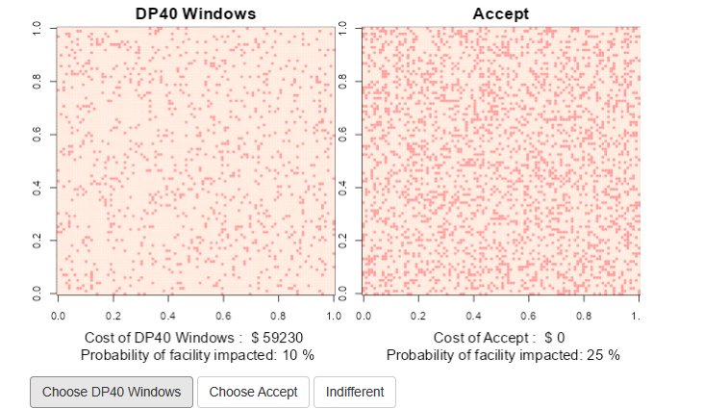
Example Pairwise Comparison - 2

Slide 10
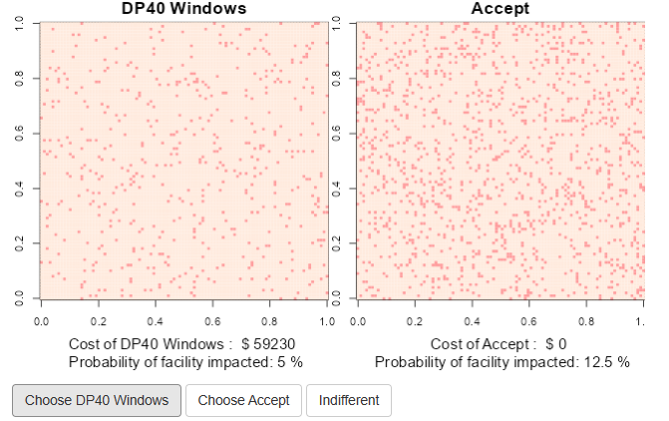
Example Pairwise Comparison - 3

Slide 11
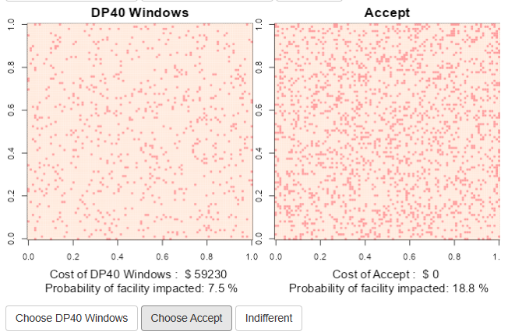
Example Pairwise Comparison - 4

Slide 12
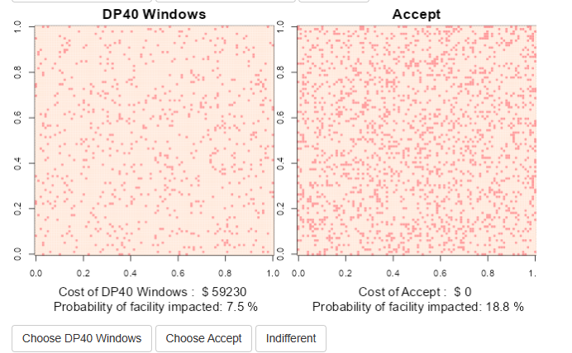
Example Pairwise Comparison - 5

Slide 13
Response Options Ranking
The Best Option is: DP50 Windows
DP50 Windows
DP40 Windows
DP30 Windows
Accept

