Slide 1
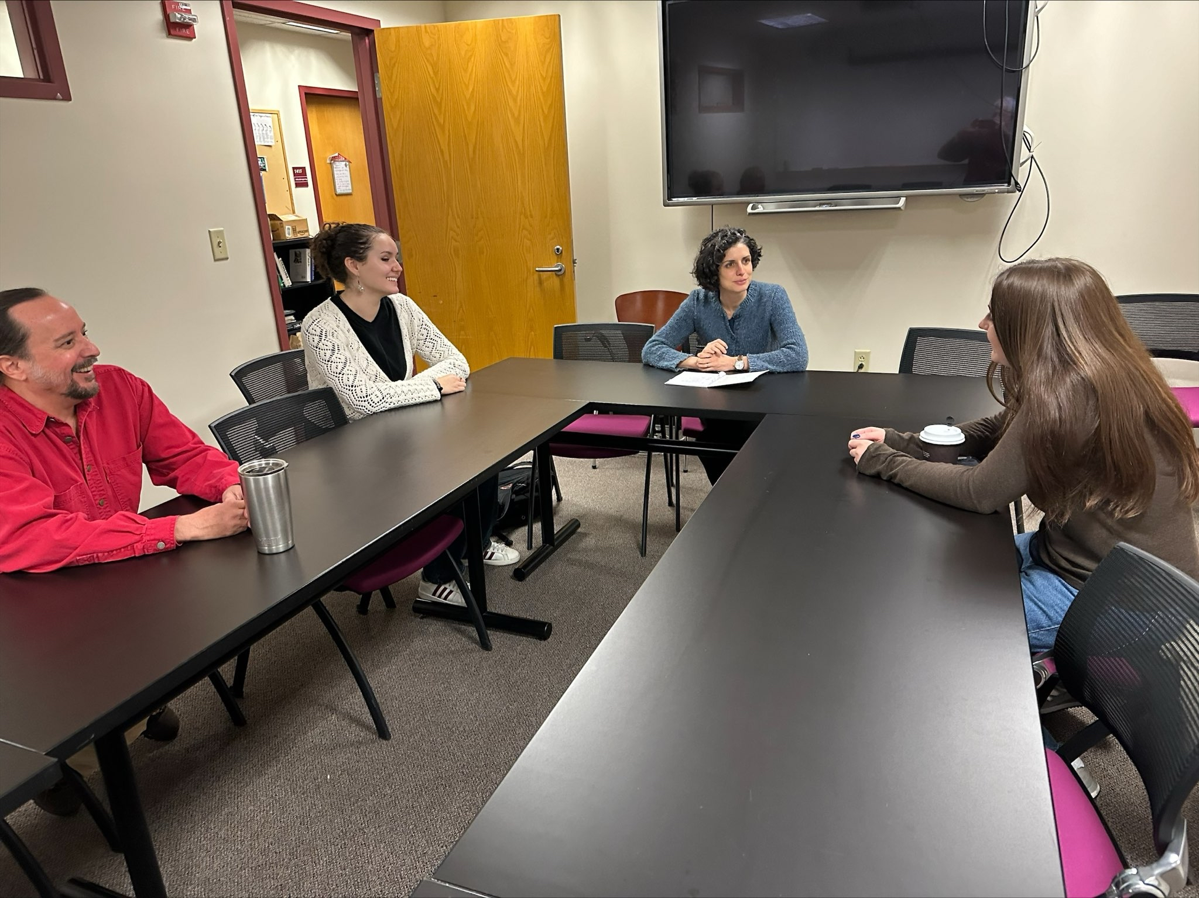
Campus Climate Lab
Student-Generated Solutions for Environmental Justice
at Boston University
Project Team:
Student Researchers
Alexia Nastasia
Cole Wilkins
Abby Dandrow
Faculty Mentors
Eric Michael Kelley, Department of Anthropology
Caterina Scaramelli, Department of Earth and Environment
Operations Support
James Eddy, Howard Thurman Center for Common Ground
Alison Parker, Geddes Language Center

Slide 2
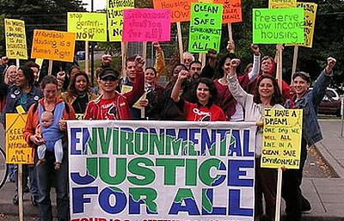
PROJECT OVERVIEW & SIGNIFICANCE
Anthropological research project with a community action focus
Scope:
to investigate the impact of existing environmental justice efforts at BU
to outline student recommendations on what can be improved for environmental justice efforts at BU
Unique features:
qualitative research leading to rich data
focus on students with diverse identities at BU
Phases:
Phase 1, Fall 2023: Literature review + database of existing initiatives
Phase 2, Spring 2024: Interviews + focus groups with BIPOC students, DACA students, students with recent immigrant backgrounds, students with refugee status, international students, and LGBTQ students
Photo Credit: Coming Clean
Notes:
Alexia Nastasia

Slide 3
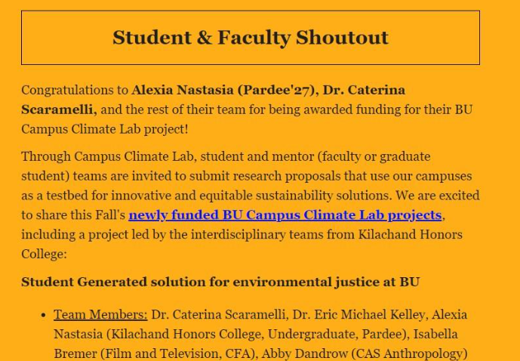
FINDINGS FROM PHASE 1
From the literature review:
Environmental problems faced by historically underprivileged communities (e.g. BIPOC) are not adequately addressed by mainstream environmental movements
The climate crisis should be addressed with:
a participatory approach including disadvantaged communities from project design to implementation
long-term partnerships sustained through mechanisms of democratic deliberation
The inclusion of students of diverse backgrounds in environmental justice projects increases effectiveness and innovation
From the database of BU efforts:
Many BU units (departments, programs, centers, student organizations) provided thoughtful responses to inquiry on what environmental justice means to them and what environmental justice efforts activities they organize
Responses ranging from a unit reporting no activity related to environmental justice to a unit’s leader arguing that “each of our activities contributes towards improving justice.”
Most utilized strategies: events, speakers, seminars, position papers, publications, community cleanups
Project Report
Notes:
Abby Dandrow

Slide 4
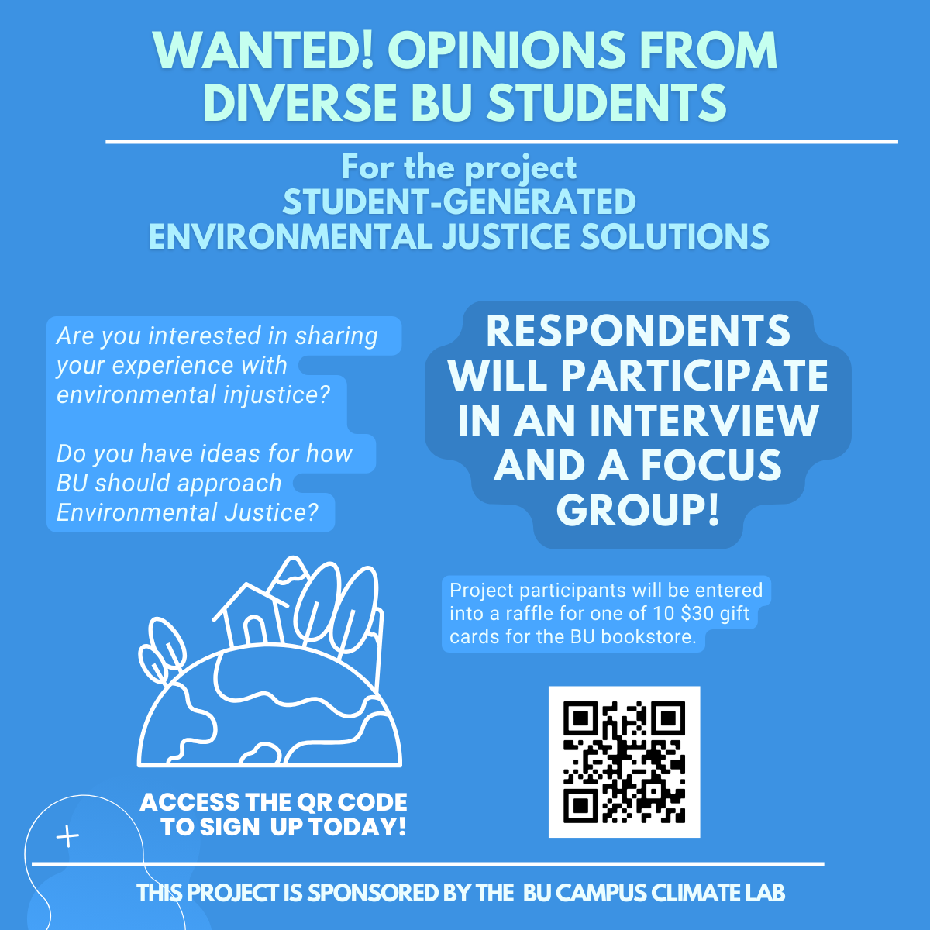
FINDINGS FROM PHASE 2
Developments:
Results are slowly coming in
We are learning about the challenges of making student voices heard
Emerging findings:
Students are among the most vulnerable groups to the climate crisis
Environmental injustice issues students encounter frequently: transportation, food, heating/cooling systems and affordability, safety during extreme weather generated by climate change
Environmental justice innovations proposed by students (emerging themes): inclusion of student voices into university governance practices, investment in green infrastructure, adaptation of services available to spatial characteristics
Notes:
Cole Wilkins

Slide 5
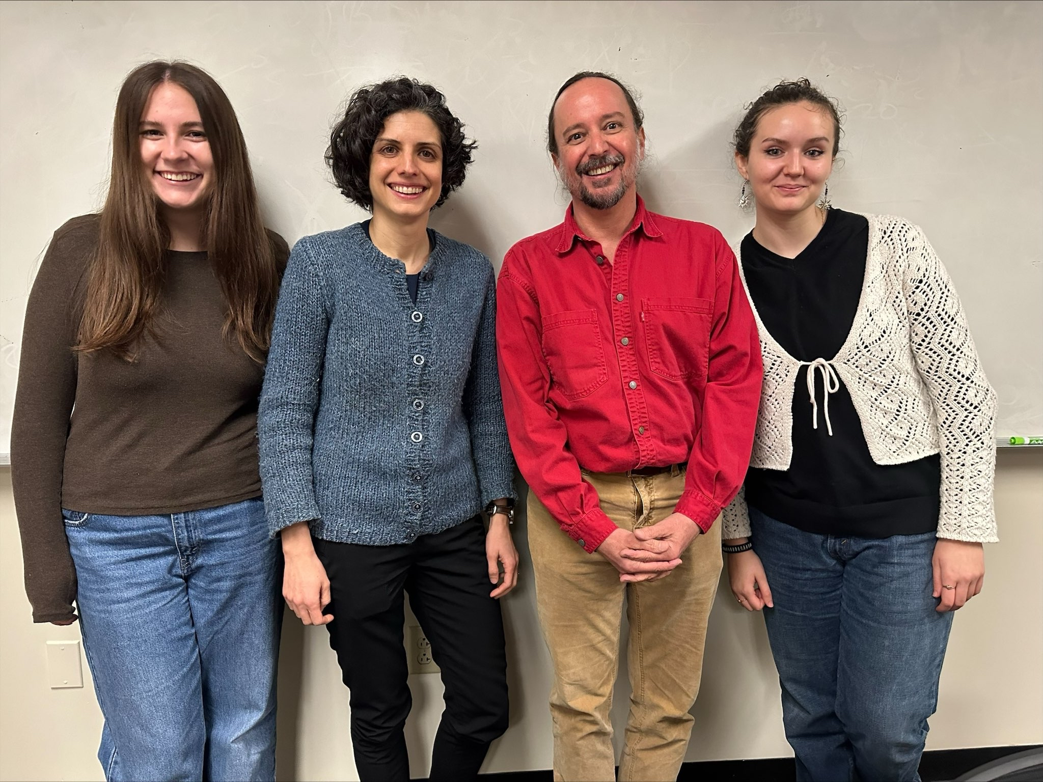
Campus Climate Lab
Student-Generated Solutions for Environmental Justice
at Boston University
Thank you for listening to our presentation!
Questions?

