Slide 1
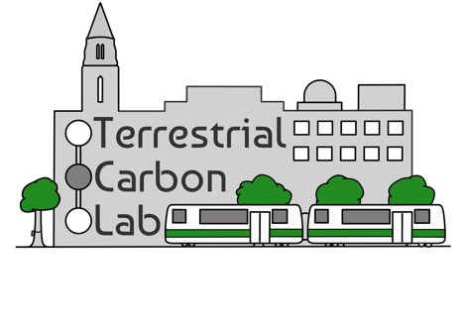
INDEXING BU’S GREEN SPACE UTILIZATION FOR EQUITABLE DISTRIBUTION
Mya Briones (CAS ‘23)
Jessica Schwarz (CAS ‘25)
Ian Smith (CAS ‘17/GRS ‘23)
Department of Earth and Environment, Boston University
²Department of Environmental Health, Boston University
April 10, 2024

Slide 2
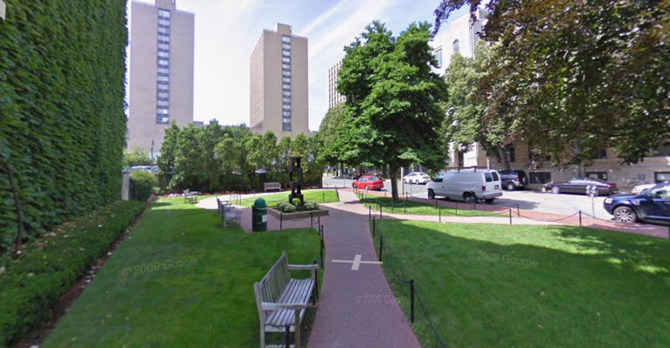
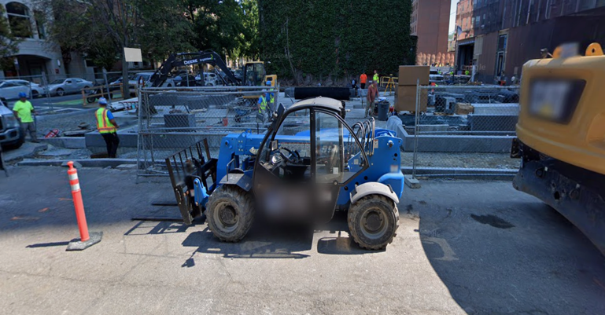
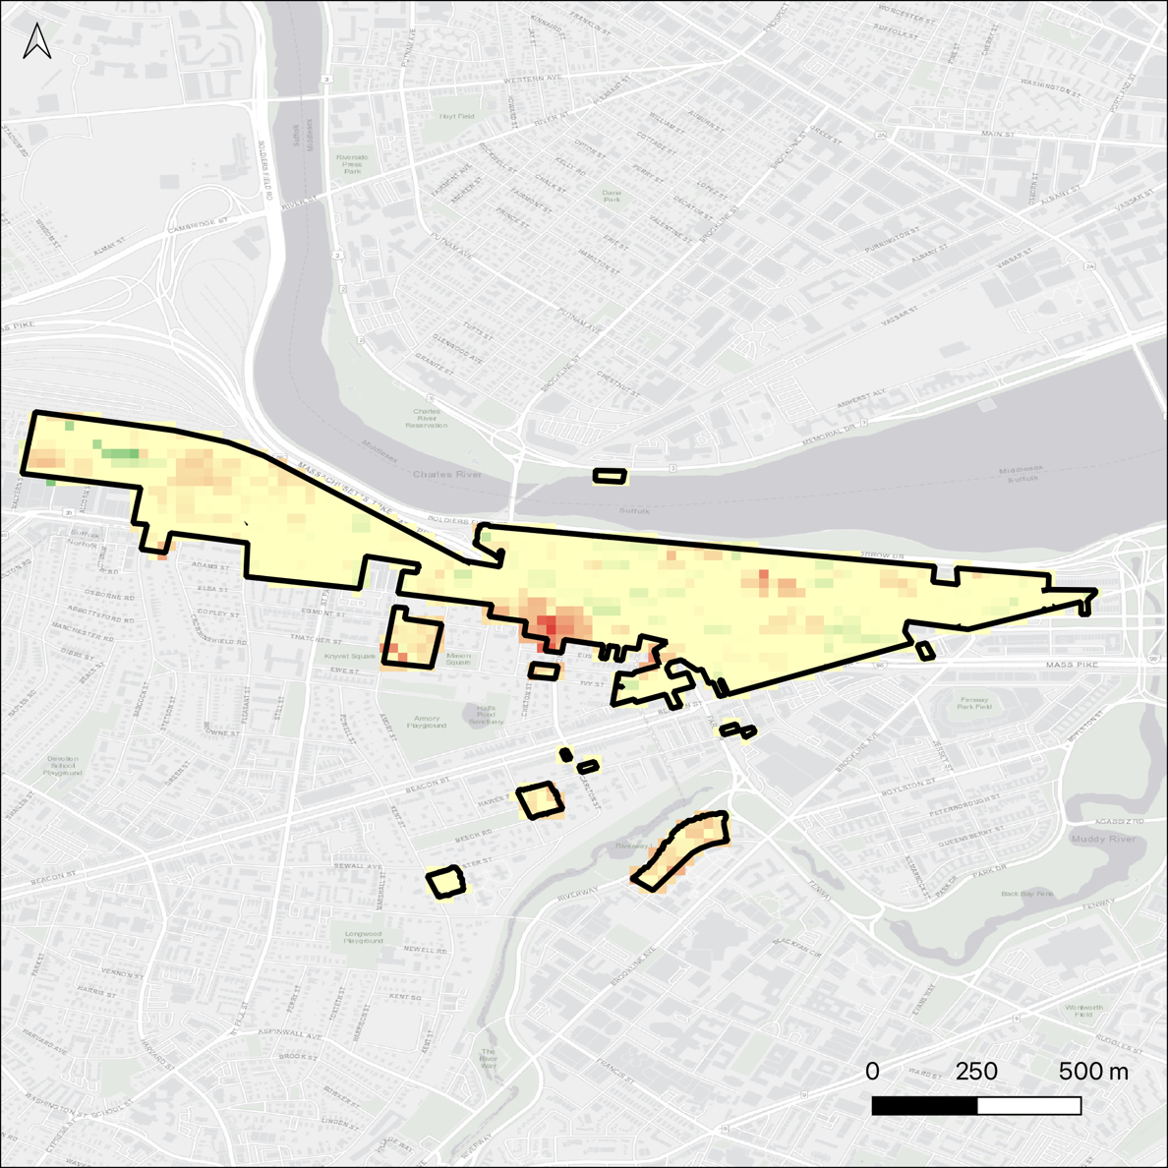
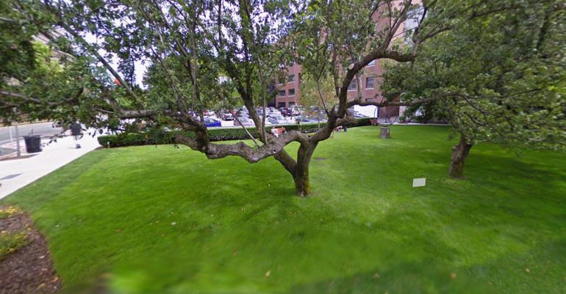
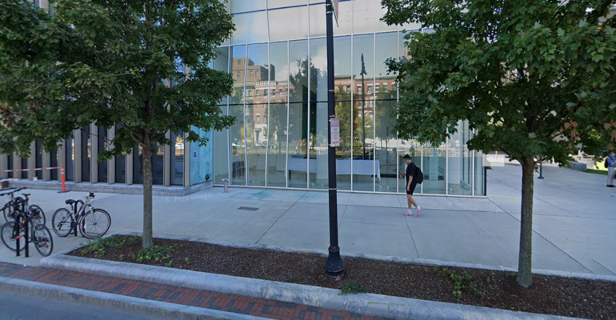
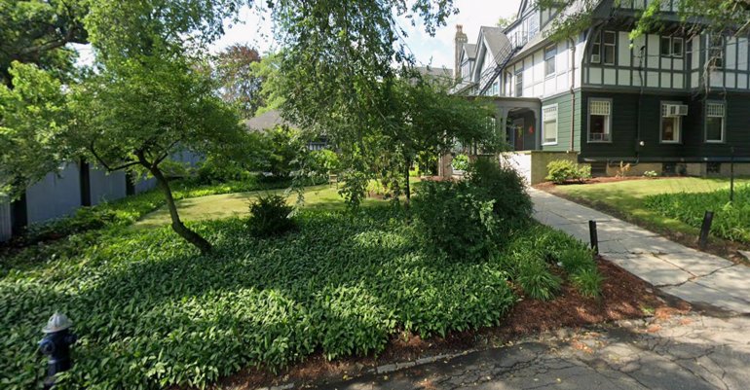
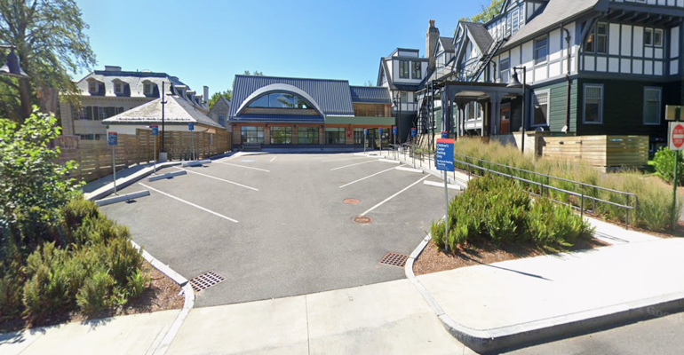
Introduction: Green Space Trends on an Urban Campus
CRC Greenness Trend
(2013 – 2023)
More Green
Less Green

Slide 3
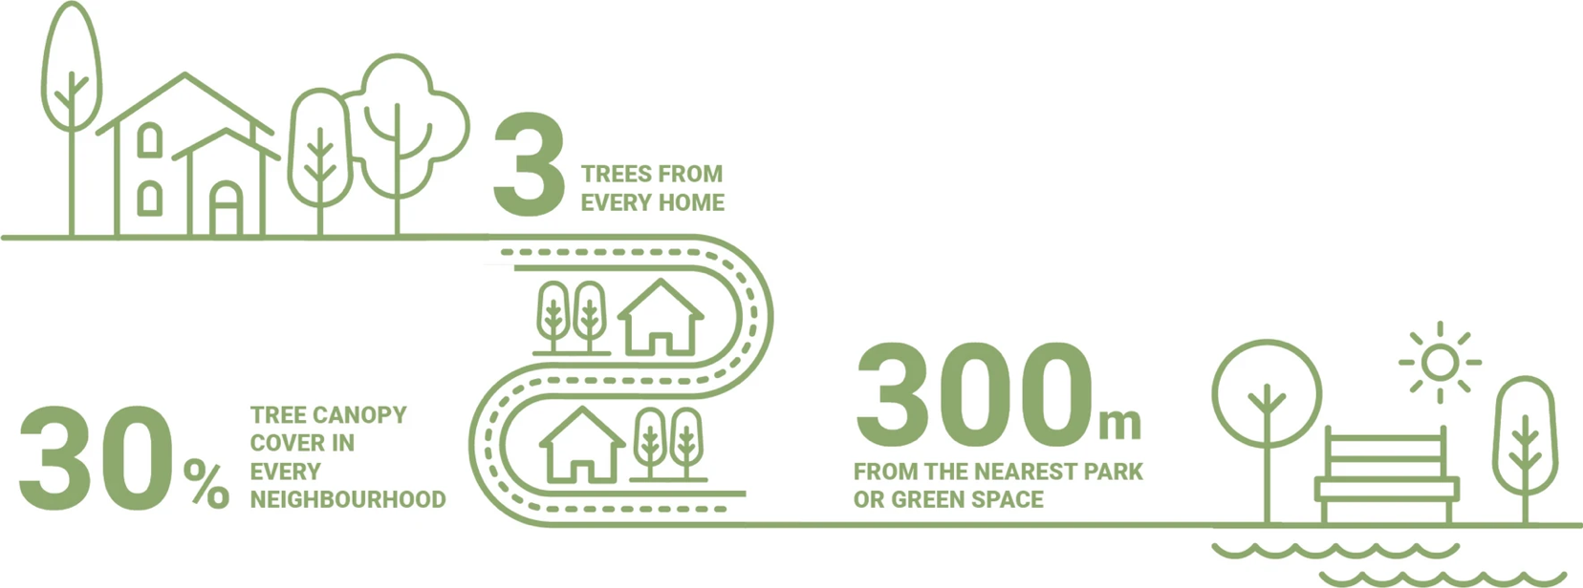
Motivation:
Benefits of Urban Green Spaces
Reducing Harm
Exposure reduction to environmental stressors such as heat & flooding
Restoring Capacities
Attention restoration and psychophysiological stress recovery
Building Capacities
Encouragement of physical activity and facilitation of social cohesion
To what extent does BU’s green space distribution comply with the 3-30-300 rule?

Slide 4
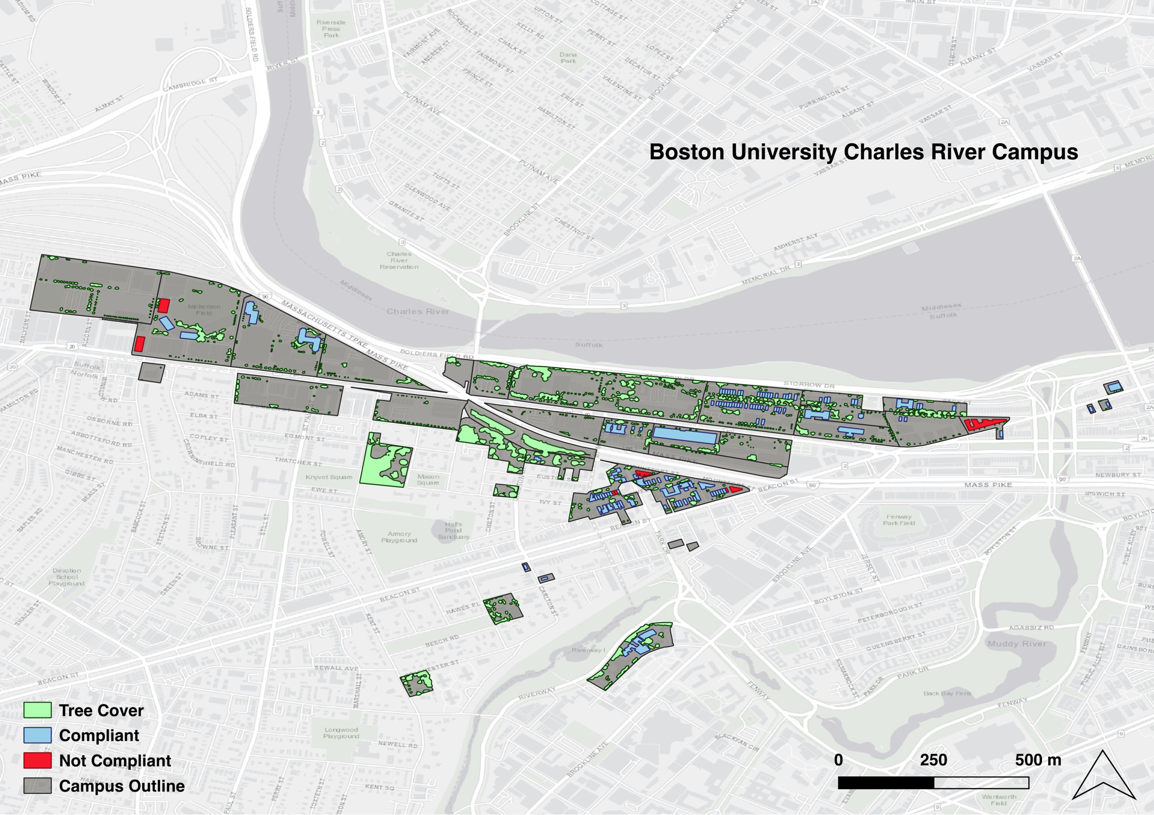
Results: 3 Trees from Every Residence
Compliance in 118 out of 126 student residences (93.6%)
Improvements could be made in part of West Campus, South Campus, and East Campus Residences

Slide 5
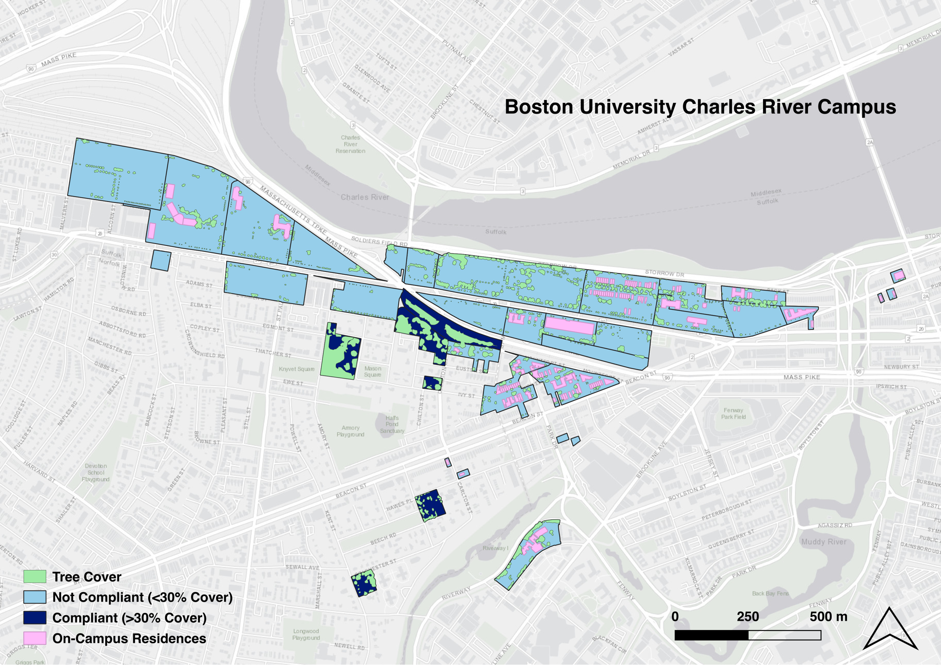
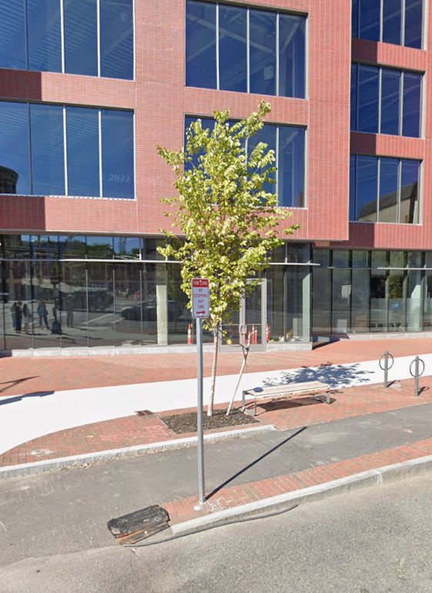
Results: 30% Canopy Cover in Each Neighborhood
Compliance in 0 out of 126 student residences (0.0%)
Lack of tree cover is primarily driven by the size/age of street trees

Slide 6
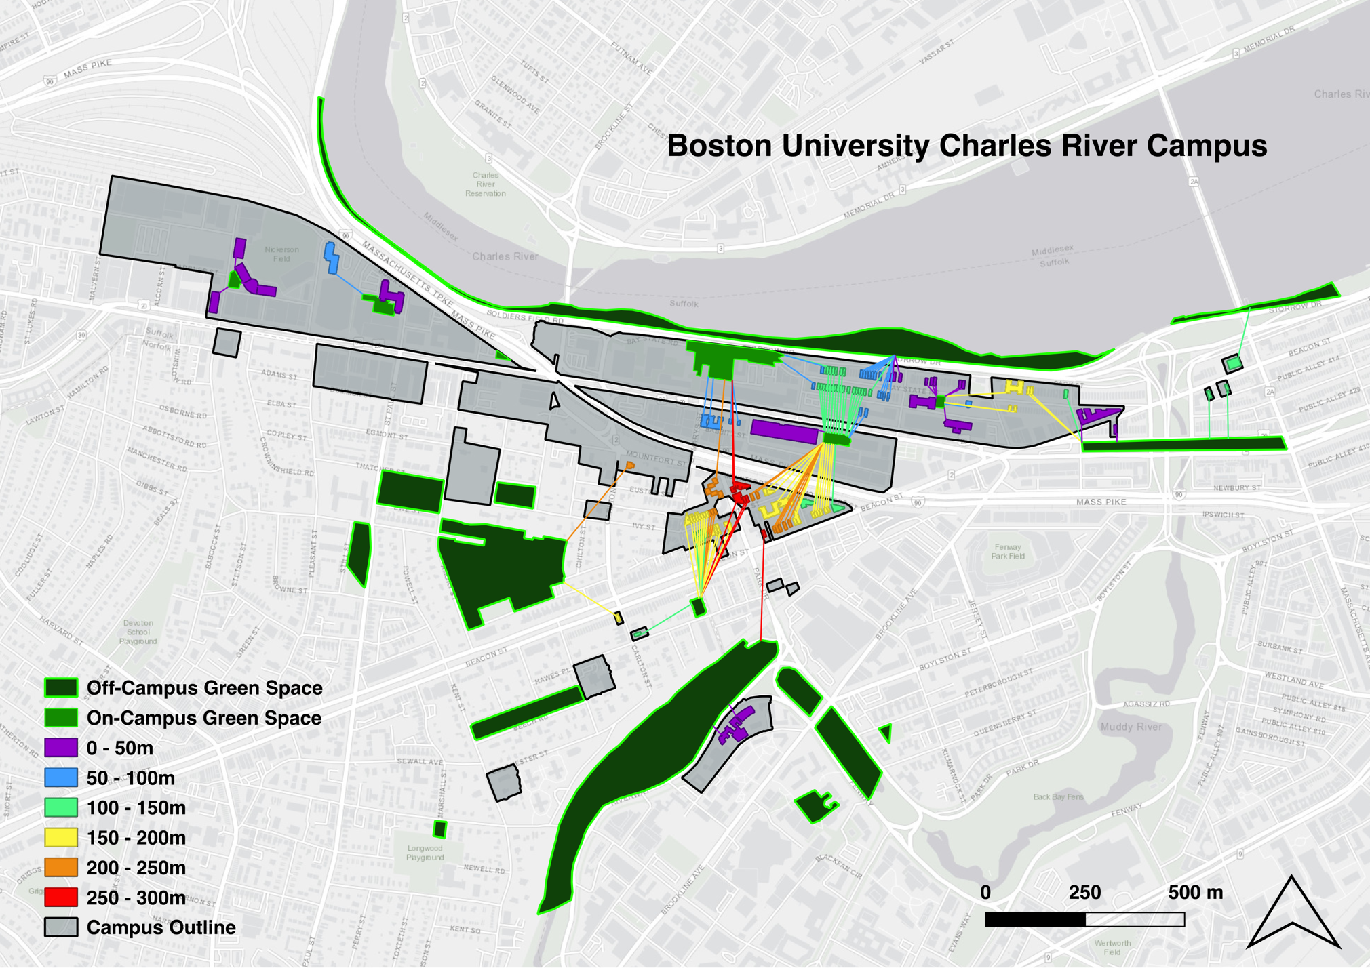
Results: Green Spaces within 300m of Each Residence
Compliance in 126 out of 126 student residences (100.0%)
Furthest student residences from green spaces are concentrated in South Campus

Slide 7
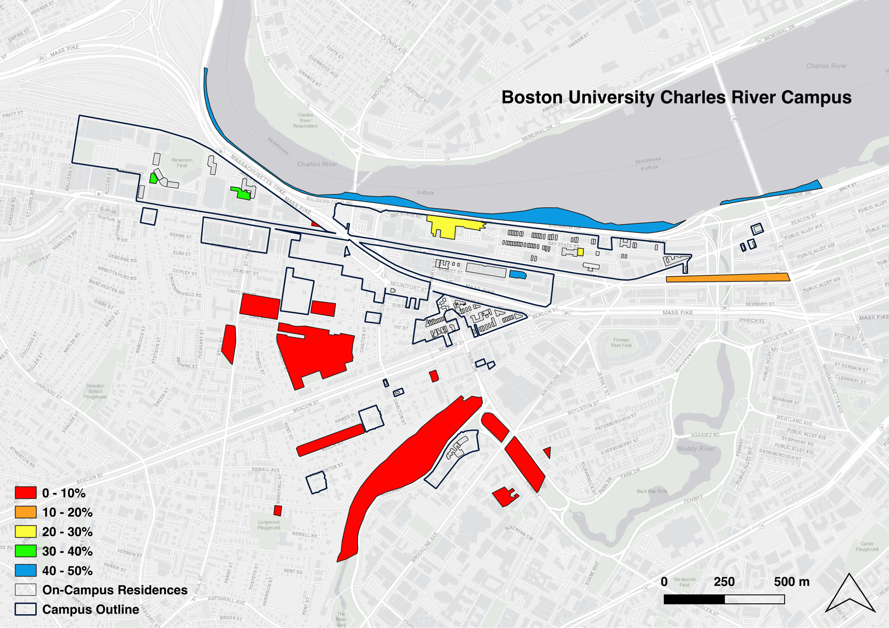
Results: Most Accessible Green Spaces on Campus
The most accessible green spaces from student residences are COMM Lawn (on-campus) and The Esplanade (off-campus)

Slide 8
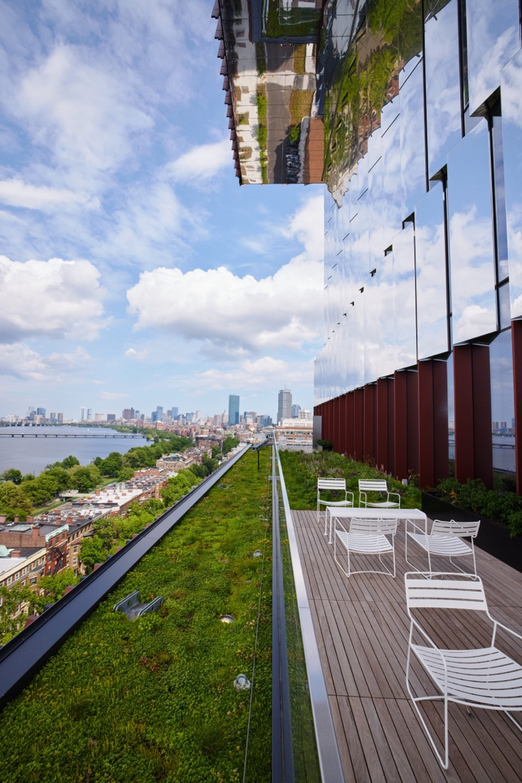
Recommendations:
1) Support/maintain young trees to increase tree canopy In densely populated neighborhoods
2) Preserve existing green spaces during new construction
and integrate green building infrastructure
Thank you!
Questions?

