Slide 1
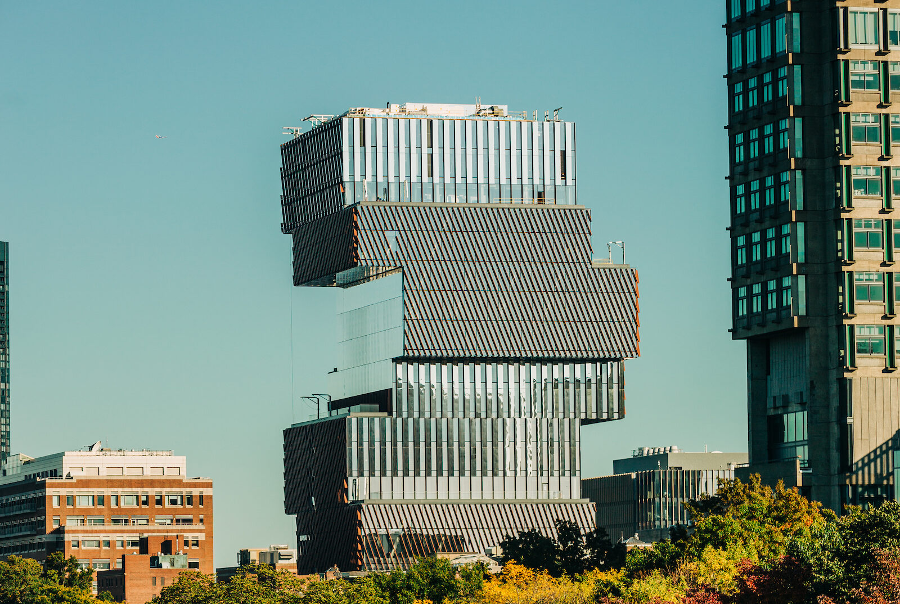
Evaluating Storage Systems for Decarbonized All-electric Buildings to reduce Peak Loads: CCDS Bldg
The problem: observe large peaks in CCDS. Impacts grid & create high demand charges
Two solutions: Electrical & thermal storage.
What causes the large electrical peaks?
Comparative performance: CCDS to other large BU building
Implications & Next Steps
Student : James Roberts (ENG ME ‘25) Faculty advisor: Michael Gevelber
BU Staff collaborators : Joe Kajunski, Mike Pieroni (CCDS bldg. manager) Multi Stack: Greg Furst

Slide 2
Overview of All-Electric Decarbonized CCDS Building
6 Electric boilers
Each 324 KW!
(& 50% of total heating capacity).
Ground source Heat Pump
All Electric Building: Zero CO₂ emissions!
Use Ground Source Heat Pumps (very efficient) to heat/cool building
When Heat Pump can not meet heating load, Electric Boilers turn on
Results in large increase in electrical demand

Slide 3
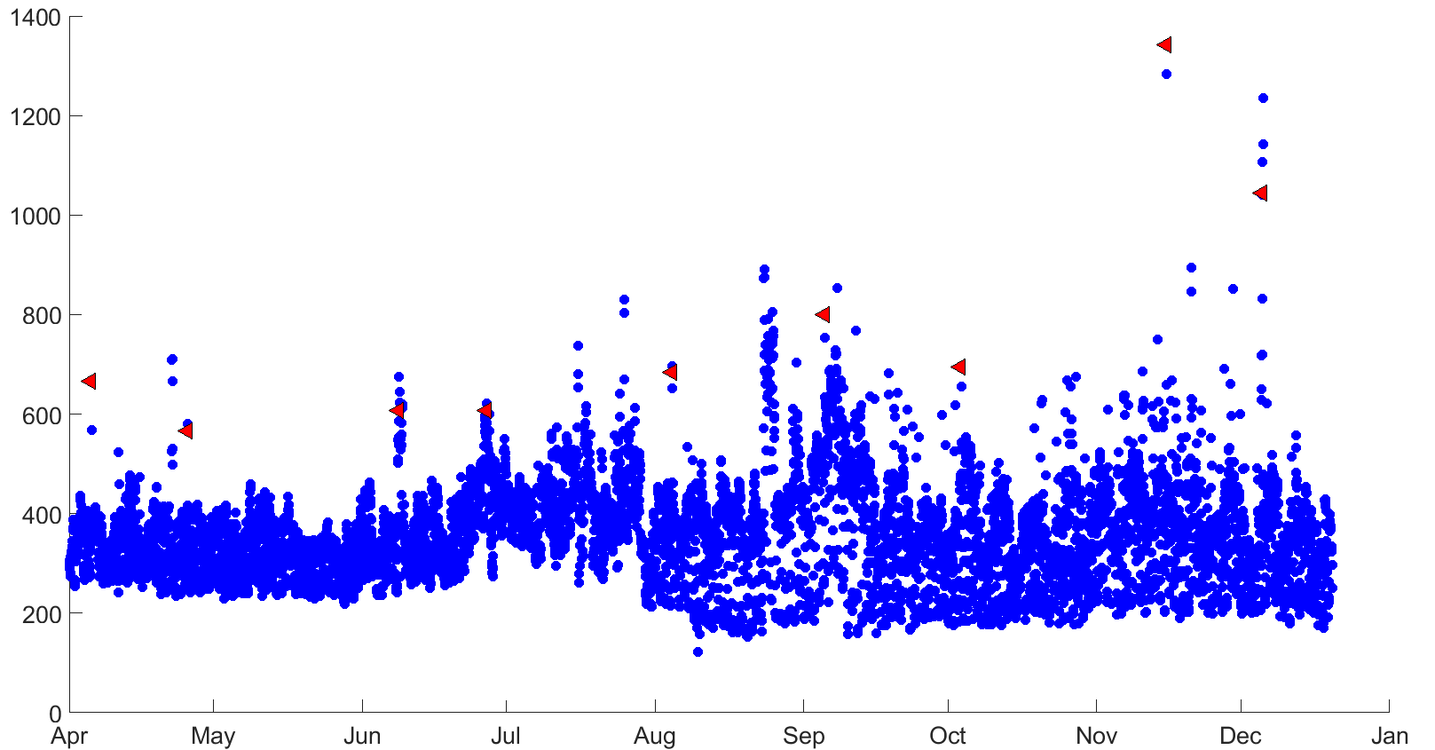
Current Performance (electrical demand) of CCDS Bldg
Demand on Grid: As more heat pumps are used in Boston, expect they will spike together on coldest days: huge grid demand!
Cost: for 1 spike, pay large demand charge for whole month. ~40-50% of electrical charges
Solutions?
Monthly peak demand
Hourly Electricity demand (kW)
Electricity Demand

Slide 4
Solutions: Thermal & Electrical Storage
Equivalent “capacity”:
- 890 kWH of Li-ion batteries
- 9000 gallons of Hot water (150F)
Cost:
Electric Battery: $155,000 & fire issues.
Thermal Storage: $60,000. (includes heat pump)

Slide 5
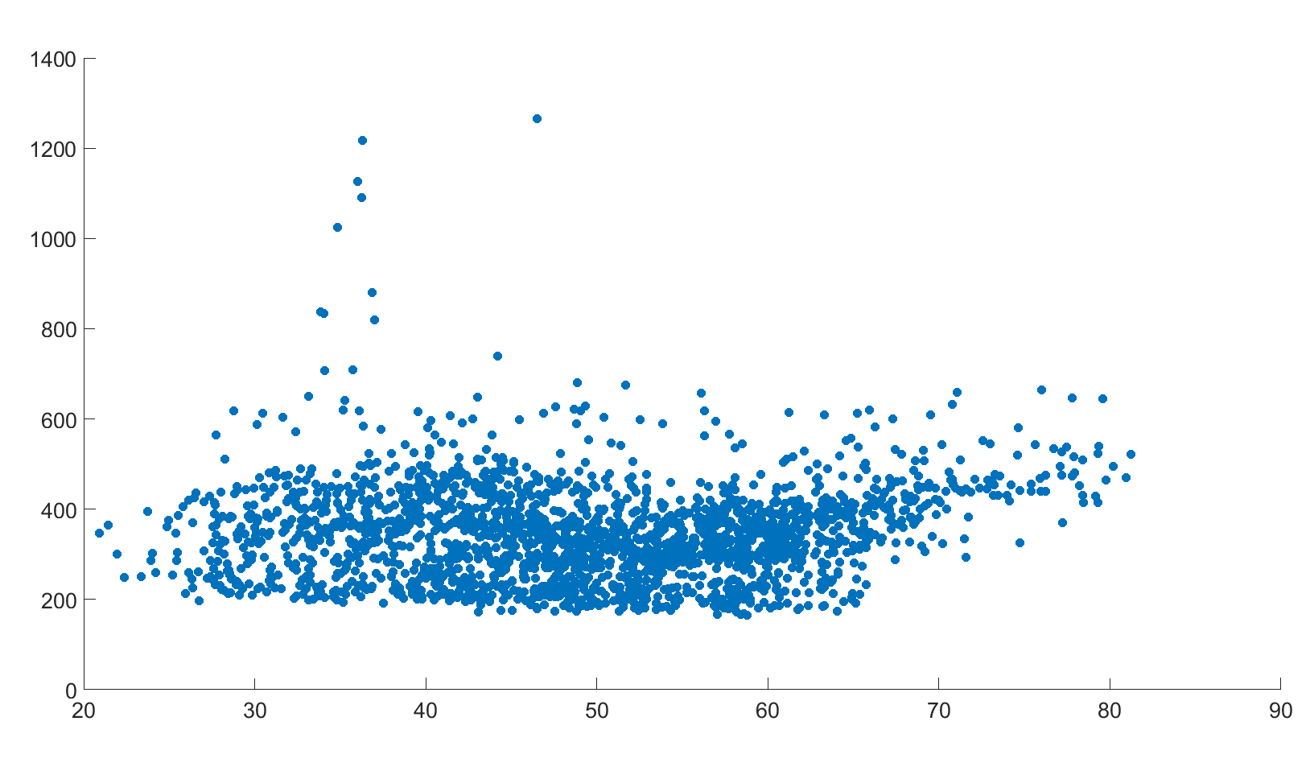
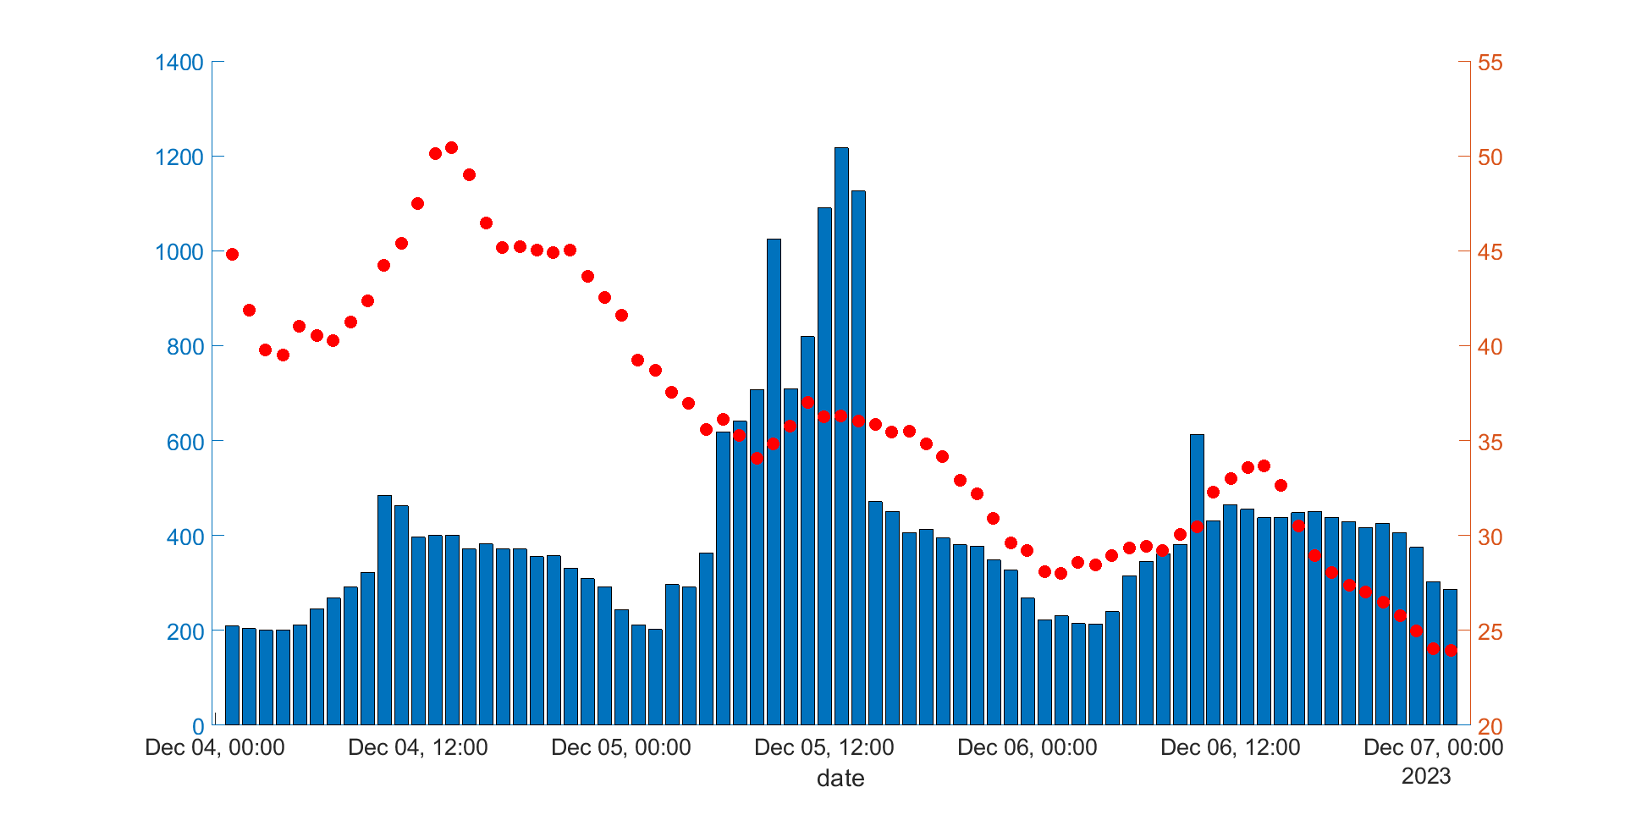
What creates large CCDS electrical spikes?
Question: what drives spikes if not outside temperature?
Hunch: better building HVAC program can reduce those spikes
What drives peak demand? 1MW
Opportunities to decrease peak demand charges
T outside
T min 27 F
Electricity demand (kW)
Elec Demand
Outside air Temp (F)
Electricity demand (kW)
Outside air temperature (F)

Slide 6
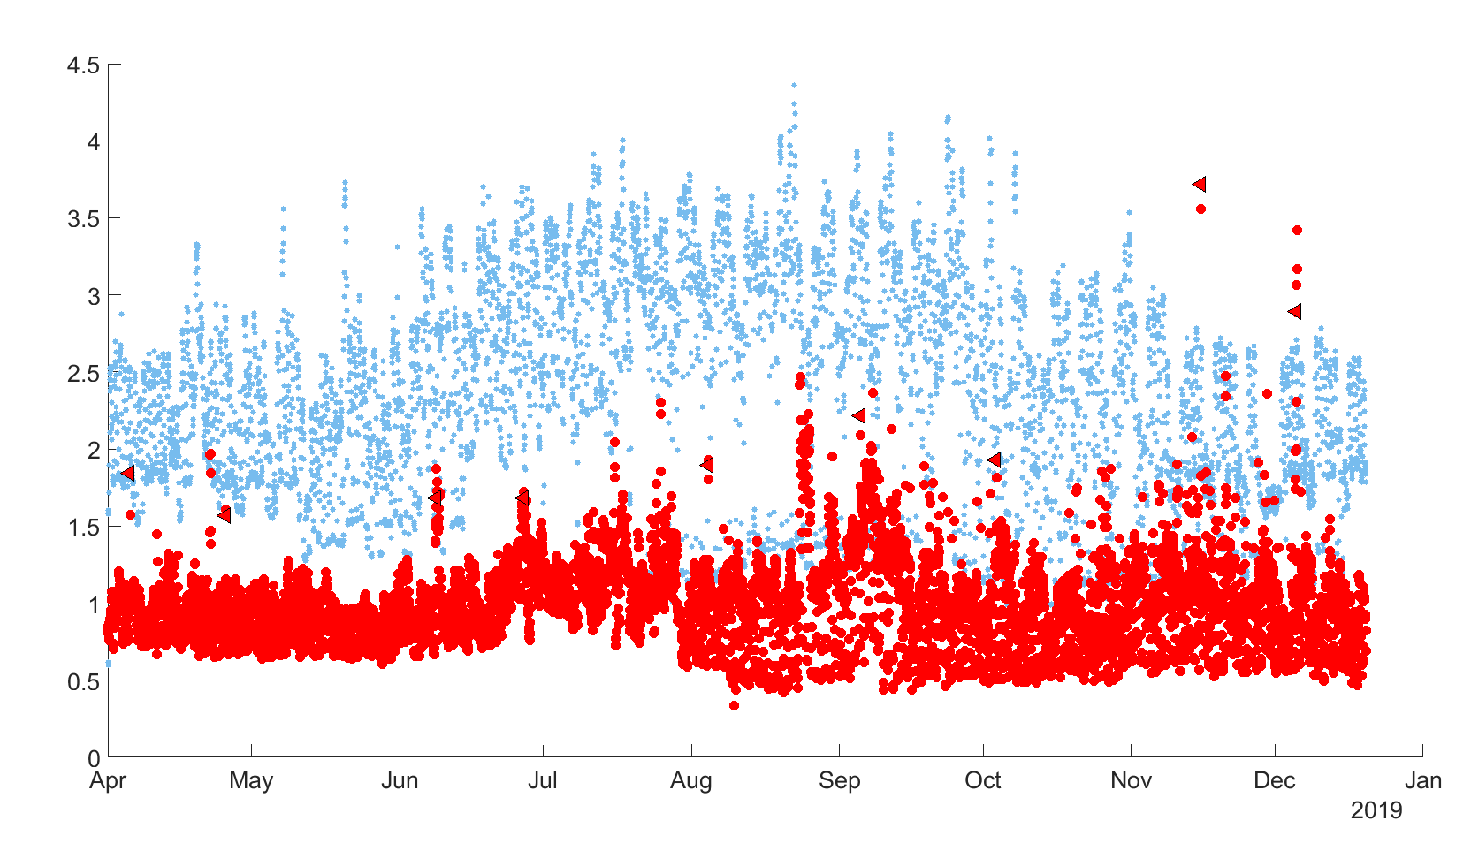
Comparative Large building performance: CCDS to Hariri
Great Performance of CCDS (includes heating!) ~3.0+X better
Reason: great HVAC design , right-size airflow, GSHP, all-glass exterior.
Hariri
CCDS
*demand normalized per 1000 sq ft

Slide 7
Implications & Next Steps
Building Operations: How to change the building software to reduce CCDS peaks. Continue working with facilities.
Question: What do we expect for the relation of large peaks to outside temperature, especially with air source heat pumps?
New technical approach: to what extent can we reduce peaks further with thermal storage?
Implications for how existing building air source heat pumps will perform as we roll-out BU decarbonization plan.

