Slide 1
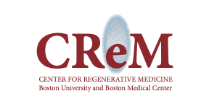
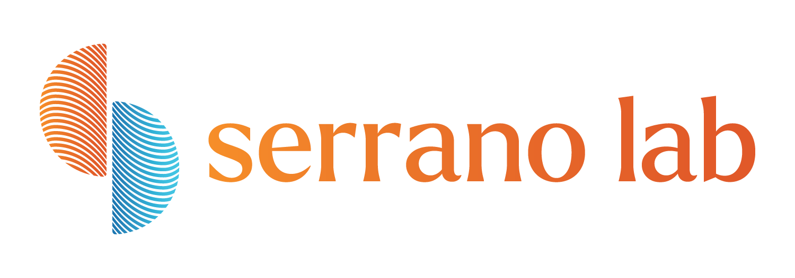


Establishing Sustainable Laboratory Practices and Standard Operating Procedures That Offset Waste Production in Biomedical Research
Saylor Williams
Serano Lab Manager
Center for Regenerative Medicine
saylorw@bu.edu
Carly Golden
PhD Student
Molecular & Translational Medicine
Center for Regenerative Medicine
csgolden@bu.edu
Greg Miller, PhD
CReM Lab Manager
Center for Regenerative Medicine
millergr@bu.edu
Angie Serrano, PhD
Mentor & PI
Center for Regenerative Medicine
masser@bu.edu
Notes:
Thank you, the title of the presentation I will be giving today is, Establishing Sustainable Laboratory Practices and Standard Operating Procedures That Offset Waste Production in Biomedical Research. I want to acknowledge that Carly, Angie, and Greg are working on this project with me, and it would not be possible without the collaboration of everyone.

Slide 2
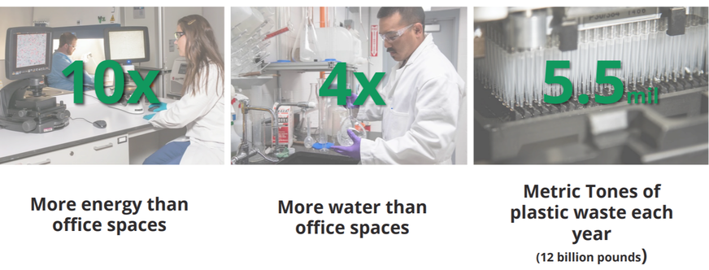
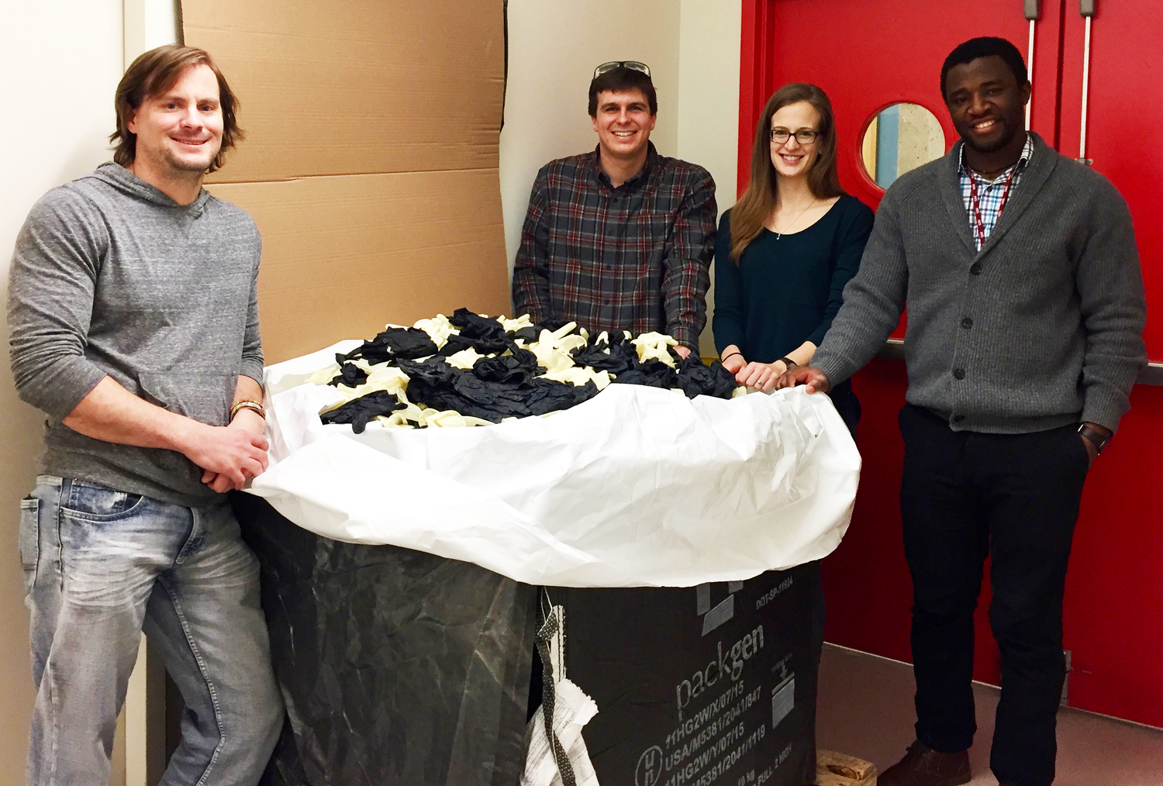
Research labs produce 12 billion lbs of plastic/yr
MyGreenLabs.org, MIT
Notes:
Research laboratories rely on numerous energy sources to function day to day, such as energy, plastics, and water. Research laboratories produce 12 billion pounds of plastic waste a year, making biomedical single-use plastics one of the driving factors of plastic waste production worldwide.
A huge amount of waste can also be generated by the gloves that scientists use daily to perform their experiments. To put it in perspective, here is a picture of graduate students from MIT collecting gloves to recycle through the Kimberly Clark RightCycle Program. It is easy to forget the amount of waste that we can generate on a daily, weekly, or yearly basis.
The Serrano Lab is a newly established lab at the Center for Regenerative Medicine (CReM) and we wanted to incorporate laboratory sustainability into our mission as a lab. With us being a new lab, we were at the unique position where we could implement sustainability from the very beginning and adapt changes as our lab evolves.

Slide 3
How can research laboratories decrease the amount of waste generated?
Indirect Emissions
Goal: Provide BU with valuable knowledge about waste produced in their research labs and with clear SOPs that sustainably manage it.
Notes:
This led us to our project for the Campus Climate Lab, where we wanted to look at the different ways research laboratories produce waste, such as plastic use and energy, and see how we can offset the impact they have on the environment. Our overall goal is to essentially create an SOP that can be used by any lab that outlines various sustainable practices, the financial commitment, and the impact they will have on the environment.
We have implemented different recycling programs at the Center for Regerneative Medicine were not only our lab, but the 8 other labs at the Center have been able to participate in. I’m going to share our progress so far.

Slide 4

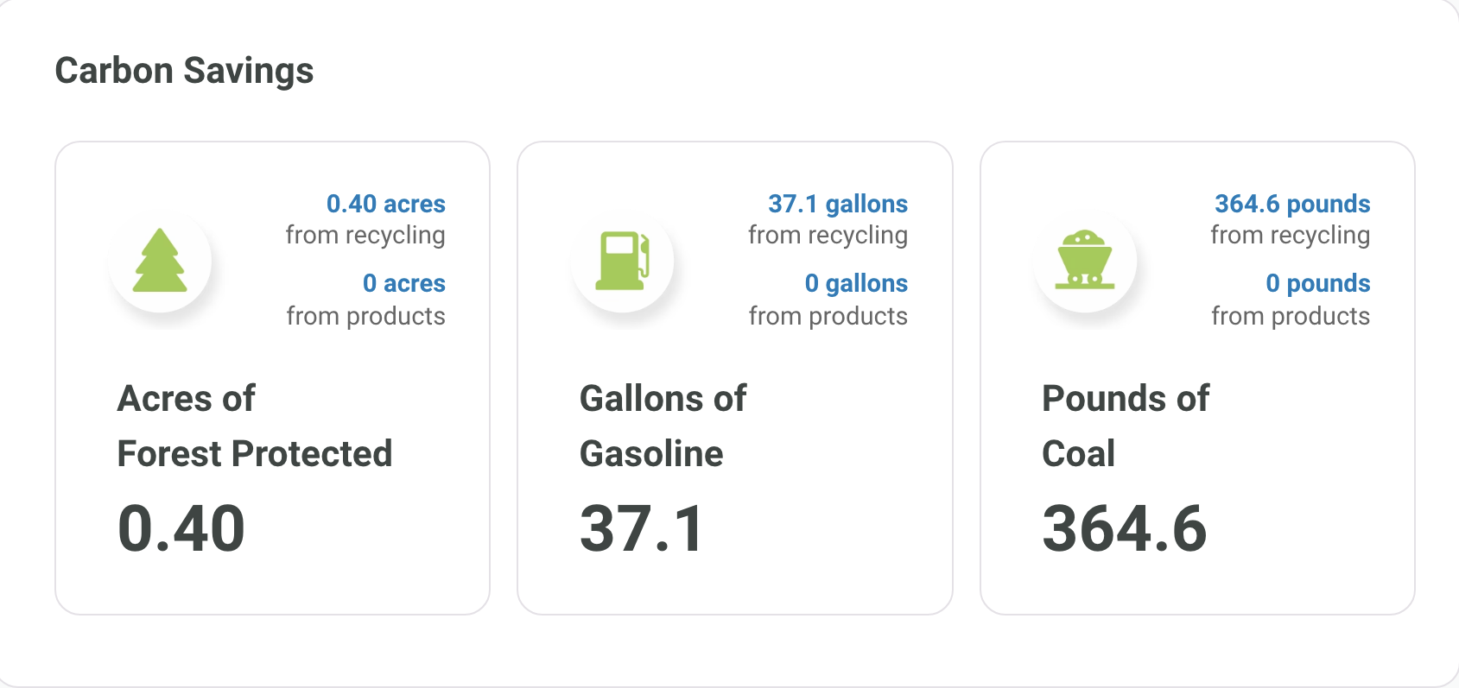
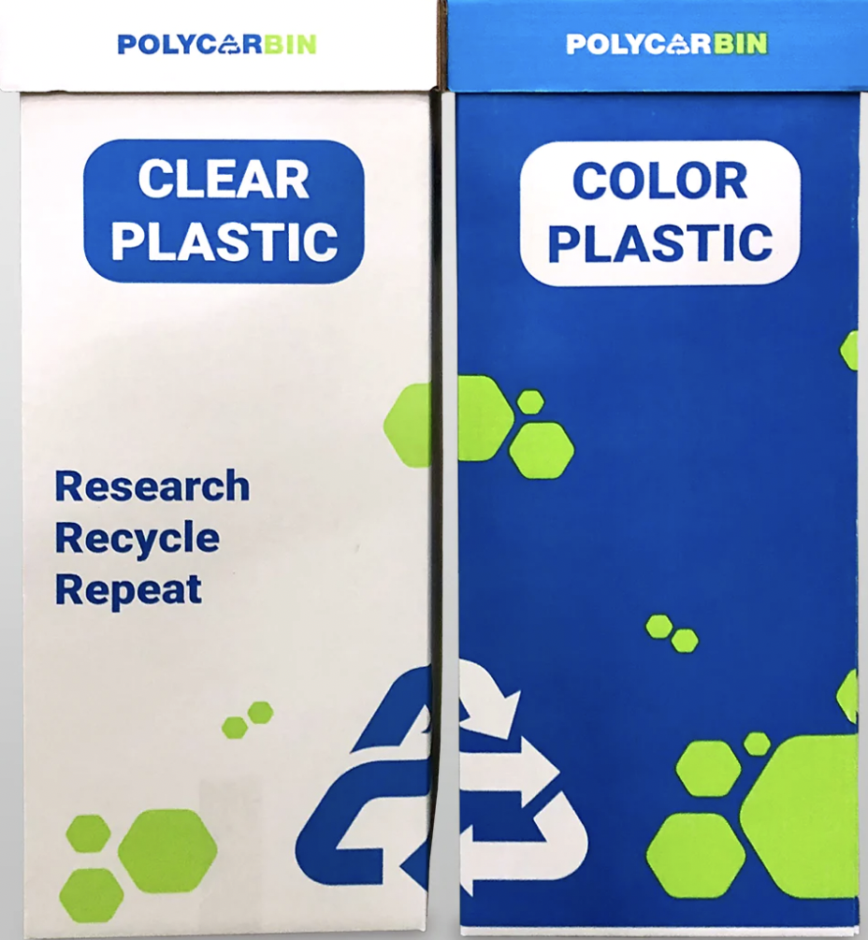
557 lbs
418 lbs
Notes:
January 17th Polycarbin boxes were put out across the CReM
186 lbs of plastic a month
The first sustainable practice we implemented was recycling single-use plastic. We are working with Polycarbin, which is dedicated to not only recycling research plastic, but closing the loop by circulating the plastic they recycle back into research products.
In January we placed recycling bins in 4 places at the Center for Regenerative Medicine for all of the different labs to use to recycle any plastic that did not come in contact with hazardous materials. Since Janurary we have recycling 557 lbs of plastic, which is roughly equivalent to 185 lbs of plastic per month.. Of this 557 pounds, 418 pounds have been circulated and were made into research products.
One feature of Polycarbin that I really like, is that they track the impact that your recycling has. For example, we can see that through this program we have saved .40 acres of forest, 37.1 gallons of gasoline, and 364.6 pounds of coal.
The first sustainable practice we implemented was recycling single-use plastic. We are working with Polycarbin, which is dedicated to not only recycling research plastic, but closing the loop by circulating the plastic they recycle back into research products.
In January we placed recycling bins in 4 places at the Center for Regenerative Medicine for all of the different labs to use to recycle any plastic that did not come in contact with hazardous materials. Since Janurary we have recycling 557 lbs of plastic, which is roughly equivalent to 185 lbs of plastic per month.. Of this 557 pounds, 418 pounds have been circulated and were made into research products.
One feature of Polycarbin that I really like, is that they track the impact that your recycling has. For example, we can see that through this program we have saved .40 acres of forest, 37.1 gallons of gasoline, and 364.6 pounds of coal.
Serrano Lab
Our lab has filled up 5 recycling boxes since last November. 3 of those boxes were for clear plastics and 2 of them were for colored.
Our lab starting using the recycling a few months before we introduced it to the rest of the CReM.
We are averaging 1 box a month for our lab. We are a very small lab with only 2 full time members doing bench work.
For styrofoam we typically average roughly 10 boxes a month. This does vary depending on how much we need to order

Slide 5
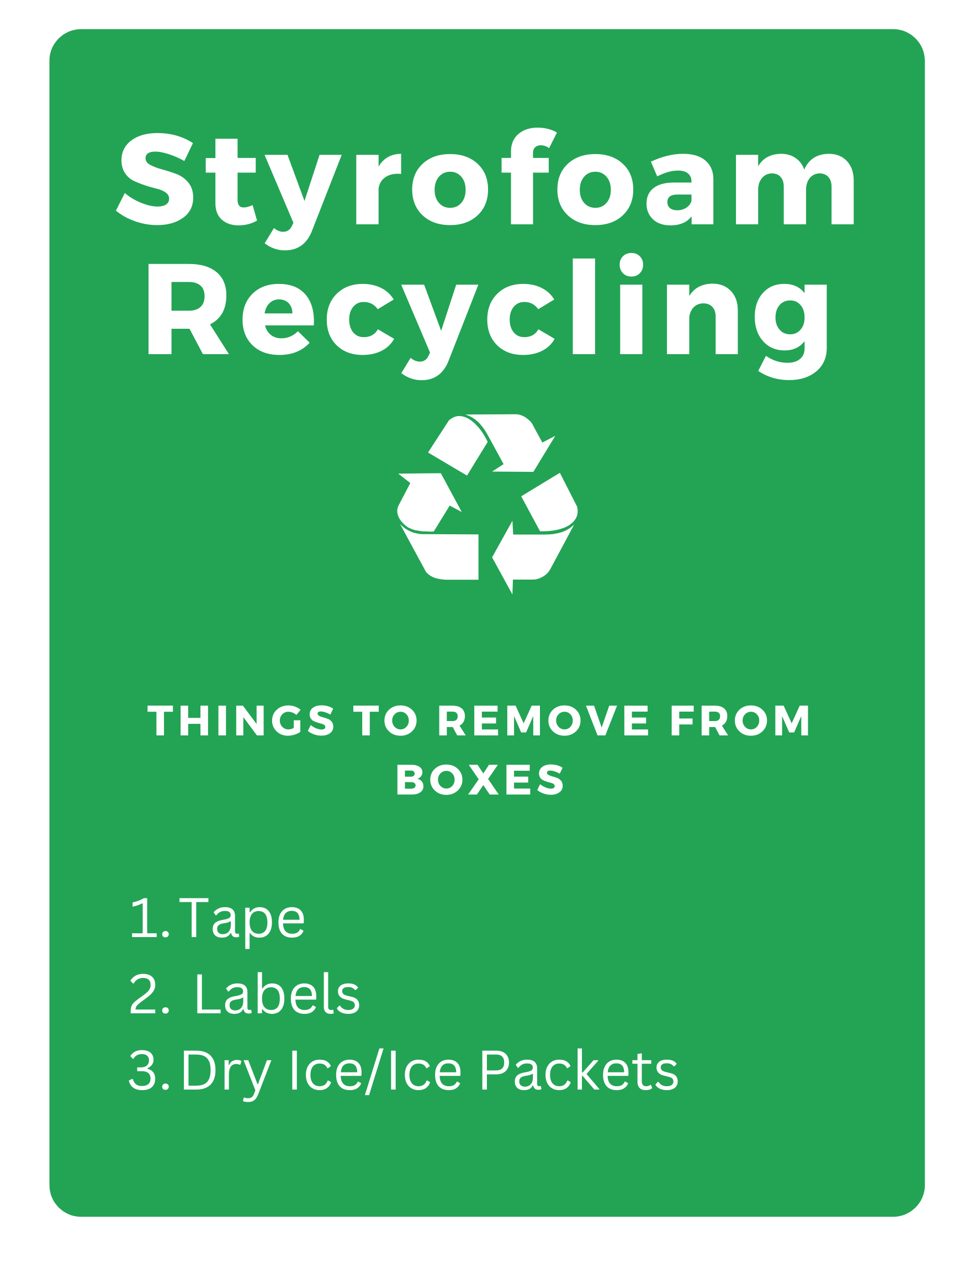
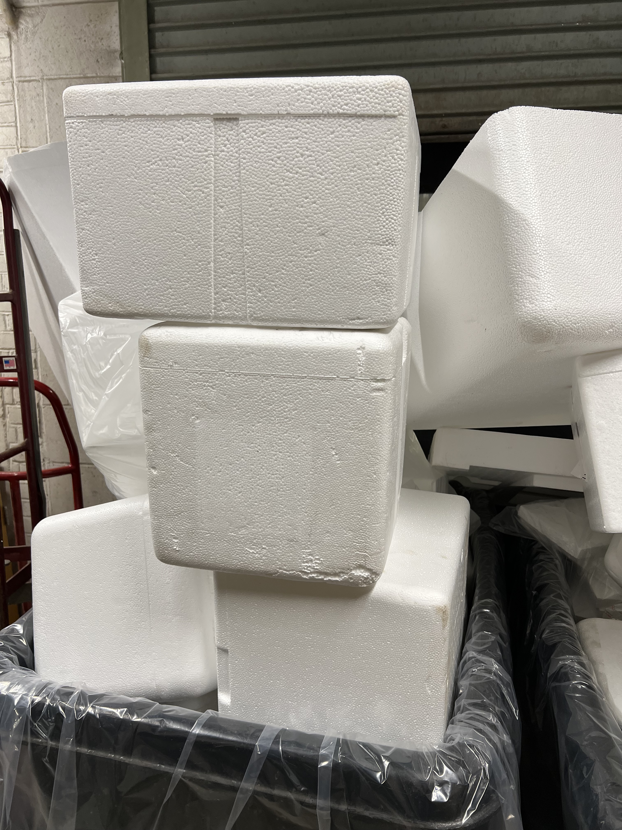
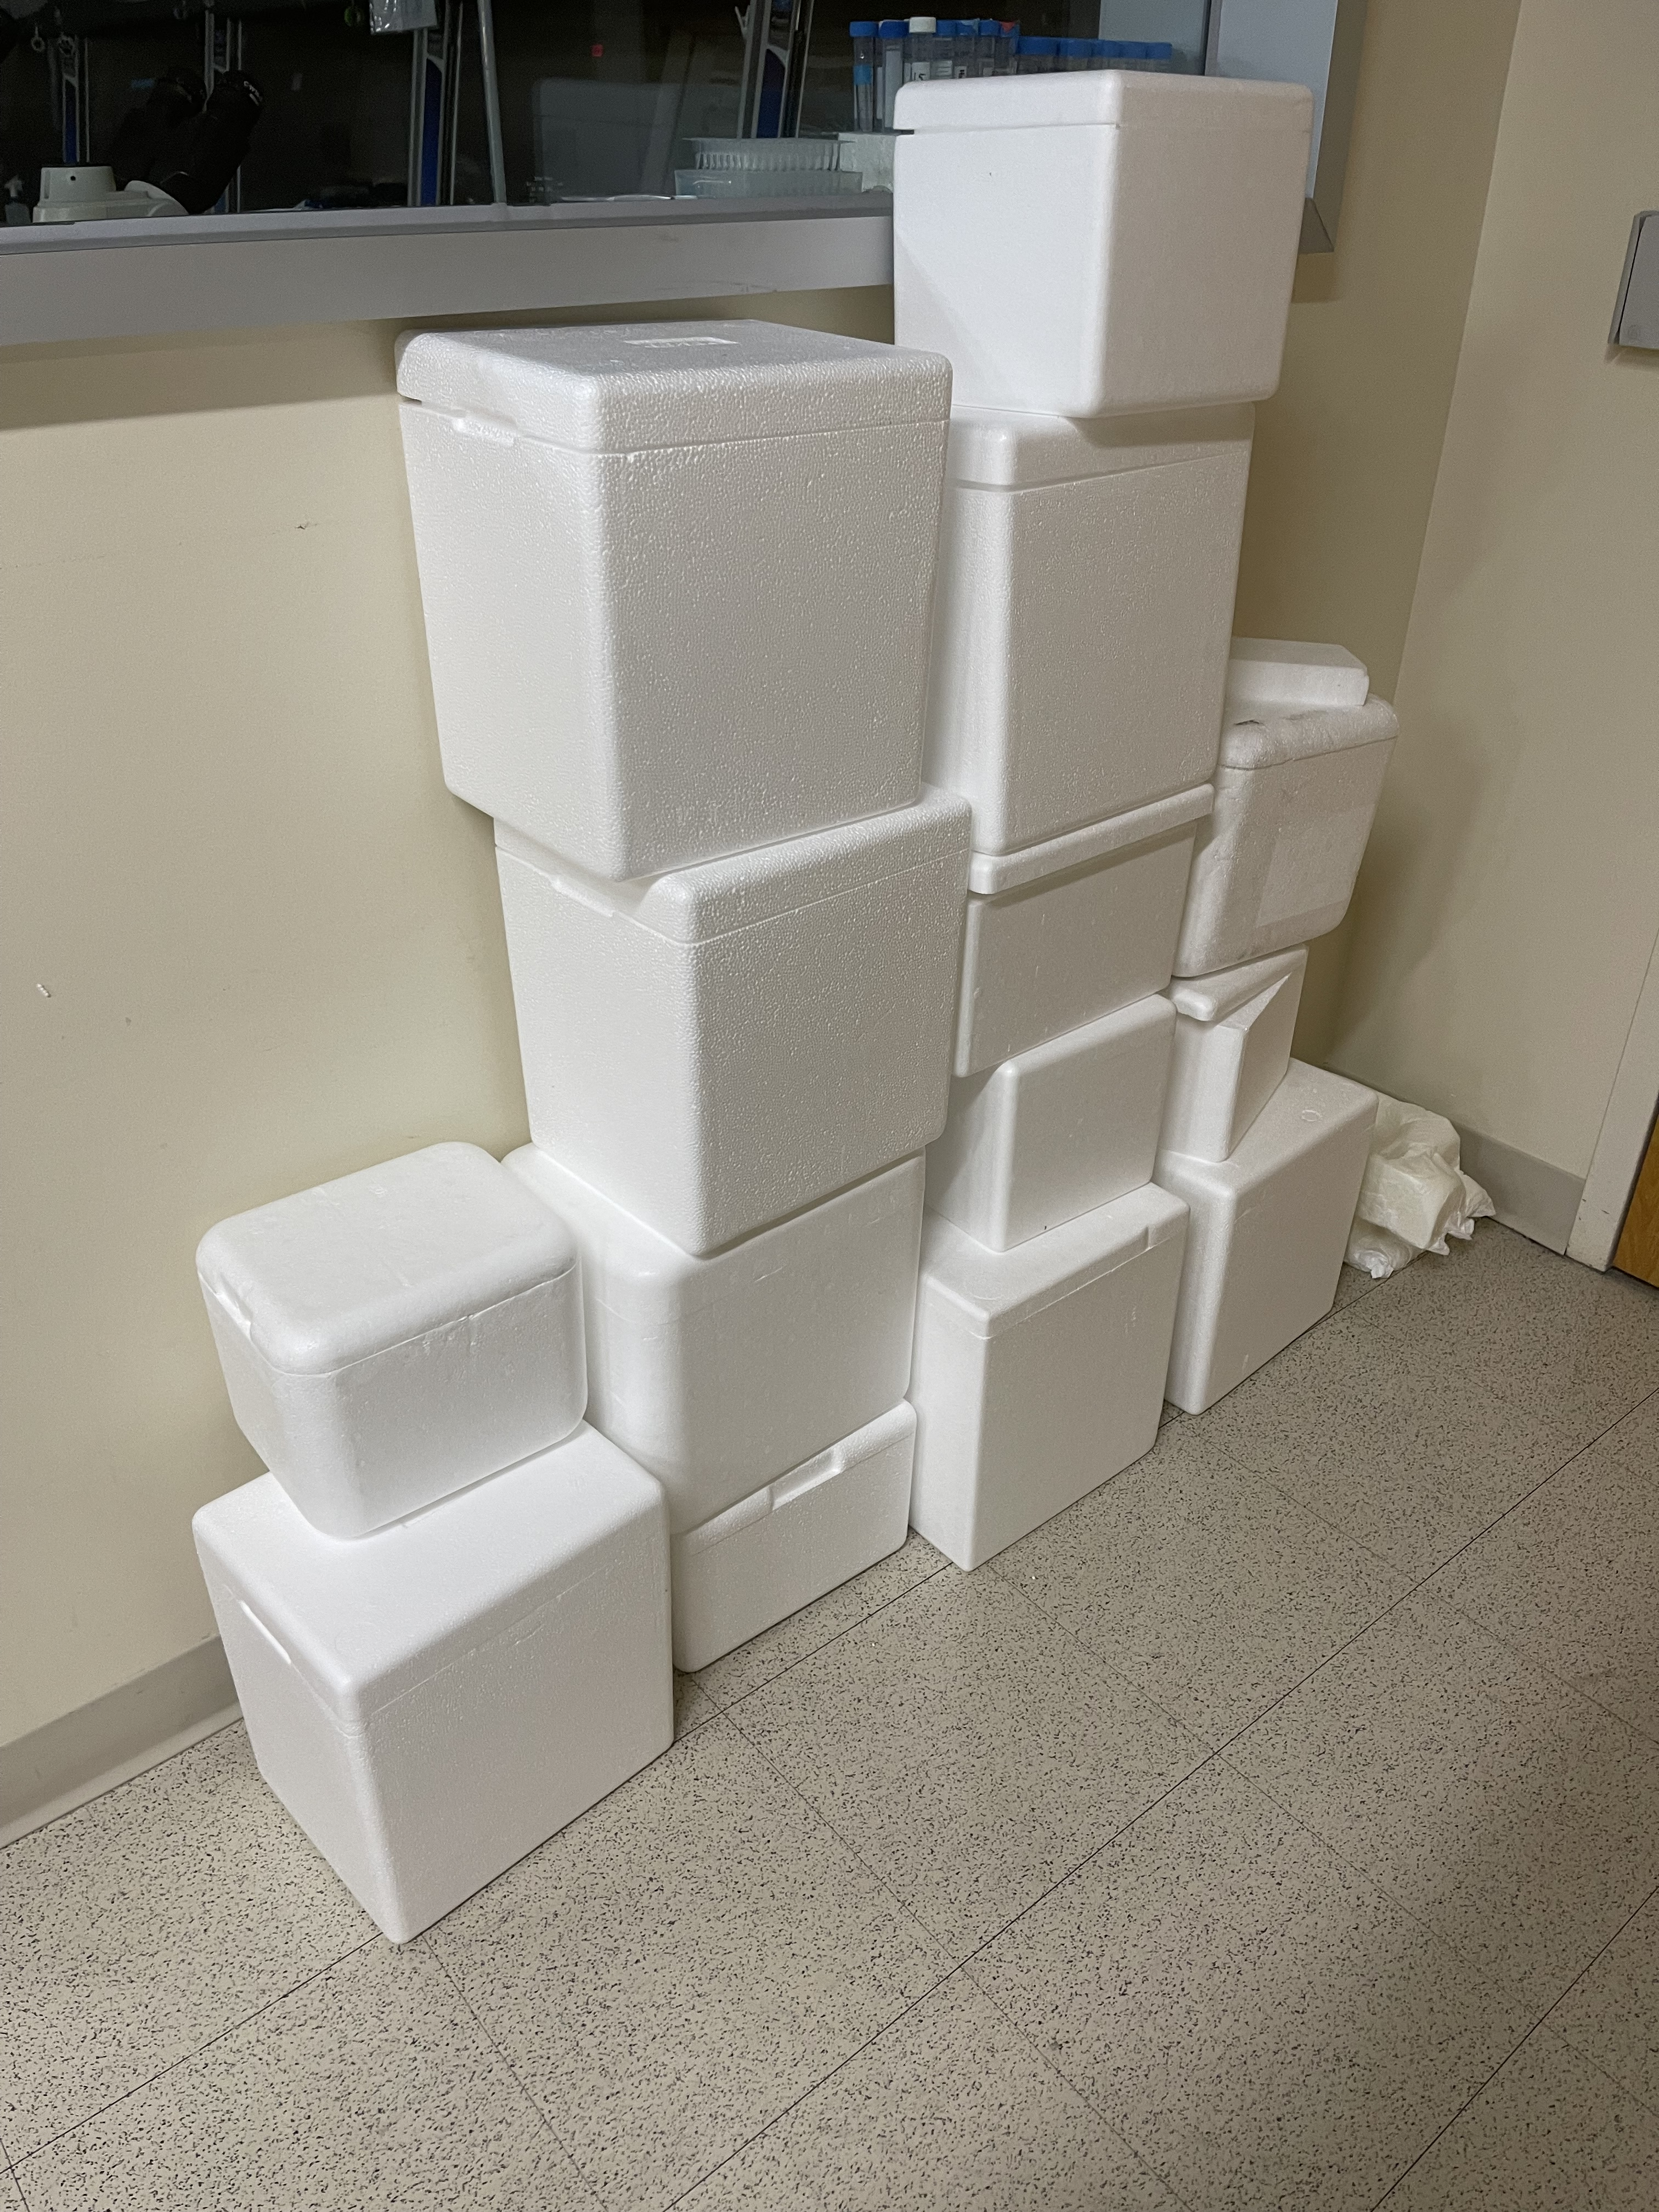
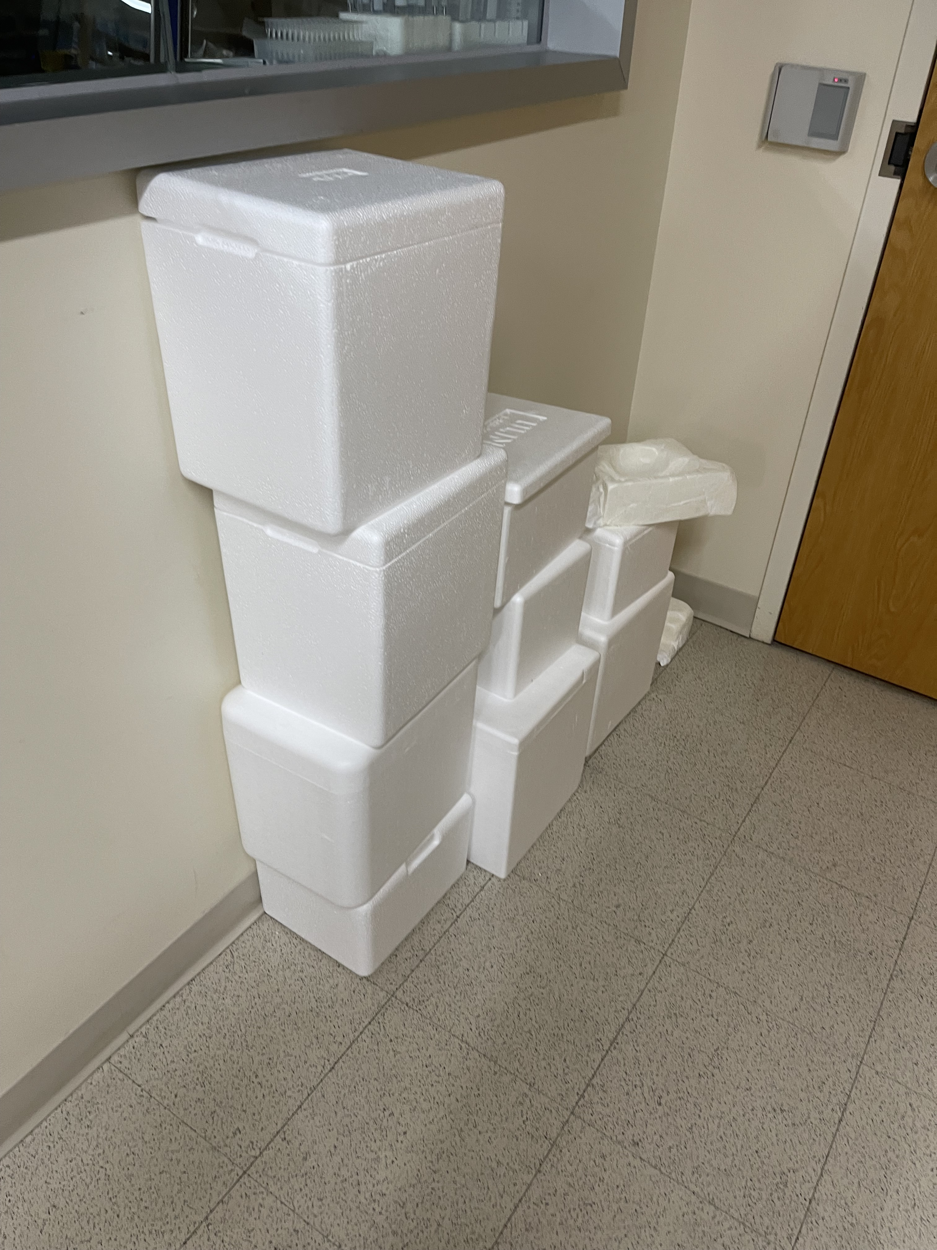
40 boxes per month
Notes:
112 Styrofoam Boxes Since January 17th
Filled 4 Small Boxes
In collaboration with BU Facilities, we are able to recycle our styrofoam boxes. We have a designated place where we collect the boxes. This also works really well for when a lab is in need of a box for shipping materials or for something else. Since starting this in Janurary we have collected 112 boxes, which is equivalent to to roughly 40 boxes of styrofoam a month.

Slide 6
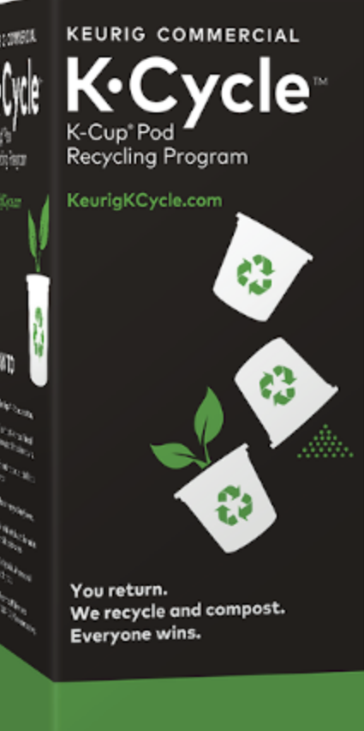
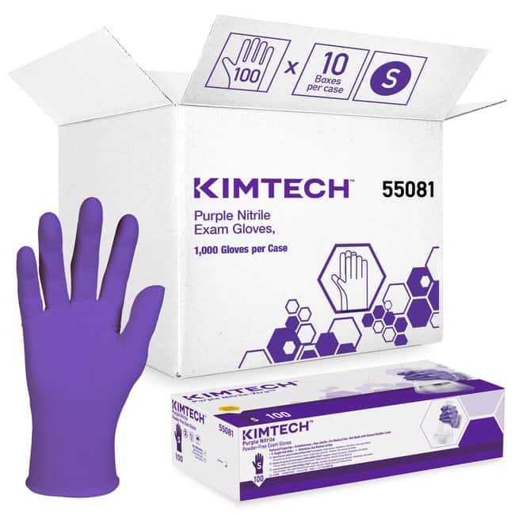
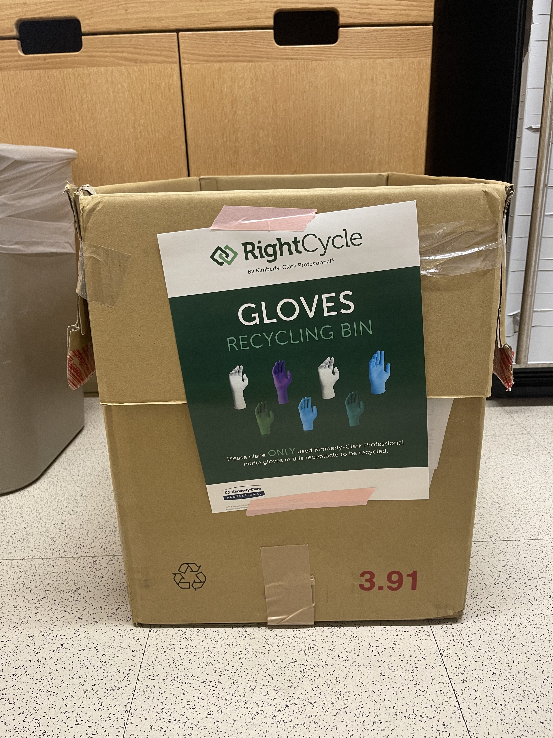
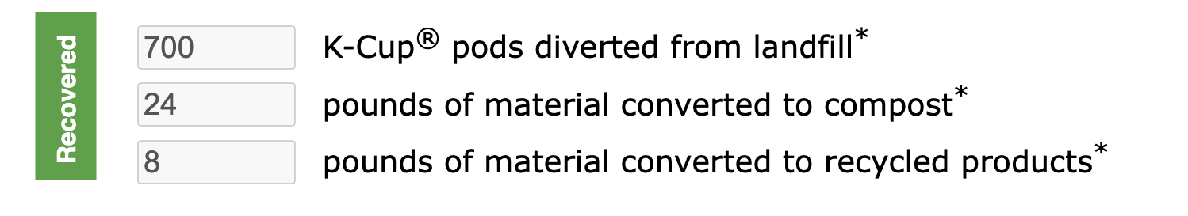
Notes:
Filled 4 Small Boxes
Two more, recycling programs we have implemented, is recycling keurig cups and gloves. We have filled 4 boxes of the K-Cycle over the course of 3 months which is equivalent to roughly 700 K pods not going into the landfill. Last presentation, someone suggested using biodegradable k-Cups which is something we are looking into.
Our lab specifically, the Serrano Lab, started collecting Kimberly gloves to recycle through the K right Cycle program. We are still in the process of collecting gloves in our collection boxes, so we don’t have specific numbers about our recycling, but are hoping to very soon.

Slide 7
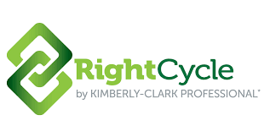

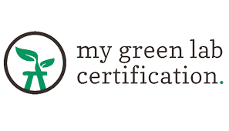

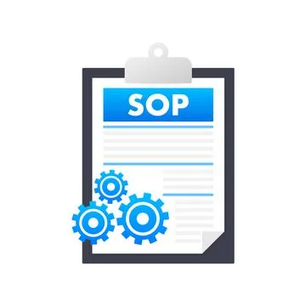
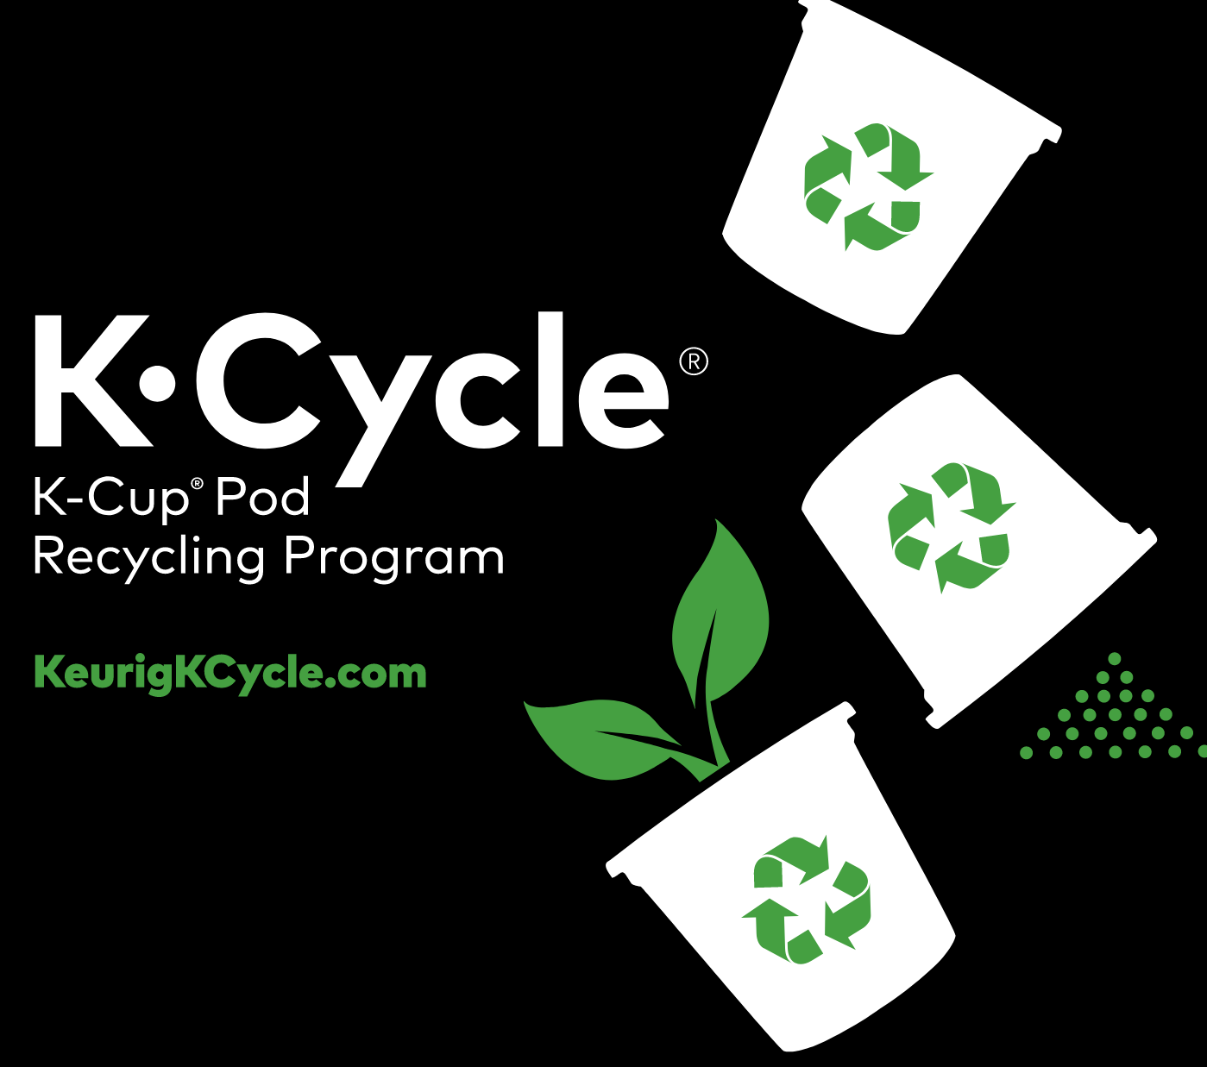
Future Directions
Certification
Data Collection
SOP
Notes:
Recently, we received feedback from the my green lab certification program about our sustainability efforts. We are in the process of going through the feedback and implementing changes.
We are going to continue recycling and collecting data from all of out recycling programs. At the end of our project, we will summarize all the information that we have into an SOP for other labs.

Slide 8
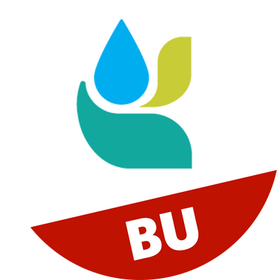
Center for Regenerative Medicine
Meenakshi Lakshminarayanan
Gabrielle Cockerham
Greg Miller
Kotton Lab
Hawkins Lab
Wilson Lab
Mostoslavsky Lab
Murphy Lab
Gouon-Evans Lab
Institute for Global Sustainability Campus Climate Lab
BU Sustainability Department
BU Facilities Department
BU Chobanian & Avedisian School of Medicine
Serrano Lab
Carly Golden
Jessica Chern
Sandeep Sreerama
Zoe Hoffmann Kamrat
Christopher Buie
Angie Serrano
Notes:
I would like to thank and acknowledge everyone who is supporting and participating in the project such as the Serrano Lab and the other lab’s at the center for regenerative medicine. Thank you to BU Sustainability and CLL for funding this project and supporting us. I’m happy to answer any questions

Slide 9
References
www.mygreenlab.org
www.nature.com/articles/d41586-020-01368-8
www.kcprofessional.com/en-us/products/scientific-and-research/lab-environment#numberOfResults=30
www.bu.edu/sustainability/vision-progress/
www.polycarbin.com
www.integra-biosciences.com

Slide 10
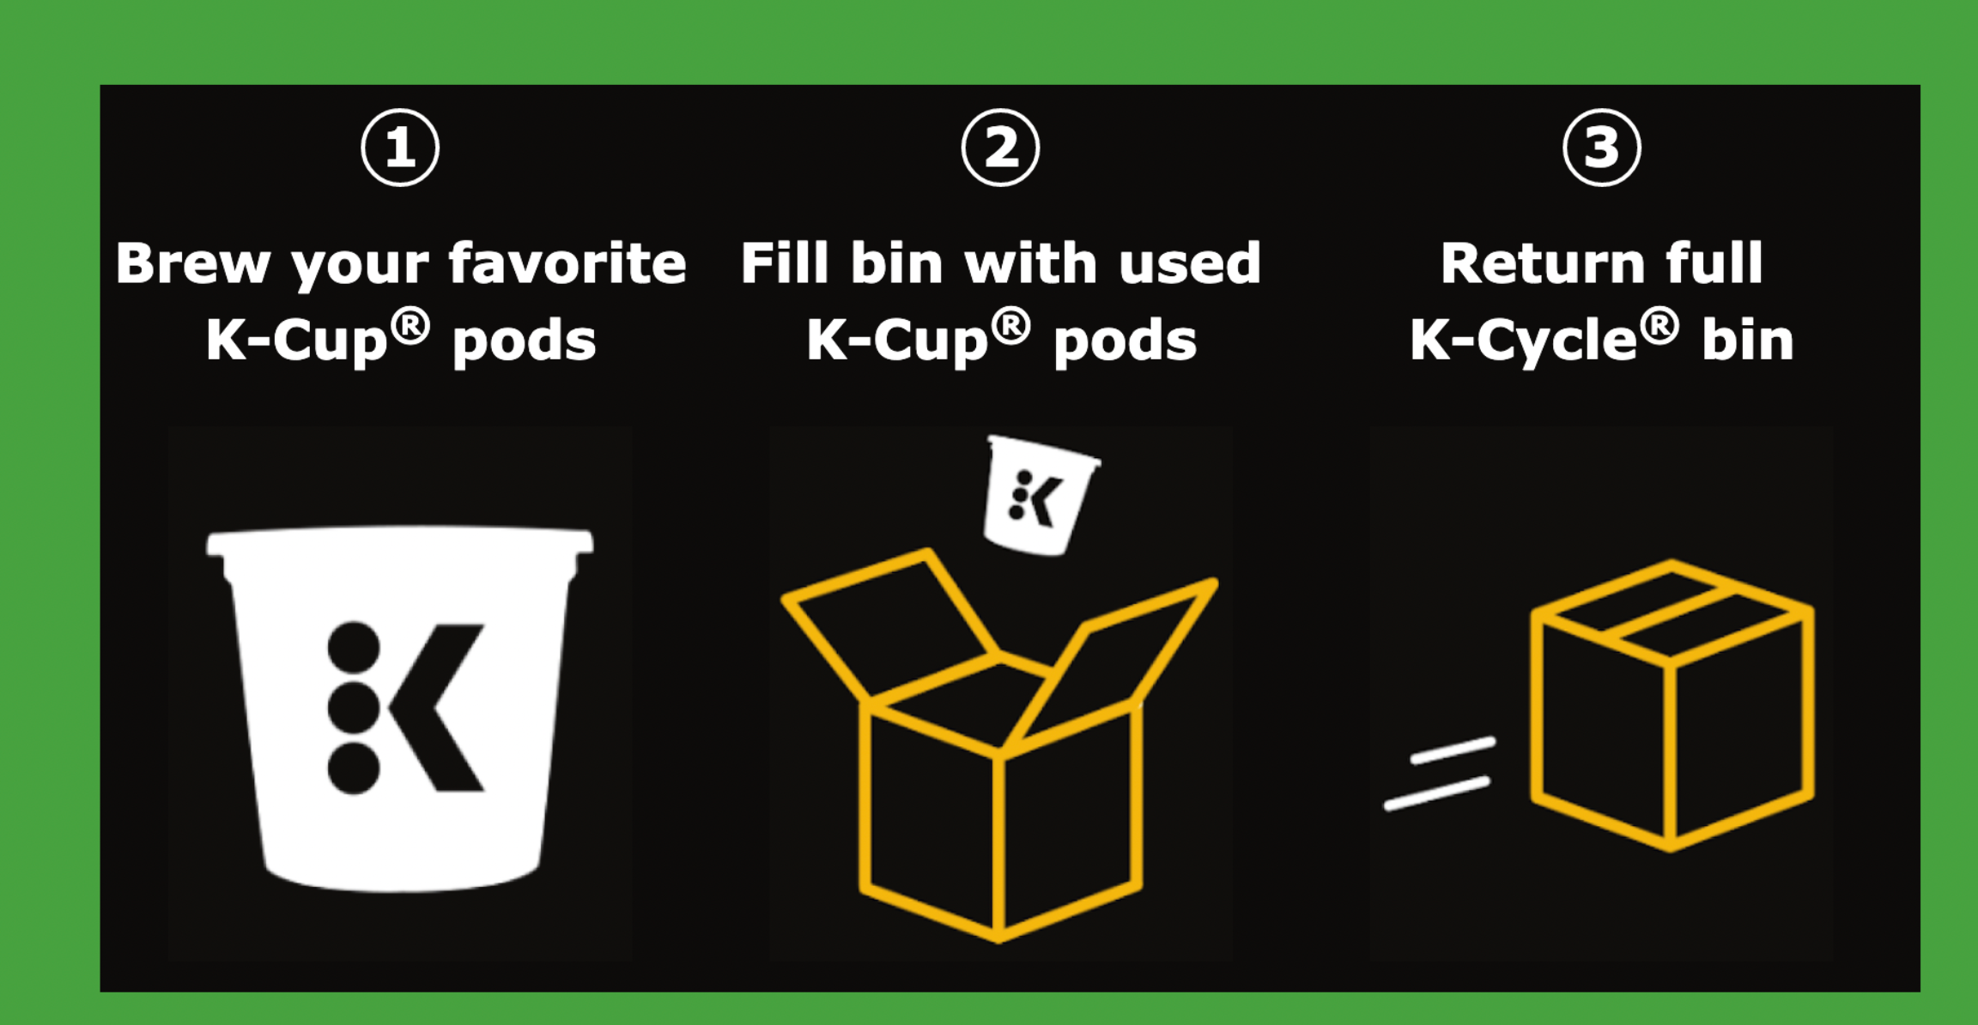
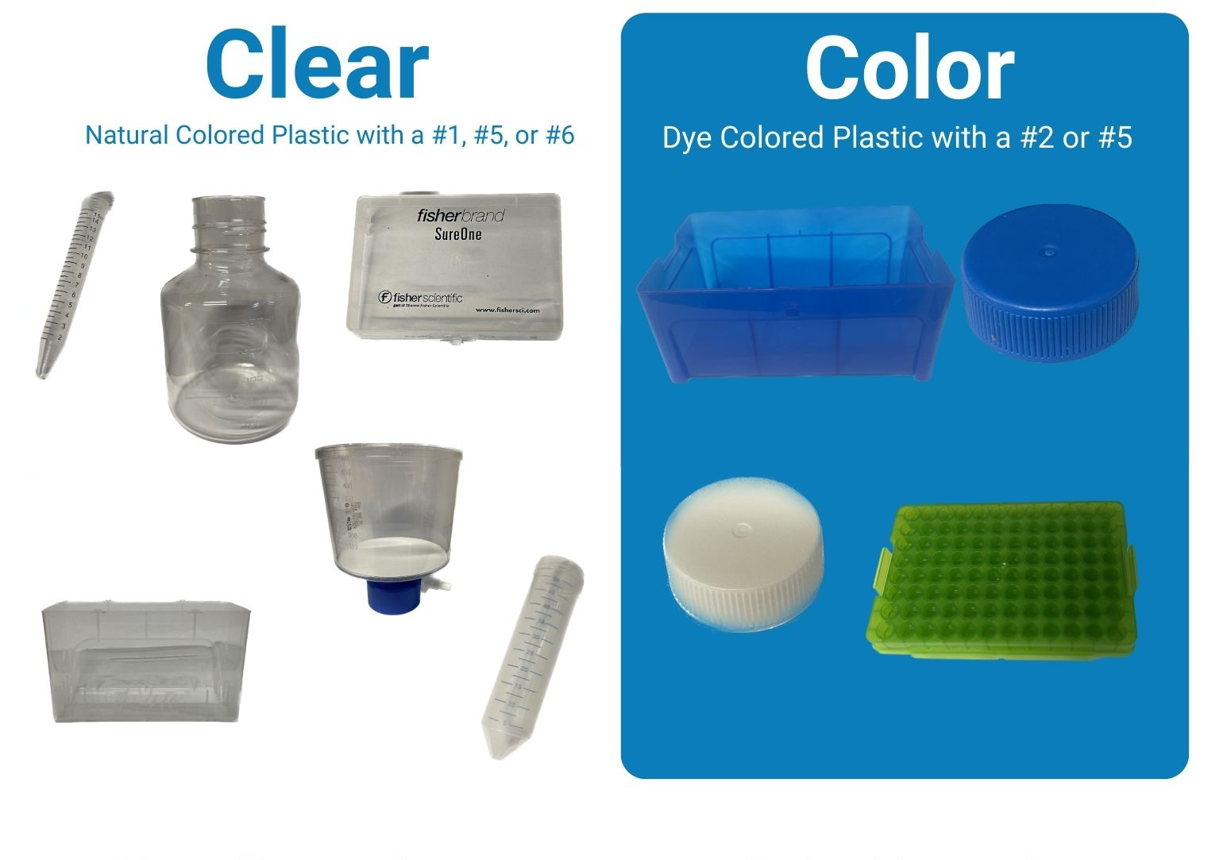

Slide 11
Research
Implementation
Evaluation
Learn about different sustainability practices
Implement the practices that would best fit our lab needs
Evaluate how effective these practices are and make changes accordingly

Slide 12
Name | Product | Amount | Price
Polycarbin | Beta Carbin Clear Plastic** | 5 boxes and return label | $440.00
Polycarbin | Beta Carbin Color Plastic** | 5 boxes and return label | $440.00
Kimberly Clark Right Cycle Program | N/A | N/A | $30.00**
K-Cup Recycling | Small K-Cycle* | 5 small boxes and return label | $94.95
*Other options available
**Estimation

Slide 13
Implement Styrofoam, K-Cup, and plastic recycling in shared spaces
January
Combine information into SOP and share it across BUMC
Implement suggestions from My Green Lab
March
SOP for recycling gloves
Plastic recycling
November
May
October
Awarded Campus Climate Lab funds
December
Plan for Styrofoam recycling
K-Cup recycling
February
Green Lab Certification
Monitor recycling in shared spaces
April
Evaluate the effectiveness of recycling programs and financial investments

