Slide 1
Fostering Diversity in Sustainability at BU
Mya Briones (CAS ‘24), Beverly Ge (BU SPH), Alice Scollins (CAS ‘24), Assoc. Prof. Anne Short, Asst. Prof. Abigail Sullivan, Lisa Tornatore

Slide 2
Our Project
Our Project Investigates:
Diversity in sustainability courses
Student experiences in sustainability courses
Perceptions of sustainability courses
Barriers to sustainability courses
Potential action items for increasing student participation and inclusivity in sustainability courses

Slide 3
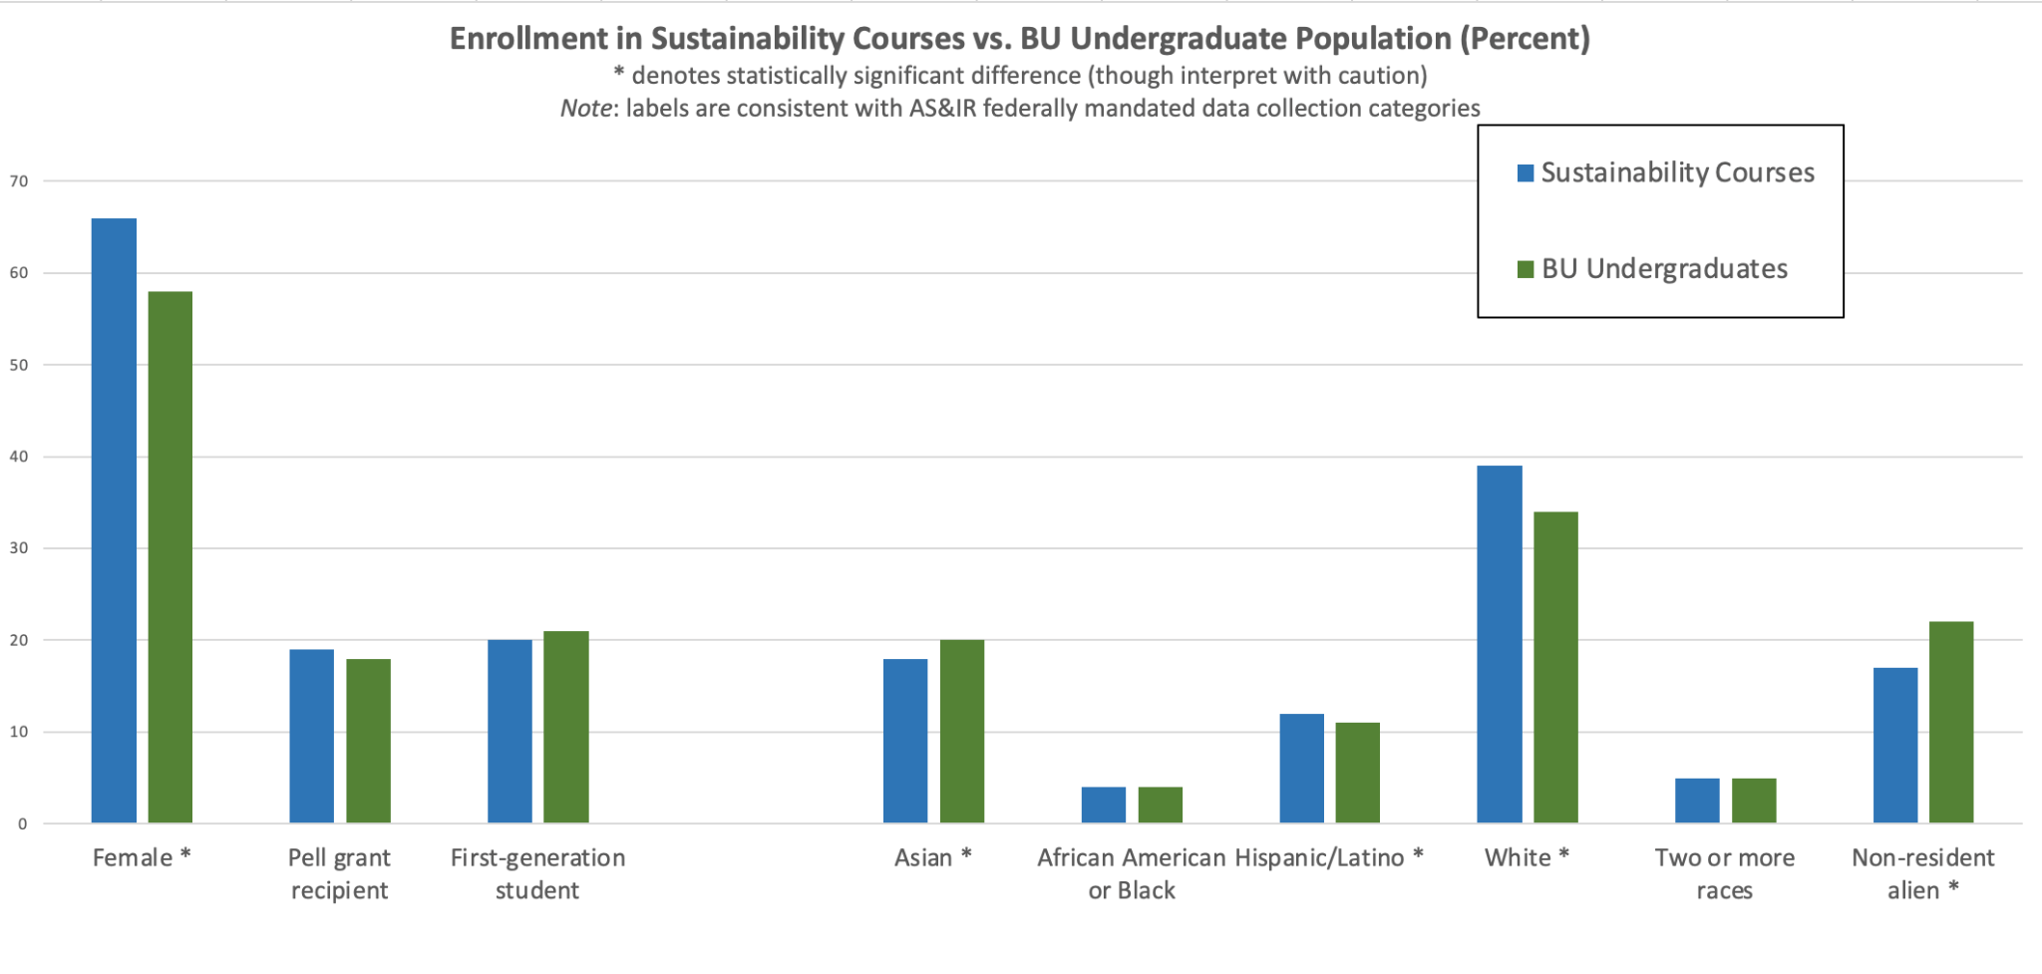
Results of Previous Work

Slide 4
Results of Previous Work
Our survey data also suggested that most students found sustainability classes to be reasonably inclusive across demographic categories such as race, ethnicity, and gender

Slide 5
Ongoing Work
To enhance our understanding of student experiences of sustainability classes, we have began hosting focus groups.

Slide 6
Key Milestones This Semester
Recruited 2 new members of research team
Developed focus group guide and materials
Obtained Institutional Review Board approval
Recruited ~20 student participants
Conducted one focus group

Slide 7
Focus Group Script Outline
Introductions + consent script
Warm-up activity: what counts as a sustainability class?
Discuss BU’s definition of sustainability, alignment of classes with this definition
Discuss experiences in sustainability classes (diversity, inclusion)
Barriers activity: rank barriers to taking sustainability courses
Discuss barriers to taking sustainability courses + potential improvements
Discuss the role of identity in experiencing sustainability courses + potential improvements
Closing
Notes:
Briefly explain each aspect

Slide 8
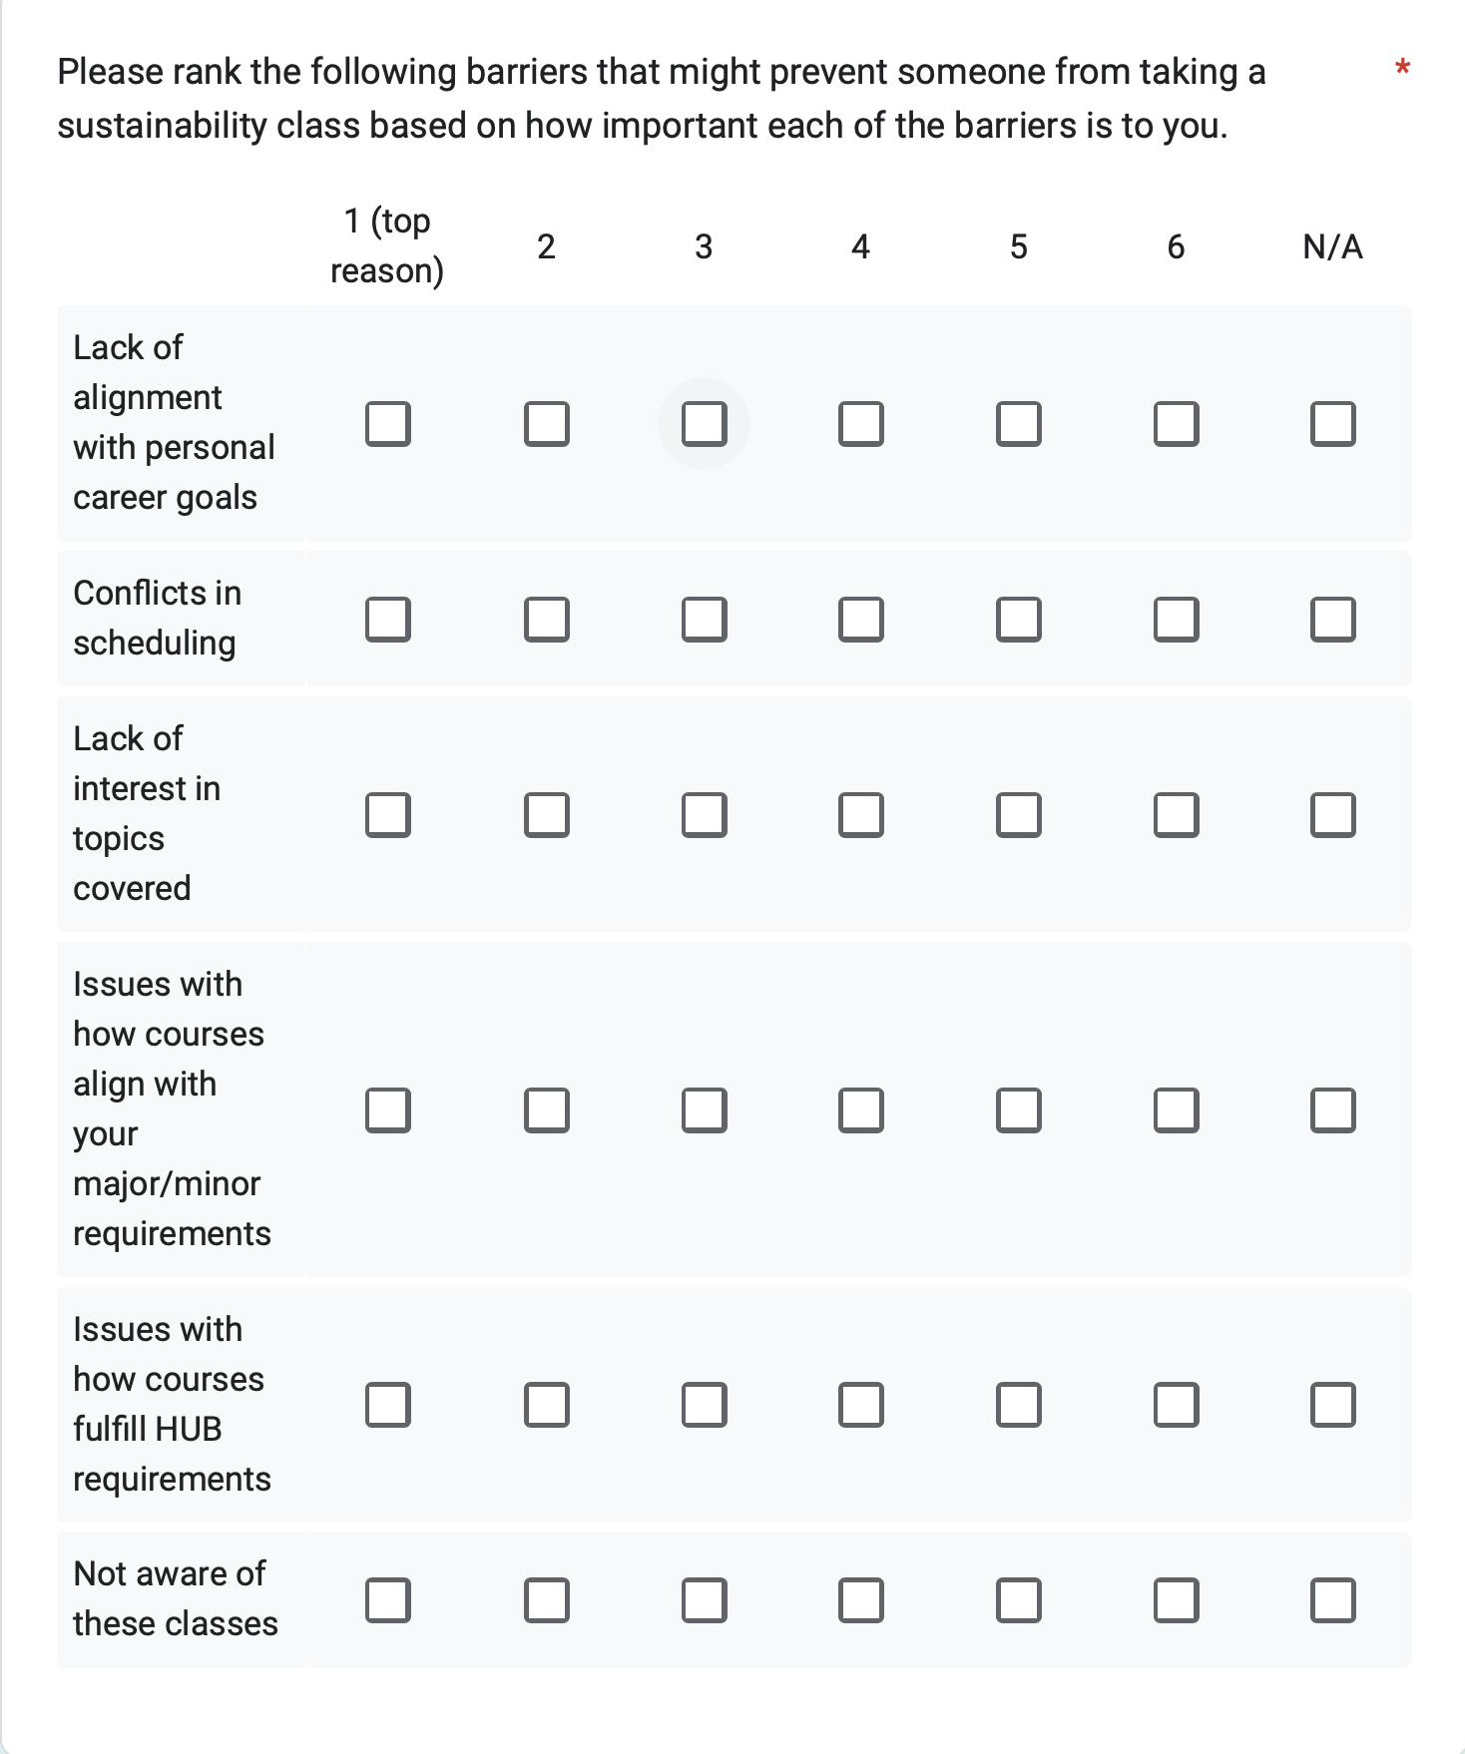
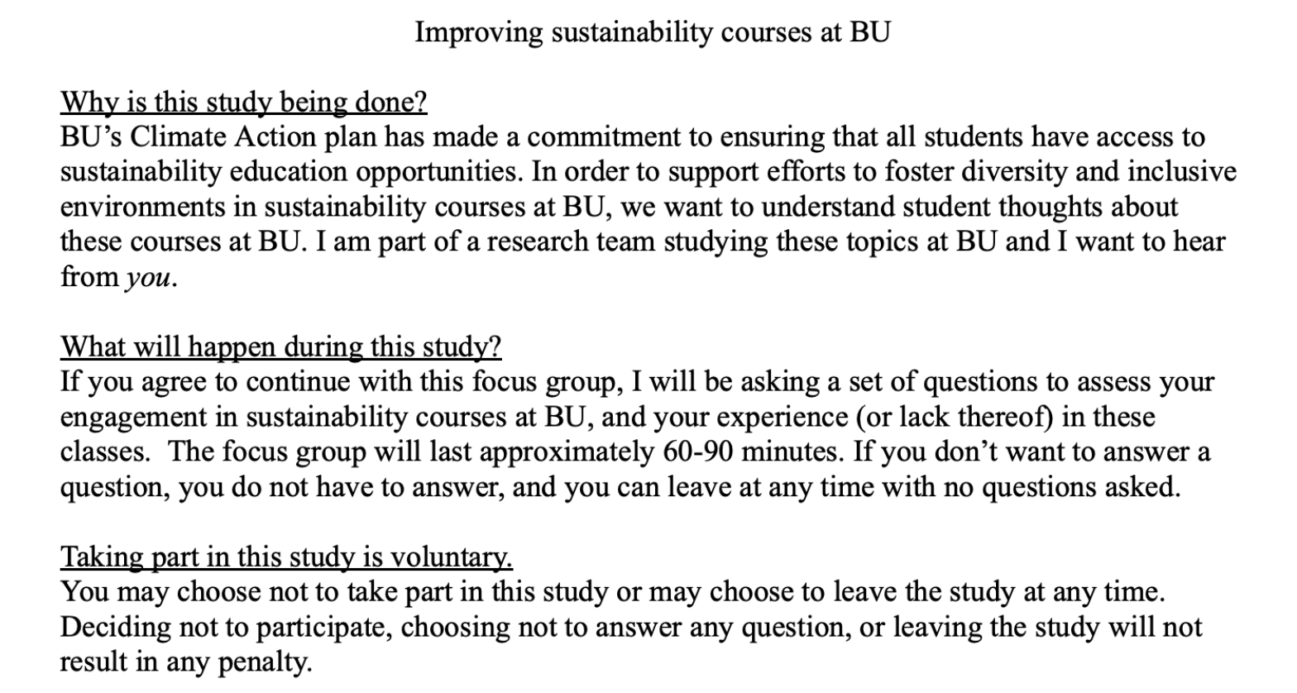
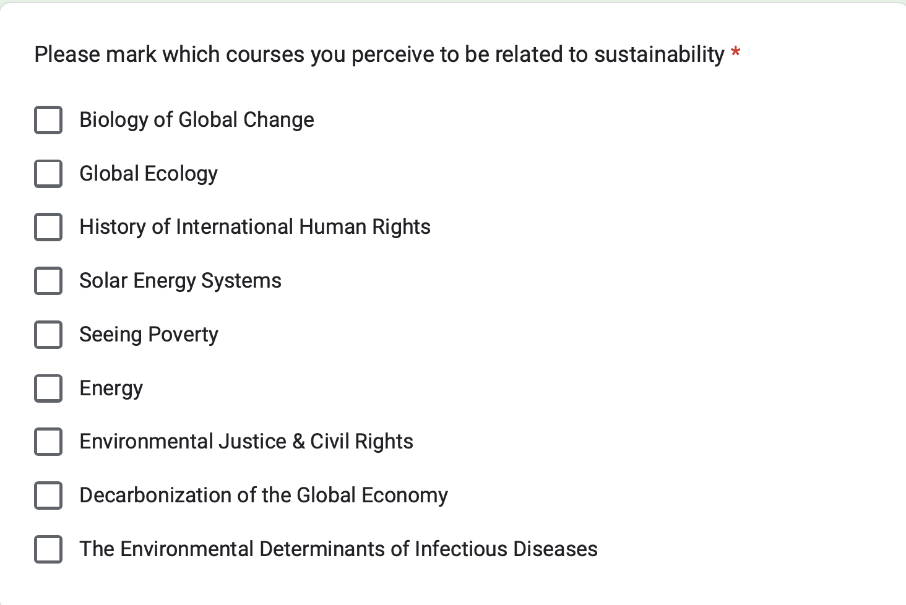
Focus Group Materials

Slide 9
Preliminary Results - Focus Group 1 (n=5)
Participants described varying experiences with sustainability courses in terms of topic coverage, inclusivity, and diversity.
BU HUB requirements: providing an opportunity for students to gain exposure to sustainability and also serve as a barrier to exposure due to structural challenges.
Participants had concrete suggestions for increasing participation in sustainability courses and improving diversity/inclusion within sustainability classrooms.
Notes:
Overall, participants had a lively and productive conversation. Although most participants did have substantial experience w/ sustainability classes at BU, there was diversity in experience and exposure.
First bullet point:
Different courses covered the “pillars” of sustainability (according to BU definition - environmental, social, and economic factors) to different degrees. Some covered multiple pillars and others didn’t.
How comfortable/inclusive the classroom environment seems to depend a lot on the teaching staff (professors, lab instructors, TAs, etc). Participants had high praise for some instructors but also criticism for others.
In terms of diversity, sustainability classrooms varied based on things like level of course and department. A few participants noted that although women might be more represented in some sustainability classes, the faculty still tended to be more male. A couple participants noted that due to the politicization of sustainability, it was unlikely to find full diversity in terms of political ideology in sustainability courses.
Second bullet point:
In general, participants expressed a lot of frustration with HUB requirements. Not all courses are even assessed for HUB compliance (the process seems to be initiated by professors) and this process is lengthy.
Third bullet point:
Participants suggested flexibility in course scheduling and having more sustainability classes being assessed for HUB
Participants suggested trying to increase diversity among teaching staff and having mandatory sensitivity trainings

Slide 10
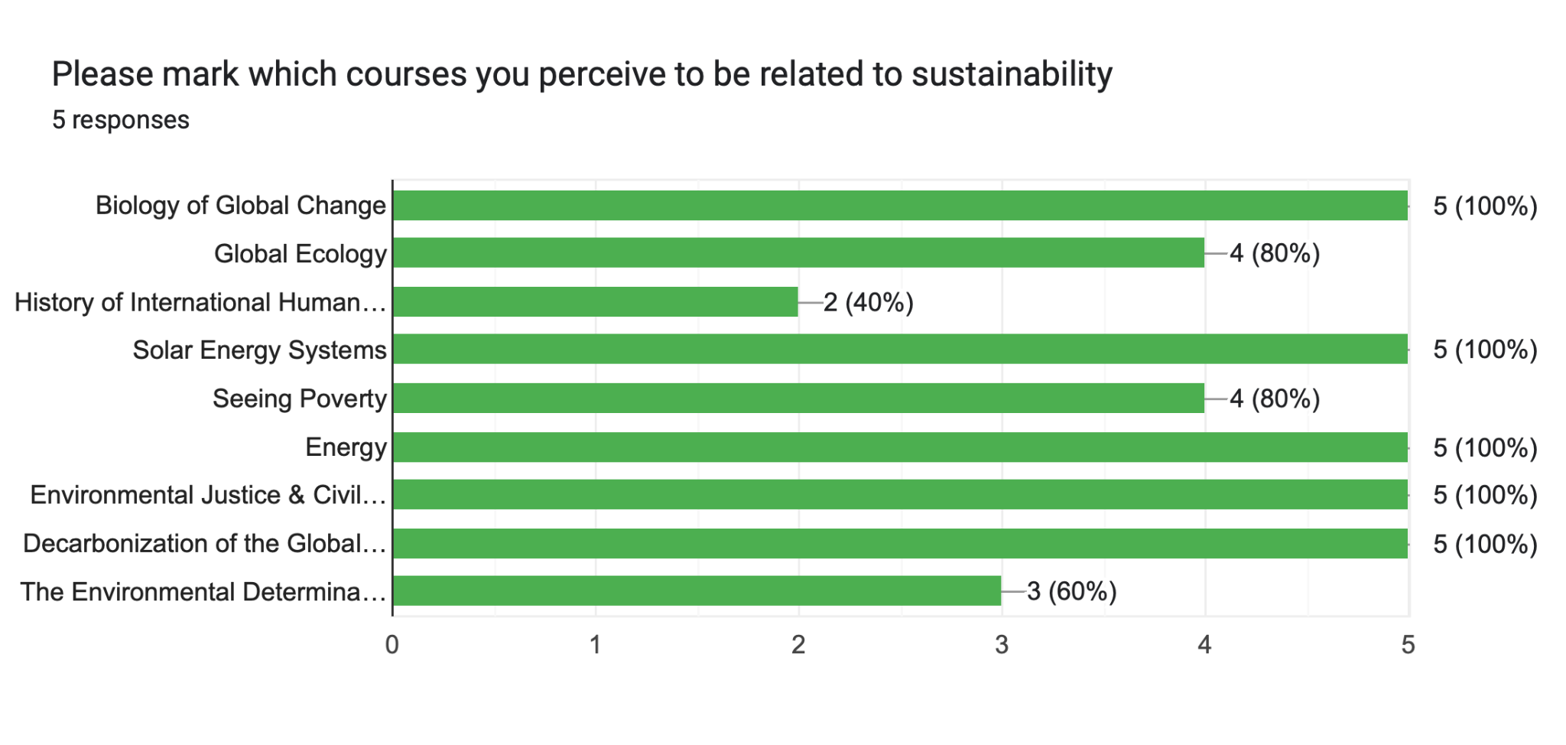
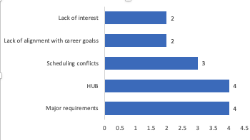
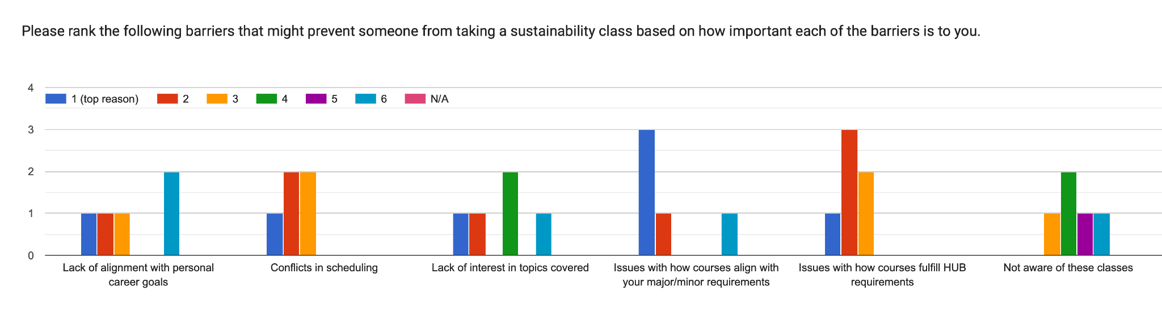
Focus Group Data

Slide 11
Lessons Learned and Next Steps
From a facilitation perspective, brainstorm ways to keep the conversation centered on sustainability courses & ensure more equitable distribution of speaking time among participants
Reconsider discussion norms
Review transcript of first focus group and refine script if necessary
Notes:
First bullet point:
Especially when the conversation drifted towards HUB requirements, students often began talking more generally. Sometimes the focus group felt like a “vent session”. Furthermore, some participants were more comfortable speaking up quickly and tended to dominate the conversation.
Second bullet point:
Along those lines, there might be some discussion norms we want to state in the future, such as raising hands and waiting to be called on before speaking and perhaps not getting into specific course names or professor names.
Third bullet point:
Although we don’t want to change the script too much (because then the results of the first focus group may not be comparable with future focus groups), there may still be tweaks we can make to the script based on the results of the first focus group to make sure we’re getting at the topics of interest.

Slide 12
Looking Forward: Spring ‘23
Conduct 3-5 additional focus groups (including one limited to BIPOC students)
Complete analysis of survey and focus group data
Synthesize results into summary report and action plan
Meet with BU sustainability faculty and staff to get feedback on action plan
Write and submit journal article based on demographic analysis, survey, and focus groups

Slide 13
Thanks for listening! Any questions?

