Slide 1
Fall 2022 Post-Consumer Waste Machine Learning Program
Ziba Cranmer, Muntasir Meah, Alexandra Raczka

Slide 2
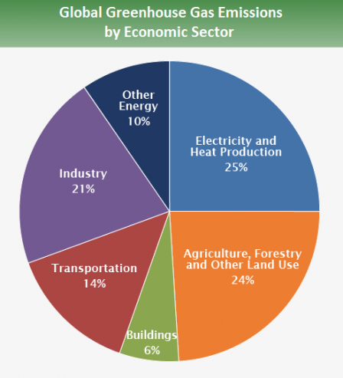
Project Explained
Machine Learning Program modelled to identify most commonly wasted food at university dining halls by classifying photos of food waste in categories (bread, rice, pizza)
  Allows dining management to modify menus
and recipes to reflect student preferences
  Reduces Scope 3 emissions associated with
  food supply chain (production, transportation, etc)
Source: Prince Student Climate Initiative

Slide 3
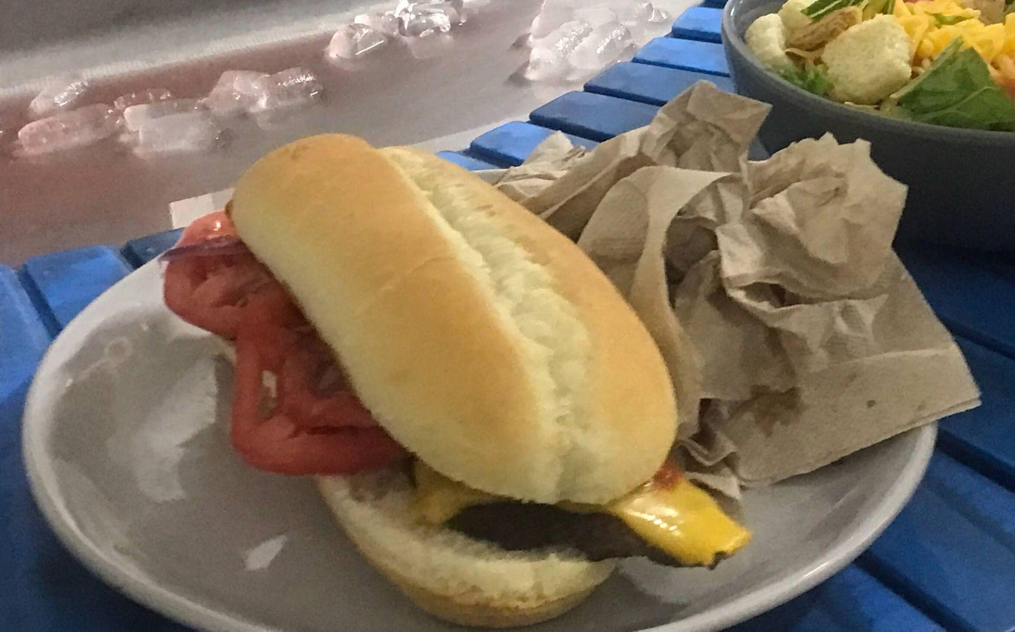
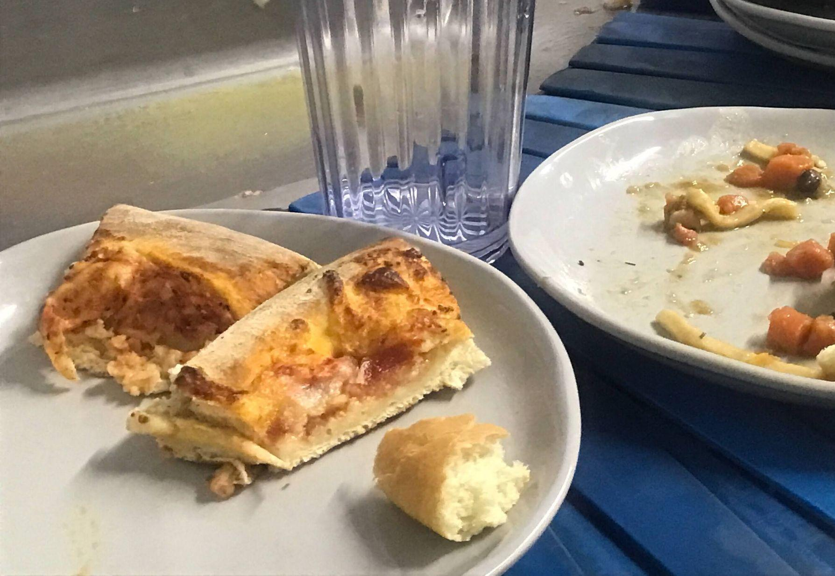
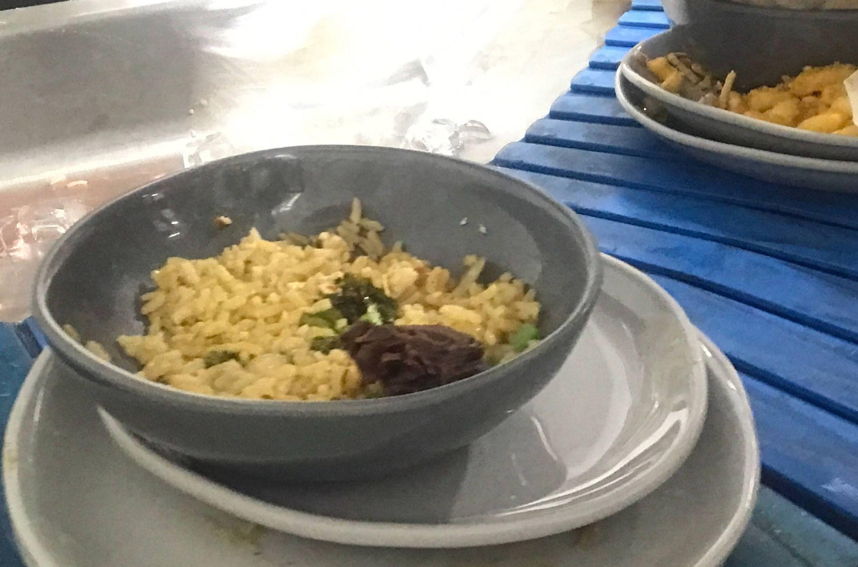
Current Progress
Second iteration of project - uses TensorFlow to access machine learning image classification models
  Mounted phone over dining hall dish belts to create datasets for pizza, bread, and rice
  ML Programs require thousands of images to create accurate classification, process yielded around 50 photos each

Slide 4
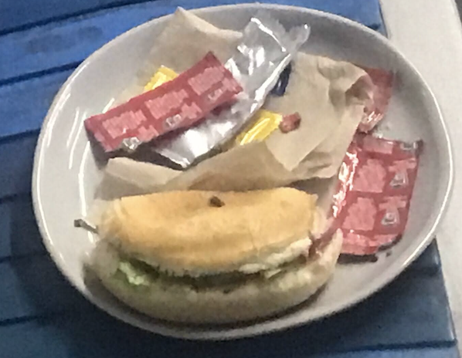
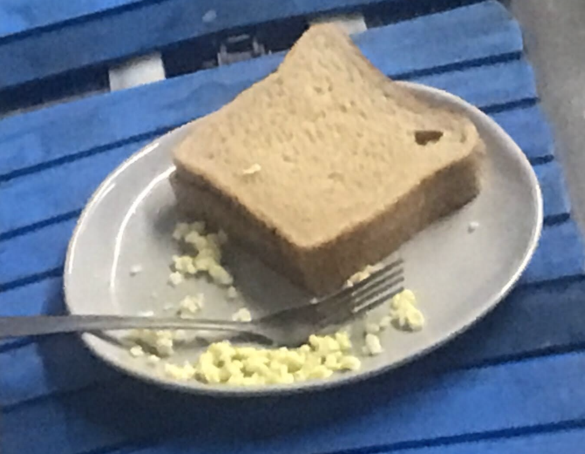
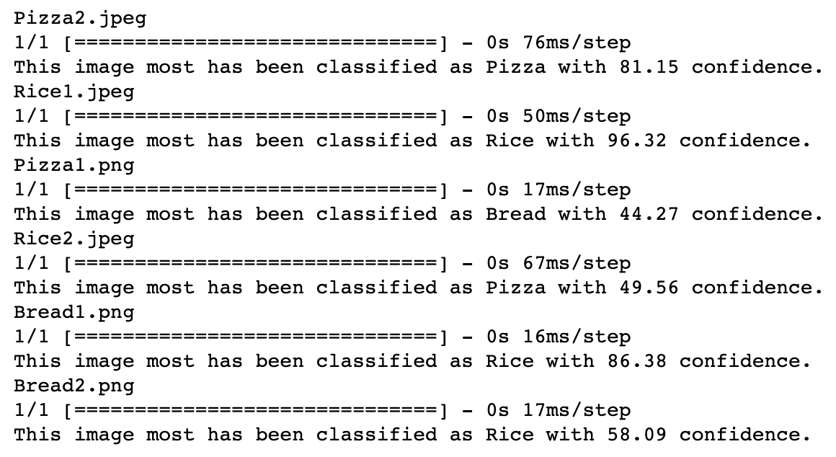
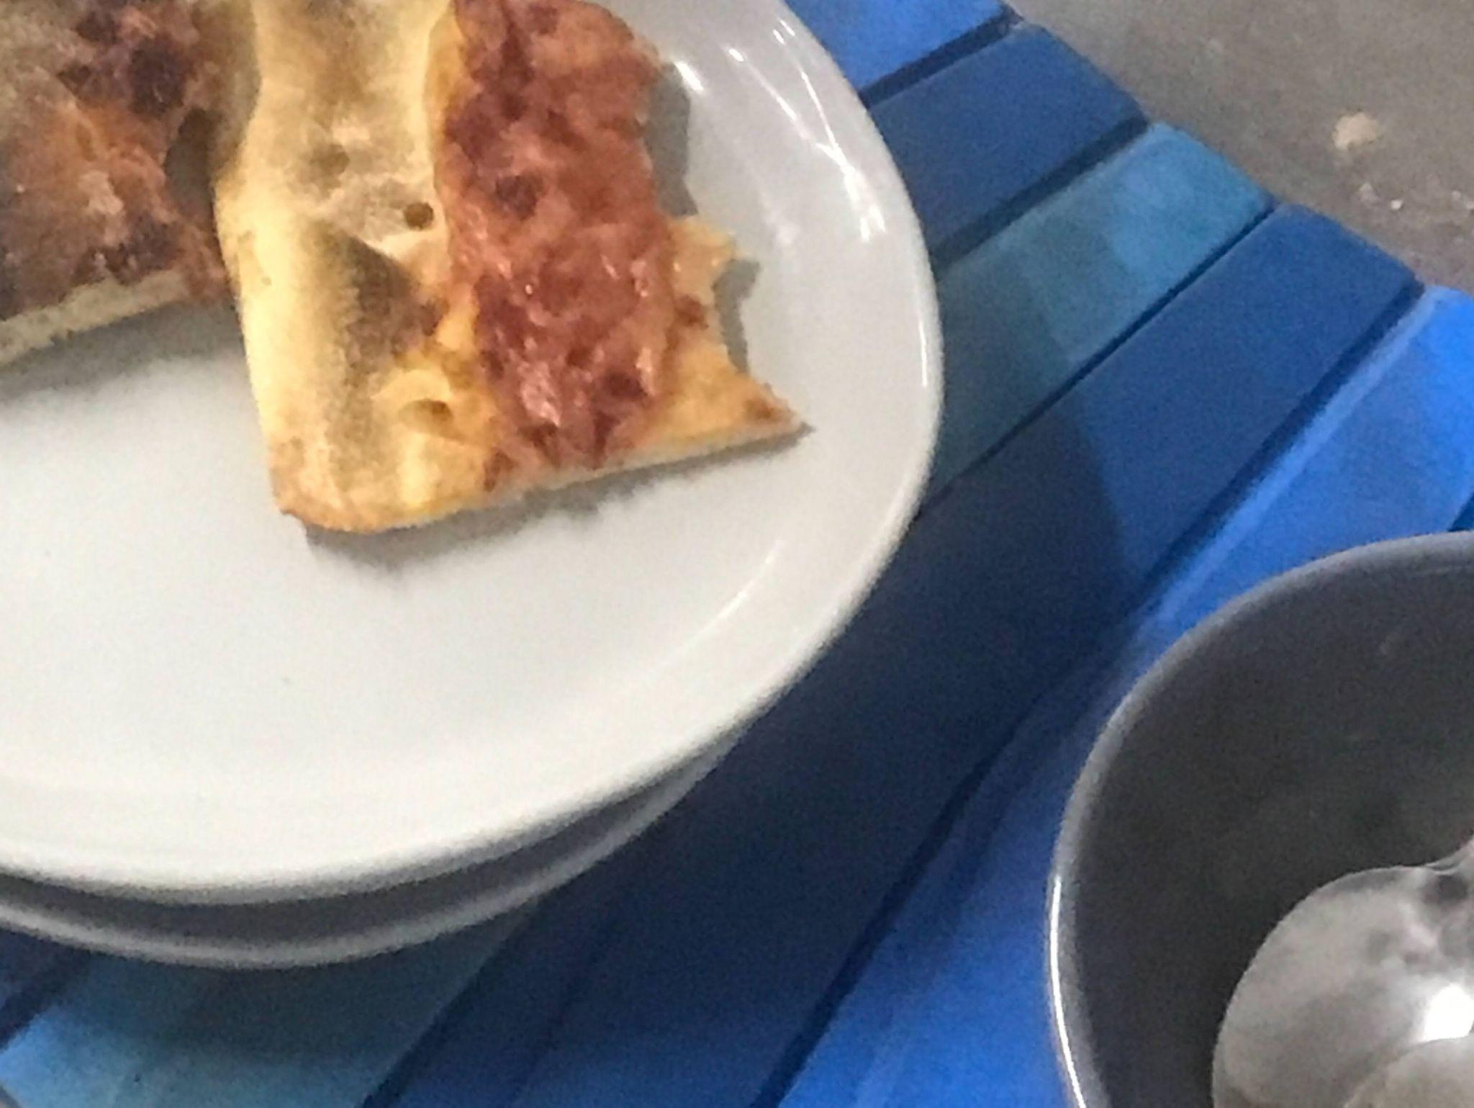
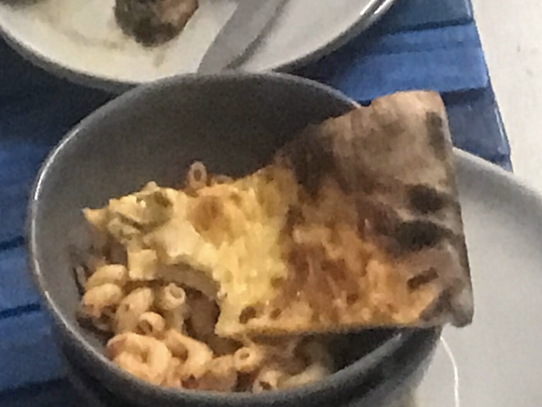
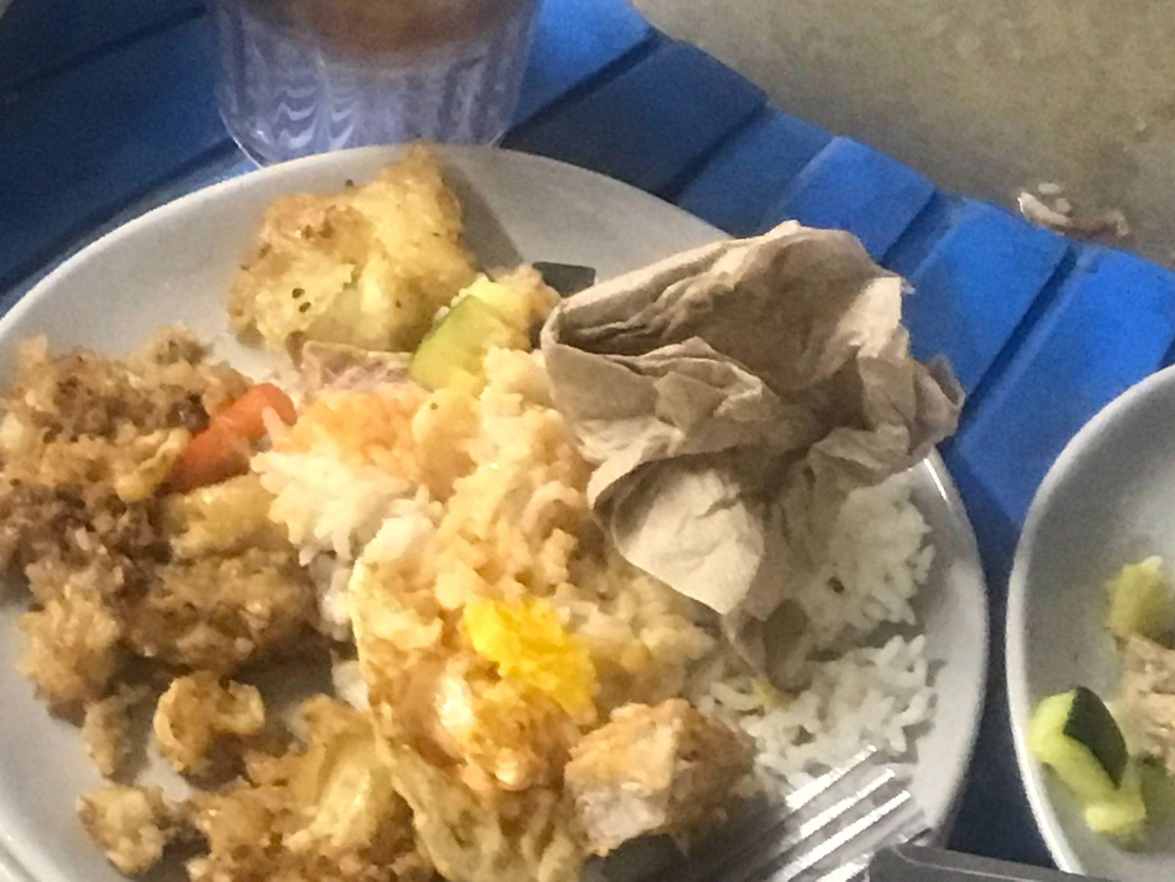
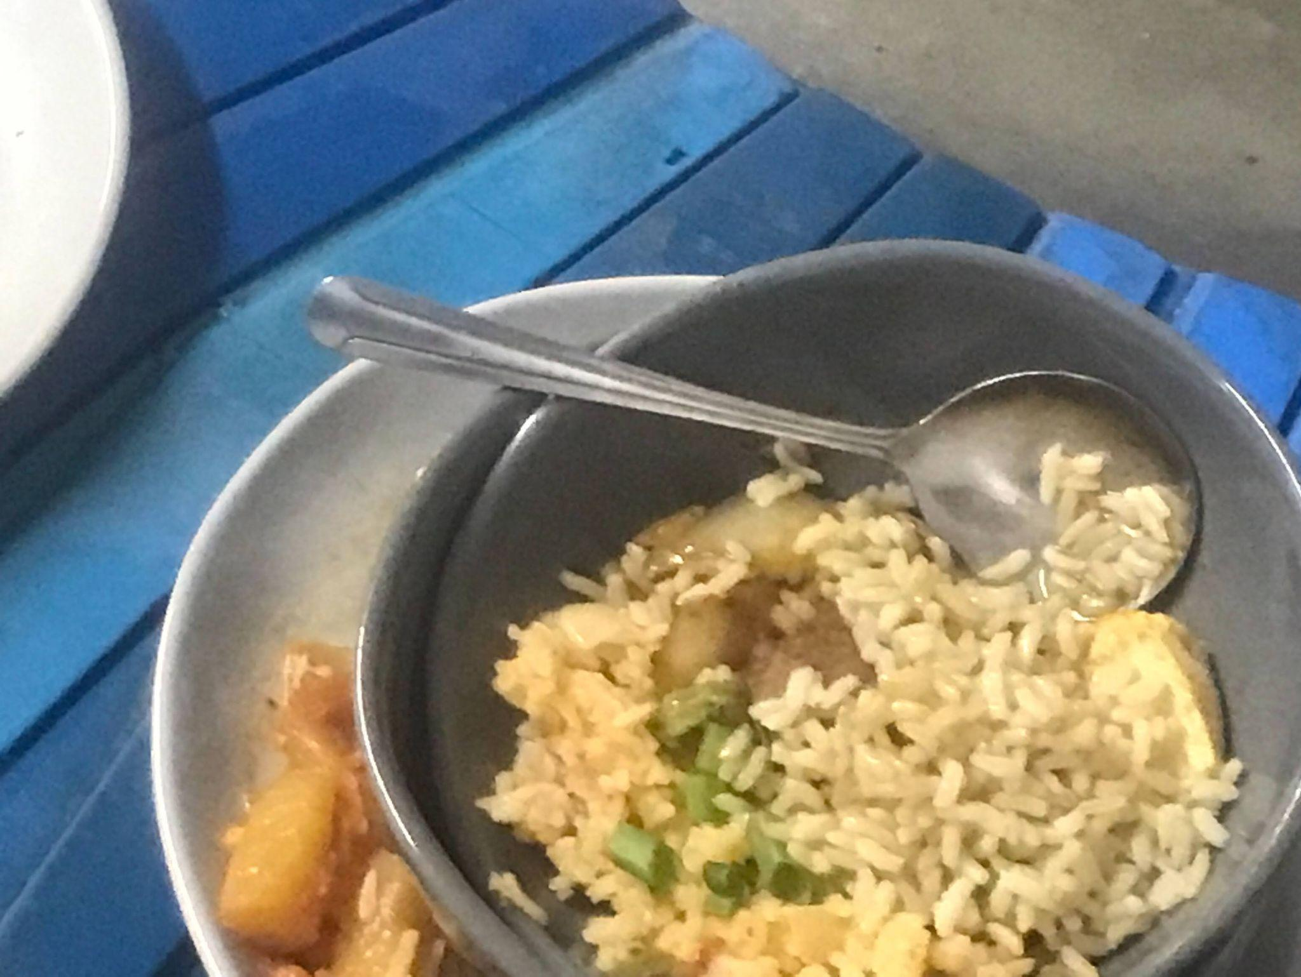
Current Progress (cont.)
Bread 1
Bread 2
Pizza 1
Pizza 2
Rice 1
Rice 2

Slide 5
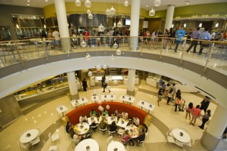
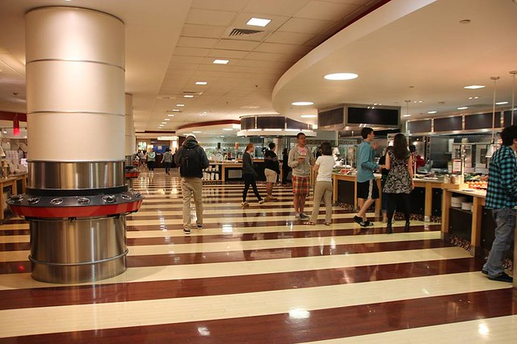
Future Plans
To increase model accuracy hundreds if not thousands of photos need to be collected for each dataset, an extended period of time must be dedicated to this process
Photo collection sites can be expanded to other dining halls to expedite process

