Slide 1
The power of art to communicate sustainability, build community and achieve system change
Talia Havivi, Valerio Iannucci, Nikki H. Huang
for Campus Climate Lab

Slide 2
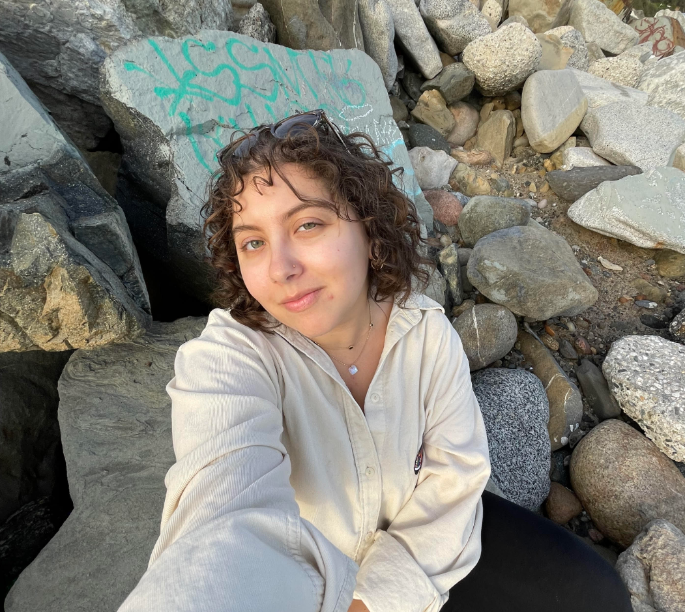
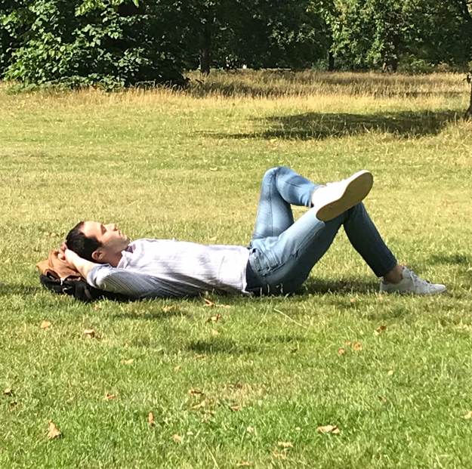
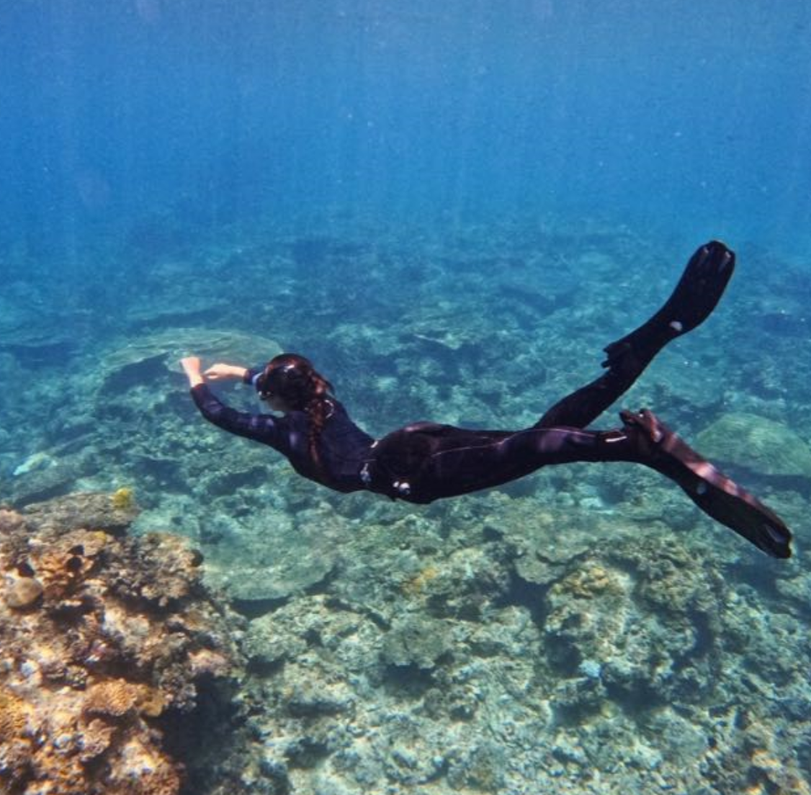
Talya Havivi
Senior (Sociology Major)
From Los Angeles (CA)
Climate Cafe co-organizer
Valerio Iannucci
PhD Student (Management)
From Rome (Italy)
Climate activist in ‘Extintion Rebellion’ Boston
Nikki Huang
Senior (Sociology Major)
From Manila (Philippines)
Wildlife preservation advocate
Notes:
So here is my team made of three students with common interest for climate change and the preservation of the planet as we have come to know it and worship it, from three different countries and continents.
+ just read briefly our short bio, and mention that Valerio is the graduate student mentor for the project

Slide 3
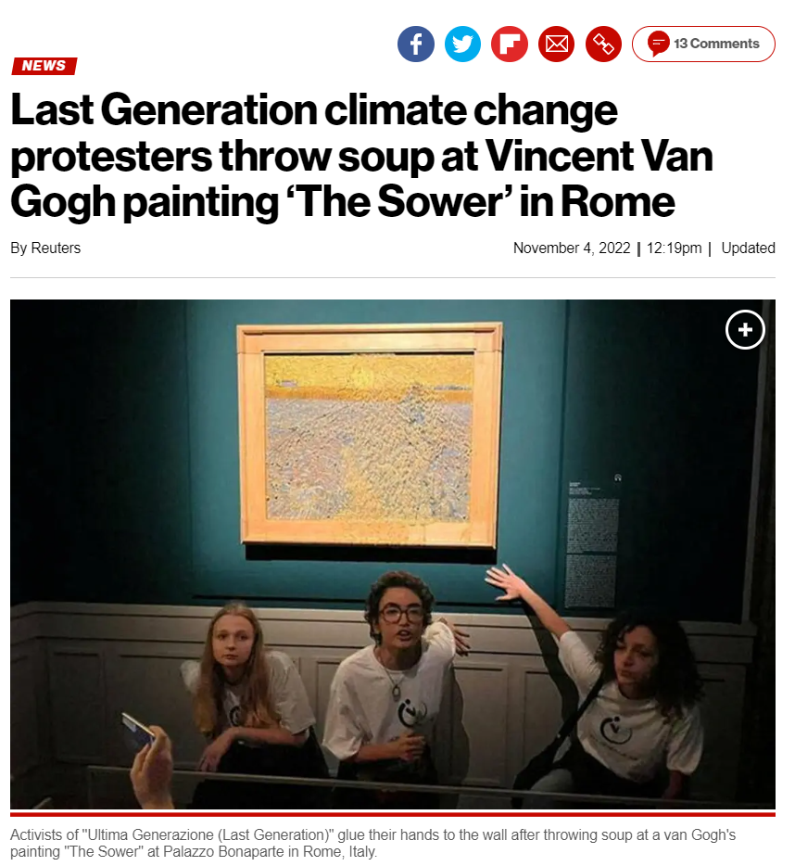
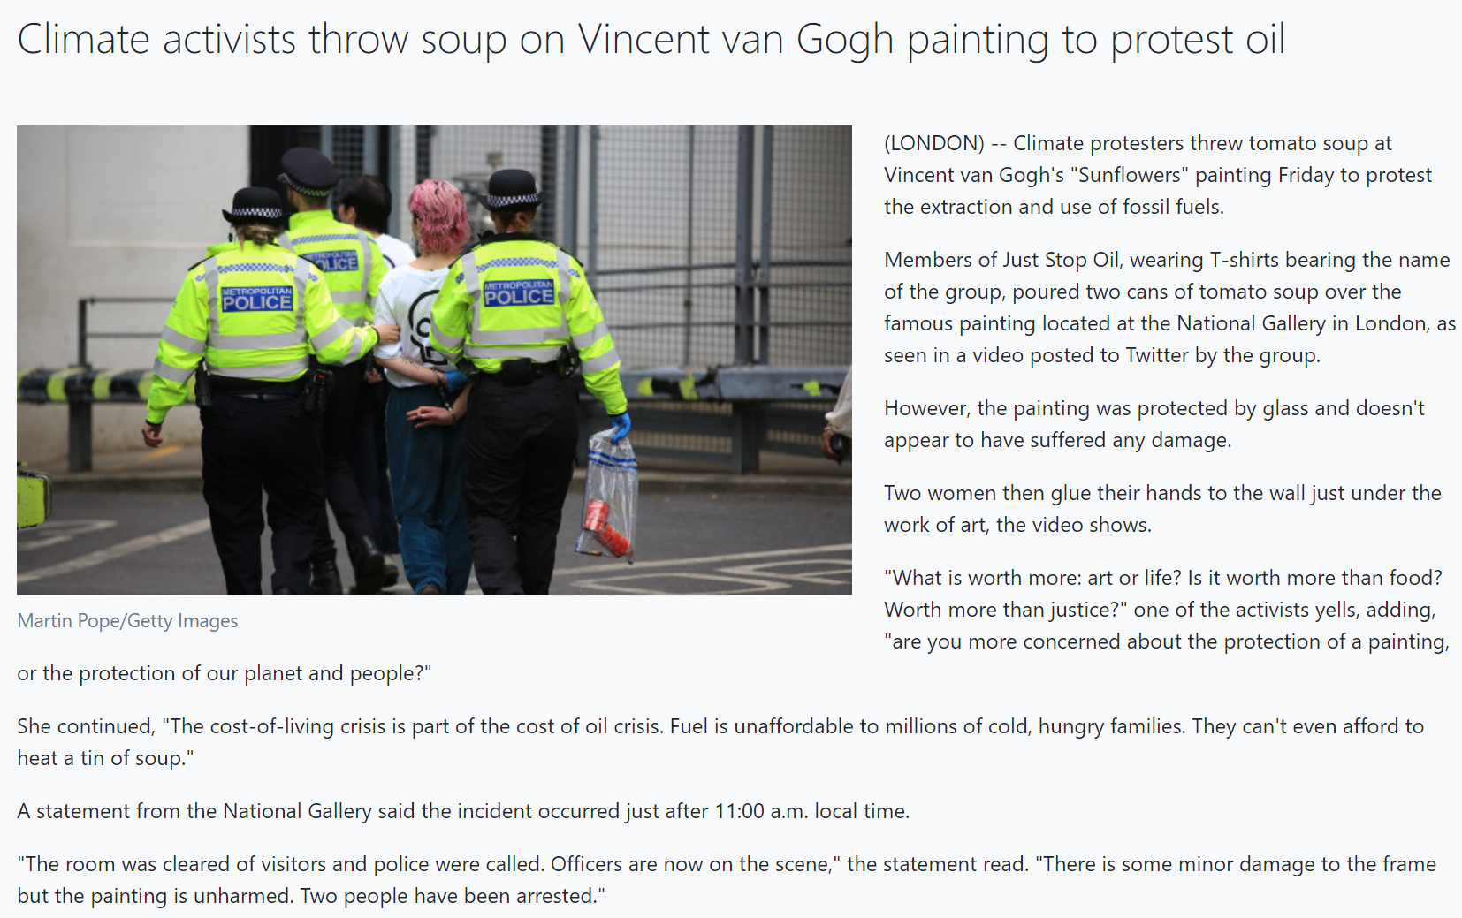
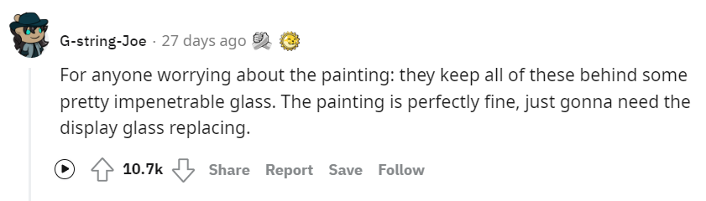
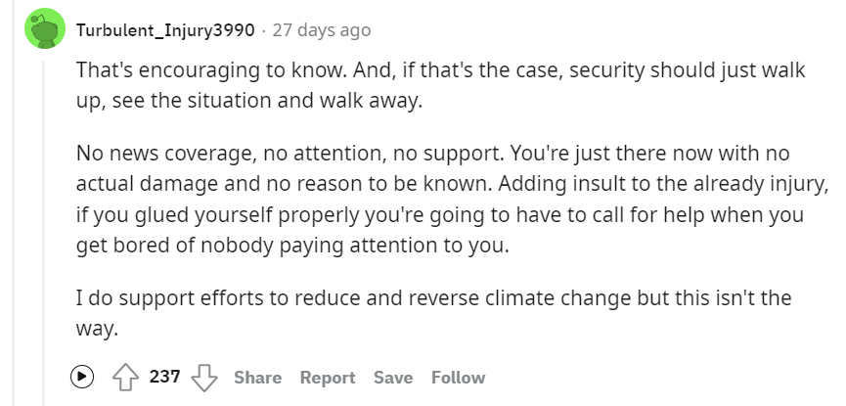
Notes:
Art and climate activists have recently made the news for the Van Gogh attack, first in London (UK), and then [click] also in Rome (Italy).
Public reception of these events has been rather ambiguous. While some say that the painting was perfectly fine [click], some others [click] believe that this is not the right way to protest.
What we should all agree on – though – is that art and activism have historically been deeply correlated, in a more broadly acceptable way.

Slide 4
1
2
Our journey so far
Next Steps
Notes:
So our agenda for today basically includes: telling a little bit on the journey so far, and introducing what we would like to do next

Slide 5
From the social-protest literature:
Art to encourage social change;
Art empower and deepen commitment;
Art to harmonize social activists within the movement;
Art to inform internally to express or reinforce values and ideas;
Art to inform externally as a more effective way to communicate movement ideals to people outside the movement;
Art to provide elements of pleasure and aesthetic joy.
Notes:
With the intent to produce an academic article out of this research, the team reviewed the literature on social protest by retrieving articles in worldwide peer-reviewed sociology outlets in search of th different roles that art played over time in social protests

Slide 6
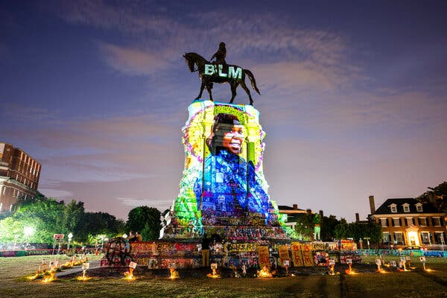
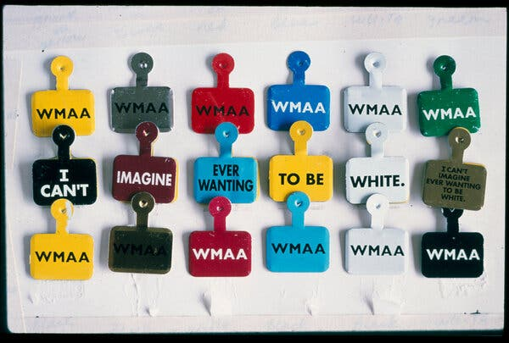
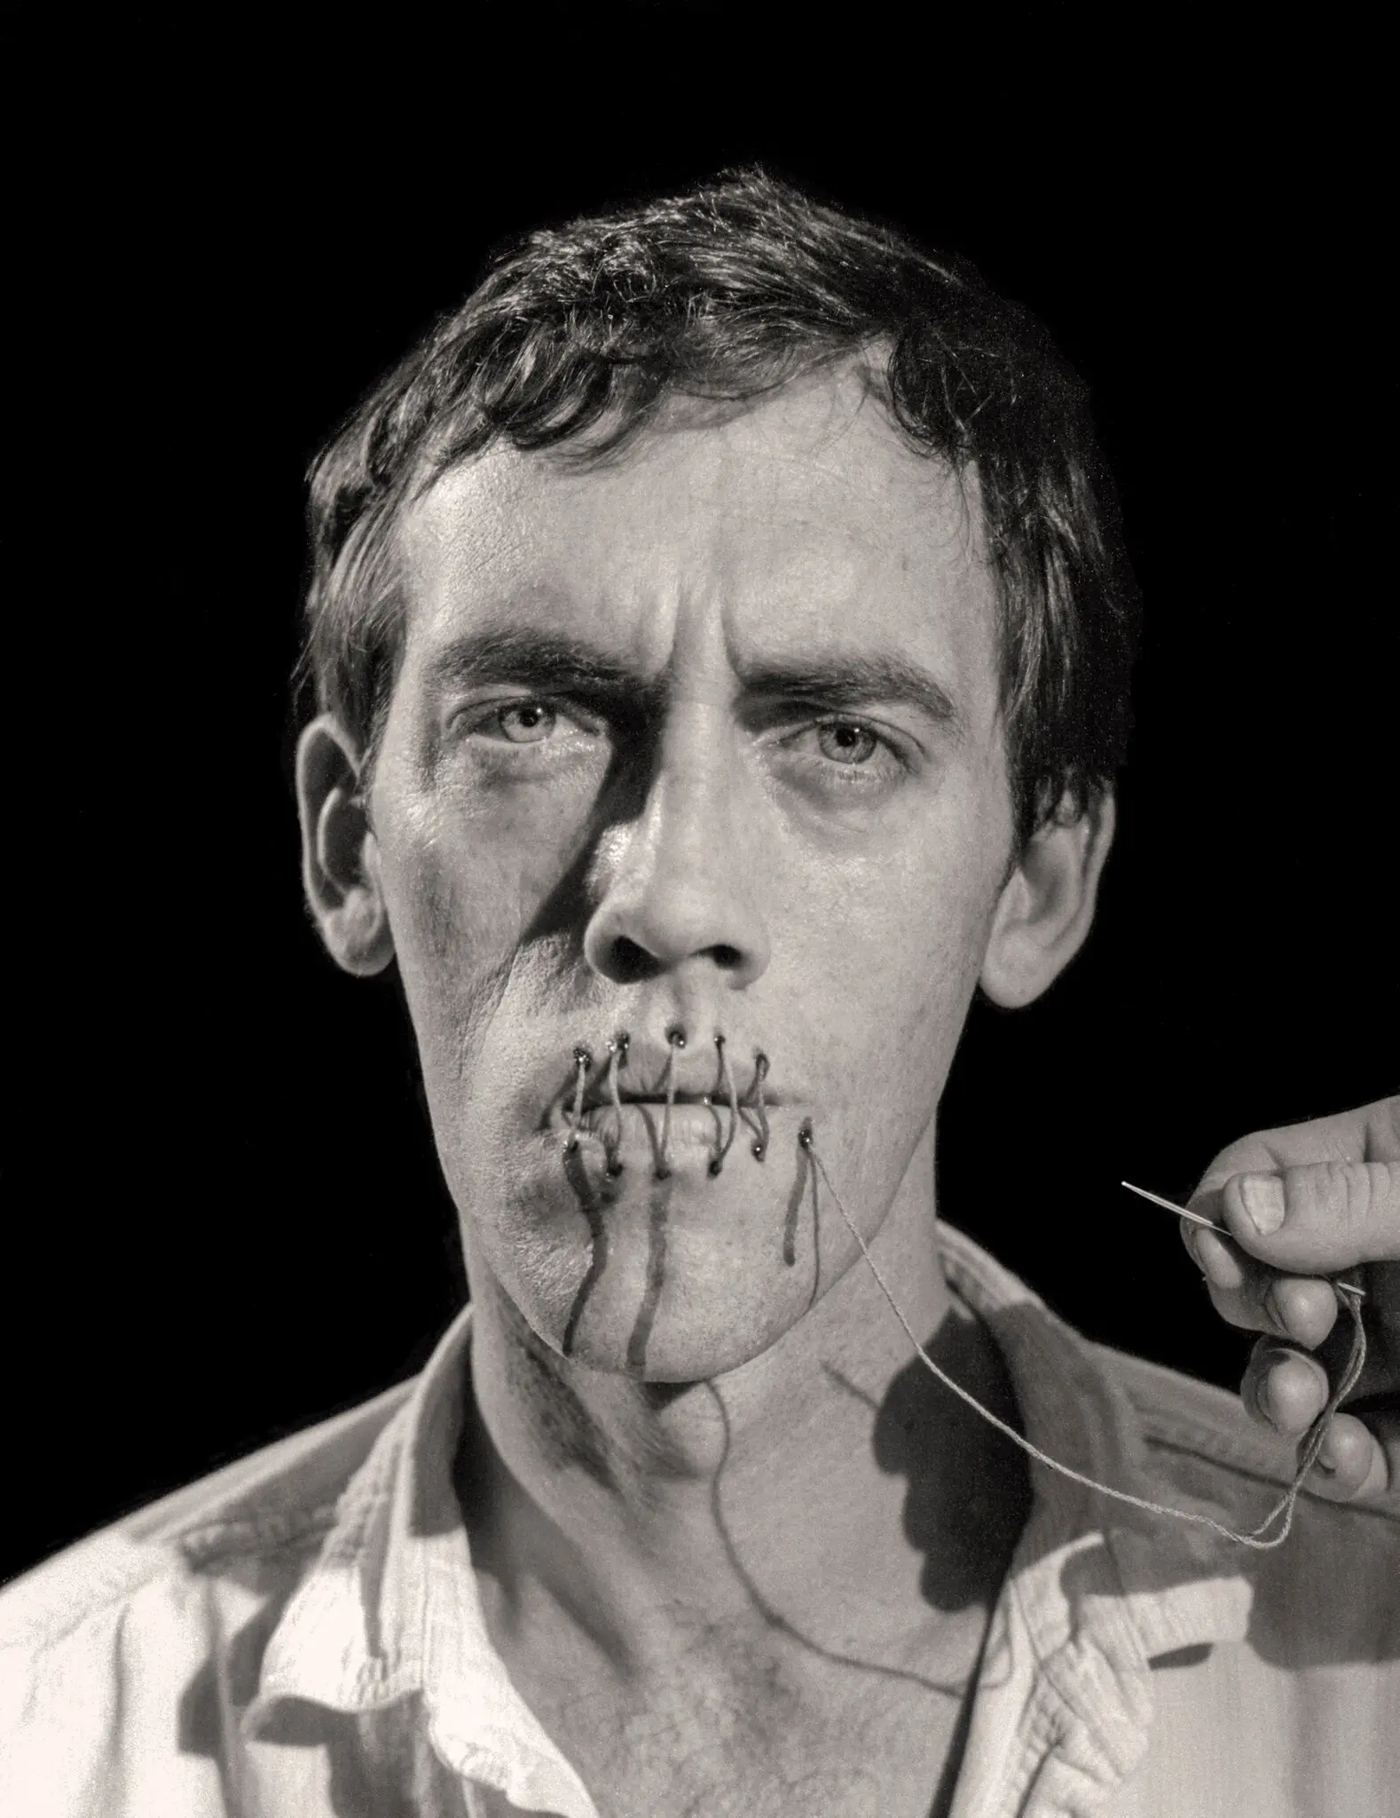
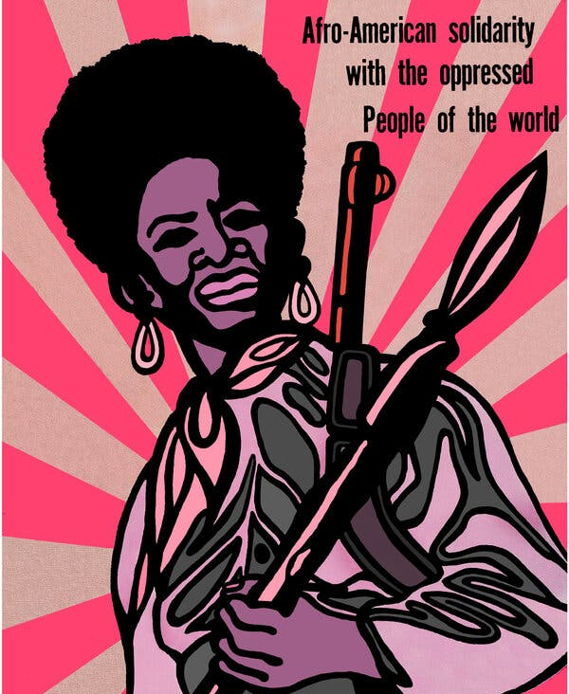
From archival research:
Community as an input through art
Community as a scale-enabler through art
Community as an output through art
Breonna Taylor’s projection onto the statue of Robert E. Lee on Monument Avenue in Richmond, Va (2020)
Daniel Joseph Martinez’s “Museum Tags: Second Movement (Overture) or Overture con Claque — Overture with Hired Audience Members” (1993)
[left] Andreas Sterzing’s “David Wojnarowicz (Silence = Death)” (1989)
[right] Emory Douglas’s “Afro-American Solidarity With the Oppressed People of the World” (1969)
Notes:
We then also went online and visited the archives of one of the biggest collections of social protest in the nation – at the University of Michigan – to read about work of protest art that made the history with the purpose of finding how those pieces of art did relate to community at all.
+ on the left, we see Breonna Taylor’s projection of a collective work of art that was produced by black US artists and featured kaleidoscopic display of graffiti and black-life-matter art. People who once avoided the statue now make pilgrimages to see what has become an emblem of the Black Lives Matter movement as well as a newly, diverse public space.
+ on the center, we see this artistic effort to turn community members into ambassadors of social protest, by – in this case – wearing the tag while enjoying a visit at the MoMa museum of NYC. The artist thought of it as a series of entry buttons for visitors to wear inside the museum, modeled on the usual colorful metal tags viewers received as proof of admission.
+ finally on the right, we see a couple of very iconic works of art that functioned as an advertisement for the mobilization of the masses – just read the titles

Slide 7



From the interviews:
        “We think of ourselves as complicated animals but… we just love stories, and we do need stories if we want to deliver the climate change message to the wider masses.“ Matt Bell
        Climate Change Artist
INFORMANTS
        “Essentially we are trying to build a global coalition of artists and creators committed to shining a light on all forms on climate change… the world needs an irrational, creative discourse to change our irrational."
        Sam Peltz
        Climate Activist
13 artists
        “Craft is therapeutic more than anything else… For me, the real value of craft art is in the powerful bonding that creates community within our craft group and between (different ones).“
        Carrie Reichard
        Climate Craft Artist
7 professors
3 climate activists
Notes:
Finally, we collected primary data in the form of semi-structured interviews that informed us about how “practitioners” in this field, activists and artists, think of art as a tool to foster communication and commitment on the message.
+click to show quotes (3 times)
+ just read the quotes (or at least the underlined part)
+ add that we are working on a theoretical model

Slide 8
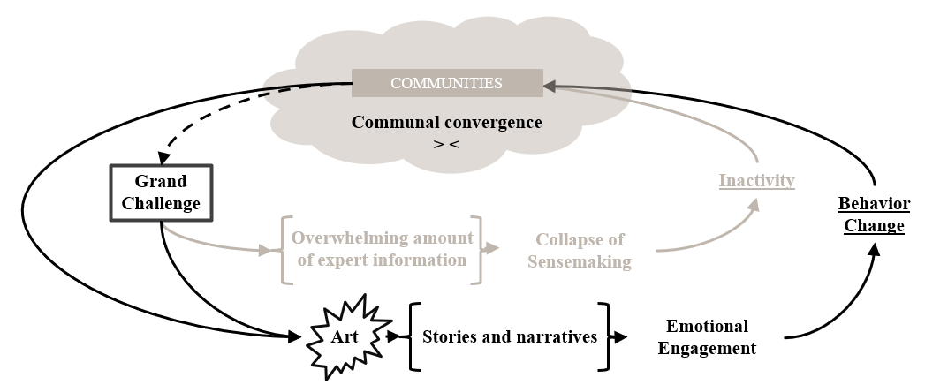
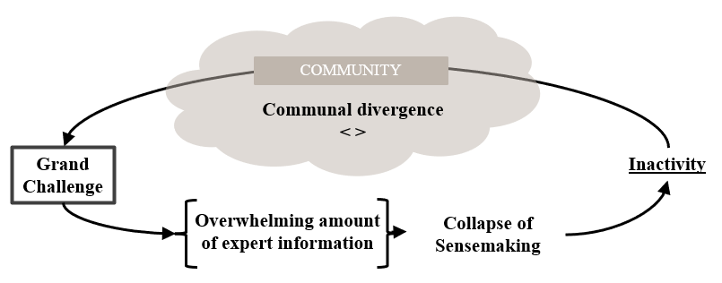
Intended contribution

Slide 9
1
2
Our journey so far
Next Steps
Notes:
Now we want to quickly show you what our next steps in the project look like

Slide 10
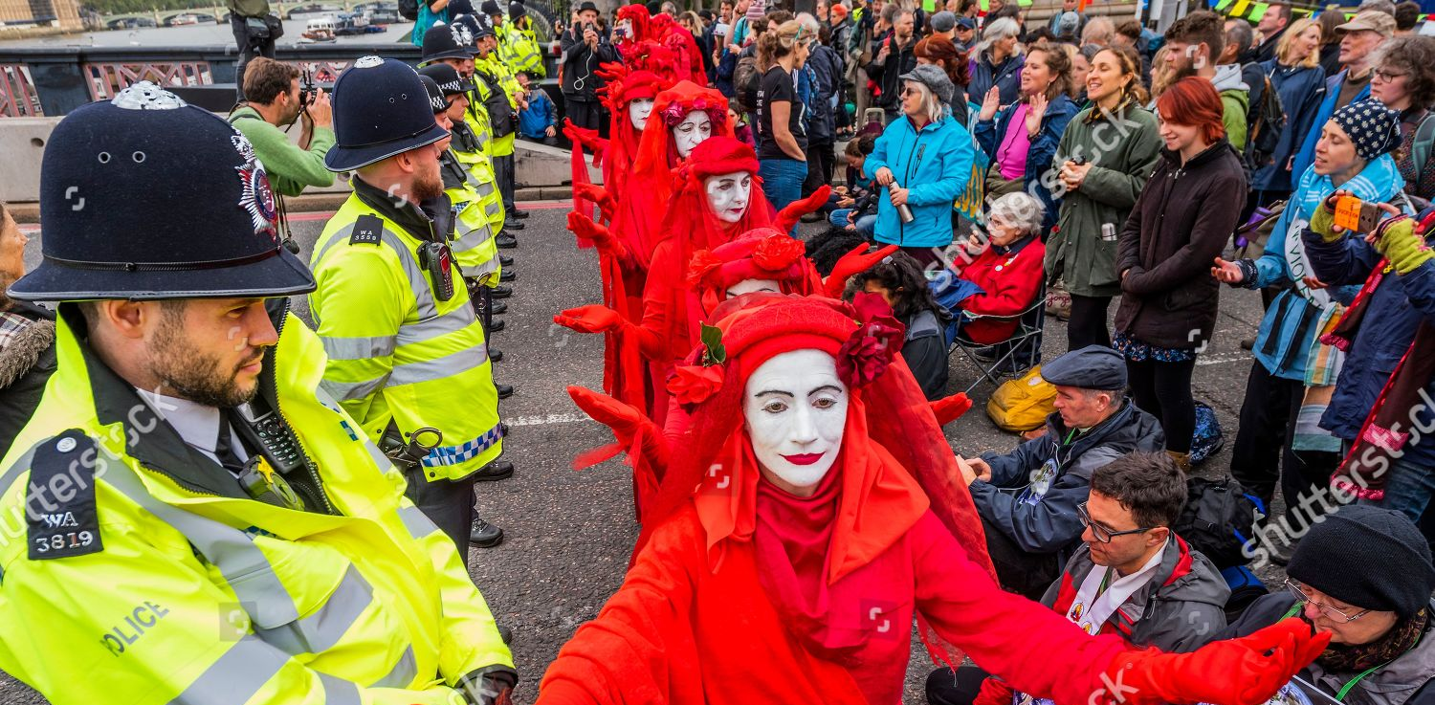
Notes:
Over the next few months we expect to take turns and attend the performances of the Red Rebel brigade – a performing art group that attends climate action protests in Boston and whole Massattcussets. These opportunities will give us exposure to people who first-hand believe in art as a way to communicate and achieve change.
Recent protests which the Red Rebel brigade attended include Earth day 22, 09/21 traffic block in Seaport Boston, the 11/11 sit in in front of Chase Bank HQ in Boston, and flight block on 01/06 at Worchester Regional Airport.

Slide 11
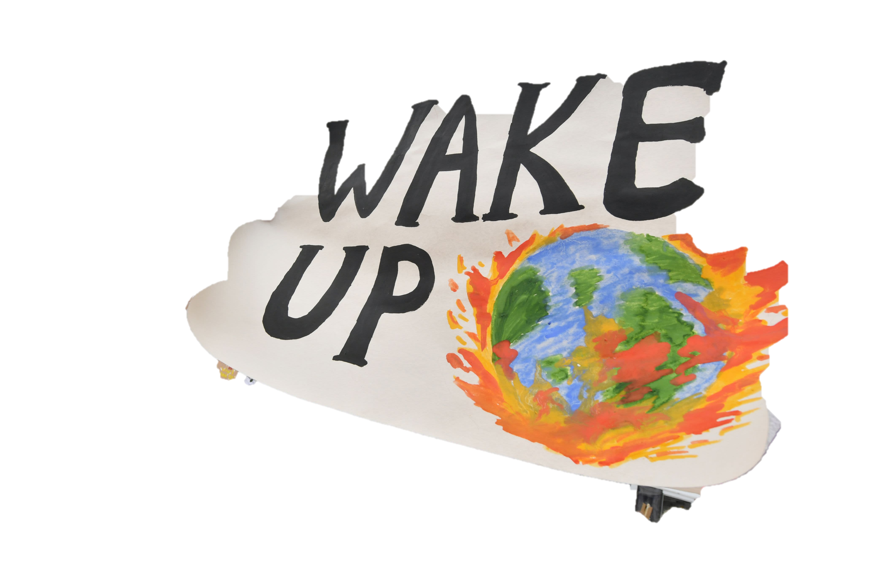
April
May
June
Earth day
End-of-semester art event
Mobilization conference
Collaborate with Climate Cafe to attend Earth-day at BU, hosting flyers of the research project and promoting the end-of-semester art event (see May)
Collaborate with the BU Arts Initiative to host a one-day even on Campus that included an art workshop open to all BU students and a panel discussion with BU faculty and climate change artists from Massattchussets to present research and discuss findings
Bringing BU Institute for Global Sustainability to an academic conference!
(Mobilization conference: abstract due to mid-March)
(ASA conference: abstract due to mid-Febraury)
Notes:
Just read

Slide 12

Q&A

Slide 13

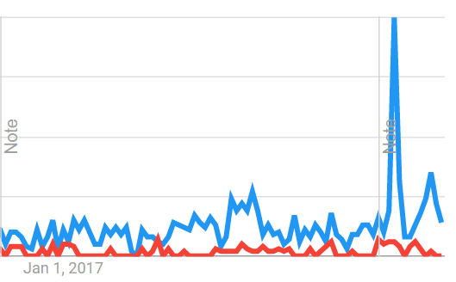




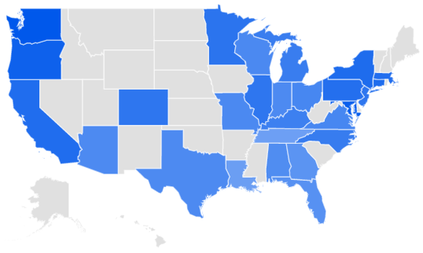


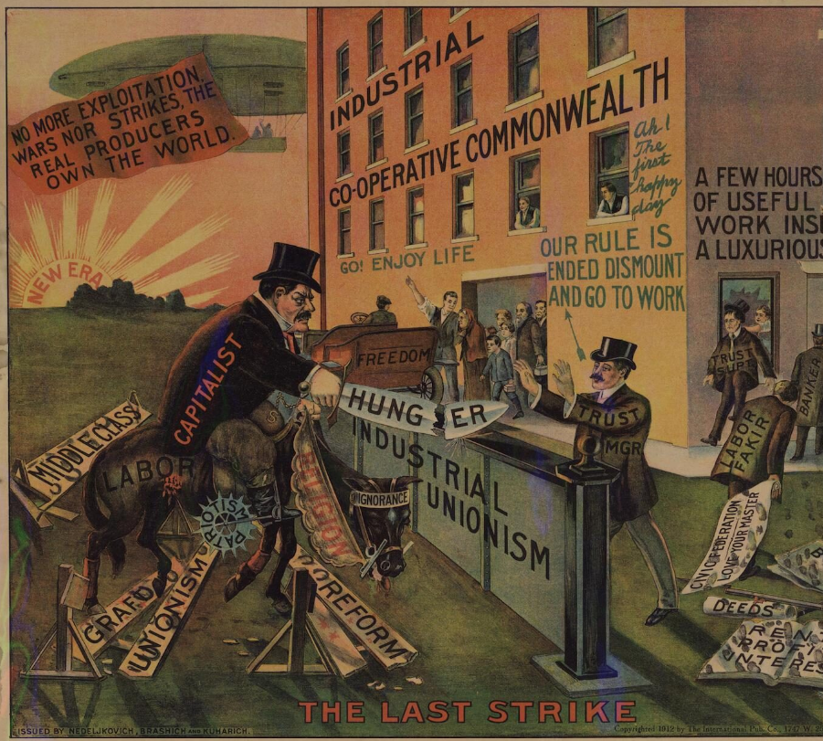
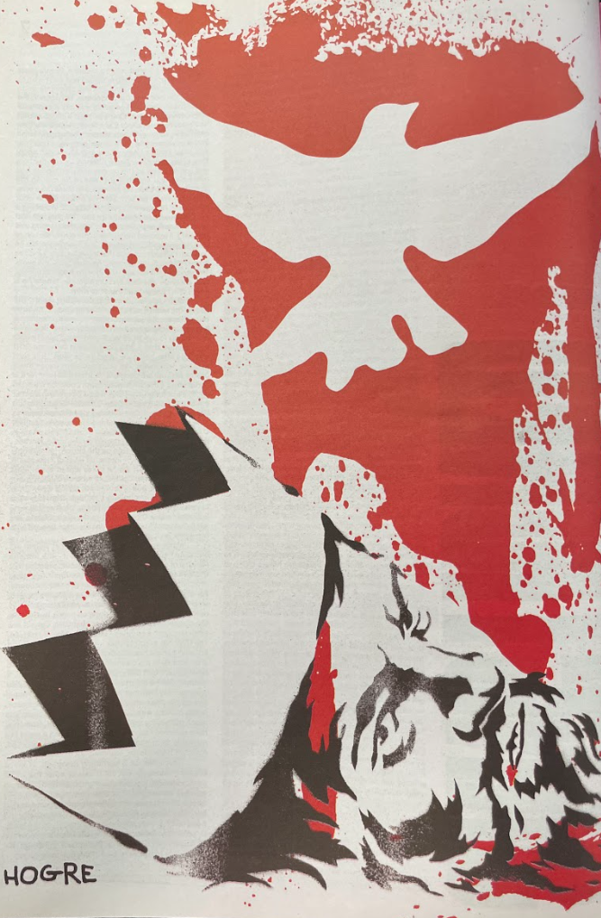
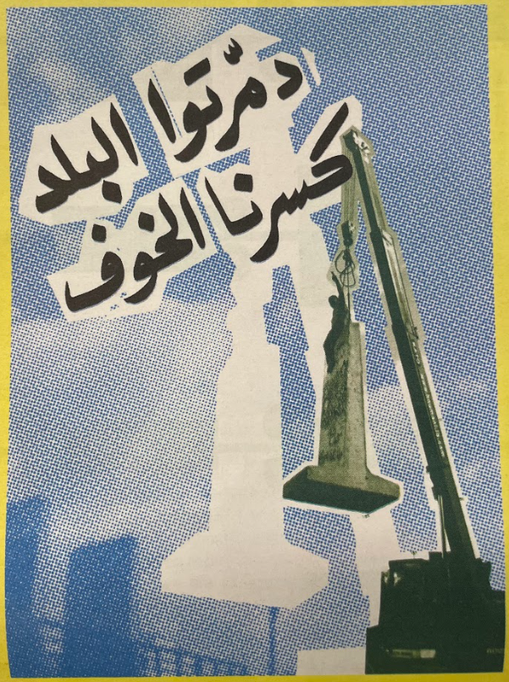
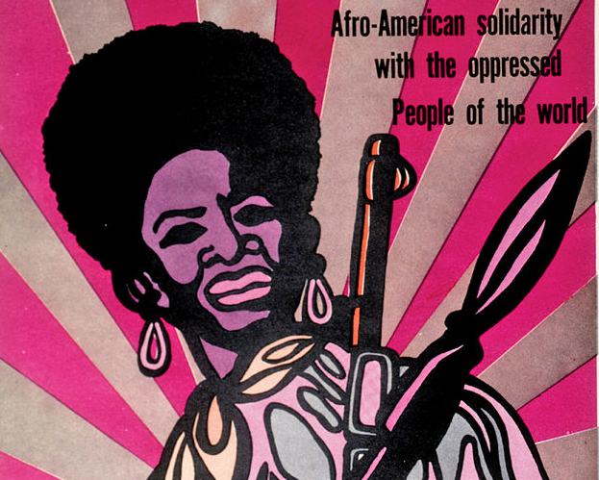
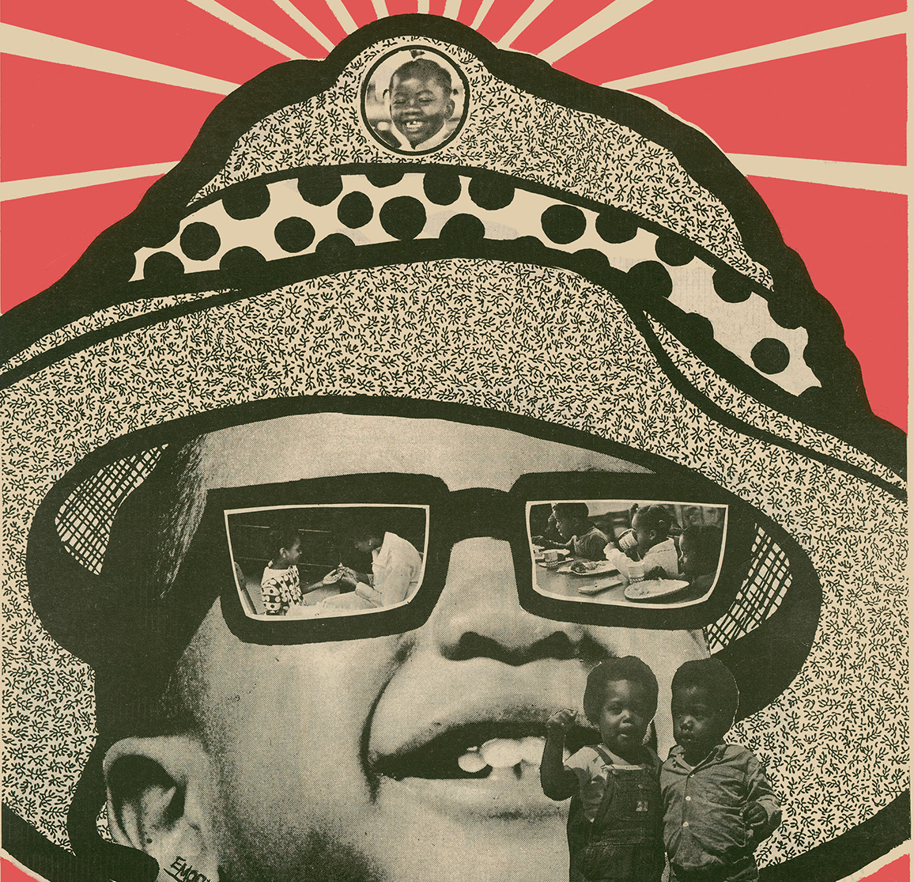
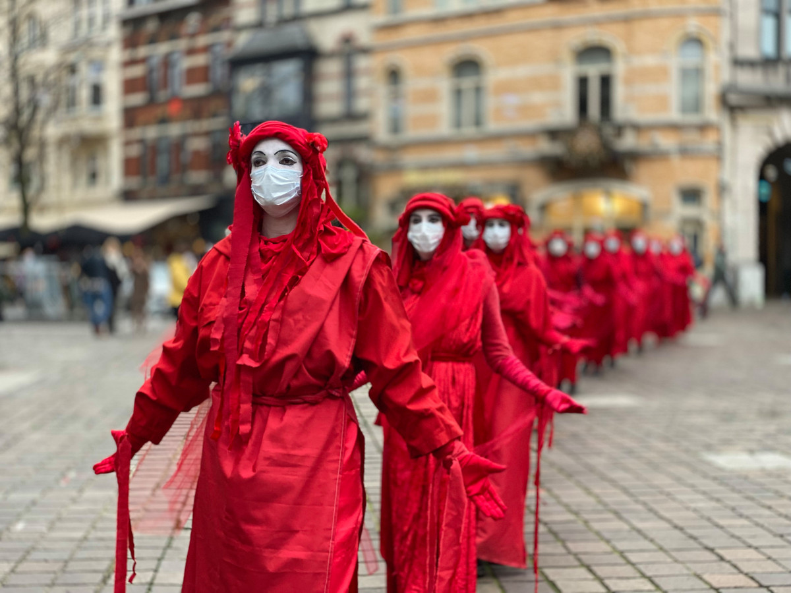
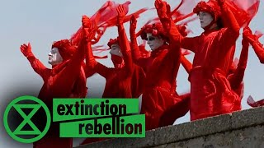
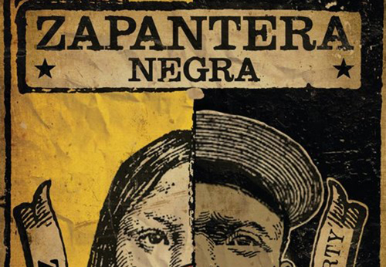
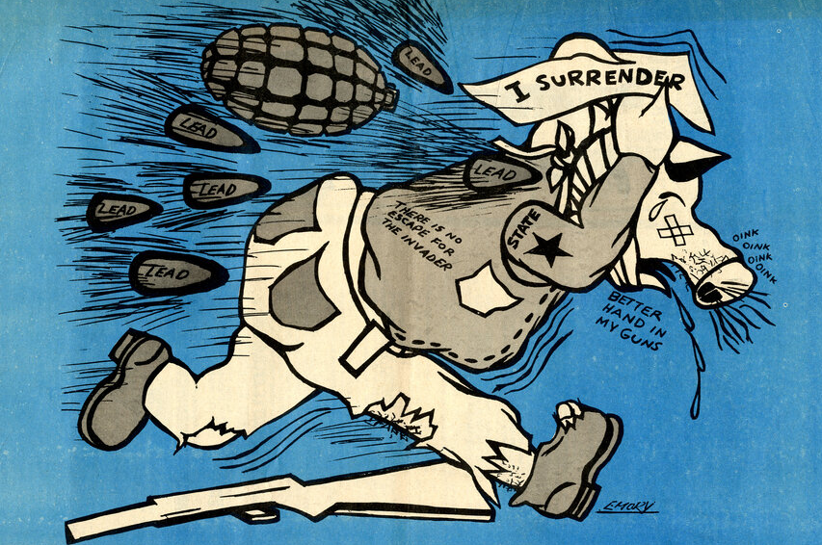
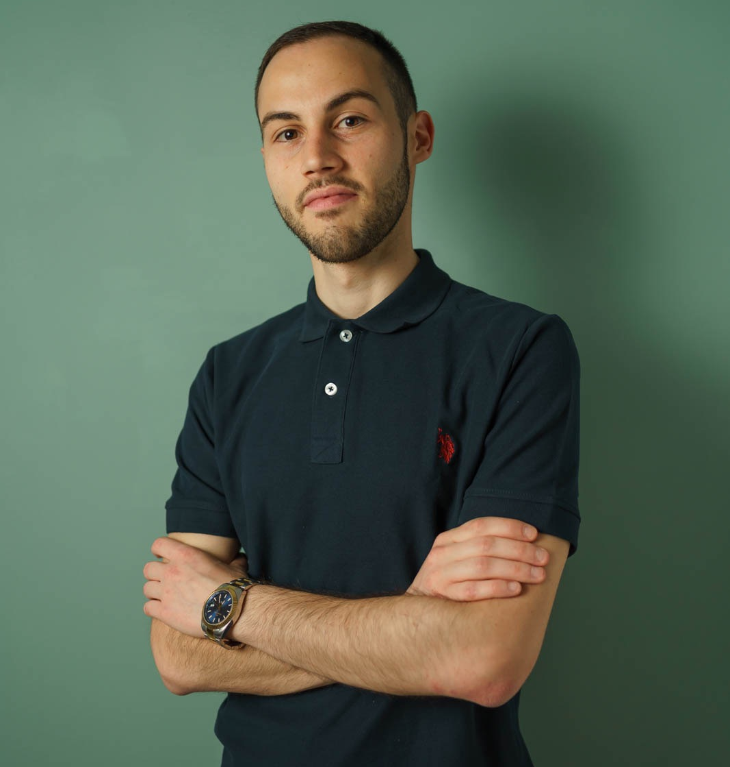
The power of art to communicate sustainability, build community and achieve system change
IS PROTEST ART EVEN A HOT DISCUSSION TOPIC?
48 journal articles
13 artists
The online debate on protest art has grown more than
that on climate change
in the last five years
3 books
7 professors
WHERE IS IT FOUND?
128 minutes of media
3 climate activists
THE TEAM
Talya Havivi
Senior (Sociology Major)
Climate Cafe co-organizer
Nikki H. Huang
Senior (Sociology Major)
Wildlife preservation advocate
Valerio Iannucci
PhD Student @ Questrom
Climate change activist

