Slide 1



Establishing Sustainable Laboratory Practices and Standard Operating Procedures That Offset Waste Production in Biomedical Research
Saylor Williams
Serano Lab Manager
Center for Regenerative Medicine
saylorw@bu.edu
Carly Golden
PhD Student
Molecular & Translational Medicine
Center for Regenerative Medicine
csgolden@bu.edu
Greg Miller, PhD
CReM Lab Manager
Center for Regenerative Medicine
millergr@bu.edu
Angie Serrano, PhD
Mentor & PI
Center for Regenerative Medicine
masser@bu.edu

Slide 2
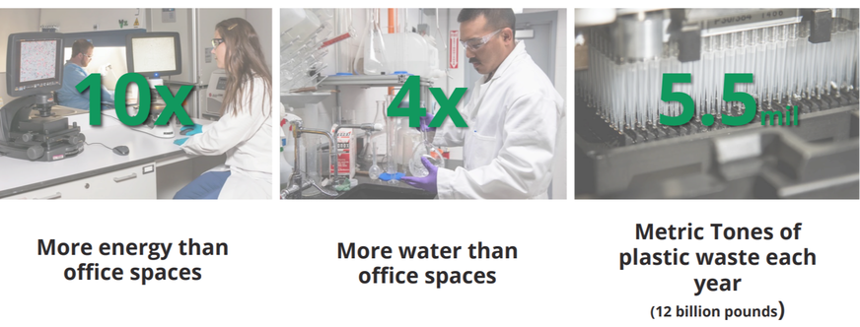
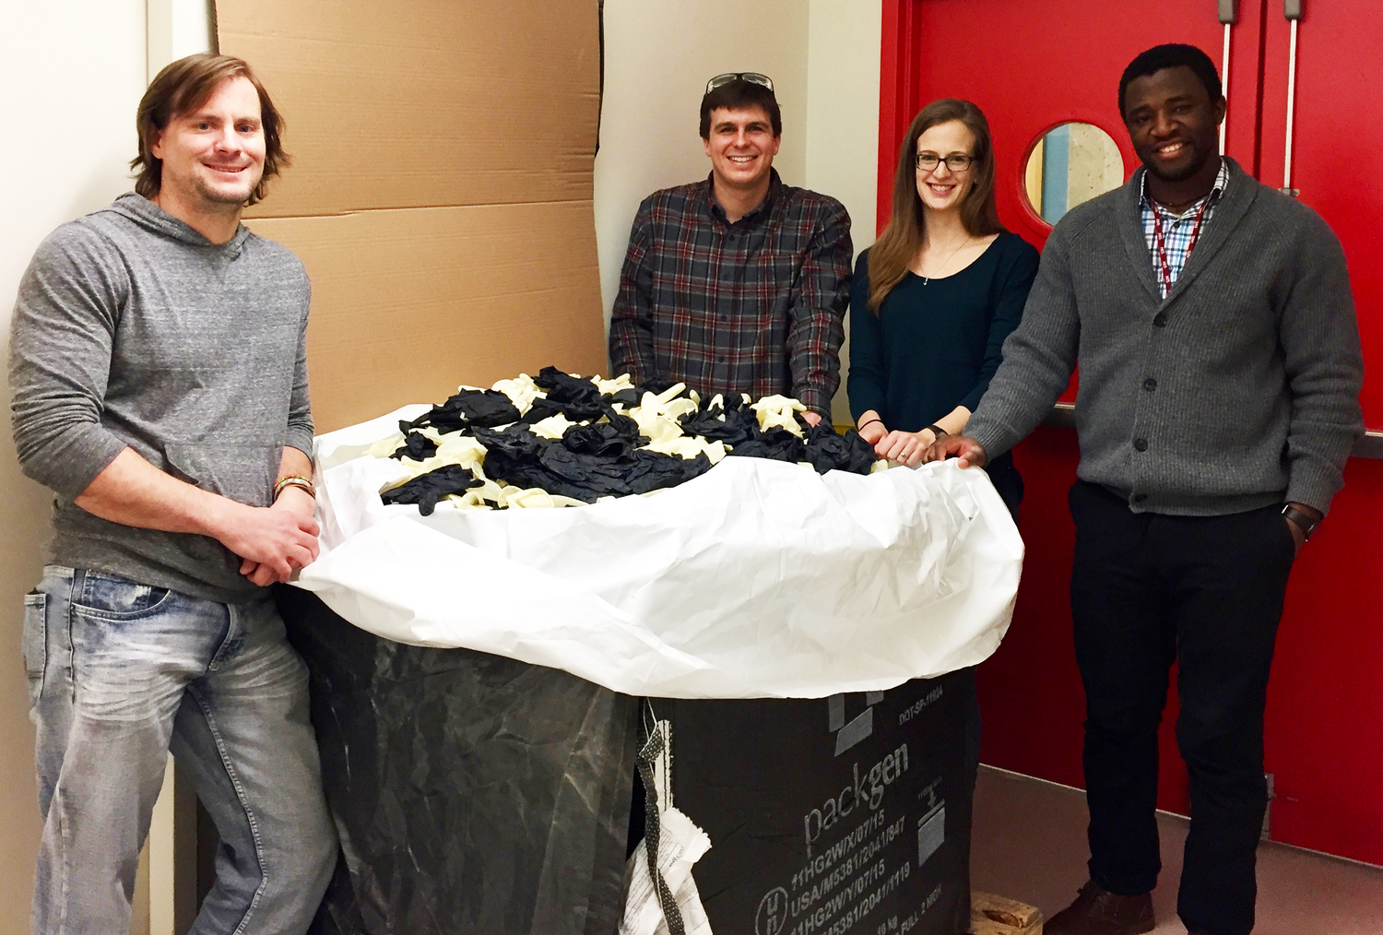
Research labs produce 12 billion lbs of plastic/yr
MyGreenLabs.org, MIT

Slide 3
How can research laboratories decrease the amount of waste generated?
Indirect Emissions
Goal: Provide BU with valuable knowledge about waste produced in their research labs and with clear SOPs that sustainably manage it.

Slide 4
Research
Implementation
Evaluation
Learn about different sustainability practices
Implement the practices that would best fit our lab needs
Evaluate how effective these practices are and make changes accordingly

Slide 5
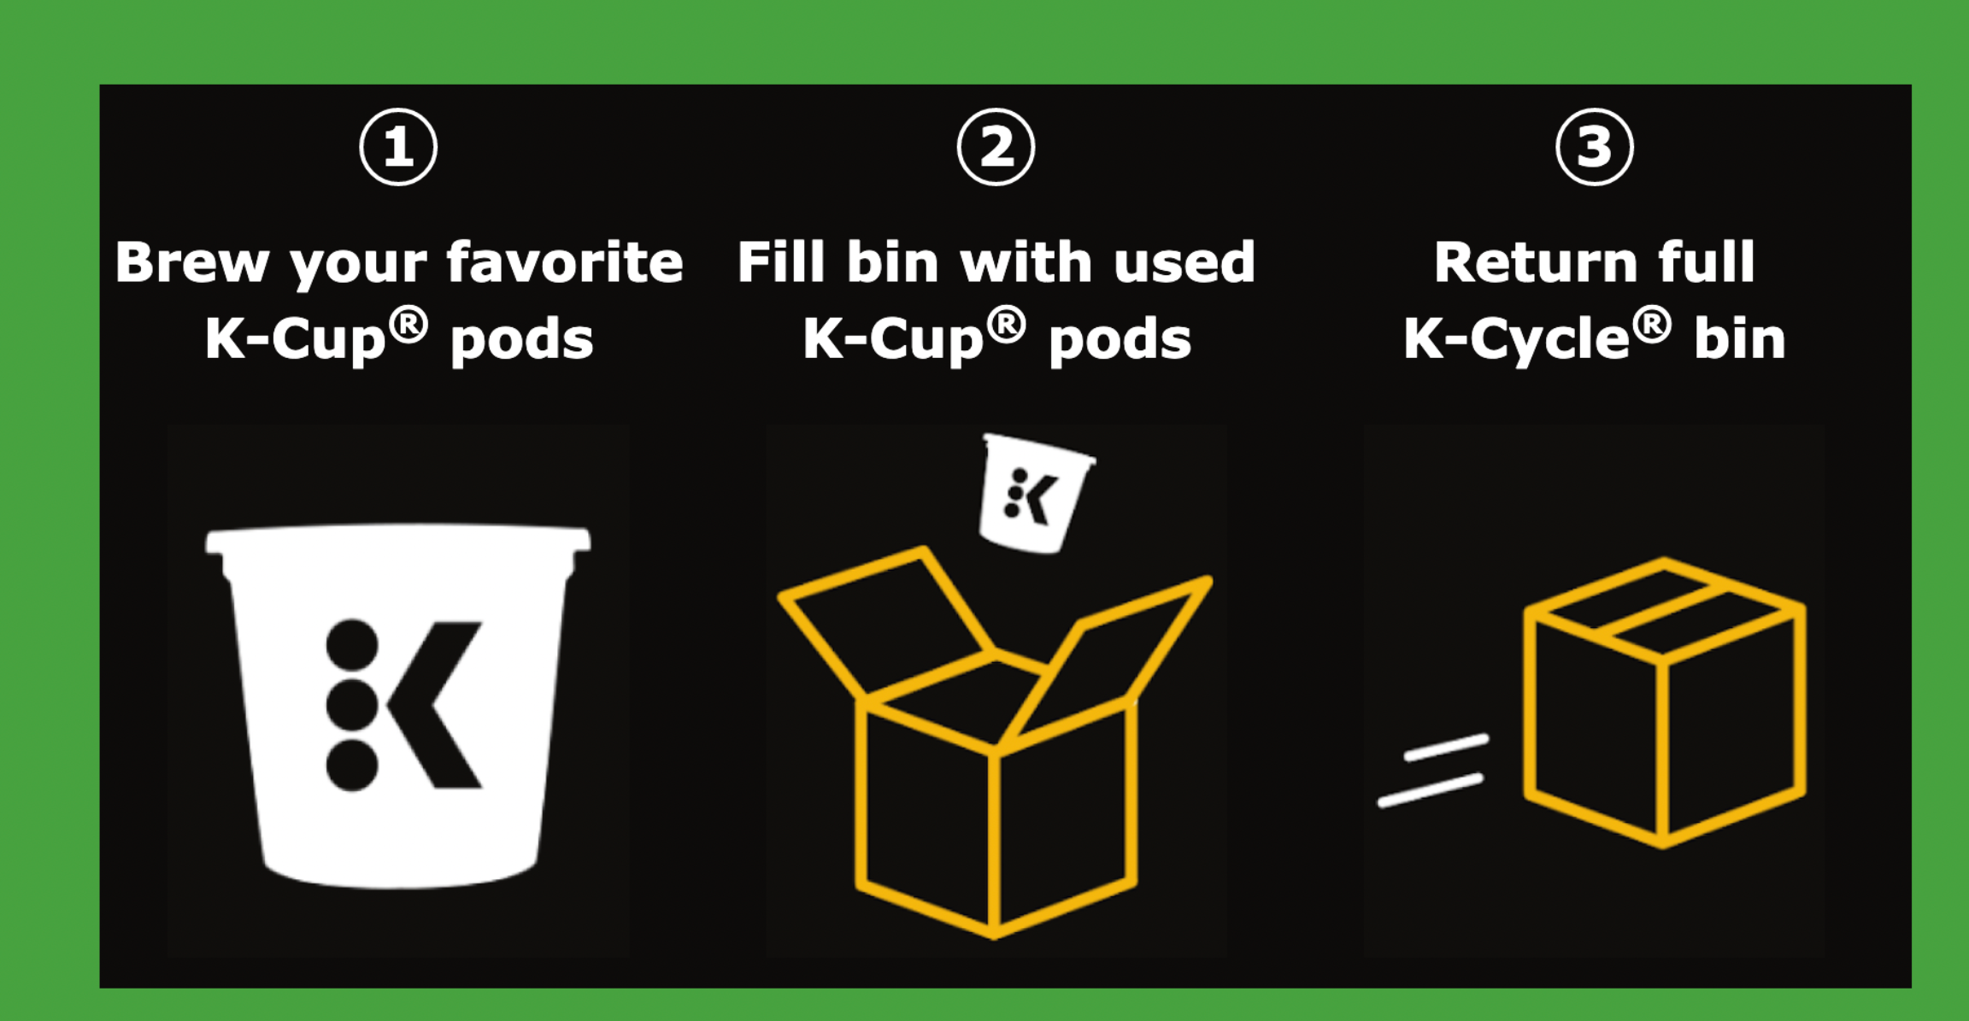
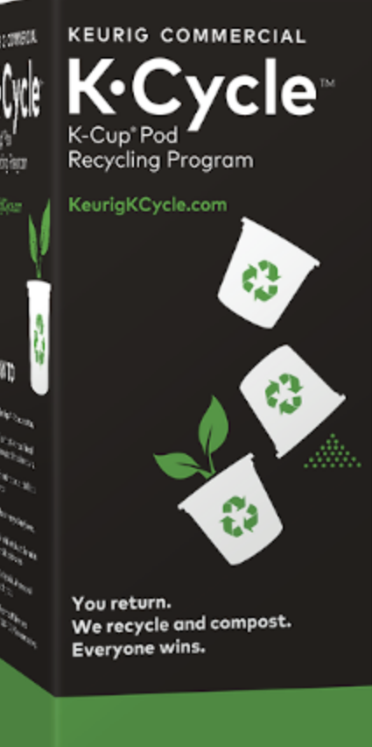
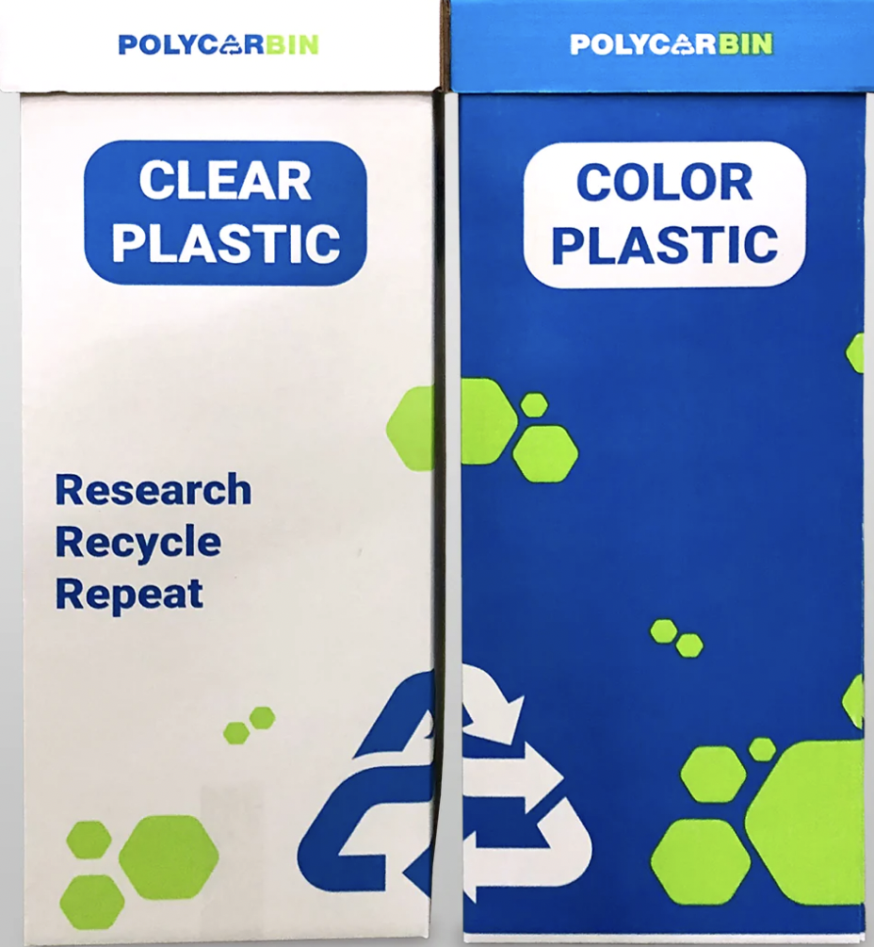
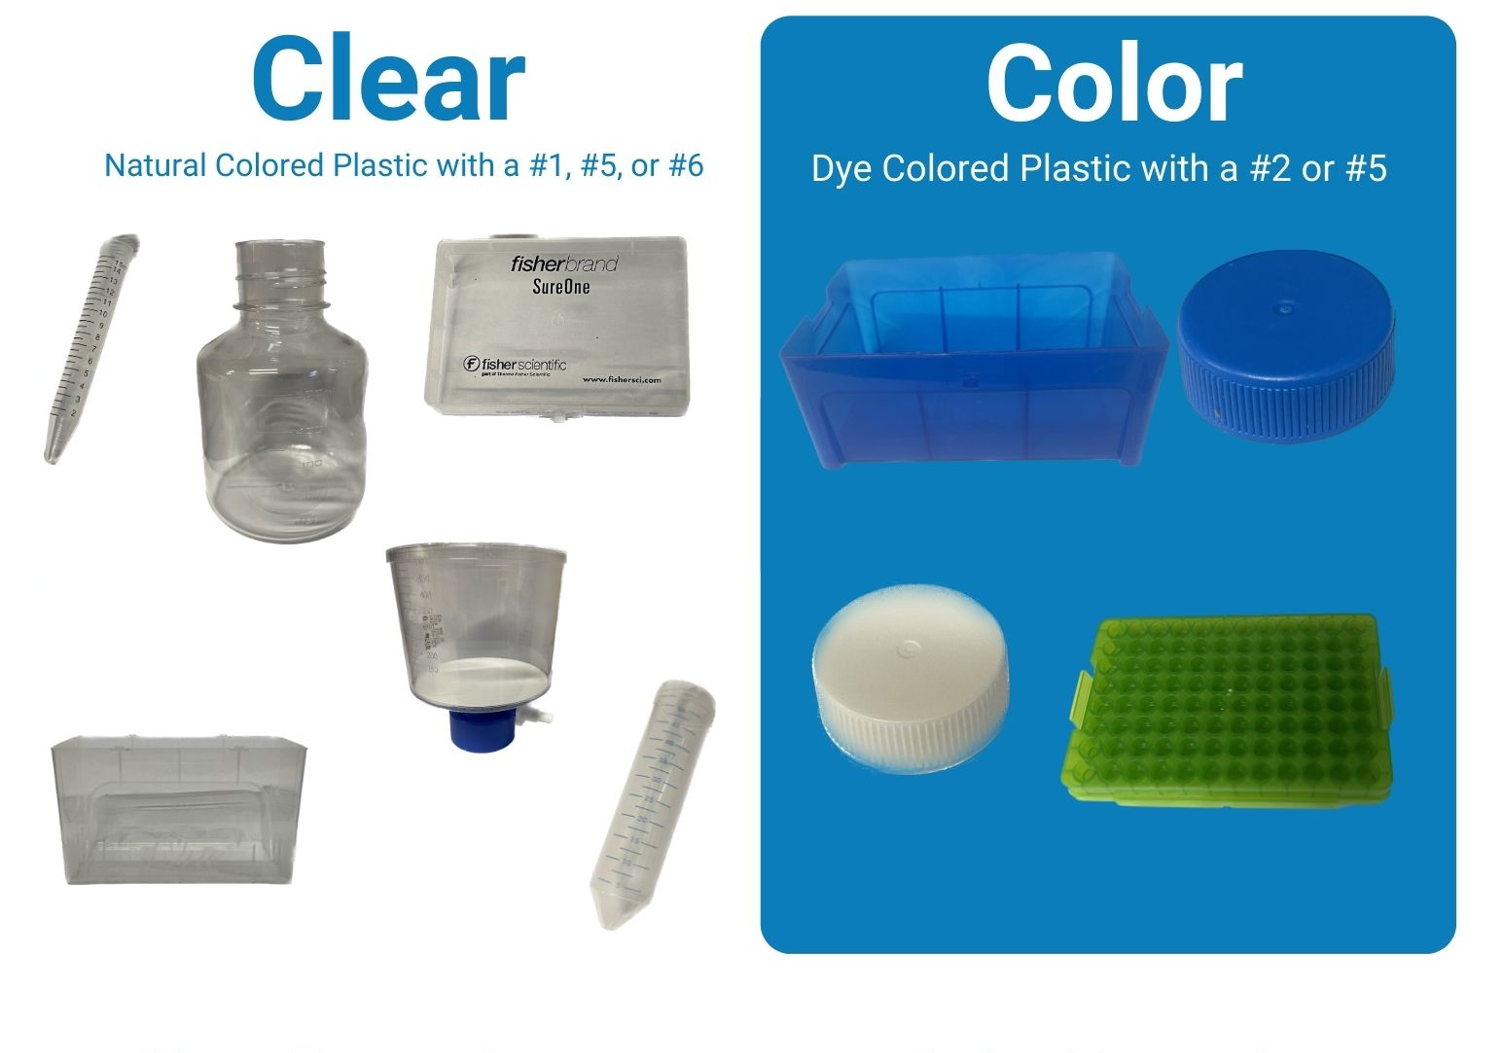
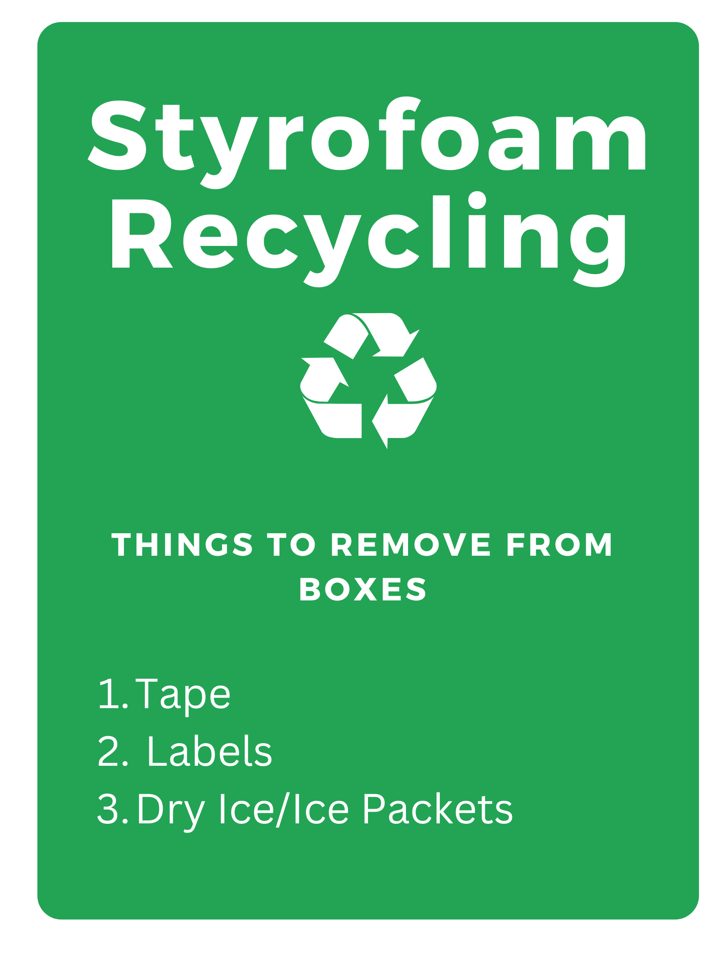
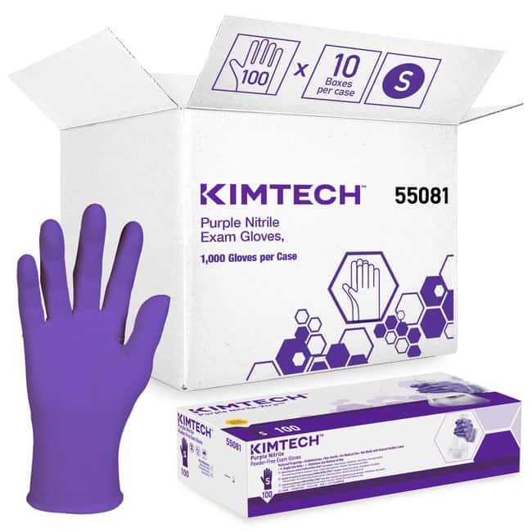
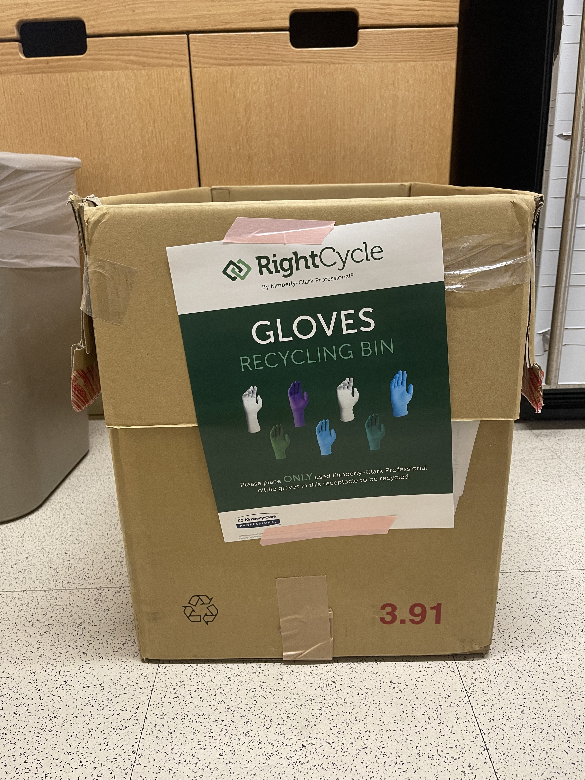
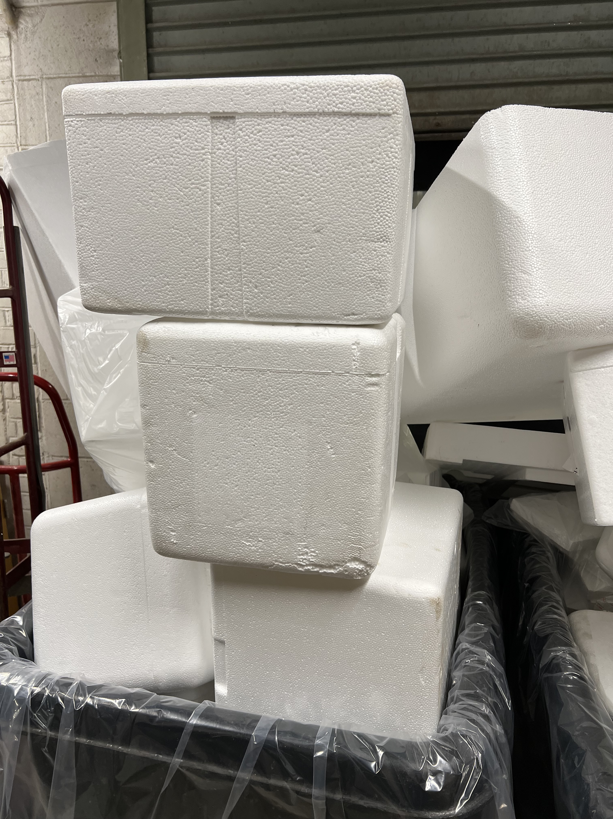

Slide 6


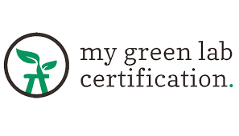

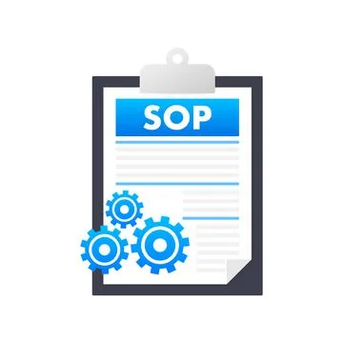
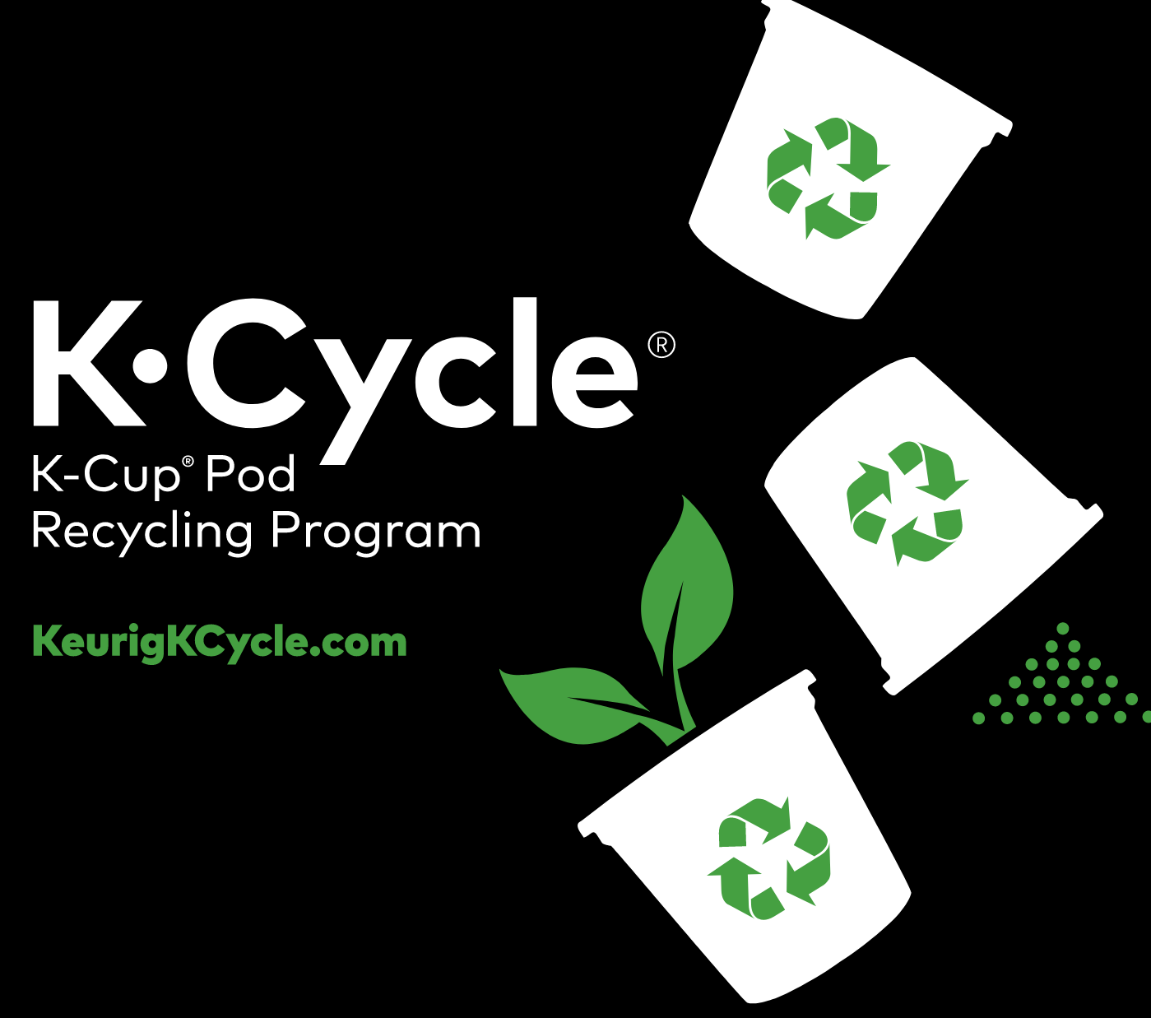
Future Directions
Certification
Data Collection
SOP

Slide 7

Center for Regenerative Medicine
Meenakshi Lakshminarayanan
Gabrielle Cockerham
Greg Miller
Kotton Lab
Hawkins Lab
Wilson Lab
Mostoslavsky Lab
Murphy Lab
Gouon-Evans Lab
Institute for Global Sustainability Campus Climate Lab
BU Sustainability Department
BU Facilities Department
BU Chobanian & Avedisian School of Medicine
Serrano Lab
Carly Golden
Jessica Chern
Sandeep Sreerama
Zoe Hoffmann Kamrat
Christopher Buie
Angie Serrano

Slide 8
References
www.mygreenlab.org
www.nature.com/articles/d41586-020-01368-8
www.kcprofessional.com/en-us/products/scientific-and-research/lab-environment#numberOfResults=30
www.bu.edu/sustainability/vision-progress/
www.polycarbin.com
www.integra-biosciences.com

Slide 9
Name | Product | Amount | Price
Polycarbin | Beta Carbin Clear Plastic** | 5 boxes and return label | $440.00
Polycarbin | Beta Carbin Color Plastic** | 5 boxes and return label | $440.00
Kimberly Clark Right Cycle Program | N/A | N/A | $30.00**
K-Cup Recycling | Small K-Cycle* | 5 small boxes and return label | $94.95
*Other options available
**Estimation

Slide 10
Implement Styrofoam, K-Cup, and plastic recycling in shared spaces
January
Combine information into SOP and share it across BUMC
Implement suggestions from My Green Lab
March
SOP for recycling gloves
Plastic recycling
November
May
October
Awarded Campus Climate Lab funds
December
Plan for Styrofoam recycling
K-Cup recycling
February
Green Lab Certification
Monitor recycling in shared spaces
April
Evaluate the effectiveness of recycling programs and financial investments

