Slide 1
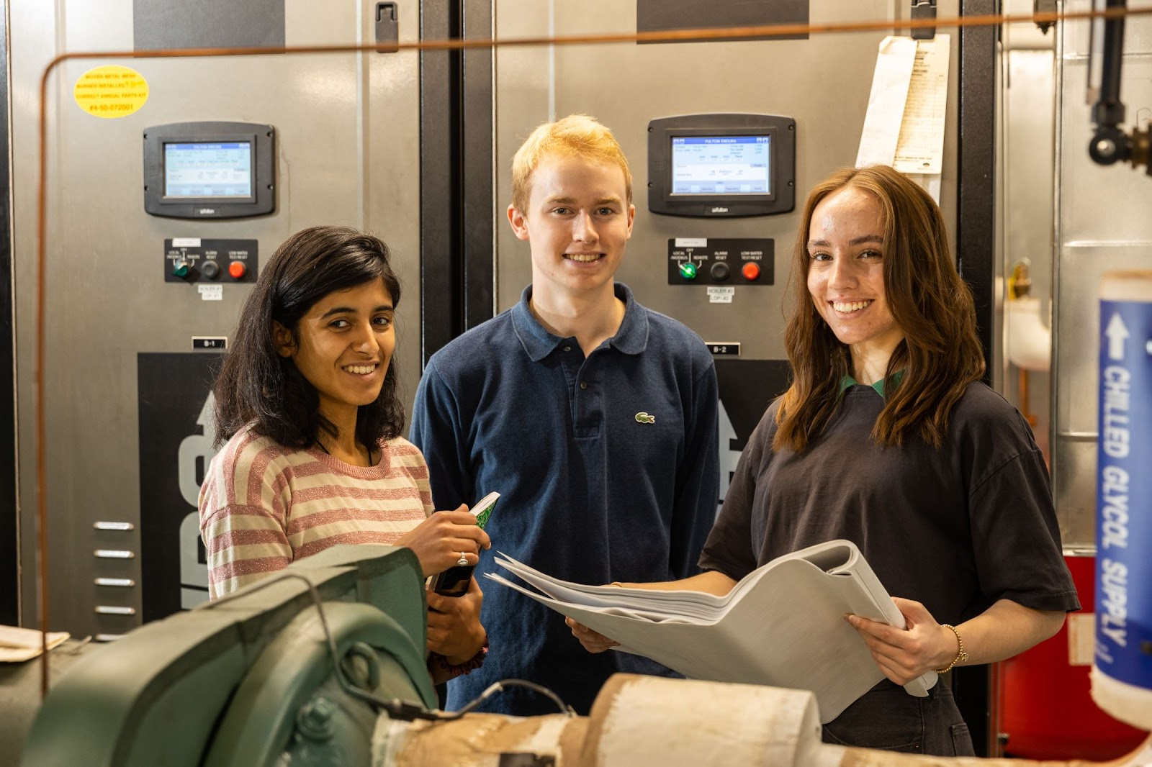
Developing Electrification Strategies to Decarbonize Boston University
Phase 5: Selection of Pilot Demonstration Buildings, Summer Re-heat,
& Analysis of Ground Source Heat Pump Opportunities
Decarbonization Framework for BU
Pilot Building Objectives & Candidates
Issues to Address in the Spring
Students: Amanda Baumann (ENG ’24), Christopher Lambert (ENG ’24), & Anjena Daswani (MS). Faculty Advisor: Michael Gevelber (ENG).
BU Facilities Collaborators: Joe Kajunski (Asst. Dir, Eng and Building Automation), Jenn Bleecker (Energy Efficiency Program Manager)
Notes:
Purpose: Introduce talk & give brief overview of insights.
- EXISTING buildings
Hi, everyone! Today, we’ll be talking through some of the technical and economic considerations to make when retrofitting large, commercial buildings and discussing a strategy we’ve analyzed to achieve deep & quick decarbonization.

Slide 2
Decarbonization Framework
46% of BU’s total GHG emissions come from NG heating loads of 341 buildings (14.3 M GSF)
Strategy: Electrify 17 largest buildings to reduce up to 47% of GHG emissions from NG heating
How can we electrify the greatest % of BU’s fossil heating systems, in the shortest time, meeting existing building heating requirements, & CapX/OpX budget constraints? → applicable to commercial buildings
What is the cost of reducing GHG emissions ($/ton) to meet Boston BERDO & how large a reduction can be achieved?
What is the GHG emissions reduction of each strategy?
What are existing building winter heating & summer reheat requirements?
What equivalent carbon tax is required to make electric heat cost competitive?
Environmental
How do heat pump performance characteristics relate to heating needs?
What are the CapX, OpX, & NPV tradeoffs of different strategies?
Technical
Financial
What are the implications of electrification on electric peak demand?
How important is reducing CapX to enabling faster retrofits of a building portfolio?
Is higher GSHP efficiency worth the higher CapX?
Notes:
Purpose: Highlight that our approach blends technical, financial, and environmental considerations to be both effective and viable to implement.
Throughout our work, we’ve been motivated by the question: [read question]
To tackle a challenge like this, we need to take a holistic approach, and consider the technical, financial, and environmental aspects of the project in order for our retrofit to be feasible and effective.
Specifically, we need to consider questions like [], environmental considerations like [], and financial questions like [].

Slide 3
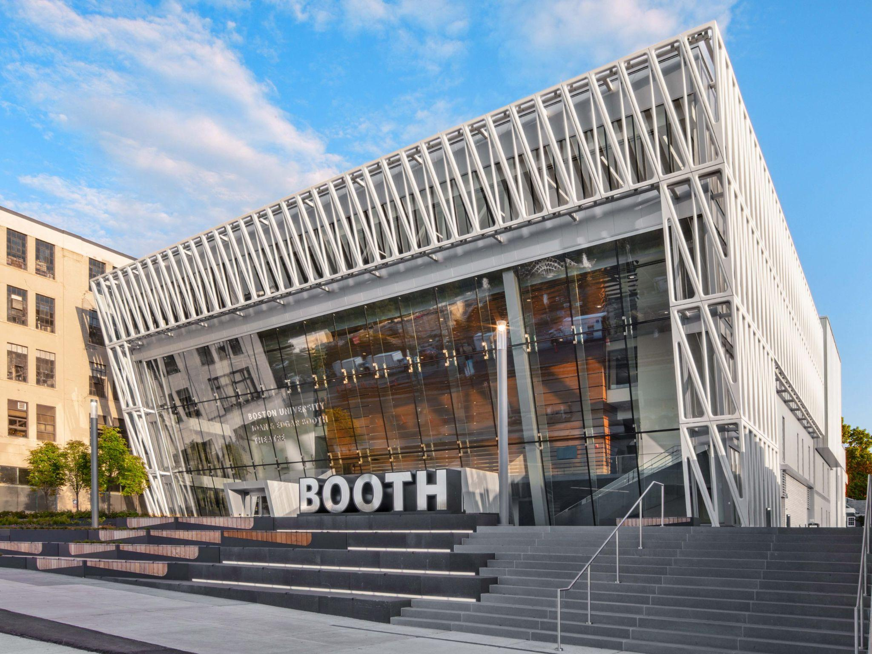
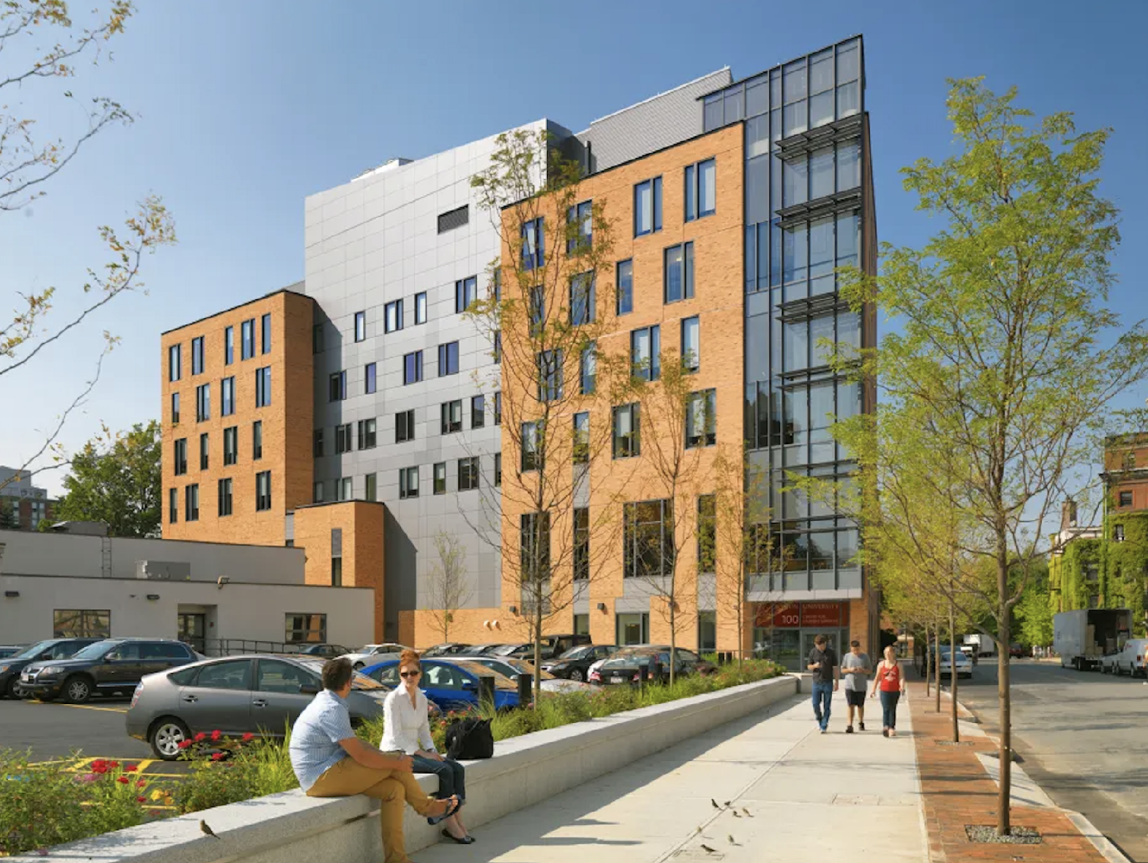
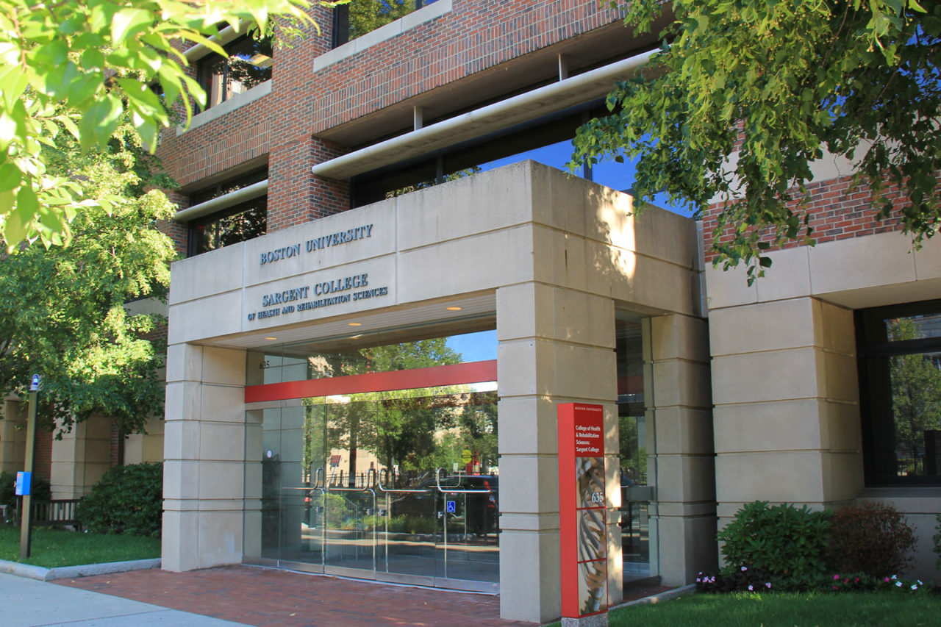
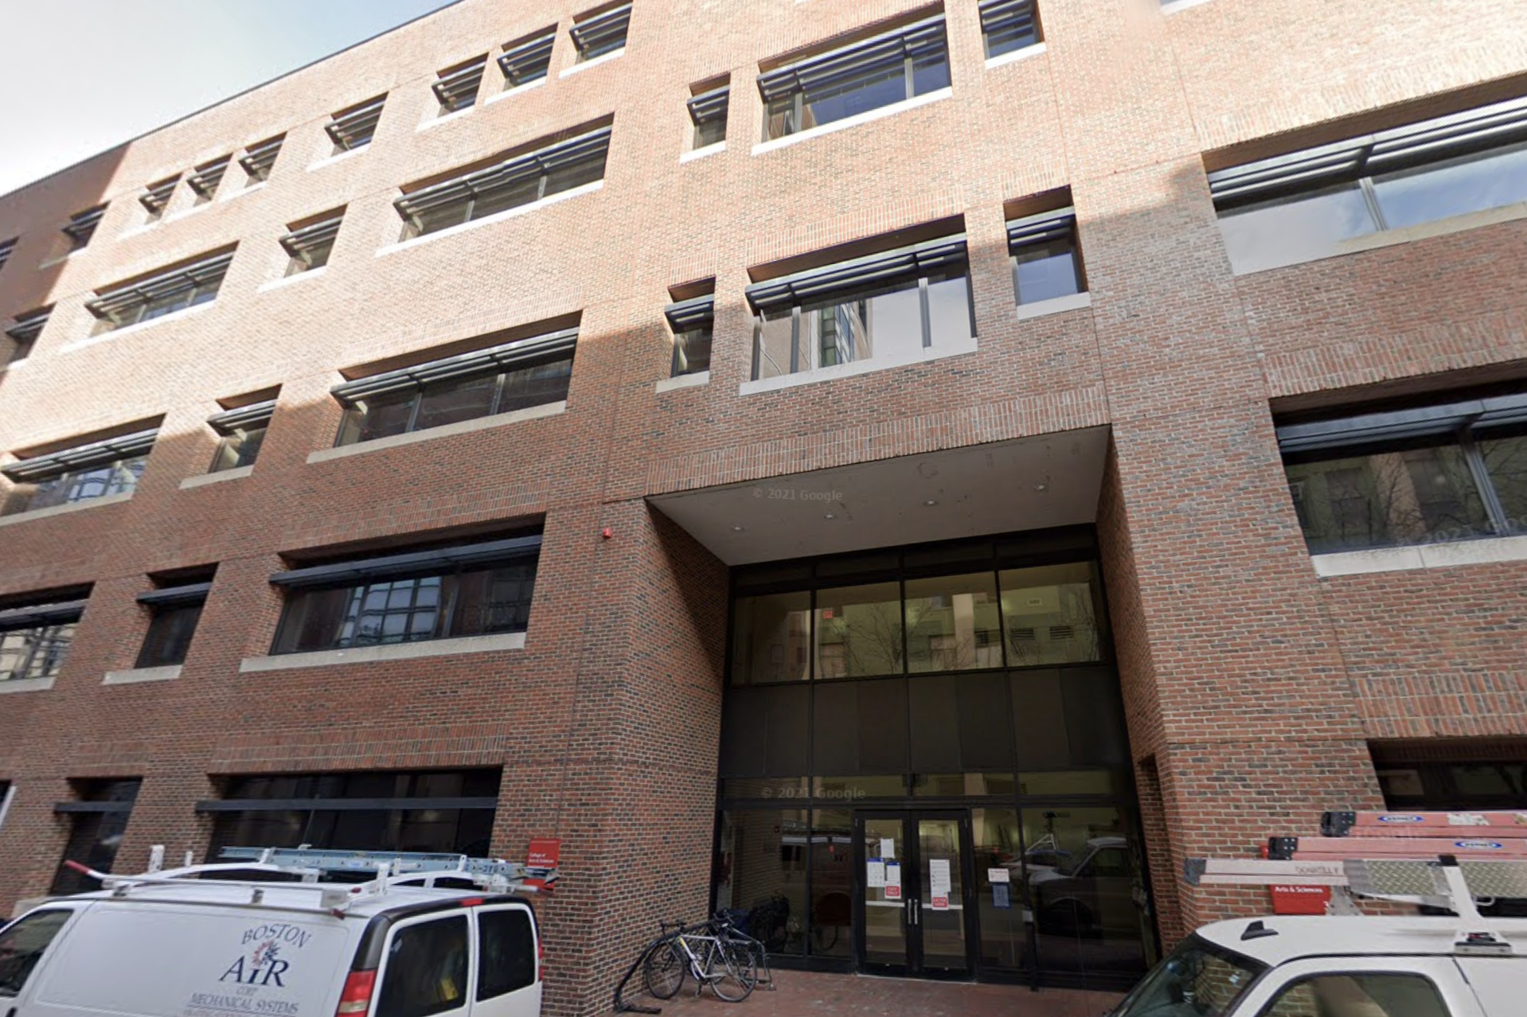
Pilot Buildings Study: Select Buildings for ASHP Pilot Projects
Questions to be Addressed by Pilot Study
How well does hybrid strategy (ASHP (130F)/natural gas) meet building 1) comfort needs, 2) heating loads, and 3) GHG emission reductions.
Confirm impact on peak electrical demand for winter, and summer reheat.
How well does integrated ASHP/boiler controls perform for building comfort and reducing GHG emissions.
What energy efficiency measures reduce a) peak heating loads, b) overall ghg emissions.
What are real costs of electrification solutions, and insight into equipment vendors.
Buildings Considered
Booth Theatre
Yawkey
Sargent
Physics Research Building
Newer, low temp (140 F),
& low air flow
Low temp (140 F), high air
flow, & dining hall
Older, high temp (160 F),
& high air flow
Labs, high temp (180 F),
high air flow, energy intensive
Notes:
Current work: Begin work with engineering consultants B2Q to prepare ASHP implementation in PRB
Goal: install hps on a couple of existing, select pilot buildings that span conditions that are representative of most BU buildings
We are considering new buildings like booth, but also older buildings like sargent. Low and high airflow, and also PRB because it has wet labs which BU has a lot of, which also require lots of air and are very energy intensive
We can work through a variety of retrofitting challenges on a smaller scale before we tackle all of the largest buildings
BIGGEST DIFFICULTY: EXISTING BUILDINGS, understand how these current systems work and how we can work hps into them
To highlight these issues, pictures of the buildings
We can have done technical analysis, need to work in these pilot buildings to understand and solve specific retrofitting challenges
Which existing BU buildings are good pilot heat pump candidates in terms of different loads/conditions in order to validate the feasibility of the use of heat pumps, find solutions to retrofitting challenges, and gain experience with alternative equipment vendors & installers.

Slide 4
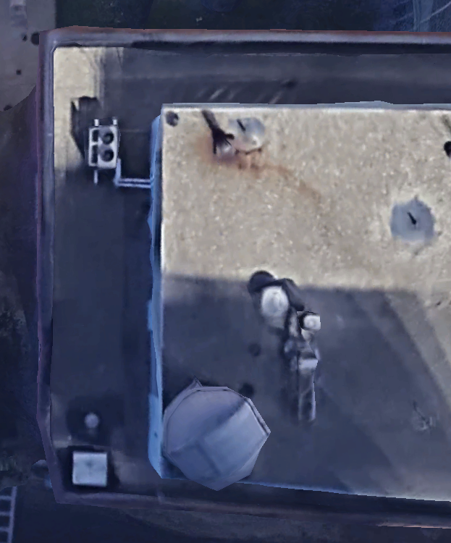

Pilot Buildings Study: Key Decision Factors and Building Comparisons
Key Decision Factors
Physics Research Building
N
Temp requirements of key existing building components: AHU, VAV, perimeter
Location of ASHP relative to boiler & boiler space
Size of thermal loads
Types of loads: eg lab, kitchen/dining area, office/general
Transformer capacity/max electrical load, electrical panels
How well does the pilot represent characteristics of primary buildings for electrification?
438 sq ft
Boilers
N
595 sq ft
Air intake
Side view of NW roof and boiler intake air
Preliminary ASHP plan
Name | Building GSF (sq ft) | CFM/ sq ft | ACH | Estimated Heat Pump Load (tons) | Inlet Design Temp AHU/VAV/Perim (F)
Yawkey | 120,000 | 0.55 | 3.3 | 177 | 140/140/140
Booth | 75,000 | 0.70 | 4.2 | 69 | 140/140/140
PRB | 150,000 | 1.21 | 7.3 | 266 | 160/180/180
Sargent | 114,000 | 0.46 | 2.8 | 96 | 160/180/180
Notes:
Analyze expected reduction of GHG emissions and cost estimates with new information about boiler/ASHP integration.

Slide 5
Fall 2022 Progress and Spring 2023 Plan
Key Meetings and Presentations
Plan for the Spring
AASHE "Deep & Quick Decarbonization" (Gayatri Sundar Rajan, Michael Gevelber, presented at the Global Conference on Sustainability for Higher Education in Oct. 2021)
Potential Pilot Buildings Presentation (to Joe Kajunski & Dennis Carlberg on 11/9/2022)
Meeting with NEAP/Multistack about BU Pilot HP study (Greg Furst, 11/30/22)
Meeting with Trane Technologies about BU Pilot HP study (Andrew Krushelnyski, 12/2/2022)
Meeting with BU-B2Q to discuss Mass Save TA study (Technology Assistance and Engineering Services) for BU Pilot HP study (12/20/2022)
Conduct experiments to determine heating capabilities at lower working fluid temperatures than the boiler is designed for (PRB).
Work with equipment vendors and specific ASHP models to determine which is best suited for high temp buildings while achieving significant decarbonization
Analyze expected GHG reduction and cost estimates with new information about boiler/ASHP integration.
Refine decarbonization estimate for the university as a whole
Cost and performance analysis of summer reheat
Energy efficiency opportunities

Slide 6
Acknowledgements
Understanding Boston University’s Planning, HVAC Implementation, & Budget
Dennis Carlberg
Robb Dixon
Shaun Finn
Dipak Intwala
Joseph Kajunski
Paul Rinaldi
Director of Sustainability, Boston University
Former Chair, Boston University Faculty Council
Assistant VP of Budget, Planning & Business Affairs, Boston University
Manager of Boston University Energy Efficiency Program
Assistant Director of Boston University Engineering and Building Automation
Assistant VP for Planning, Boston University
Business Professor, Boston University
Boston University
Thank you to the BU Campus Climate Lab for generous research funding and project support!
BU Campus Climate Lab Student Electrification Research Team
Gayatri Sundar Rajan, Keeley Bombard, Cathy Cheng & Sabrina Dilig
Author of "BU CRC Electrification" Analysis (Jan 2018)
David Staller (ME '18)
Authors of "Energy Efficiency Opportunities on CRC" Analysis (May 2017)
Gabriella Henkels, Charles Bradley Miller, Ryan Peters, Carly Baracco, Anthony Graziano, Cole Ashman Paul Chiampa Jr., Jessica Gimbel, Cristian Morales
Understanding Building HVAC Design & Heat Pumps
Bradley Campbell
Nicholas Conklin
Cris Copley
Robert Fisher
Greg Furst
Anthony Hardman
Jacob Knowles
Paul Kondrat
Andrew Krushelnyski
James McQueen
Carolyn Meadows
Joshua Michaud
Chris Schaffer
Neetu Siddharth
Timothy Simpson
Mike Walters
President, Conservation Law Foundation
Director of Global Product Strategy, Carrier HVAC Program
Principal of HVAC & Mechanical Design, BR+A
VP of Facilities, Roxbury Community College
Sales Engineer, New England Applied Products
Senior BPA, The Green Engineer Inc.
Director of Sustainable Design, BR+A
Principal, CannonDesign
Account Executive, Trane Technologies
Project Manager, Boston Arts Academy
Director of Strategic Initiatives, Boston Arts Academy
Associate Principal of HVAC, BR+A
Founder & President, The Green Engineer Inc.
Principal, The Green Engineer Inc.
AERMEC Product Specialist, Emerson Swan
Principal & Expert in Distributed Heating Systems, Salas O’Brien
Estimating Costs & Financing Large CapX Projects
Domenic Armano
Phillip Eash-Gates
Michael Gibbs
Megan Howard
Judith Judson
Robert Kaufmann
Jeremy Koo
Nalin Kulatilaka
Paul Lyons
President, Guardian Energy Management
Senior Associate, Synapse Energy Economics
Former Assistant Executive Officer, CARB;
Former Deputy Secretary of Climate Action, CalEPA; Former Senior Vice-President, ICF International;
Director, MassCEC
VP of Distributed Energy Systems, Ameresco
Earth & Environment Professor, Boston University
Founding Partner, First Fuel Software;
Associate, Cadmus Group
Business Professor, Boston University
Founding Partner, First Fuel
President, Zapotec Energy Inc
Geothermal: Heating & District Heating
T.J. Bernier
Owen Brady
Jarred Mullen
Tracey Ogden
Erik Pekkala
Nathan Phillips
Gap Mountain Drilling
Manager of Future of Heat Program, National Grid
Skillings and Sons
Principal, TAO Consulting
Growth Portfolio Lead of New Energy Products, National Grid
BU Earth & Environment Professor, Boston University
Notes:
Purpose: Highlighting past team members and people who’ve sanity-checked our project throughout the years!
Big thank you to everyone who has worked on this project throughout the years, just want to highlight how many people have contributed, all of the industry experts who have given input to make this project feasible
Thank you for listening!

